Slide 1
Cathode Discharge Simulation
William Kyle
Dr. Glenn Horton-Smith

Slide 2
Dune Recap

Slide 3
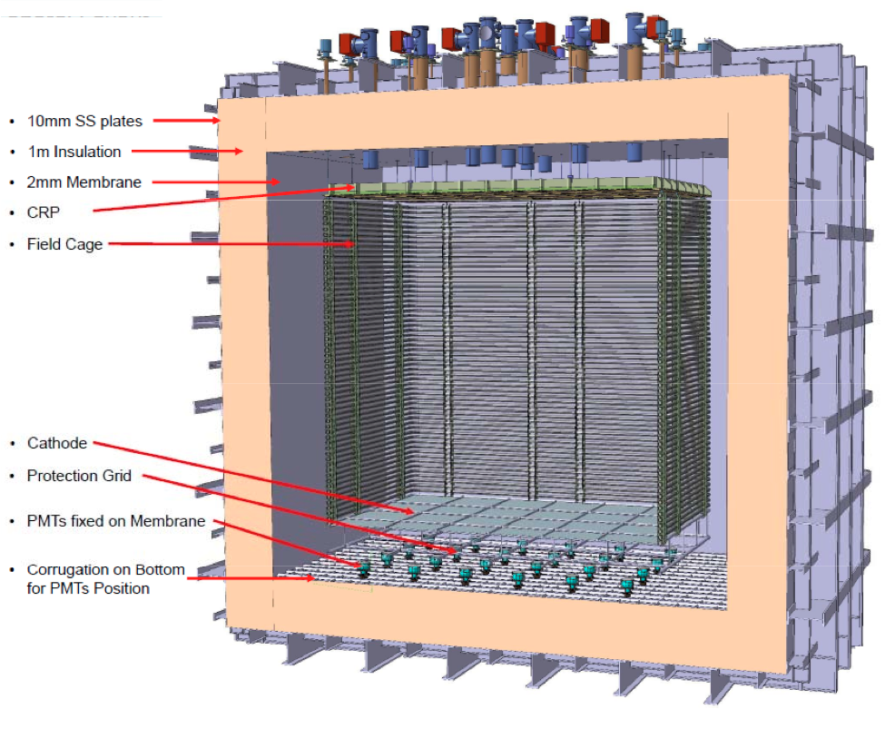
It’s a Giant Capacitor

Slide 4
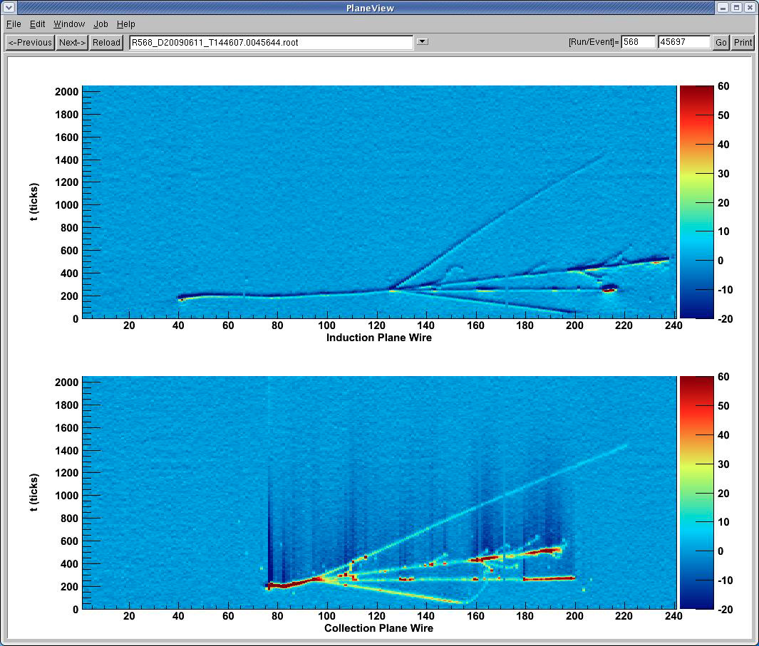
That Does Physics

Slide 5
Review of CPA Results

Slide 6
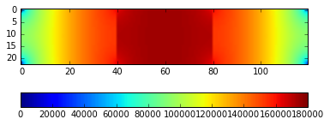
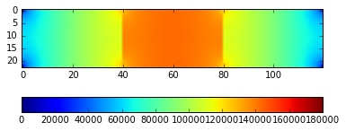
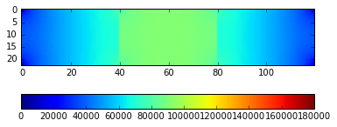
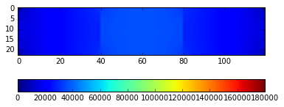
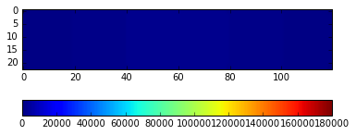
T = 40 us
T = 100 us
T = 200 us
T = 400 us
T = 1 ms

Slide 7
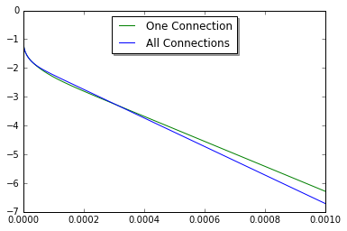
What’s the Difference
Log Plot of Current (A) vs Time (s)

Slide 8
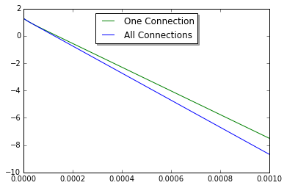
Log Plot of Energy (J) vs Time (s)

Slide 9
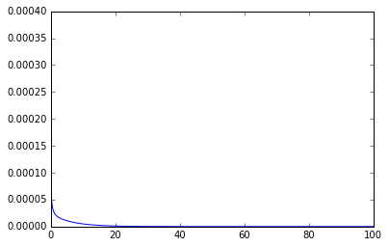
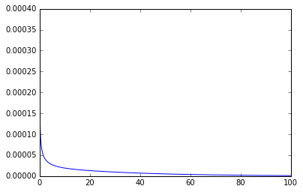
Adding the Field Cage
After presenting this to the DUNE HV group, I was then asked if I could adding in a simulation of the field cage discharging as they are fed by the same HV cable. So I did that for both of the side lengths of the field cage.
Short Side I Long Side I

Slide 10
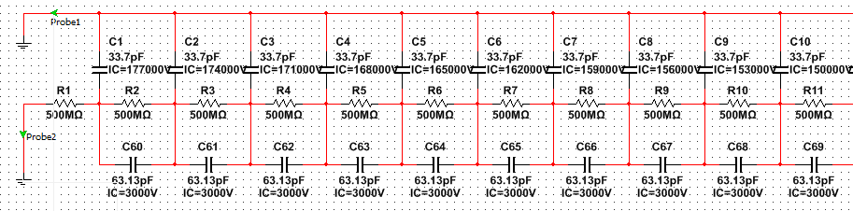
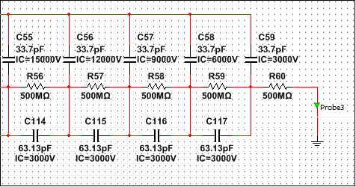
Comparison
Then, I made a SPICE circuit simulation of the field cage discharge to compare with my results
…
…

Slide 11
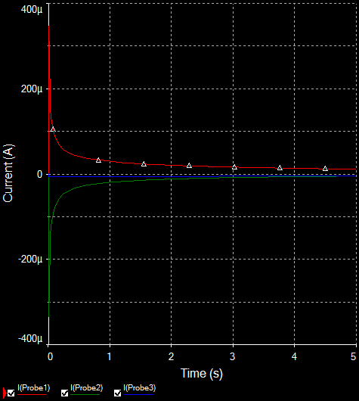
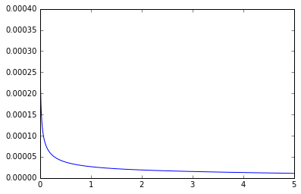
Comparing Results
SPICE
PYTHON

Slide 12
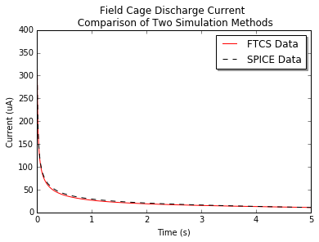
Direct Comparison of FTCS and SPICE
Shown data is for one complete side of the field cage on the shorter dimension of CPA / LArTPC of 1.15 m (vs long side of 6.0 m)

Slide 13
Induced Current at APA

Slide 14
What’s the Goal Here
We have plenty of knowledge/understanding of what sort of behavior we should see from Voltage/E field in LArTPC/at APA in steady state of detector operation.
However, the fields resultant of the CPA during a discharge are vastly more complicated, due to the non uniformities and wide ranges of voltages of different elements across the Cathode.
Therefore, finding any sort of exact solutions to even the quasi-static approximations of the electric fields all but impossible, and completely impractical for our needs.
So, I instead decided that I could get a close enough approximation to provide meaningful outputs using just the monopole term of a multipole expansion to get Voltages res. from cathode, at z=3.6m=dist. btw the APA and the CPA.

Slide 15
Method Used for Monopole Approx.
However, what I did wasn’t a monopole approximation of the CPA as a whole. Rather, I realized that our FTCS method was already breaking up the CPA into many sections of CPA at set V’s, and with defined sizes and relative locations.
So, I decided to do a monopole term approx. separately for each individual CPA section, (in this case: 5 cm x 5 cm sections)
I.e. Since the CPA has a know Capacitance/m² , I could find a C for each.05x.05 m section: C = (Capacitance/m²)*(.05²). Hence, as Q=C/V, and our simulation give a V of each section at every time-step, we also know a total charge, (the monopole moment), of each section.

Slide 16
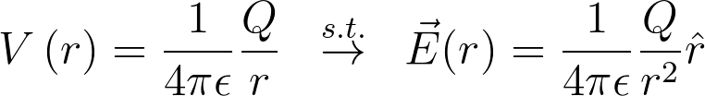
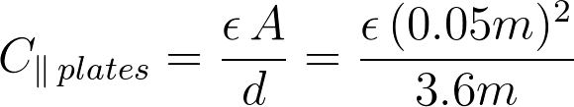
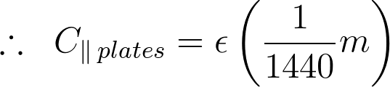
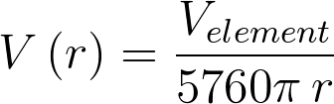
Monopole Method Cont’d
We know the equations describing a point charge to be:
And from our previously assumed geometry of CPA and APA as a finite parallel plate capacitor:
Hence:
where
and

Slide 17
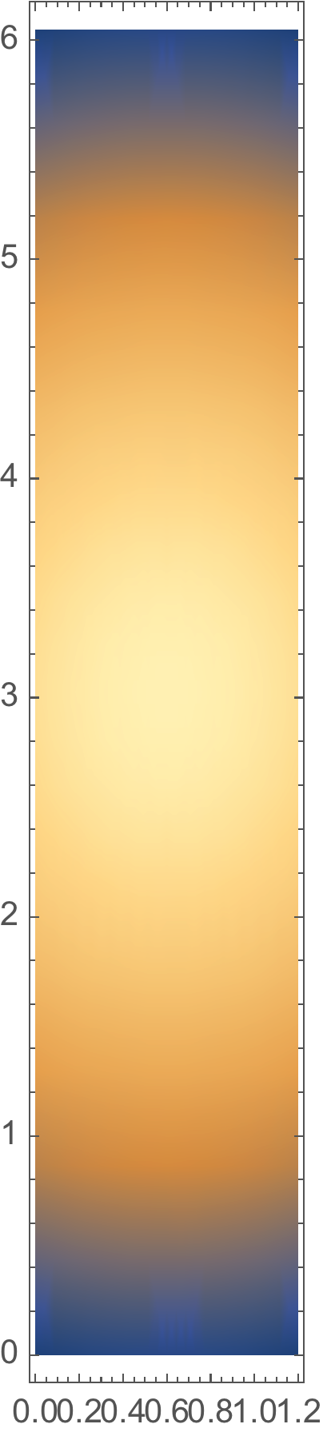
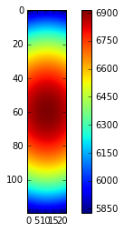
What Results Do We Get From This?
Mathematica Test of Initial Cond.
Python IC Result

Slide 18
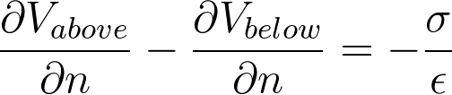
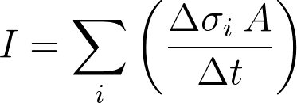
Getting Induced Charge on APA from Voltage
Assumed a conducting plane at 0V and used boundary conditions equation of
This gives us a surface charge (sigma) for each element at each time step.
We wanted worst case scenario so we summed over the 6m length of the anode plane

Slide 19
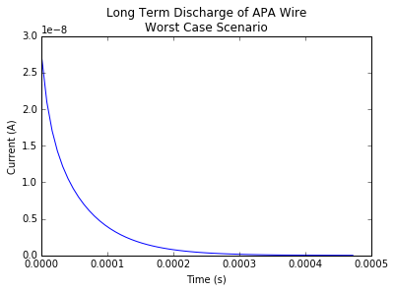
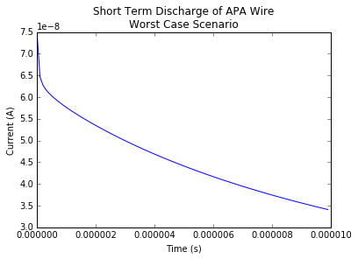
Results

