Slide 1
Cathode Discharge Simulation
William Kyle
Dr. Glenn Horton-Smith

Slide 2
Simulation Operation
A Python Based FTCS Method

Slide 3
The Forward Time, Central Space Method
Movement of Voltage (i.e. charge) through cathode is governed by a diffusion equation.
Uses central difference approx. for laplacian (2nd spacial derivative in 2d)
Combining this with the explicit Euler integration method

Slide 4
We want to model the cathode as not just a single plate of dimension Height x Width, but also as a series of n cathodes with dim. (height/n) x width
Found the simplest method was to use separate numpy arrays for each cathode rather than to combine them into a single array
To account for the loss of dimension by two in our finite difference calculation of the Laplacian, we can pad each array by 1 on all sides
Assumed that no current flows out of cathode except at connections to HV. i.e. no current through the frame. Therefore our padding is set equal to next inward array elements to have no effect on derivatives
Then, we can connect the cathodes by changing the padding values at specified connection points to the value of the array element of the other cathode to which it is connected.
Same approach allows connection to HV by instead setting at 0V

Slide 5
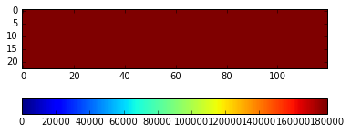
This multiple array method allows allows us to simulate a single cathode plate by simply connecting the arrays at all points across the edge
Shown below is a 12m x 2.3m cathode initialized to 180000V, using square 10cm elements

Slide 6
Apples to Apples

Slide 7
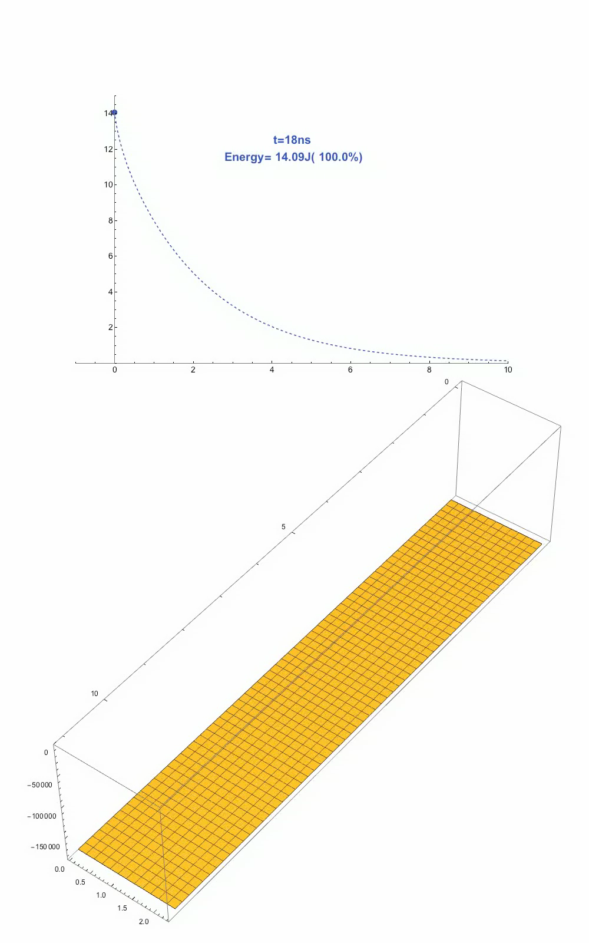
Past Simulation Results
Past results from Bo Yu and Sergio Rescia showed a single cathode plate dropped to ~56% of its initial energy after 1s of discharge
So, we set up the same cathode parameters, but with our code not accounting for effects from the cathode frame

Slide 8
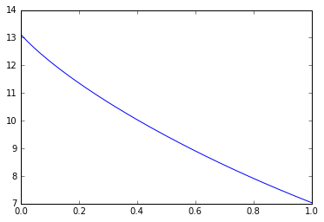
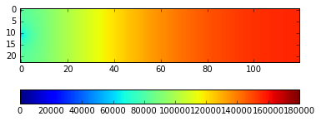
Our Results
Plot of Energy v. Time
After 1 s of discharge, our simulation found that the energy of the cathode had decreased to 53.7% of its original energy.
Cathode Voltage at t=1s

Slide 9
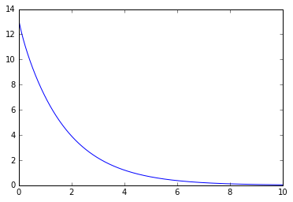
Additionally, over the course of the full 10s data range of the previous results, we saw the following behavior.
Energy
Time (seconds)

Slide 10
New Findings

Slide 11
Initial Results for Multi Segment Cathodes
Now:
split same cathode into 3 segments
Connected to 0V at topmost and bottommost corners
Segments have 2 connections on either side
Still using a 12m by 2.3m cumulative size for cathode
Still have dx = .1m
New R and C
R = 1e6 Ohms/sq.
C = 7.398e-12 F/m^2

Slide 12
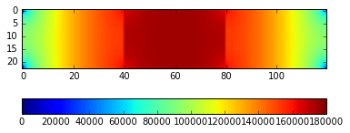
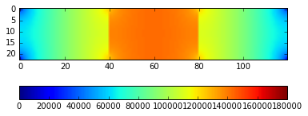
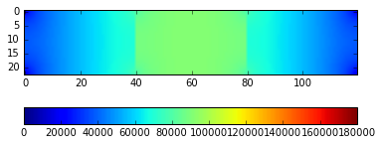
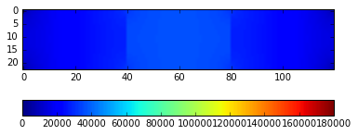
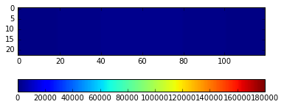
T = 40 us
T = 100 us
T = 200 us
T = 400 us
T = 1 ms

Slide 13
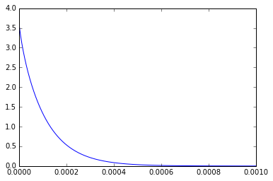
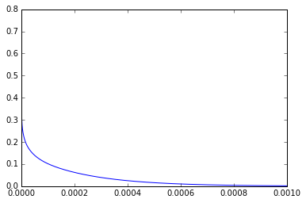
Plotting Energy and Current Out
Energy v. Time
I_{out} v. Time

Slide 14
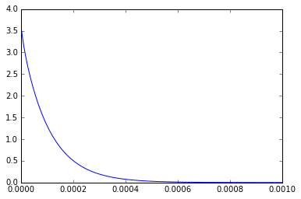
Doubling The Number of Connections on Each Side
Energy v. Time
I_{out} v. Time

Slide 15
One Connection
Energy v. Time
I_{out} v. Time

Slide 16
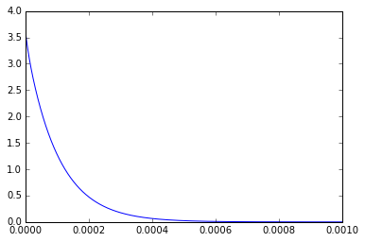
Comparison to all connections
Energy v. Time
I_{out} v. Time

Slide 17
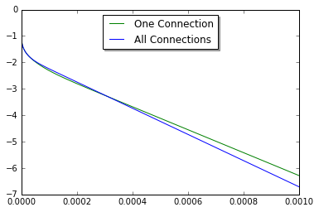
What’s the Difference
Log Plot of Current (A) vs Time (s)

Slide 18
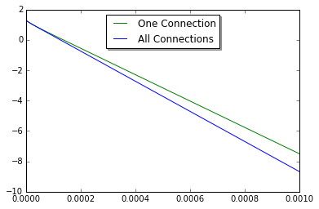
Log Plot of Energy (J) vs Time (s)

Slide 19
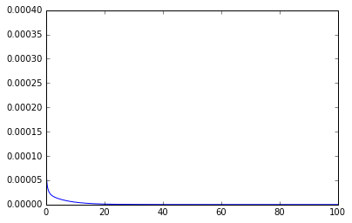
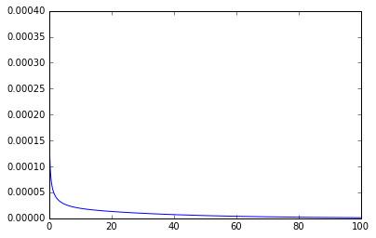
Adding the Field Cage
After presenting this to the DUNE HV group, I was then asked if I could adding in a simulation of the field cage discharging as they are fed by the same HV cable. So I did that for both of the side lengths of the field cage.
Short Side I Long Side I

Slide 20
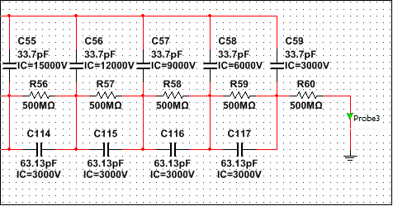
Comparison
Then, I made a SPICE circuit simulation of the field cage discharge to compare with my results
…
…

Slide 21
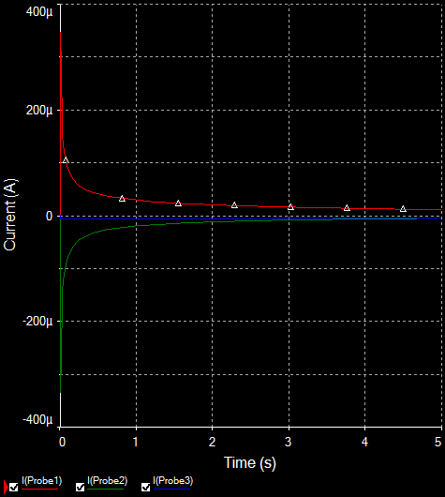
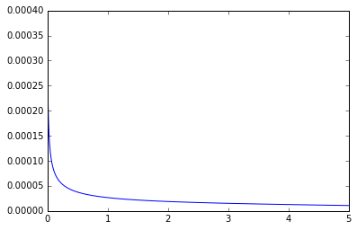
Comparing Results
SPICE
PYTHON

Slide 22
What’s Next?
Now, I’m working on using these simulations of the changing voltage in the cathode to look at what this does to the electric field at the anode plane, to see if the induced currents are large enough to be a problem for the sensitive detection apparati to which it is connected.

