Slide 1
Compact Diode Laser for Near Infrared Methane Spectroscopy
Ottillia Ni
Mentor: Dr. Kristan Corwin
August 5, 2016

Slide 2
Motivation
Expand gas-filled hollow fiber references to 1.6 microns wavelengths.
  Absorption spectroscopy and sub-Doppler spectroscopy in methane-filled hollow fibers

Slide 3
Challenges of the Diode Laser
Using the Littrow configuration to calculate the diffraction angle off the diffraction grating.
Reconstructing and machining of an adapted diode laser design at the new grating angle.
Redesigning the mirror mount to avoid beam clipping, passing a beam radius 4x the full width half maximum (FWHM).
Needing high power to saturate methane for sub-Doppler spectroscopy

Slide 4
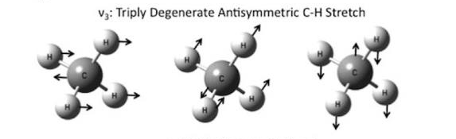
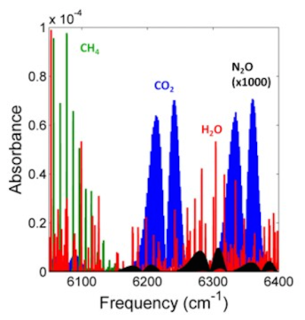
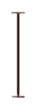
Methane (CH₄)
4.0Å
ν₃= 3158.6 cm⁻¹, 2ν₃= 6317.2 cm⁻¹
https://www.researchgate.net/figure/278652214_fig4_Figure-18-18-Methane-vibrational-normal-modes
http://www.nist.gov/pml/electromagnetics/grp05/other-activities.cfm
Notes:
Tetrahedral molecule
Four Vibrational modes – dictate movement of molecule
Only vibrational modes ν₃ and ν₄ interact directly with infrared light where there is motion in both the carbon and hydrogen as a result of the dipole moment.
2nu₃ methane band because it covers the 1630 nm wavelength

Slide 5
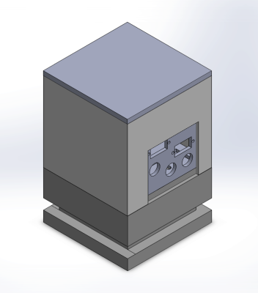
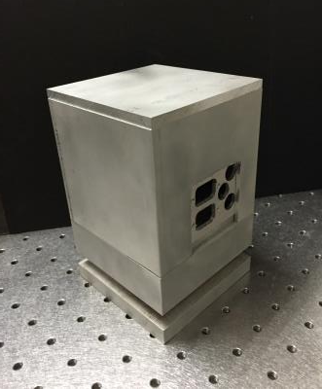
Assembling a Compact Diode Laser
Notes:
Existing diode laser design:
Compact size (4x4x6.25 in), exterior made of aluminum, comprised of common, affordable commercial parts.
Wavelength: 780 nm, Power: 100 mW.
Adapted diode laser design:
Wavelength: 1600nm, Power 250 mW.
Mount of diffraction grating significantly altered.
Interlocking added. Electrical connections reconfigured for convenience and diode laser integrity.

Slide 6
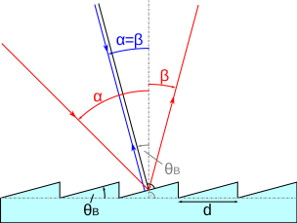
Interior of the Diode Laser
Littrow Configuration
d= line spacing
α= incidence angle
β= diffraction angle
Θ_{B}= blazed angle
https://en.wikipedia.org/wiki/Blazed_grating
Notes:
Using the Littrow configuration, the diffraction angle is calculated to be at 29.5°. The Littrow configuration determines an angle that makes the diffraction angle and incidence angle identical. The diffraction grating selects one wavelength to diffract back into the laser, narrowing the output and providing tunability.
Uses a mirror to compensate beam motion (some translation of the beam results, but no change in direction).

Slide 7
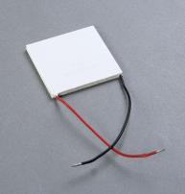
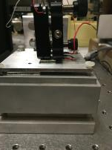
Laser Parts
Thermoelectric coolers (TECs) - heat pumps used to cool systems.
PZT – fine tune position of the the laser
Thermistor- electrical resistor used for measurement and heat control
Temperature Chip – determines the temperature of laser
http://www.ebay.com/itm/400W-12V-Thermoelectric-Cooler-Peltier-Plate-TEC-NEW-/111201613218
Notes:
Benefits: high reliability, small size, low cost, low weight, precise temperature control, safety from hazardous electrical environments¹

Slide 8
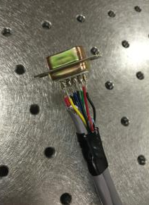
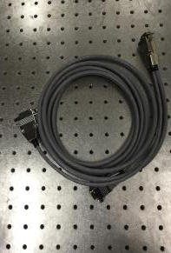
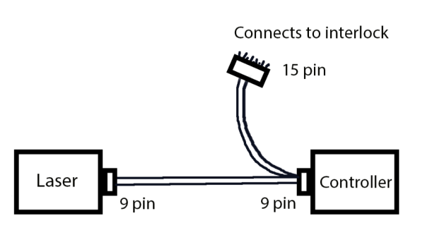
Powering the diode laser
Cable: 6ft long
Notes:
Since my laser is at such high power, I need to interlock my laser. saturation of methane= sub–Doppler Spectroscopy= High power = interlock
Since most people have been on the tour of the JRM lab, you might remember how they mentioned interlocking lasers. This is to ensure that no one walks into the lab with a chance of getting injured. The controller helps me control the temperature and current.

Slide 9
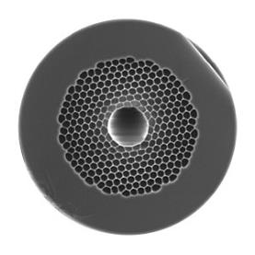
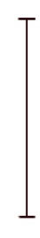
Future Works
Align and fiber-couple the laser, fill a hollow core fiber with methane, and tune the laser to the resonance of the methane line
Conduct absorption spectroscopy and sub-Doppler spectroscopy at 1.6 microns
Develop sealed hollow-core fibers filled with methane absorbing laser light as a frequency reference.
Ø20 µm
https://www.thorlabs.com/thorproduct.cfm?partnumber=HC19-1550

Slide 10


Acknowledgements
Special thanks to:
Dr. Kristan Corwin
Dr. Brett DePaola
Dr. Brian Washburn
Ryan Luder
Sajed Hosseini-Zavareh, Neda Dadashzadeh, Kushaan Weerasinghe, Manasa Thirugnanasambandam
Fellow Physics REU Peers
Dr. Brett Flanders
Kim Coy
This work is partially funded by the National Science Foundation (NSF) and the Air Force Office of Scientific Research (AFOSR) through NSF grant number PHYS-1461251.

Slide 11
Questions?

