Slide 1
Ultrafast Nonlinear Optics: High Harmonic Generation
Justus Kornkven
Advisor: Dr. Vinod Kumarappan

Slide 2
Project Goals
5th Harmonic Generation using the Kansas Light Source (KLS) laser.
What is Harmonic Generation?
Fundamental Frequency:
5th Harmonic Frequency:
$$ω=\frac{c}{λ1}$$
$$5ω=\frac{c}{λ2}$$
$$λ2= \frac{1}{5} λ1$$
For KLS: 790nm goes to 158nm

Slide 3
Design
$$β−Barium Borate −BBO$$
$$ω$$
$$ω$$
$$ω$$
$$3ω$$
Argon Gas
$$5ω$$
$$2ω$$
$ω$ + 3$ω$
$$2ω$$
$$ω$$
BBO
Calcite
HWP
BBO
Chamber
THG
FHG
Method References:
Marcus Beutler, Masood Ghotbi, Franck Noack, 2011, Generation of Intense Sub-20-fs vacuum ultraviolet pulses compressed by material dispersion, Optics Letters, Vol. 36
Rimantas Budriunas, Collinear Setup For Two-Color High Harmonic Generation, Lund University

Slide 4
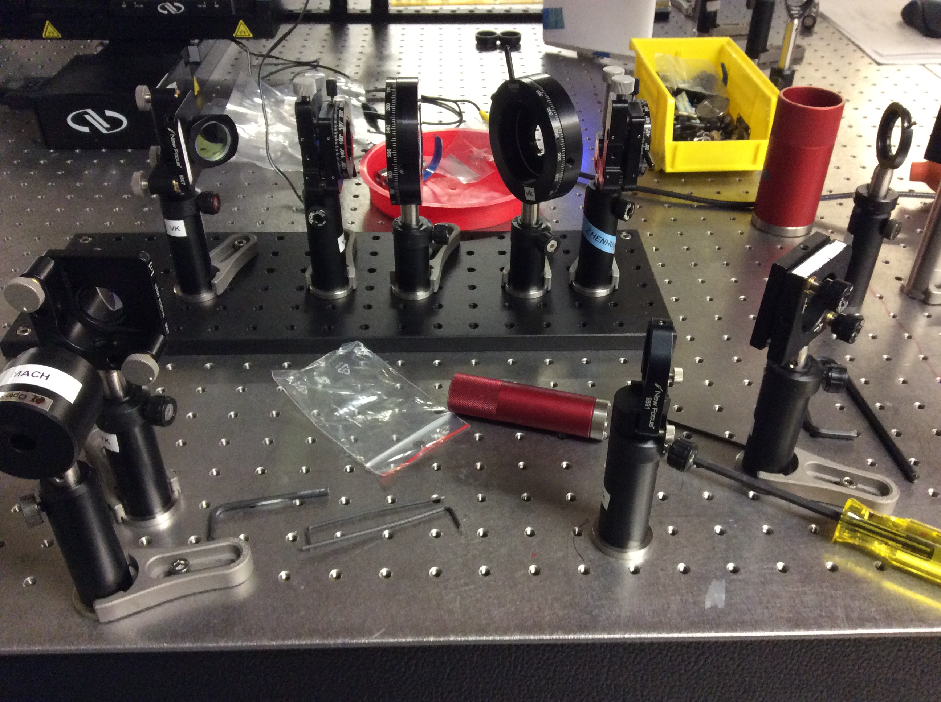
Results

Slide 5
Conclusion
We were able to generate 3rd harmonic light with a power conversion efficiency of 5%
Design and purchase components for 5th Harmonic Generator
Build, Optimize, and Test 5th Harmonic Generator setup
Future Work

Slide 6
Questions?

