Slide 1
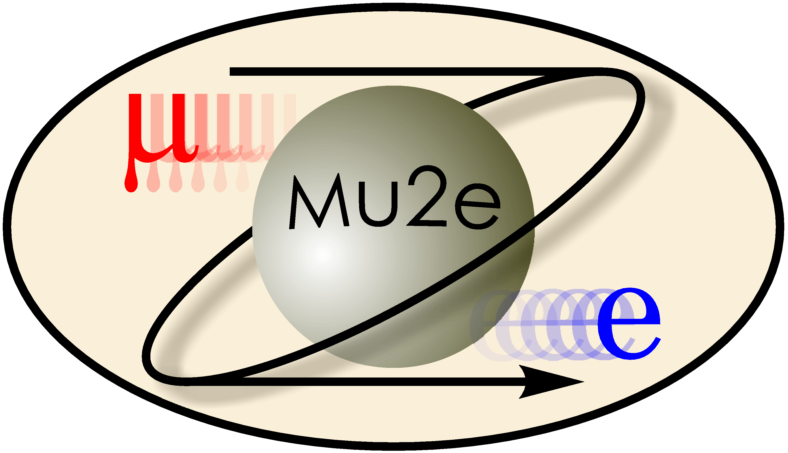
Token Bit Manager Testing & Background Estimates of Radiative Pion and Muon Capture
Timothy J. Baker & Ramiro Torres
Advisors: Dr. Tim Bolton &
Dr. Glenn Horton-Smith

Slide 2
Token Bit Manager Chips(TBM):
The Large Hadron Collider will undergo a series of upgrades in 2017.
Part of these upgrades will be the implementation of improved digital TBMs.
They reduce the amount of data saved per second by significant amounts.
We performed electrical testing on the TBMs.

Slide 3
Mu2e’s Goal:
Mu2e probes physics beyond the standard model of particle physics (SMP).
It will do so by searching for the neutrinoless muon-electron conversion
$$μ^{−}+Al →e^{−}+Al$$
Which compared to the ordinary muon to electron conversion:
$$μ^{−}+Al →e^{−}+ \overline{ν_{e}}+ν_{μ}+Al$$

Slide 4
Our Goal:
Because of the nature of the mu2e experiment there are potential sources of background.
We focus on the background sources radiative pion capture(RPC) and radiative muon capture(RMC).
How does experiment this work and where do these sources come from?

Slide 5
Experiment Setup for Mu2e:
*Woman is placed near the setup, to provide a sense of scale.

Slide 6
Experiment Setup for Mu2e

Slide 7
Experiment Setup for Mu2e:

Slide 8
RPC and RMC
Radiative Pion Capture:
$$π^{−}+Al → γ+X$$
$↳({ e^{+} e}^{−})$
Radiative Muon Capture:
$$μ^{−} + Al →ν_{μ}+ γ+Mg$$
$$↳\left(e^{+} e^{−}\right)$$

Slide 9
Previous Background Estimates
Previous estimates of RPC and RMC were direct calculations.
Hoped to predict the contribution of background from RPC and RMC.
The ultimate goal was to show that the contributions were small.
However, we took a different approach.

Slide 10
Approach
We simulated a direct measurement of the number of electron-positron pairs from RPC and RMC.
Simulation estimates give an idea of the magnitude of photon conversions that can be expect in Mu2e.
The motivation for simulation came from a hand calculation of the amount of photon conversion. (based on geometry & physics)
HEP software such as Root and Geant4 were used to create and run simulation

Slide 11
Histograms for Photon Conversion Momentum:

Slide 13
Histograms for Electron Conversion Momentum:

Slide 15
Energy Asymmetry for Electron-Positron Pair:

Slide 16
Opening Angle between Electron-Positron Pair:

Slide 17
Conclusion:
Our results reflected that about 0.4-1.50% of photons that are emitted by RPC and RMC produce an electron-positron pair.
This suggests that during the experiment it could be expected to see around150 billion electron-positron pairs.
If Mu2e chooses to follow the approach of direct measurement of RMC and RPC, it will not only account for the background but also provide valuable data for other processes for potential use.

Slide 18
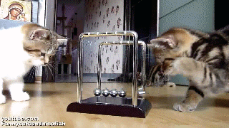
Acknowledgements
Special Thanks to Dr. Bolton, Dr. Horton-Smith, Dr. Corwin and Kim Coy for all of their help and advice.
Thanks to the NSF for funding: Grant Number: PHYS-1461251
Thanks to KSU for hosting the 2015 REU Program

Slide 19
Questions?

