Slide 1
Photoionization of atoms using high harmonics
Lydia Bender
Mentor: Dr. Artem Rudenko

Slide 2
Project Focus
Study ionization of atoms and molecules using high harmonics
  My specific focus:
  Compare multiphoton ionization by strong infrared laser and single-photon ionization with its high-order harmonics
  - Figure out what harmonics we were producing from the XUUS (eXtreme Ulraviolet Ultrafast Source)

Slide 3
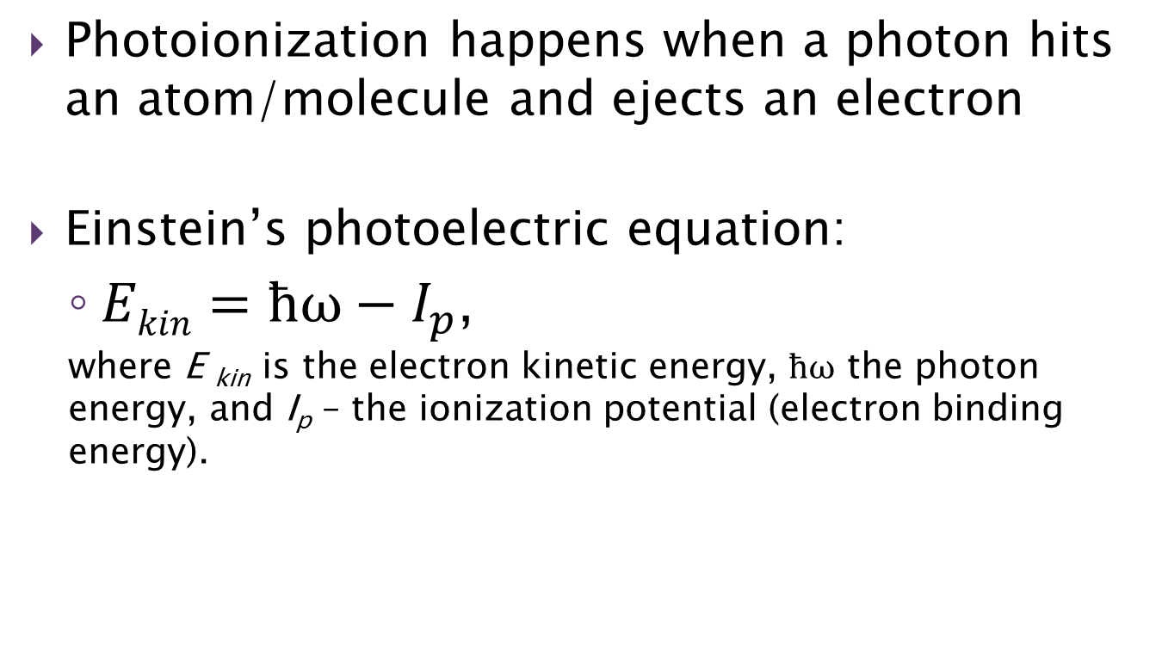
Photoionization
Photoionization happens when a photon hits an atom/molecule and ejects an electron
Einstein’s photoelectric equation:
  $Ekin=ħω−I_{p}$,
  where E _{kin} is the electron kinetic energy, $ħω$ the photon energy, and I_{p} – the ionization potential (electron binding energy).
Notes:
If photon energy isnt big enough an electron doesn’t pop out

Slide 4
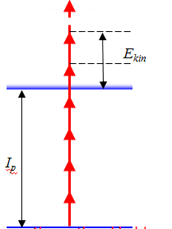





Photoionization: many photons
Low frequency, long wavelength (visible or infrared light):
has to absorb multiple photons before it can overcome the ionization threshold
Can happen only if the light has high intensity: “strong-field” regime
$$ħω$$
$$ħω$$
Threshold of ionization
$$ħω$$
Multiphoton ionization
$$ħω$$
Generalized Einstein’s photoelectric equation:
  $$Ekin=nħω−I_{p}$$
“Above-threshold” ionization: ATI
Notes:
Use the PULSAR beam directly for ATI

Slide 5
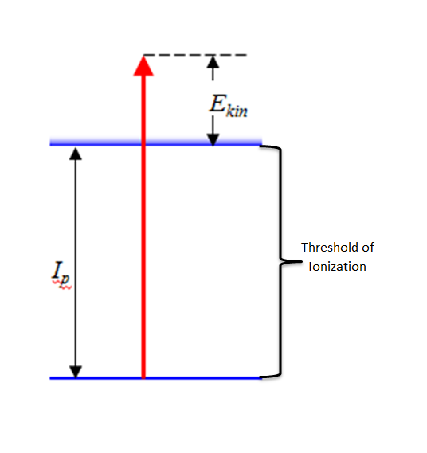

Photoionization: single photon
High frequency, short wavelength:
a single photon (with a large energy) can overcome the ionization threshold
Typically happens in a “weak-field” regime – only one photon is absorbed
$$ħω$$
Single-photon ionization
Notes:
Use the PULSAR beam directly for ATI

Slide 6


High Harmonic Generation
- happens when atoms or molecules are irradiated by strong laser field
Since the electron has gained large energy, the photon energy also has to be large due to the conservation of energy
A single electron is ejected from the parent atom/molecule
The electron gains energy in an electric field of the laser
The electron crashes back into the atom
The electron
recombines, the atom returns to the ground state
High-energy photon is emitted
Notes:
Intense electric field
Odd harmonics

Slide 7

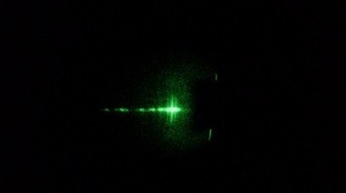
High Harmonics

Slide 8
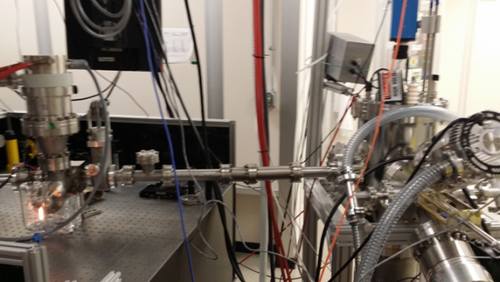

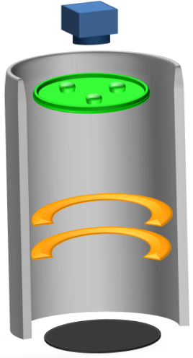
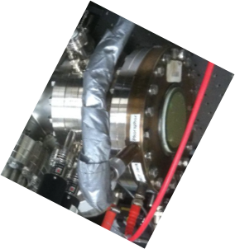
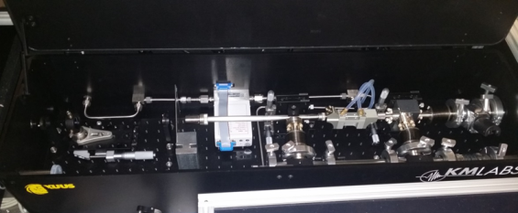
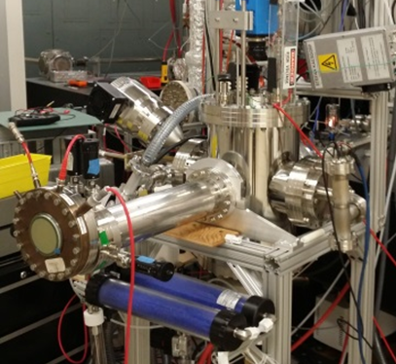
Experimental Setup
PULSAR laser beam (800 nm)
XUUS
Beam Viewer
VMI
XUV-IR
Separator
Toroidal
Mirror
Filters
Notes:
Filtering harmonics
What does VMI stand for? Will you talk about it later?

Slide 9
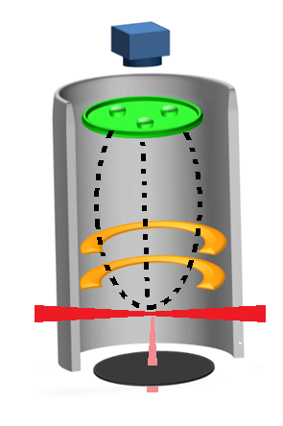
Velocity Map Imaging (VMI)
Camera
MCP/Phosphor screen
Extractor
Laser
Repeller
Gas

Slide 10
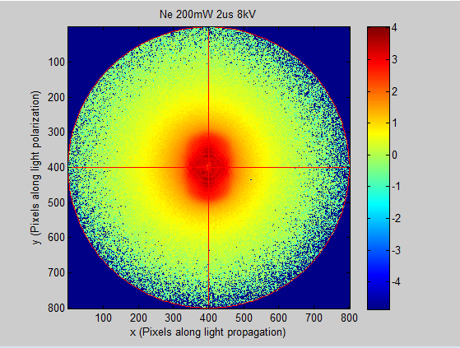
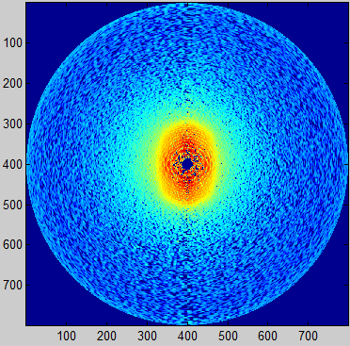
Photoelectron images with the laser
Neon at 300mW laser power
(ATI: Above-Threshold Ionization)
Non-inverted image
(raw data)
Inverted image
Notes:
200mW?

Slide 11
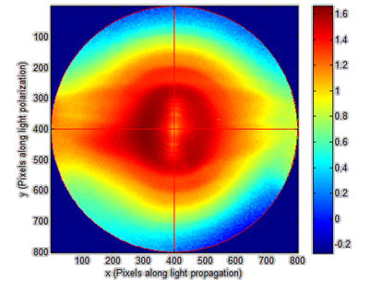
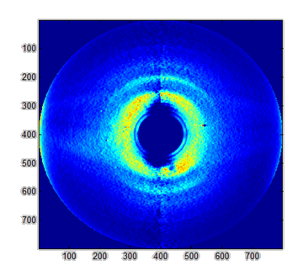
Photoelectron images with high harmonics
Helium with
HHG
Non-inverted image
(raw data)
Inverted image

Slide 12
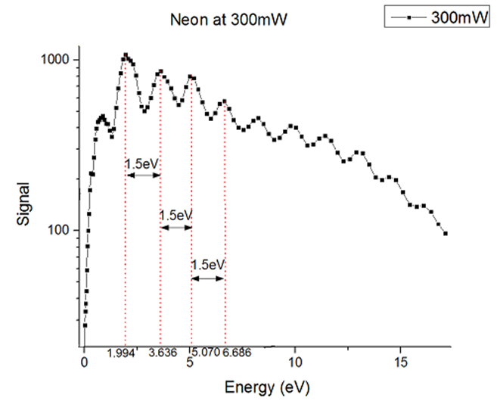
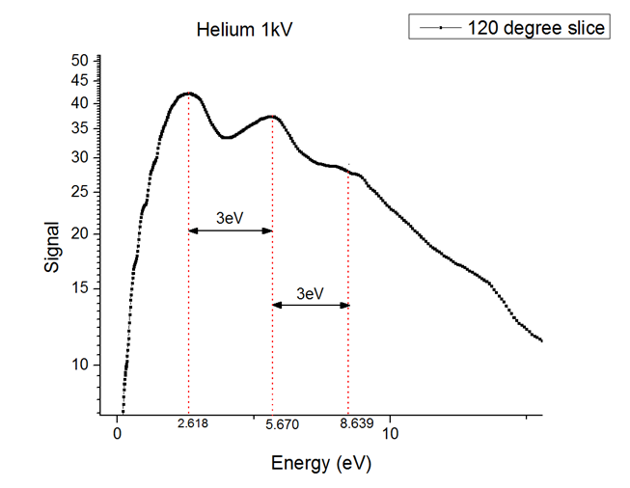
Photoelectron energy spectra
Ionization with high harmonics
Ionization with a laser: ATI

Slide 13
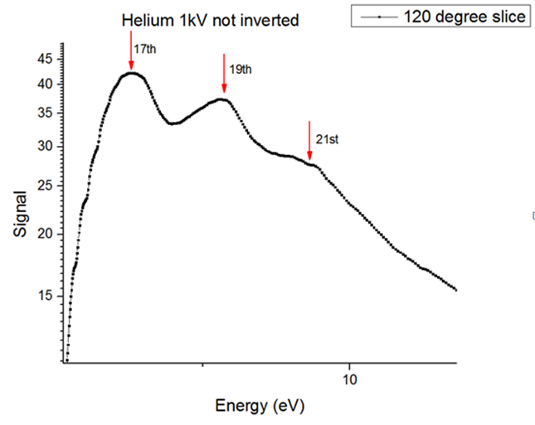
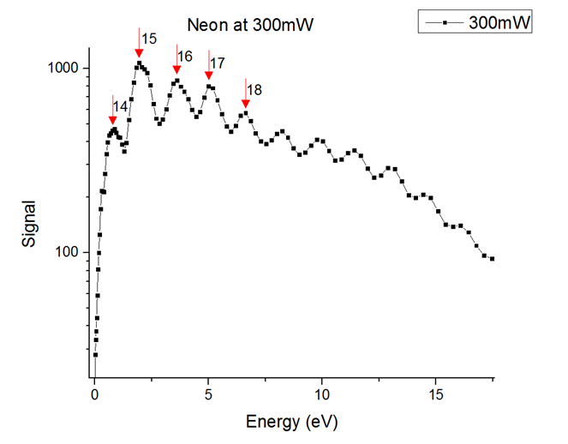
Photoelectron energy spectra
Number of infrared
photons absorbed
Harmonic order
(only one photon
Is absorbed!)
Ionization with high harmonics
Ionization with a laser: ATI

Slide 14
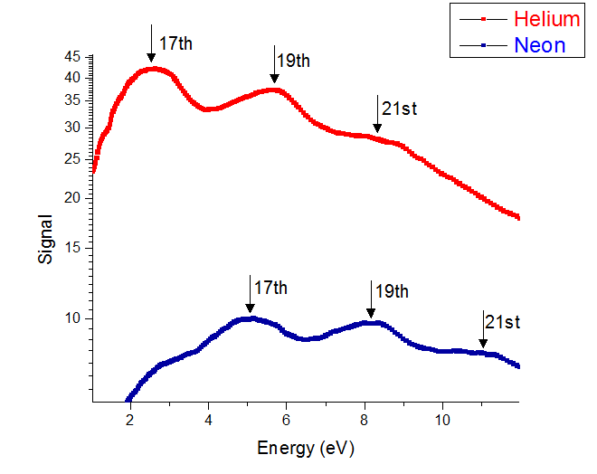
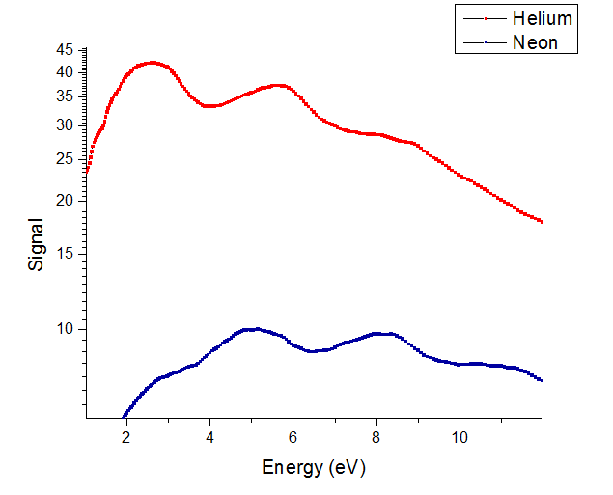

Photoelectron spectra with different targets
Helium and Neon at 1kV
Helium and Neon at 1kV
17th
19th
I_{p}(He) = 24.6 eV
21st
17th
19th
15th
21st
I_{p}(Ne) = 21.5 eV
15th

Slide 15
What now?
Characterization of the harmonic source
Photoionization of different atoms and molecules
Measurements of ions
Pump-probe experiments using laser + high harmonics

Slide 16
Acknowledgements
Special thanks to:
Dr. Artem Rudenko
Dr. Daniel Rolles
Jeff Powell
Lee Pearson
Seyyed Javad Robatajazi
NSF funding: through grant number PHYS-1461251.

Slide 17
Questions?

