Slide 1


Coulomb Explosion Imaging and Ionization of Diiodomethane in Strong Laser Pulses
Kyle Jensen
Mentors: Dr. Artem Rudenko and Dr. Daniel Rolles
Kansas State University

Slide 2
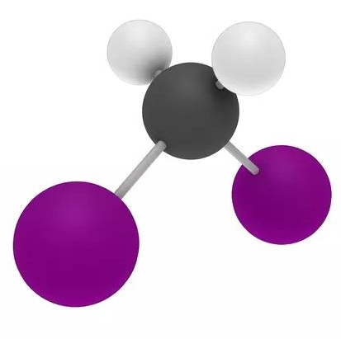
Motivation
Halomethanes are a hot topic within atmospheric chemistry
  Halomethanes provide a source of reactive halides leading to ozone destruction
  S. R. Nichols, “Strong field dynamics and control of molecular dissociation”, PhD Thesis, Stony Brook University, 2008.
In particular, diiodomethane (CH₂I₂) represents a good test system for studies of atomic motion in molecules triggered by light: dissociation, vibrations, …
D. Geißler, B.J. Pearson and T. Weinacht, „Wave packet driven dissociation and concerted elimination in CH₂I₂”, J. Chem Phys. 127 204305 (2007).
The main goal of this project: create a “movie” of the molecule either vibrating or breaking apart (dissociating).
Notes:
Citation: Strong field dynamics and control of molecular dissociation
By Sarah Roxanna Nichols

Slide 3
Overview
Background
A Concept of the Pump-Probe Experiment
Experimental Setup
Results
Summary and Outlook

Slide 4
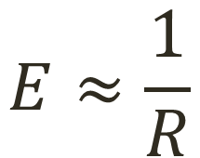
Pump-Probe Concept
A “snapshot” of molecular motion
molecule
Pump pulse excites vibrations (rotations, dissociation, etc…
Probe pulse removes two electrons from the two nuclei, and the molecule “explodes” due to the Coulomb repulsion: “Coulomb explosion imaging”
Distance between the fragments is reconstructed from the measured fragment energies:
$$E≈\frac{1}{R}$$

Slide 5
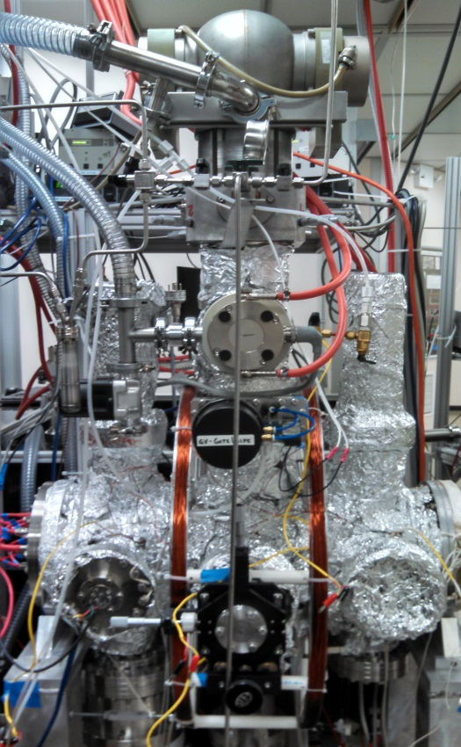
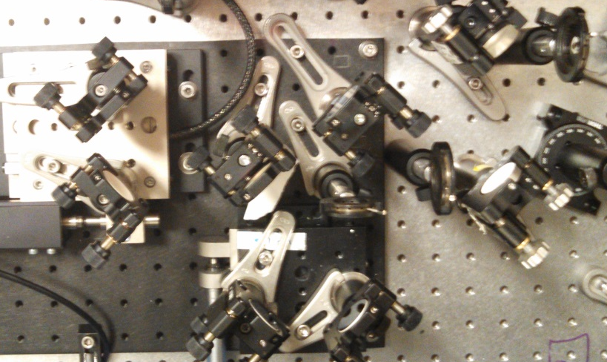
Experimental Setup
Laser
Interferometer
COLTRIMS:
A “Reaction Microscope”
for ions

Slide 6
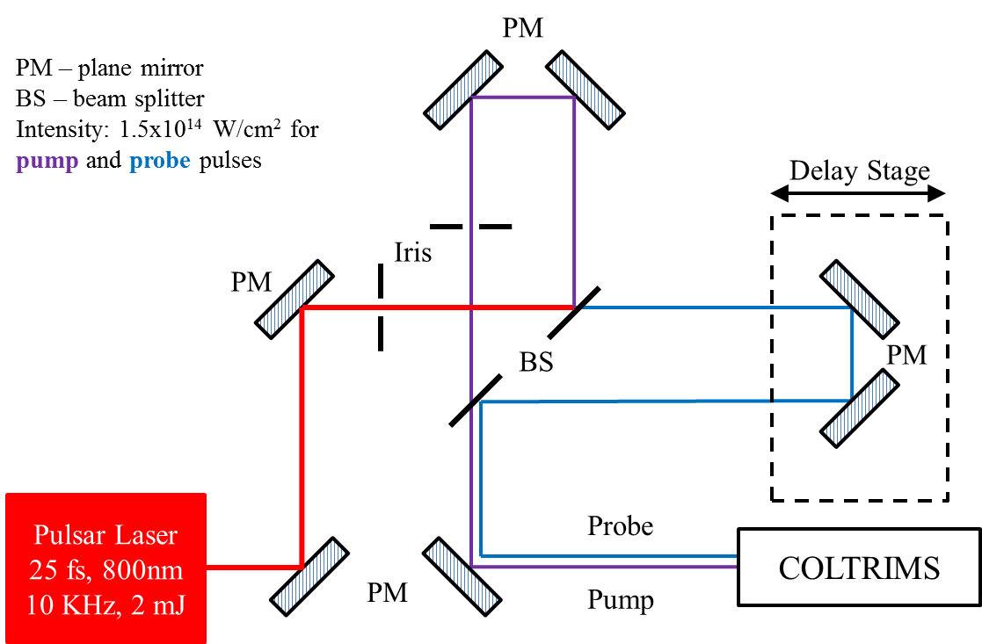
Mach-Zehnder Interferometer

Slide 7
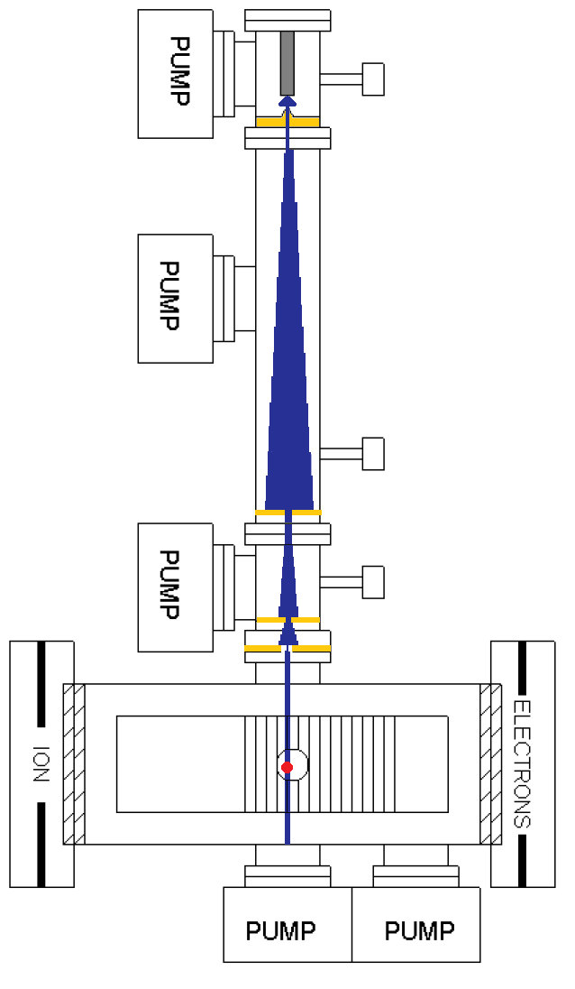
COLTRIMS
10⁻⁴
Cold target recoil ion momentum spectroscopy
Detects resulting ions and electrons after ion/photon interactions with a gas target (measures mass to charge ratios, kinetic energies and emission angles)
Provides insight for a target’s potential dissociation channels
C. M. Maharjan, “Momentum imaging studies of electron and ion dynamics in a strong laser field”, PhD Thesis, Kansas State University, 2007.
10⁻⁶
--- Laser
--- Gas Jet
10⁻⁹
10⁻¹¹
E,B
Notes:
Chakra

Slide 8
COLTRIMS
10⁻⁴
Main components
  Gas jet
  Ultrahigh vacuum chamber
    Pressure: 10⁻¹¹ torr
  Differential pumping stages
  Spectrometer
  Time- and Position Sensitive Detector (MCP + Delay line)
  Focusing mirror (not shown)
Laser directed into vacuum from the back
1
3
10⁻⁶
--- Laser
--- Gas Jet
10⁻⁹
4
2
5
Notes:
Citation: [2]

Slide 9
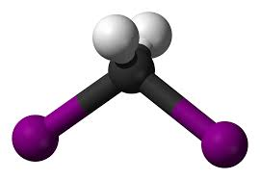
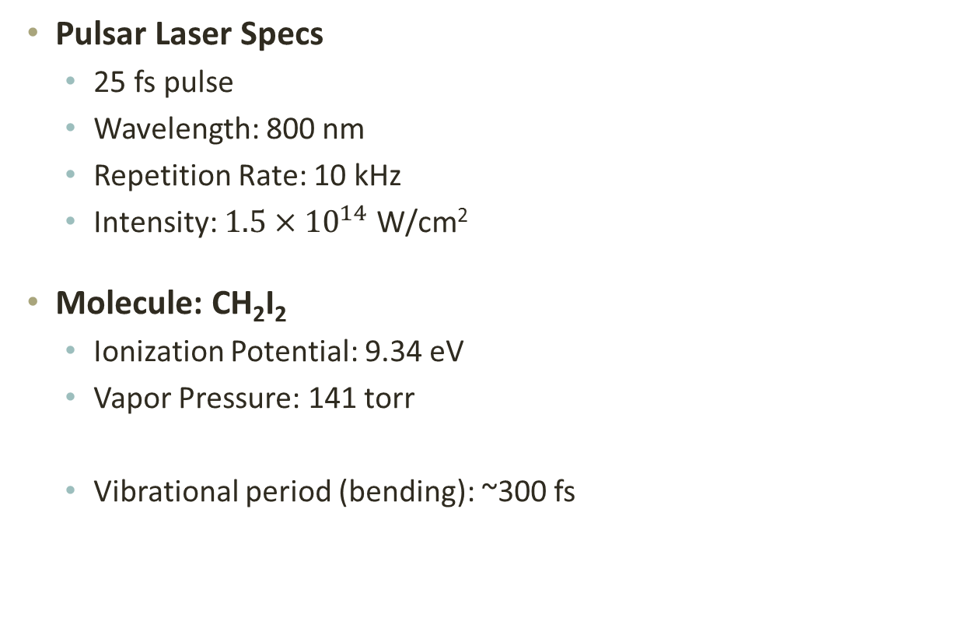
Experimental Specifications
~300 fs
Pulsar Laser Specs
  25 fs pulse
  Wavelength: 800 nm
  Repetition Rate: 10 kHz
  Intensity: $1.5×{10}^{14} \text{W}\text{/}\text{cm}\text{2}$
Molecule: CH₂I₂
  Ionization Potential: 9.34 eV
  Vapor Pressure: 141 torr
  Vibrational period (bending): ~300 fs
Diiodomethane (CH₂I₂)
Notes:
Pulsar Laser
25 fs pulse
800 nm
10 KHz
2 mJ
1.5x10^14 W/cm^2 intensity for pump and probe pulses
Ionization potential citation http://www.indsci.com/docs/manuals/VX500_IP.pdf
Vapor pressure: http://www.chemicalbook.com/ProductMSDSDetailCB6854214_EN.htm#2

Slide 10
Data Analysis
Calibrate Time of Flight (ToF) spectra
  (define mass to charge ratios)
Classify potential dissociation channels and measure fragment energies
Analyze the ion yields and kinetic energy release (KER) as a function of pump-probe delay

Slide 11
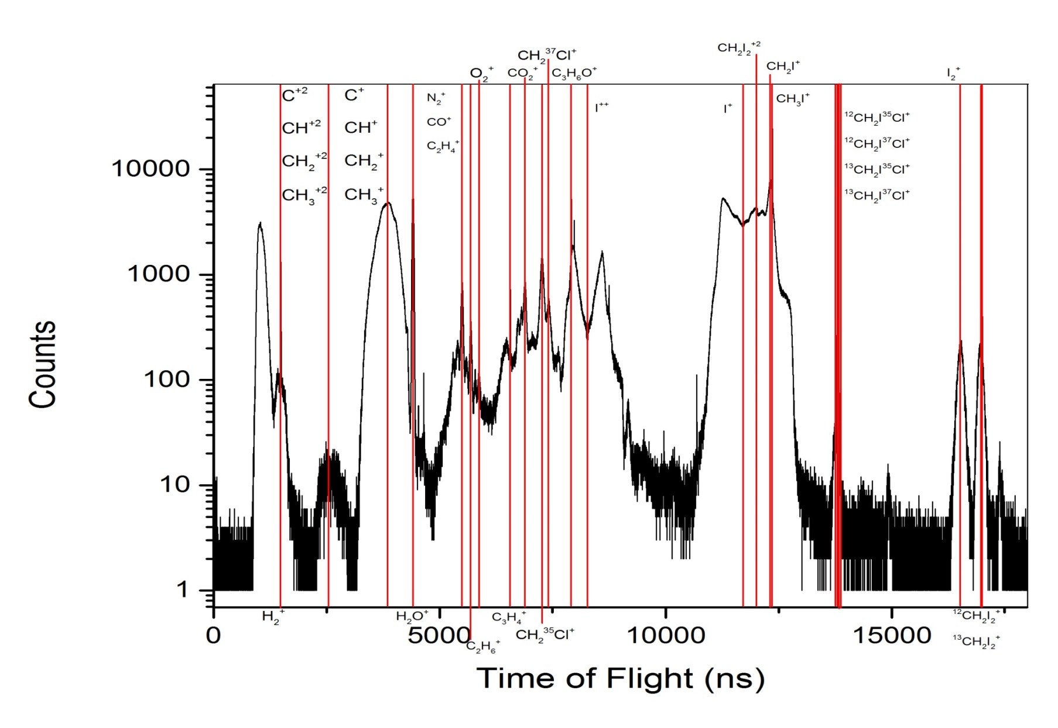
ToF Ion Calibration

Slide 12
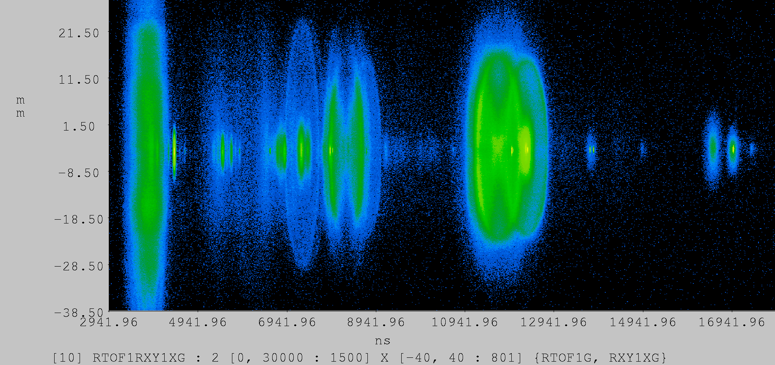
ToF Spectrum
CH₂⁺
I⁺⁺
CH₂I⁺
H₂O⁺
CH₂I₂⁺
CH₂I₂⁺⁺
I₂⁺
I⁺

Slide 13
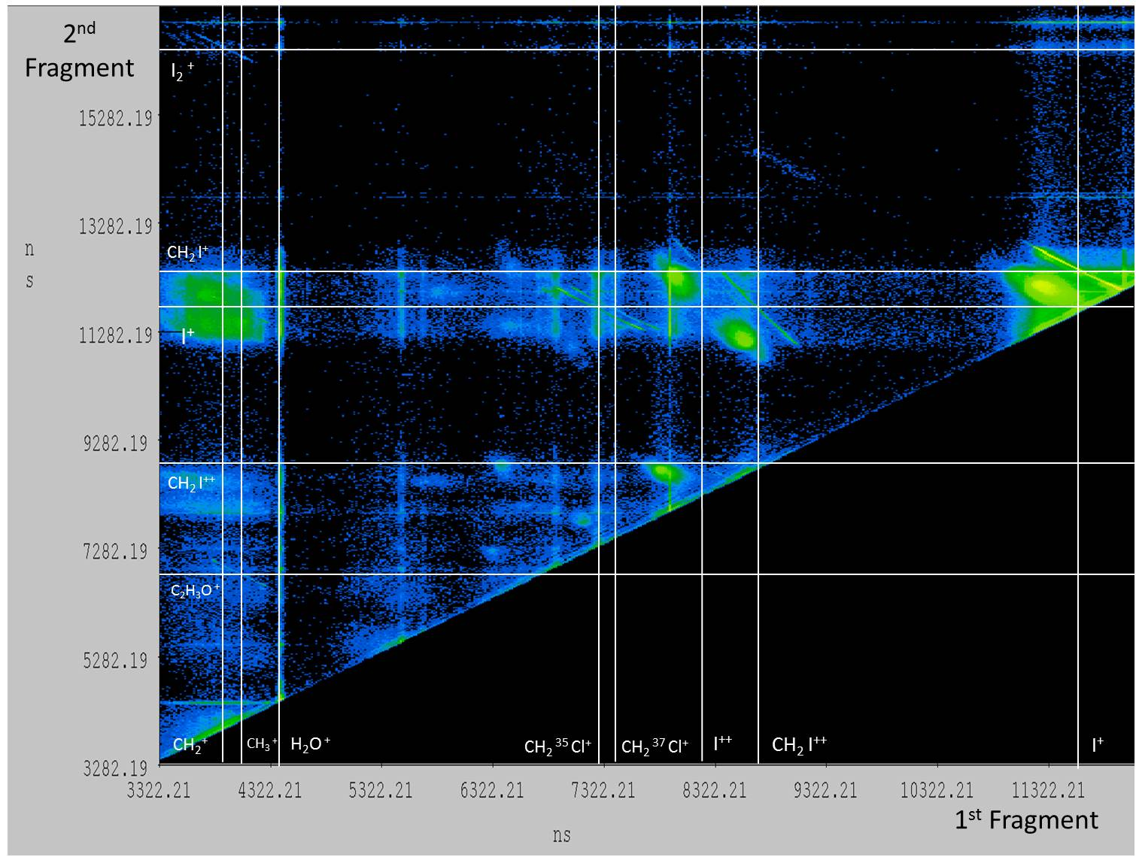
Classification of Dissociation Channels: Ion-Ion Coincidence Spectrum
CH₂I⁺+I⁺

Slide 14
Delay-dependent yields of different fragments
- I⁺
CH₂I⁺
I₂⁺
CH₂I₂⁺
300 fs: bending vibrations!
Normalized ion yield
~300 fs
Delay / fs

Slide 15
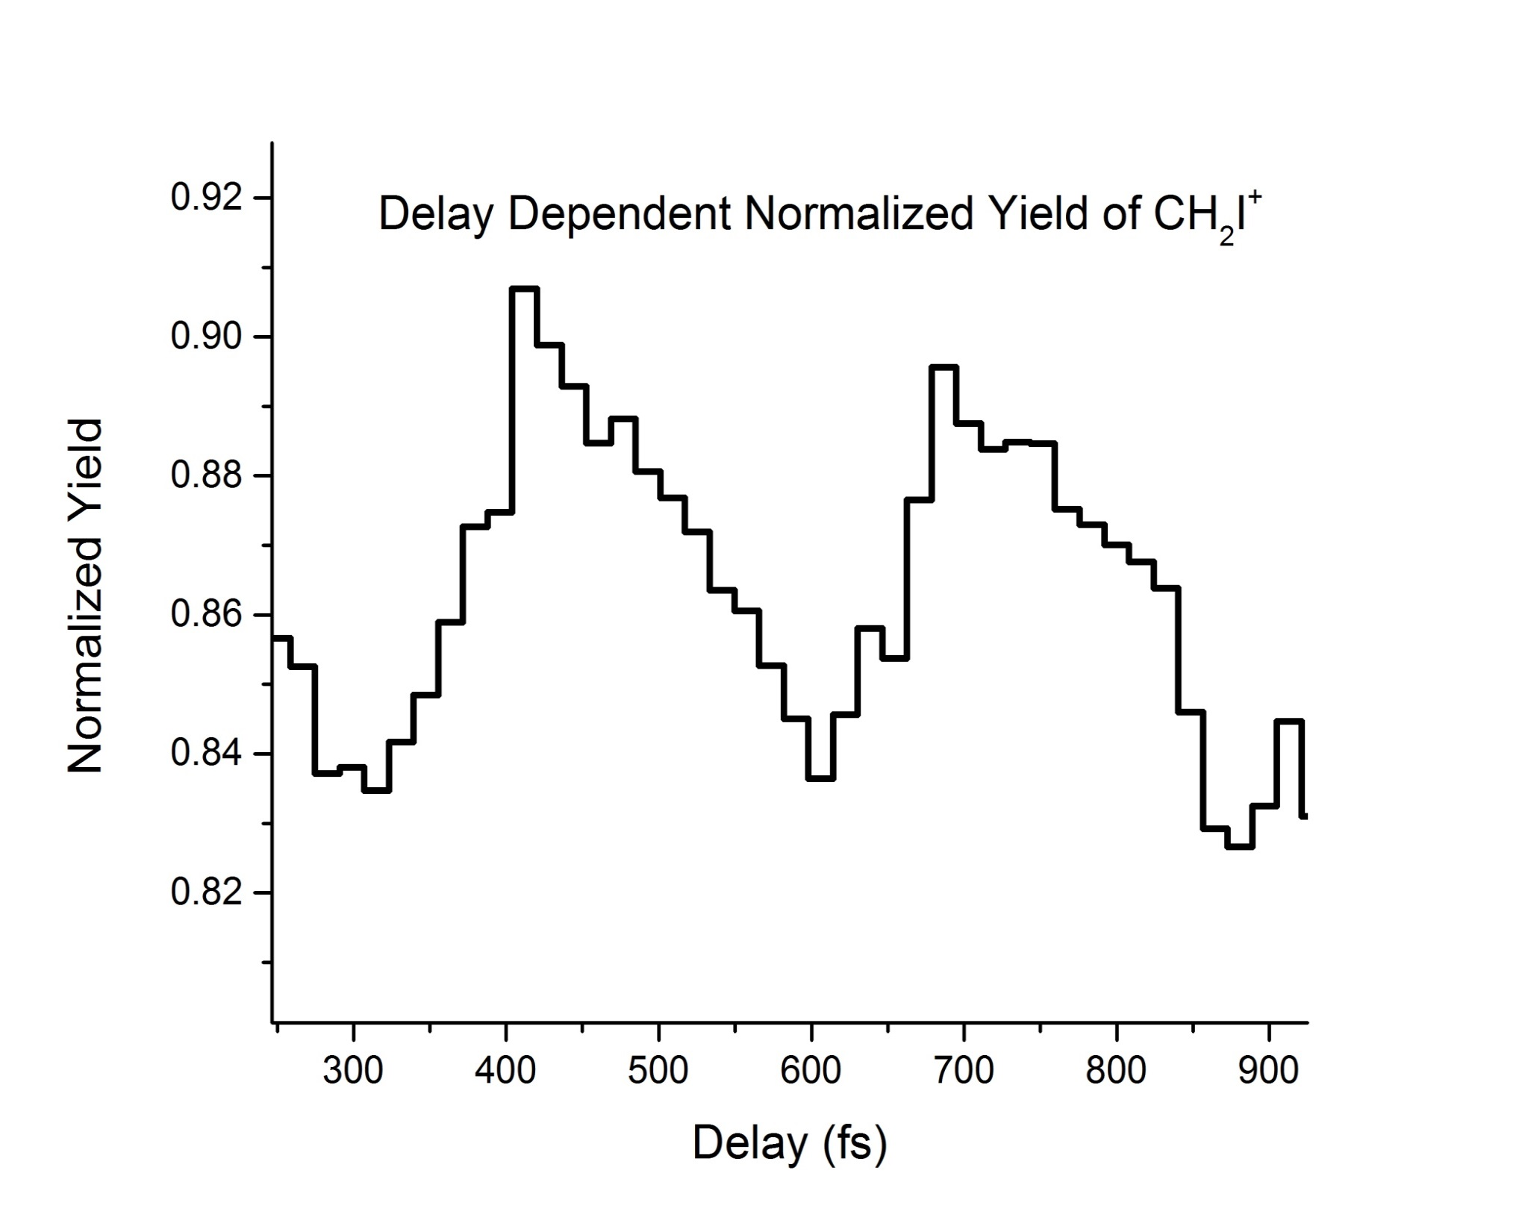
Enlarged view of the CH₂I⁺ channel
~300 fs
~300 fs

Slide 16
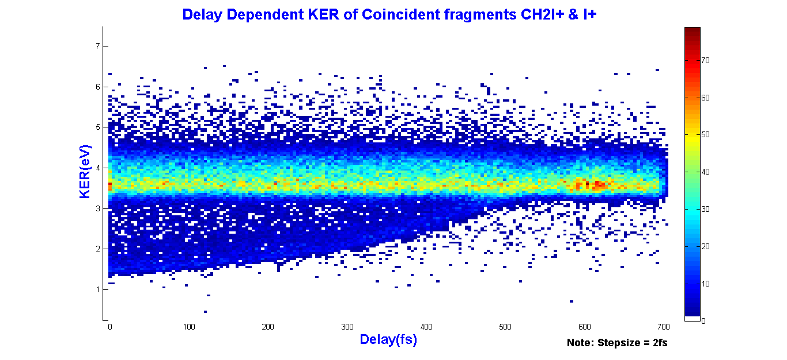

Delay-dependent KER of CH₂I⁺ + I⁺
coincident channel
$$E≈\frac{1}{R}$$
Bound molecule
KER (eV)
Dissociating molecule
Delay (fs)

Slide 17
Conclusions and Outlook
We have measured the ionic fragments after ionization, dissociation and Coulomb explosion of CH₂I₂ molecule in a pump-probe experiment
We observe bending vibrations of the molecule and mapped one of the dissociation pathways
In the future, this technique will be applied to study different light-induced reactions in similar molecules
Notes:
Through the use of an ultrafast pump-probe setup and high-resolution techniques, Coulomb explosion imaging was achieved. We classified various ion fragments and dissociation channels after ionization of diiodomethane via pump and probe pulses. Furthermore, we observed bending vibrations within the molecular structure after dissociation. Future work will be conducted to establish a complete movie of the molecule’s motion as well as study different light-induced reaction in similar molecules.

Slide 18
Acknowledgements
This material is based upon work supported by National ScienceFoundation Grant: NSF grant number PHYS-1461251
Dr. Artem Rudenko
Dr. Daniel Rolles
Lee Pearson
Balram Kaderiya
Farzaneh Ziaee
Raju Pandiri
Notes:
NSF grant number PHYS-1461251

