Slide 1
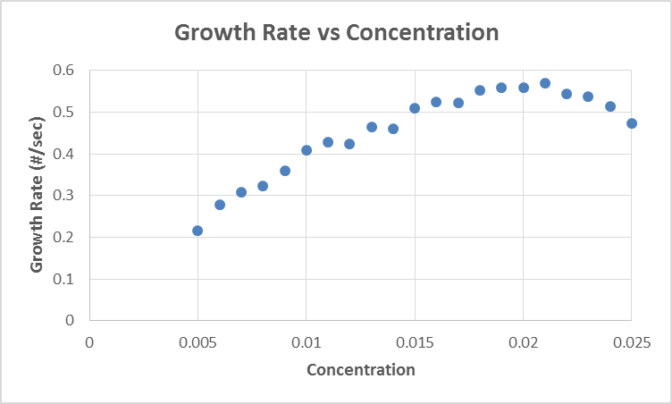
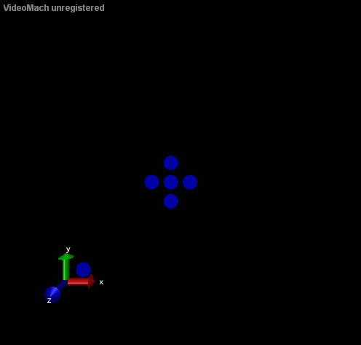
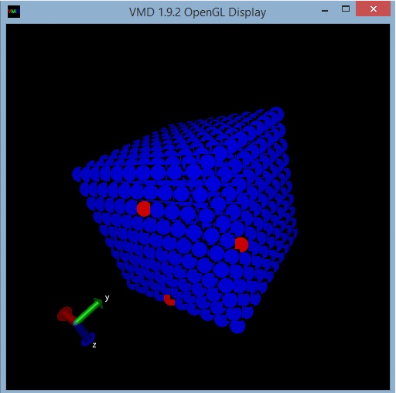
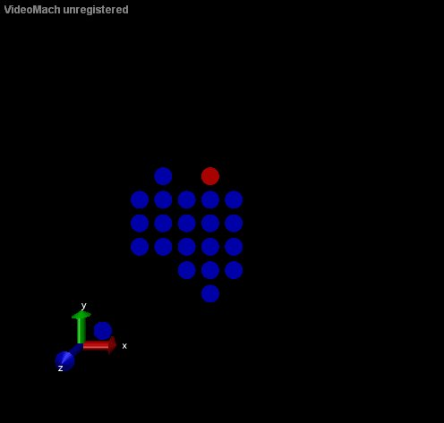
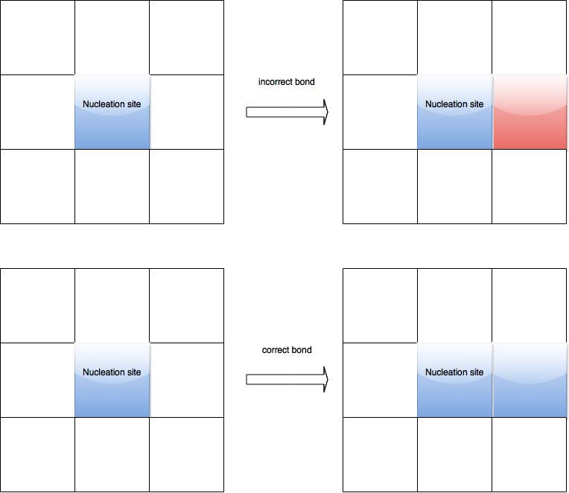
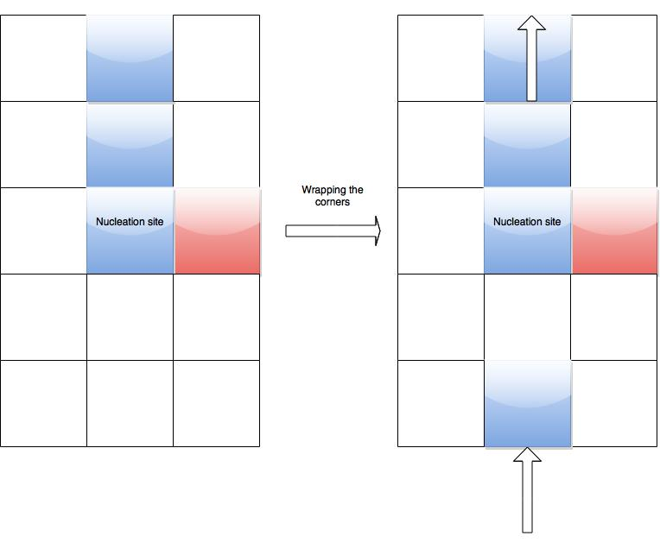
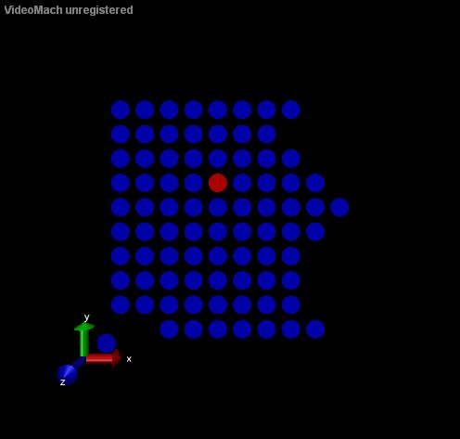
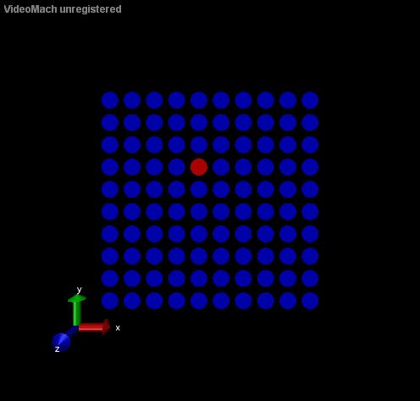
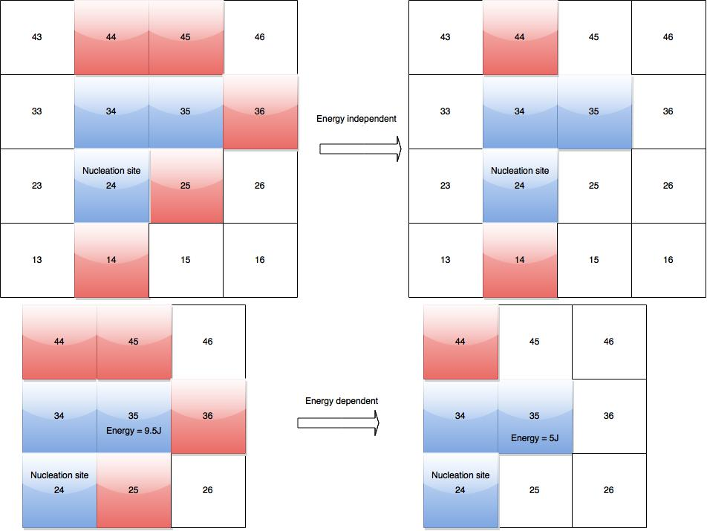
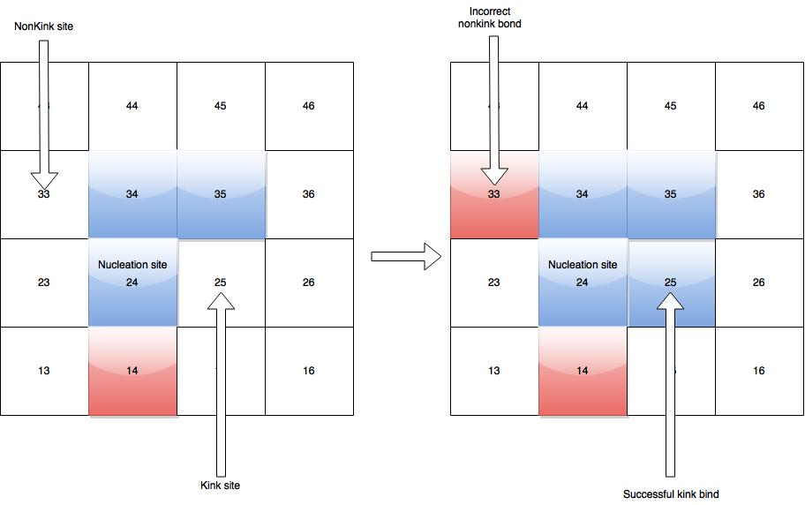
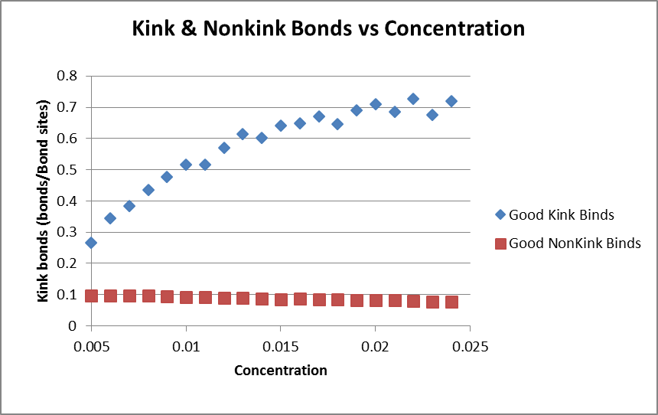
Self Assembly Growth Rate Simulations Jon del’Etoile¹² Advisor: Dr. Jeremy Schmit² ¹Bridgewater State University ²Kansas State University
Introduction
Self assembly systems can be modeled as a two-body interaction. This two body-body interaction can be described in a dichotomy, either molecules bind correctly or incorrectly^{[1]}. For this project it was of interest to examine self assembly and growth of this system in relation to concentration.
To simulate this system a Gillespie algorithm or stochastic simulation algorithm was used. Stochastic algorithm’s have proven to be a way of simulation systems with many molecules. Previous simulations were done by developing an ordinary differential equation which assumed the system was continuous and deterministic. Gillespie produced the same result with this algorithm which develops discrete and stochastic systems^{[2]}.
Simulation and Data
The simulation was built by original code in C++. Visualization came from Virtual Molecular Dynamics (VMD)^{[3]}
Results and further work
Binding and unbinding during growth is governed by the Arrhenius factor $k=Ae^{e_{a}/k_{B}T}$ modified into $k=Ae^{e_{a}/c}$
The findings of this project warrant further work with self assembling systems. Specifically, this project could benefit from longer simulations and gathering of statistics on incorrect binding as a function of concentration.
Building the Simulation
Binding Correctly vs Incorrectly
Dealing with boundaries
References
[1] J.D. Schmit, “Kinetic theory of amyloid fibril templating”, J. Chem. Phys. 138, 185102 (2013)
[2] Gillespie, Daniel T. (1977). "Exact Stochastic Simulation of Coupled Chemical Reactions". The Journal of Physical Chemistry 81 (25): 2340–2361.
[3] http://www.ks.uiuc.edu/Research/vmd
Growing an energy based system
3-D visual of grown lattice showing trapped incorrect bonds.
kink and nonkink bonds
Acknowledgements
I would like to thank NSF, Kansas State University, Dr.Corwin, Dr.Flanders and my advisor Dr.Schmit.
This project was funded by the
National Science Foundation through
grant number PHYS-1461251

