Slide 1
Self Assembly Growth Rate Simulations
Jon del’Etoile
Advisor: Dr. Jermey Schmit

Slide 2
Big picture
If you assume a protein of 200 amino acids and let it randomly sample 3 different states every nanosecond it would take
3²⁰⁰ ns = 5.8 x 10⁶⁸ x age of universe^{[1]}
Your body has about 10¹³ cells and 10¹⁴ bacteria^{[2]}. Single celled organisms have been shown to produce ~ 10² proteins a day^{[3]}. On average your ecosystem produces
10¹⁶ Proteins per ns
There must be some physics behind this system

Slide 3
Project Overview
Task : build a self assembling system that follows a biological system using a Gillespie algorithm.
Procedure :
Figure out how to write original code that follows Gillespie.
Build a black box that simulates a self assembling system.
Take data on growth rate of the system.
Put windows on the black box to figure out what's going on.

Slide 4
Gillespie
large molecule systems were modeled from developing an equation for your system using the master equation^{[4]}
$$\frac{δP\left(x,t \right|x_{0},t_{0})}{δt}= \sum_{j=1}^{M}{\left[a_{j}\left(x−v_{−j}\right)P\left(x−v_{j},t \right|x_{0},t_{0}\right)−a_{j}\left(x\right)P\left(x,t \right|x_{0},t_{0})]}$$
Gillespie figured out an algorithm that is an exact solution to the master equation^{[4]}
Direct method first reaction method
$P\left(τ\right)=ae^{−at}$ $τ_{j}= a_{j}(X)e^{−a_{j}(X)τ}$
$$P\left(j\right)= \frac{a_{j}(X)}{a}$$

Slide 5
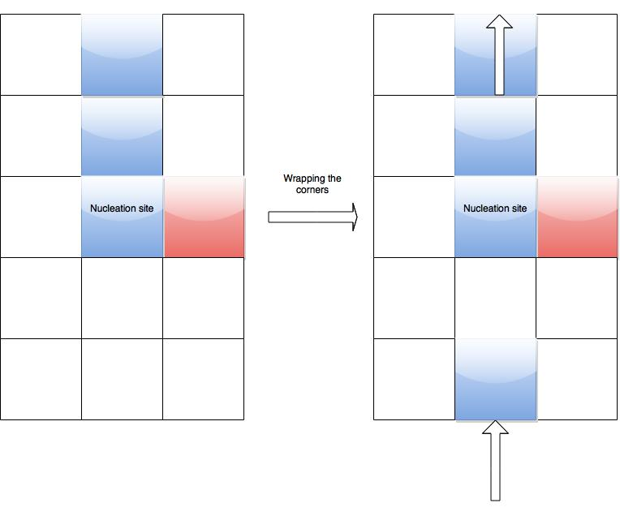
Building the Simulation

Slide 6
Building Continued

Slide 7
Visualizing in VMD

Slide 8
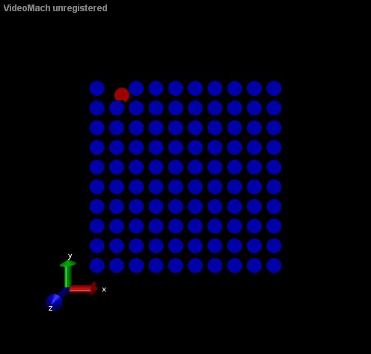
Movies From VMD

Slide 9
Data

Slide 10
Kink Sites

Slide 11
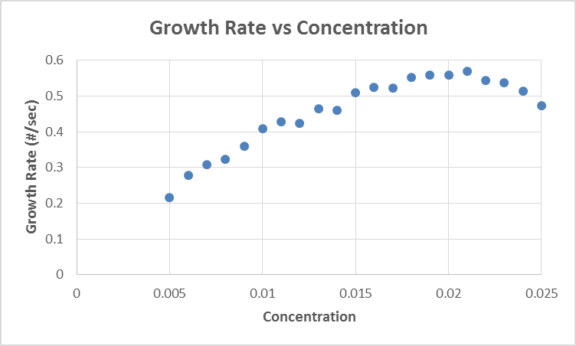
Windows on the black box

Slide 12
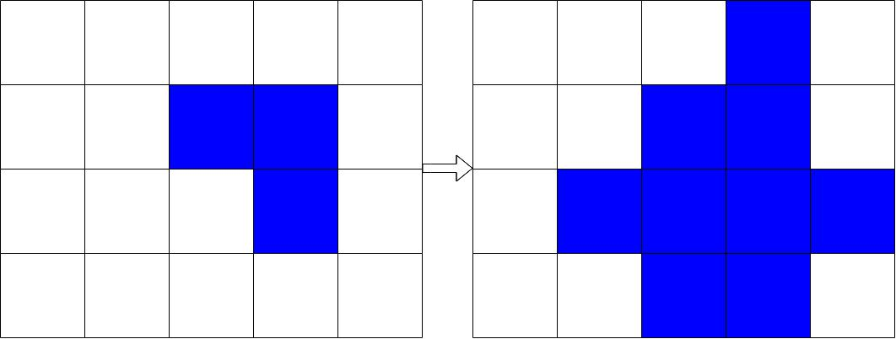
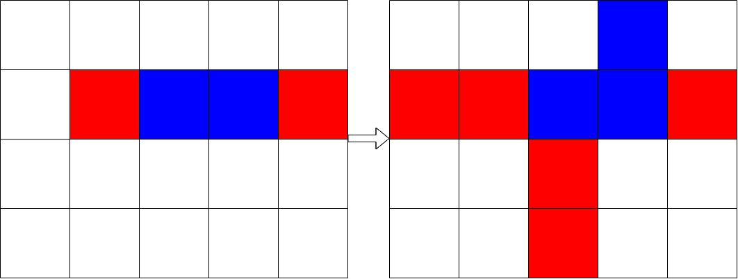
Hypothesis
There will be less kink sites
If there are less kink sites there is more non kink incorrect binding
If there is more nonkink incorrect binding, growth will be affected

Slide 13
References
[1] lecture from Jeremy Schmit
[2] http://discovermagazine.com/galleries/zen-photo/m/microbiome
[3] http://www.hfsp.org/frontier-science/hfsp-success-stories/how-many-protein-molecules-do-we-have-our-cells
[4] http://www.smoldyn.org/andrews/papers/Andrews_Arkin_2009.pdf

Slide 14
Acknowledgments
I would like to thank Dr. Jeremy Schmit for providing a challenging project
Also Dr. Corwin and Dr. Flanders for coordinating the REU
Finally I would like to thank NSF for funding this research experience
Grant number PHYS-1461251

Slide 15
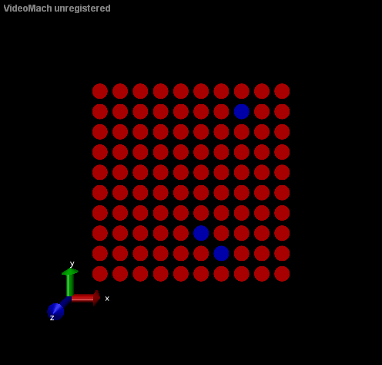
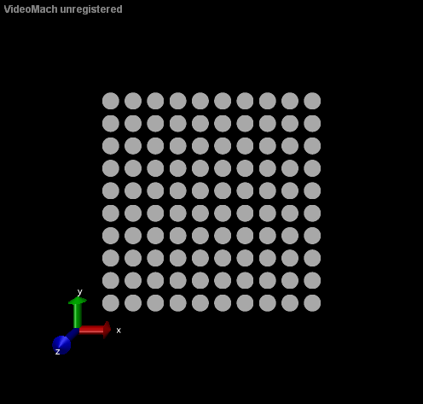
Questions?

