Slide 1
Computational Light-Matter Interactions
Mentor: Dr. Depaola
Mentee: Daniel Keylon
This material is based upon work supported by National Science Foundation Grant: Kansas State University: Interactions of Matter, light, and learning; NSF Grant number: PHYS-1461251

Slide 2
Background
An Experimental Problem
A Theoretical Solution with Caveats
Scaling
Tedium
Modifying system
A Computational solution to the problems with our solution.

Slide 3
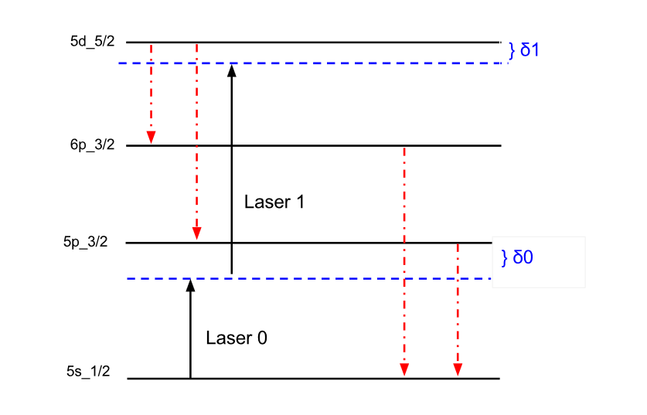
A Computational Solution to a Physical Problem
The picture to the left is a 4-level atomic energy system. Each black bar is a distinct energy level.
The blue dotted lines represent the detuning of the laser from resonance. The δ’s represent this detuning in units of Hz.
The black vertical arrows represent the energy transitions that the lasers cause the system to undergo. The red vertical arrows represent energy transitions due to spontaneous emission.
The numbers on the far left are merely the quantum numbers that denote each energy level.

Slide 4
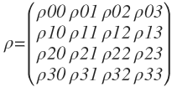
The Unifying Equation of My Project

Slide 5
Rate Equation Building
The 1st Equation:
The commutator definition
Also the population change rate equation for cases without spontaneous emission.
The 2nd Equation:
The full equation with spontaneous emission.
The 3rd Equation:
Method for deriving the Gamma-Rho matrix.

Slide 6
Enter the Hamiltonian
Development of the Hamiltonian
Apply Dipole Approximation
More Approximations
Set potential energy of ground state to 0
The Hamiltonian appears!

Slide 7
The Final Piece
Decay Rate Calculations
Wigner Coefficients
Not Matrices
Reduced Matrix Element
Database of Values

Slide 8
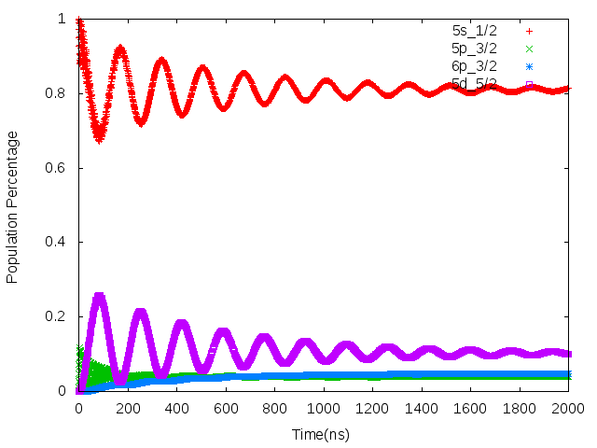
Parameter Graphs!
Energy Levels: 5s$\frac{1}{2}$, 5p$\frac{3}{2}$, 6p$\frac{3}{2}$, 5d$\frac{5}{2}$
No Hyper-Fine splitting; 2 Laser Transitions
For 5s$\frac{1}{2}$ to 5p$\frac{3}{2}$:
q = 0 (The laser is linearly polarized)
Detuning = 1 GHz
Intensity = 1000 $\frac{mW}{cm^{2}}$
For 5p$\frac{3}{2}$ to 5d$\frac{5}{2}$:
q = 0 (The laser is linearly polarized)
Detuning = 0 GHz
Intensity = 1000 $\frac{mW}{cm^{2}}$

Slide 9
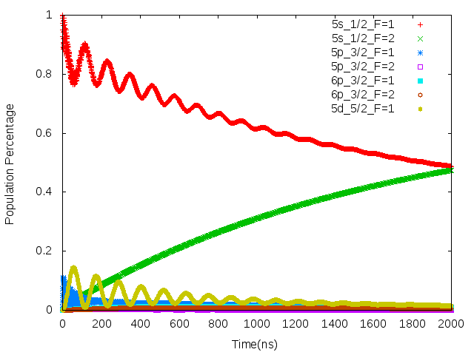
Graphs+
Energy Levels: 5s$\frac{1}{2}$, 5p$\frac{3}{2}$, 6p$\frac{3}{2}$, 5d$\frac{5}{2}$
All levels Hyper-Fine split; 2 Laser Transitions
For 5s$\frac{1}{2}$_F=1 to 5p$\frac{3}{2}$_F=1:
q = 0 (The laser is linearly polarized)
Detuning = 1 GHz
Intensity = 1000 $\frac{mW}{cm^{2}}$
For 5p$\frac{3}{2}$_F=1 to 5d$\frac{5}{2}$_F=1:
q = 0 (The laser is linearly polarized)
Detuning = 0 GHz
Intensity = 1000 $\frac{mW}{cm^{2}}$

Slide 10
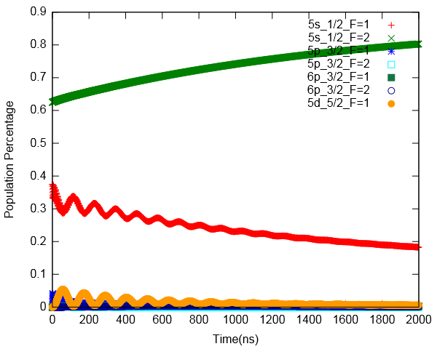
Graphs++
Energy Levels: 5s$\frac{1}{2}$, 5p$\frac{3}{2}$, 6p$\frac{3}{2}$, 5d$\frac{5}{2}$
All levels Hyper-Fine split; 2 Laser Transitions
For 5s$\frac{1}{2}$_F=1 to 5p$\frac{3}{2}$_F=1:
q = 0 (The laser is linearly polarized)
Detuning = 1 GHz
Intensity = 1000 $\frac{mW}{cm^{2}}$
For 5p$\frac{3}{2}$_F=1 to 5d$\frac{5}{2}$_F=1:
q = 0 (The laser is linearly polarized)
Detuning = 0 GHz
Intensity = 1000 $\frac{mW}{cm^{2}}$

Slide 11
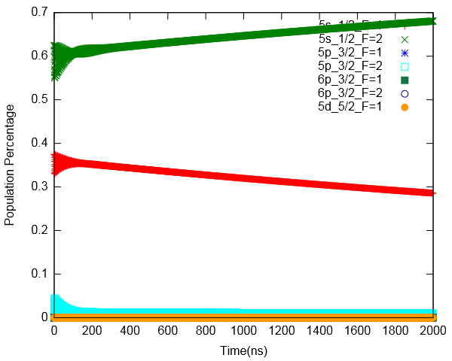
Graphs Extended
Same parameters as last
Except:
1 new laser:
5s$\frac{1}{2}$_F=2 to 5p$\frac{3}{2}$_F=2
All polarities now = 1(right circularly polarized)

Slide 12
Bibliography
B. D. Depoala, Notes for Lectures on Coherent Excitation
B. D. Depoala, Wigner relationships connecting fully differential dipole matrix elements to reduced matrix elements, (Department of Physics, Kansas State University, Manhattan, Kansas 66506-2601), June 26, 2015
B. D. Depoala, personal communication

