Slide 1
Stabilizing Carrier-Envelope Phase
Brett Chrisler
Kansas State University REU 2015
Mentor: Dr. Vinod Kumarappan

Slide 2
Project Background
Atomic, Molecular, and Optical (AMO) Physics
Mentor: Dr. Vinod Kumarappan
Postdoctoral: Rajesh Kushawaha
Graduate: Huynh Lam
Kansas Light Source (KLS) located in the James R. Macdonald Laboratory at Kansas State University
KLS Laser
800 nm wavelength
3 millijoules/pulse at 25 femtoseconds/pulse
2kHz

Slide 3
Carrier-Envelope (CE) Phase
Peak Electric Field
Peak Pulse Envelope
Offset
[1] Moon, Eric Wayne. "Carrier-Envelope Phase Stabilization of Grating- Based Chirped-Pulse Amplifiers." Diss. Kansas State U, 2009. Abstract. 4. Print.

Slide 4
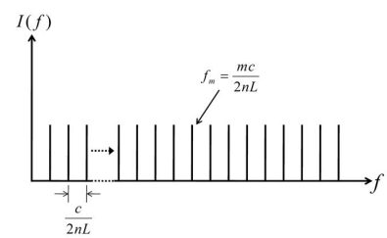
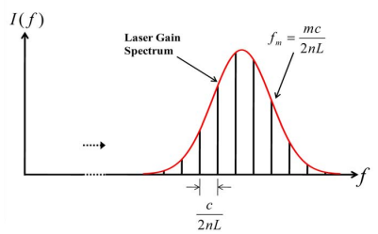
Mode-Locked Lasers
Sequences of pulses on the order of femtoseconds result.
Each mode is set apart at the same interval leading to a frequency comb.
Crystal (e.g. Ti:Sapphire) starts the lasing process and creates a gain spectrum and allows modes under this spectrum specifically to become excited.
[3] Moon, Eric Wayne. "Carrier-Envelope Phase Stabilization of Grating- Based Chirped-Pulse Amplifiers." Diss. Kansas State U, 2009. Abstract. 9. Print.

Slide 5
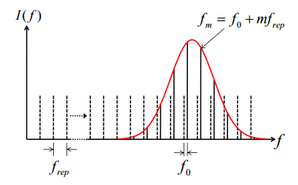
Offset Frequency
Pulse
Phase velocity -> Carrier-Wave
Not the same = Carrier-Envelope Phase Shift Group velocity -> Envelope
Dashed line – Same
Solid line – Different
[4] Moon, Eric Wayne. "Carrier-Envelope Phase Stabilization of Grating- Based Chirped-Pulse Amplifiers." Diss. Kansas State U, 2009. Abstract. 16. Print.

Slide 6
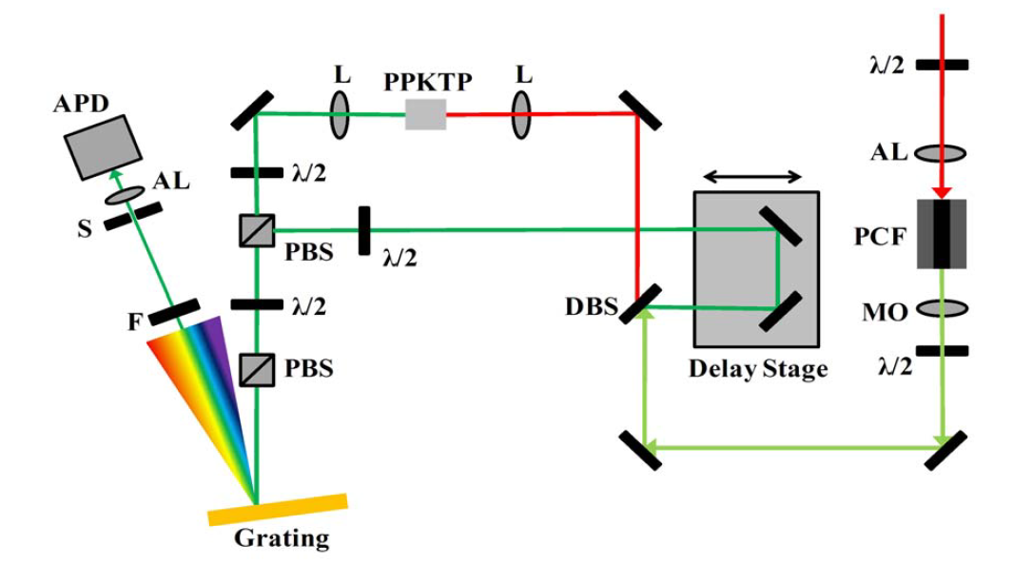
Original f-to-2f Setup
Area changed
[5] Moon, Eric Wayne. "Carrier-Envelope Phase Stabilization of Grating- Based Chirped-Pulse Amplifiers." Diss. Kansas State U, 2009. Abstract. 28. Print.

Slide 7
Current f-to-2f Setup
L
PPKTP
L
Camera
Delay Stage
λ/2
532 nm
1064 nm
F
PBS
λ/2
λ/2
DBS
S
PBS
L
Sapphire
L
Grating
70 mm
200 mm
P
P – Periscope
L – Lens
DBS – Dichroic Beamsplitter
PPKTP – Periodically-Poled Potassium Titanyl Phosphate
λ/2 – Half-Waveplate
PBS – Polarizing Beamsplitter Cube
F- Filter
S – Slit
AL – Aspheric Lens

Slide 8
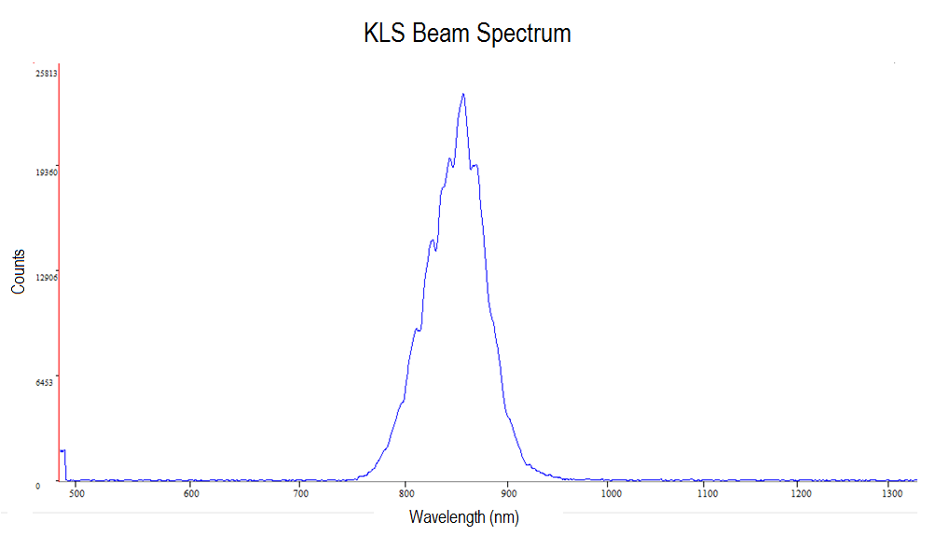

Slide 9
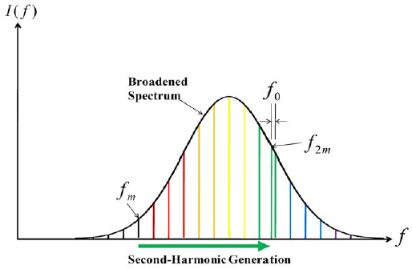
Broadened Spectrum
Broadening the spectrum
Octave – f and 2f
Second Harmonic Generation
Doubled frequency
CEP Experiment
532 nm and 1064 nm
[5] Moon, Eric Wayne. "Carrier-Envelope Phase Stabilization of Grating- Based Chirped-Pulse Amplifiers." Diss. Kansas State U, 2009. Abstract. 18. Print.

Slide 10
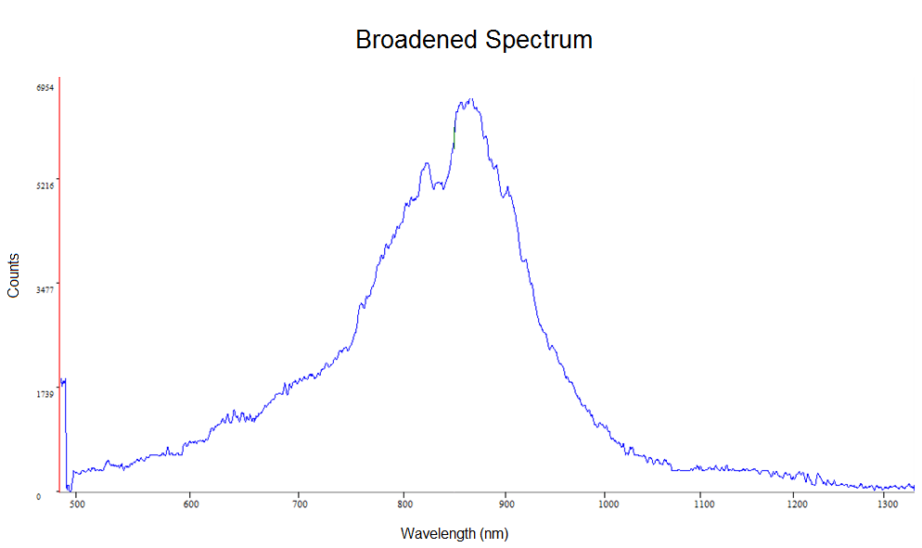
L
Sapphire
L

Slide 11
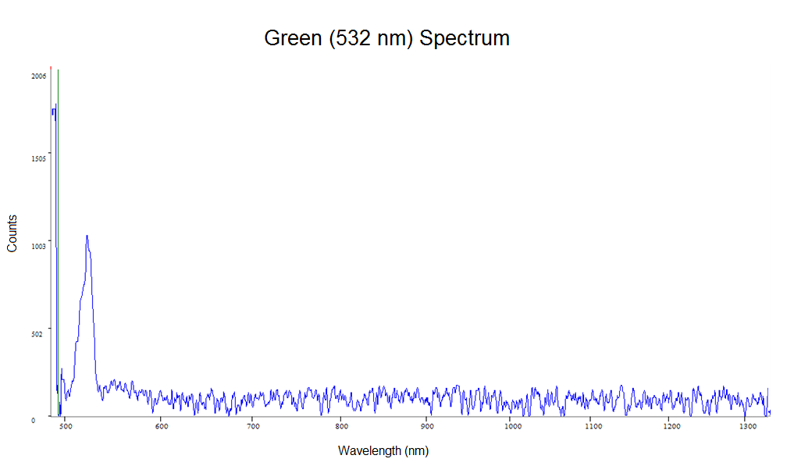
DBS

Slide 12
Results
Fringes appeared on camera on both beams indicating diffraction patterns in the beams themselves.
There was some movement in the camera, which would indicate overlap and an interference between the two. However, this was extremely difficult to determine due to noise.

Slide 13
Future Improvements
Rid of fringe/diffraction pattern on beam.
Use better positioning of lenses to allow smaller movements for sapphire crystal with stage.
Allow for rotation of the sapphire crystal to have better control on the beam.
Add an iris before the second lens to help with collimating the beam.
Put irises in the path to the periscope for alignment.
Collect data from a photo-diode.
Overall, more time and precision can allow this experiment to succeed.

Slide 14
Acknowledgments
This program is funded by the National Science Foundation through grant number PHYS-1461251. Any opinions, findings, and conclusions or recommendations expressed in this material are those of the author(s) and do not necessarily reflect the views of the National Science Foundation.
Dr. Vinod Kumarappan
Rajesh Kushawaha
Huynh Lam
Dr. Bret Flanders
Dr. Kristan Corwin
Fellow REU students

