Slide 1
Interfacial Tension of a Settling Amoeboid Cell
Angelynn Simenson

Slide 2
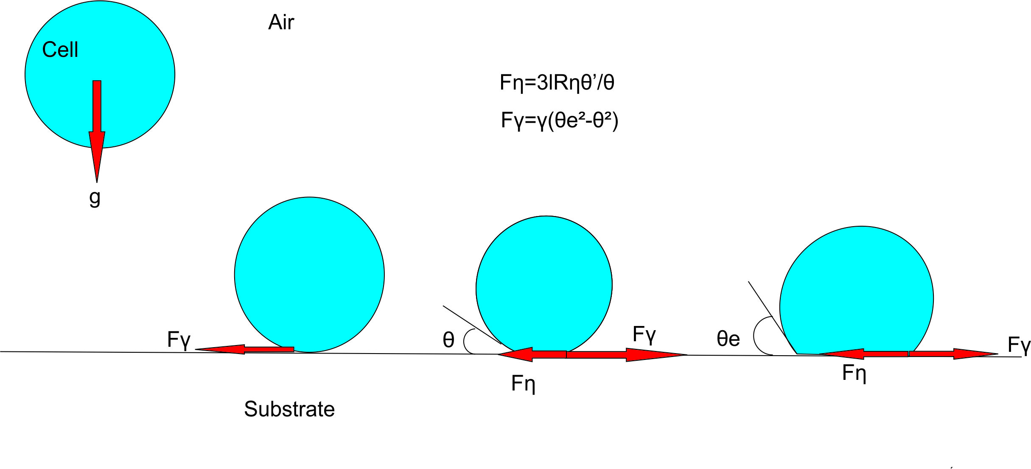
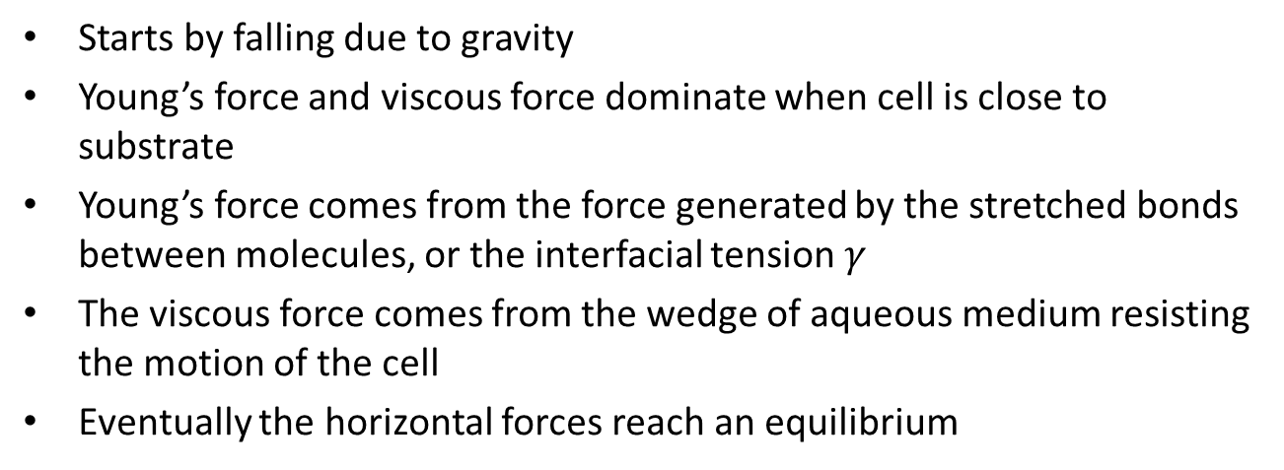
Cell Settling
Starts by falling due to gravity
Young’s force and viscous force dominate when cell is close to substrate
Young’s force comes from the force generated by the stretched bonds between molecules, or the interfacial tension $γ$
The viscous force comes from the wedge of aqueous medium resisting the motion of the cell
Eventually the horizontal forces reach an equilibrium

Slide 3
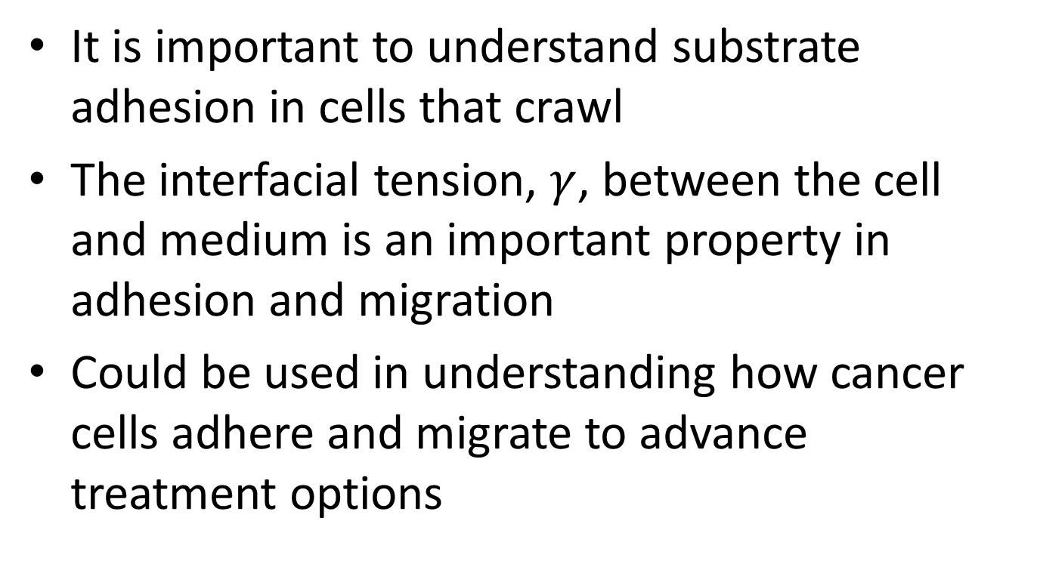
Importance
It is important to understand substrate adhesion in cells that crawl
The interfacial tension, $γ$, between the cell and medium is an important property in adhesion and migration
Could be used in understanding how cancer cells adhere and migrate to advance treatment options

Slide 4
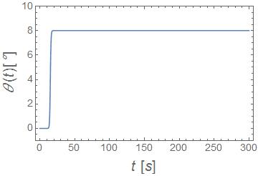
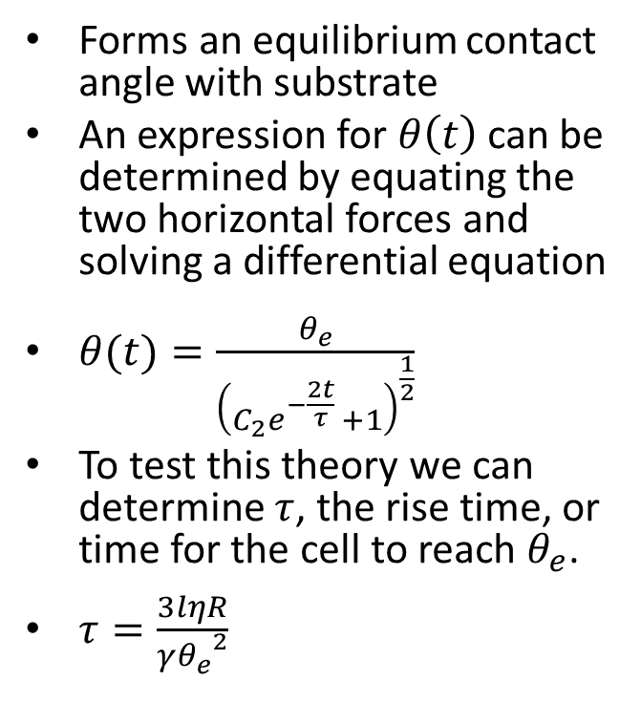
Cell at Equilibrium
Forms an equilibrium contact angle with substrate
An expression for $θ\left(t\right)$ can be determined by equating the two horizontal forces and solving a differential equation
$θ(t)=\frac{θ_{e}}{{\left(C_{2}e^{−\frac{2t}{τ} }+1\right)}^{\frac{1}{2}}}$
To test this theory we can determine $τ$, the rise time, or time for the cell to reach $θ_{e}$.
$τ=\frac{3lηR}{γ{θ_{e}^{}}^{2}}$

Slide 5
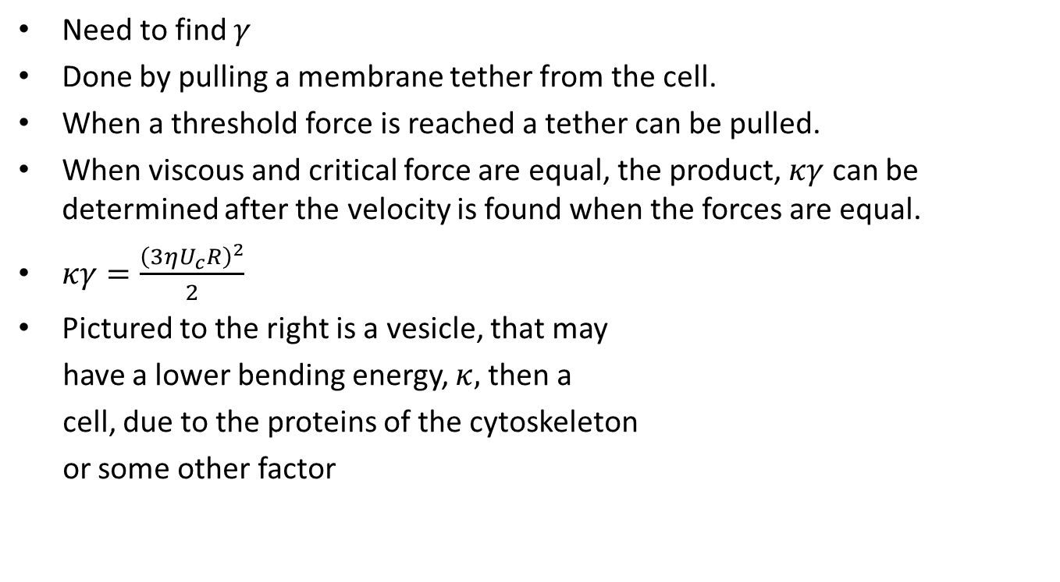
Theory Behind Experiment
Need to find $γ$
Done by pulling a membrane tether from the cell.
When a threshold force is reached a tether can be pulled.
When viscous and critical force are equal, the product, $κγ$ can be determined after the velocity is found when the forces are equal.
$κγ=\frac{{\left(3ηU_{c}R\right)}^{2}}{2}$
Pictured to the right is a vesicle, that may
have a lower bending energy, $κ,$ then a
cell, due to the proteins of the cytoskeleton
or some other factor

Slide 6
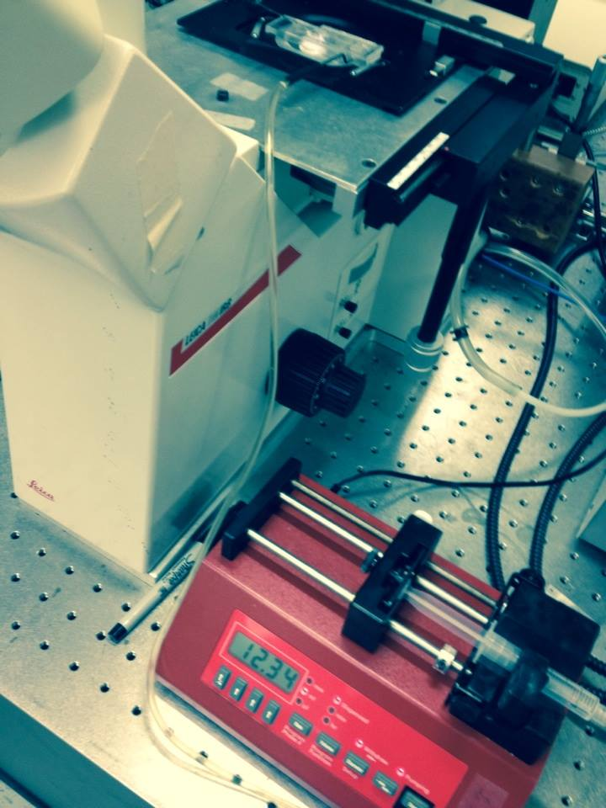
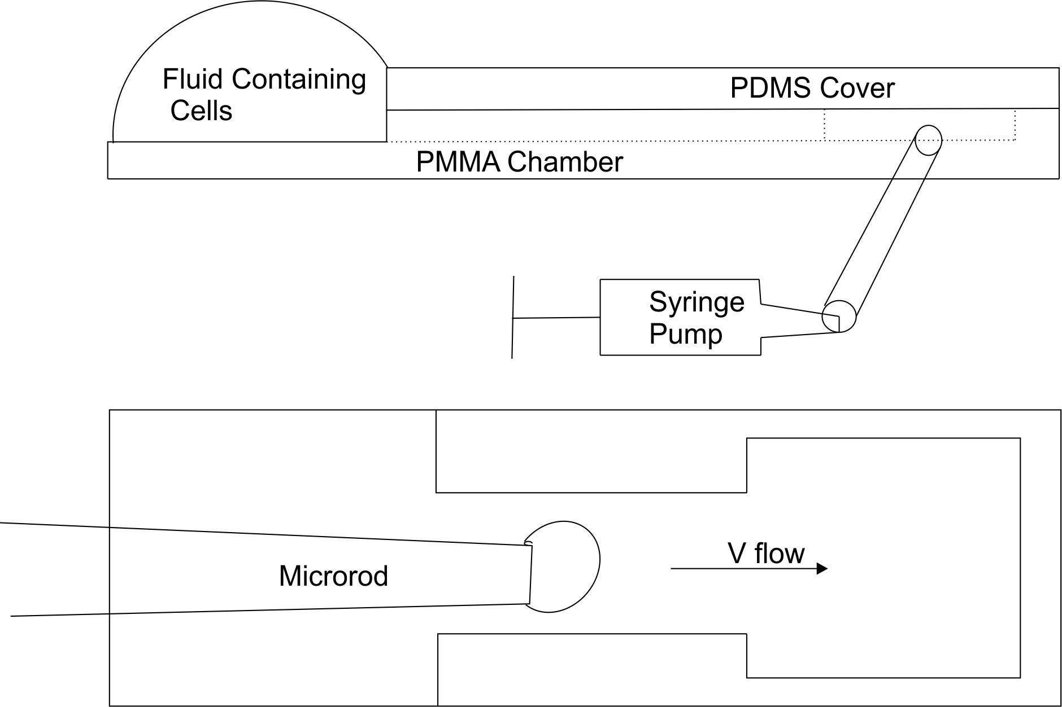
The Apparatus

Slide 7
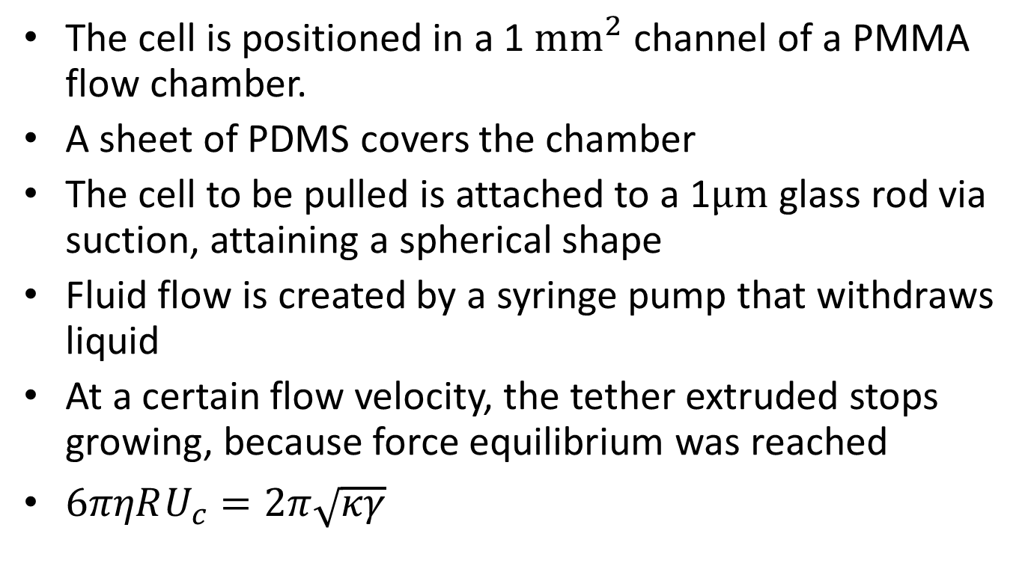
The Experiment
The cell is positioned in a 1 ${mm}^{2}$ channel of a PMMA flow chamber.
A sheet of PDMS covers the chamber
The cell to be pulled is attached to a 1$μm$ glass rod via suction, attaining a spherical shape
Fluid flow is created by a syringe pump that withdraws liquid
At a certain flow velocity, the tether extruded stops growing, because force equilibrium was reached
$6πηRU_{c}=2π\sqrt{κγ}$

Slide 8
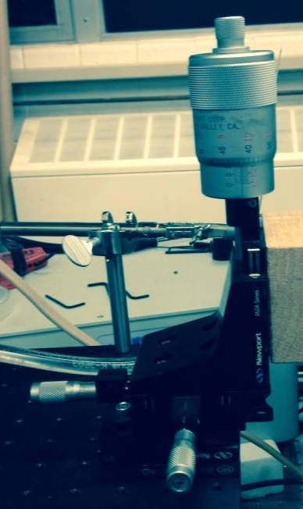
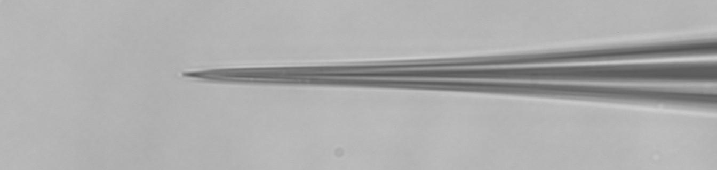
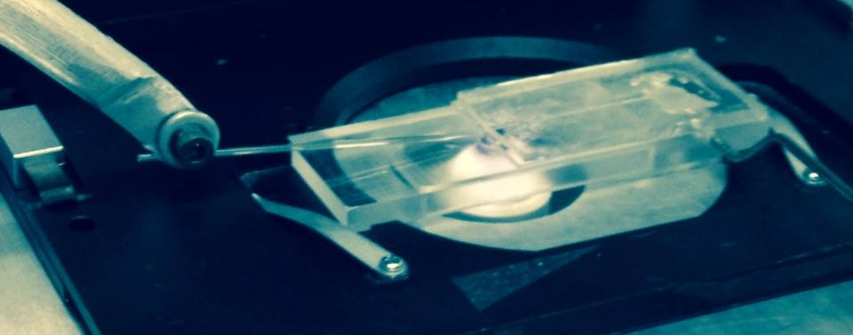
The Parts
Top left: a close up image of the microrod in the channel, taken with the microscope
Bottom left: an outside view of the microrod in the channel
Above: the 3-D stage used to move and insert the microrod into the channel

Slide 9
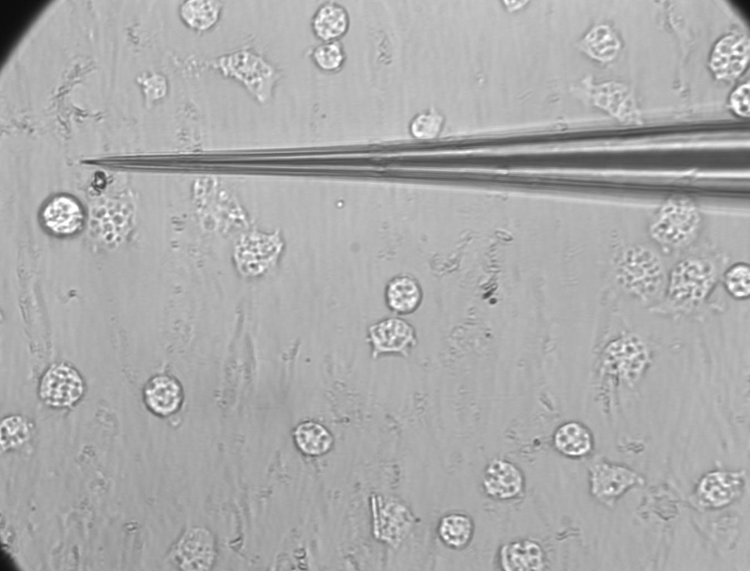
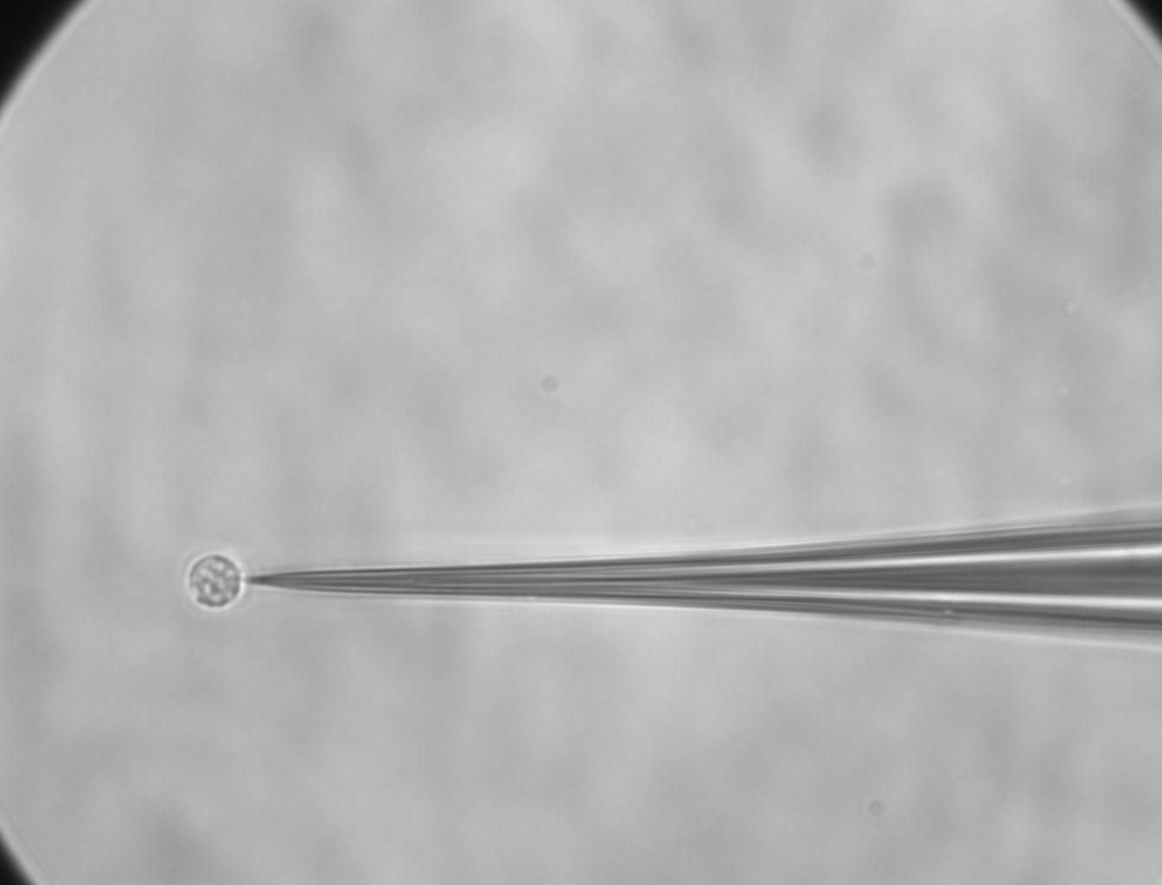

Picking Up Cells
Left: find an unsettled cell by moving the microrod with the 3D stage. The brighter cell below the rod is the loose cell. To pick it up we moved the rod until it was in contact with the cell.
10 $μm$
Right: a sitting cell is adhered to the rod.

Slide 10
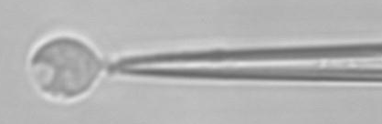
Almost Tether!
Problems:
  Having to unload the syringe
  Having to reload the liquid so frequently
  Having such a small tip
  Having a weak adhesion due to no lectin

Slide 11
Small Improvements
A larger syringe was used to decrease the amount of times it needed to be emptied, because that sometimes dislodged cells.
A flatter, wider microtube tip is more ideal for picking up cells and created by pushing the tip against the wall of the chamber

Slide 12
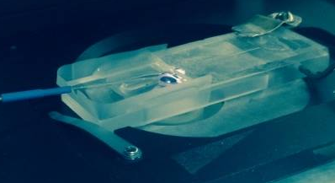
Chamber Modifications
Window milled out under chamber to get a closer working distance
Used tape to create a wall around the chamber so that fluid had to be loaded into the chamber less

Slide 13
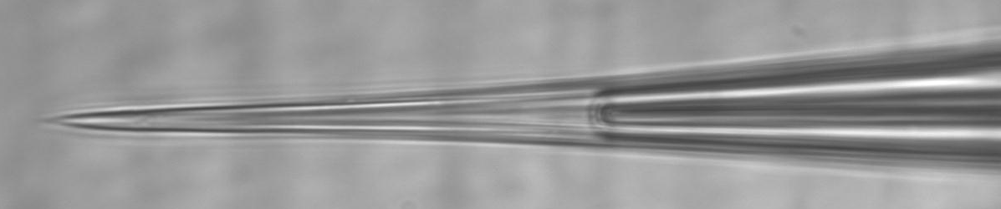
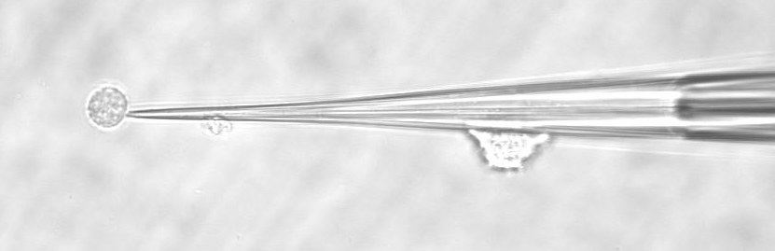
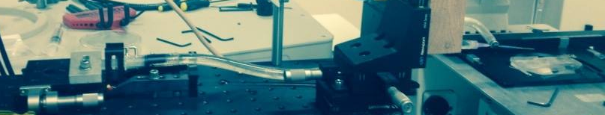
Better Cell Adhesion
Microtubes used instead of microrods
Suction created by making a syringe pump and withdrawing liquid to pull cell in (top)
Cell stuck better when suction pulled it to the microtube (middle)
The whole setup consisted of a syringe, a tube, a stage to control the syringe, another syringe to fit the microtube, and the microtube (pictured below)

Slide 14
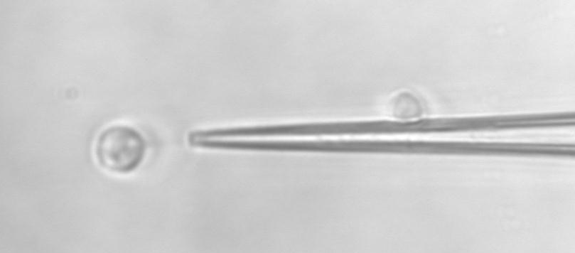
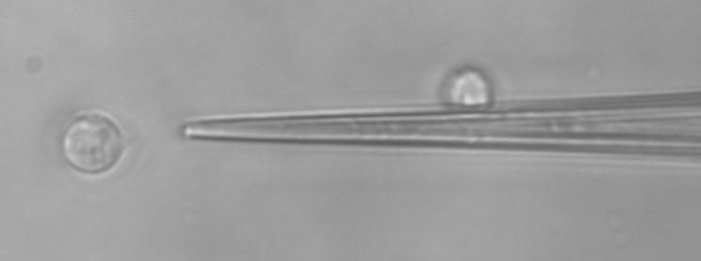
Tether!
Left: a membrane tether being pulled at a flow rate of 4.2 mL/min
The tether length when the viscous and Young’s force are equal is 10.1 microns.

Slide 15
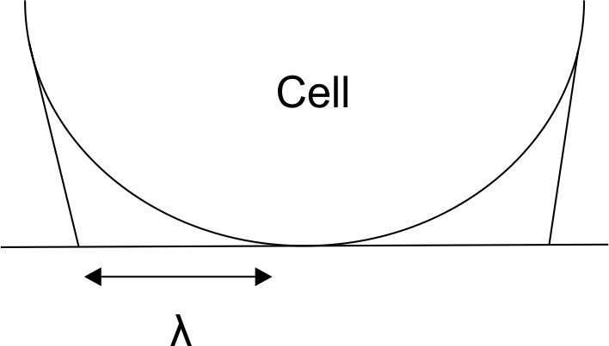
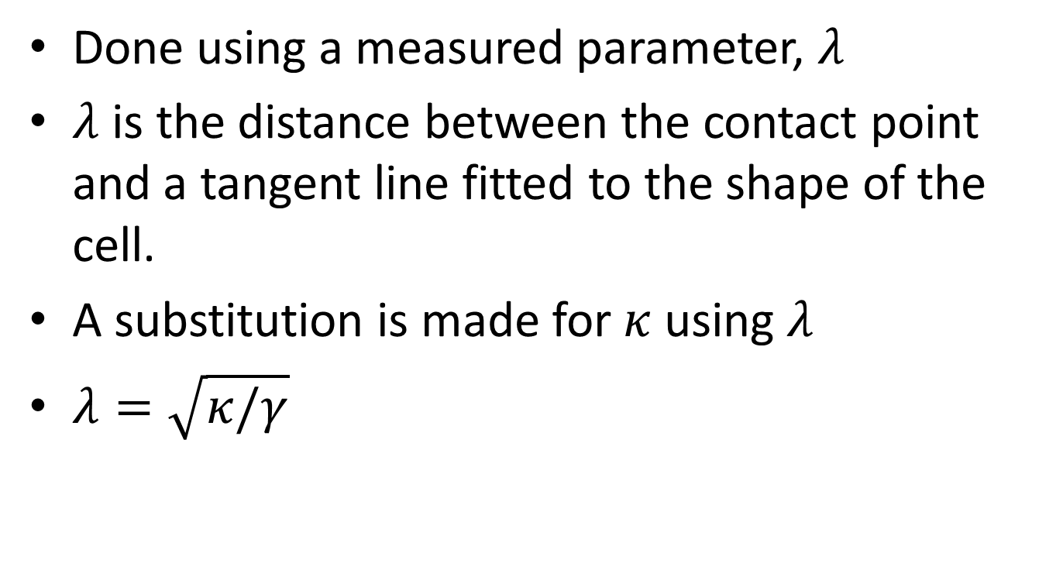
Calculation
Done using a measured parameter, $λ$
$λ$ is the distance between the contact point and a tangent line fitted to the shape of the cell.
A substitution is made for $κ$ using $λ$
$λ=\sqrt{κ/γ}$

Slide 16
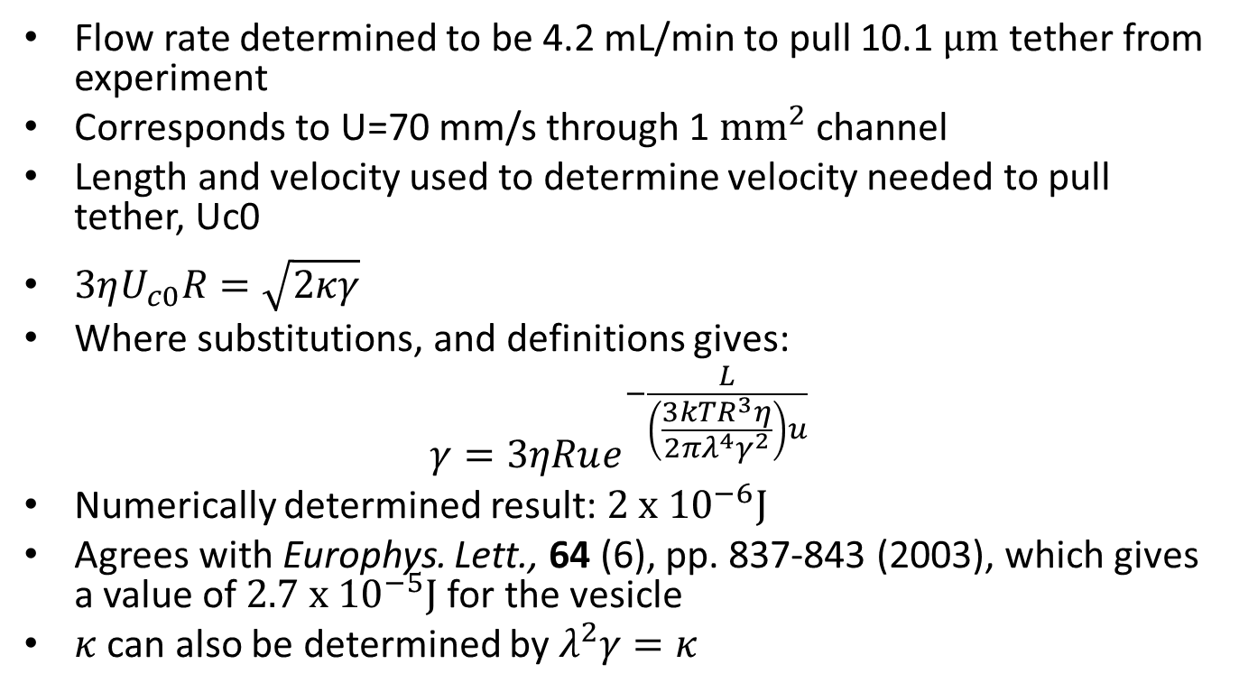
Result
Flow rate determined to be 4.2 mL/min to pull 10.1 $μm$ tether from experiment
Corresponds to U=70 mm/s through 1 $mm^{2}$ channel
Length and velocity used to determine velocity needed to pull tether, Uc0
$3ηU_{c0}R=\sqrt{2κγ}$
Where substitutions, and definitions gives:
$$γ=3ηRue^{−\frac{L}{\left(\frac{3kTR^{3}η}{2πλ^{4}γ^{2}}\right)u}}$$
Numerically determined result: $2 x{ 10}^{−6}J$
Agrees with Europhys. Lett., 64 (6), pp. 837-843 (2003), which gives a value of $2.7 x {10}^{−5}J$ for the vesicle
$κ$ can also be determined by $λ^{2}γ=κ$

Slide 17

Future Studies
Improve precision of L and $λ$ determinations
Compare experimentally determined rise time to time calculated with these parameters

