Slide 1
Compact Muon Solenoid Detector (CMS) & The Token Bit Manager (TBM)
Alex Armstrong & Wyatt Behn
Mentor: Dr. Andrew Ivanov

Slide 2
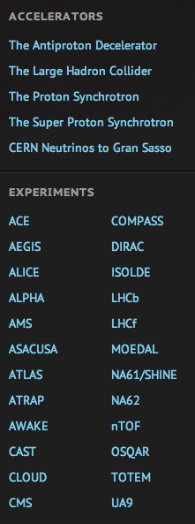
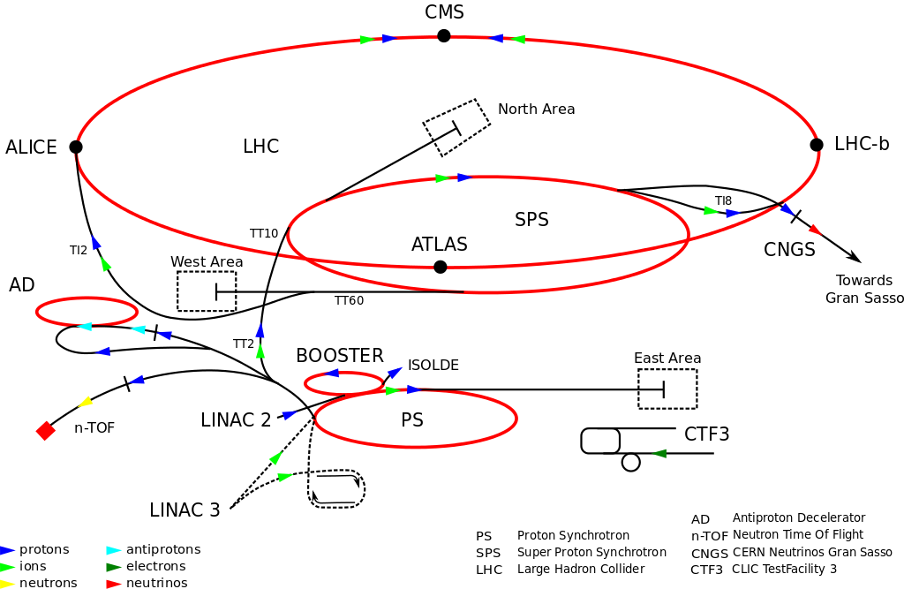
CERN
Conseil Européen pour la Recherche Nucléaire
(European Council for Nuclear Research)
(1952)

Slide 3
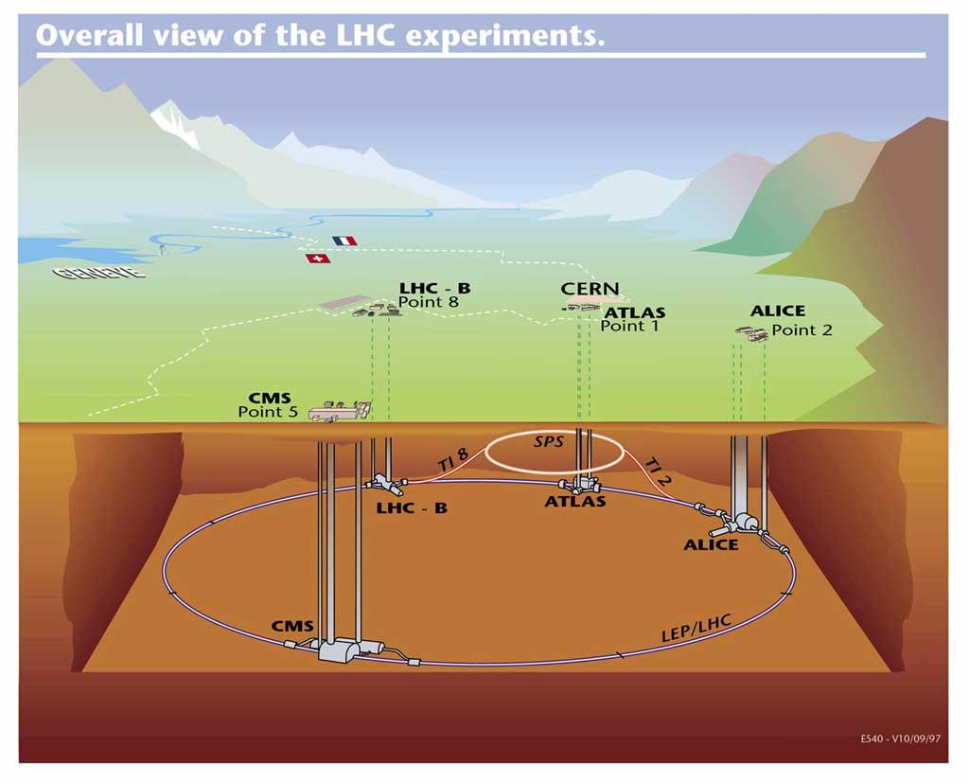
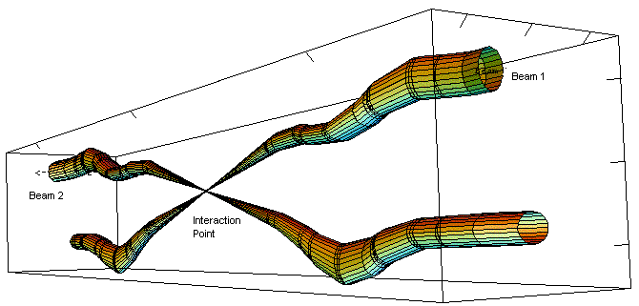
CERN -> LHC
Large Hadron Collider (2008)
Two proton beams travel in opposite directions until collision in detectors
1) ATLAS
2) ALICE
3) LHCb
4) CMS
Notes:
4 detectors

Slide 4
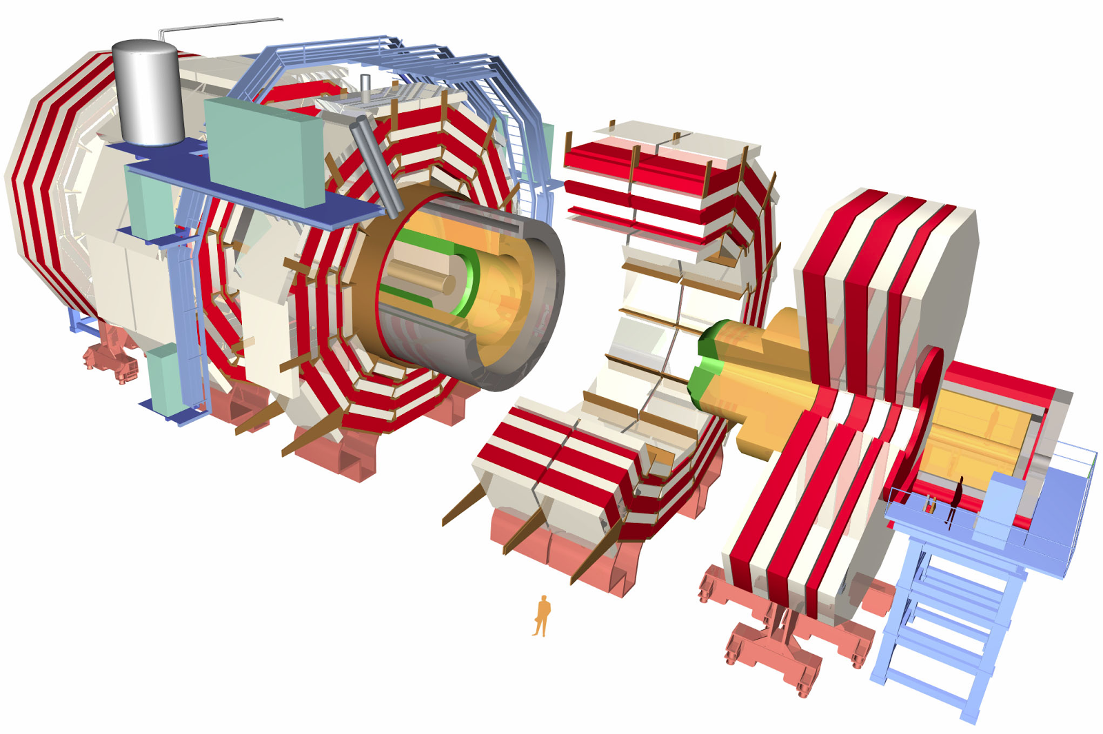
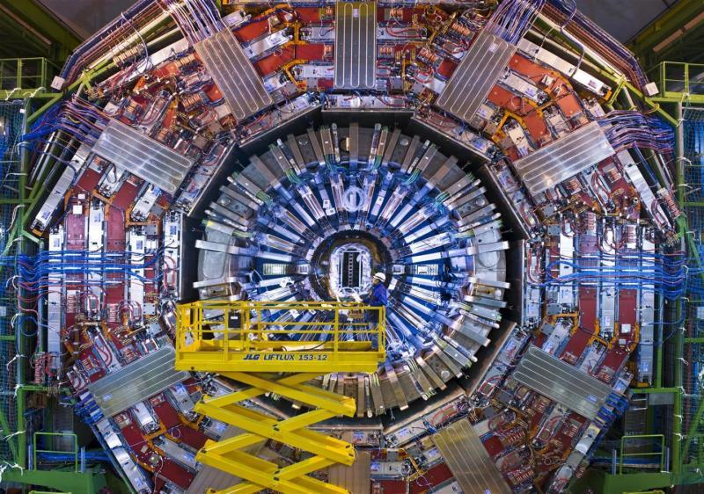
CERN -> LHC -> CMS
Compact Muon Solenoid (2008)

Slide 5
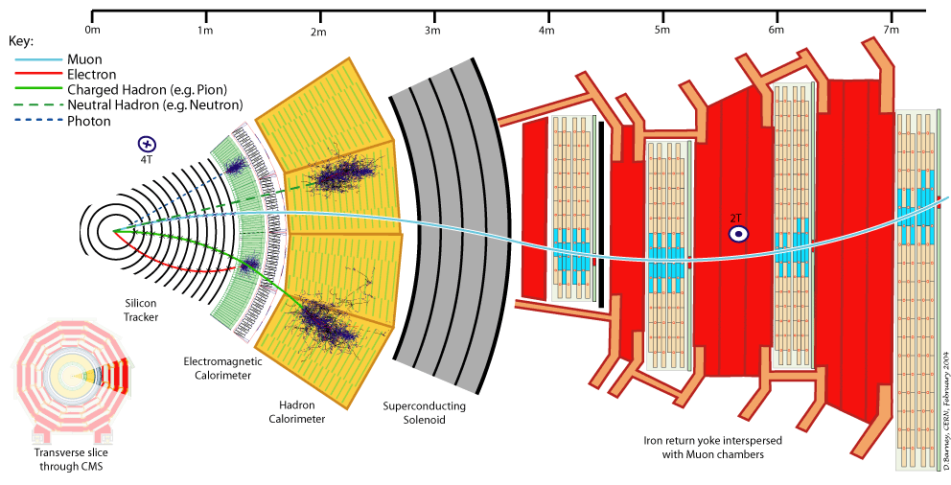
CMS Detector System

Slide 6
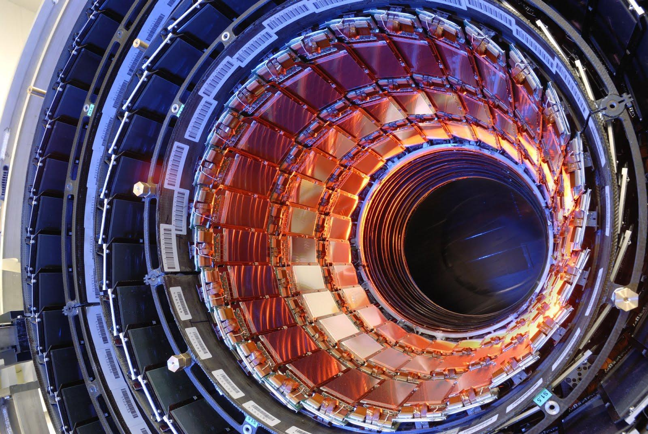
Inner Detectors
Silicon strip detectors in the inner tracking system detect position of particles at a given time

Slide 7
CMS Detector System

Slide 8
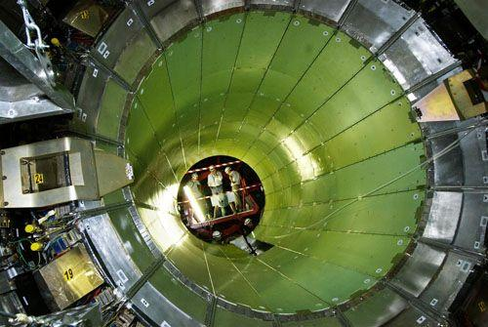
Electromagnetic Calorimeter (ECAL)
Lead tungstate crystals formed into supermodules measure energy of electrons and photons

Slide 9
CMS Detector System

Slide 10
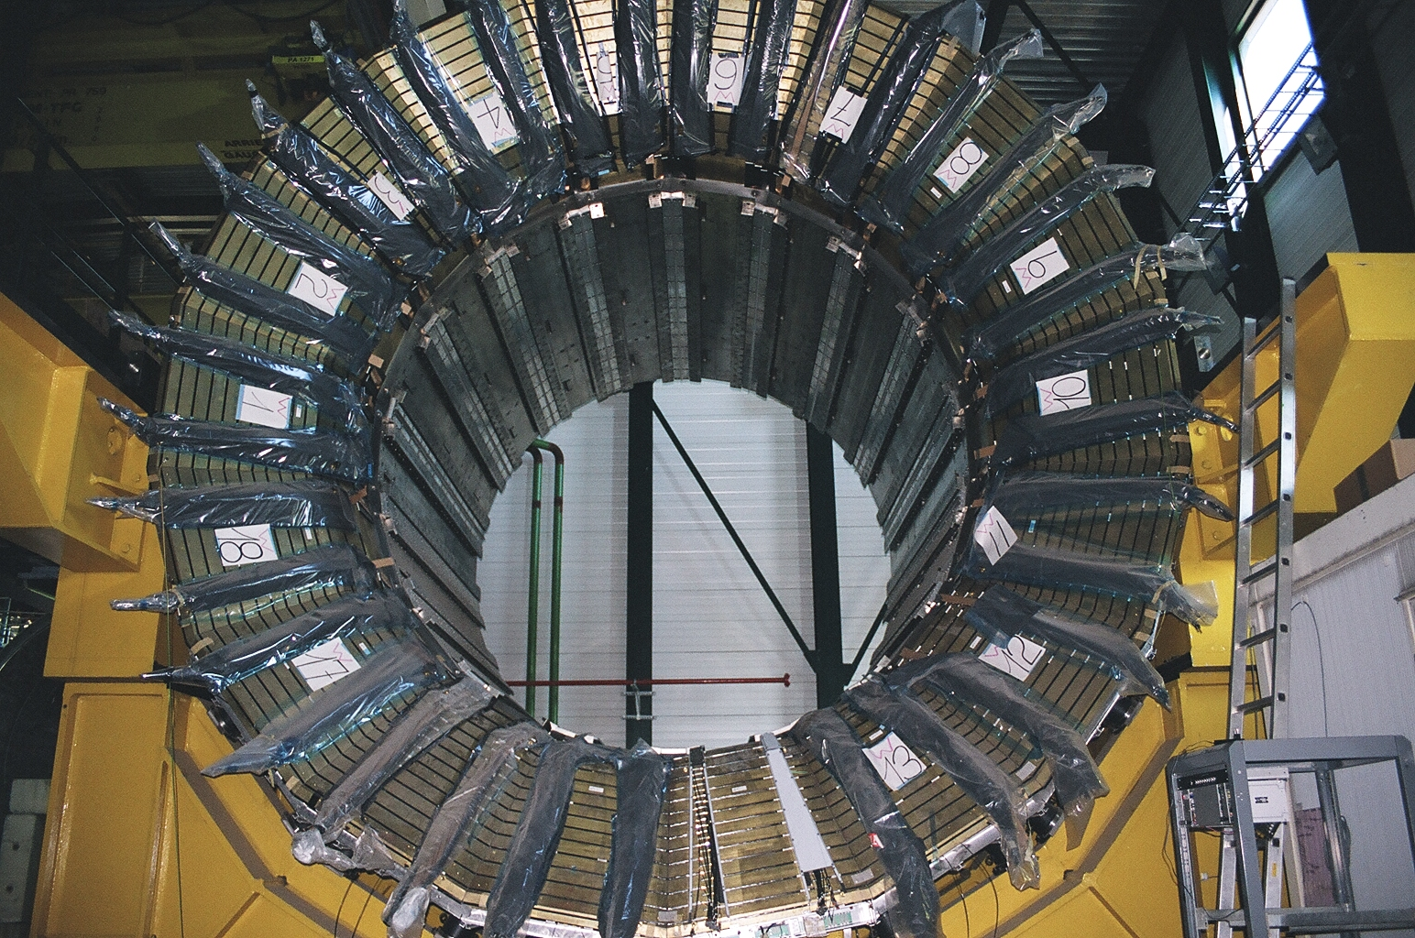
Hadron Calorimeter
Repeated layers of absorber plates (brass and steel) and active scintillating material detect neutral and charged hadrons

Slide 11
CMS Detector System

Slide 12
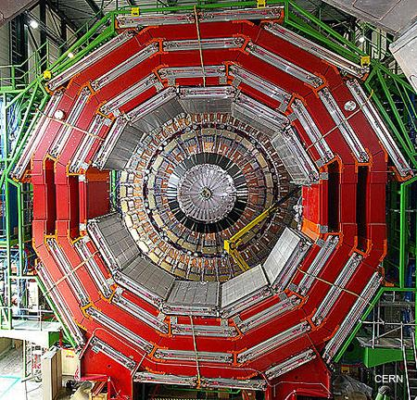
Muon Chambers
4 layers of muon detection stations interspersed with iron “return yoke” plates detect muons

Slide 13
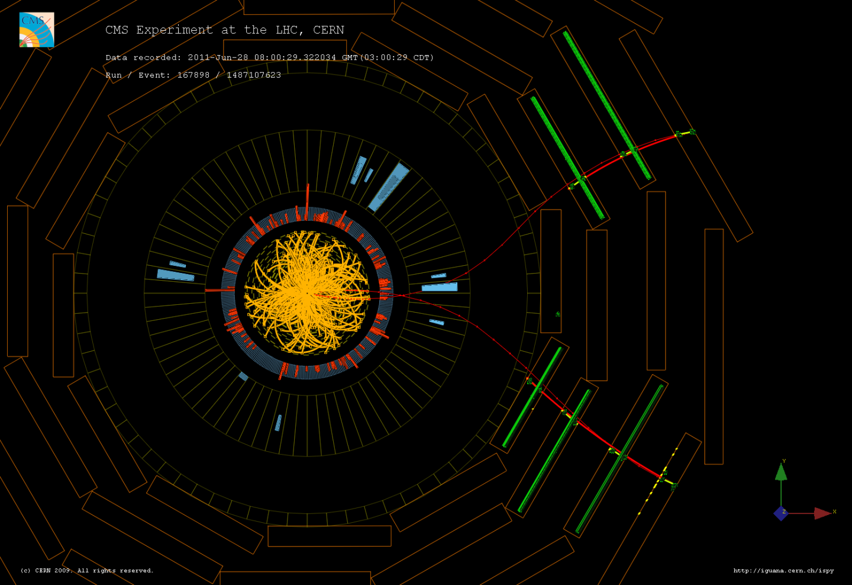
CMS Detector System

Slide 15
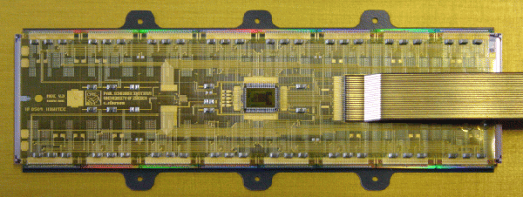
Inner Tracking System
Consists of 3 barrels of pixel detectors that amounts to a 4.4-10.2 cm radius tube
ROCs
TBM
[This picture displays a TBM connected to 16 ROC (read out chips)]
Notes:
The TBM itself mediates the ROCs and using a token pass to limit error and input bytes.

Slide 16
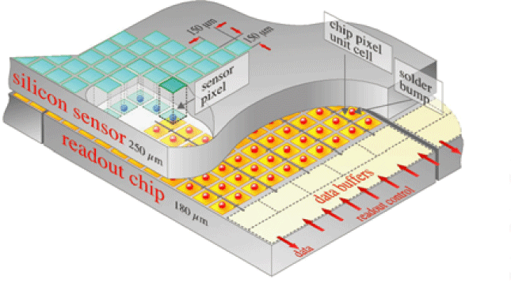
More Inner Tracking
The Inner Tracking Detector has 66 million pixels
The whole system is
cooled to -20⁰ C
Each silicon sensor
is only 150 x 100 μm
(about 2 hair widths)
Notes:
The cooling system runs through the layers between the pixel sheets.

Slide 17
Problems

Slide 18
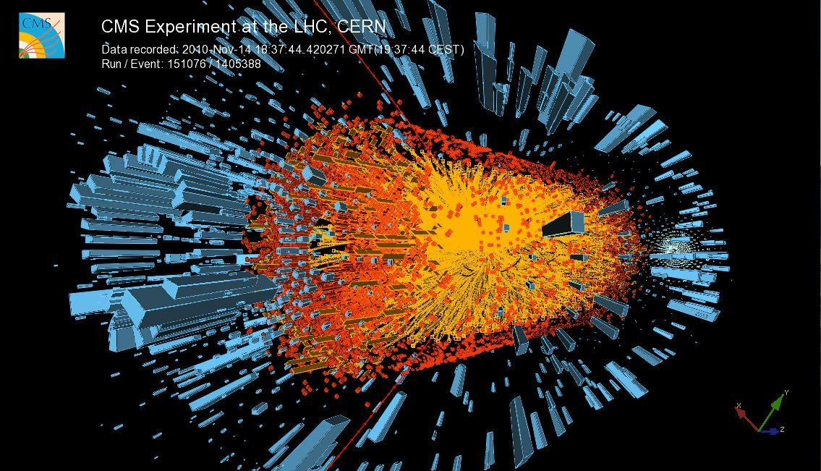

Slide 19
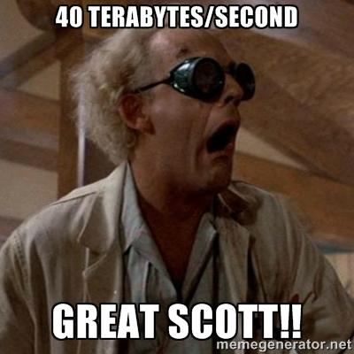
Problems
1) SO MUCH DATA! - 40 terabytes/second
Level 1 Trigger System - L1T (3500ns latency)
Higher level trigger - HLT
2) High Collision Rate - 40 MHz (25ns gap)
Buffer zones in ROCs and high time resolution

Slide 20
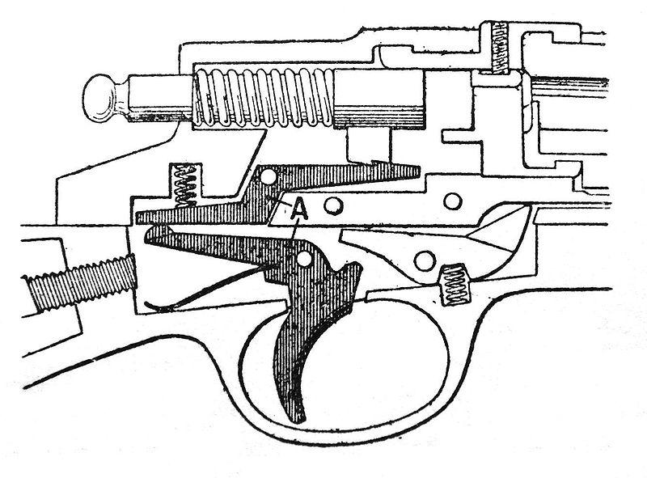
Level 1 Trigger
Completely Automatic - No Software
Selects ~1/10,000 hits
The whole system is the trigger
1) Detection by Calorimeter and Muon Chambers
2) Hardware analysis selects desirable events
3) Acceptance/rejection message sent to TBM
4) TBM sends message to ROC to collect or discard
5) Collected messages are sent downstream
Notes:
1) Trigger makes you think of a trigger on a gun or a trigger to detonate something. The trigger here is the entire system and serves a similar function because when an event demonstrates certain desired characteristics, the system triggers an acceptance or rejection procedure that allows the data to be passed through to back-end electronics or to be dumped. To make things more confusing, the trigger can also refer to the signal being sent or any element of the overall system involved in the selection process.
2) Calorimeter measures energy while Muon chambers detect track patterns

Slide 21
What We’re Doing/Specifics
Presently, working on understanding the code used for testing the TBM chips (VC++)
Using Cascade software for controlling the testing station
Understanding how the TBM interacts and functions as part of the detector system

Slide 22
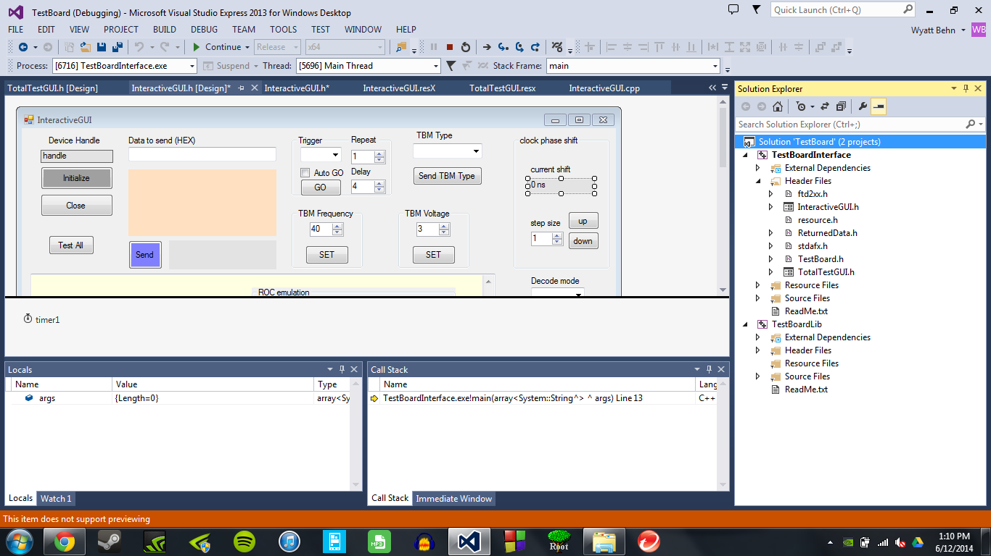
The Testing Software/Code
Interface Header
GUI Headers
Reference Library for Code
Notes:
The code consists of two main parts: the headers for the interface and the resource library. The interface headers contain all the GUI and interactive parts, as well as the output stream to display. The library contains the references that allow for voltages and other tests to be inputted into the test board and interprets the responses from the TBM to be outputted and declared a pass or fail.

Slide 23
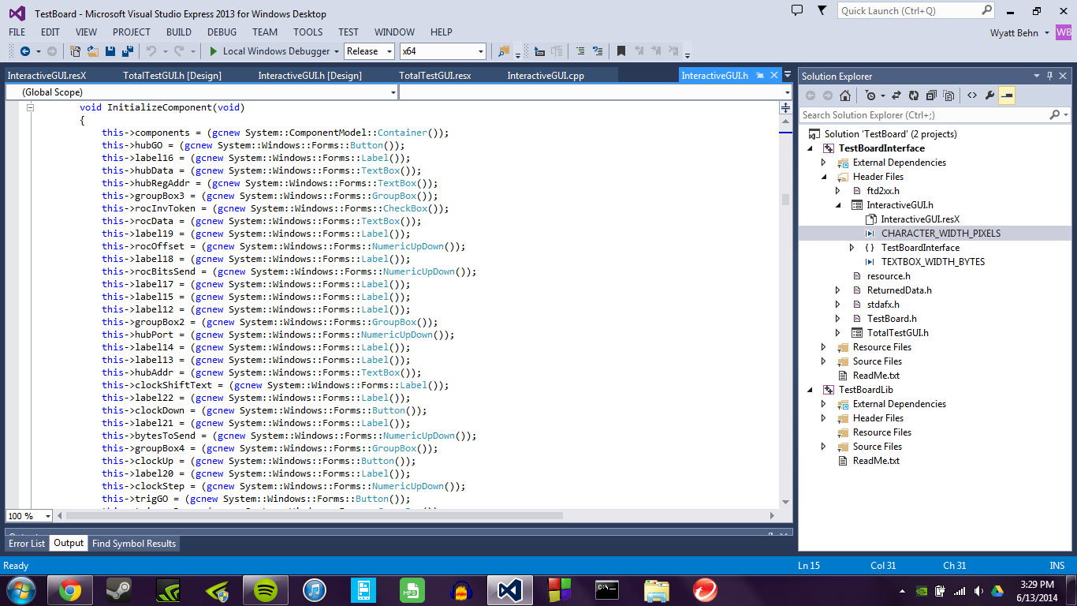
Notes:
There is a lot of code...

Slide 24
Hardware & Calibration
Using Cascade Probe Station and Nucleus 3.2 Interactive Software
The stage (or chuck) moves freely beneath a stationary testing board that contains a probing zone
The wafer is placed on the chuck and raised up to the board to make a connection and run tests (Note: Only 50 μm of freeplay are allowed when making connection)
Some issues with the chuck being unbalanced could lead to crashing the probe

Slide 25
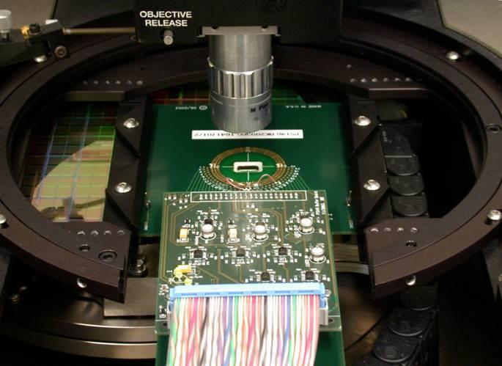
The Probing Station
The test board floats above a free moving stage.
The microscope is placed above for navigation.

Slide 26
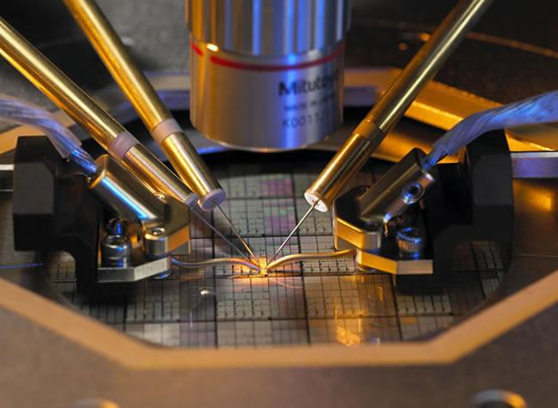
Current Group Problem
Unstable electronic connection between TBM chip and probe

Slide 27
Our Endgame
Have a fully automated way of testing each wafer, and each unique version of TBM chip, with an automatic data output (pass/fail) identifying individual TBMs
Alternatively, an efficient way to test all TBMs on each wafer so we at least know if they work as designed

Slide 28
Why CMS is Important
CMS is one of the proposals for a more powerful detector at the Large Hadron Collider (LHC)
It will be able to handle higher-energy collisions (greater luminosity) with more accuracy and be able to reduce the data stream to a manageable load

Slide 29
Wyatt’s Quandaries
How do the calorimeters and other detectors work in tandem with the TBM to reduce the data?
Theoretically, what are we interested in seeing? More particles, or reinforcement? More about the particles and interactions in question.
Using ROOT to analyze actual data/making pretty graphs.

Slide 30
Alex’s Goals of Understanding
- The testing code
- TBM Chip design
- ROOT
- Top Quark Research

