Slide 1
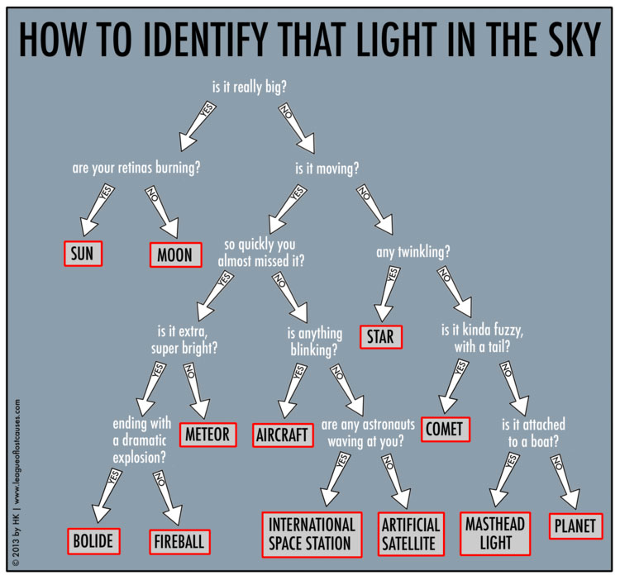

Slide 2
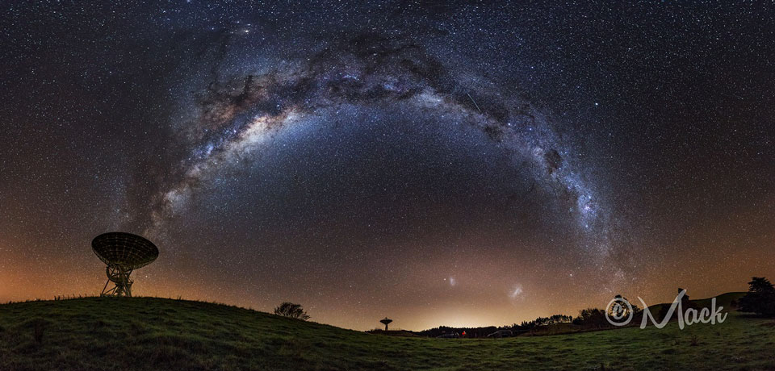
The Lithium Abundance Problem
Stephen Houston
Kansas State University
Reu 2014
Dr. Bharat Ratra
http://apod.nasa.gov/apod/ap140611.html
Date: June 13, 2014

Slide 3
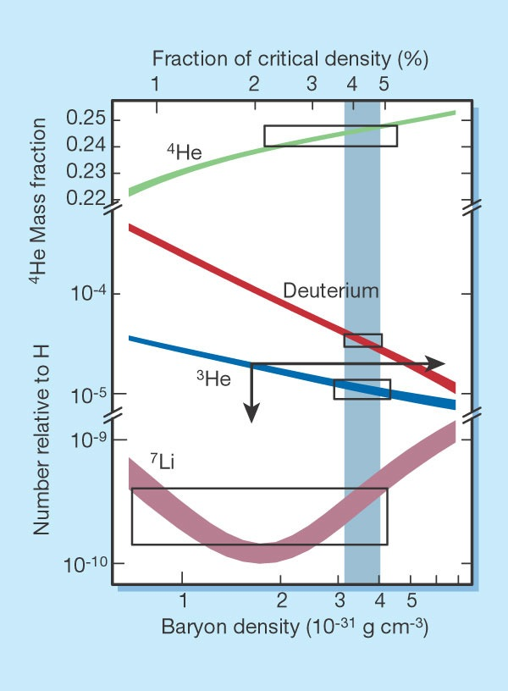
Big Bang Nucleosynthesis Model
Predicts the abundance of light elements in the primordial universe.
Duration ~10 secs. - 20 mins.
Boxes indicate the observational estimates of the primordial abundances.
From “Charbonnel, Nature 415, 27-29 (2002)”

Slide 4
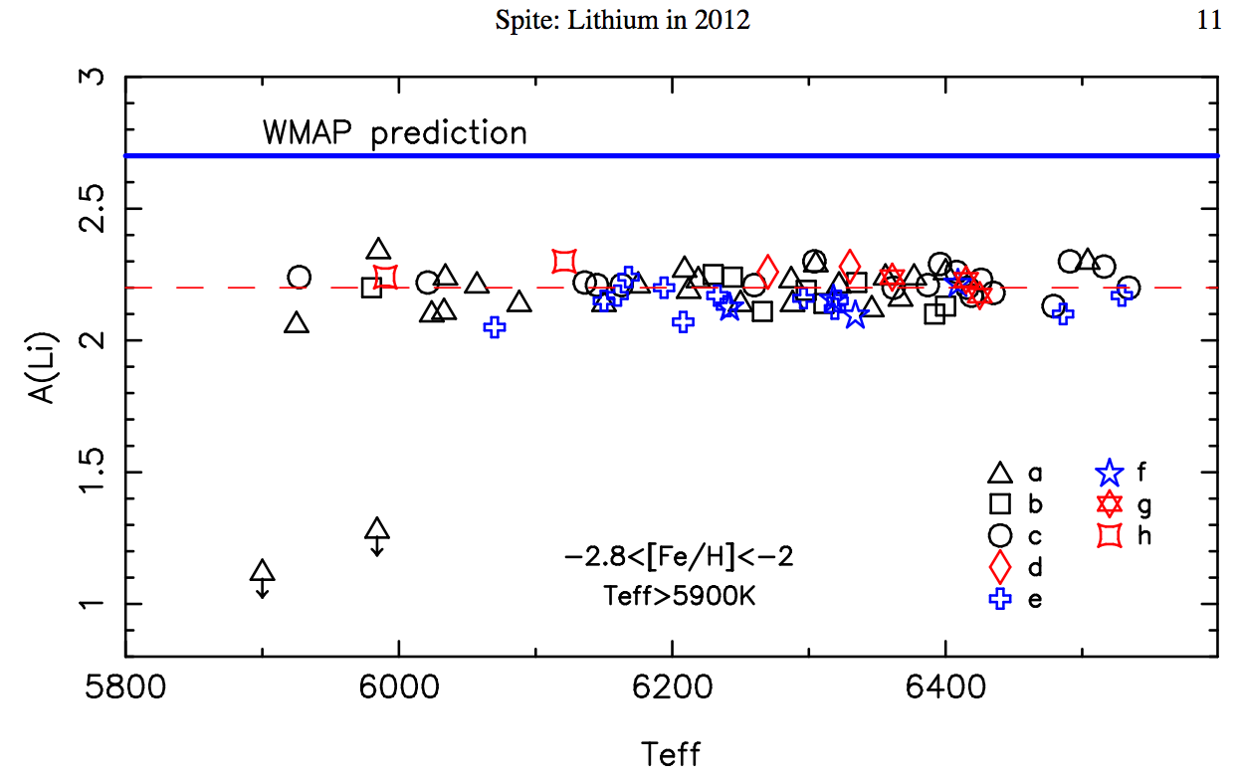
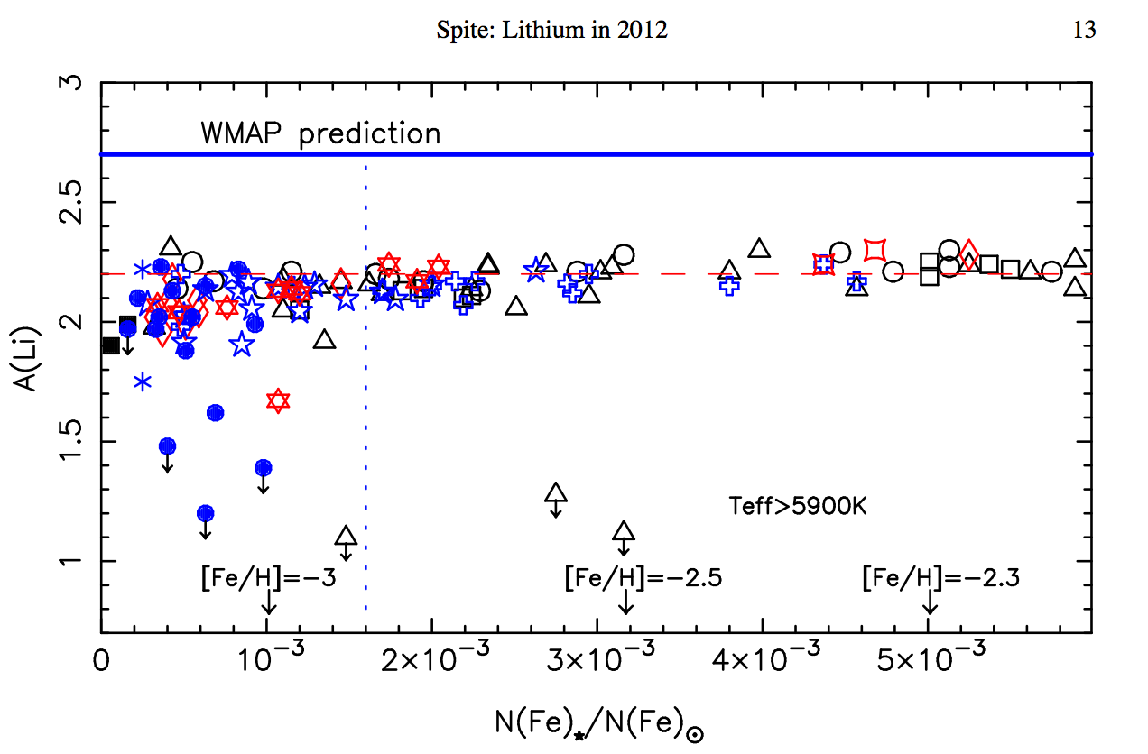
What Stars Should We Observe?
a - Charbonnel & Primas (2005)
b - Asplund (2006)
c - Melendez (2010)
d - Aoki (2009)
e - Hosford (2009)
f - Bonifacio (2007)
g - Sbordone (2010)
h - Schaeuble & King (2012)
From “Spite, Memorie della Societ\`a Astronomica Italiana Supplementi, 2012 Vol. 22, pag. 9”
Metallicity [Fe/H]?
Between -2.8 and -2.0
Effective Temperature?
5900K

Slide 5
Lithium Abundance Plateau
2.7
a - Charbonnel & Primas (2005)
b - Asplund (2006)
2.2
c - Melendez (2010)
d - Aoki (2009)
e - Hosford (2009)
f - Bonifacio (2007)
g - Sbordone (2010)
h - Schaeuble & King (2012)
From “Spite, Memorie della Societ\`a Astronomica Italiana Supplementi, 2012 Vol. 22, page 9”
Metallicity [Fe/H]?
Between -2.8 and -2.0
Effective Temperature?
5900K

Slide 6
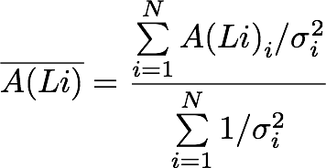
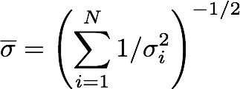
Statistical Analysis
Median:
A(Li) = 2.17
Median Upper/Lower Sigma:
= 0.084
= 0.066
Standard Deviation:
σ = 0.07
Weighted Mean:
= 2.1827
Weighted Mean Standard Deviation:
= 0.00536
The number of standard deviations the value is from the weighted mean:

Slide 7
N-Sigma Limits
Function | Scale | 68.3% | 95.4%
Gaussian | 1 | 1.00 | 2.00
Gaussian | 1.9 | 1.90 | 3.80
Cauchy | 1 | 1.80 | 1.40
Cauchy | 2.0 | 3.68 | 27.6
Student’s t (n=2) | 1 | 1.30 | 4.50
Student's t (n=6) | 2.8 | 3.10 | 7.03
Double Exponential | 1 | 1.15 | 3.08
Double Exponential | 1.7 | 1.95 | 5.23
Observed Weighted Mean |  | 1.40 | 2.50
Observed Median |  | 1.50 | 2.80

Slide 8
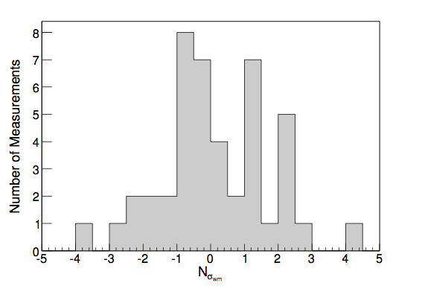
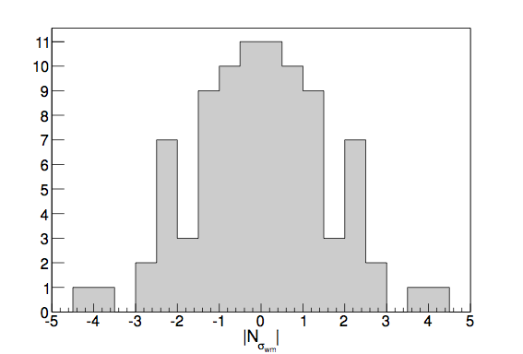
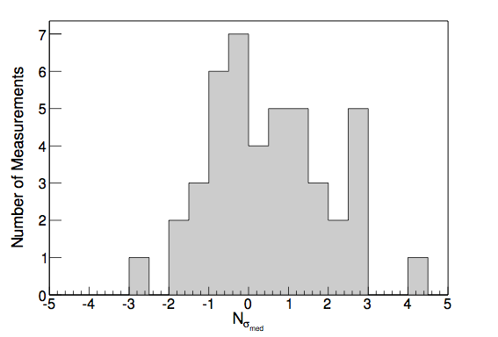
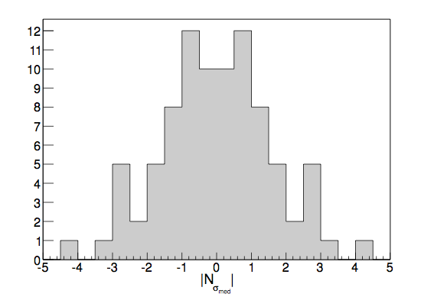
N-Sigma

Slide 9
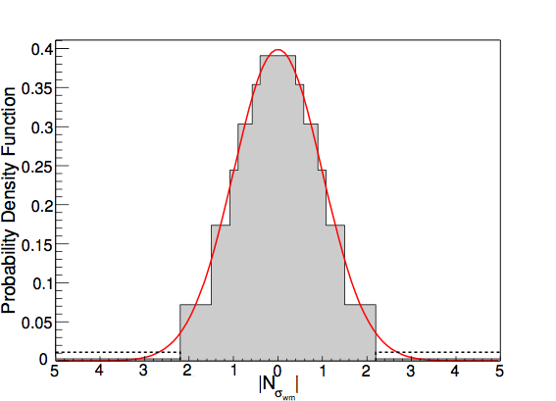
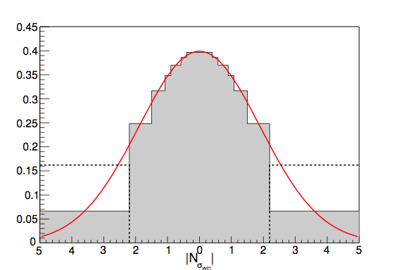
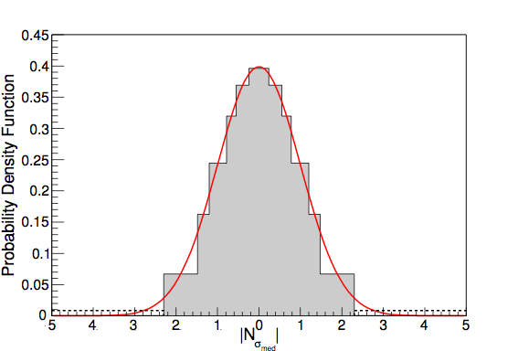
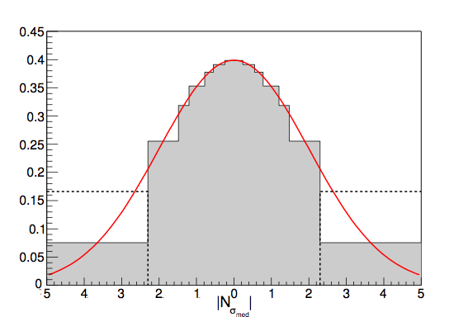
Gaussian Probability Distribution

Slide 10
Expected Fractions
Function | Scale | Nsigma <= 1 | Nsigma <= 2
Gaussian | 1 | 68.3% | 95.4%
Gaussian | 1.9 | 40.1% | 70.7%
Cauchy | 1 | 50.0% | 71.0%
Cauchy | 2.0 | 29.5% | 50.0%
Student’s t (n=2) | 1 | 58.0% | 82.0%
Student's t (n=6) | 2.8 | 26.7% | 49.8%
Double Exponential | 1 | 63.0% | 87.0%
Double Exponential | 1.7 | 44.5% | 69.2%
Observed Weighted Mean |  | 47.7% | 75.0%
Observed Median |  | 50.0% | 80.0%

Slide 11
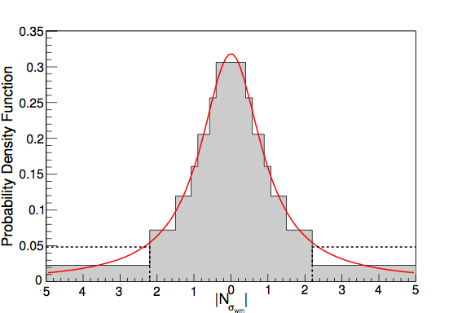
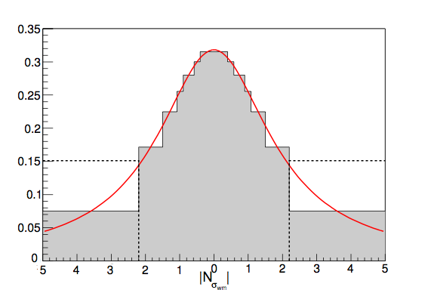
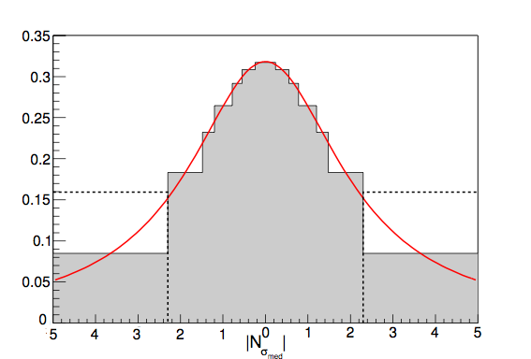
Cauchy Probability Distribution

Slide 12
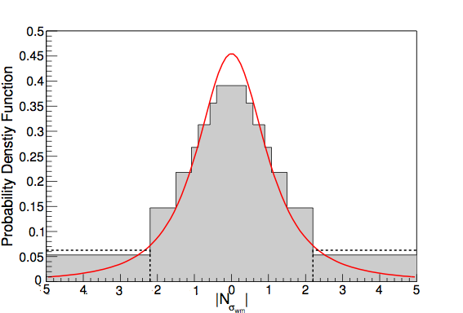
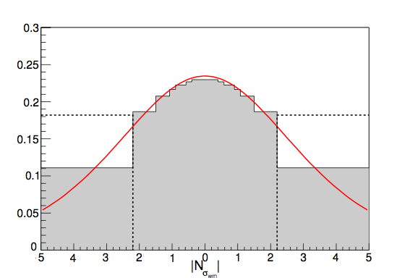
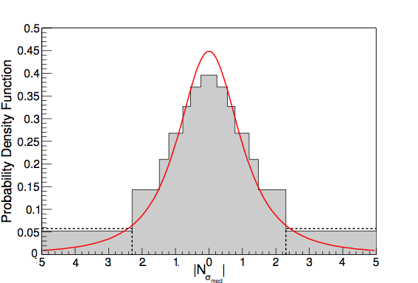
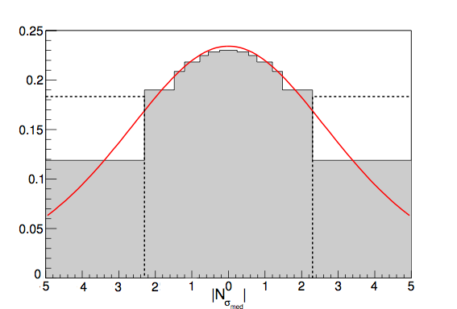
Student’s t Probability Distribution

Slide 13
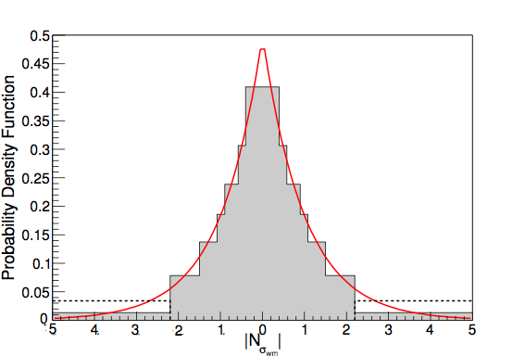
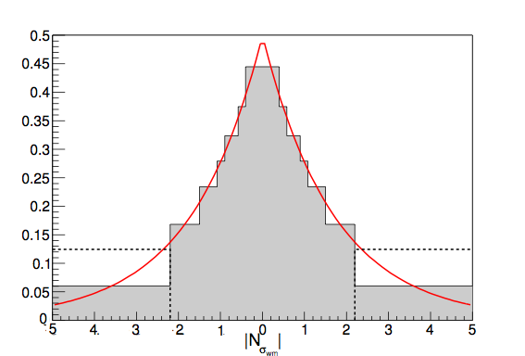
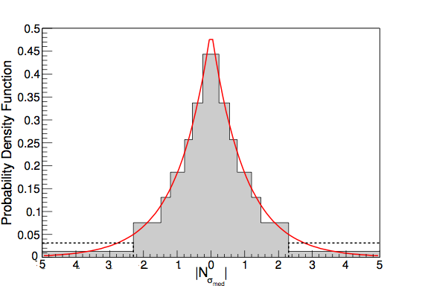
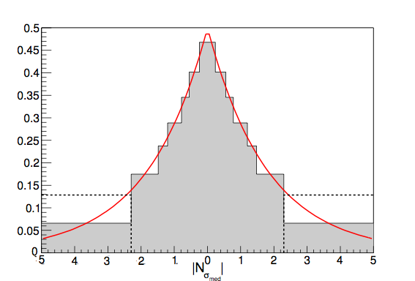
Double Exponential Probability Distribution

Slide 14
Goodness-of-Fit
 | Weighted Mean |  |  |  | Median
Function | Scale | x²v | ν | Probability (%) | Scale | x²v | ν | Probability (%)
Gaussian | 1 | 68.2 | 6 | <0.1 | 1 | 155 | 6 | <0.1
Gaussian | 1.9 | 6.84 | 5 | <0.1 | 2.0 | 7.07 | 5 | <0.1
Cauchy | 1 | 6.34 | 6 | <0.1 | 1 | 8.85 | 6 | <0.1
Cauchy | 2.0 | 3.58 | 5 | 0.3 | 2.2 | 3.77 | 5 | 0.20
n=2 Student’s t | 1 | 5.5 | 5 | <0.1 | 1 | 6.01 | 5 | <0.1
n=6 Student’s t | 2.8 | 1.89 | 4 | 10.84 | 3.0 | 1.95 | 4 | 9.95
Double Exponential | 1 | 9.54 | 6 | <0.1 | 1 | 14.4 | 6 | <0.1
Double Exponential | 1.7 | 5.91 | 5 | <0.1 | 1.8 | 6.58 | 5 | <0.1

Slide 15
N-Sigma Limits
Function | Scale | 68.3% | 95.4%
Gaussian | 1 | 1.00 | 2.00
Gaussian | 1.9 | 1.90 | 3.80
Cauchy | 1 | 1.80 | 1.40
Cauchy | 2.0 | 3.68 | 27.6
Student’s t (n=2) | 1 | 1.30 | 4.50
Student's t (n=6) | 2.8 | 3.10 | 7.03
Double Exponential | 1 | 1.15 | 3.08
Double Exponential | 1.7 | 1.95 | 5.23
Observed Weighted Mean |  | 1.40 | 2.50
Observed Median |  | 1.50 | 2.80

Slide 16
Lithium Abundance Plateau
2.7
0.5
a - Charbonnel & Primas (2005)
b - Asplund (2006)
2.2
c - Melendez (2010)
d - Aoki (2009)
0.06
e - Hosford (2009)
f - Bonifacio (2007)
g - Sbordone (2010)
h - Schaeuble & King (2012)
From “Spite, Memorie della Societ\`a Astronomica Italiana Supplementi, 2012 Vol. 22, pag. 9”
Metallicity [Fe/H]?
Best |Nσ|< 1 limit = 3.1
= 8.33σ
Between -2.8 and -2.0
0.07
0.16
= 2.30σ
2.7 - 2.2
= .16
Effective Temperature?
3.1
5900K

Slide 17
Work Cited
Charbonnel C., Primas F., 2005, A&A 442 961
Asplund M., Lambert D.L., Nissen P.E., Primas F., Smith V.V., 2006, ApJ 644, 229
Mele ́ndez J., Casagrande L., Ram ́ırez I., Asplund M., Schuster W.J., 2010, A&A 515, L3
Aoki W., Barklem P.S., Beers T.C., Christlieb N., Inoue S. et al., 2009, ApJ 698, 1803
Hosford A., Ryan S.G., Garc ́ıa Pe ́rez A.E., Norris J.E., Olive K.A., 2009, A&A 493 601
Bonifacio P., Molaro P., Sivarani T., Cayrel, R., Spite M., Spite F., Plez B., Andersen J., Barbuy B., Beers T.C. et al., 2007, A&A 462, 851
Sbordone L., Bonifacio P., Caffau E., Ludwig H.-G., Behara N.T., Gonza ́lez Herna ́ndez J.I., Steffen M., Cayrel R., Freytag B., van’tVeer C. et al., 2010, A&A 522, 26
Schaeuble M., King J.R., 2012, PASP 124, 164

