Slide 1
Programmable Arbitrary Timing Pulse Generator
Madilena Mendiola
John Lyons and Dr. Brett DePaola
Kansas State University
Manhattan, KS 66506

Slide 2
Goals
Need a simple and affordable device that outputs timing signals on multiple channels.
Turn devices (for example, lasers) off/on
Provide timing information to data acquisition system
Need a visually intuitive user interface
Use a BeagleBone Black computer

Slide 3
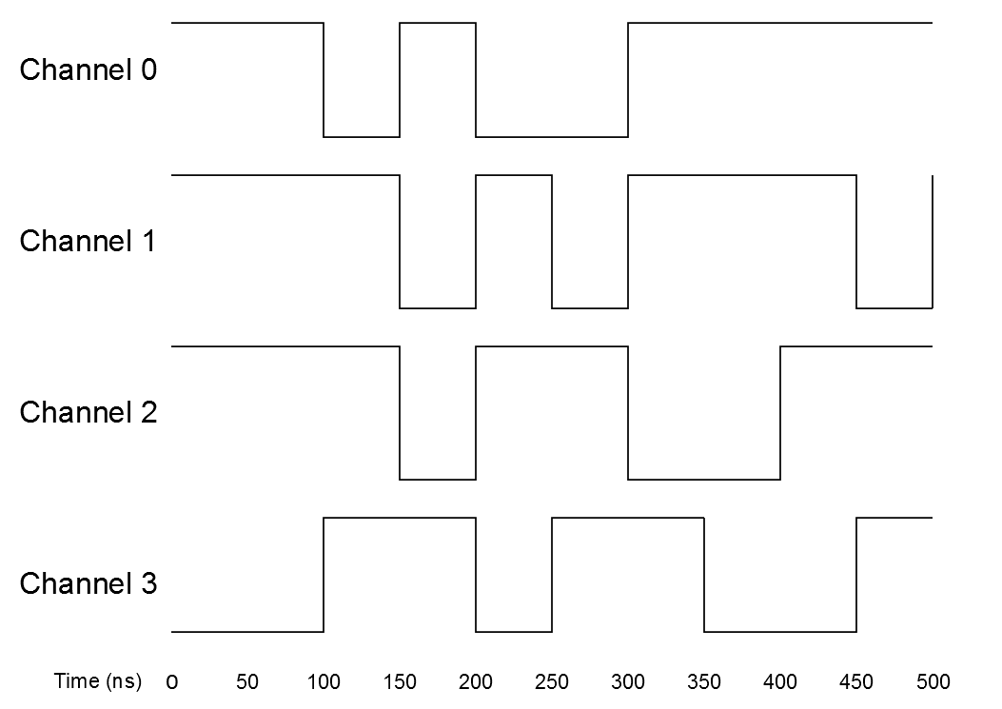
The Graphical User Interface and Corresponding Signal Output

Slide 4
Device Features
20 ns minimum time structure
Unlimited temporal range
Versatility
10 independent output channels
Simple, intuitive, and accessible interface
Uses BeagleBone Black computer
ARM processor’s PRU operates without interupts
Flexible operating system (Linux)

Slide 5
Device Features Continued
Large number of general purpose I/O ports
Gain experience with embedded devices
Affordable (The BBB is $45)

Slide 6
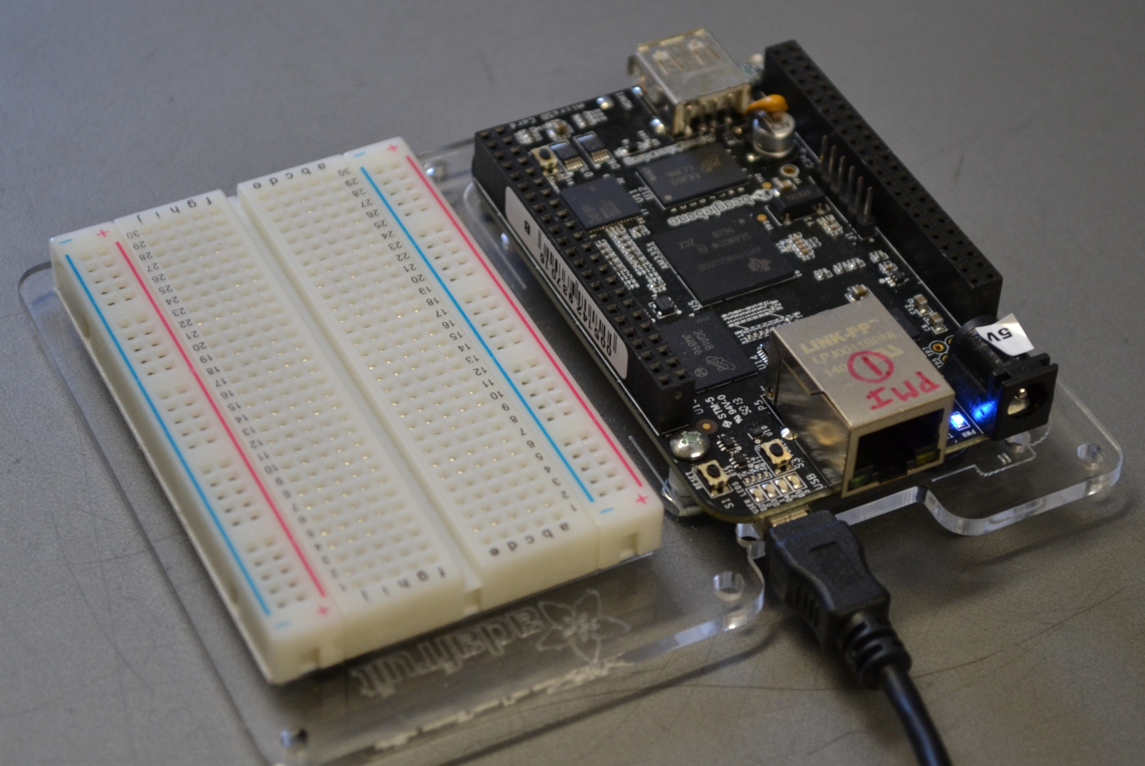
The BBB is attached to the data acquisition computer’s USB port.
The data acquisition computer becomes the user interface to the BBB

Slide 7
Applications for Our Device
With this pulse generator we can control the timing of multiple lasers, shutters, and other components in our experimental setups.
The device is a convenient tool for controlling the timing of optical pulses, especially in multi- laser experiments, like those involving trapping and cooling of atoms and molecules.

Slide 8
Summary
We have designed a multichannel, programmable timing signal generator.
The programming interface is simple and intuitive.
The device has both short minimum step size and “infinite” temporal range.

Slide 9
Summary Continued
By having the BBB’s PRU control the outputs, interrupt issues are eliminated.
The device is a convenient tool for controlling the timing of optical pulses, especially in multi- laser experiments, like those involving trapping and cooling of atoms and molecules.
Timing sequences that have been created can be saved and later recalled

Slide 10
Acknowledgments
Funding provided by NSF grant number 1157044

Slide 11
Circuit fo Shorter Pulse Widths
We have already built this piece of hardware.

