Slide 1
A New Design for a Tunable External Cavity Diode Laser
J. W. Lyons, M.D. Mendiola and B. D. DePaola

Slide 2
An Abstract
“We have designed and built a robust tunable external cavity diode laser that is easily constructed from commercial components. It requires only minimal, low tolerance machining, allowing for increased streamlining and ease of construction. The design also allows for the most commons types of laser diode packages, adding versatility.”

Slide 3
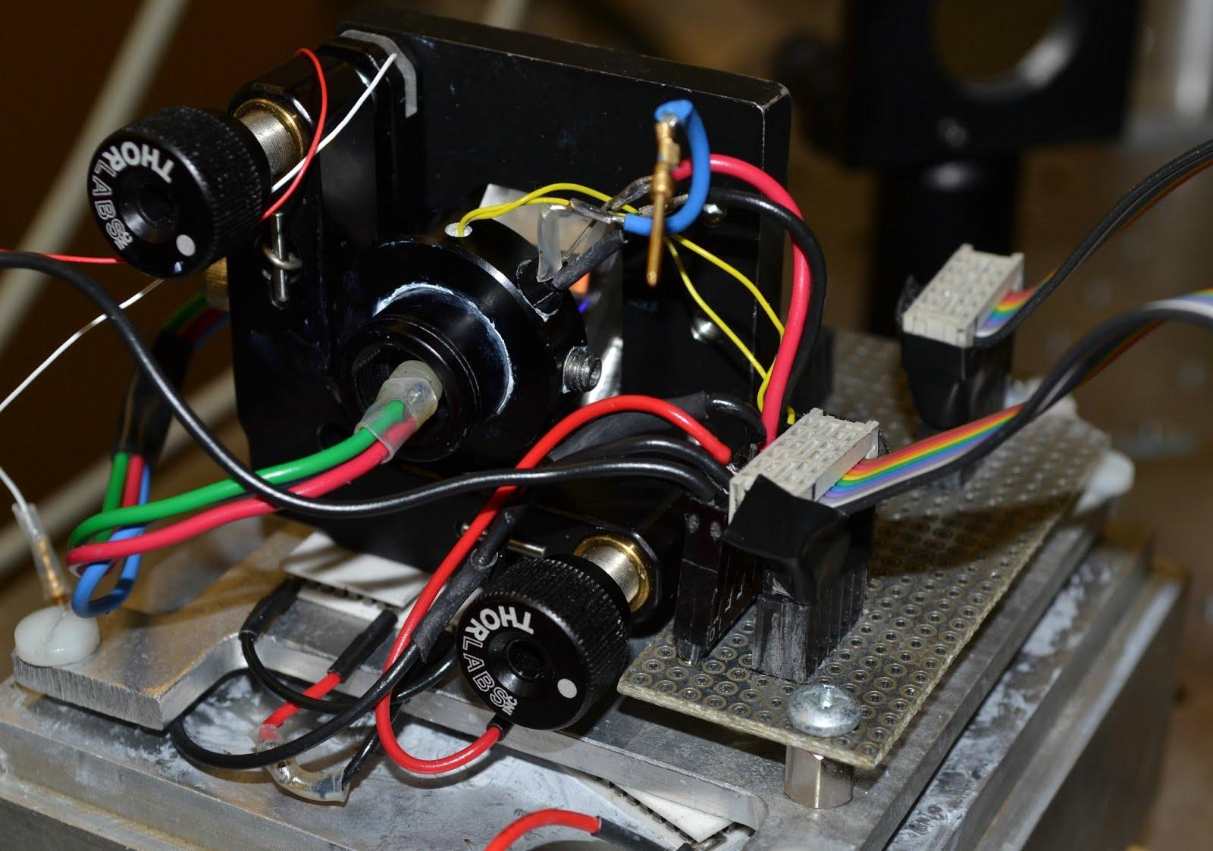
What does that really mean?
We wanted a laser that:
was cheap
was easy to make
was adaptable

Slide 4
What’s the Laser For?
Using these for our MOTRIMS experiment
MOT=Magneto Optical Trap
RIMS= Recoil Ion Momentum Spectroscopy
We use this to directly observe the populations in energy levels

Slide 5
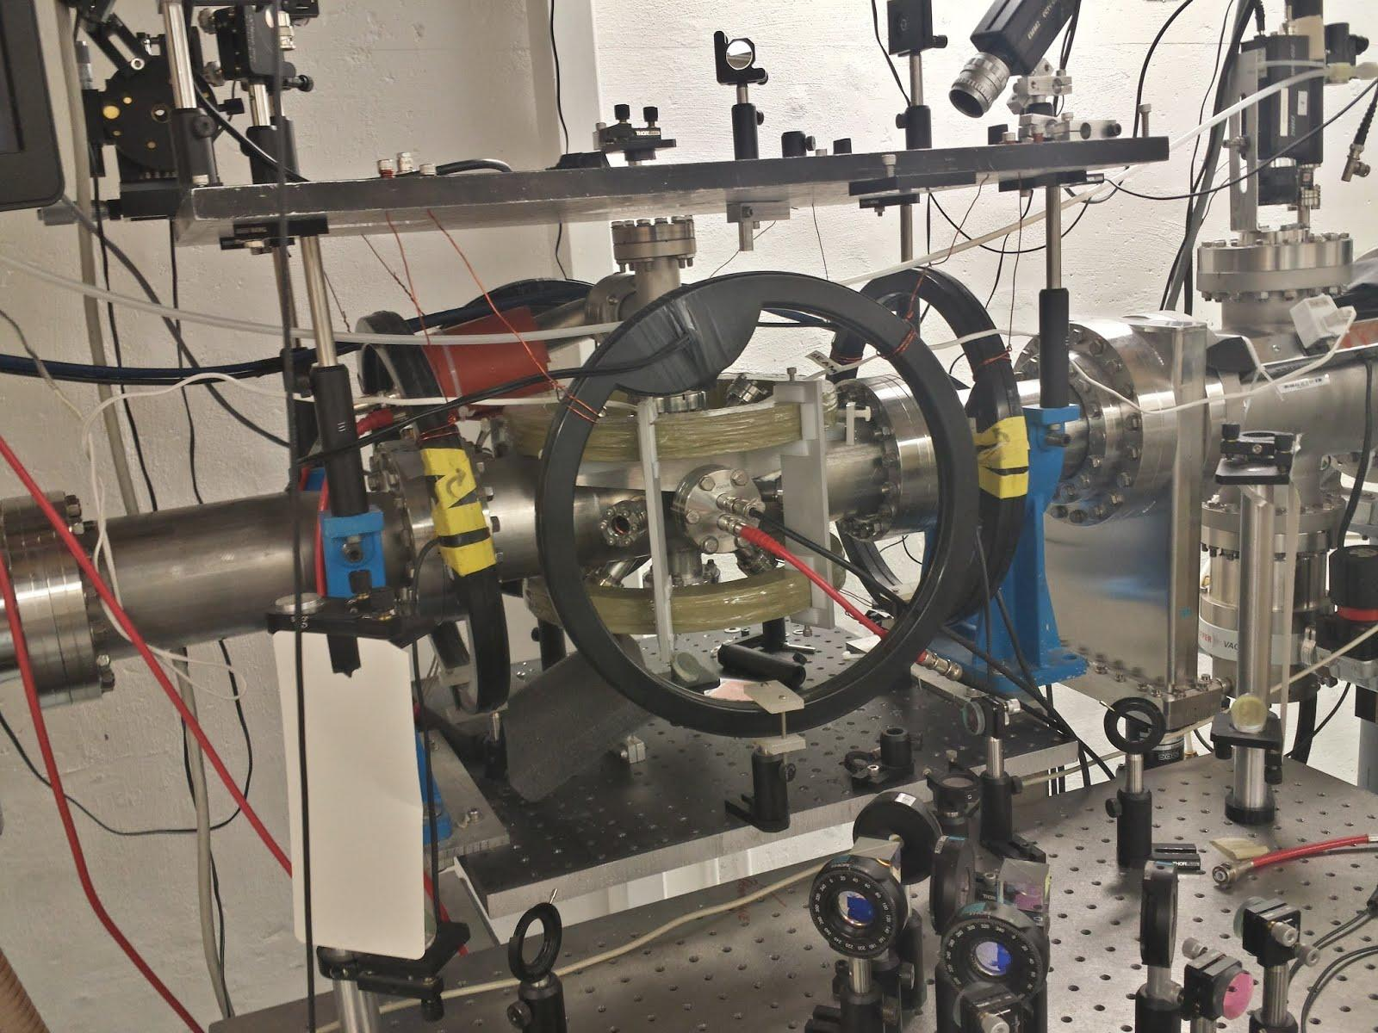
A Short “MOT” Review
Lasers use doppler shift to cool atoms
Zeeman Effect provides location-dependent force for trapping (an “Optical Molasses”)

Slide 6
A Short “RIMS” Review
A beam on Na+ ions are fired at Rubidium-87
Rb absorb an electron=momentum change
Number of ions at each location gives population count of energy levels

Slide 7
Laser Construction
Coarse and fine control of diffraction grating
Control temperature
Simplify wiring
Accomodate other diodes

Slide 8
PZT for Wavelength Tuning
Redirection Mirror
Laser Diode, Temperature Sensors, Collimating Tube
Diffraction Grating
Small, Regulated TECs
Large, Unregulated TECs
Aluminum Heat Sink
Base Plate
Diffraction grating mounted on commercial mirror mount.
Grating-diode distance is finely controlled by a PZT.

Slide 9
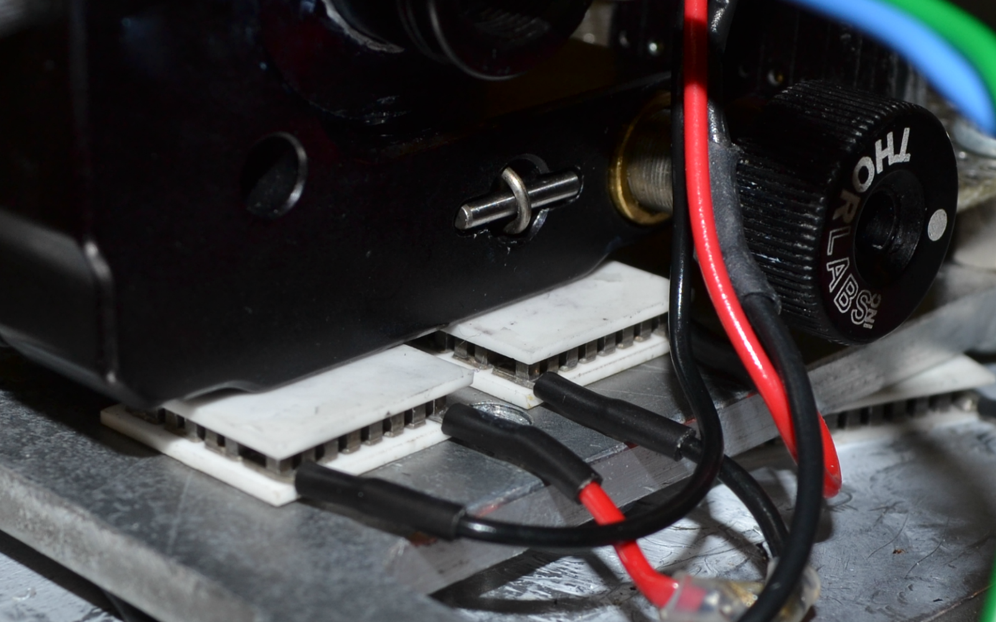
Two TECs between to thermally regulate diode in feedback loop with controller.
Two lower, unregulated TECs cool the device generally.

Slide 10
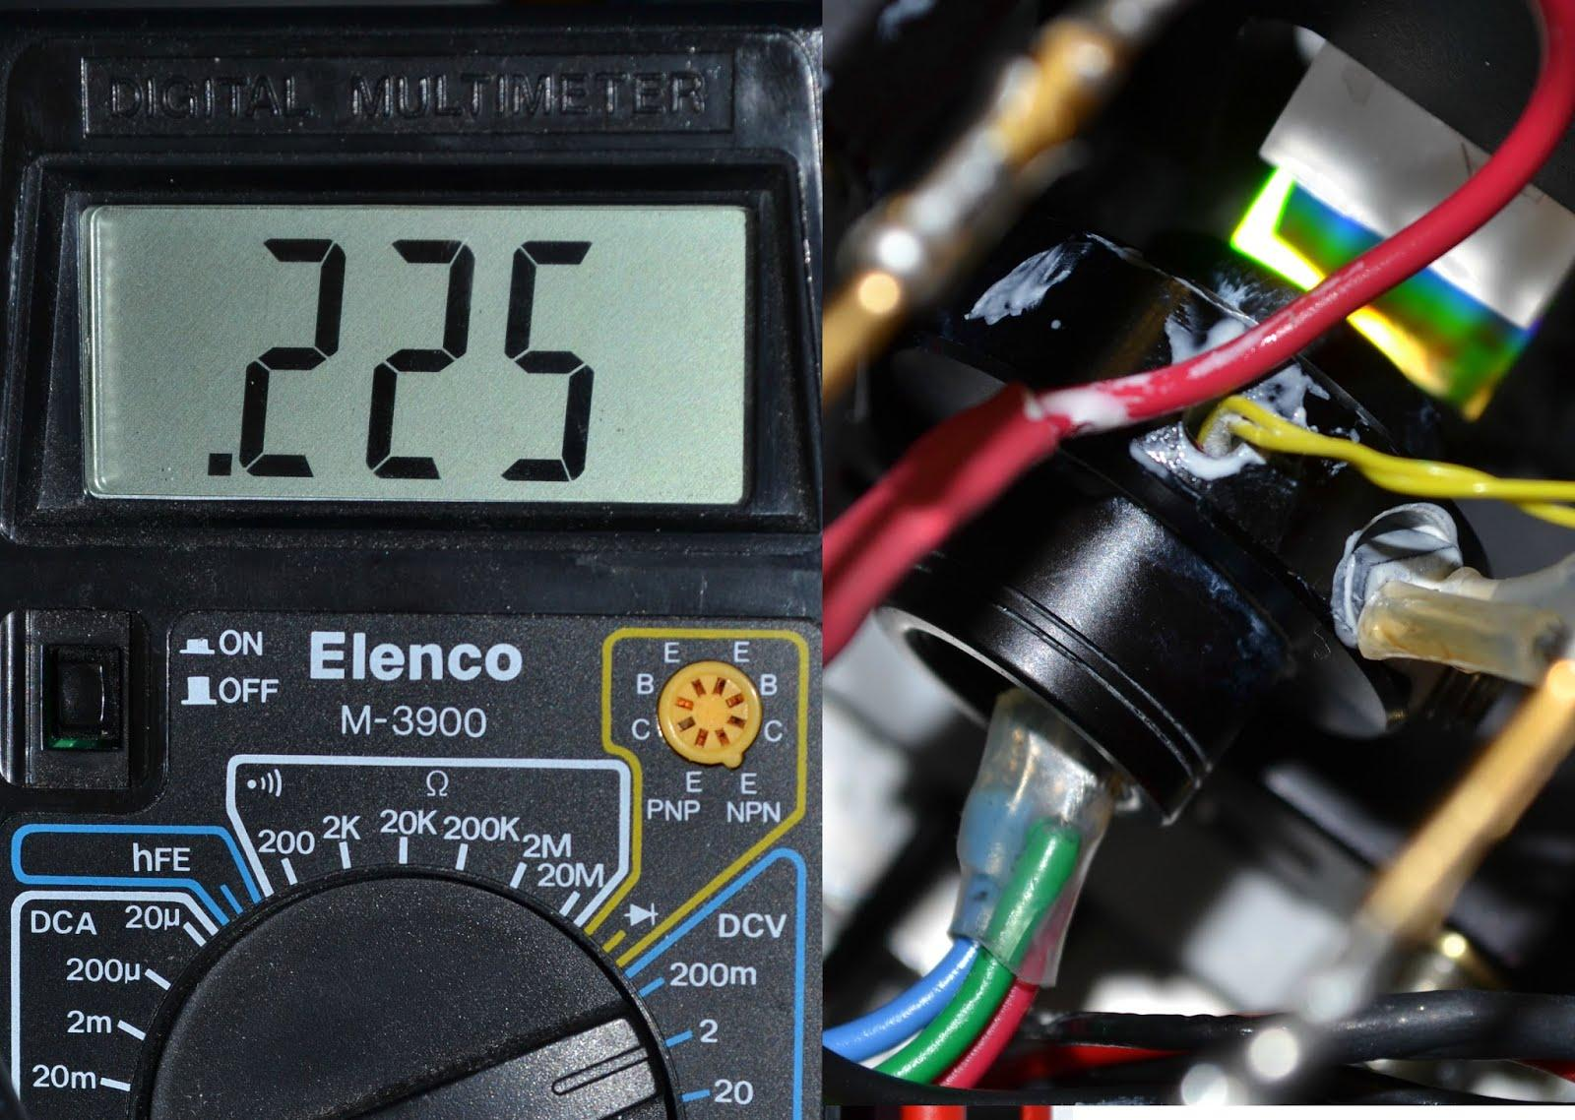
Diode ring contains a separate temperature sensor to produce a human-interpretable output.

Slide 11
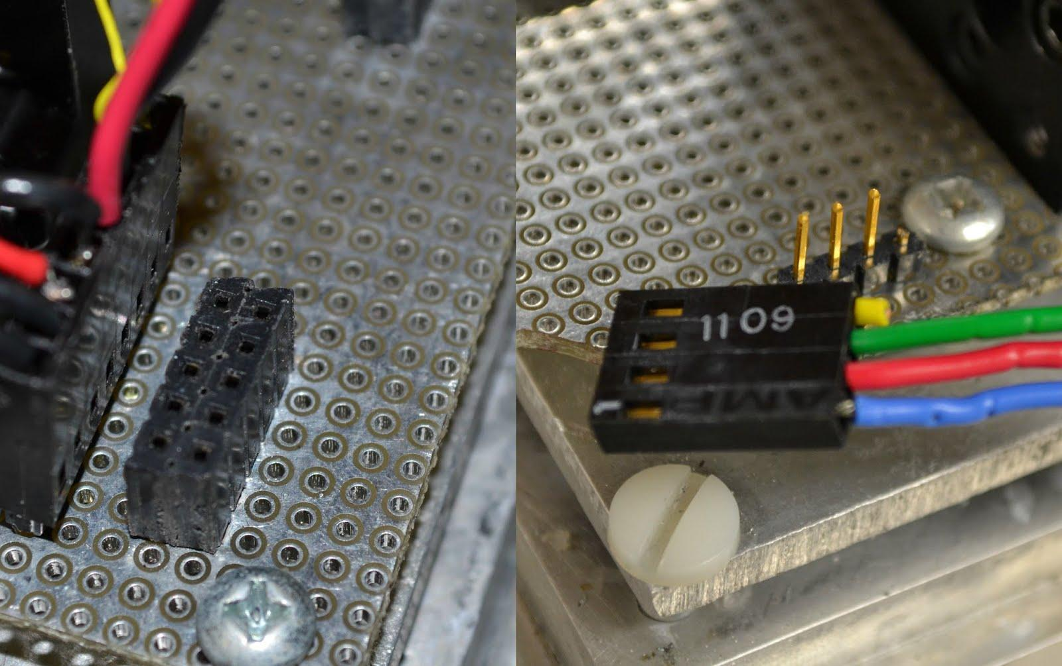
Most components are connected to SIP sockets soldered to a circuit board mounted above the plate.

Slide 12
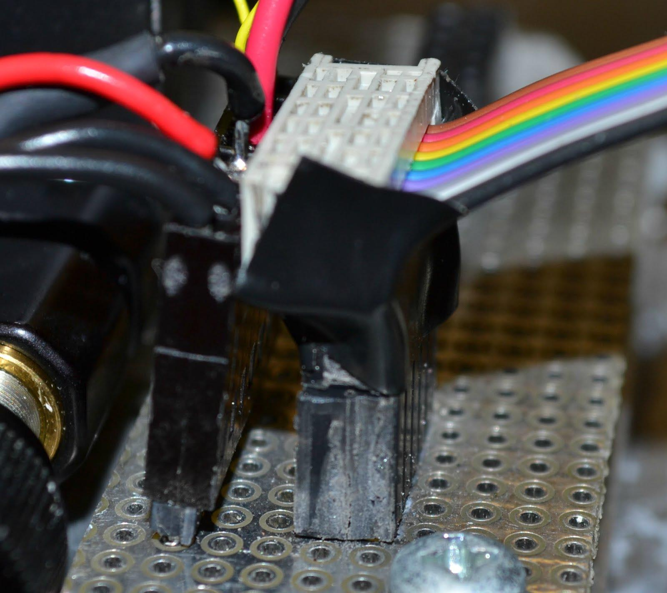
Sockets are wired on the board to a DIP socket, where a DB-9 can connect via ribbon cable.

Slide 13
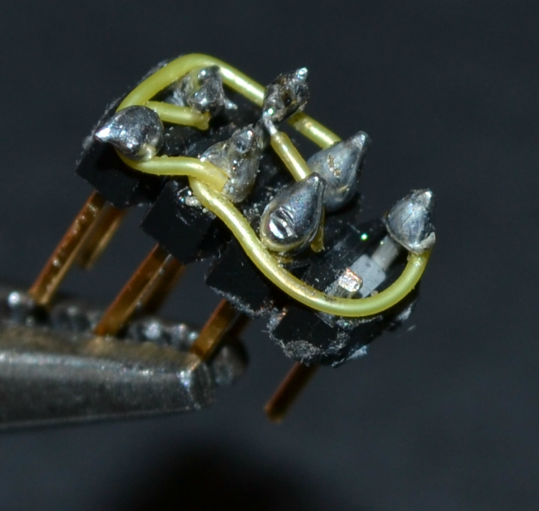
To accommodate different diodes, “keys” can be constructed and placed in an intermediary socket. This accounts for diode differences.

Slide 14
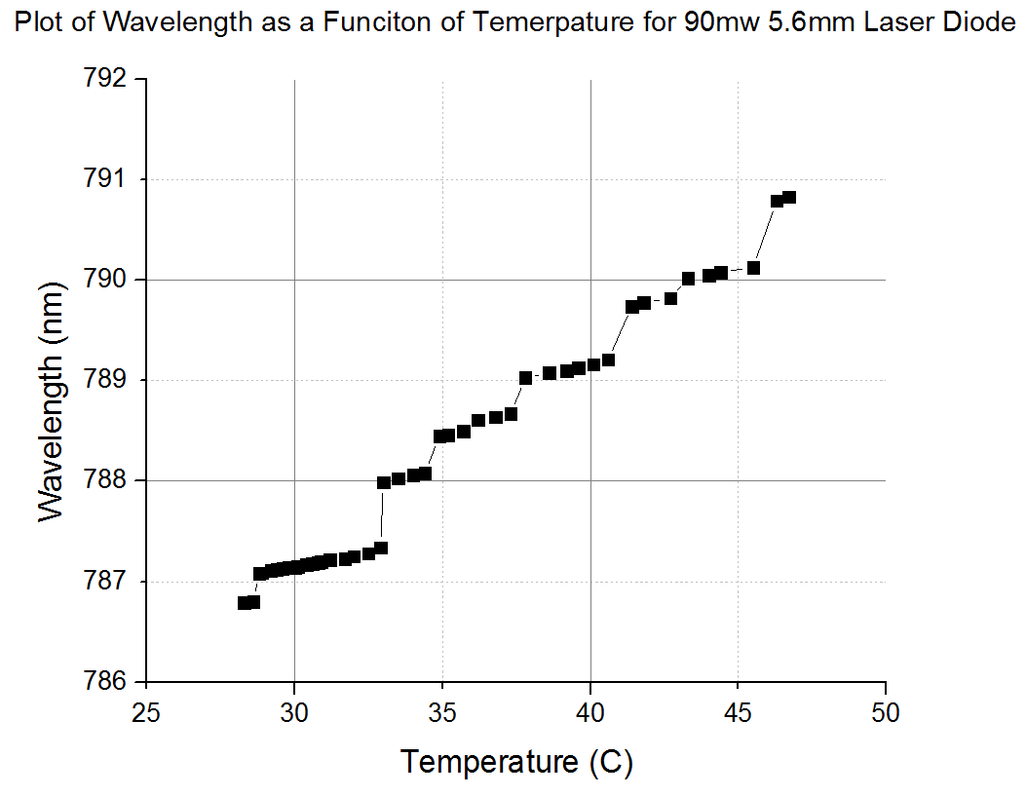

Slide 15
Features
Very simple design
Only a small amount of machining required (all low tolerance)
Adaptable for many different diodes
Capable of very effectively regulating internal temperature
Easy to disassemble/reassemble for troubleshooting and maintenance
Additional mirror eliminates beam steering during tuning
Works with easy to use commercial modules

Slide 16
Acknowledgements
Thank you to:
Dr. DePaola
Madilena
K-State
NSF

