Slide 1
Quantifying the Bessel Beam
Josh Nelson

Slide 2
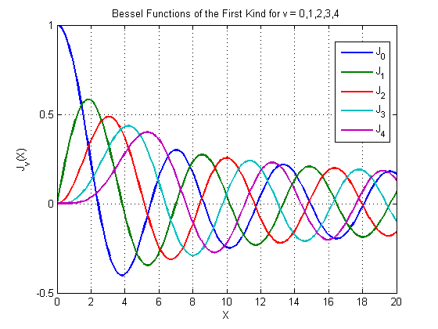
Motivation
Ultimately we want to understand the Bessel beam we send into fiber optics.
  Thus, we must quantify our Bessel beam using a fitting algorithm
  There is no already made one so it must coded

Slide 3
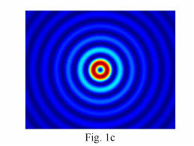
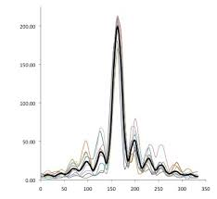
Before the code
Slicing
Normalizing

Slide 4
Code Basics
We want a model of the form:
  c0*J0(A0*x) + c1*J1(A1*x) + … + c9*J9(A9*x) + F
  21 total constants: c0 – c9, A0 – A9, F
  Restrictions: constants less than or equal to one.
So we must find the correct 21 constants! How?

Slide 5

The Loop
Steps:
  Define all different combinations of Bessel Functions at 0.1 step sizes for coefficients
  Take first combination and find intensity for all residual x-points in data
  Find the difference between each residual intensity and square value

Slide 6
The Loop
Steps (cont):
  Add all differences up and that gives total difference (or error) for Bessel function with those coefficients
  Repeat for all combinations of Bessel Functions
  Bessel function with the smallest difference is the best fit of the data

Slide 7

Problem
The number of calculations done is the number of steps for each coefficient to the power of the number of coefficients.
  number of steps for each coefficient = 10
  number of coefficients = 21
  Number of calculations = 10^21

Slide 8
Problem
How long does that take to calculate?
  10^5 calculations = 20 minutes
  So:
    (10^5)/(10^21) = (20 min)/time
    So time = 20*10^16 minutes
    Or time = 380,517,503,805.2 years
      What does this mean?

Slide 9


Slide 10
Solution… maybe
Loop functions seperately:
c0, A, F 6. c5, G, F
c1, B, F 7. c6, H, F
c2, C, F 8. c7, I, F
c3, D, F 9. c8, K, F
c4, E, F 10. c9, L, F

Slide 11
Solution… maybe
Each loop now has 10^3 calculations and takes about 2 seconds.
  This gives a nice fit in about 20 seconds.
We can redo this same process starting with the new coefficients and refine the fit.

Slide 12
Possible Problem
Finding Local Minimum instead of Global Minimum

Slide 13
Future
Adding code for fitting at finer resolutions
Completely restarting if this turns out to just be a local minimum.

