Slide 1
Quantifying the Bessel Beam Part 2
Josh Nelson
Adam Summers
Danny Todd
Carlos Trallero

Slide 2
New Problems
We forgot to account for background
Code from last week will not find the global minimum
Background

Slide 3
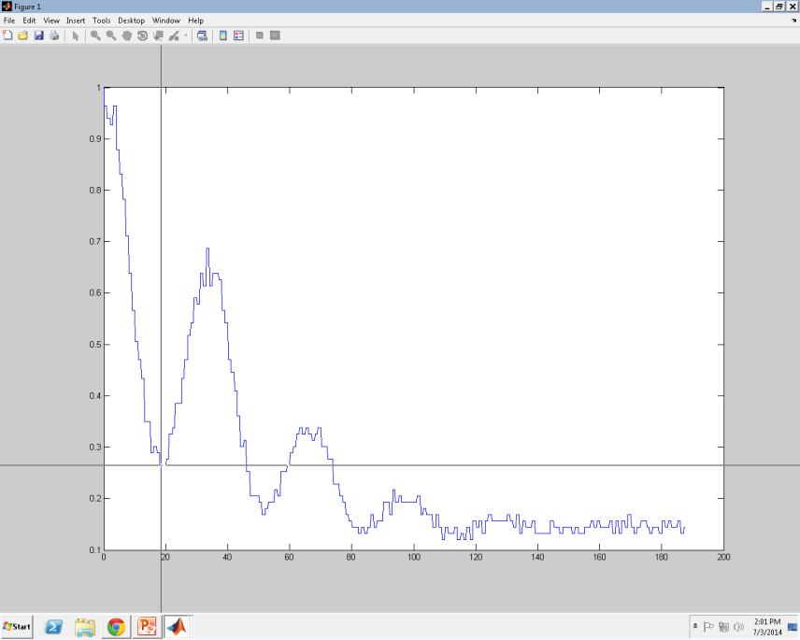
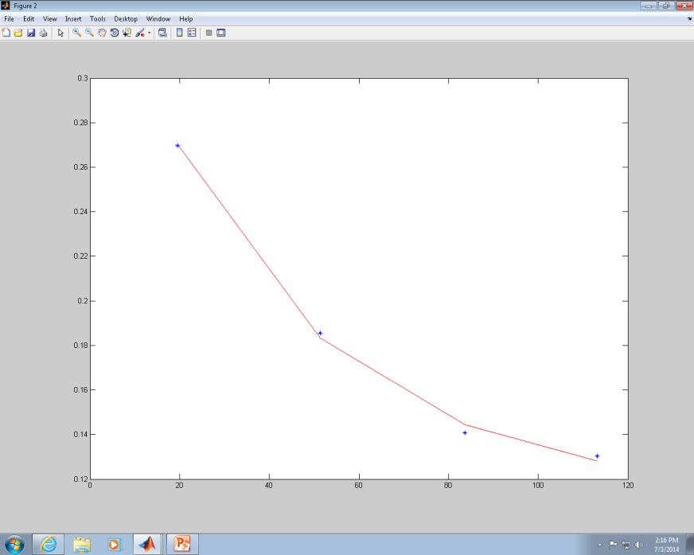
Accounting for Background
To take away contribution from the background we had to make all minimums zero
Step 1. Use ginput to fit minimums to exponentially decaying function (Pause to show)

Slide 4
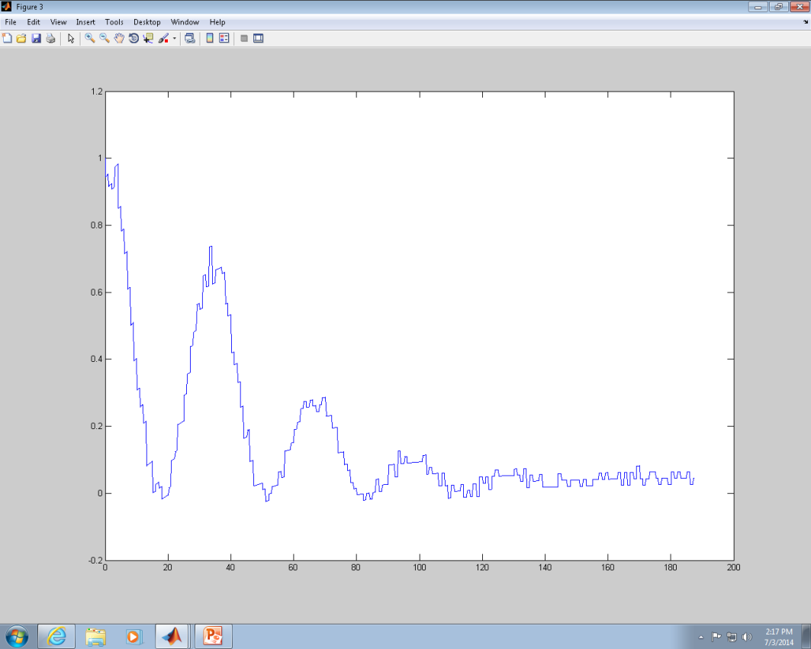
Accounting for Background
Step 2. Subtract all y values from y values in decay function and renormalize

Slide 5
Nelder Mead Method
Using 51 coefficients, 1 argument, and 1 offset
C0*J0(A*X) + C1*J1(A*X) + … + C50*J50(A*X) + F
Basic idea:
Fit using geometric shapes
I apologize, the next three slides may be incorrect due to our lack of knowledge of the theory behind this method

Slide 6
Nelder Mead Method
Each coefficient/constant = 1 dimension/vertex
1 error vertex as well
So, dimension of geometry = n + 1
We have 54 dimensions so our geometry has 54 vertices
With 3 dimensions:

Slide 7
Nelder Mead Method
Matlab runs the program at starting vertices.
Then the worst coefficient is changed to a completely new vertex/coefficient and the program/equation re-evaluates.
This repeat occurs (defaultly) 200*n times
Our case: 200*53 times

Slide 8
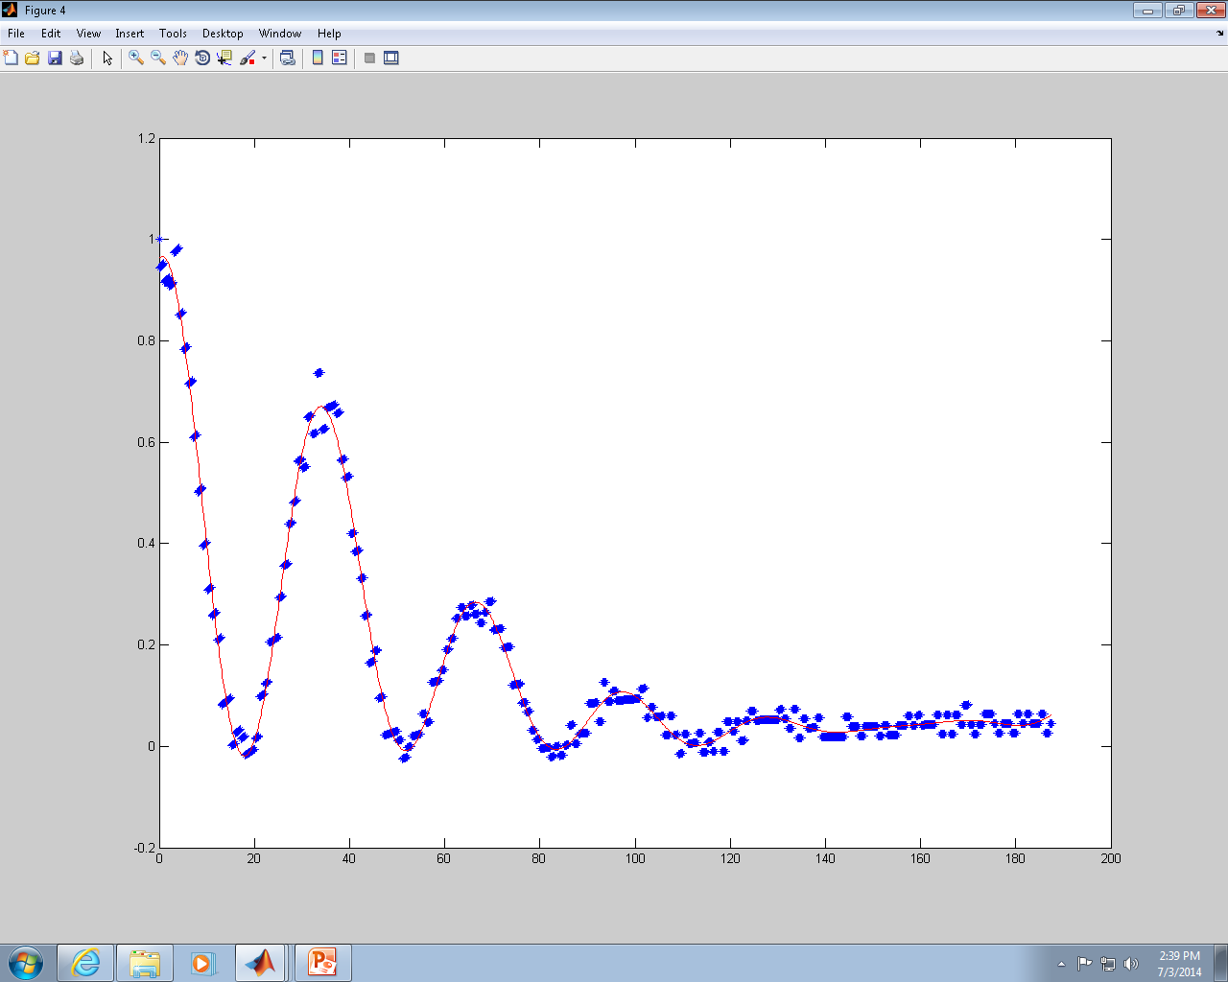
Nelder Mead Method
The 200*nth evaluation shows the coefficients for the best fit:

Slide 9
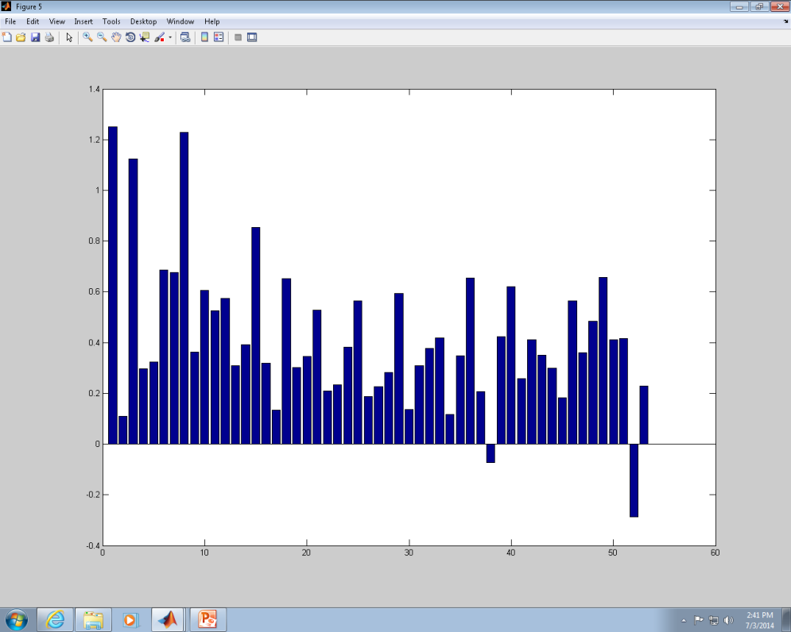
Problems
We should be able to get the right fit with less than fiftyone bessel functions
Coefficients are not being well controlled (between 0 and 1)
No trend

Slide 10
Future
Work on getting right fit with less bessel functions
Attempt the program with more pictures
Produce results, write papers, and become famous!!!!!!!!

