Slide 1
Nuts and Bolts Difference Frequency Generation (DFG) Beam Time 7/15/14
Josh Nelson
Derrek Wilson
Carlos Trallero

Slide 2
Goals
Create DFG from signal and idler (OPA)
Confirm that a beam from DFG is produced

Slide 3
OPA
Signal = 1000 – 1550 nm
Idler = 1600 – 2500 nm
Conservation of Energy and momentum give out signal and idler
signal
Pump Beam
OPA
idler

Slide 4
DFG Process
DFG
Signal
Idler
Conservation of Energy
ω_{s} – ω_{i} = ω_{DFG}
Conservation of Momentum
K_{s} – K_{i} = K_{DFG}

Slide 5
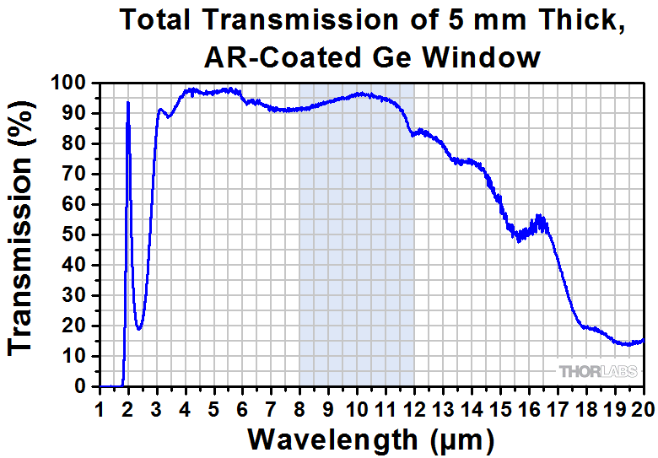
Setup for DFG
AgGaS2 (silver thiogallate)
Block
S
KLS
2 mJ, 2 KHz, 30 fs
OPA
0.5 mJ for S + I
S
800 nm
DFG crystal
I
I
DFG
Power Meter
Germanium Window

Slide 6
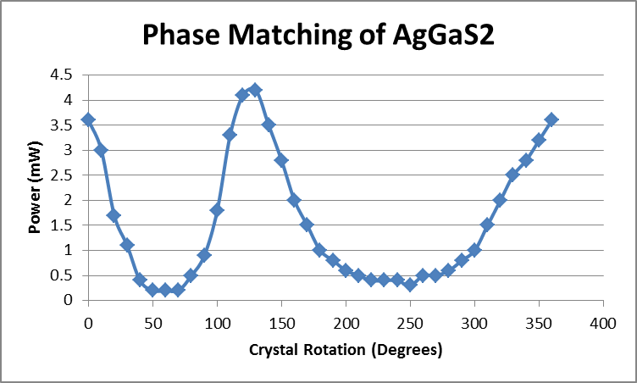
Data
Signal = 1470 nm
Idler = 1750 nm
1/λ_{s} – 1/ λ_{i} = 1/λ_{DFG}
λ_{DFG} = 9200 nm
Energy Split: S = 83% I = 17%
Showed Phase Matching

Slide 7
Data
Signal = 1450 nm
Idler = 1705 nm
1/λ_{s} – 1/ λ_{i} = 1/λ_{DFG}
λ_{DFG} = 9700 nm
Energy Split: S =66% I = 34%
Power after OPA = 1 W
Calcite aligned so that signal and idler lose overlap in time
10.5 mW
1.2 mW
1.0 mW

Slide 8
Conclusion/Future
Effectively demonstrated DFG procedure
Found the wavelength of DFG in which gives us the largest power
Future:
Change setup to allow for better control over time overlap of signal and idler
Use setup on HITS

