Slide 1
Bessel Color Images

Slide 2
Click Dots to see Bessel Modes
Dots do not indicate accurate distance from axicon. Images are 2.5 mm apart starting at 155 mm and ending at 200 mm.

Slide 3
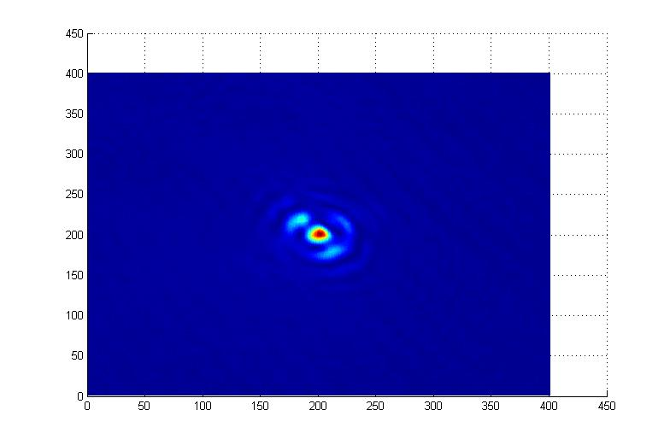
155 mm – Click to choose new image

Slide 4
157.5 mm – Click to choose new image

Slide 5
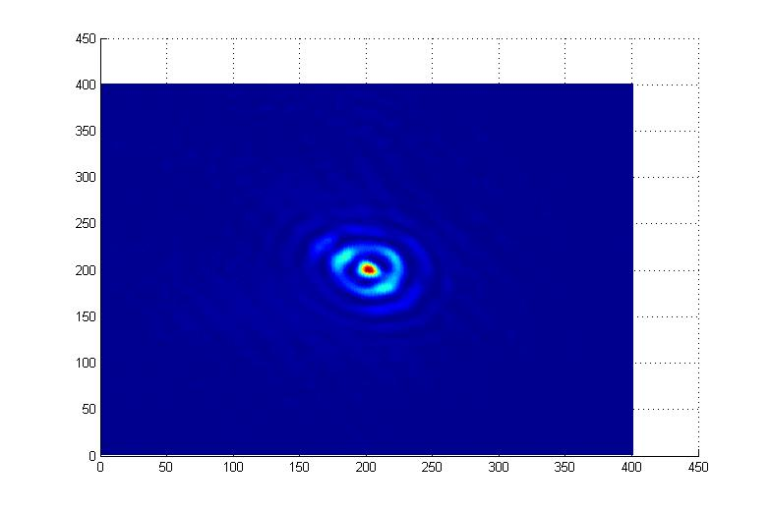
160 mm – Click to choose new image

Slide 6
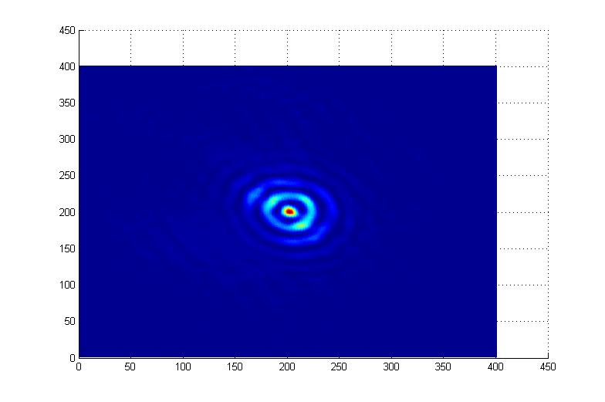
162.5 mm – Click to choose new image

Slide 7
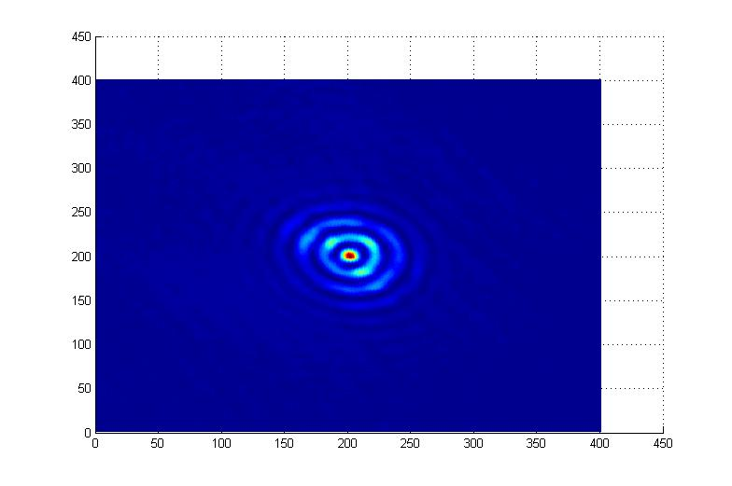
165 mm – Click to choose new image

Slide 8
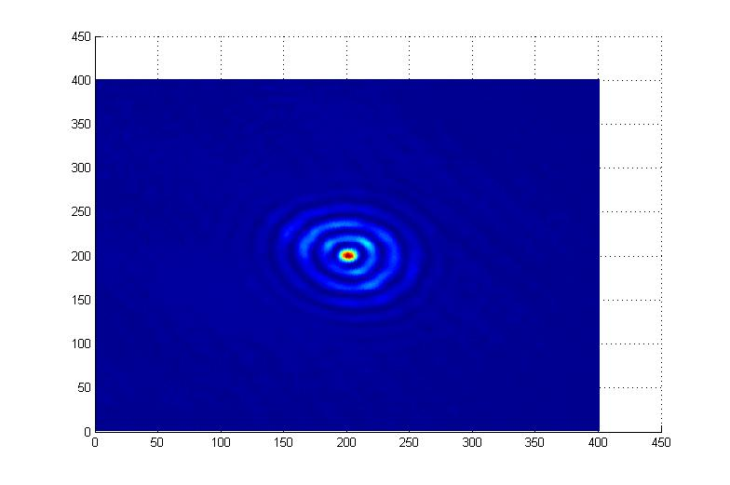
167.5 mm – Click to choose new image

Slide 9
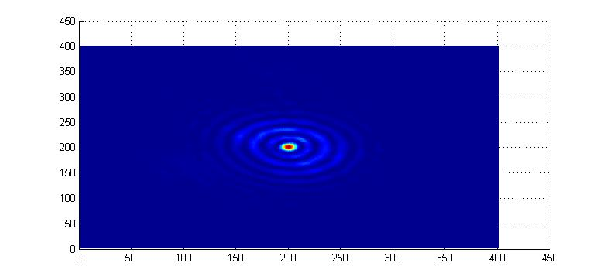
170 mm – Click to choose new image

Slide 10
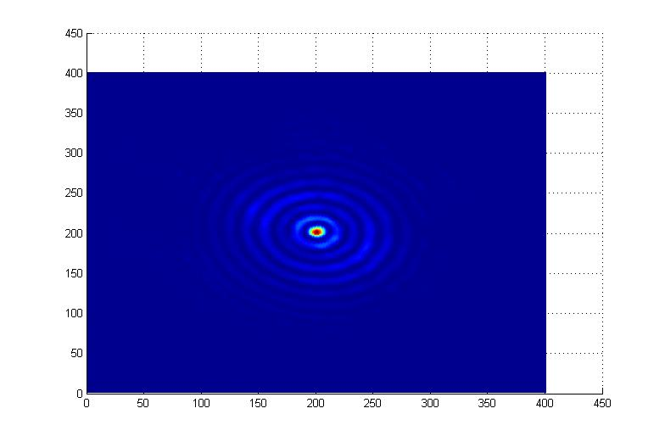
172.5 mm – Click to choose new image

Slide 11
175 mm – Click to choose new image

Slide 12
177.5 mm – Click to choose new image

Slide 13
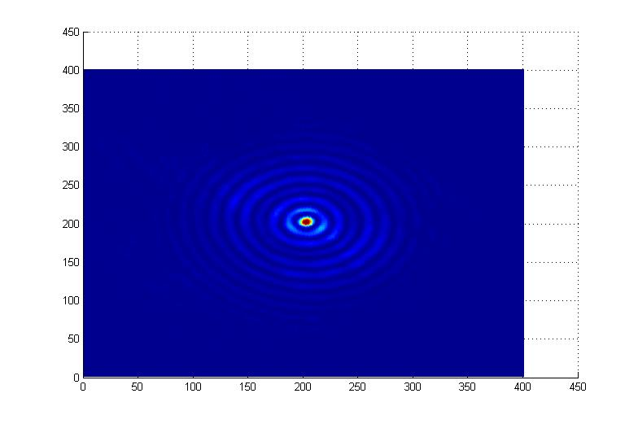
180 mm – Click to choose new image

Slide 14
182.5 mm – Click to choose new image

Slide 15
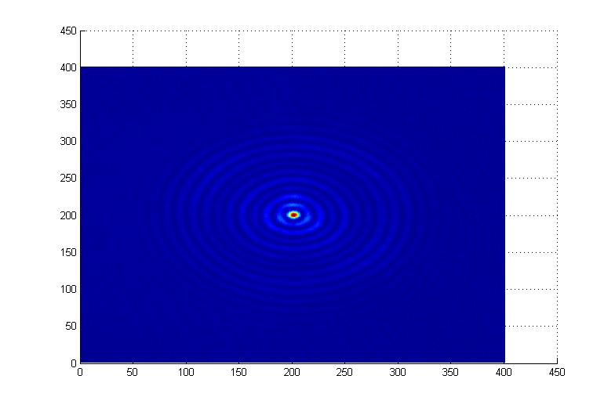
185 mm – Click to choose new image

Slide 16
187.5 mm – Click to choose new image

Slide 17
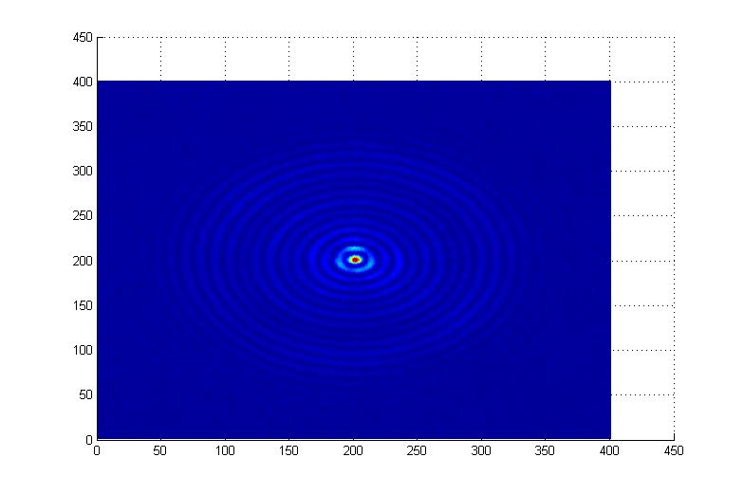
190 mm – Click to choose new image

Slide 18
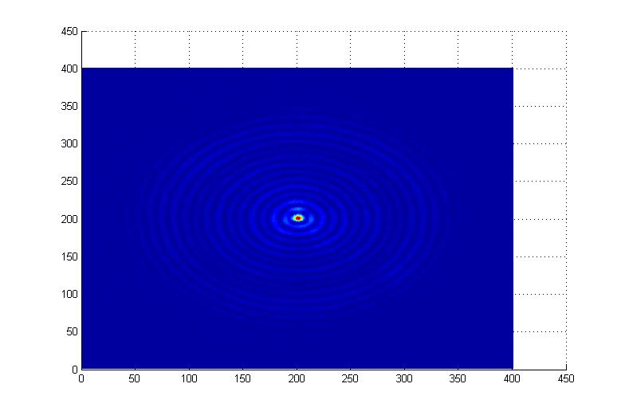
192.5 mm – Click to choose new image

Slide 19
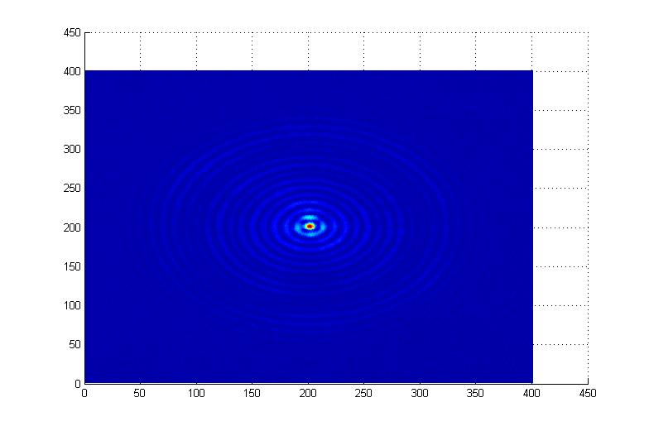
195 mm – Click to choose new image

Slide 20
197.5 mm – Click to choose new image

Slide 21
200 mm – Click to choose new image

