Slide 1
Compact Muon Solenoid Detector (CMS) & The Token Bit Manager (TBM)
Alex Armstrong & Wyatt Behn
Mentor: Dr. Andrew Ivanov

Slide 2
Part 1: The TBM and CMS
Understanding how the LHC and the CMS detector work as a unit
Learning how the TBM is a vital part of the CMS detector
Physically handling and testing the TBM chips in the Hi-bay

Slide 3
Motivation
The CMS detector requires upgrades to handle increased beam luminosity
Minimizing data loss in the innermost regions of the detector will therefore require faster, lighter, more durable, and more functional TBM chips than the current TBM 05a
We tested many of the new TBM08b and TBM09 chips to guarantee that they meet certain standards of operation.

Slide 4
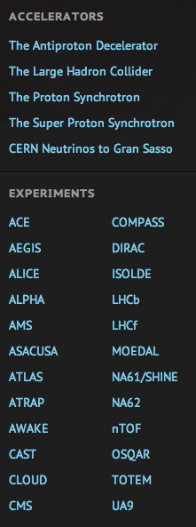
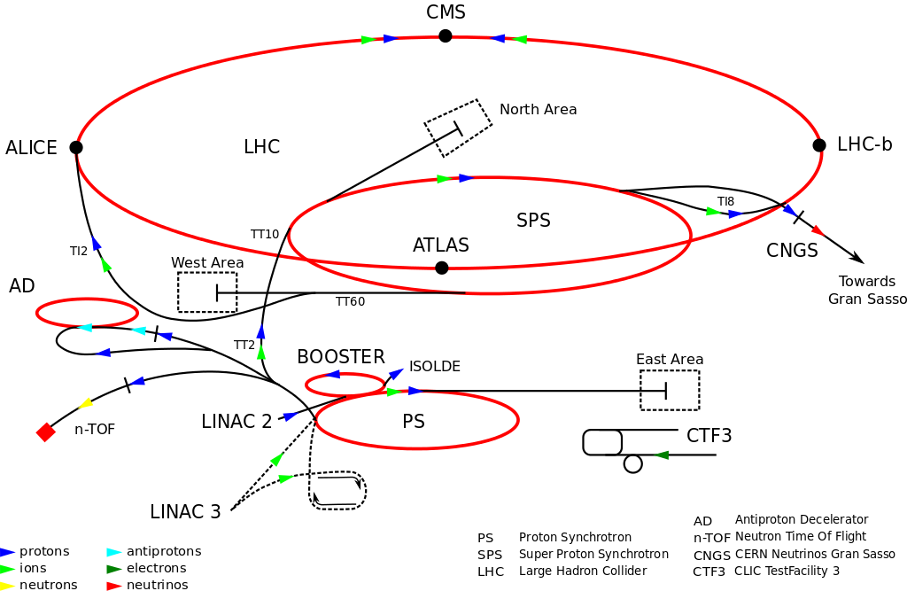
CERN
Conseil Européen pour la Recherche Nucléaire
(European Council for Nuclear Research)
(1952)
Image Credit:: http://home.web.cern.ch/

Slide 5
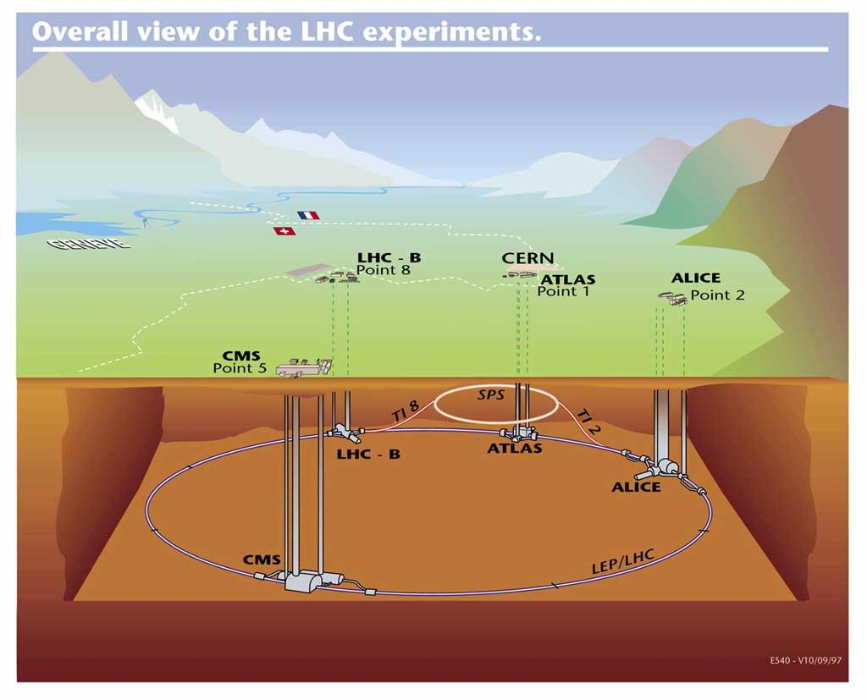
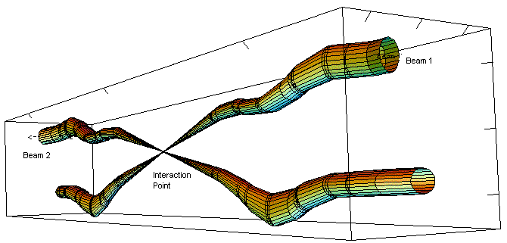
CERN -> LHC
Large Hadron Collider (2008)
Two proton beams travel in opposite directions until collision in detectors
1) ATLAS
2) ALICE
3) LHCb
4) CMS
Image Credit: hep://home.web.cern.ch/topics/large-­‐hadron-­‐collider
Image Credit: http://lhc-machine-outreach.web.cern.ch/lhc-machine-outreach/collisions.htm
Notes:
4 detectors

Slide 6
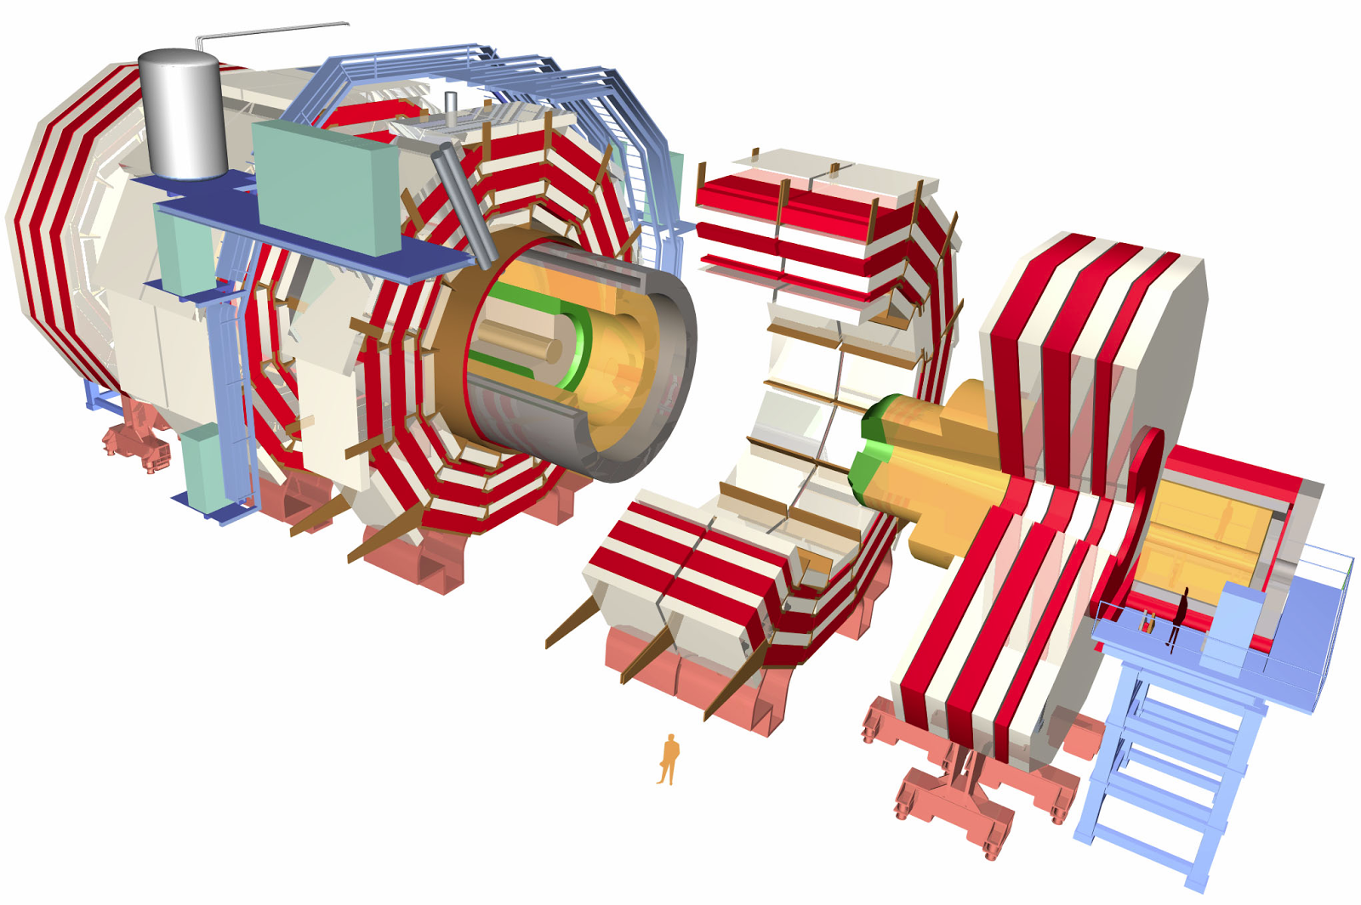
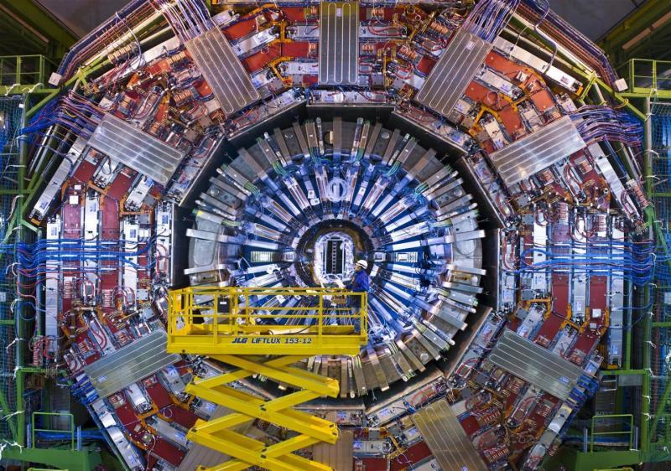
CERN -> LHC -> CMS
Compact Muon Solenoid (2008)
Image Credit: hep://cms.web.cern.ch/
Image Credit: http://home.web.cern.ch/about/experiments/cms

Slide 7
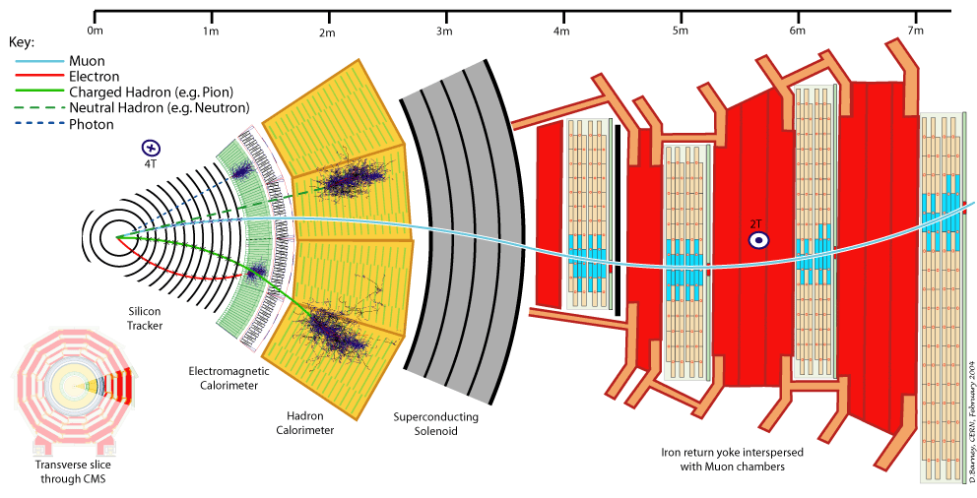
CMS Detector System
Image Credit: hep://home.web.cern.ch/about/experiments/cms

Slide 8
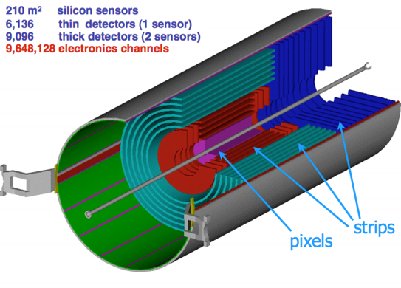
Inner Silicon Tracker
Semiconductor detector technology used to measure and time stamp position of charged particles
Inner layers consist of pixels for highest possible resolution
Outer layers consist of strips for lower production cost
Image Credit: https://inspirehep.net/record/1234410/plots

Slide 9
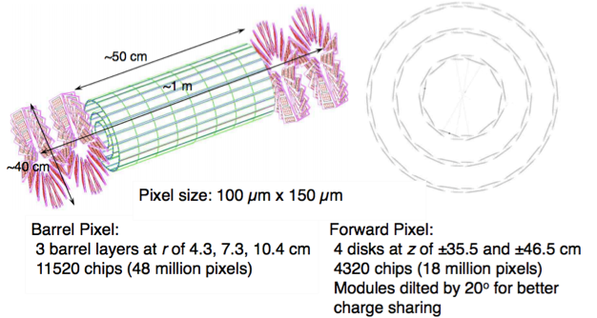
Inner Silicon Pixel Tracker
The layers consist of individual pixels grouped into modules managed by the TBMs
Pixel layers provide the highest resolution data for positions of charged particle
Image Credit: CMS CR -2011/256

Slide 10
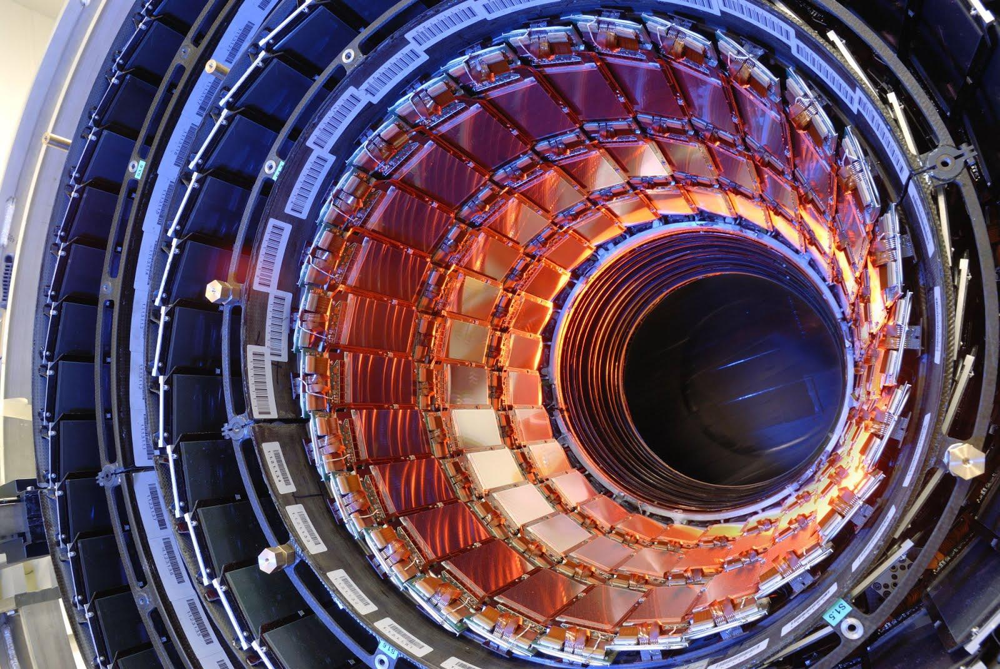
Inner Silicon Pixel Tracker
Image Credit: http://www.hep.ph.ic.ac.uk/~hallg/Pix_CMS/

Slide 11
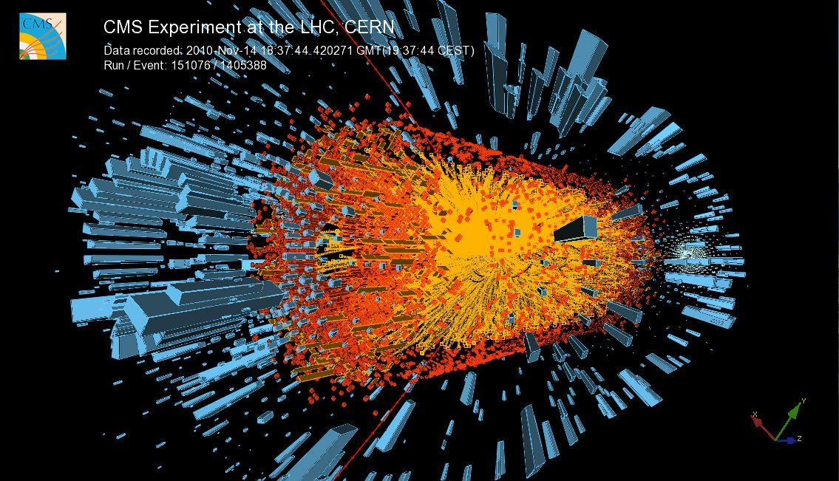
Image Credit: hep://cms.web.cern.ch/news/cms-­‐observes-­‐hints-­‐mel@ng-­‐upsilon-­‐par@cles-­‐lead-­‐nuclei-­‐collisions

Slide 12
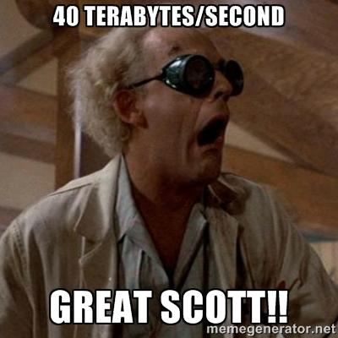
Problems & Solutions
1) SO MUCH DATA! - 40 terabytes/second
Level 1 trigger system (3500ns latency)
Higher level trigger system
2) High Collision Rate - 40 MHz (25ns gap)
Buffer zones in ROCs
High time resolution

Slide 13
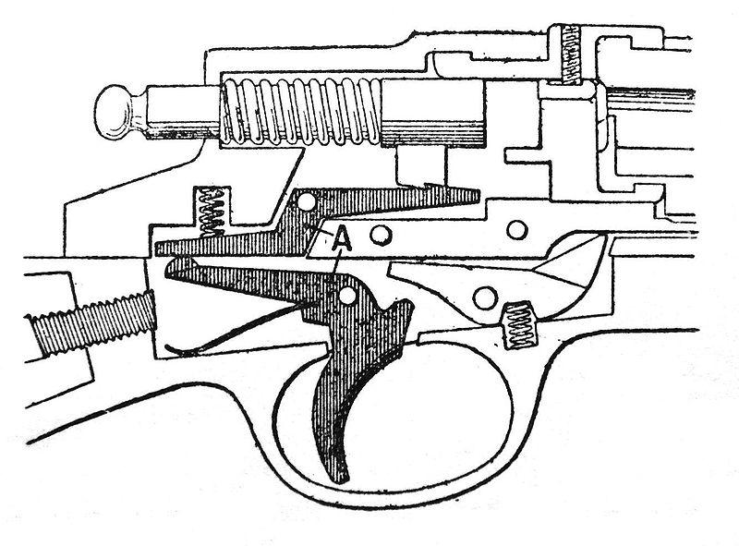
Level 1 Trigger
Completely Automatic - No Software
Selects ~1/10,000 hits
The Selection Process:
1) Detection by Calorimeter and Muon Chambers
2) Trigger Electronics selects desirable events
3) Acceptance/rejection trigger sent to TBM
4) TBM sends message to ROC to collect or discard
5) Collected messages are sent downstream
Notes:
1) Trigger makes you think of a trigger on a gun or a trigger to detonate something. The trigger here is the entire system and serves a similar function because when an event demonstrates certain desired characteristics, the system triggers an acceptance or rejection procedure that allows the data to be passed through to back-end electronics or to be dumped. To make things more confusing, the trigger can also refer to the signal being sent or any element of the overall system involved in the selection process.
2) Calorimeter measures energy while Muon chambers detect track patterns

Slide 14
From Scatta to Data
Particles
Data Signal
Trigger Signal

Slide 15
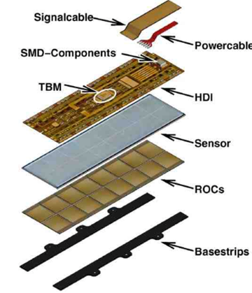
What Makes A Module?
The ROCs are the base for the silicon pixel sensor
The TBM is integrated directly onto the circuit above the sensor
3 layers of pixel detectors will form the Inner Tracking Level
Image Credit: hep://arxiv.org/pdf/1001.3933.pdf

Slide 16
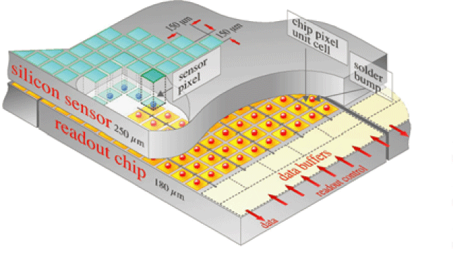
The Pixels/ROC Data Storage
The Inner Tracking Detector has approx 48 million pixels
Each silicon sensor is only 150 x 100 μm (about 2 hair widths)
The ROCs keep their time-stamped information until they are cleared to release to the data stream
Image Credit: hep://cms.web.cern.ch/news/silicon-­‐pixels

Slide 17
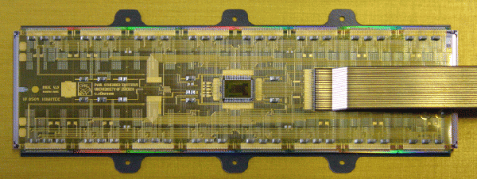
Pixel Detectors/Modules
The TBM chip (shown below) is used to manage ROC’s data release and reset
ROCs
TBM
[This picture displays a TBM connected to 16 ROC (read out chips)]
3.2 mm
4.78 mm
Image Credit: hep://arxiv.org/Hp/arxiv/papers/0707/0707.1026.pdf
Notes:
The TBM itself mediates the ROCs and using a token pass to limit error and input bytes.

Slide 18
The TBM and Token Passing
The TBM uses a “token” to control and convey information to the ROCs
The token is also used by the TBM to register the state of each ROC
TBMs send tokens through the ROCs before acquiring data, if the token is not returned to the TBM in a certain time interval, the event is labeled a “No Token Pass” and the ROCs clear their data buffers
The TBMs are a direct line of communication between the detector and the LHC operators above CMS

Slide 19
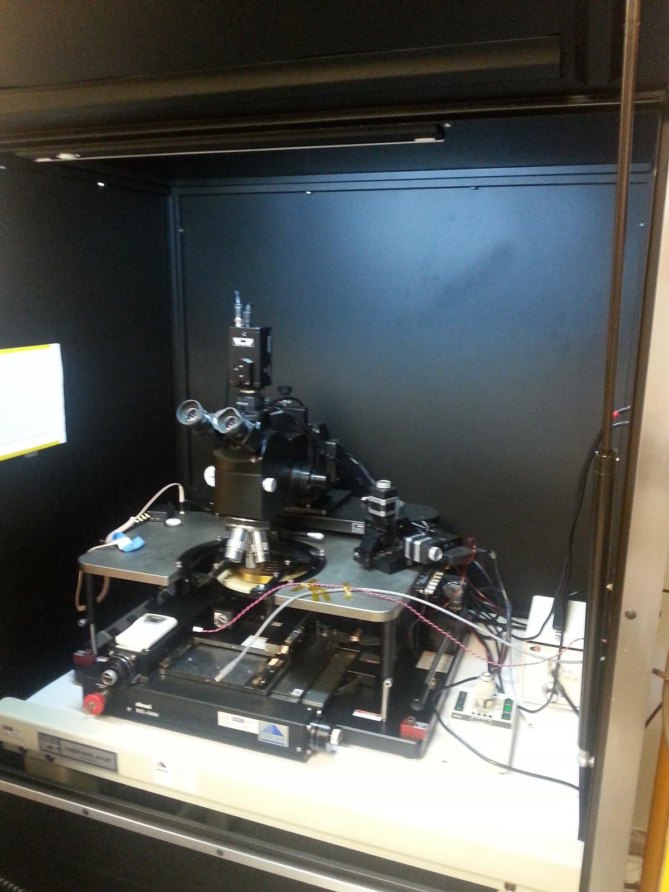
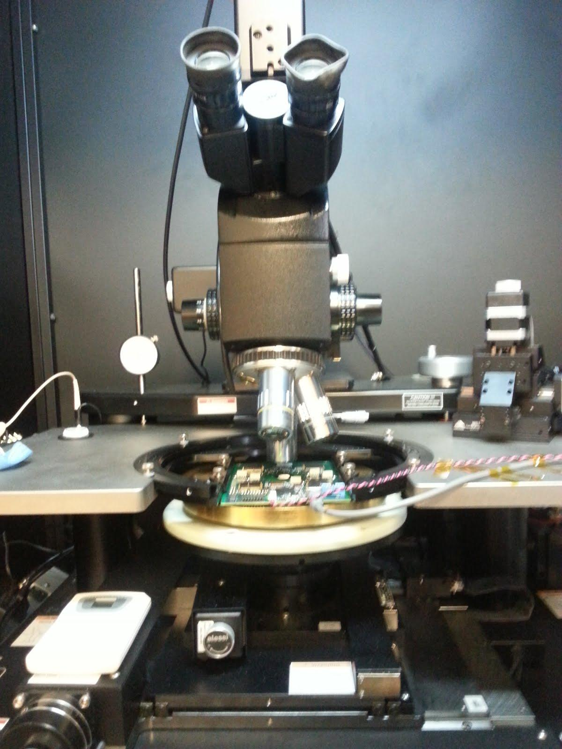
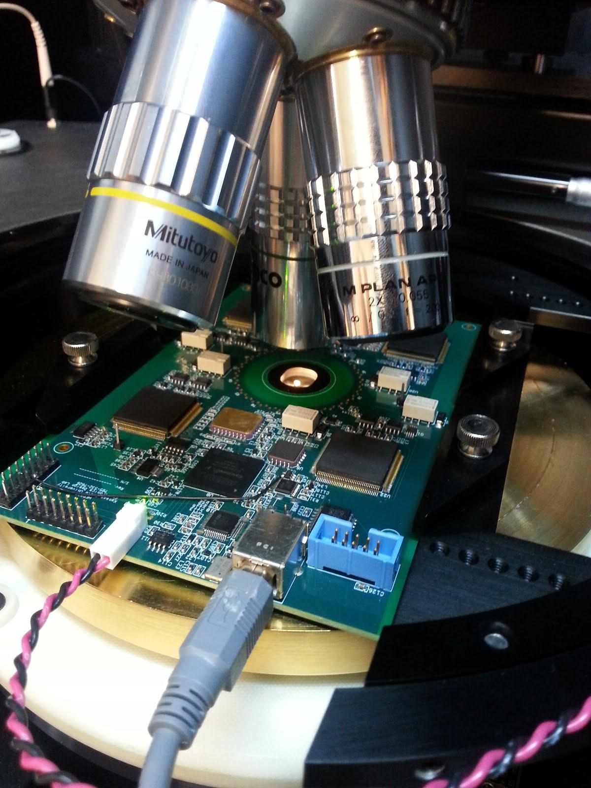
Testing the Chips - The Setup

Slide 20
Hardware & Calibration
Using Cascade Probe Station and Nucleus 3.2 Interactive Software
The stage (or chuck) moves freely beneath a stationary testing board that contains a probing zone
The wafer is placed on the chuck and raised up to the board to make a connection and run tests (Note: Only 50 μm of freeplay are allowed when making connection)
Some issues with the chuck being unbalanced could lead to crashing the probe

Slide 21
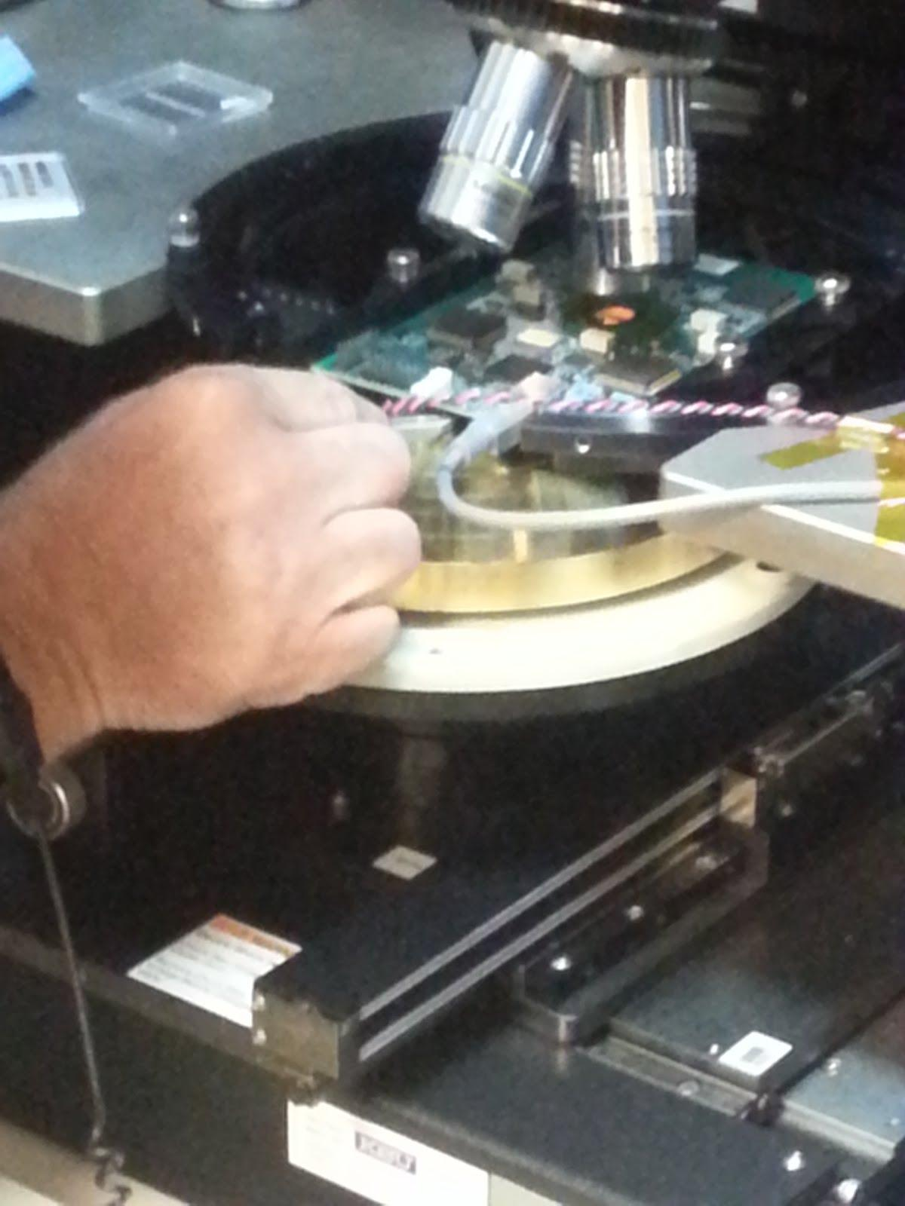
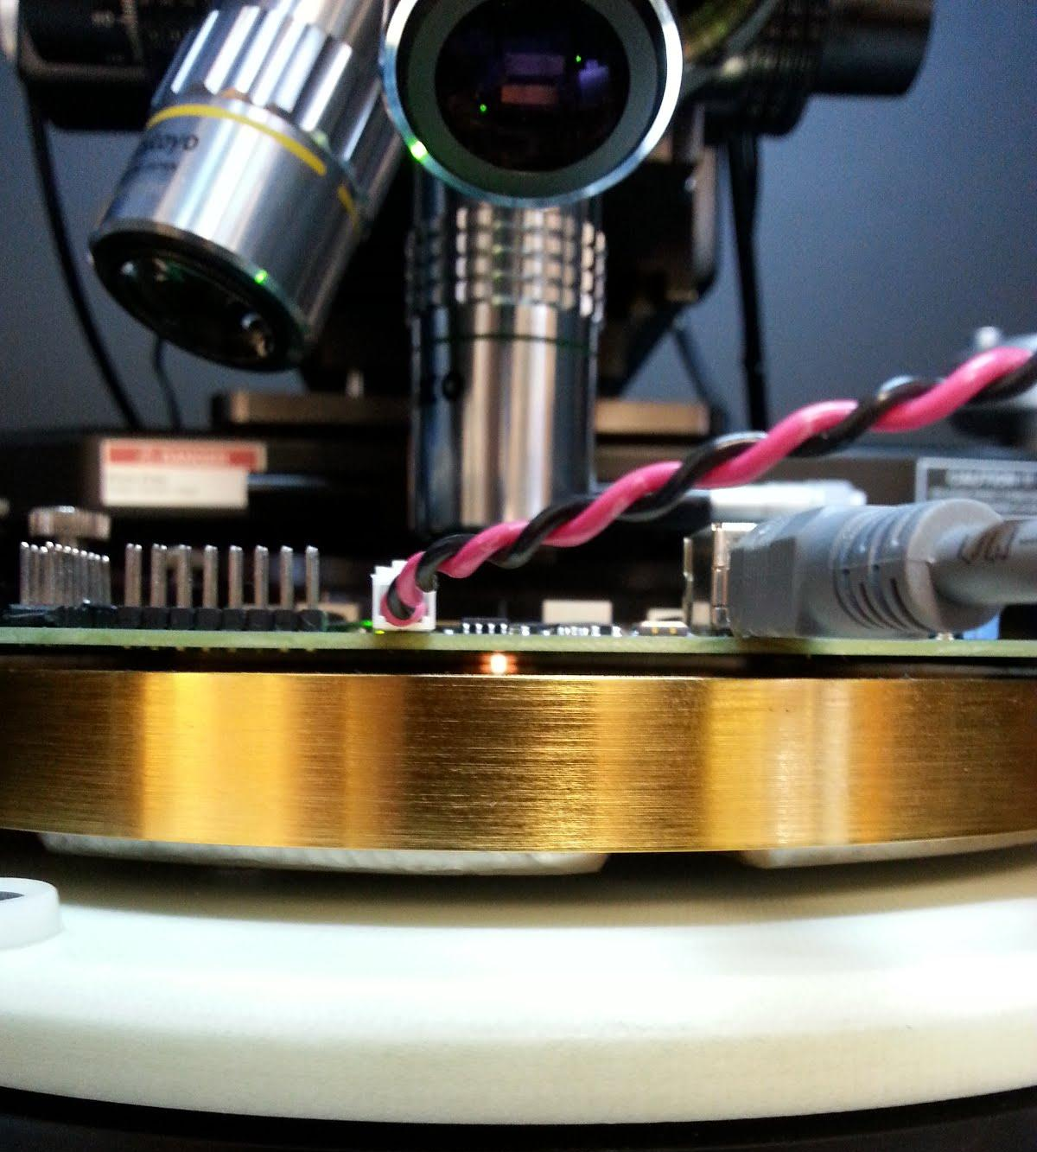
Putting on a Single TBM Chip
~1.6 cm

Slide 22
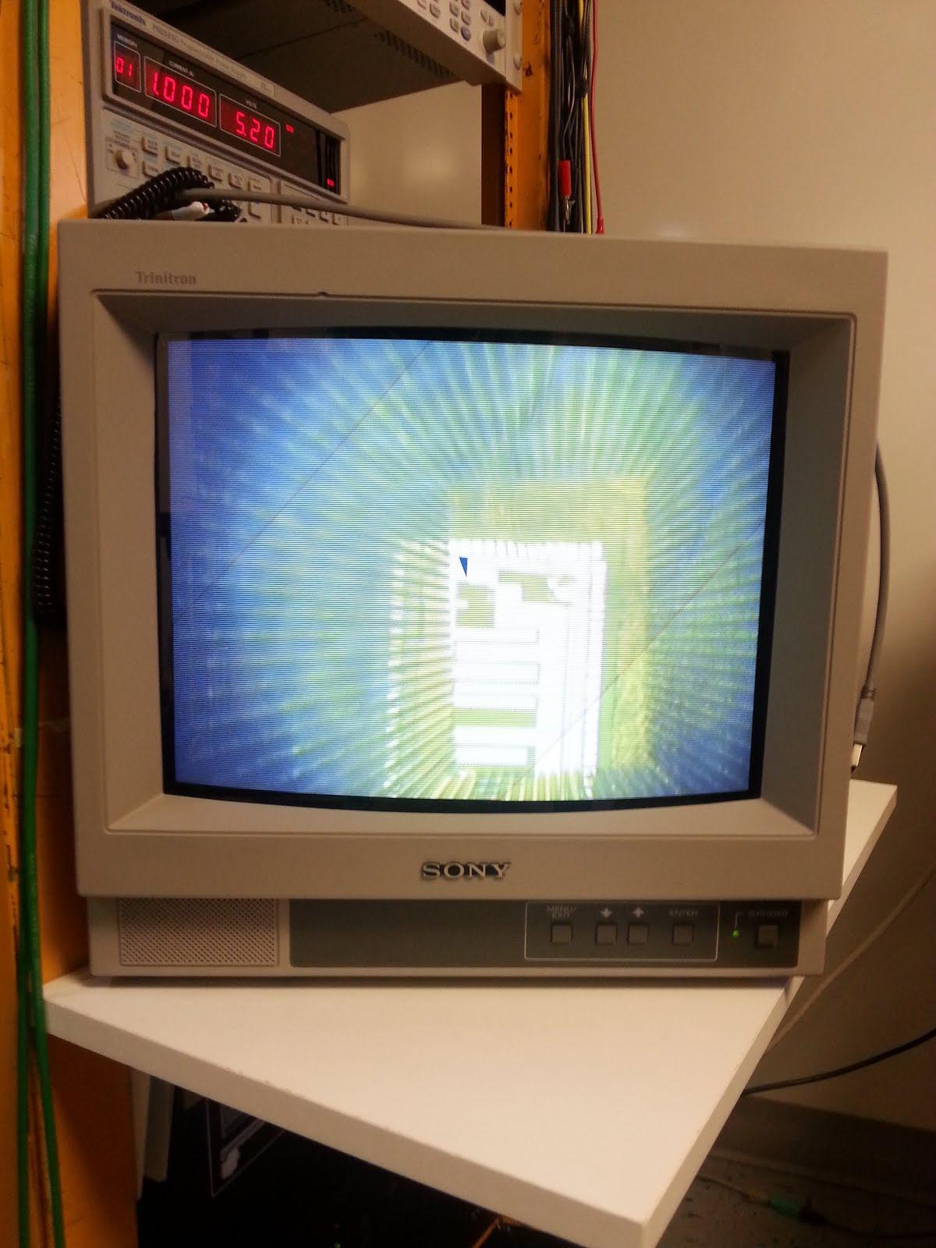
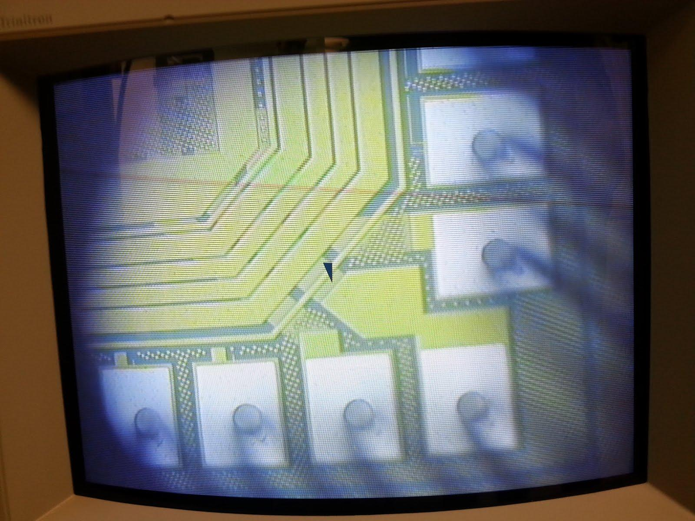
Aligning the Probe

Slide 23
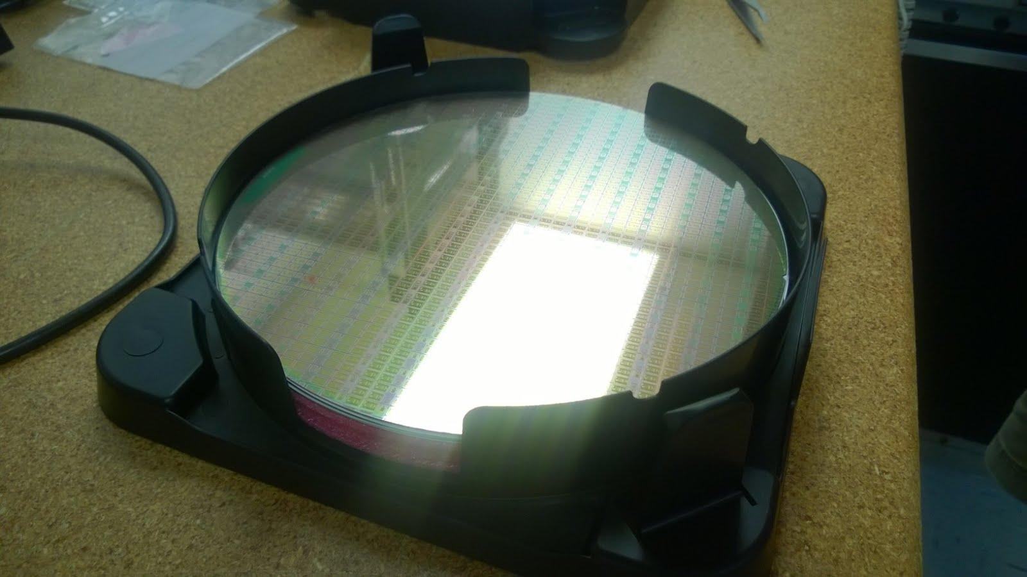
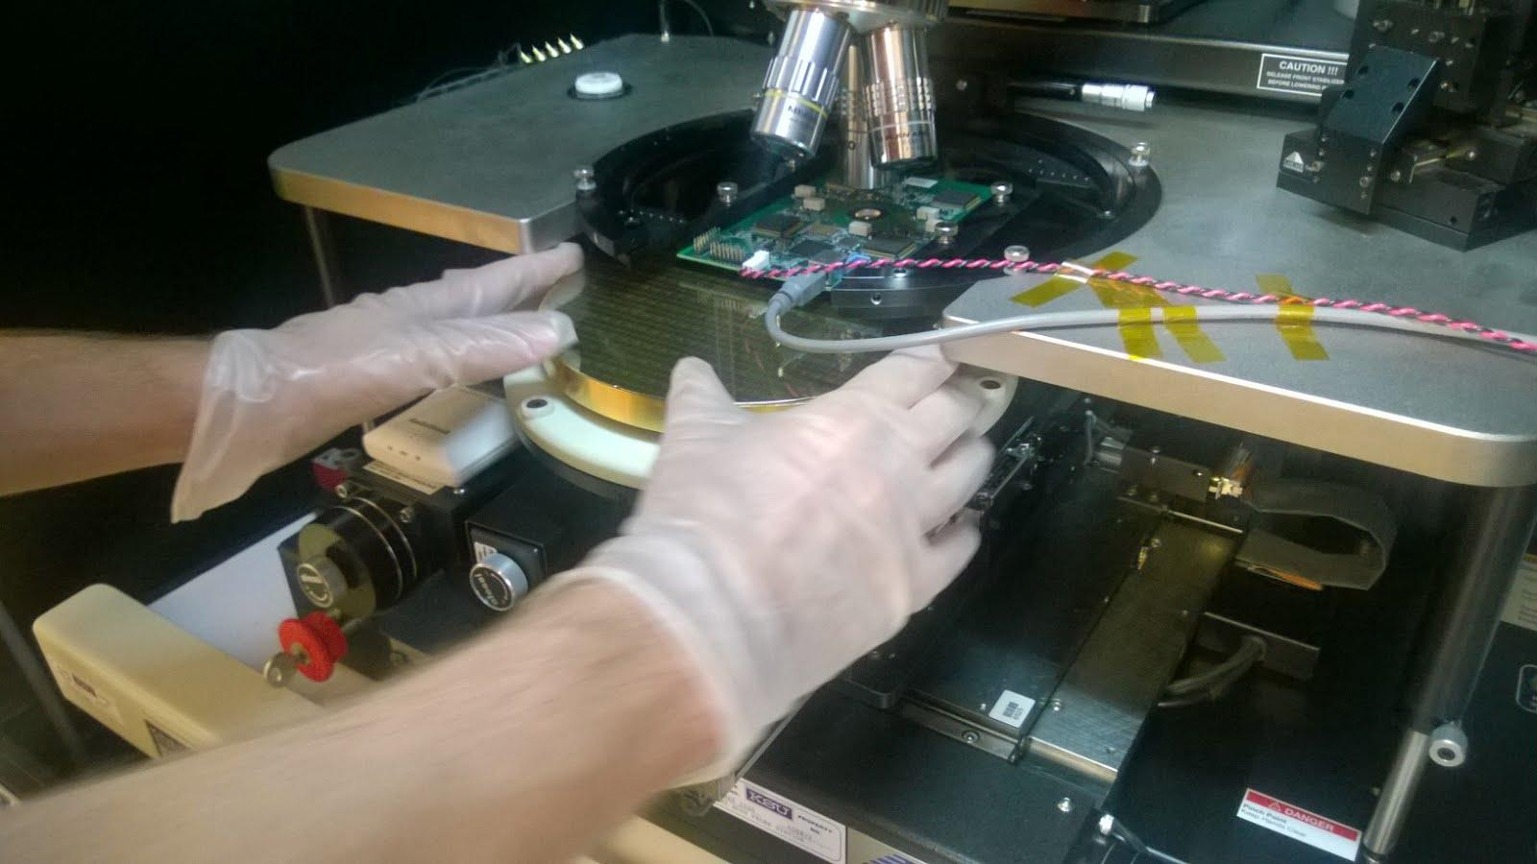
Testing Wafers
Contain thousands of TBM chips
200 mm diameter wafer with 3 different types of TBM chips on it

Slide 24
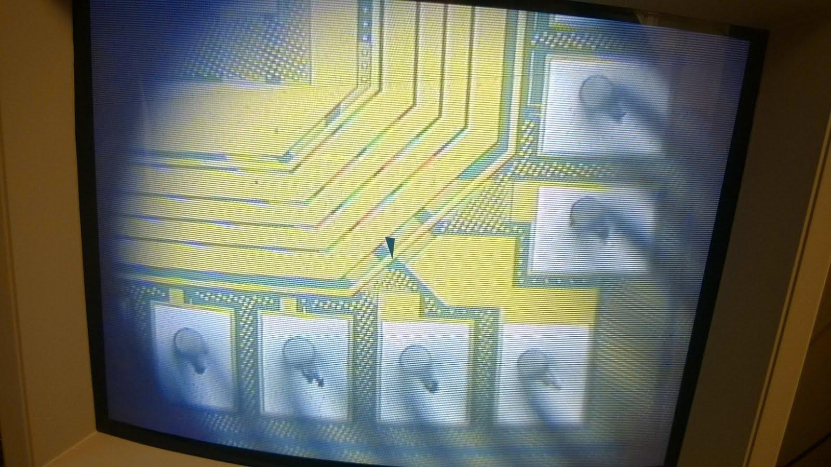
Making Contact
Scratches Indicate Clear Contact

Slide 25
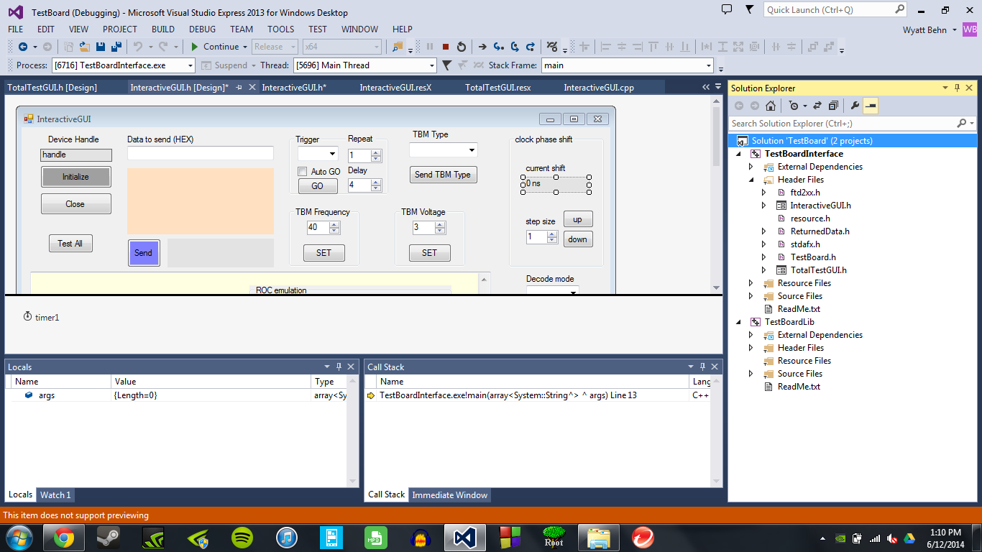
Running the Test Code
Interface Header
GUI Headers
Reference Library for Code

Slide 26
Summary of New TBM Benefits
TBM 09 is digital, whereas the current version is analog (TBM 05a)
The TBM 09 uses two TBM 08b cores that it splits between the ROCs, this allows for a more precise control when analyzing malfunctions
Because the ROCs are distributed, the control room can reset certain ROCs without resetting a whole module (this is good for testing issues)
The TBM 09 is more radiation resistant and also has the benefit of being made of less material which interferes with possible particle detection far less

Slide 27
Part 2: Coding
Work with the programming language of C++
Using the data analysis framework ROOT to interpret simulated data
Using these two in tandem to create small programs that create useful interpretations of data

Slide 28
Analyzing the Data
Data analysis framework used to effectively store, recall, and analyze the large amounts of data output by the LHC

Slide 29
Data Analysis - Simulation
Simulated data is used to show how possible particle collisions and outcomes may play out
Simulations also help to show discrimination between theory and experimental result
Comparing theoretical vs. experimental allows us to look for new and exciting things

Slide 30
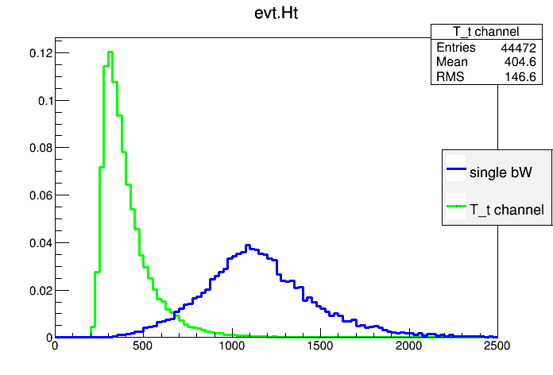
Signal vs. Background - Ex.
This is an example of the total energy of a top anti-top particle creation event
The green background is clearly different from the blue signal information

Slide 31
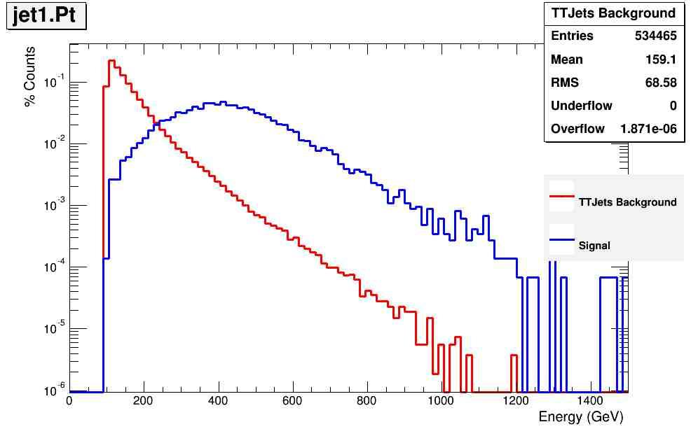
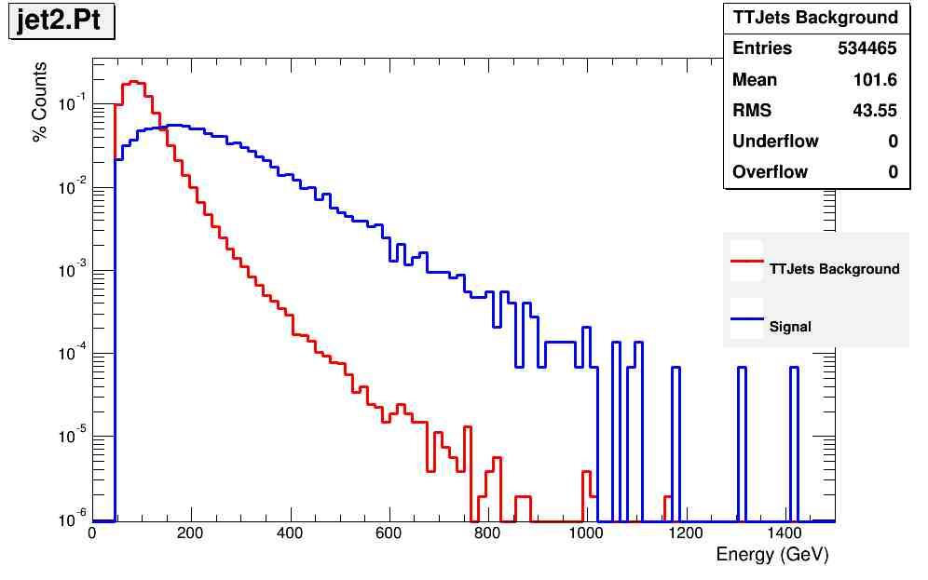
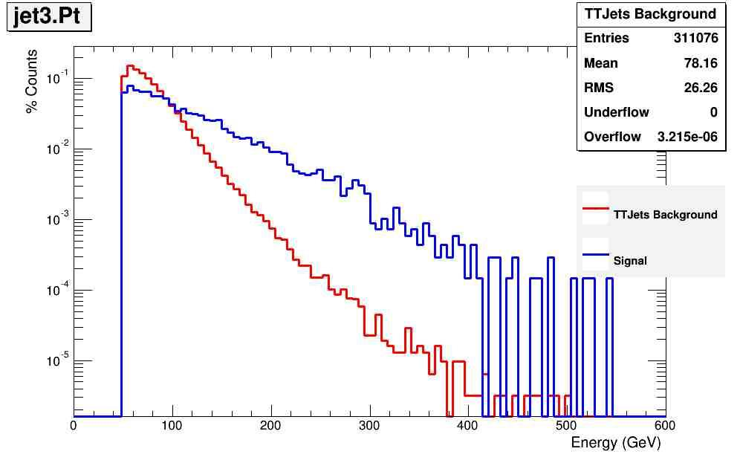
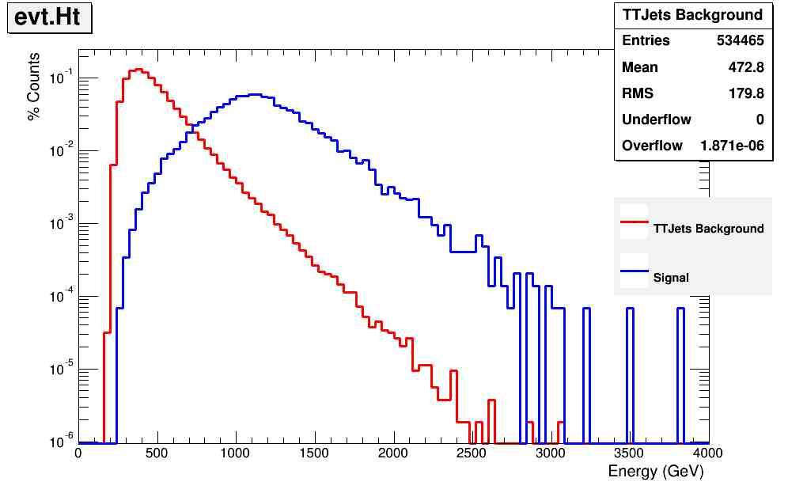
Interesting Jets

Slide 32
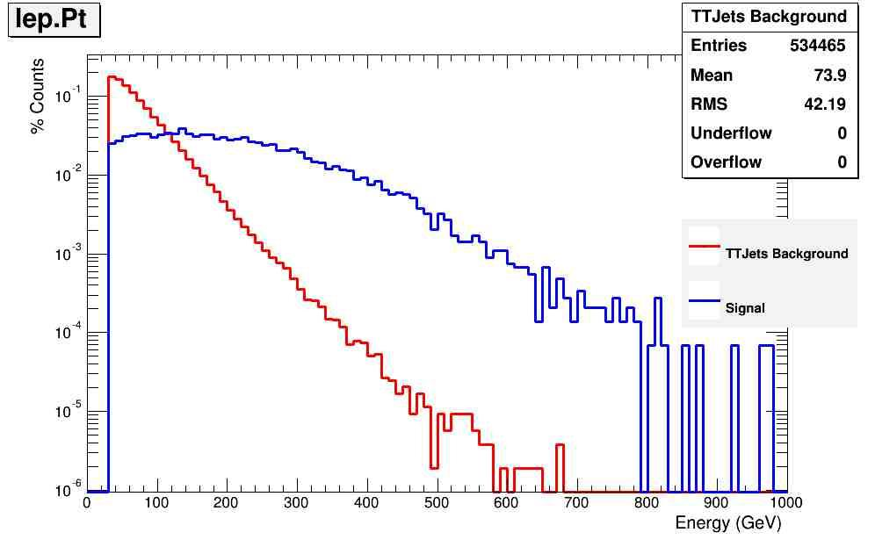
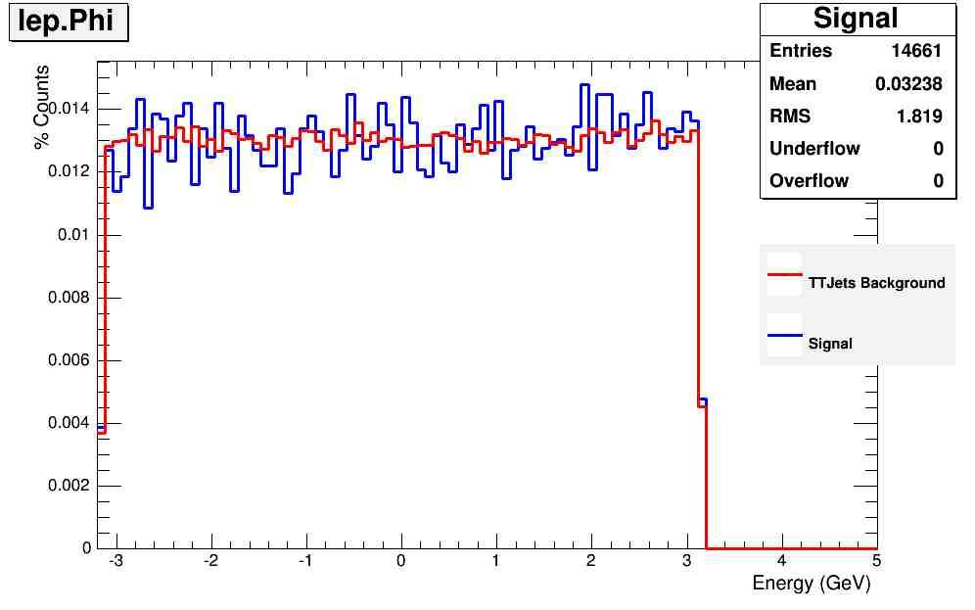
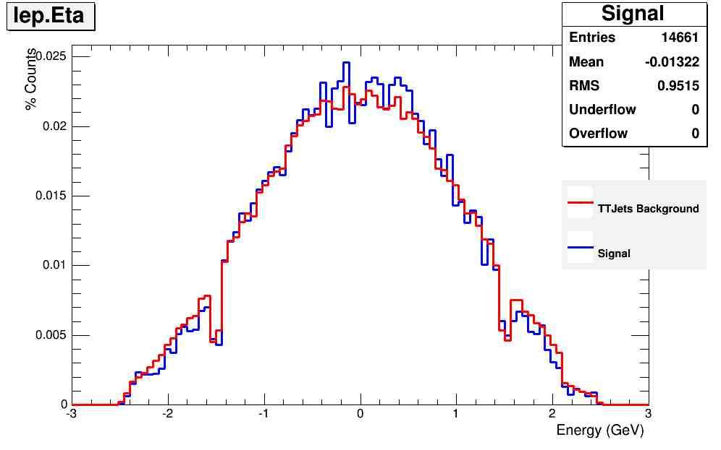
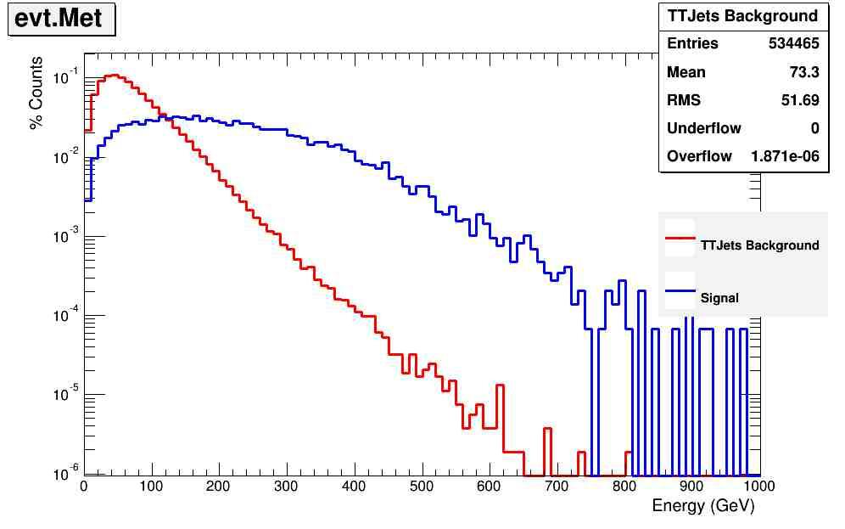
Interesting Leptons

Slide 33
T H E E N D

