Slide 1
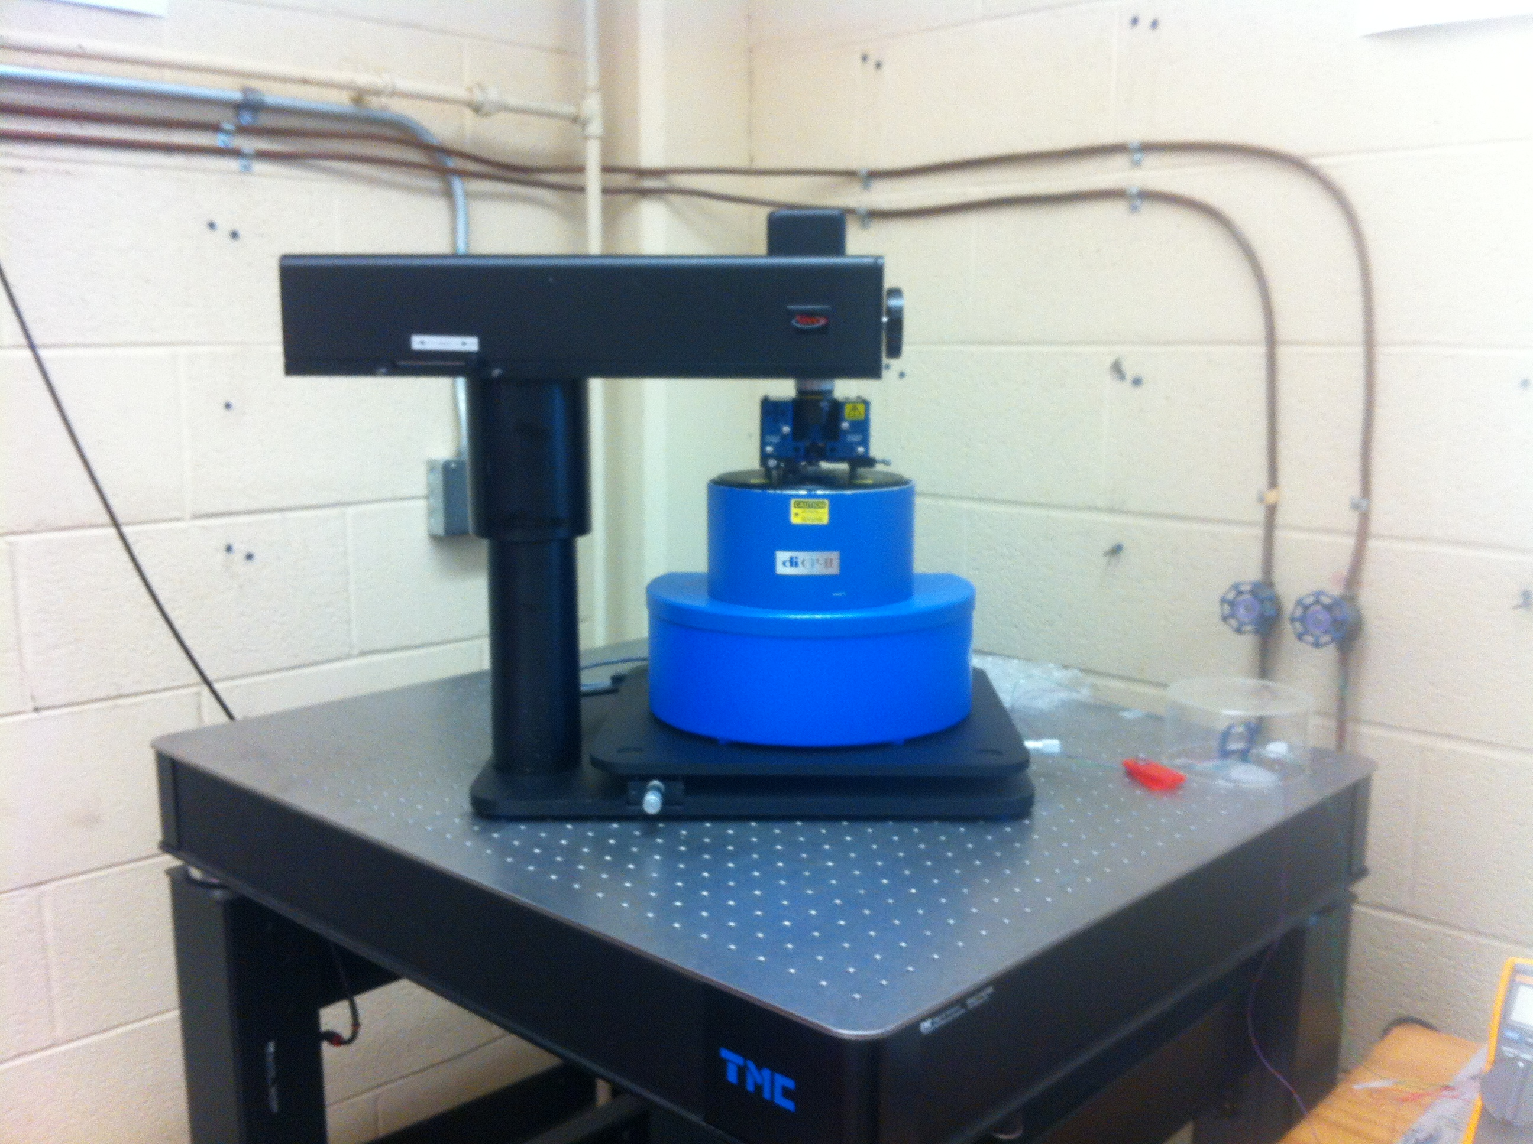
AFM Summer Research

Slide 2
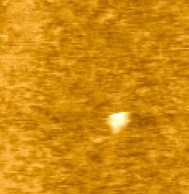
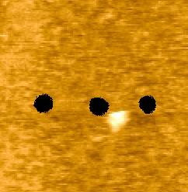
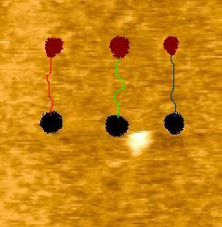
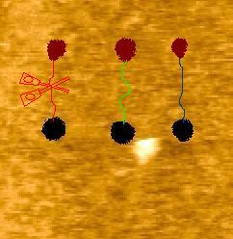
Project Overview

Slide 3
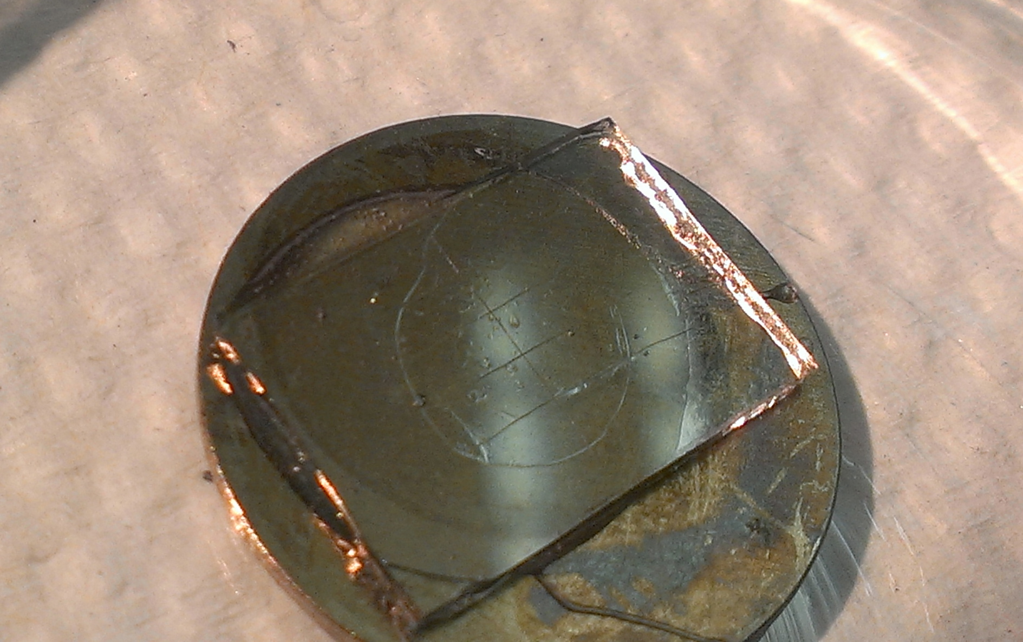
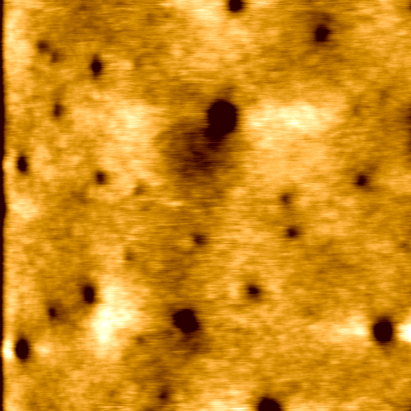
Polymer
Phone camera picture
2μm x 2μm AFM scan
The polymer is explained in detail in: Robert Szoszkiewicz, Takashi Okada, Simon C. Jones, Tai-De Li, William P. King, Seth R. Marder, and Elisa Riedo, 2007, High Speed, Sub-15 nm Feature Size Thermochemical Nanolithography, Nano Letters, v. 7, p. 1064-1069

Slide 4
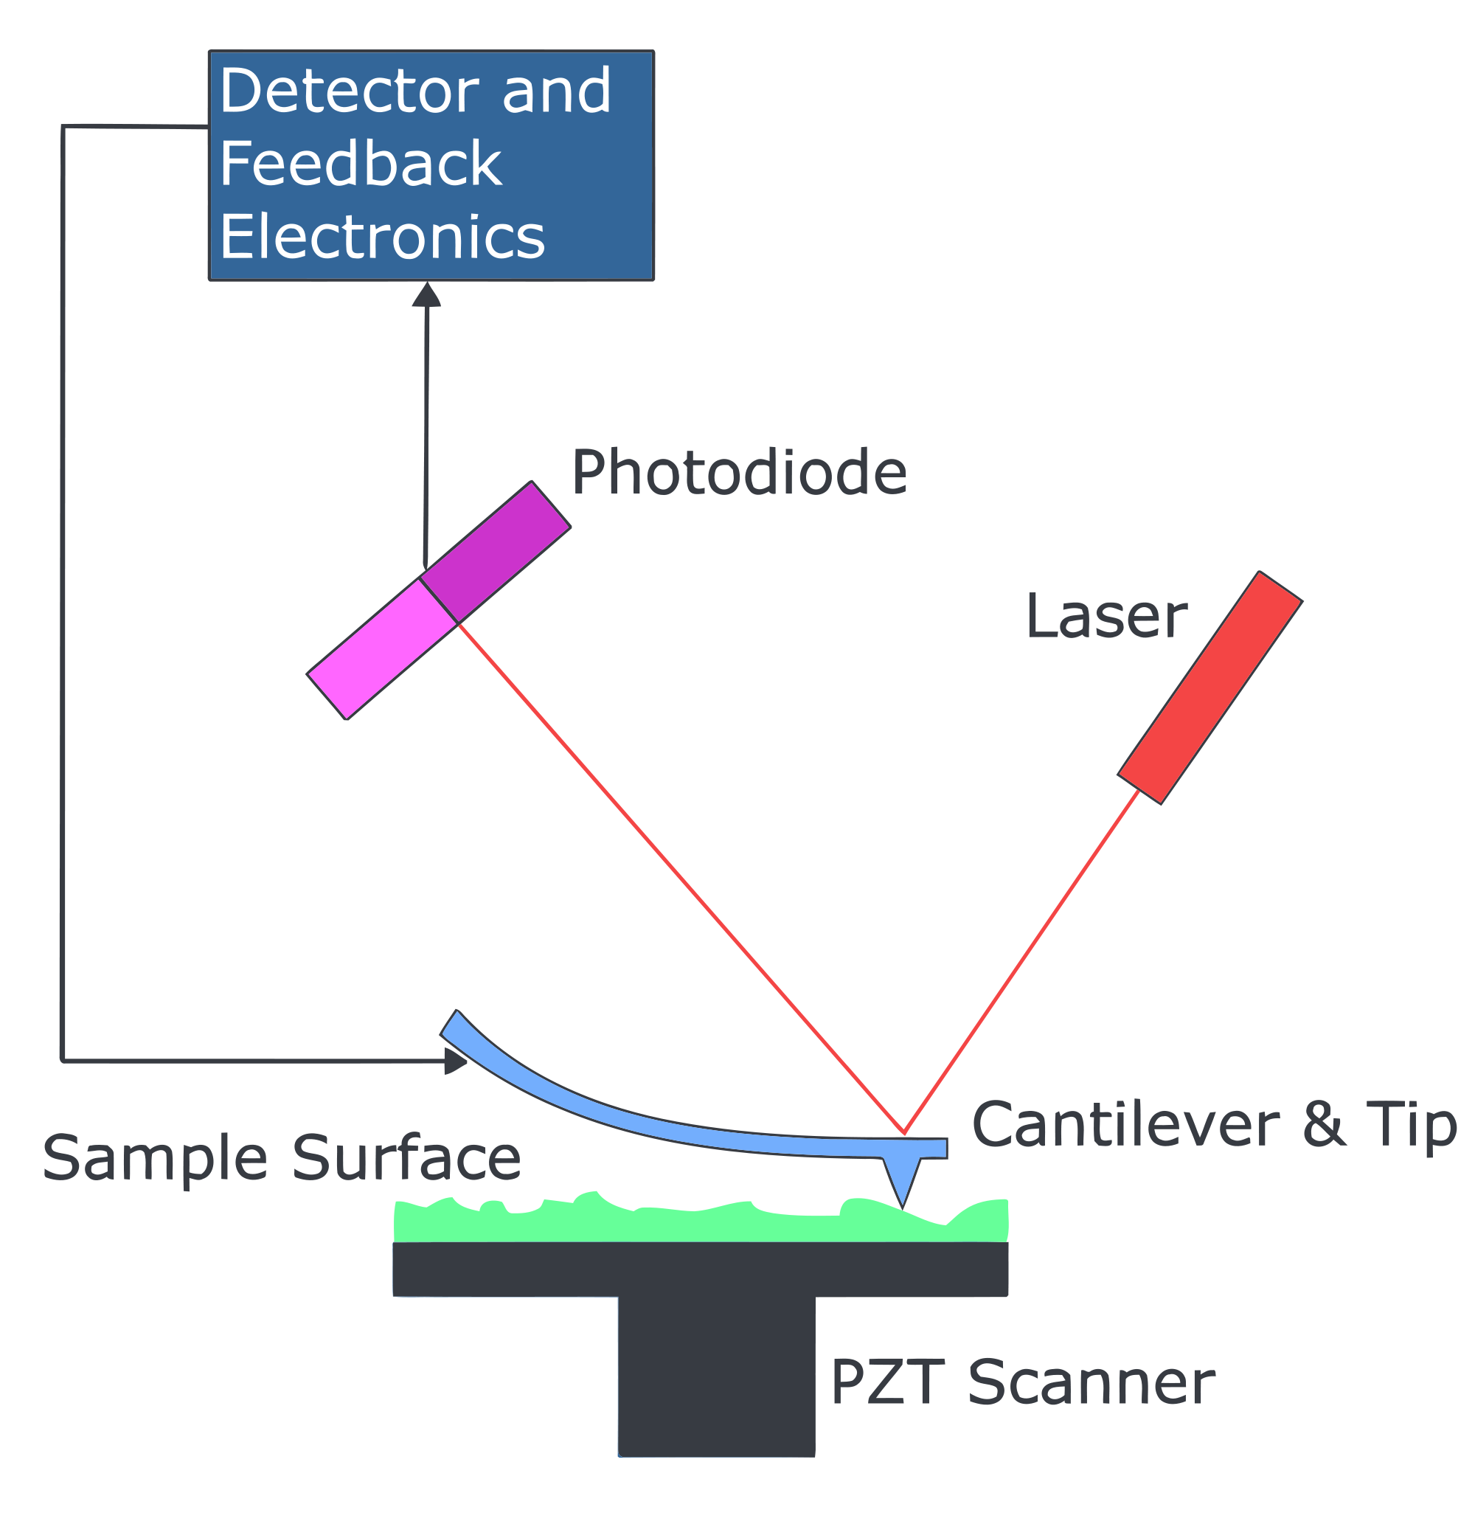
AFM
Picture taken from wikipedia’s article on atomic force microscopy

Slide 5
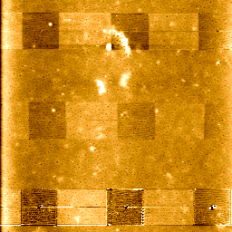
TCNL
350°C →
300°C →
400°C →

Slide 6
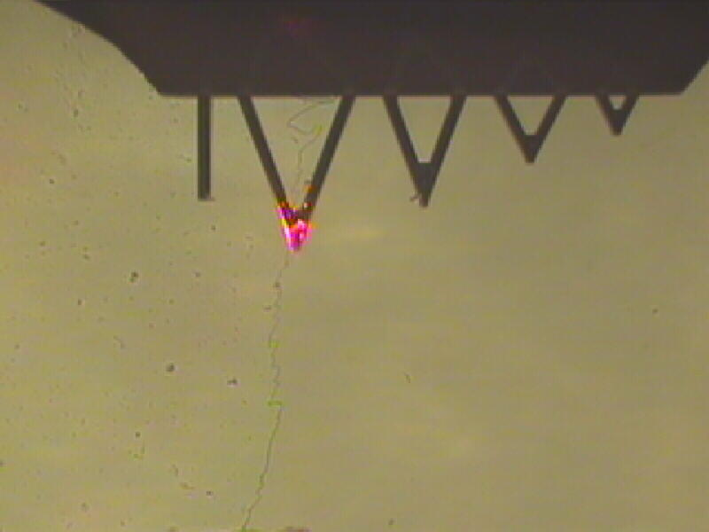
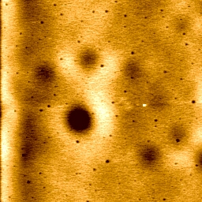
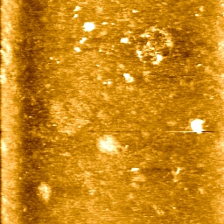
Incubation Can Destroy Polymer

Slide 7
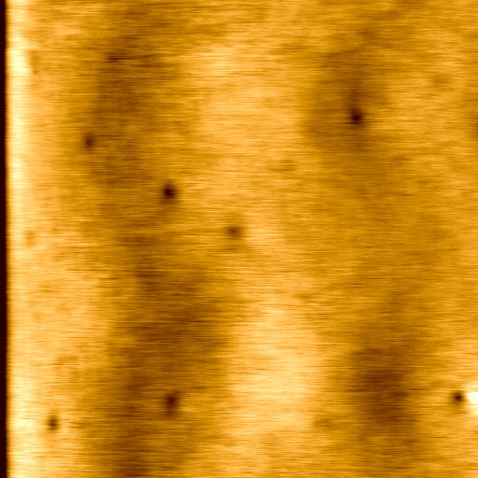
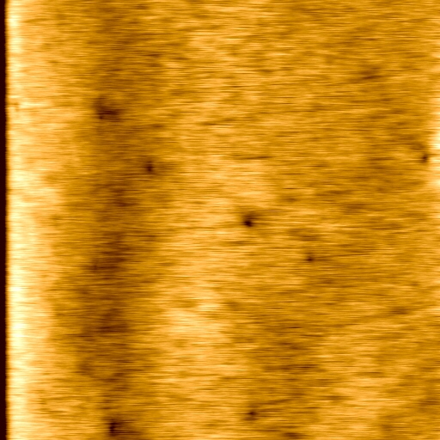
Not Sure Whether “Balloons” Stick
Before Incubation
After Incubation

Slide 8
Conclusions and Future Work
Despite difficulties, I can thermally pattern and incubate the polymer with “balloons.”
I am not sure whether the “balloons” stick yet, and this would be the subject of later work.
Further steps would be to develop a better process that would consistently preserve the polymer during incubation. Also, there needs to be testing of our strategy with particular “scissors.”

Slide 9
Acknowledgments
Dr. Szoszkiewicz
Nicoleta Ploscariu
Dr. Weaver and Dr. Corwin

