Slide 1
Calibrating for Light backscatter from fractal aggregates

Slide 2
Why?
[1]

Slide 3
The source
Spherical Liquid Water Droplet Aerosol (m=1.33)

Slide 4
Backscatter Setup
CCD Detector
Laser (λ= 633nm)
Aerosol Target
Beam splitter
Beam Dump

Slide 5
Results
Intensity (arbitrary units)
Angle (˚)

Slide 6
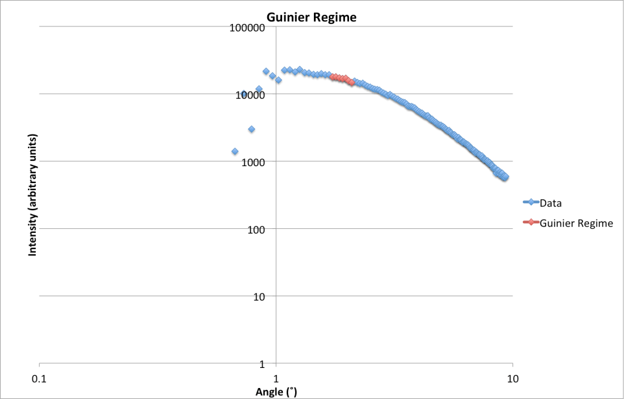
Sizing: forward scattering
Mie ripples, but polydispersity wipes them out
Guinier regime: θ~λ/(πd)
CCD Detector
Laser (λ= 633nm)
Mirror
Aerosol Target
Lens
Polarizers
Iris

Slide 7
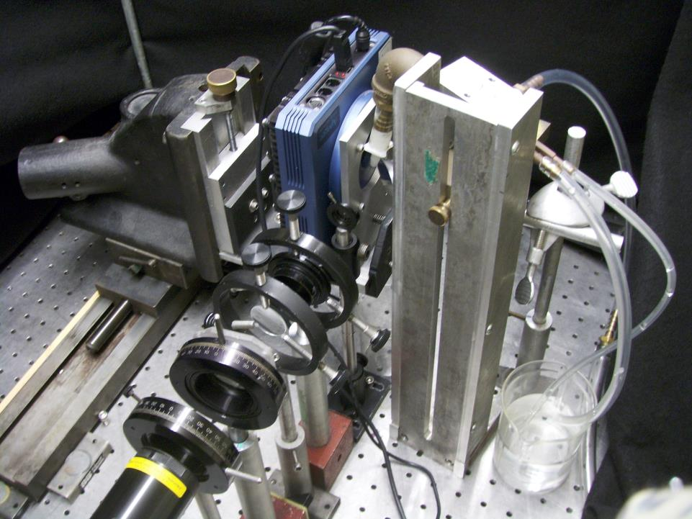

Slide 8
Results

Slide 9
Final Results
Backscatter suggests smaller size: ~1.5µm
Forward scattering suggests bigger size: ~6µm
DLS suggests mid-range size: ~2.5-4µm
Very likely polydisperse.
Backscatter apparatus likely works, but needs more testing.

Slide 10
Reference
[1]"Contribution of Working Group I to the Fourth Assessment Report of the Intergovernmental Panel on Climate Change, 2007." IPCC - Intergovernmental Panel on Climate Change. Ed. S. Soloman, D. Qin, M.Manning, and Z. Chen. Internation Panel on Climate Change. Web. 09 Nov. 2011.

