Slide 1
Fast beams of neutral molecules – the next generation of laser induced molecular dissociation imaging
Drew Rotunno
Mentor: Dr. Itzik Ben-Itzhak,
Bethany Joachim

Slide 2
Motivations
AMO – Atomic and Molecular Collisions
DETECTOR

Slide 3
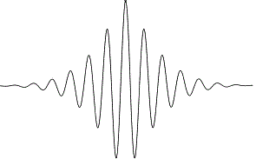
Motivations
AMO – Femtosecond laser pulses
Laser-induced molecular dissociation imaging
DETECTOR

Slide 4
Motivations
Laser + Target Neutrals
Not enough energy to detect
DETECTOR
DETECTOR
E

Slide 5
Motivations
Laser + Fast Neutrals
DETECTOR

Slide 6
Motivations
Q: How do we get fast neutrals?
A: Neutralize fast ions

Slide 7
How do we neutralize?
Remove an electron from a negatively charged ion
Add an electron to a positively charged ion
e

Slide 8
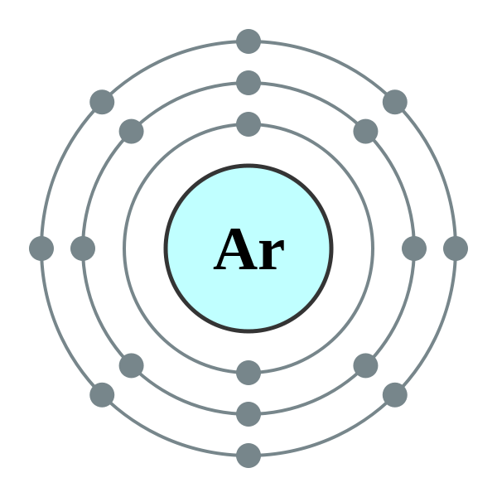
Target Choice
Noble Gasses
Argon (jet, cell)
Ionization energy
~15eV / atom
vs. Alkali ~5eV
Very cheap
and available
and safe

Slide 9
The Theory
H⁺
H₂⁺
Ar
H₂⁺
H₂
(H₂*)

Slide 10
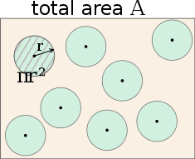
Cross sections
Collision probability, reinterpreted as area
Depends on species, both target and projectile
Depends on Beam energy

Slide 11
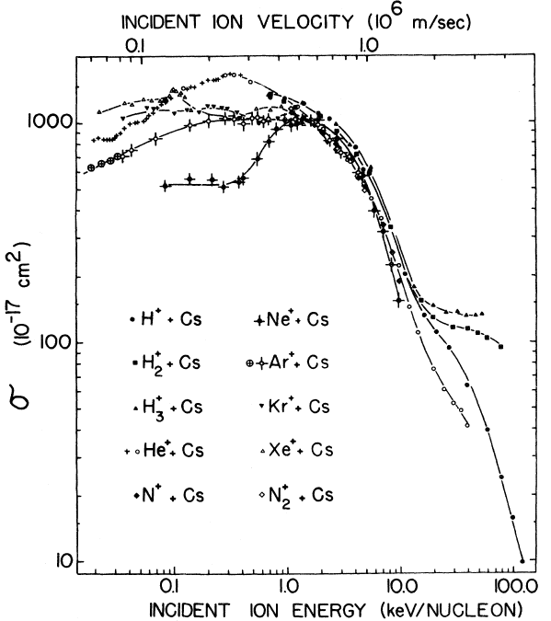
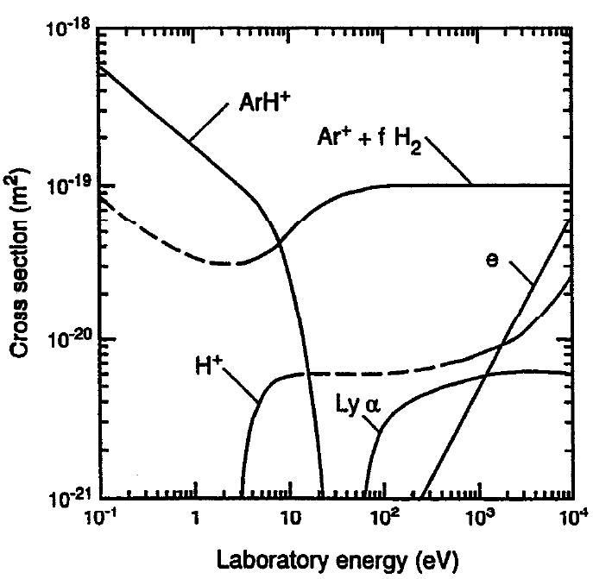
Measurements of Cross sections
H2⁺ + Ar, separated by product
Charge transfer from Cs, by projectile
A.V. Phelps (1992)
F.W. Meyer et al. (1977)

Slide 12
Conversion rates
Yield
(H2)
$$\frac{Y}{N_{P}}= n_{T}∙l_{T}∙σ$$
Number of incoming particles
(H2⁺)
Cross Section
Target particles per unit volume
Length

Slide 13
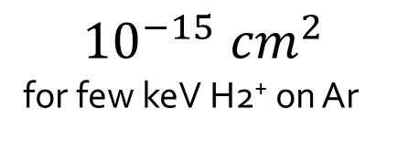
Conversion rates
$$\frac{Y}{N_{P}}= n_{T}∙l_{T}∙σ$$
Want 10%
$${10}^{−15} {cm}^{2}$$
for few keV H2⁺ on Ar
~ 3 cm
?
Solving for target density shows we need about $3×{10}^{13} \frac{atoms}{{cm}^{3}}$
At STP, this means we need 1 mTorr = .001 mmHg of pressure

Slide 14
The Theory
H⁺
H₂⁺
Ar
H₂⁺
H₂
(H₂*)

Slide 15
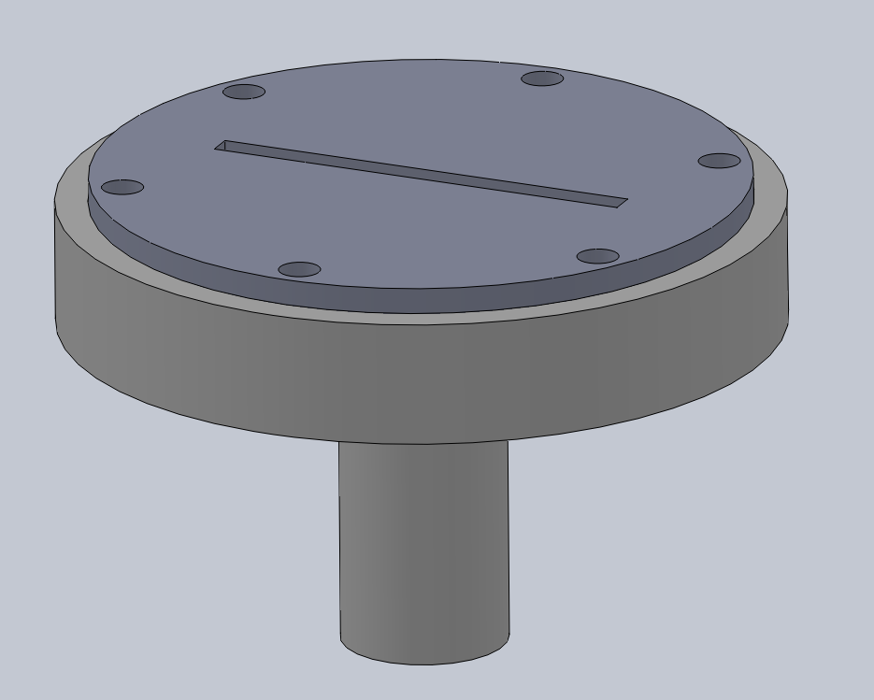
The Piece
diameter ~ 2 inches

Slide 16
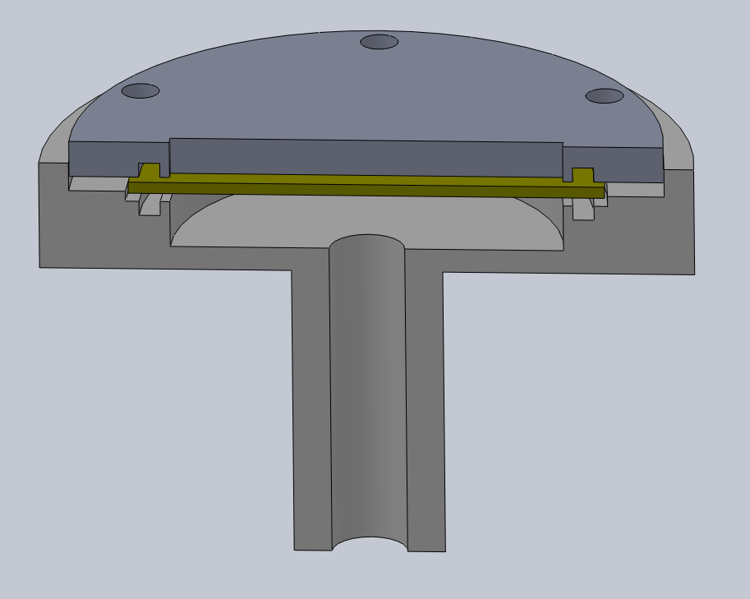
The Cut-away
MicroChannel Plate
Argon gas in

Slide 17
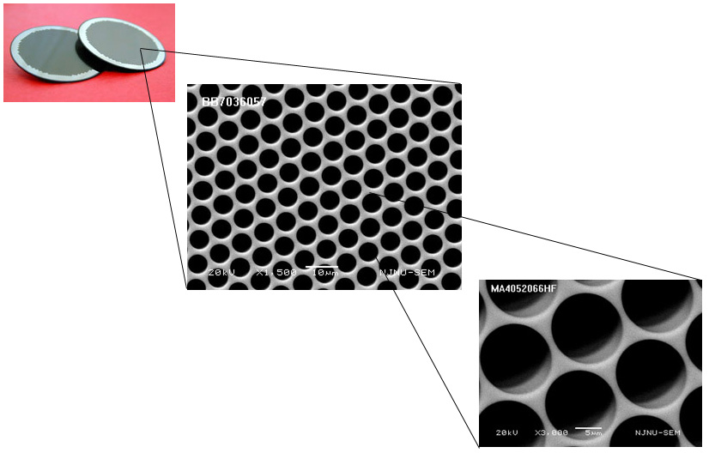
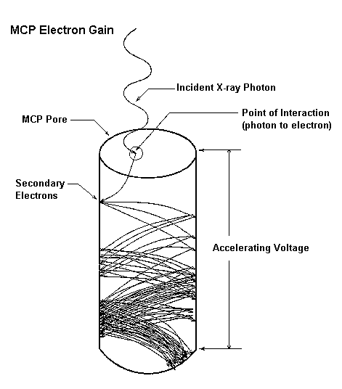
The Microchannel Plate

Slide 18
The Cut-away
“Gas Mask”
MicroChannel Plate
Argon gas in

Slide 19
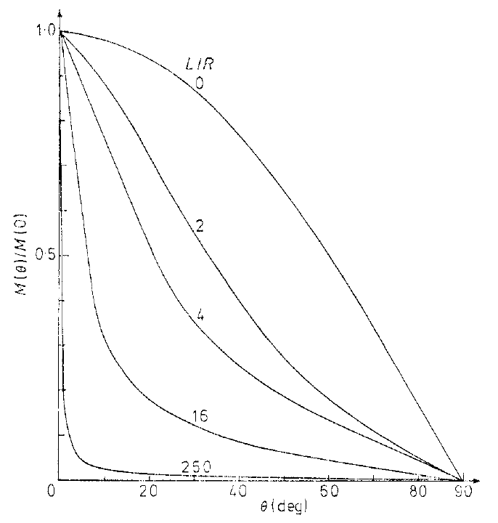
Fluid Flow Through Tubes
Higher length/radius ratio leads to more directed flow
Preserves vacuum
Ours: L/R ~ 80
W. Steckelmacher et al. (1978)

Slide 20
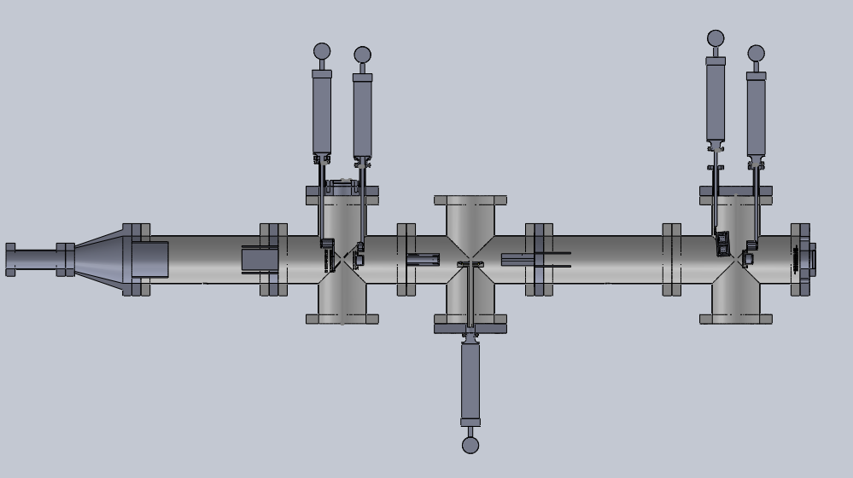
Test Beamline

Slide 21
Next Step - Testing
Measuring conversion factor
How much H2 do we get? ( H fragments too)
Maximize
Fast feedback to optimize pressure
Too high – double collisions, more H fragments
States of molecules
Populations of ground vs. excited states
Hard to determine, but interesting to study

Slide 22
End
Thanks KSU,
Dr. Itzik Ben-Itzhak, IBI Group,
National Science Foundation

