Slide 1
The Stabilities of Protein Crystals
Jeremy D. Schmit
(working with Yen Bui)
© Prof Jeremy D. Schmit, 2011-2012

Slide 2
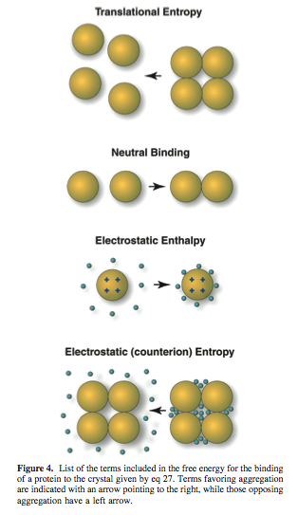
Essentially
Model of protein crystallization equilibra
  Protein translation entropy opposes crystallization
  Proteins are attracted to each other by a nonelectrostatic contact free energy favoring crystallization
  Proteins in crystal repel each other but, to a great extent, the counterions opposeses their sequestration into the crystal – opposing crystallization.
  The translational entropy of the counterions opposes their sequestration into the crystal – opposing crystallization
© Prof Jeremy D. Schmit, 2011-2012

Slide 3
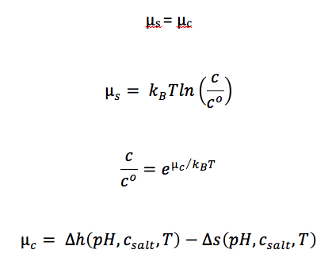
Essentially:
© Prof Jeremy D. Schmit, 2011-2012

Slide 4
Data Extraction
Essentially my tasks have been so far:
  Finding References
  Extracting Data
  Compiling Data
© Prof Jeremy D. Schmit, 2011-2012

Slide 5
References
Guilloteau, J., M. Ries-kautt, and A. Ducruix, 1992. Variation of lysozyme solubility as a function of temperature in the presence of organic and inorganic salts. Journal of Crystal Growth. 122:223-230.
Demattei, R., And R. Feigelson, 1991. The solubility dependence of cavanalin on pH and temperature. Journal of Crystal Growth. 110:34-40.
Cacioppo, E. 1991. The solubility of the tetragonal form of hen egg white lysozyme from pH 4.0 to 5.4 Journal of Crystal Growth. 114: 286-292.
Mikol, V., and R. Giege. 1989. PHASE DIAGRAM OF A CRYSTALLINE PROTEIN: DETERMINATION OF THE SOLUBILITY OF CONCANAVALIN A BY A MICROQUANTITIATION ASSAY. Journal of Crystal Growth. 97: 324-332.
Boistelle, R., J.P. Astier, G. Marchis-Mouren, V. Desseaux, and R. Haser. 1992. Solubility, phase transition, kinetic ripening and growth rates of porcine pancreatic [alpha-amylase isoenzymes. Journal of Crystal Growth. 123: 109-120.
Veesler, S., S. Lafont, S. Marcq, J.P. Astier, and R. Boistelle. 1996. Prenucleation, crystal growth and polymorphism of some proteins. Journal of Crystsal Growth. 168: 124-129.
Lafont, S., S. Veesler, J.P. Astier, and R. Boistelle. 1994. Solubility and prenucleation of aprotinin (BPTI) molecules in sodium chloride solutions. Journal of Crystal Growth. 143: 249-255.
Budayova, M. J.-p. Astier, S. Veesler, A. Belaich, and R. Boistelle. 1999. Characterization and crystallization of the Endoglucanase A from Clostridium Cellulolyticum in solution. Journal of Crystal Growth. 196: 297-304.
© Prof Jeremy D. Schmit, 2011-2012

Slide 6
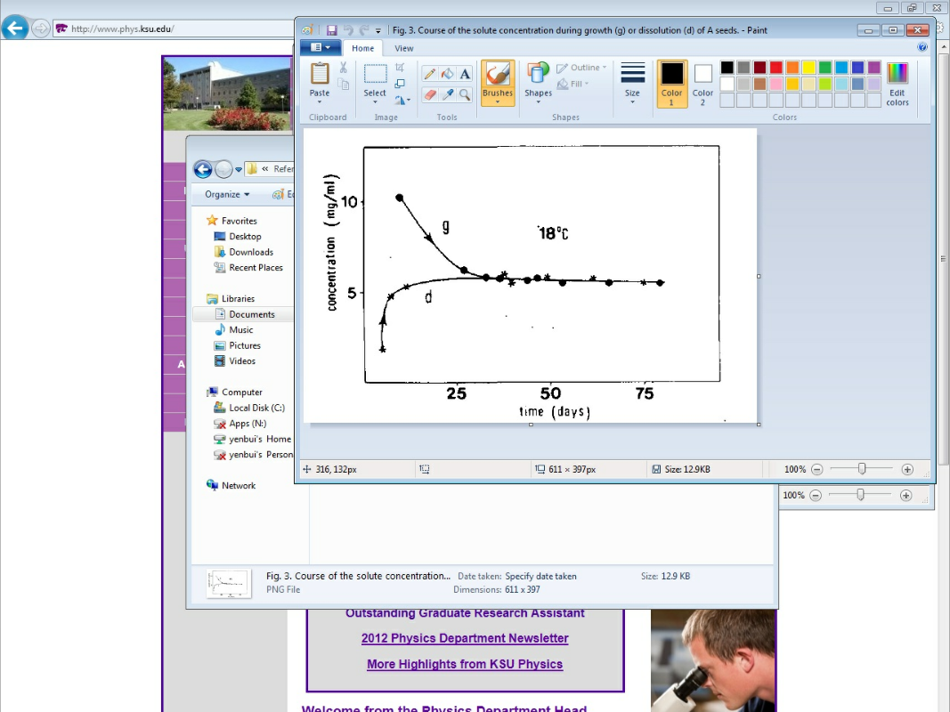
Data Extraction
© Prof Jeremy D. Schmit, 2011-2012

Slide 7
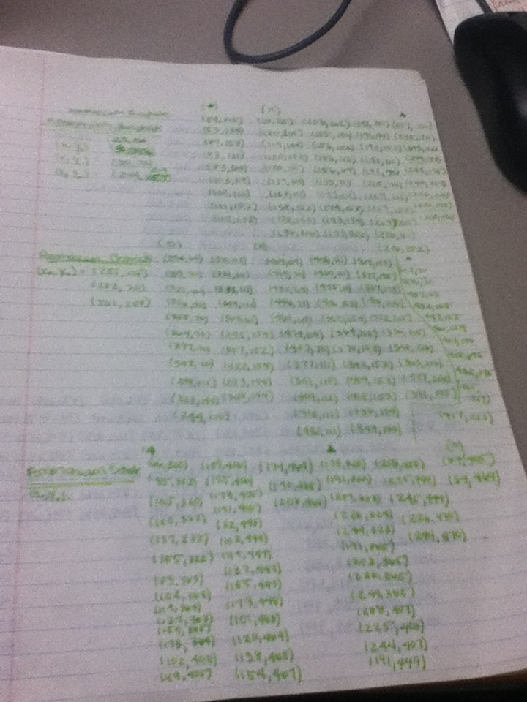
Note-Taking
Pixel Coordinates
Excel
© Prof Jeremy D. Schmit, 2011-2012

Slide 8
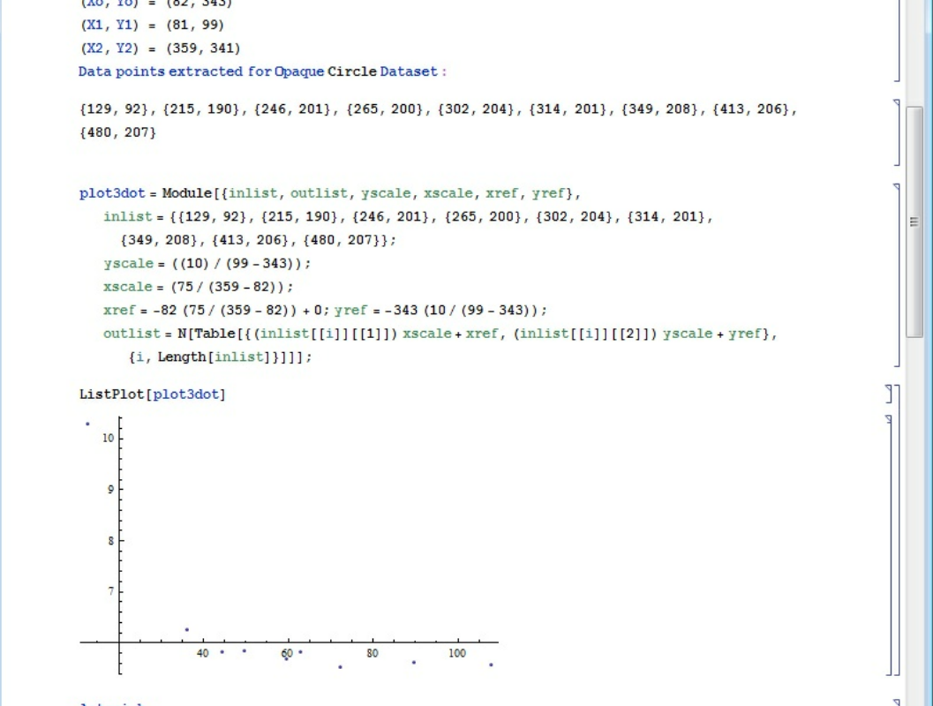
Mathematica
© Prof Jeremy D. Schmit, 2011-2012

Slide 9
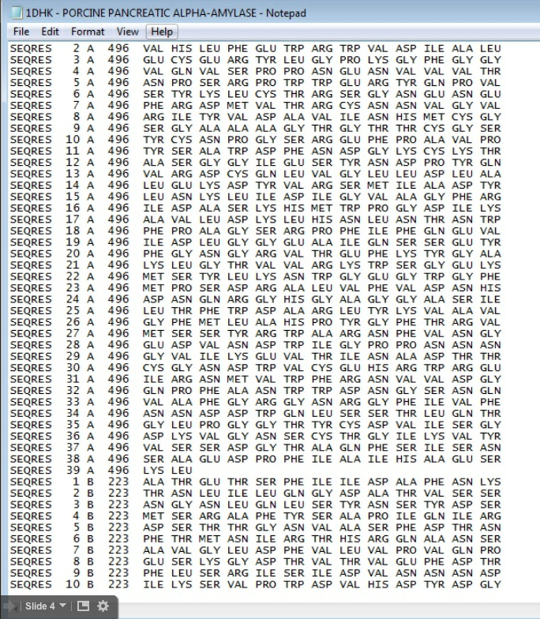
Calculating Protein Charges
Tallying Up Amino Residues
Chymera
© Prof Jeremy D. Schmit, 2011-2012

Slide 10
Future Plans
Start using Data → Model
Apply Data to the Poisson-Boltzmann equation
Electrostatic Potential (0)
Dielectric Constant of Water
Fixed Charge Distribution on Surface of Protein
Distance from Center of Protein
Bulk Saltwater Concentration
Vacuum Permeability
© Prof Jeremy D. Schmit, 2011-2012

Slide 11
References
Schmit, Jeremy D. and Ken A. Dill. The Stabilities of Portein Crystals. Department of Pharmaceutical Chemistry, University of California at San francisco, Sanfrancisco, California 94158
© Prof Jeremy D. Schmit, 2011-2012

