Slide 1
The Stabilities of Protein Crystals
Jeremy D. Schmit
(working with Yen Bui)
© Prof Jeremy D. Schmit, 2011-2012

Slide 2
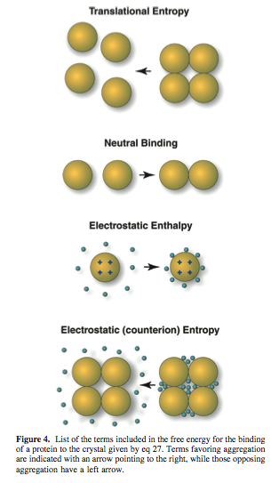
Essentially
Model of protein crystallization equilibra
  Protein translation entropy opposes crystallization
  Proteins are attracted to each other by a nonelectrostatic contact free energy favoring crystallization
  Proteins in crystal repel each other but, to a great extent, the counterions opposeses their sequestration into the crystal – opposing crystallization.
  The translational entropy of the counterions opposes their sequestration into the crystal – opposing crystallization
© Prof Jeremy D. Schmit, 2011-2012

Slide 3
Protein
1DHK – Porcine Pancreatic Alpha-Amylase
  Boistelle, R., J.P. Astier, G. Marchis-Mouren, V. Desseaux, and R. Haser. 1992. Solubility, phase transition, kinetic ripening and growth rates of porcine pancreatic [alpha-amylase isoenzymes. Journal of Crystal Growth. 123: 109-120.
1DPX – Hen Egg White Lysozyme
  Broide, M.L., T. Tominc, and M. Saxowsky. 1996. Using Phase transition to investigate the effects of salts on protein interactions. Physical Review. E. 53: 6325-6335
1EDG – CELCCA
  Budayova, M. J.-p. Astier, S. Veesler, A. Belaich, and R. Boistelle. 1999. Characterization and crystallization of the Endoglucanase A from Clostridium Cellulolyticum in solution. Journal of Crystal Growth. 196: 297-304.
1G6X – Bovine Pancreatic Trypsin Inhibitor
  Lafont, S., S. Veesler, J.P. Astier, and R. Boistelle. 1994. Solubility and prenucleation of aprotinin (BPTI) molecules in sodium chloride solutions. Journal of Crystal Growth. 143: 249-255.
1JBC – Concavalin A
  Mikol, V., and R. Giege. 1989. PHASE DIAGRAM OF A CRYSTALLINE PROTEIN: DETERMINATION OF THE SOLUBILITY OF CONCANAVALIN A BY A MICROQUANTITIATION ASSAY. Journal of Crystal Growth. 97: 324-332.
1DGW – Canavalin from Jack Bean
  Demattei, R., And R. Feigelson, 1991. The solubility dependence of cavanalin on pH and temperature. Journal of Crystal Growth. 110:34-40.
© Prof Jeremy D. Schmit, 2011-2012

Slide 4
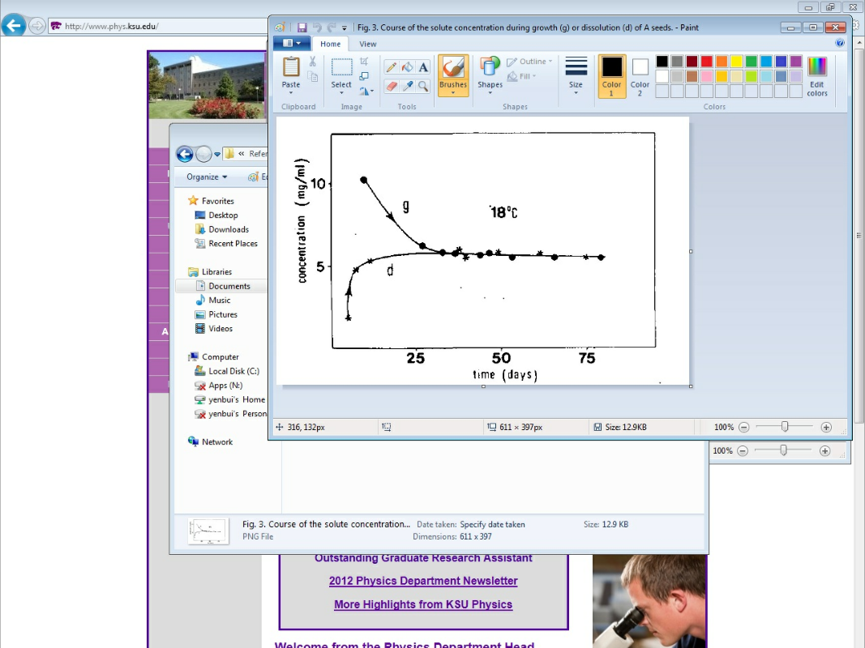
Data Extraction
Salt Concentration
pH = charge
Temperature
© Prof Jeremy D. Schmit, 2011-2012

Slide 5
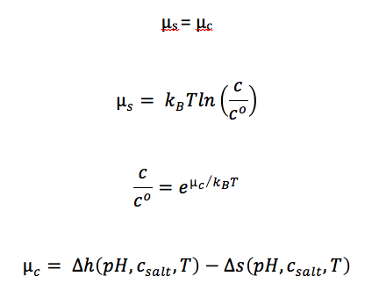
Essentially:
© Prof Jeremy D. Schmit, 2011-2012

Slide 6
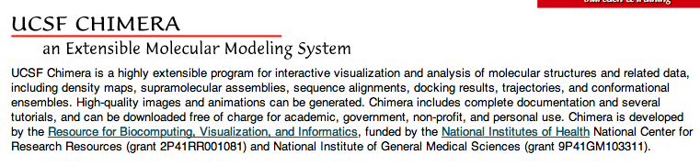
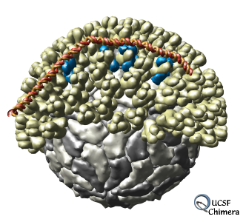
Chimera
© Prof Jeremy D. Schmit, 2011-2012

Slide 7
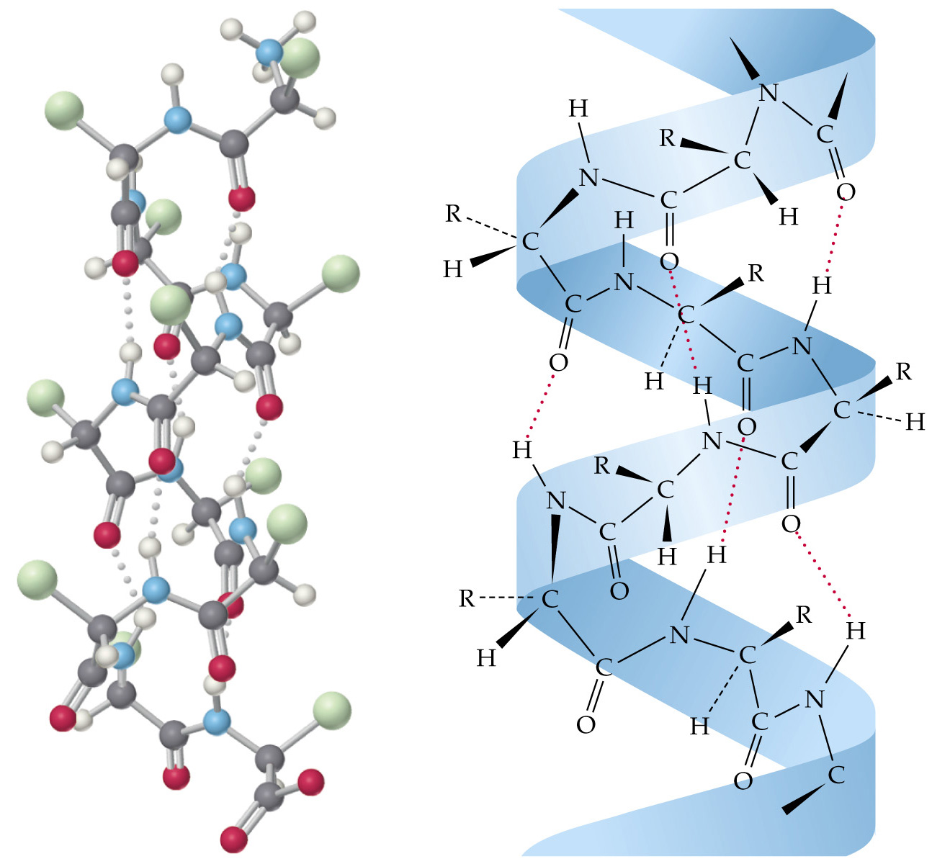
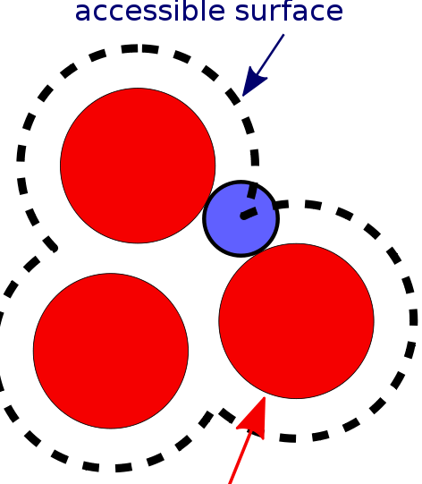
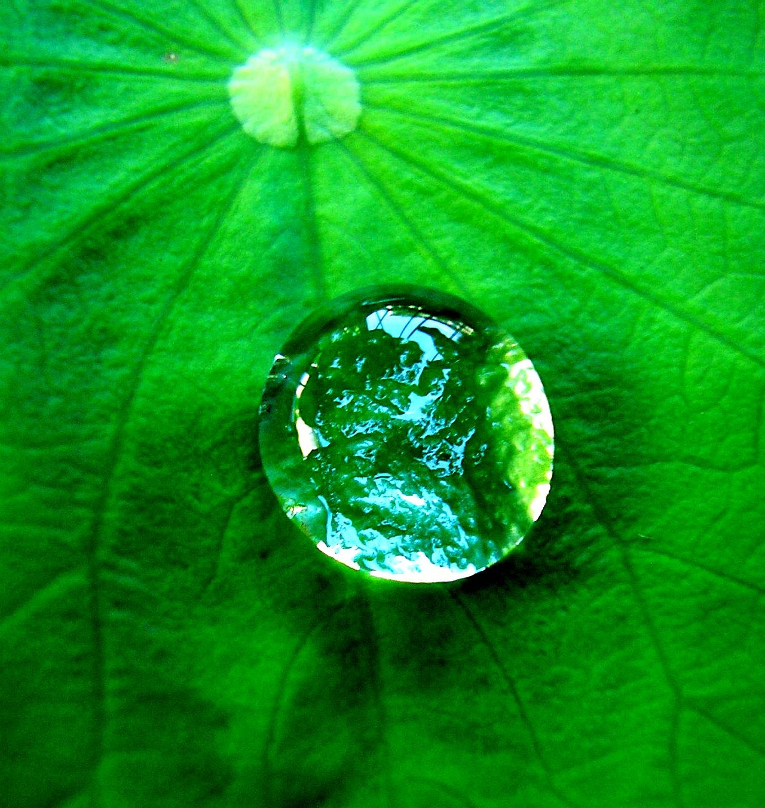
Finding Non-Electrostatics
The Hydrophobic Effect
  Buried Surface Area
Hydrogen Bonding

Slide 8
Calculating NonElectrostatics
The Hydrophobic Effect
Hydrogen Bonding

Slide 9



Electrostatic Interactions
© Prof Jeremy D. Schmit, 2011-2012

Slide 10
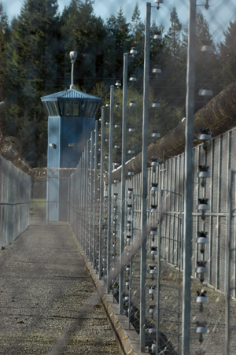

Electrostatics
KDebyeT
  Charge Screening Distance
FieldE2
  Field E = calculates the energy stored in the
  electric field (Enthalpy)
Spart2
  Entropic cost of packing ions into the shells (Entropy)
© Prof Jeremy D. Schmit, 2011-2012

Slide 11

Recreating Table
New Protein
Enthalpy | Entropy | H-TS
Compile Data & Computations
© Prof Jeremy D. Schmit, 2011-2012

Slide 12
Results

Slide 13
What Have We Learned:
Main Goal:
  To Account For the Binding Stability
Left-Overs:
  Significantly Overestimating the Crystal Stability
Reasons:
  Overestimating Strength of the H-Bonds
  Unaccounted Large Repulsive Effects
    Side Chain Rotations
  Variations in Contact Points
    Big vs. Small
  Presence of Salt

Slide 14
Giving Thanks:
Dr. Schmit
Dr. Corwin & Dr. Weaver
Kansas State University

Slide 15
References
Schmit, Jeremy D. and Ken A. Dill. The Stabilities of Portein Crystals. Department of Pharmaceutical Chemistry, University of California at San francisco, Sanfrancisco, California 94158
© Prof Jeremy D. Schmit, 2011-2012

