Slide 1
The Stabilities of Protein Crystals
Jeremy D. Schmit
(working with Yen Bui)
© Prof Jeremy D. Schmit, 2011-2012

Slide 2
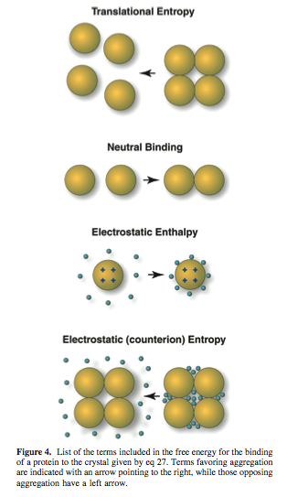
Essentially
Model of protein crystallization equilibra
  Protein translation entropy opposes crystallization
  Proteins are attracted to each other by a nonelectrostatic contact free energy favoring crystallization
  Proteins in crystal repel each other but, to a great extent, the counterions opposes their sequestration into the crystal – opposing crystallization.
  The translational entropy of the counterions opposes their sequestration into the crystal – opposing crystallization
© Prof Jeremy D. Schmit, 2011-2012

Slide 3
Protein
1DHK – Porcine Pancreatic Alpha-Amylase
1DPX – Hen Egg White Lysozyme
1EDG – CELCCA
1G6X – Bovine Pancreatic Trypsin Inhibitor
1JBC – Concavalin A
1DGW – Canavalin from Jack Bean
© Prof Jeremy D. Schmit, 2011-2012

Slide 4


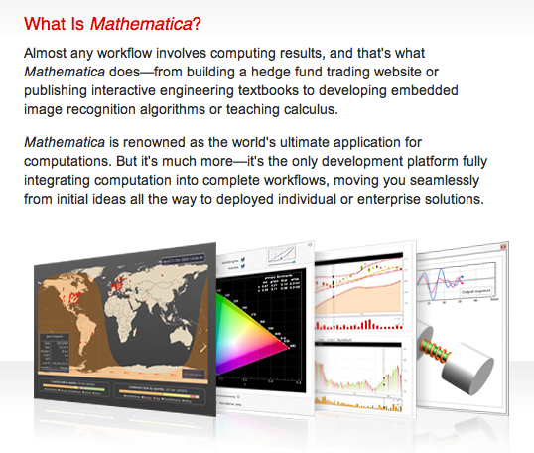
Electrostatic Interactions
© Prof Jeremy D. Schmit, 2011-2012

Slide 5
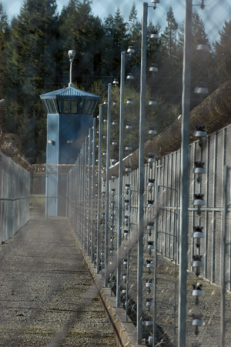

Last Week I Was Calculating:
KDebyeT
  Charge Screening Distance
FieldE2
  Field E = calculates the energy stored in the
  electric field
Spart2
  Entropic cost of packing ions into the shells
© Prof Jeremy D. Schmit, 2011-2012

Slide 6
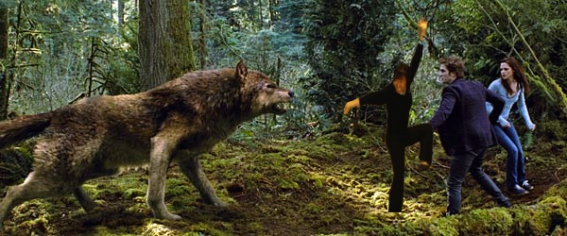
Perseverance
© Prof Jeremy D. Schmit, 2011-2012

Slide 7
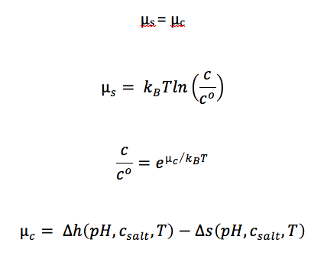
Essentially:
© Prof Jeremy D. Schmit, 2011-2012
Notes:
The amount of buriedSAS is proportional to the amount of hydrophobic effect….which will give us more information on the nonelectrostatic forces that are are contributing to the aggregation of proteins.

Slide 8
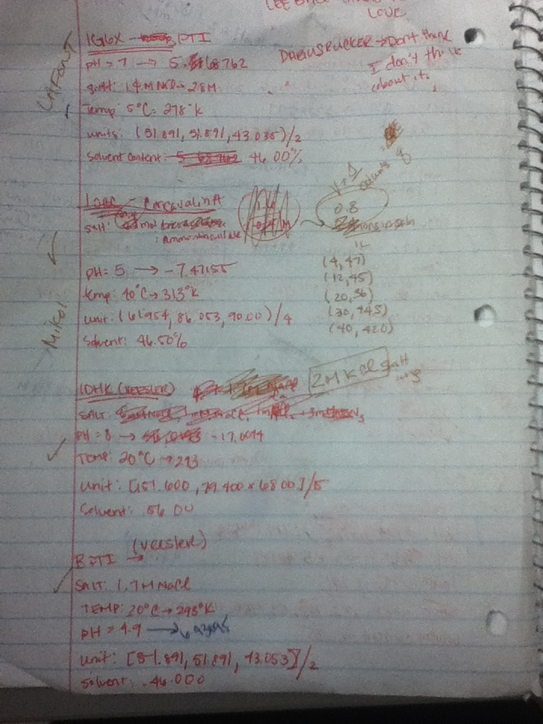
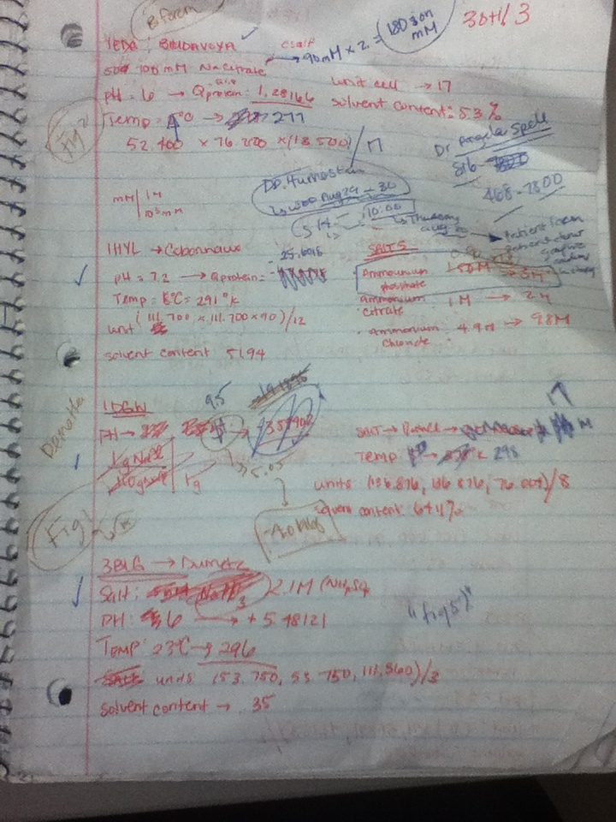
Skills to Learn
© Prof Jeremy D. Schmit, 2011-2012

Slide 9

Goal for the Week
New Protein
Enthalpy | Entropy | H-TS
Compile Data & Computations
© Prof Jeremy D. Schmit, 2011-2012

Slide 10
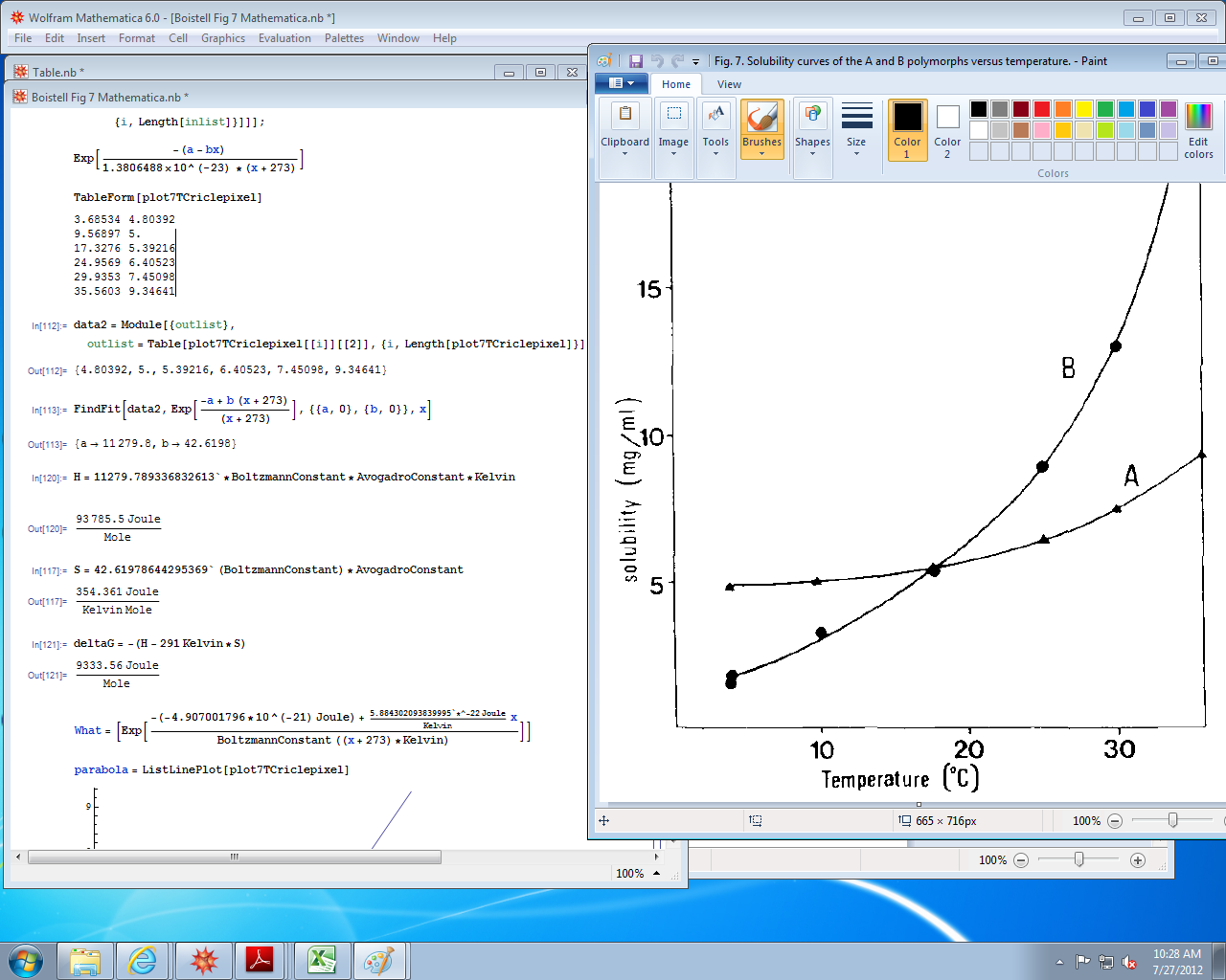
Struggle
© Prof Jeremy D. Schmit, 2011-2012

Slide 11
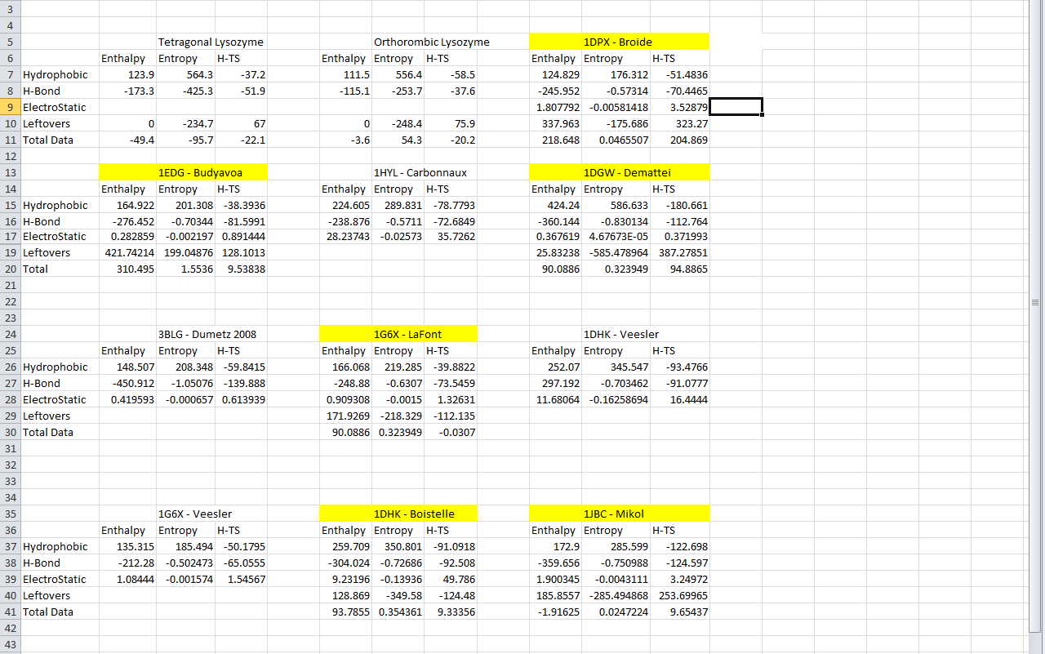

Success?
© Prof Jeremy D. Schmit, 2011-2012

Slide 12
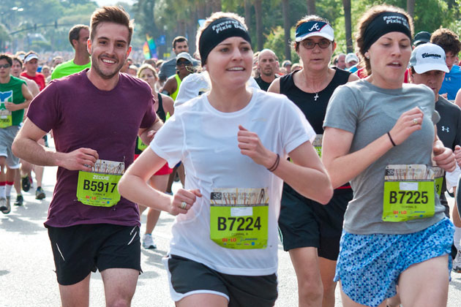

Last Step Of the Trek
Meet with Dr. Schmit
Talk about Results
Wrap Project

Slide 13
References
Schmit, Jeremy D. and Ken A. Dill. The Stabilities of Portein Crystals. Department of Pharmaceutical Chemistry, University of California at San francisco, Sanfrancisco, California 94158
© Prof Jeremy D. Schmit, 2011-2012

