Slide 1
The Stabilities of Protein Crystals
Jeremy D. Schmit
(working with Yen Bui)
© Prof Jeremy D. Schmit, 2011-2012

Slide 2
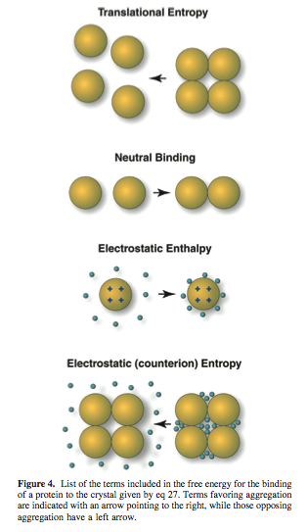
Essentially
Model of protein crystallization equilibra
  Protein translation entropy opposes crystallization
  Proteins are attracted to each other by a nonelectrostatic contact free energy favoring crystallization
  Proteins in crystal repel each other but, to a great extent, the counterions opposeses their sequestration into the crystal – opposing crystallization.
  The translational entropy of the counterions opposes their sequestration into the crystal – opposing crystallization
© Prof Jeremy D. Schmit, 2011-2012

Slide 3
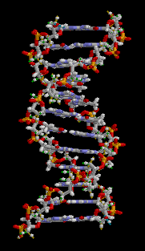
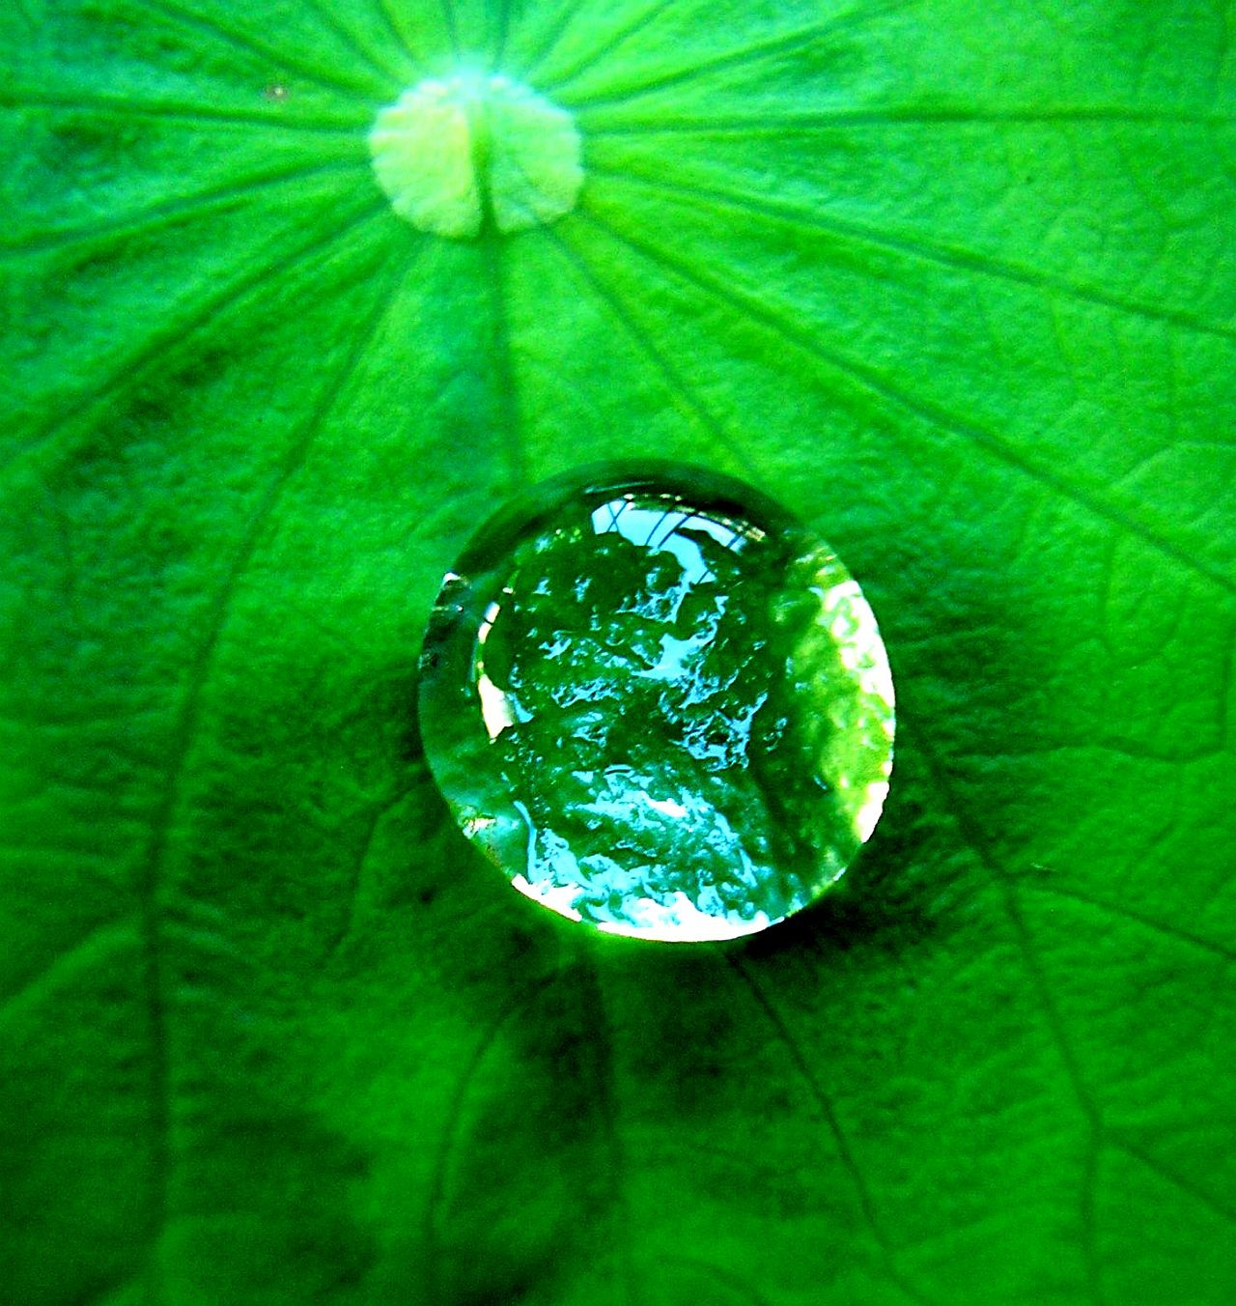
The Hydrophobic Effect
observed tendency of nonpolar substance to aggregate in aqueous solution and exclude water molecules.
“Like dissolves like.”
  Oil & Water
© Prof Jeremy D. Schmit, 2011-2012

Slide 4
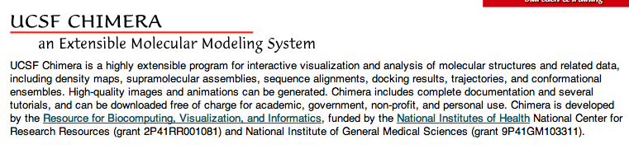
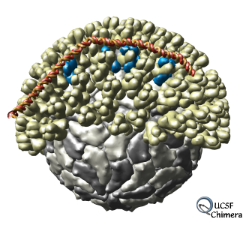
Chimera
© Prof Jeremy D. Schmit, 2011-2012

Slide 5
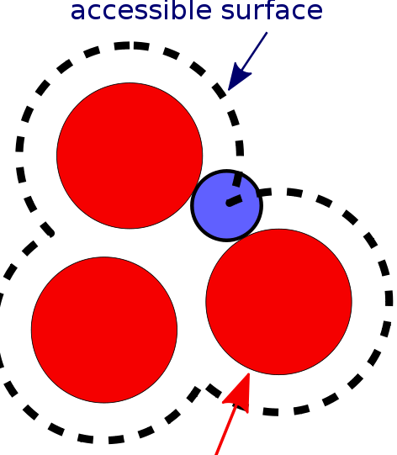
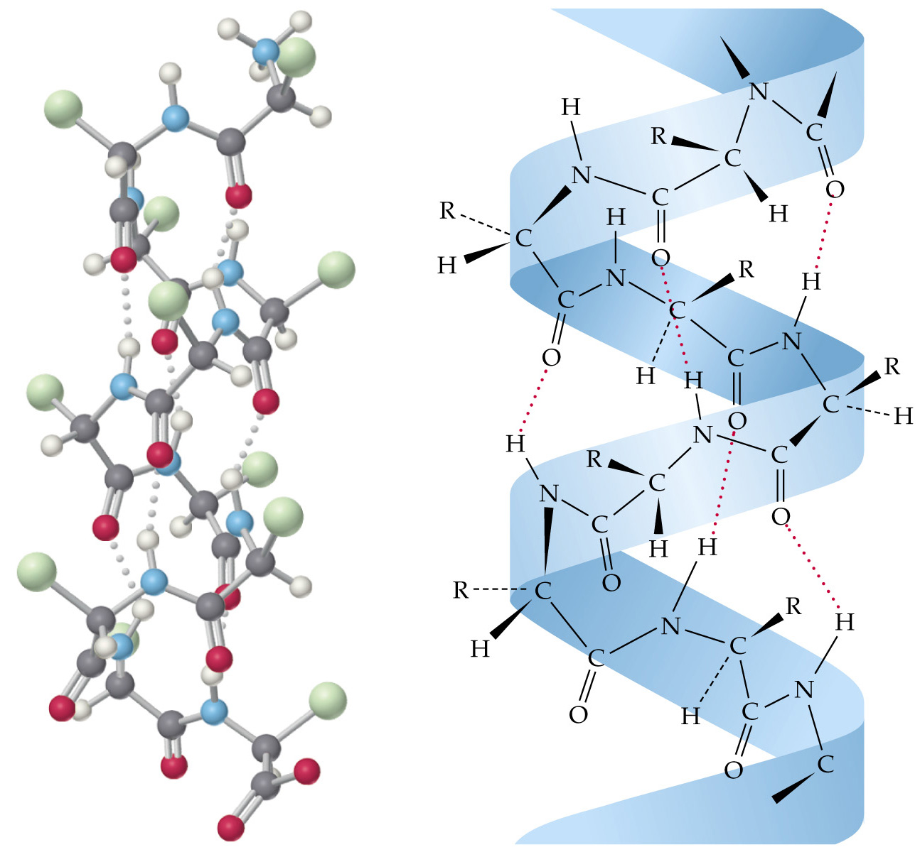
Accessible Buried Area & Hydrogen Bonding
  Function:
  Sum(atom.buriedSAS)
  Find H-Bonds
© Prof Jeremy D. Schmit, 2011-2012

Slide 6
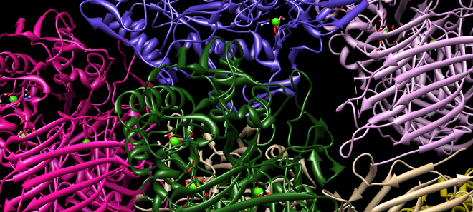
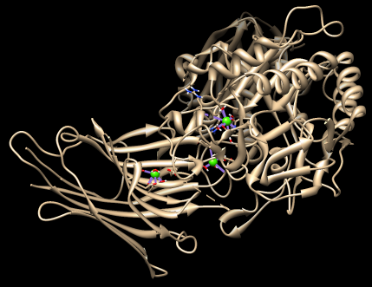
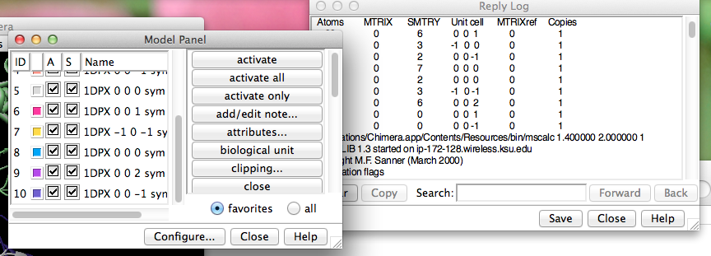
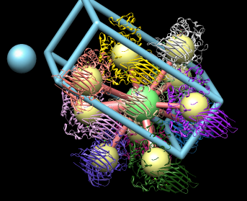
One Protein @ a Time…
© Prof Jeremy D. Schmit, 2011-2012

Slide 7
Protein
1DHK – Porcine Pancreatic Alpha-Amylase
1DPX – Hen Egg White Lysozyme
1EDG – CELCCA
1HYL – Hypderma Lineatum Colleagenase
2CAU – Canavalin from Jack Bean
3BLG – Bovine Beta-Lactoglobulin
1G6X – Bovine Pancreatic Trypsin Inhibitor
1JBC – Concavalin A
© Prof Jeremy D. Schmit, 2011-2012

Slide 8
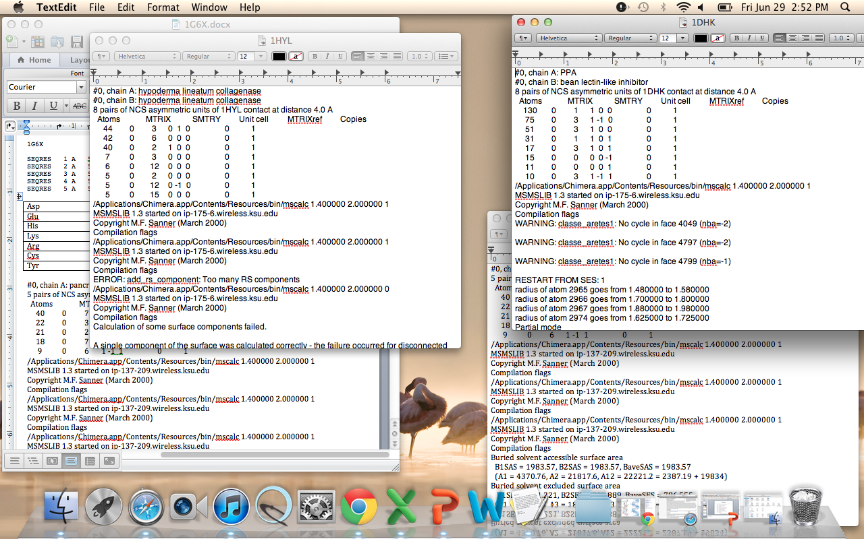

Slide 9
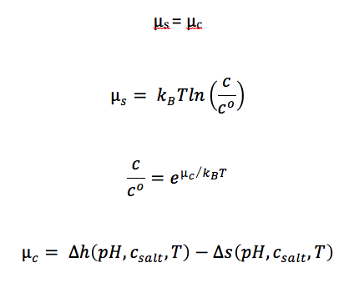
Essentially:
© Prof Jeremy D. Schmit, 2011-2012
Notes:
The amount of buriedSAS is proportional to the amount of hydrophobic effect….which will give us more information on the nonelectrostatic forces that are are contributing to the aggregation of proteins.

Slide 10
Future Plans
Start using Data → Model
Apply Data to the Poisson-Boltzmann equation
Electrostatic Potential (0)
Dielectric Constant of Water
Fixed Charge Distribution on Surface of Protein
Distance from Center of Protein
Bulk Saltwater Concentration
Vacuum Permeability
© Prof Jeremy D. Schmit, 2011-2012

Slide 11
References
Schmit, Jeremy D. and Ken A. Dill. The Stabilities of Portein Crystals. Department of Pharmaceutical Chemistry, University of California at San francisco, Sanfrancisco, California 94158
© Prof Jeremy D. Schmit, 2011-2012

