Slide 1
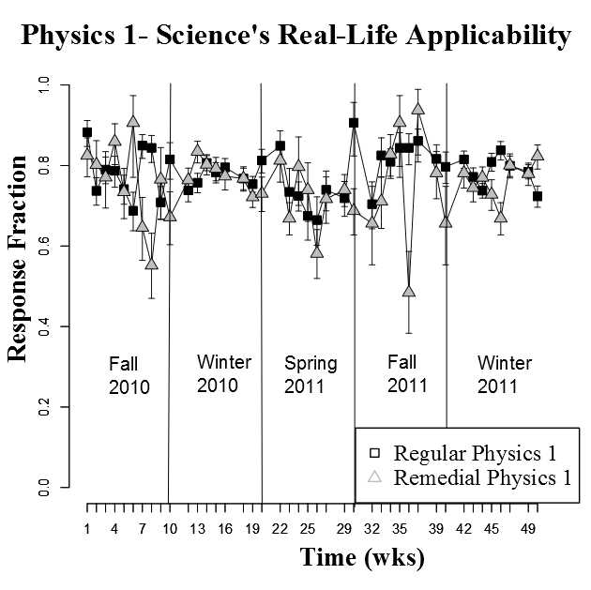
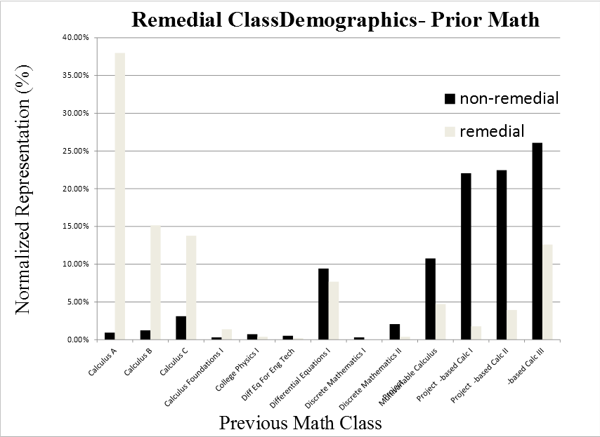
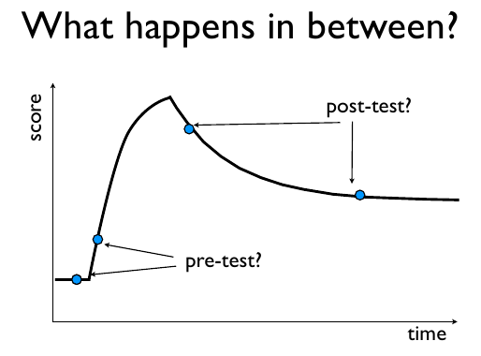
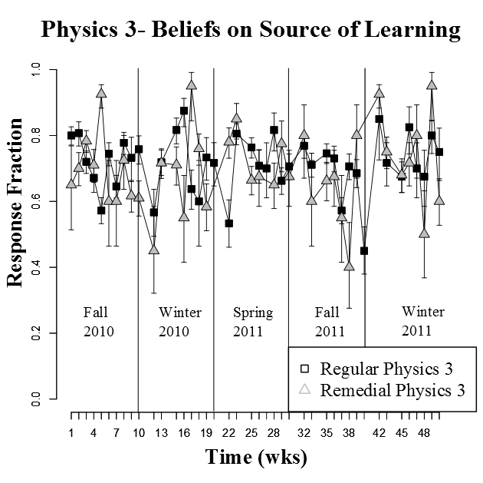
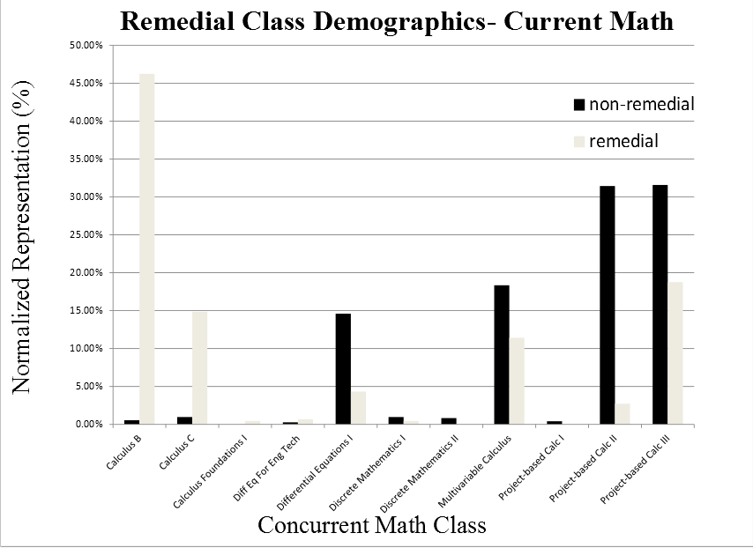
Changes in Students’ Epistemologies
Timothy D. Brown
University of Tulsa
timothy-brown@utulsa.edu
Eleanor C. Sayre
Kansas State University
esayre@ksu.edu
The RAWR System
Questions
Conclusions
Rapid Assessment and Web Response (RAWR) tests students over various physics topics
Online “tasks” allow large data sets, drawn weekly from Rochester Institute of Technlogy (RIT)
RIT introductory sequence is physics 1, 2, and 3, (N=100) with remedial-level classes (N=60)
How do student epistemologies change during introductory physics instruction?
Are changes correlated to demographics groups?
Linear correlation shows very little (|r| < 0.01) correlation between data and negative linear model
Data has no effects with semester-period indicating lack of testing or ]topic effects
Remedial classes’ scores vary extremely with time
Results
EBAPS and CLASS
No general decrease in epistemological sophistication during instruction
Poor negative linear fit to data
Higher volatility observed in remedial-level physics classes
Possible correlation with math instruction
Discussion
Epistemology tasks use Likert-style epistemology surveys, the EBAPS and CLASS
EBAPS
Science’s real-life applicability
Beliefs on the source of learning
CLASS
Problem Solving Ability and Sophistication
Developing sophisticated epistemologies is necessary to deep understanding of physics
Physics instruction does not necessarily harm epistemological development
Instruction in expert-held physics epistemologies could increase effectiveness of classroom education
By task axis
Demographics
Response Curve Methodology
Implications for instruction
Between-student sampling: Every student is assigned a different task every week
Avoids test-retest effects
Course factors (topic instruction, testing) most likely to influence task scores
Resulting response curve gives more information on within-semester trends than pre/post testing
Results suggest possible need for instruction reform
Physics: Explicit instruction in expert epistemologies
Math: Reform to studio-based instruction
References
E. F. Redish, J. M. Saul, and R. N. Steinberg, American Journal of Physics 66, 212-224 (1998).
K. Perkins, W. Adams, S. Pollock, N. Finkelstein, and C. Wiemann, Physics Education Research Conference Proceedings 790, 61–64 (2004).
E. C. Sayre, S. V. Franklin, S. Dymek, J. Clark, and Y. Sun, Phys. Rev. ST Phys. Educ. Res. 8 (2012).
A. Elby, Epistemological Beliefs Assessment for Physical Science, URL http://www2.physics.umd.edu/~elby/EBAPS/home.htm
.E. C. Sayre. “Using Extant Data to Predict Future Data.” AAPT. Jacksonville, FL. 10 Jan 2011.
This program is funded by the National Science Foundation through grant number PHY-1157004
RAWR also collects demographics information
Gender, math exp., major, etc.
Allows investigation of demographics factors

