Slide 1
Software Improvement for Liquid Argon Neutrino Oscillation Physics
Andres Medina, Bard College, NY
Deana Del Vecchio, Saint Anselm College, NH
Mario Johnson, Southern University, LA
Dr. Tim Bolton, Dr. Glen Horton-Smith, Dr. David McKee

Slide 2
LArTPC
Liquid Argon Time Projection Chamber
Reasons for using Argon
Purpose of LArTPC experiments

Slide 3
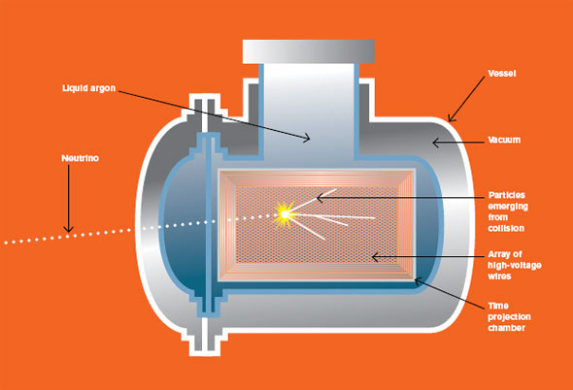
ArgoNeuT
How does it work?

Slide 4
Neutrino Beam Physics
What are neutrinos?
Why neutrinos?
Neutrino oscillations
What is neutrino mixing?

Slide 5
Challenges in Programming
Learning to use C++
Programming within a framework (LArSoft)
Programming for detector independence

Slide 6
Calculating Resolutions
By Deana Del Vecchio

Slide 7
Goals:
Calibrating the uncertainty of the timing differences between wires
Calculating the angular resolution between track like objects

Slide 8
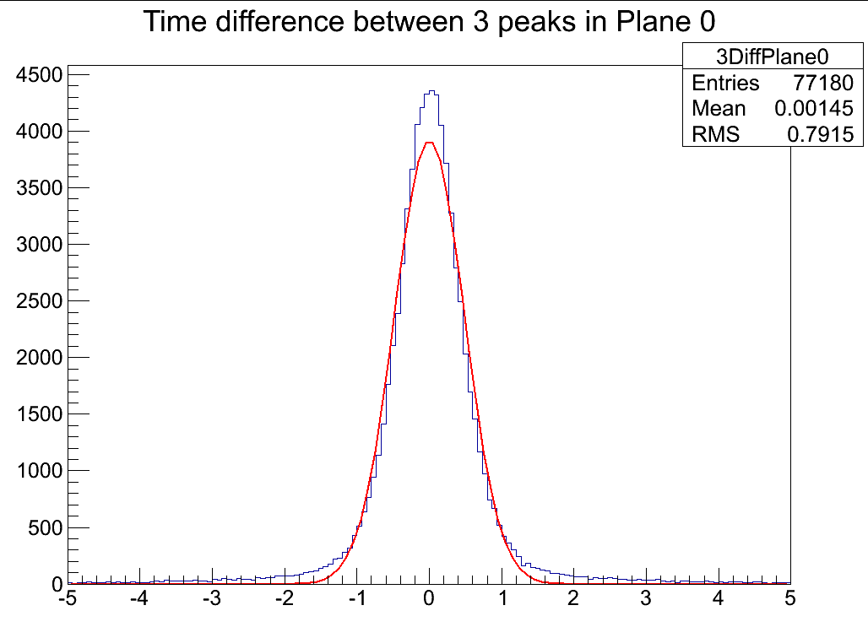
Uncertainty on Wires
Spread in the angles
Timing difference between
hits on three consecutive wires

Slide 9
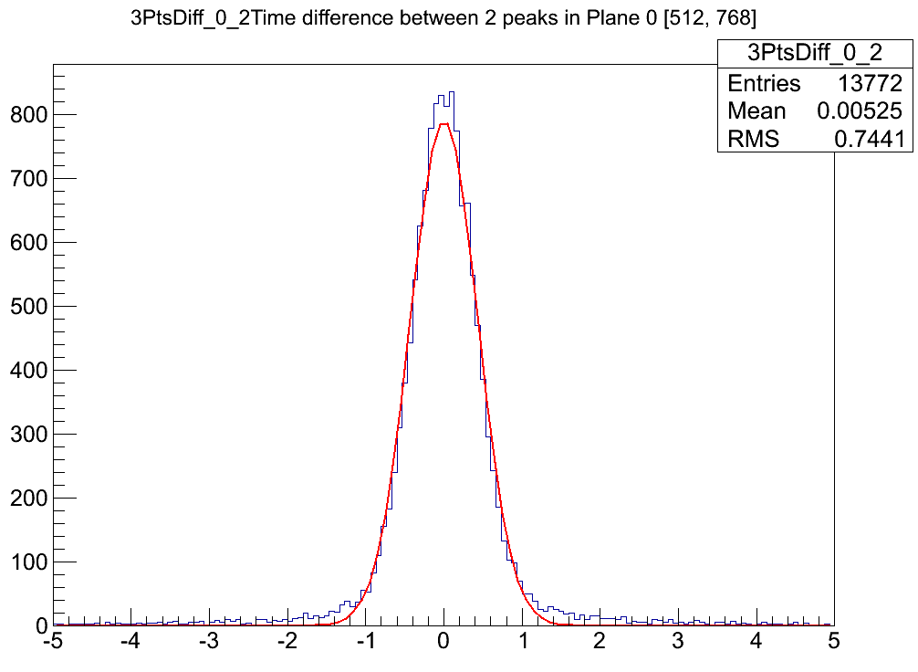
Timing spread (1,3,5,7)

Slide 10
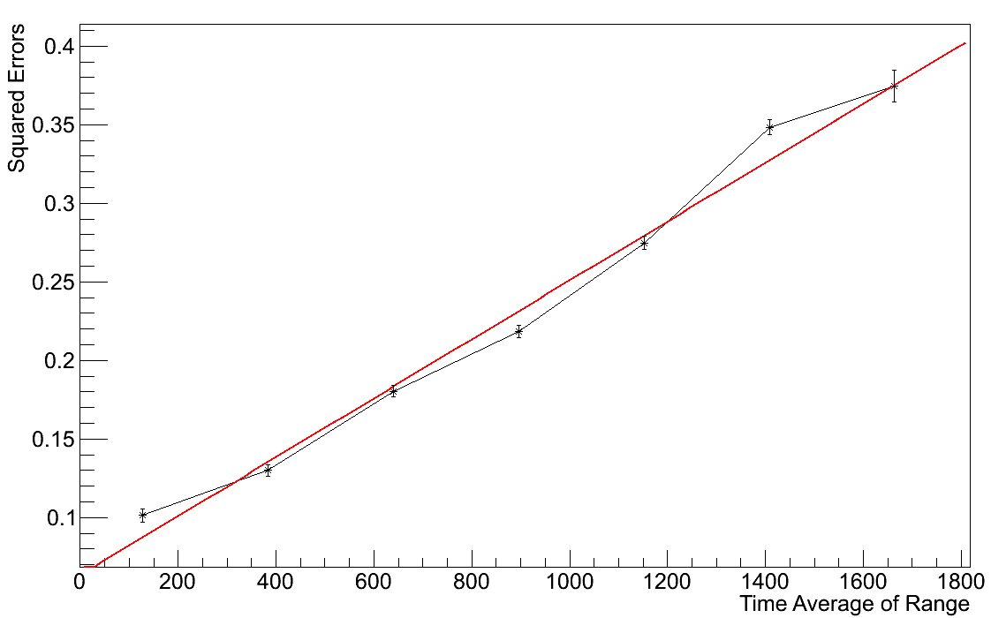
The Uncertainty
Graphs of the Error VS The Timing
Error
Squared Error

Slide 11
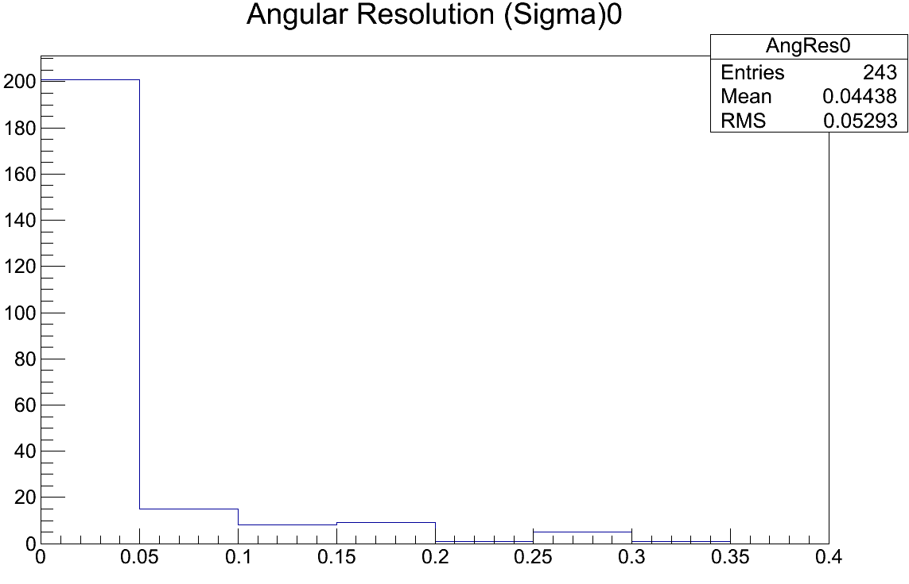
Differentiating between tracks
Can differentiate two track-like objects within .032 radians ( ~1.8°) and within 1 wire

Slide 12
Testing the Feasibility of Neutron Source for LArTPC in MicroBooNE Experiment and Birk’s Constant Calibration

Slide 13
Big Picture
Working in Liquid Argon Time Projection Chamber (LArTPC)
All data simulated and analyzed in LArSoft program
Testing the charge deposition of protons to measure Birk’s Constant

Slide 14
During The Summer
Programming in LArSoft
Simulated experiments
Tested saturation limits

Slide 15
Reasons for Research
Studying the relationship between neutron energy, proton energy and measured charge in the detector
No naturally occurring proton sources
Need different $\frac{dE}{dx}$ values (i.e. lower value for Muons and higher values for Protons)

Slide 16
Birk’s Constant Calculation
$∆Q_{0}=C ∙\left(\frac{dE}{dx}\right) ∙ ∆x$
Ideal Situation:
$∆Q_{D}=k ∙ ∆Q_{0}$
Actual Situation:
$∆Q_{D}≈k\frac{∆Q_{0}}{1+K_{B}∙ ∆Q_{0}}$
K_{B} = Birk’s Constant

Slide 17
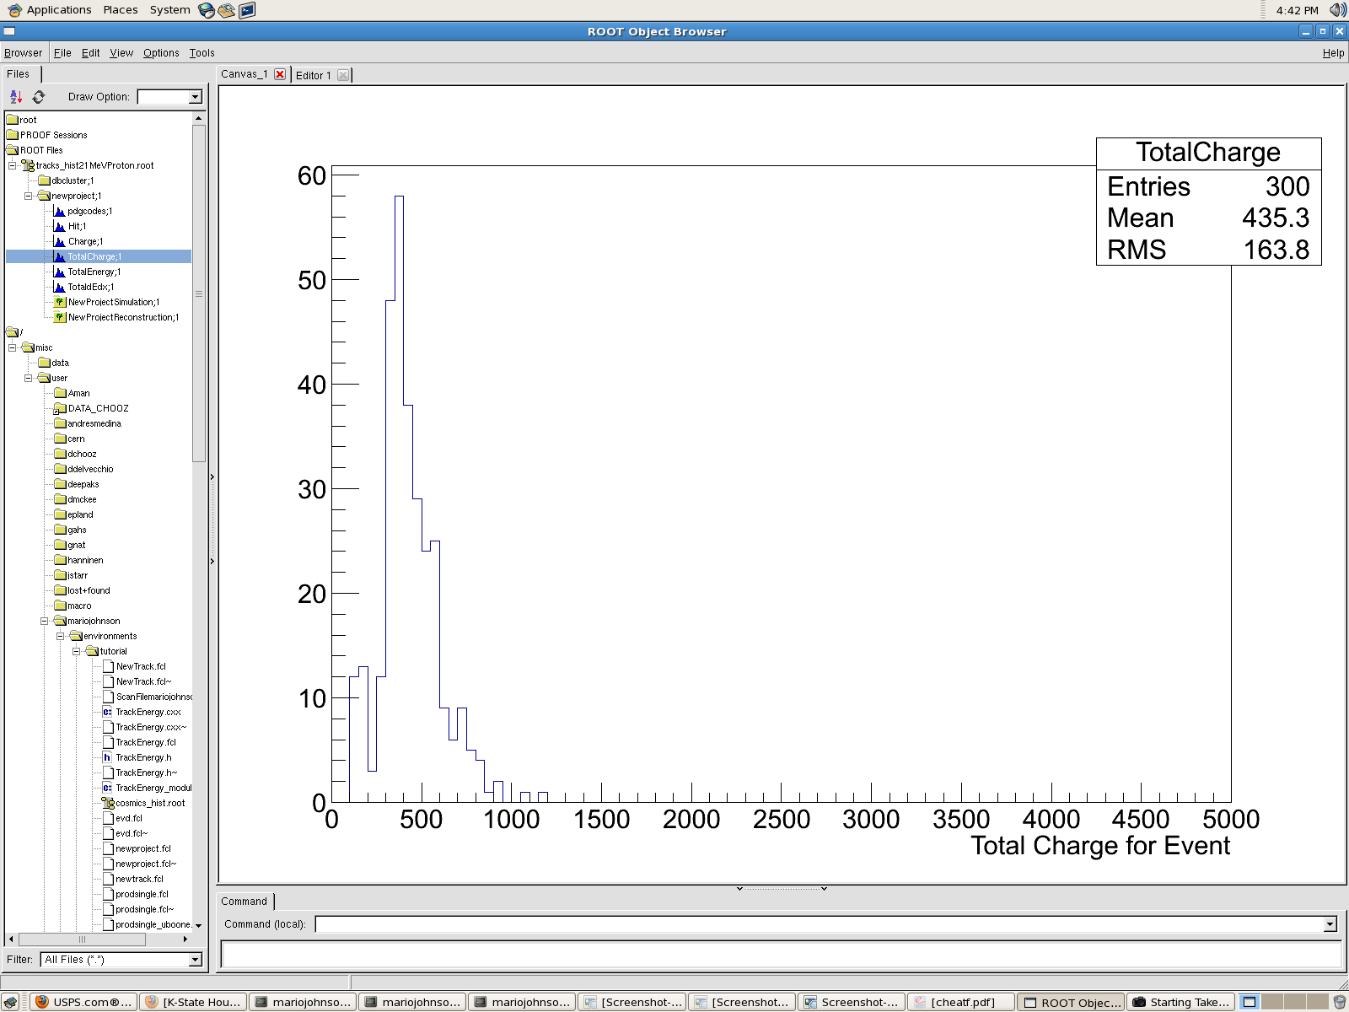
Results
← 14 MeV Proton Total Charge
21 MeV Proton Total Charge →

Slide 18
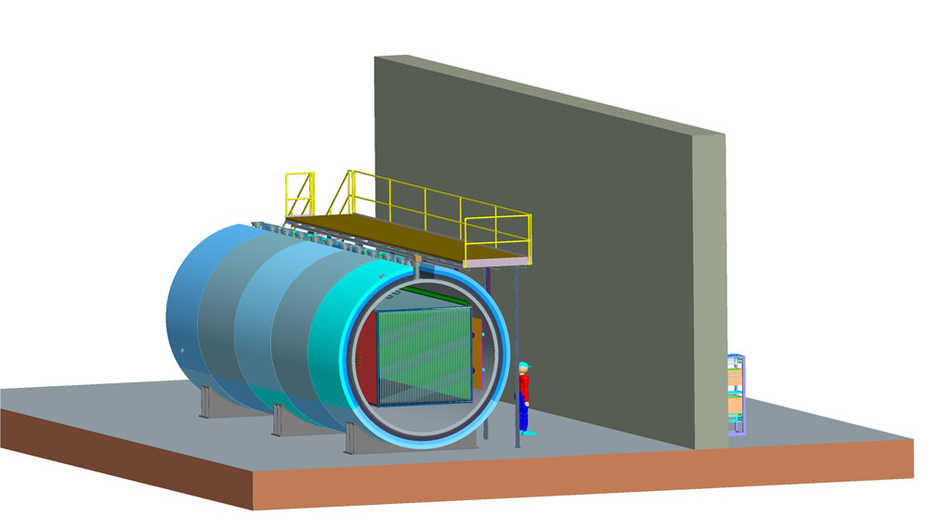
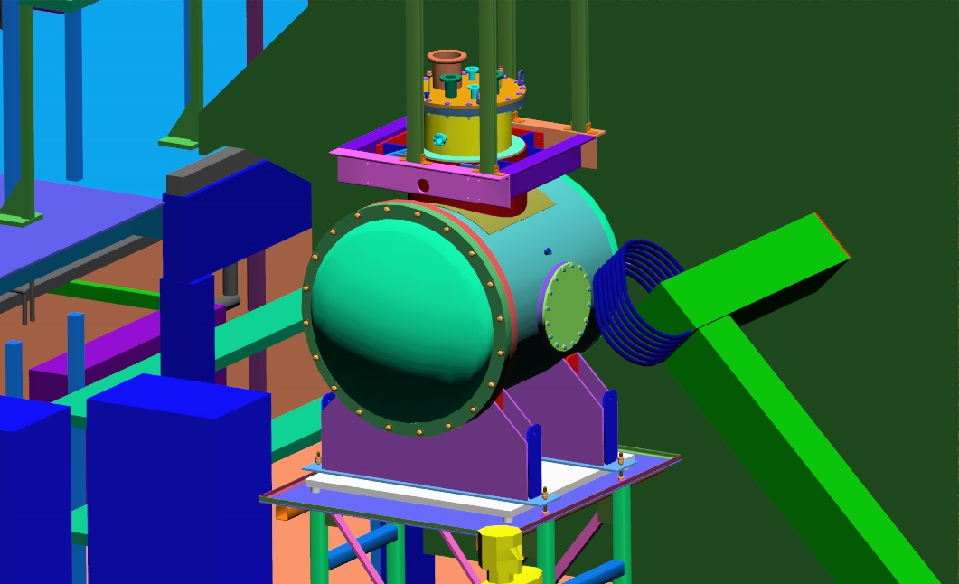
Particles ID Identification for Tracks in LArTPC
MicroBooNE
ArgoNeuT

Slide 19
What have I been trying to do in the past 9 weeks?
ID identification for Tracks.
Figure out the particles that are inside the detector in a particular event.
Why Kaons?
Measurement of cosmogenic kaon backgrounds for proton decay searches

Slide 20
Results
Kaons
Energy: 0.5 GeV

Slide 22
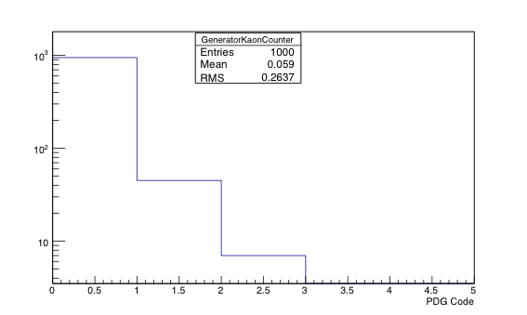
Genie and Prodsingle
Prodsingle Generator MC
Genie Generator MC

Slide 23
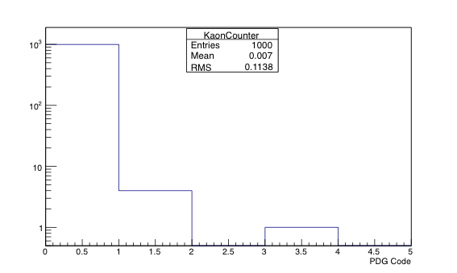
Kaon Count
Prodsingle
Genie

Slide 24
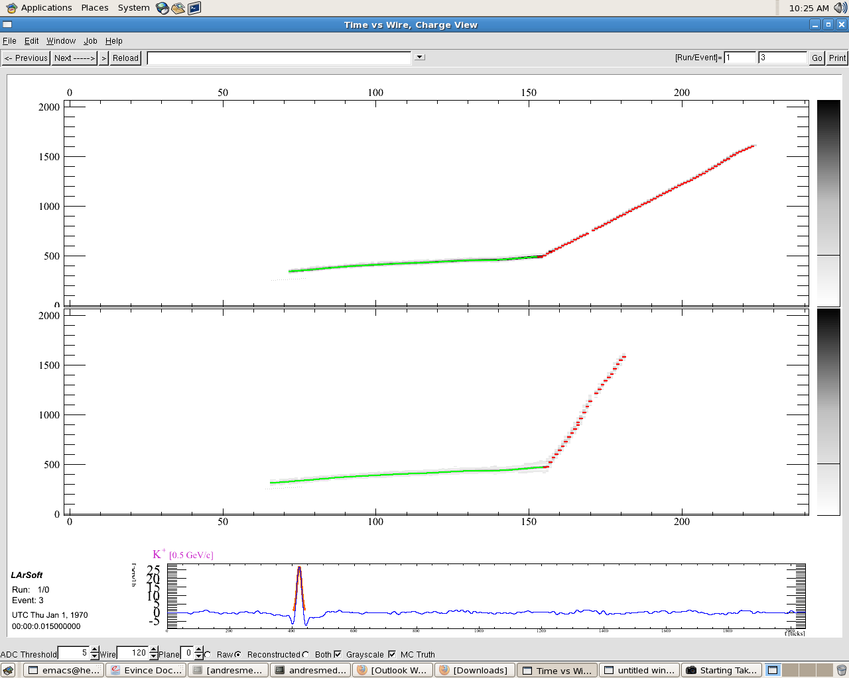
Event Display

Slide 25
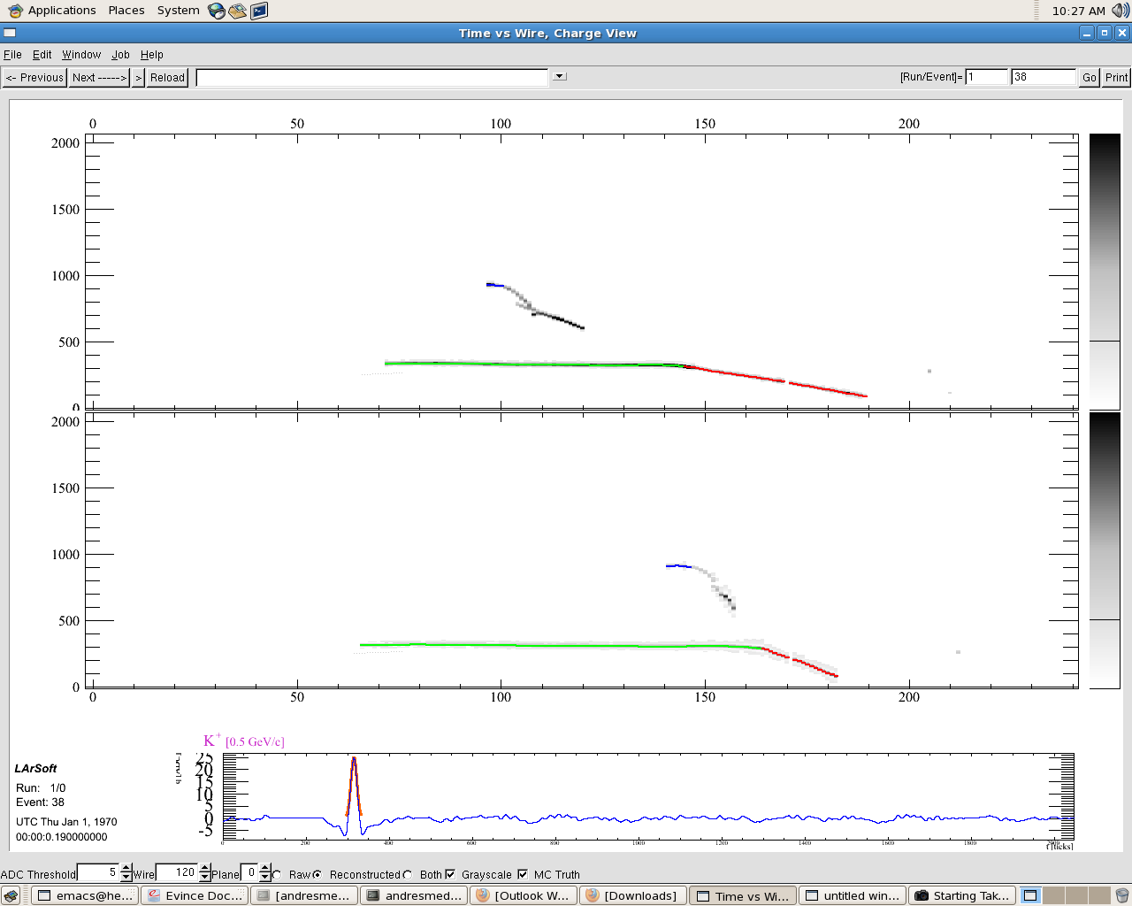
Continue

Slide 26
Problems with the Track and Possible Solution
The Track Identifier is not working well
Use others trackers such as Bezier Track

Slide 27
In Conclusion…
Deana has developed an angular and timing resolution filter for the framework
Mario has been developing ways to detect the energy deposition of particles and calibrating Birk’s Constant
Andres has been working on an identifier for particle tracks.

Slide 28
Acknowledgements
Tim Bolton, Glenn Horton-Smith, David McKee
Larry Weaver and Kristan Corwin
National Science Foundation (NSF)
Kansas State University and the High Energy Physics Group
Fellow REU Students

Slide 29
Back up

Slide 30
Bethe – Bloch Equation
β = v/c
v = velocity of particle
E = Energy of particle
z = particle charge
x = distance particle traveled
c = speed of light
e = electron charge
m_{e} = electron rest mass
n = electron density of target
I = mean excitation of potential target
ε₀ = vacuum permittivity

