Slide 1
Rotating Pulsed Magnetic Field Design and a Pulsed Field Study of Nanoparticle Phase Dynamics
By J. Nick Moore

Slide 2
Magnetic Hyperthermia vs. Nanodrills
Magnetic Hyperthermia: Superparamagnetic nanoparticles absorb power from AC magnetic fields and heat surrounding tissue via Neel and Brownian relaxation
Nanodrills: Magnetic nanorods cut through surrounding tissue cells as they rotate in the presence of a high-frequency rotating magnetic field

Slide 3
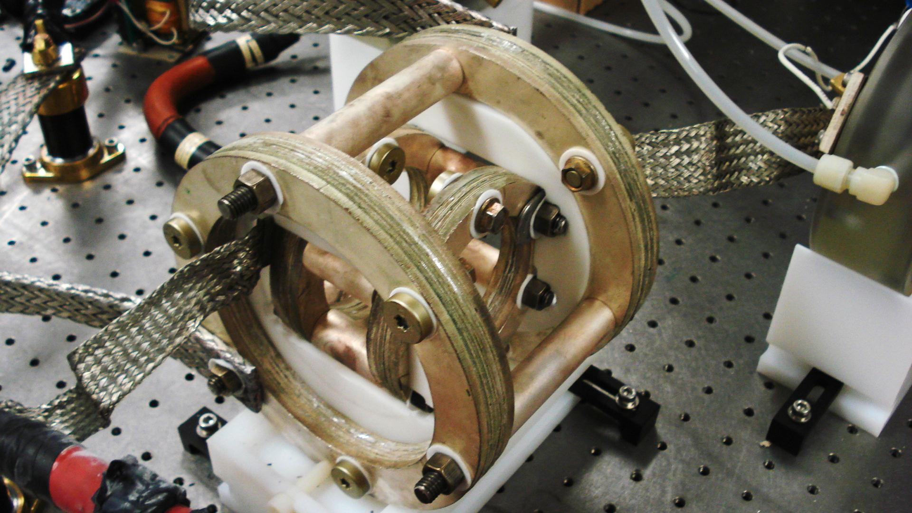
Nested Helmholtz Coil

Slide 4
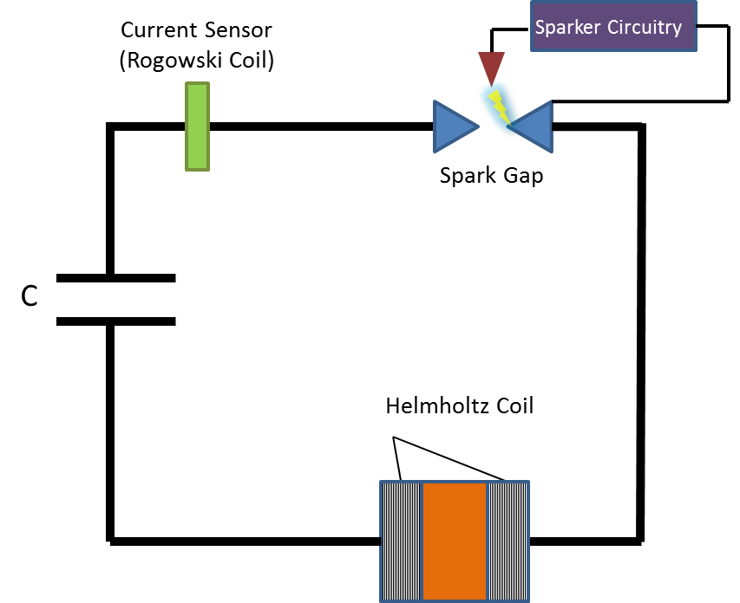
Single Coil RLC Circuit

Slide 5
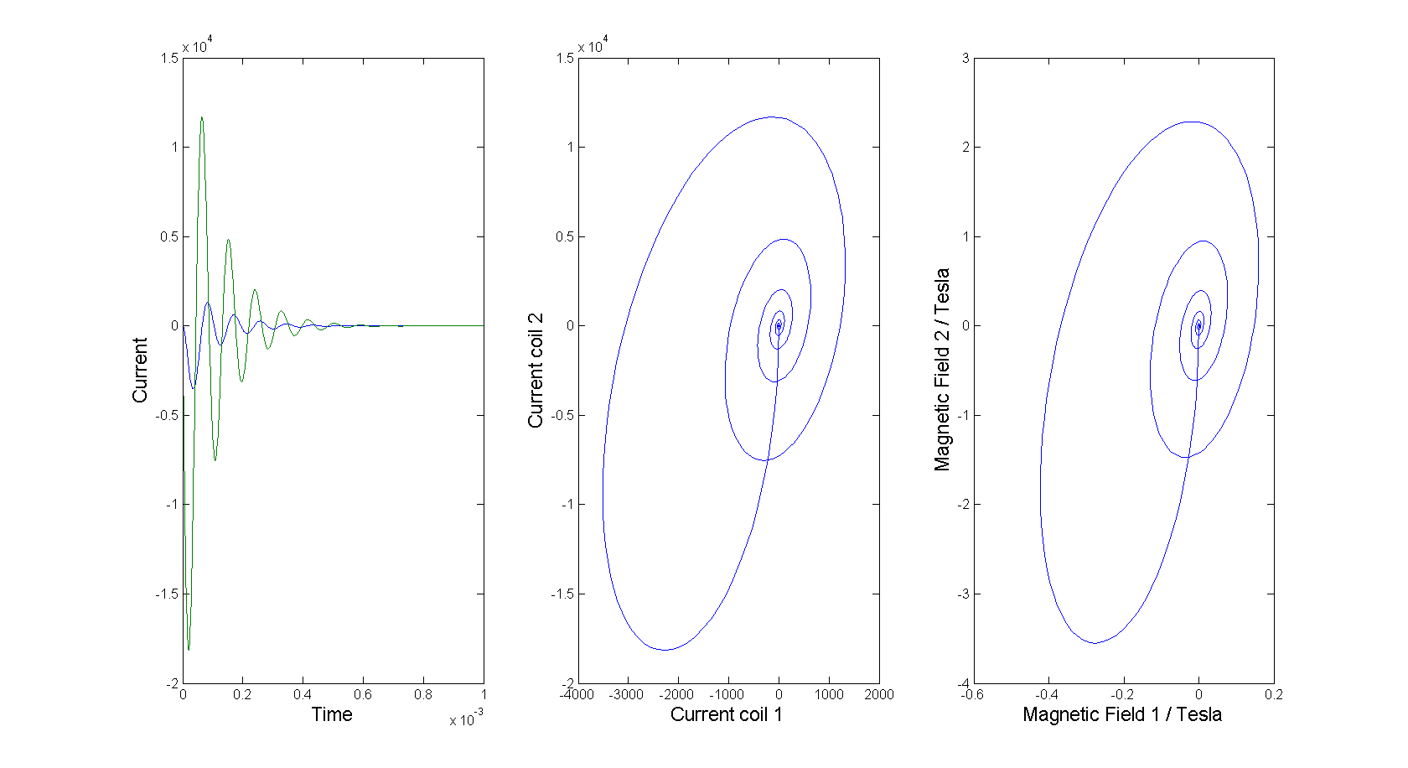
Rotating Magnetic Field Model

Slide 6
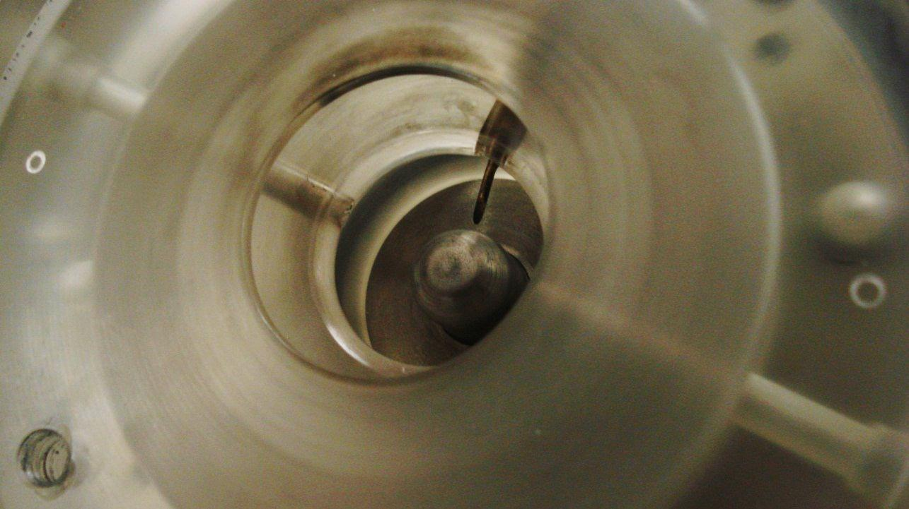
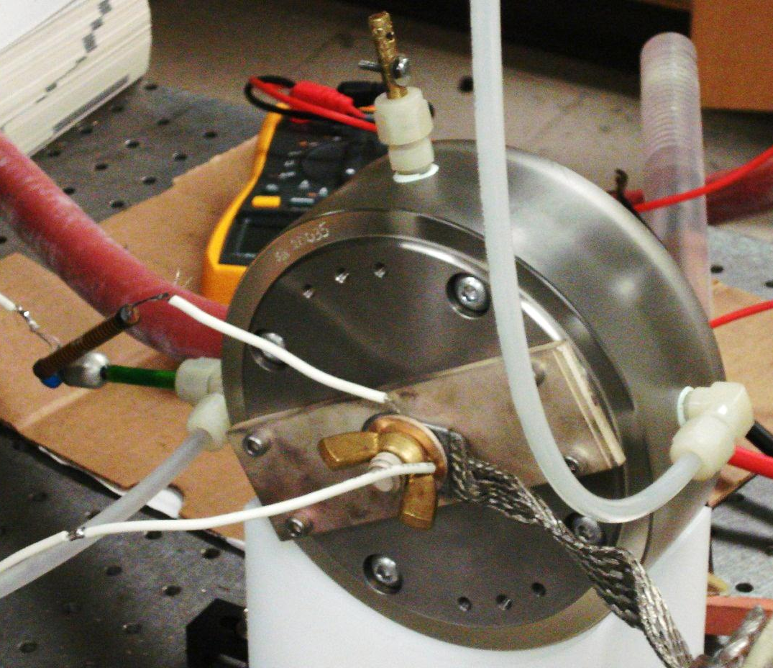
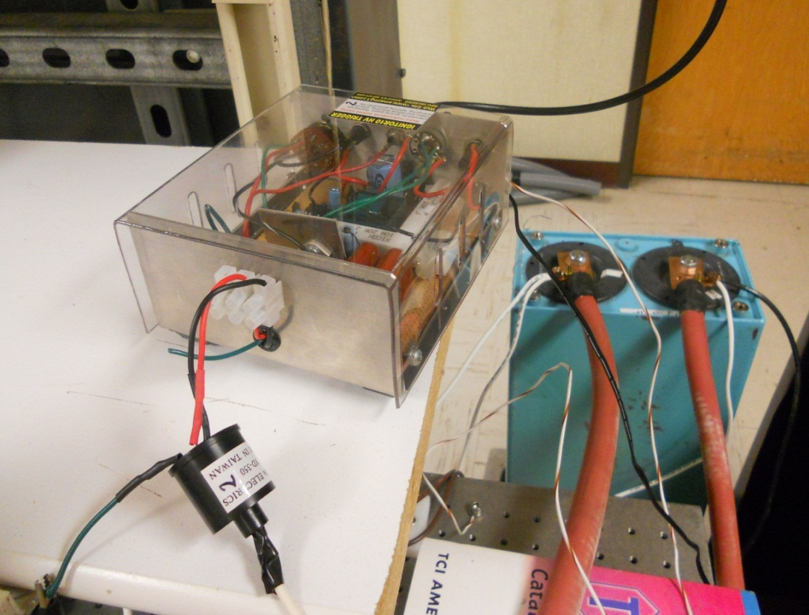

Slide 7
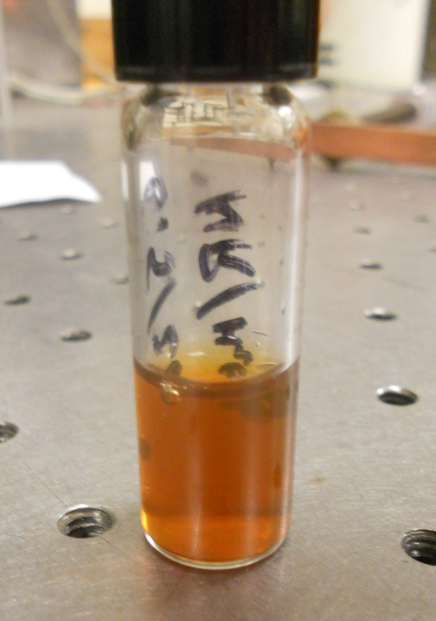
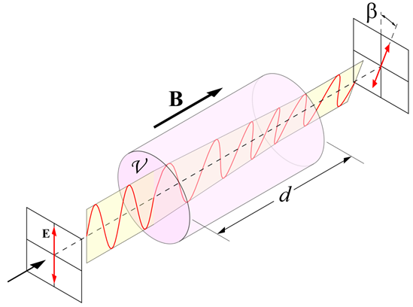

Faraday Rotation
EMG 707 nanoparticle solution
$$β=𝒱Bd$$

Slide 8
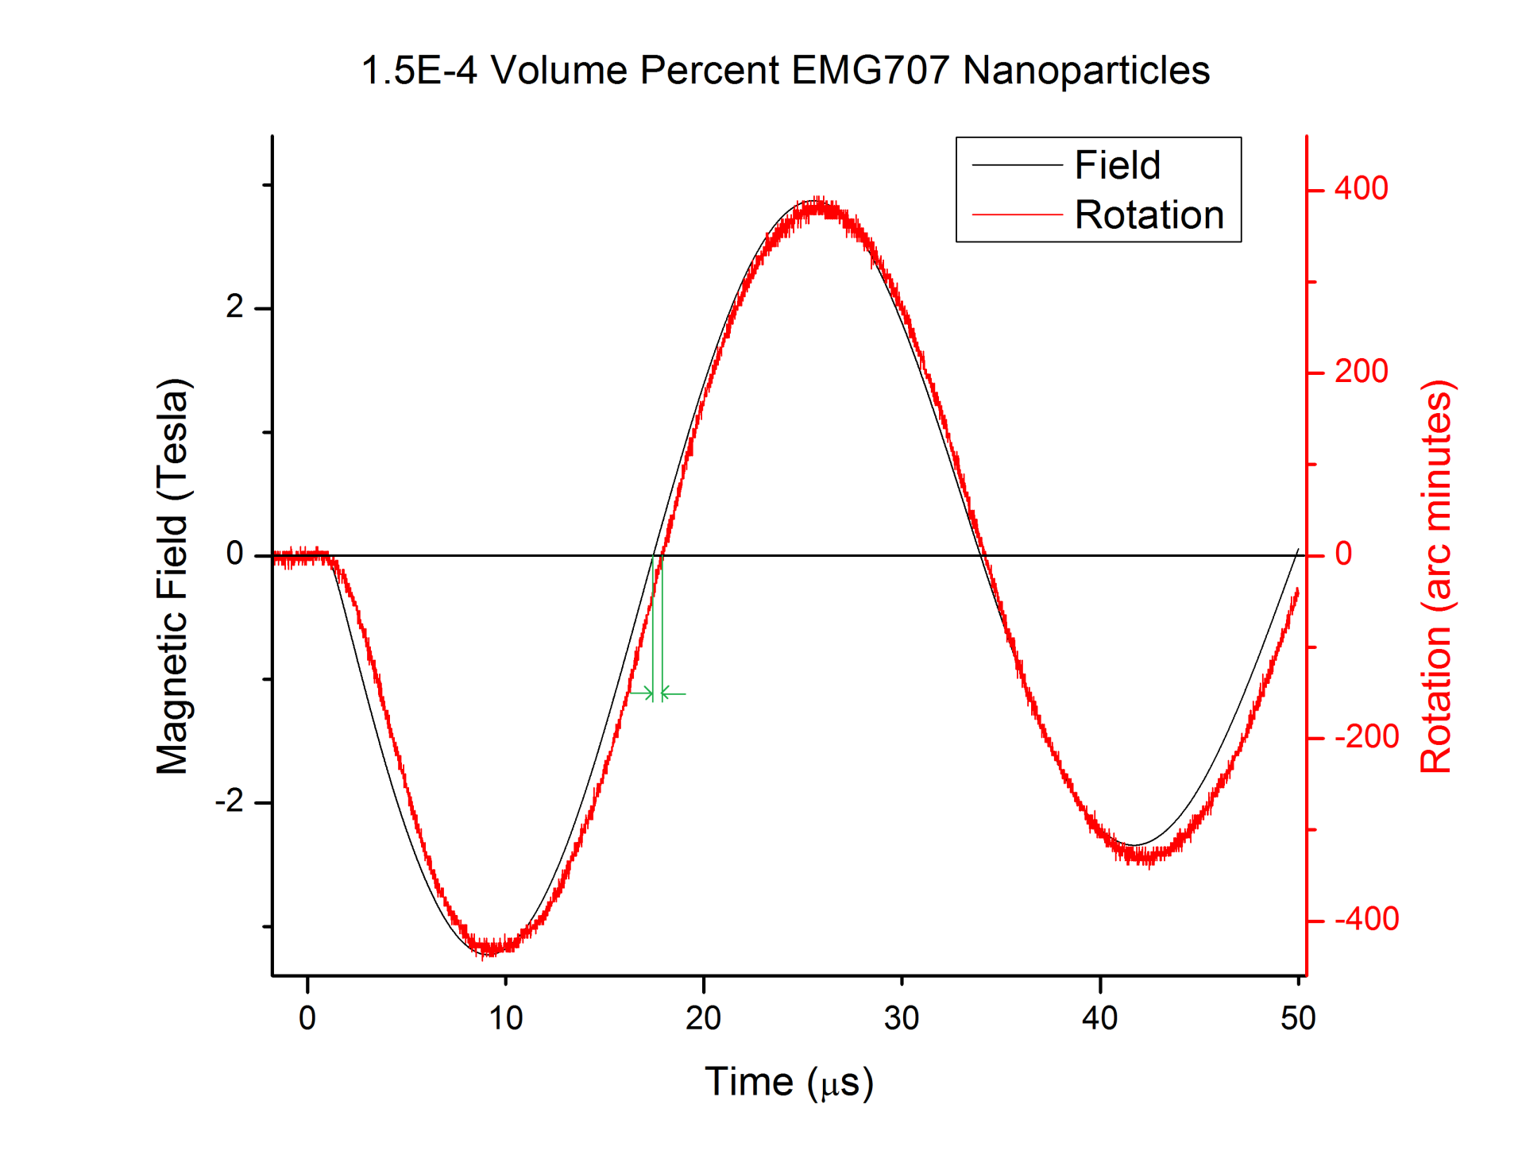

$$phase ∆φ$$

Slide 9
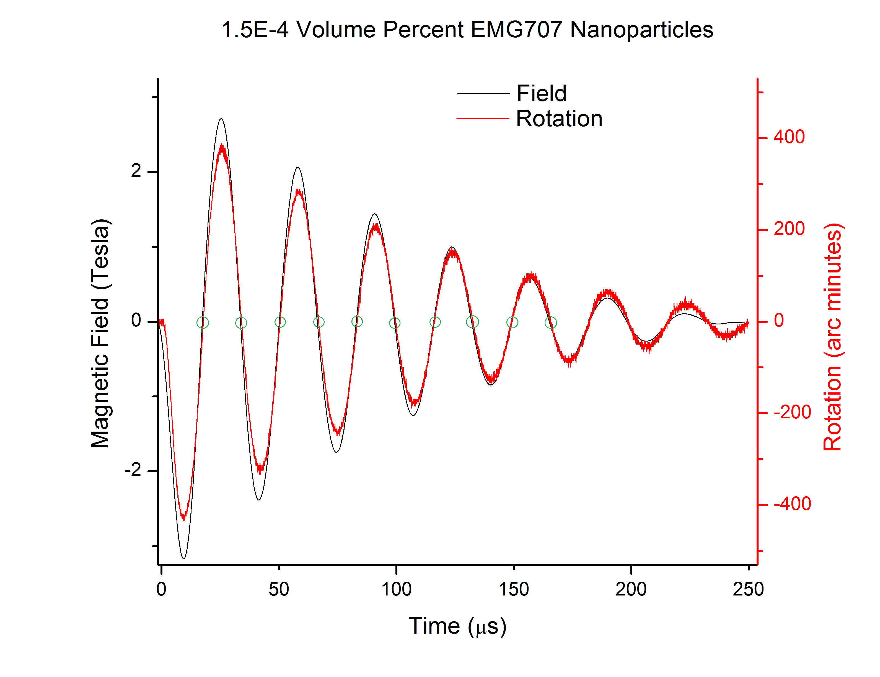

Slide 10
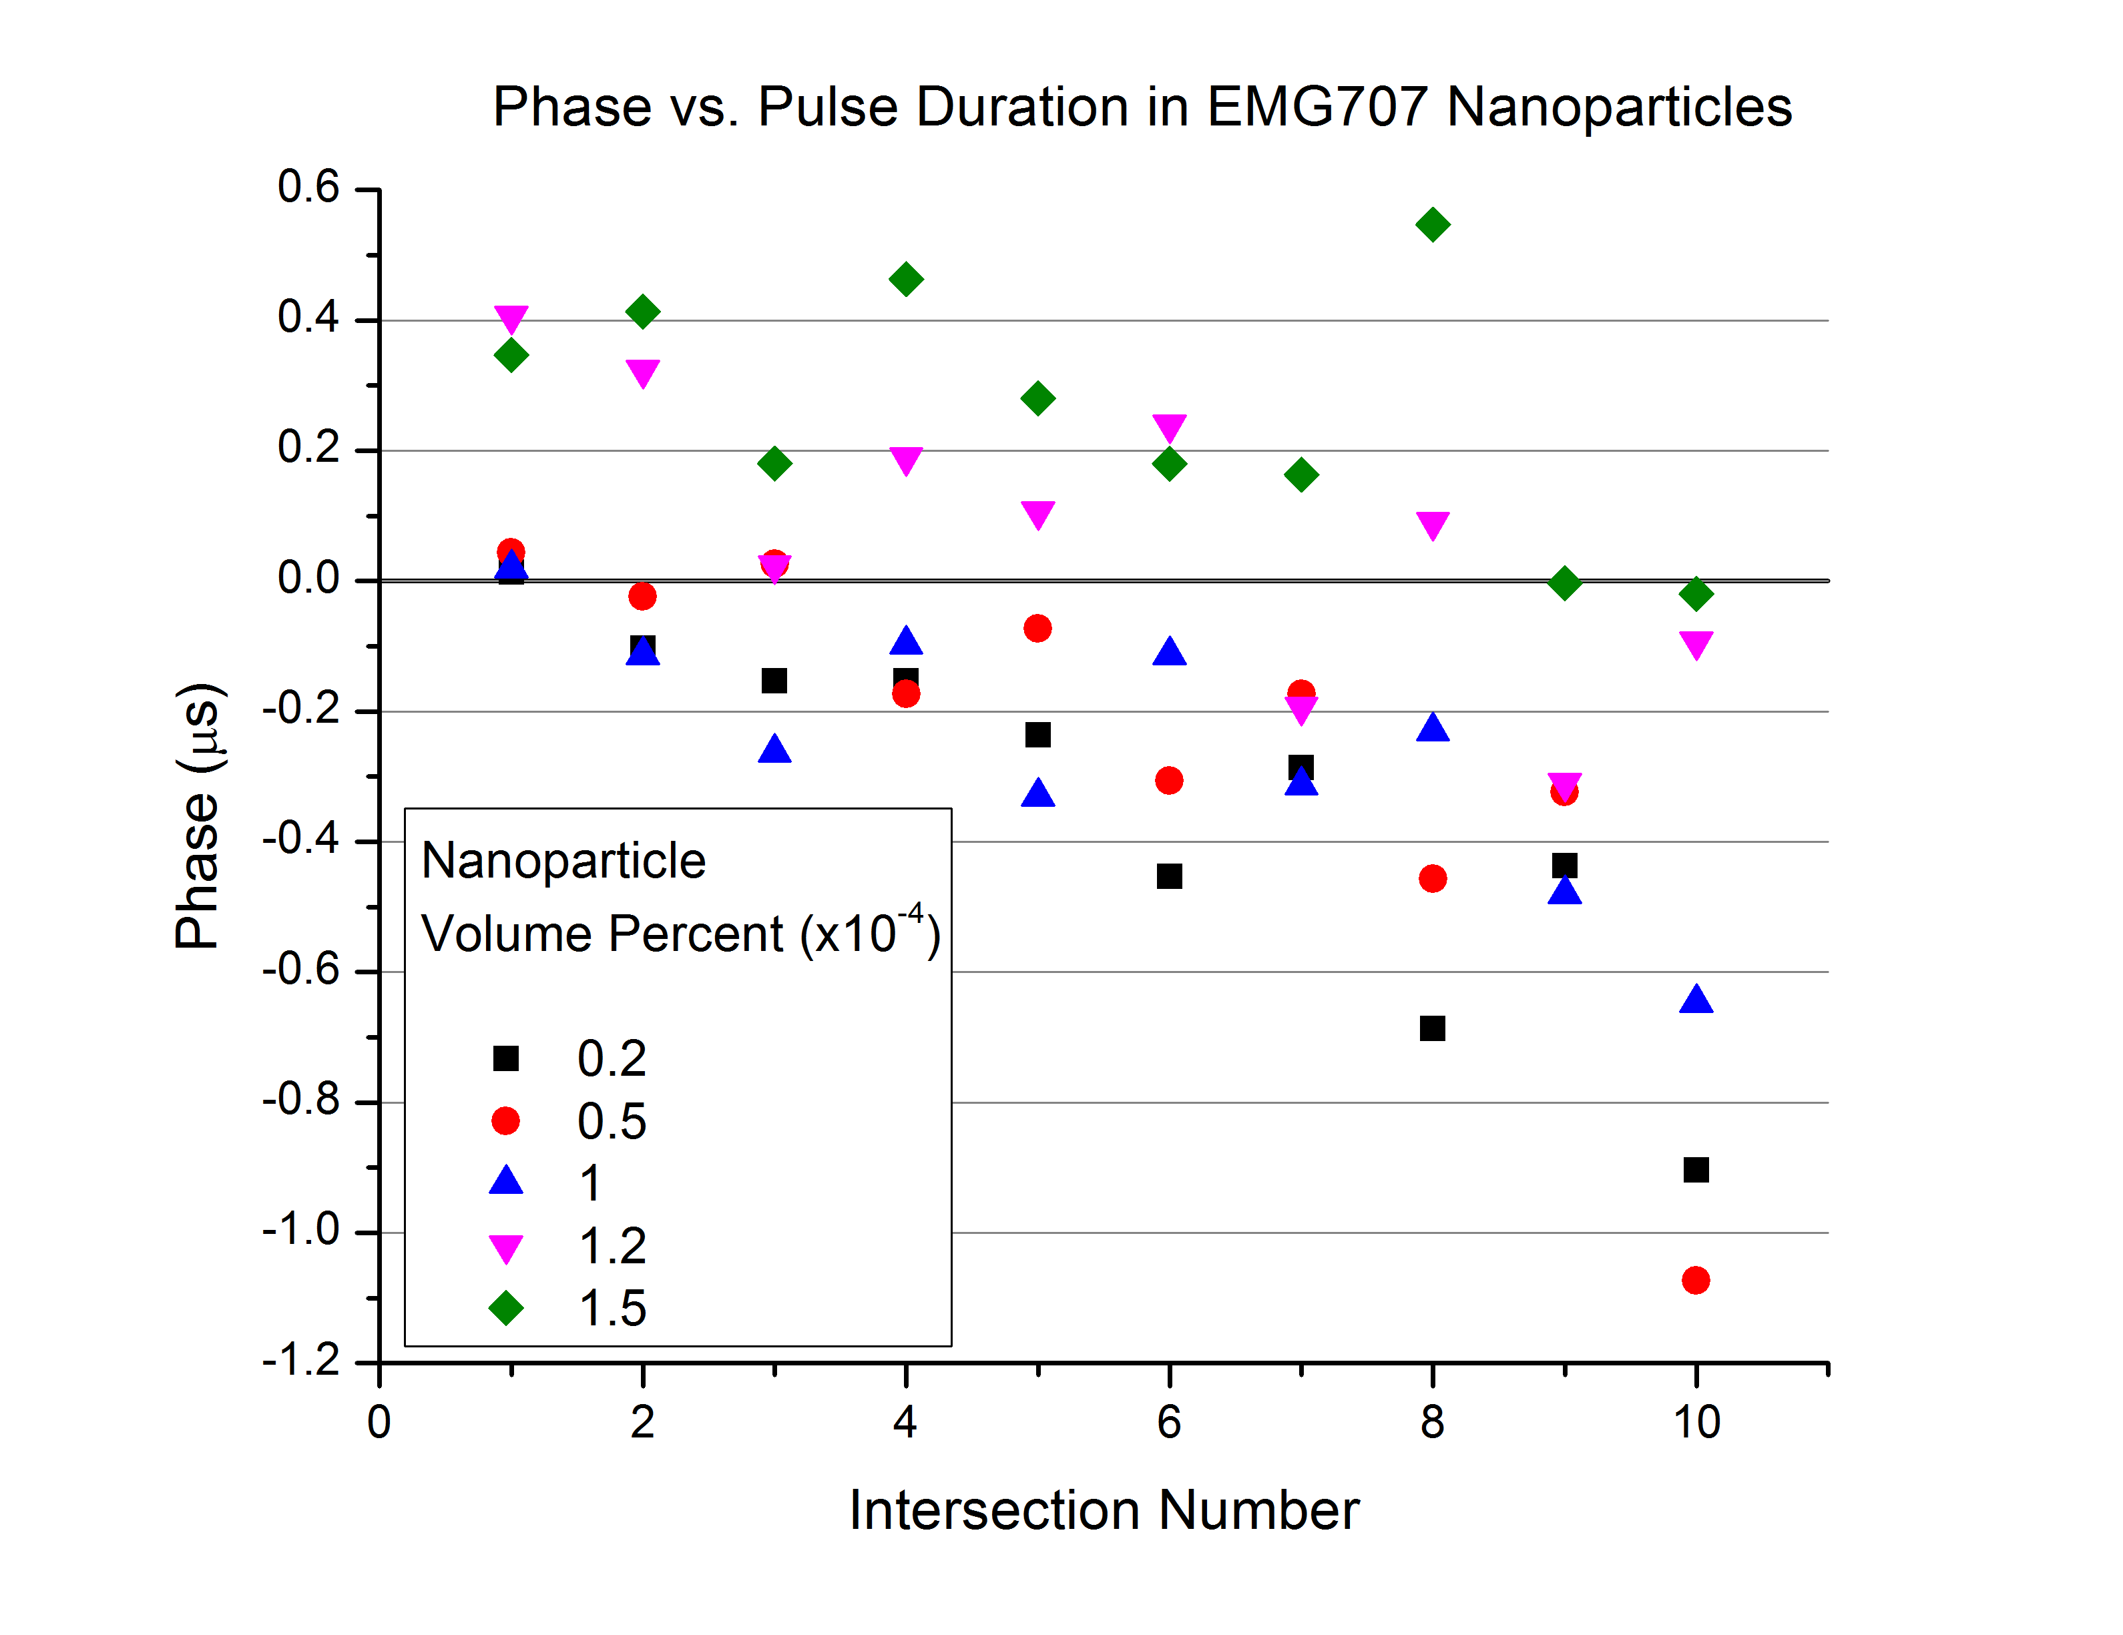

Slide 11
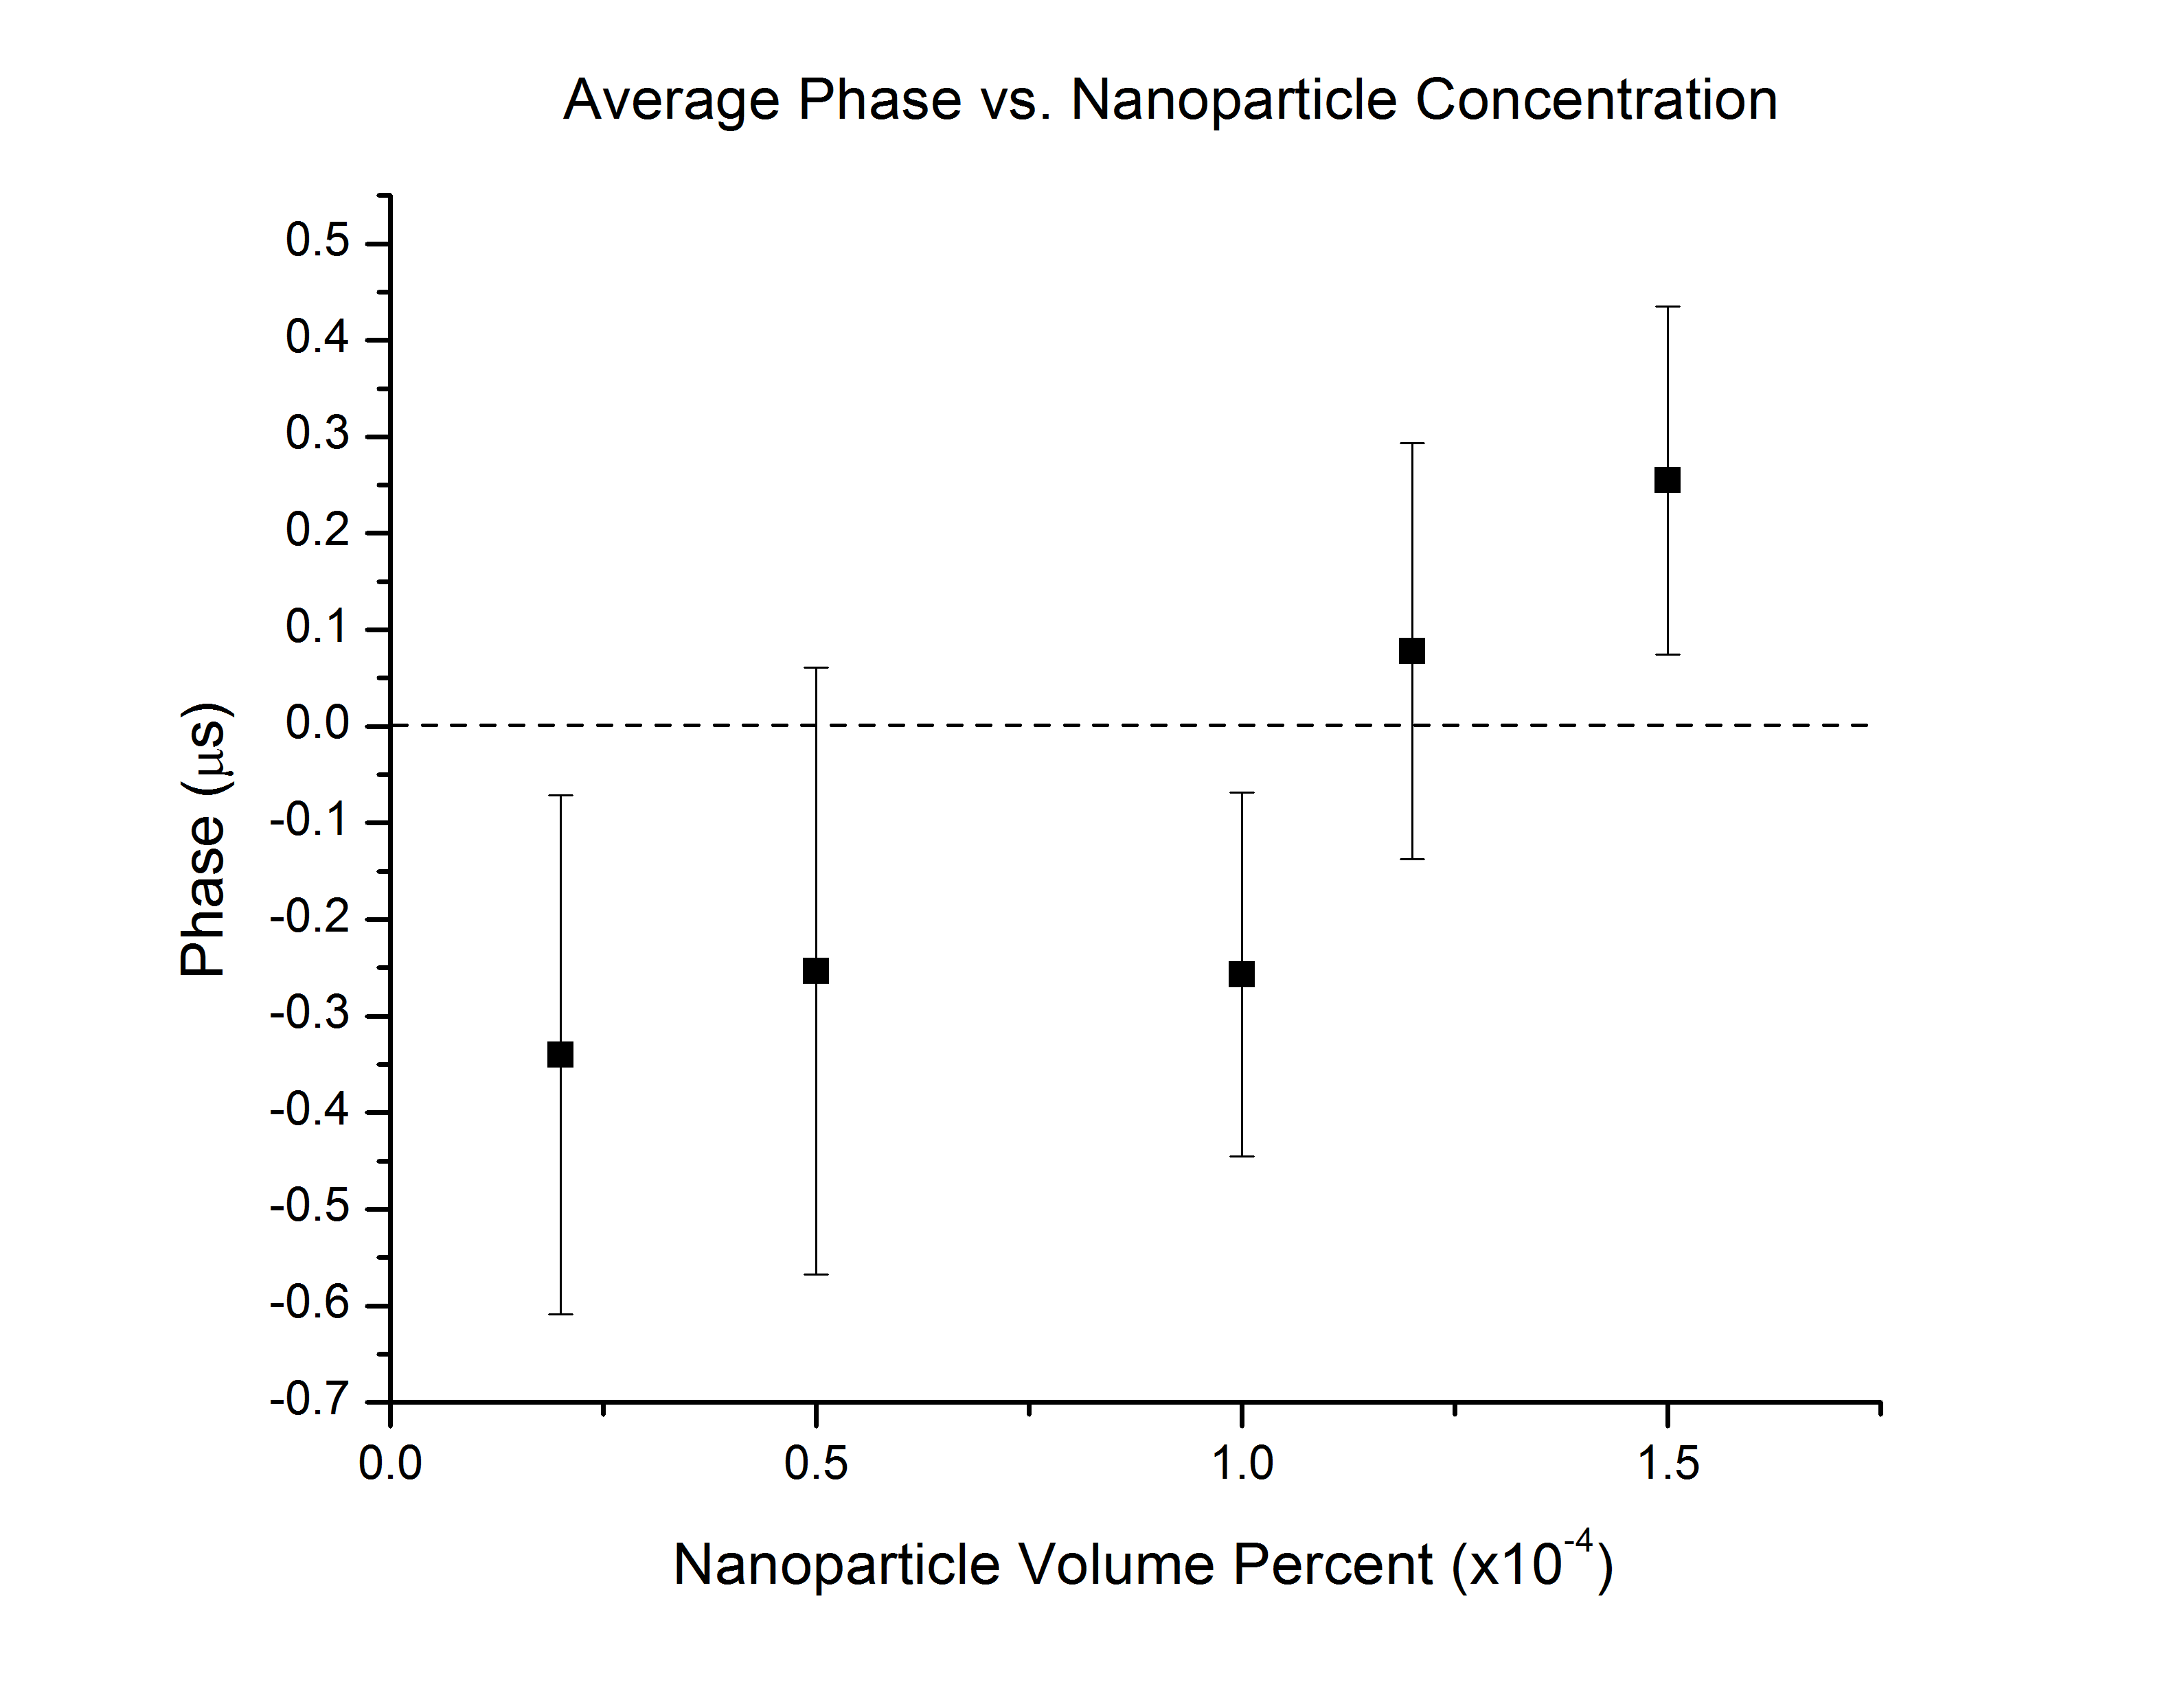

Slide 12
Dynamic Light Scattering Results
EMG 707 nominal particle diameter: 10nm

Slide 13
Conclusions
There is a relative increase in phase delay as nanoparticle concentration increases
  This may be due to stronger dipole-dipole interactions as particle spacing shrinks
  Or it may be due to longer relaxation times of aggregates that are forming at higher concentrations
There is a relative phase decrease as the magnetic pulse diminishes and cycles through more peaks
  This may be evidence of the system becoming more ordered through consecutive exposure to field peaks, allowing it to respond more quickly

Slide 14
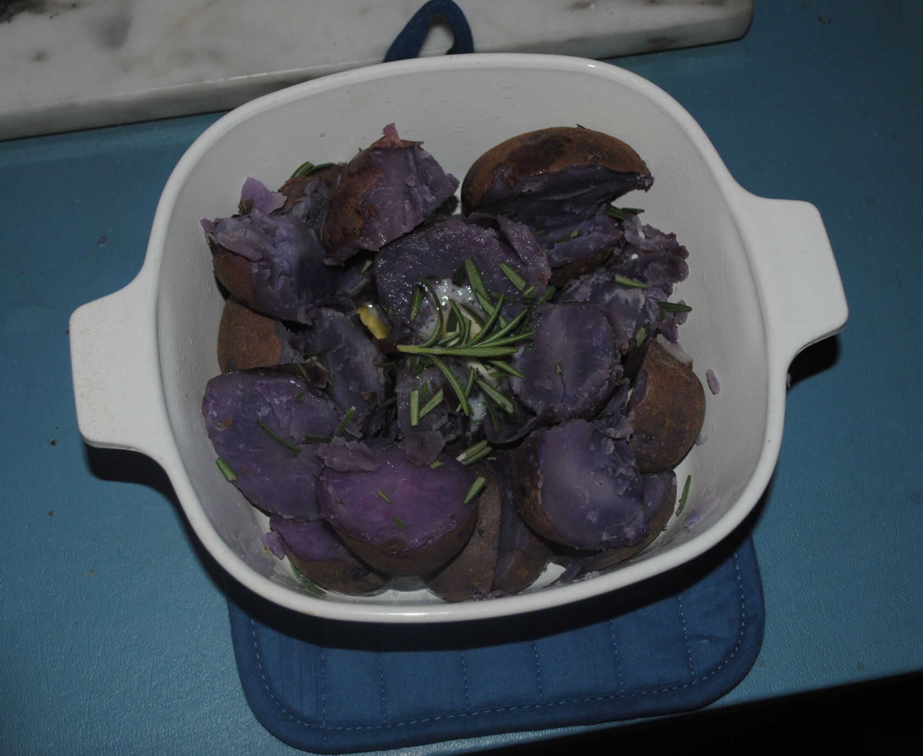

Potatoes come in purple!?

