Slide 1
Fiber Laser Preamplifier
Ryan Marshall
Dr. Kristan Corwin
Dr. Brian Washburn
Shun Wu
KSU REU 2011
Funded by the NSF PHY-0851599

Slide 2
Outline
Introduction
  Frequency Combs
  Direct Comb Spectroscopy
Amplifier
  Components
  Maximize Power
  Minimize Autocorrelation Width
  Goal: More power per combed tooth

Slide 3
Frequency Combs
Modelocked laser
  Pulsed
Need to be amplified, filtered for comb based spectroscopy
  10nw/tooth 10mW/tooth
  My Amp: 100μW/tooth
Time domain
E(t)
Δφ
2Δφ
t
τ_{r.t} = 1/f_{r}
Frequency domain
f_{o}
f_{r}
I(f)
0
f_{n} = nf_{r} + f_{o}
f
D. J. Jones, et al. Science 288, 635 (2000)

Slide 4
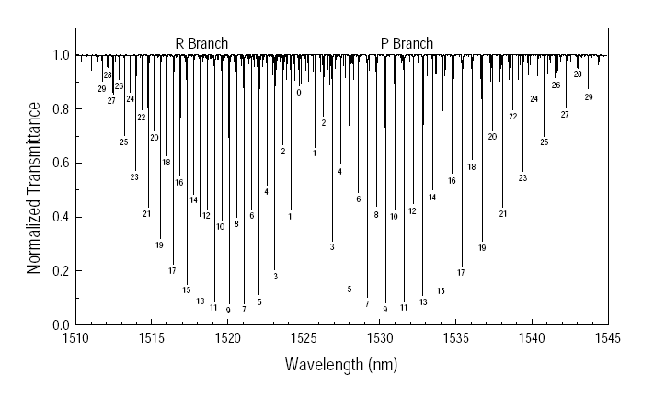
Direct Comb Spectroscopy of Acetylene
Lock combed tooth to Acetylene absorption line
P13 is good compromise between properties of Er and C₂H₂
W.C. Swann and S.L. Gilbert. (NIST), Opt. Soc. Am. B, 17, 1263 (2000).

Slide 5

Modelock fiber laser
Phase-stabilized comb
Self-reference + f₀ stabilization
100MHz frep,10nW/tooth
PreAmp
Saturated absorption
Spectral filter
Optical Amp
F-P cavity
50GHz @ C₂H₂ line
2GHz frep,20mW/tooth
90%
pump
Scan aperture
10%
probe
VIPA
C₂H₂ filled HC-PCF
PBS
PD or CCD array

Slide 6
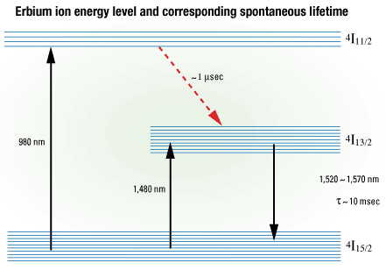
Amplified Signal
Signal
1560nm, 0.19mW
Bigger, broader
Pump
1480nm, 1W
1560 nm
100mW
http://www.fiberoptics4sale.com/wordpress/edfa-fundamentals-explained-in-details/
~10% efficient

Slide 7
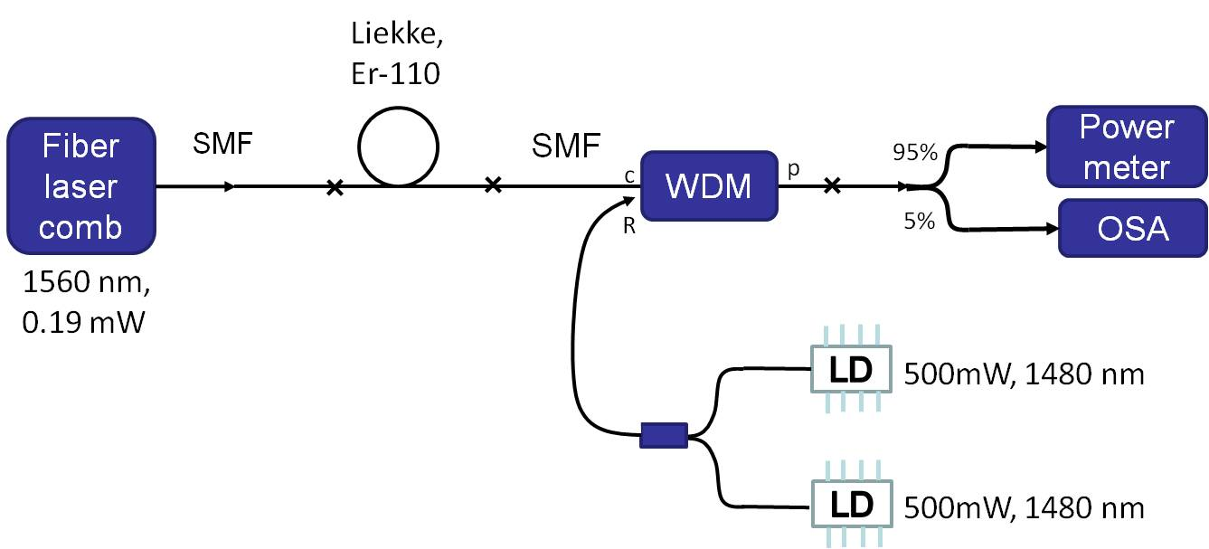
Pre-Amplifier
110 mW
Optimize gain fiber length to maximize average power
Optimize SMF fiber length to minimize pulse duration
Broaden the spectrum to get enough gain at 1532nm

Slide 8
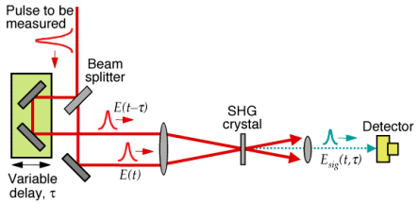
Autocorrelator
Autocorrelation
Pulse
t
delay
t
delay
http://www.swampoptics.com/tutorials_autocorrelation.htm

Slide 9
Minimizing Pulse Duration
Maximize Peak Power
Challenges
  Dispersion
  Nonlinearities
Optimize SMF length
Spectral BW
  60fs pulse
  88fs autocorrelation

Slide 10
Autocorrelation
SHG

Slide 11


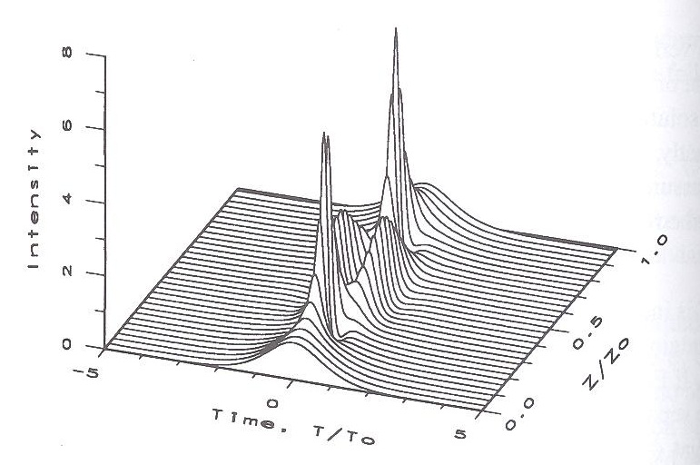
Solitons
= 4.0m Soliton Period
N =3
Third-Order Soliton
Agrawal, G.P. Nonlinear Fiber Optics, 3rd ed.
Academic Press 1995

Slide 12
Filtering out 1532.8nm
1533nm Fiber Bragg Grating
Look for repetition rate (98.6 MHz)
  P_{el} = -17dBm at 98.6 MHz
  ΔV = 0.03 V
  V_{measured} = 0.076 V

Slide 13
Summary
Frequency Combs
  Amplified and Stabilized
  Comb based spectroscopy
Preamplifier
  Strategies
  Factor of 5 short on power
    20 μW/tooth 100 μW/tooth at 1532.8nm
  Broaden with HNLF

Slide 14
Extra Slides

Slide 15
Frequency References
Applications
  Frequency standards in telecommunications
  Targeting
    Navigation
    Astronomy
Portable
  Convenient
  Accurate
W.C. Swann and S.L. Gilbert. (NIST), Opt. Soc. Am. B, 17, 1263 (2000).

Slide 17
System Set-Up
Autocorrelator
Comb
AMP
Optical Spectrum Analyzer

Slide 18
PC = Fiber polarization controller
FROG
PC2
PC1
Isolator
GRENOUILLE
Amp
Comb
Erbium doped fiber amplifier
Fiber to free-space
Autocorrelator
ND filter
LP
50/50 beamsplitter
Coupling free-space beam back to fiber
Flipper mirror
ND filter
OSA
½ WP

Slide 19
Autocorrelation

Slide 20
