Slide 1
Nanoparticles at the Solid-Liquid Interface
Lynza Halberstadt
Dr. Bruce M. Law
Kansas State University Department of Physics

Slide 2
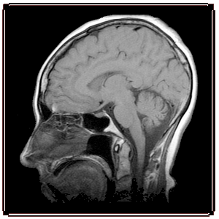
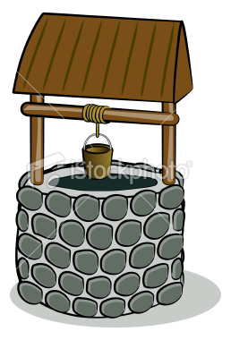
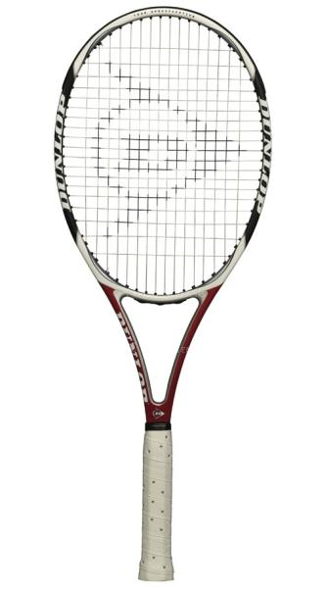
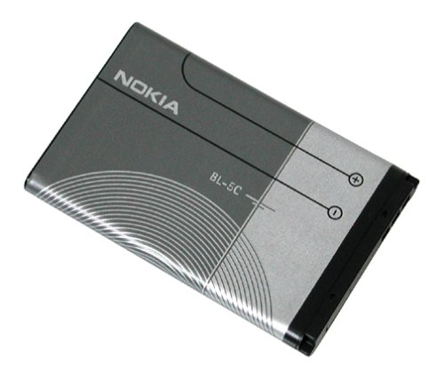
Nanoparticles
FeO enhances MRI images of cancerous tumors and cleans As from water wells
Si increases battery power and reduces recharge time on Li-ion batteries
SiO₂ strengthens tennis rackets
Ag makes clothing odor-resistant

Slide 3
Surface Energy
Pure Octadecane: γ = 22.3 ± 0.2 mN/m (n=10)
CdSe@TOPO in Octadecane: γ = 22.3 ± 0.2 mN/m (n=10)
Au@DDT in Octadecane: γ = 18.1 ± 0.2 mN/m (n=10)

Slide 4
Marangoni Effect
30 °C
26 °C

Slide 5
Marangoni Effect
30 °C
26 °C

Slide 6
Marangoni Effect
γ = 18.1 mN/m
γ = 22.3 mN/m
30 °C
26 °C

Slide 7
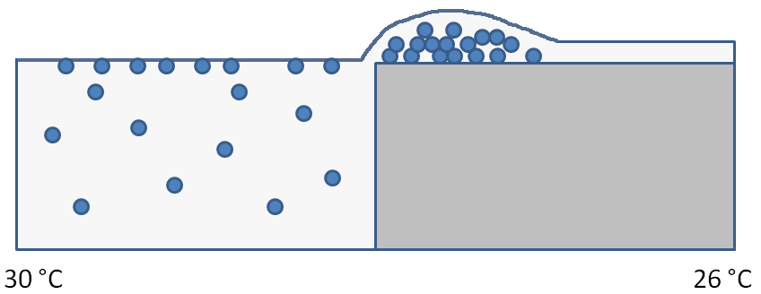
Marangoni Effect

Slide 8
Particle vs. Temperature
30 °C
26 °C

Slide 9
Soret Effect
Positive Soret effect
Negative Soret effect
30 °C
26 °C
30 °C
26 °C

Slide 10
Surface Energy
Octadecane: γ = 22.3 ± 0.2 mN/m (n=10) temperatre Marangoni effect
CdSe@TOPO: γ = 22.3 ± 0.2 mN/m (n=10) positive Soret effect
Au@DDT: γ = 18.1 ± 0.2 mN/m (n=10) particle Marangoni effect

Slide 11
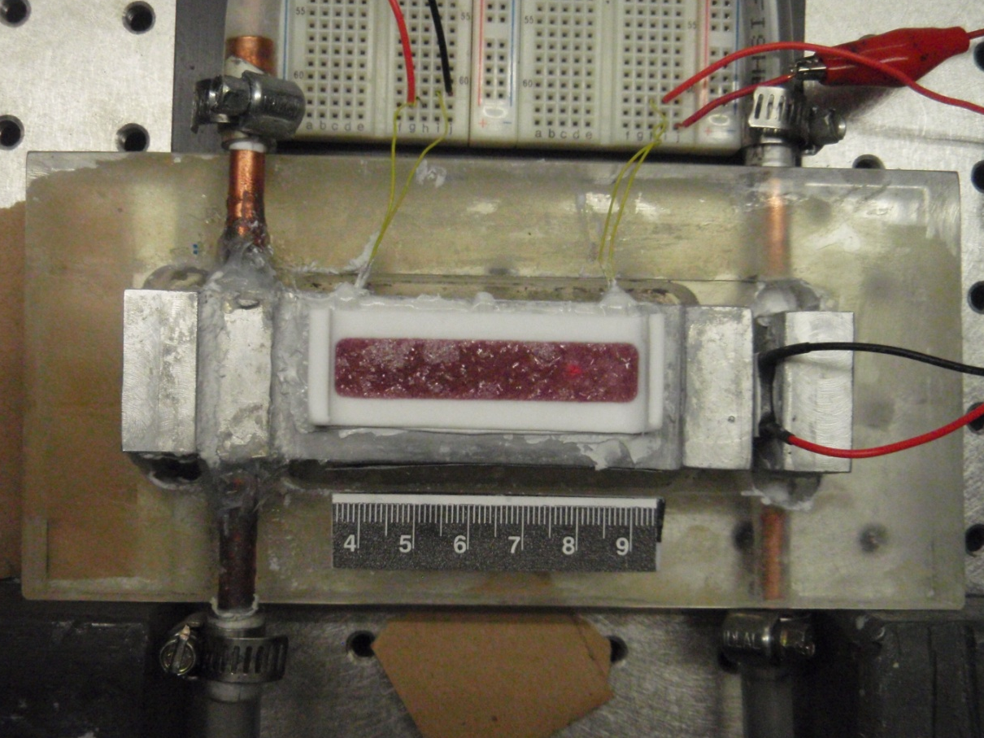
Experimental Setup

Slide 12
Experimental Setup

Slide 13
What Mountain Building Looks Like

Slide 14
T = 0.0 h

Slide 15
T = 0.5 h

Slide 16
T = 1.0 h

Slide 17
T = 1.5 h

Slide 18
T = 2.0 h

Slide 19
T = 2.5 h

Slide 20
T = 3.0 h

Slide 21
T = 3.5 h

Slide 22
T = 4.0 h

Slide 23
T = 4.5 h

Slide 24
T = 5.0 h

Slide 25
T = 5.5 h

Slide 26
T = 6.0 h

Slide 27
T = 6.5 h

Slide 28
T = 7.0 h

Slide 29
T = 7.5 h

Slide 30
T = 8.0 h

Slide 31
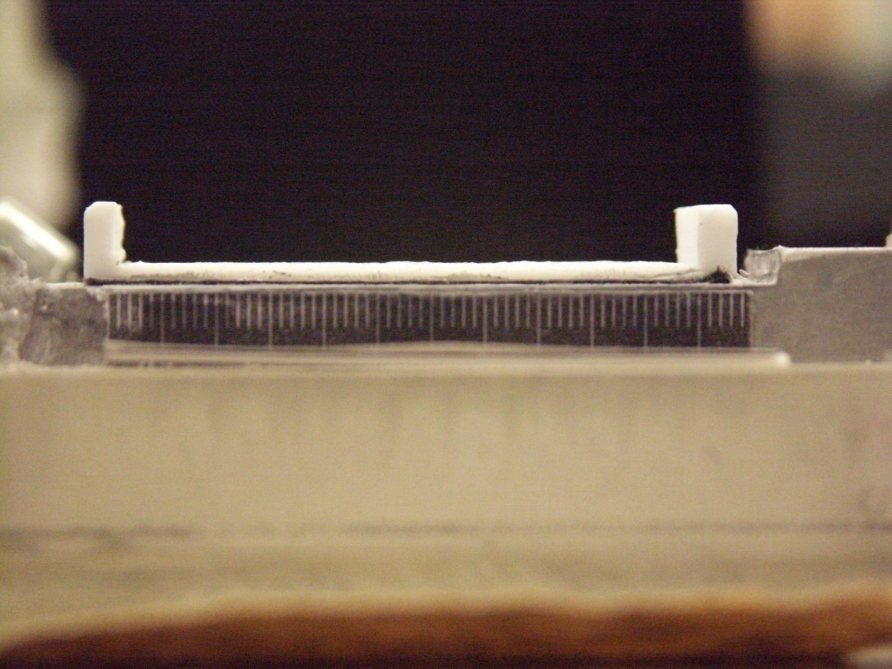
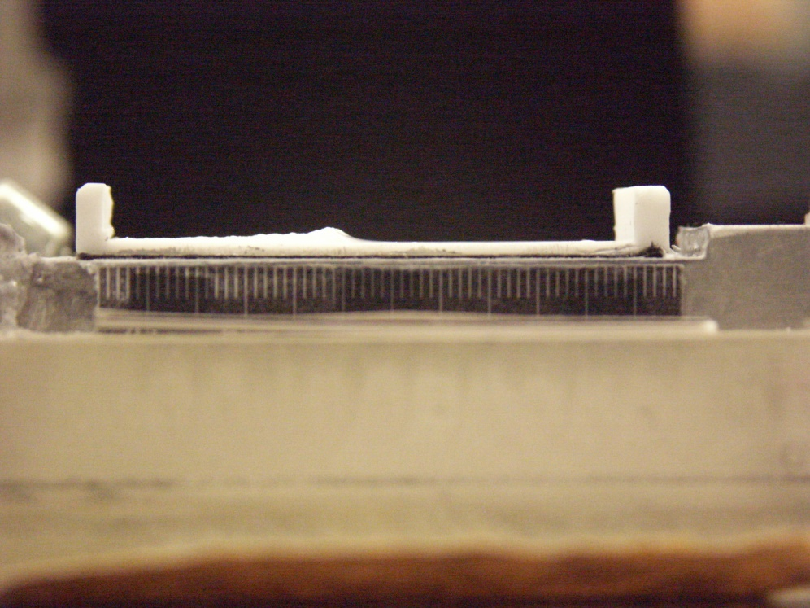
Octadecane Mountain Building
T = 0 h T = 8 h

Slide 32
Octadecane Mountain Heights

Slide 33
Octadecane Mountain Rates

Slide 34
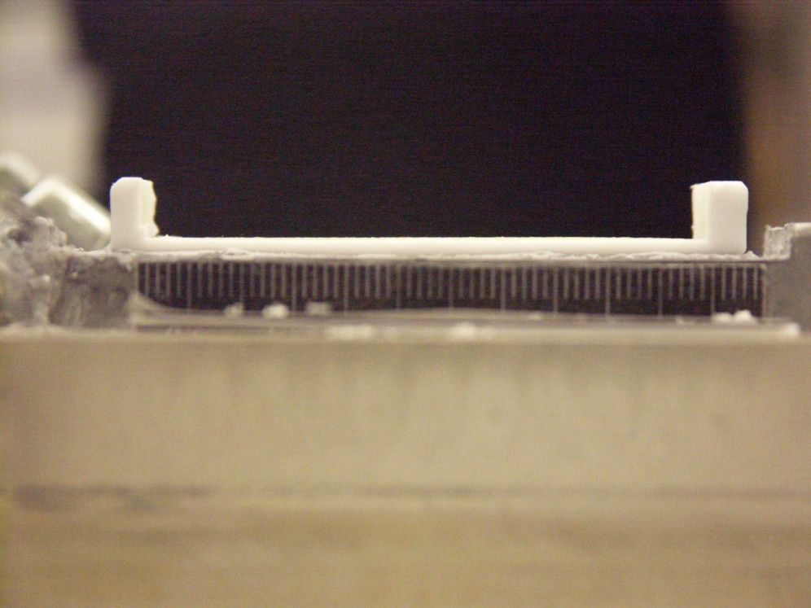
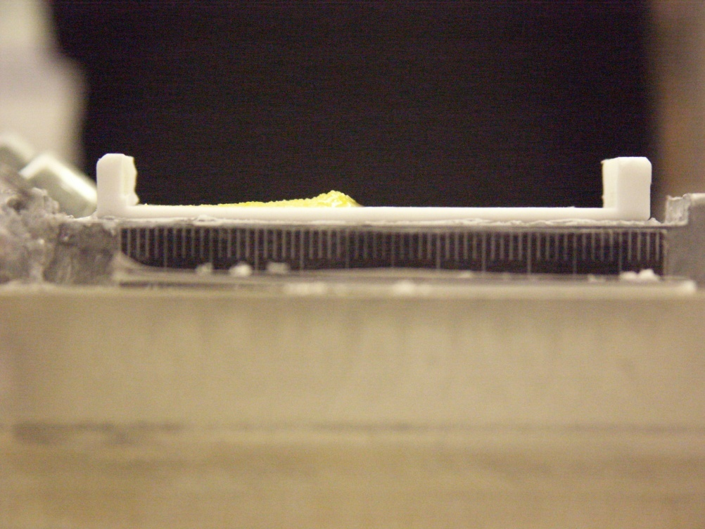
CdSe@TOPO Mountain Building
T = 0 h T = 8 h

Slide 35
CdSe@TOPO Mountain Heights

Slide 36
CdSe@TOPO Mountain Rates

Slide 37
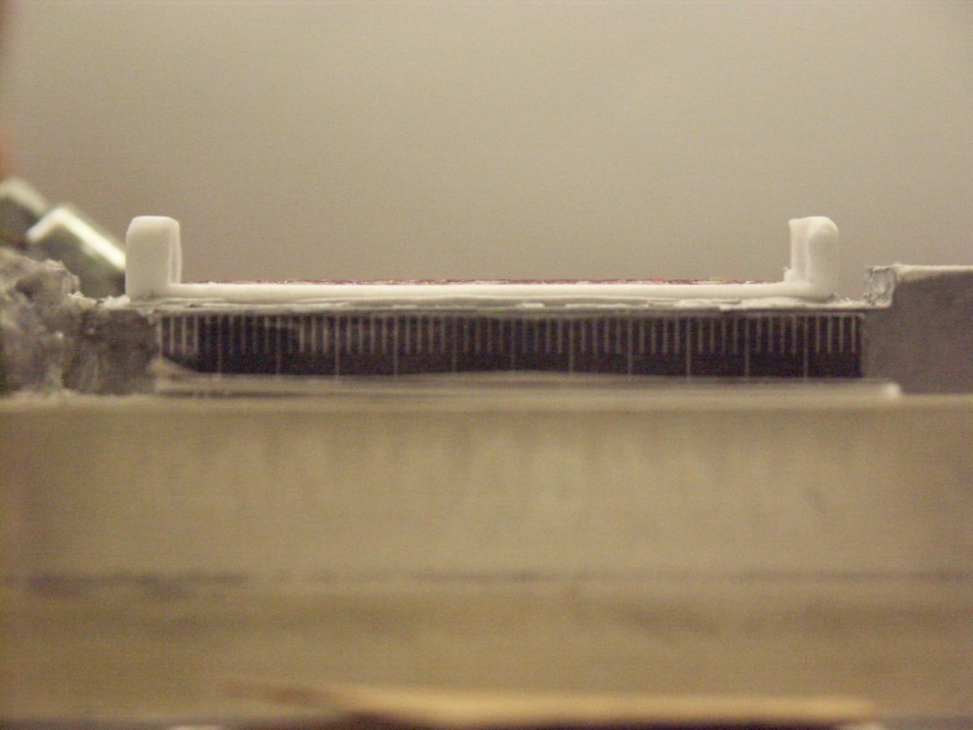
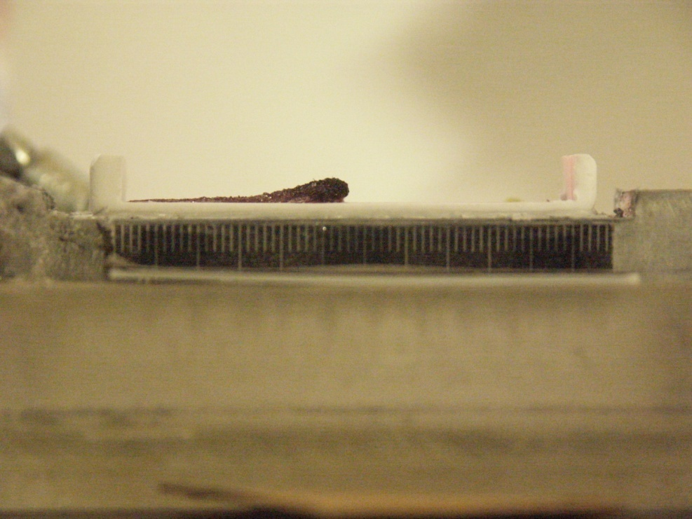
Au@DDT Mountain Building
T = 0 h T = 8 h

Slide 38
Au@DDT Mountain Heights

Slide 39
Au@DDT Mountain Rates

Slide 40
Overall Mountain Heights

Slide 41
Overall Mountain Rates

Slide 42
Conclusion
Pure Octadecane
Temperature Marangoni Effect
Au@DDT in Octadecane
Particle Marangoni Effect
CdSe@TOPO in Octadecane
Temperature Marangoni Effect
NOT Soret Effect

