Slide 1
Effects of Visual Cueing on Beginner Problem Solvers in Physics
Tanner Stevens, Adrian Carmichael, N. Sanjay Rebello
Kansas State University, REU Summer 2010

Slide 2
Motivation
Multimedia in science education
Guide students’ attention
Activate prior knowledge, deeper conceptual understanding.

Slide 3
Research Question
Does visual cueing influence problem solving ability?
Do students reason differently after visual cueing?

Slide 4
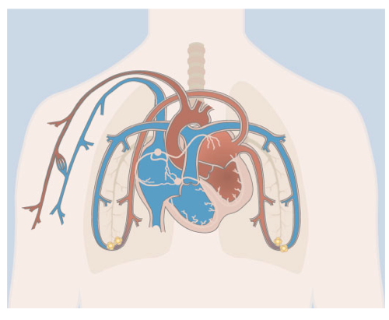
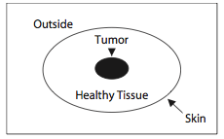
Previous Research (1)
Attentional Cueing
Visual cues on animation of cardiovascular system enhanced comprehension and transfer performance.^{[1]}
Participants whose eyes were guided while solving Duncker’s radiation problem solved more quickly.^{[2]}
1. B. Koning et. al. (2007) 2. L. Thomas & A. Lleras (2007)

Slide 5
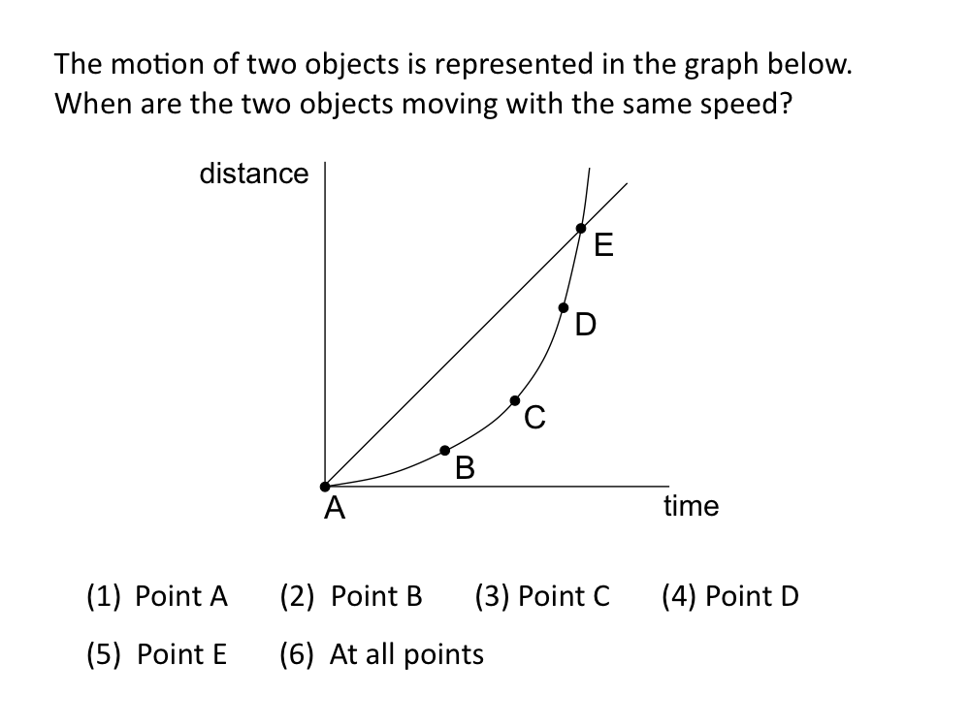
Previous Research (2)
Visual Attention Differences
Participants who responded correctly visually attended to the diagram differently.^{[3]}
3. Carmichael et. al. (2010)
Percentage of Time Spent in Viewing Area
Relevant Area
Correct: 30%
Incorrect: 18%
Salient Area
Correct: 13%
Incorrect: 25%

Slide 6
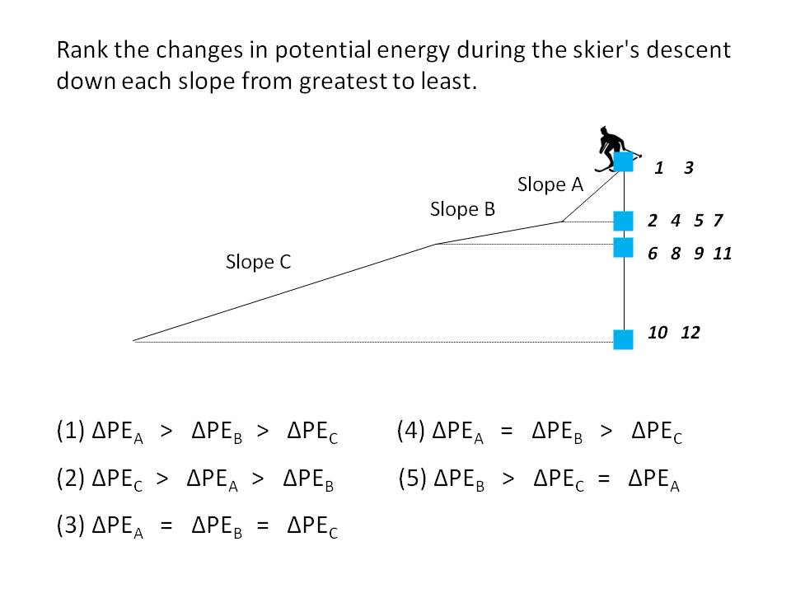
Visual Cueing
Can we guide novices’ attention to relevant parts of a diagram using visual cues to help activate correct prior knowledge and answer correctly?

Slide 7
Experimental Design
Initial Problem
1st Cued Problem
2nd Cued Problem
3rd Cued Problem
Correct Explanation?
Correct Explanation?
Correct Explanation?
Correct Explanation?
no
no
no
no
yes
yes
yes
yes
Transfer Problem

Slide 8
Experimental Design
Initial Problem
1st Similar Problem
2nd Similar Problem
3rd Similar Problem
Correct Explanation?
Correct Explanation?
Correct Explanation?
Correct Explanation?
no
no
no
no
yes
yes
yes
yes
Transfer Problem

Slide 9
Experimental Design
Similar problems
– same concept, similar surface features

Slide 10
Experimental Design
Example Cues

Slide 11
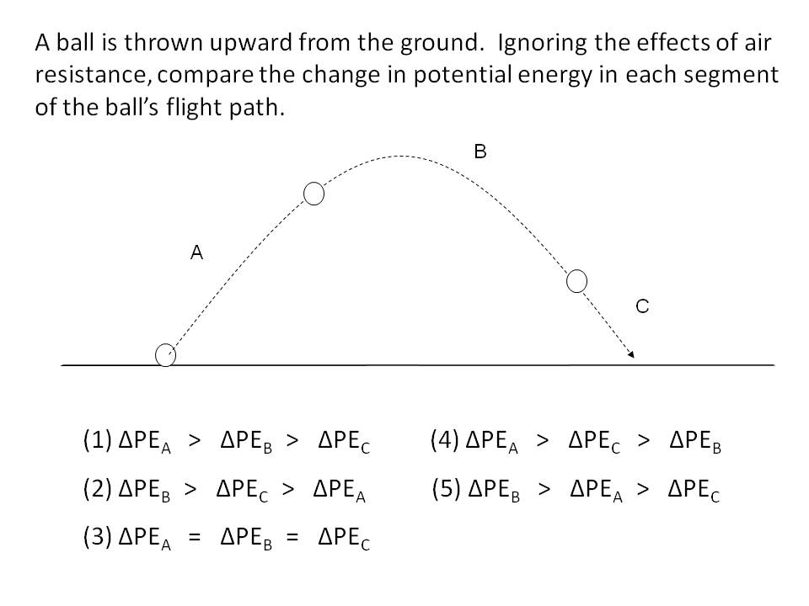
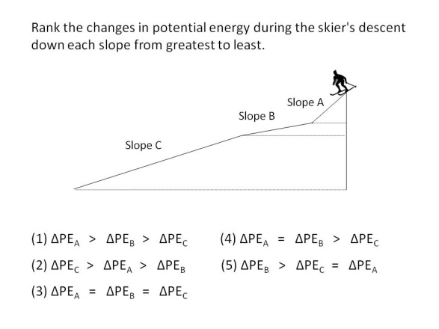
Experimental Design
Transfer Problem
– same concept, different surface features.

Slide 12
Analysis
15 participants (8 cued, 7 non-cued)
Compared transfer problem responses in cued and non-cued groups.
Categorized participants verbal explanations to analyze changes in conceptual reasoning within problem sets between cued and non-cued groups.
“The hill was steeper in A, so it will be going faster.”
“There are less bumps in A, so it will be going faster.”

Slide 13
Results

Slide 14
Results

Slide 15
Conclusions
Cued participants changed reasoning more often on two problems.
Visual cueing may have a smaller effect on problem solving correctness.
Small sample size, large error

Slide 16
Future Research
Different number of similar problems
Different Cueing methods
Larger sample size

Slide 17
Acknowledgements
Adrian Carmichael
Sanjay Rebello
KSU-PER Group
Kansas State Physics REU Program
Larry Weaver
Kristan Corwin
The National Science Foundation

Slide 18
Thanks for listening!
Further questions?
Contact me @:
steve461@umn.edu

Slide 19
Outline
Research Question
Previous Research
Experimental Design
Results & Analysis

Slide 20
References
B. Koning, H.K. Tabbers, R. Rikers & F. Paas, Applied Cognitive Psychology 21, 731-746 (2007).
L. Thomas & A. Lleras, Psychonomic Bulletin & Review 14, 663-668 (2007)
A. Carmichael, A. Larson, E. Gire, L. Loschky & N. S. Rebello, submitted to AIP Conf. Proc. (accepted for publication, 2010).

Slide 21
Experimental Design
Highly visual conceptual problems
Verbal explanation
If incorrect, show similar problems
Cued vs. Non-cued
Transfer Problem – conceptual understanding, different context

