Slide 1
Corrections to H⁺ deflection and time of flight for an ideal parallel plate deflector using a real deflector simulated with SIMION
By Bret Polopolus
Thanks to Itzik Ben-Itzhak and Bishwanath Gaire
J.R. Macdonald Laboratory, Physics Department, Kansas State University, Manhattan, Kansas 66506
This work was partially funded under NSF grant number PHY-0851599
Supported by the Chemical Sciences, Geosciences, and Biosciences Division,
Office of Basic Energy Sciences, Office of Science, U.S. Department of Energy

Slide 2
Overview
A molecular ion beam is sent toward a detector
The laser interacts with the ion beam dissociating
H₂⁺ → H + H⁺
The particles move through a parallel plate deflector to separate their detection

Slide 3
Ideal Parallel Plate Deflector
Geometry
Plate Length L = 64 mm
Plate separation d = 30 mm
Detector’s distance from plates z = 668 mm,
Distance from interaction to detection l = 944 mm
Real Parallel Plate Deflector

Slide 4
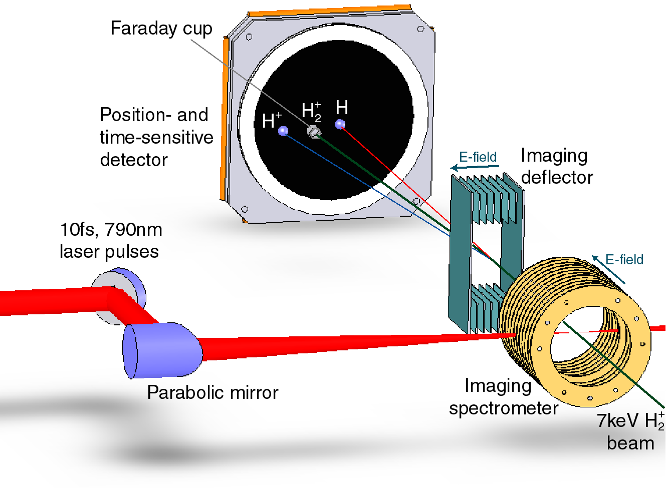
x
ẑ
ŷ
Without a deflector
Fragments with a low Kinetic Energy Release (KER)
are lost in the faraday cup
Ion Beam is run with an energy of 3-8 keV

Slide 5
O₂⁺ dissociation
40 fs laser
0.075
Low KER fragments are lost into the faraday cup

Slide 6
What is the deflection with y_{i} = 0 and v_{yi} = 0?
Equation for deflection
Slope with our geometry
qV/E is a useful scaling factor between the beam and the defelctor

Slide 8
x
ẑ
ŷ

Slide 9
Correction factor: ratio of real slope simulated in SIMION to ideal slope
896.63/746.67 = 1.20

Slide 10
What can we conclude?
Modified ideal equation:
Correction factor seems independent of detector position and likely the result of the fringing electric field:

Slide 11
Effect of varying initial position

Slide 12
Deflection along y axis by real deflector with z = 668 mm simulated in SIMION
Worst Case Scenario
Deflection spread
for qV/E = 0.04
±0.04 mm, which is o.11%
Resolution requirement
0.1 mm

Slide 13
Result
Largest δy was about 0.0408 mm for qV/E = 0.04
Resolution limit on distinguishing deflections:
δy ≥ 0.1 mm
qV/E = 0.0632 → δy = 0.1014
Irrelevant because proton would miss 40 mm detector
Conclusion:
no need to modify the ideal equation for initial position
nor run SIMION for every variation

Slide 14
Effect of varying initial transverse velocity, v_{yi}

Slide 15
Worst Case Scenario
Deflection spread about ±40 mm
Ideal equation
t is not constant

Slide 17
Result
y intercept is
Expectation: identical slopes for same qV/E
Not the case
Explanation → v_{yi} and time of flight are coupled
Time of flight is not constant!
Use t_{simion} instead of t_{ideal}

Slide 18
Time of Flight (TOF) y_{i} = 0 and v_{yi} = 0

Slide 19
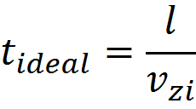
The Ideal TOF
t_{simion} ≠ t_{ideal}

Slide 20
x = qV/E
Resolution Requirement
25 ps

Slide 21
TOF dependence on initial position along y-axis, y_{i}

Slide 22
Spread ≈ ±71 ps
Resolution Requirement
25 ps

Slide 23
TOF dependence on initial y-velocity, v_{yi}

Slide 29
Summary

Slide 30
Deflection y_{i} = 0
no modification
Deflection spread
±0.04 mm
v_{yi} and time of flight are coupled
v_{yi} ≠ 0, Deflection spread about ±40 mm
TOF correction for y_{i} = 0, v_{yi} = 0
x = qV/E
y_{i} ≠ 0 after y = 0 correction error is reduced to about ± 71 ps
v_{yi} ≠ 0 introduces an error of up to 2 ns

Slide 31
Future Directions
Simulations of v_{yi} directed away from the detector should be run
Imaging
Rewrite equations to reconstruct v_{yi}

