Slide 1
Dynamic High Repetition Rate Carbon Nanotube Fiber Laser Frequency Comb
By: Tyler McKean
Rose-Hulman Institute of Technology Terre Haute, IN
July 23, 2009
Notes:
Credit everyone?

Slide 2
Outline
Frequency Combs
Characterization of carbon nanotubes
Laser designs containing carbon nanotubes
Applications of these lasers to frequency combs

Slide 3
Frequency Comb
Cundiff, Steven T. and Ye, Jun. ‘Phase stabilization of mode-locked lasers.’ Journal of Modern Optics, 52:2, 201-219 (2005)
Notes:
Mode Locked lasers produce series of optical pulses separated by the trip time. Spectrum of this pulse train is series of delta functions separated by rep rate. This is a frequency comb

Slide 4
Frequency Comb Metrology
Cundiff, Steven T. and Ye, Jun. ‘Phase stabilization of mode-locked lasers.’ Journal of Modern Optics, 52:2, 201-219 (2005)

Slide 5
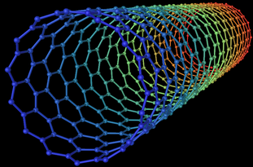
Saturable Absorption
3-D Model of a Carbon Nanotube

Slide 6
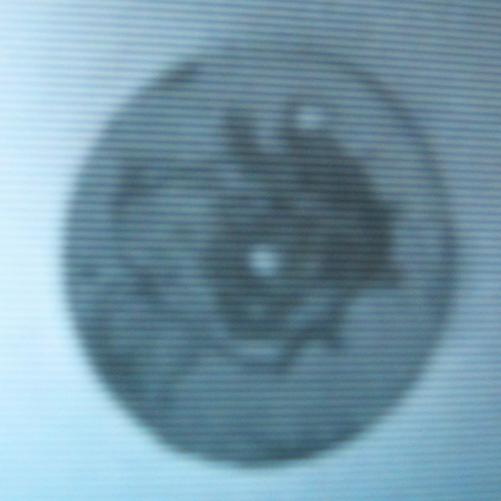
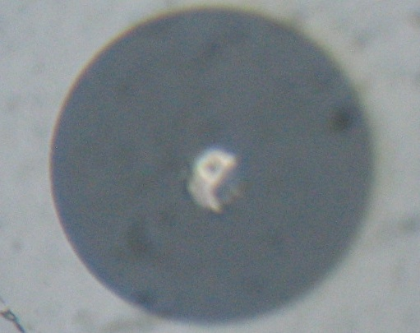
Damage Threshold of Carbon Nanotubes
Nanotubes damage at 40-50mW CW laser light
Without Deposition
With Deposition
Damaged End
m
O

Slide 7
Wavelength Dependent Absorption
-Sze Y. Set et al. ‘ultrafast Fiber Pulsed Lasers Incorporating carbon nanotubes.’ IEEE Quantum Electronics vol. 10, No. 1 (2004)

Slide 8
100 MHz Rep. Rate CNFL
LD
48 cm
15 cm
WDM
20 cm
40 cm
PM
90/10
CNs
95/5
16 cm
12 cm
13 cm
OSA
19 cm
10 cm
EDF
SMF
HI 1060

Slide 9
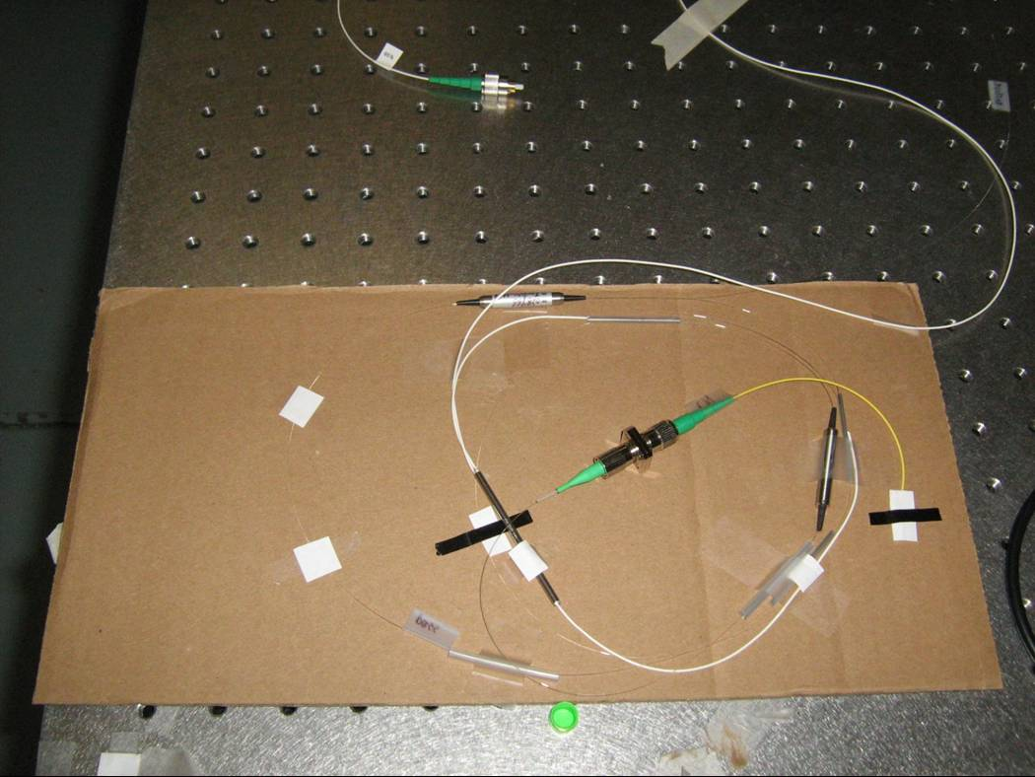
Advantages of this
Easily mode locked
Durable
Short cavity length
Light weight/portable
High Rep. Rate

Slide 10
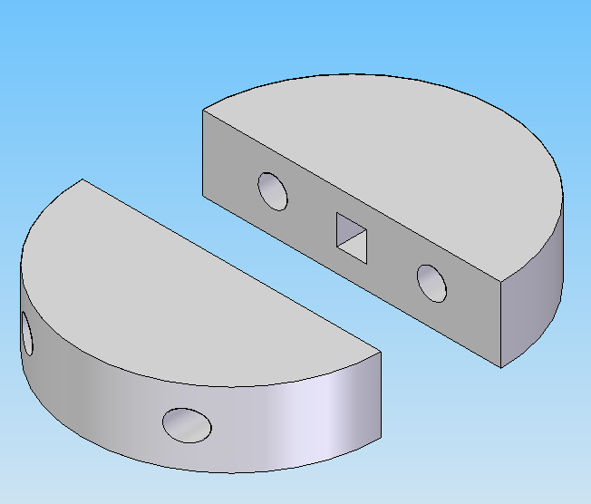
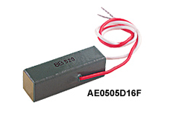
Piezoelectric Transducer
Crystal that expands when electricity is applied
17.4 μm change in size
Used to stretch fiber

Slide 11
High Dynamic Rep. Rate Laser Design

Slide 12
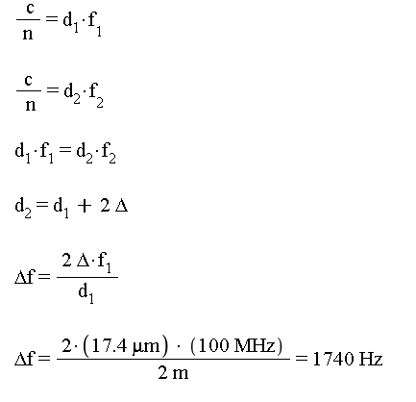
Dynamic Rep. Rate Calculation

Slide 13
Recap
Want to do Frequency Comb Metrology
Stable Mode-Locked Frequency Comb Reference
Use Nanotubes as Mode-Locking Mechanism
Short Cavity Length for High Rep. Rate
Dynamic Control over Rep Rate

Slide 14
Thank You!
Questions?

