Slide 1
Surface Optical Properties of Gold Nanoparticles
Emily Walker
Rose-Hulman Institute of Technology
Kansas State University Physics REU 2008
Dr. Bruce Law
Dr. Chris Sorensen

Slide 2
Outline
Project Goals
Gold Nanoparticles
Research Method
Ellipsometry
Theoretical Models
Results
Contact Angle
Conclusions

Slide 3
Project Goals
Examine how concentration affects optical properties of gold nanoparticles.
Determine if the particles form a layer on the surface of the glass.

Slide 4
Gold Nanoparticles
5 nm in diameter
Dissolved in tert-butyl toluene (tBT)
Kept separate by dodecane thiol ligands
Ligands increase overall size to ~7.4 nm
        5 nm 1.2 nm

Slide 5
Research Method
Ellipsometry readings at different concentrations
Theoretical models of ellipsometry results
Contact angle measurements

Slide 6
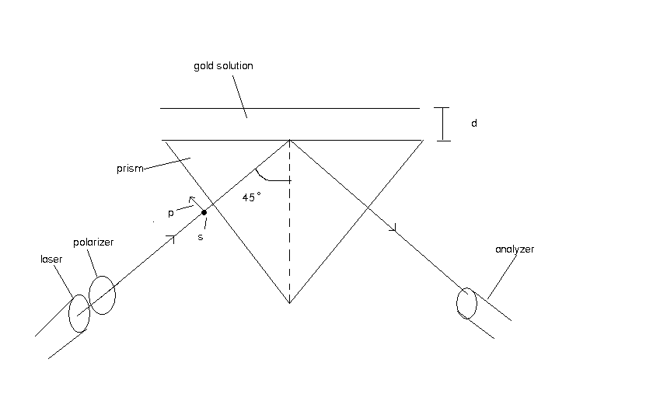
Ellipsometry
Able to see sub mono-layers of molecules
Non-destructive
Measures the change of polarization after surface reflection

Slide 7
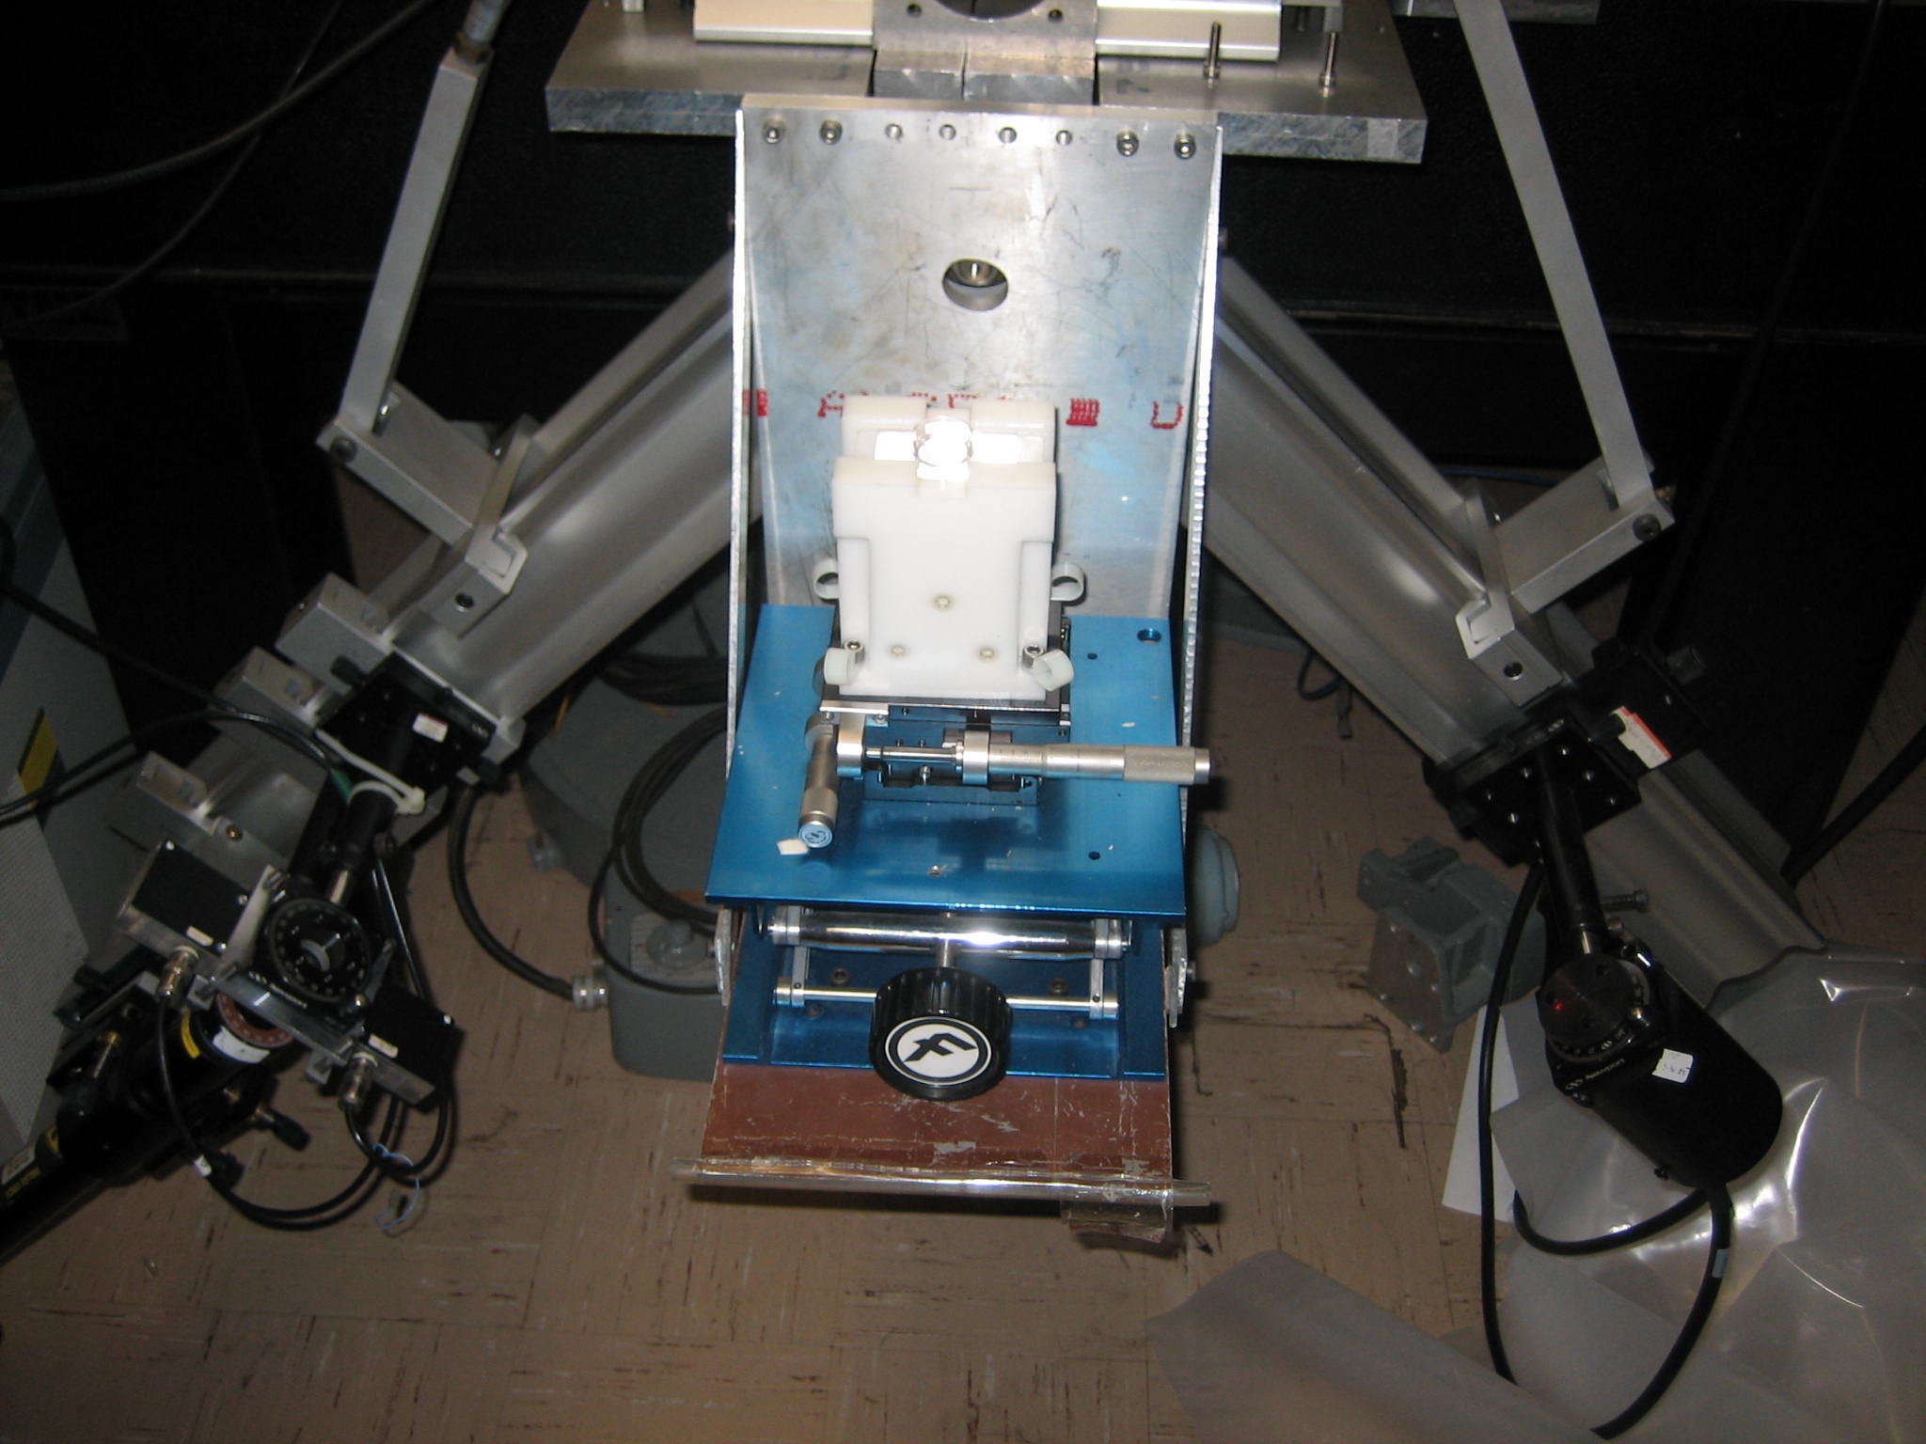
Ellipsometry

Slide 8
System Properties
λ = 6328.0 Å
θ = 45°
n1 (glass) = 1.472
ε2 (gold) = 11.0 + 1.37i
ε3 (tBT) = 2.18744

Slide 9
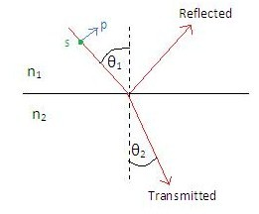
Fresnel Reflection
The reflectance of a thin film can be modeled using Fresnel’s equations.

Slide 10
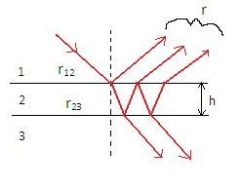
Fresnel Reflection
This occurs at each surface, so we use the equation
Where beta is the phase
shift upon reflection expressed by

Slide 11
Problem
Inconsistent results

Slide 12
Better Cleaning Methods
Method 1:
1. Detergent clean
2. Acetone, ethanol and toluene
3. Ultra-high purity (UHP) nitrogen
4. Ozone cleaning
Method 2:
1. Detergent clean
2. Acetone, ethanol and toluene
3. Ultra-high purity (UHP) nitrogen
4. Plasma cleaning
5. Millipore water

Slide 13
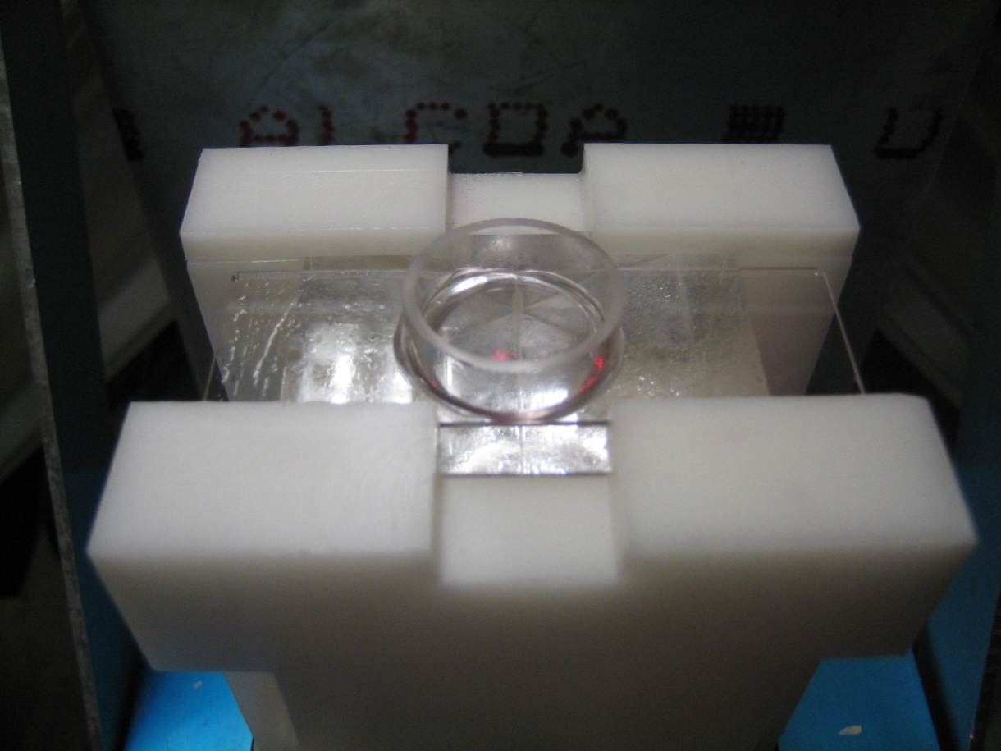
Sample Cells
Microscope slides
Glass rings attached with UV-curing glue
Hold less than
2 ml liquid

Slide 14
Results

Slide 15
Computer Modeling
I used two simple models to characterize the behavior of the particles at varying concentrations
Python script written by Frank, edited by me, was used to model the ellipsometer readings for different systems

Slide 16
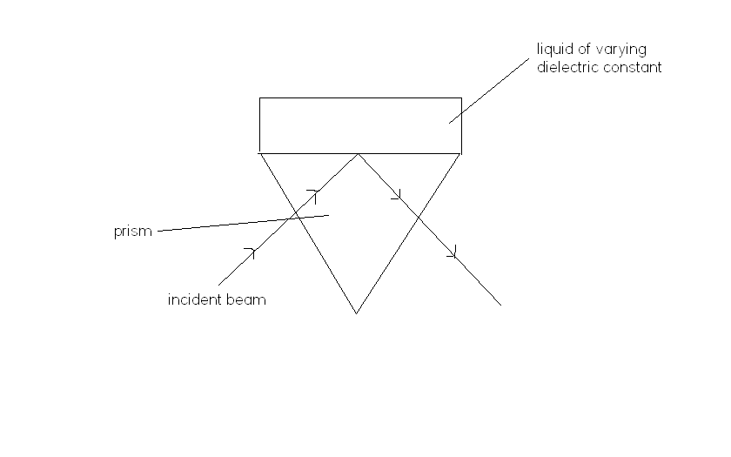
Model 1 (Bulk Effect)
The gold nanoparticles stay in solution
The dielectric constant of the solution changes as a function of concentration

Slide 18
Gold at Varying Concentrations

Slide 19
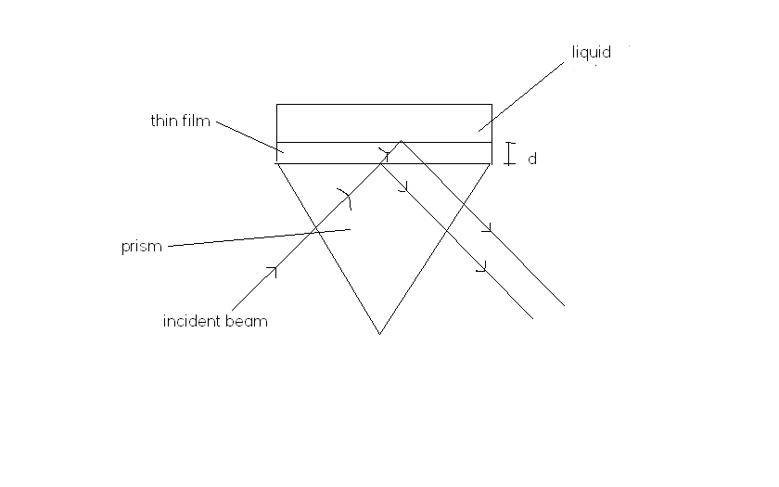
Model 2 (Layer Effect)
The particles form a layer on the bottom of the container
The layer becomes thicker as more particles are added
h

Slide 20
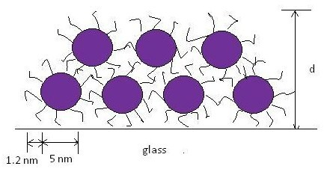
Model 2 (Layer Effect)
h

Slide 21
Contact Angle
Angle a liquid or vapor makes with a solid surface
First, tested with the cleaning method that yielded consistent results
Next, tested without the plasma cleaning

Slide 22
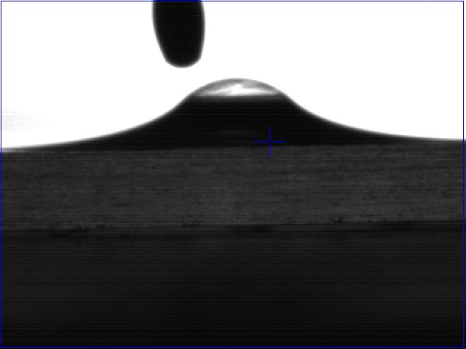
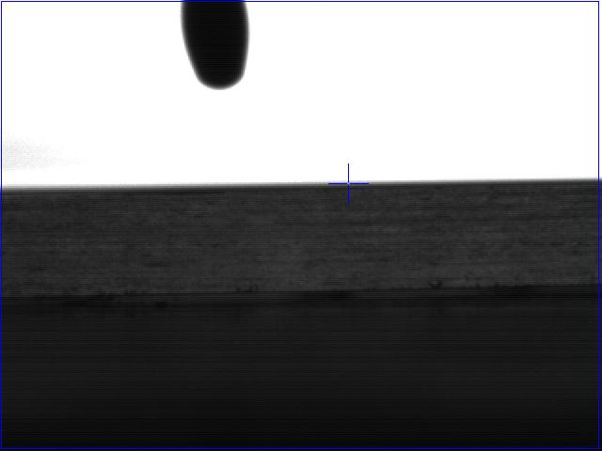
Nanoparticle Contact Angle Without Plasma Cleaning
After nanoparticle solution was dropped on glass slide
54 seconds after solution was dropped

Slide 23
Conclusions
Neither of the two models used to characterize the data fit well
The nanoparticle solution completely wets the surface of the glass regardless of whether it has been plasma cleaned

Slide 24
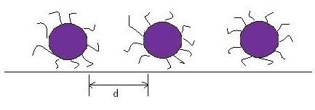
Future work
A third model could be applied to the system
The spacing between particles varies rather than the thickness of the layer

Slide 25
What I Learned
Ellipsometry
How to hook up a gas regulator
How to work with other people
How the dielectric constant of a medium depends upon concentration
Consistent results are a precious commoditiy

Slide 26
Thank you
Dr. Law
Dr. Sorensen
Dr. Weaver
Dr. Corwin
Frank Male
Sean McBride
Erik Stalcup
Ashley Cetnar
Sreeram Cingarapu
Dr. Aakeroy
Tahereh Mokhtari

