Slide 1
Dark Matter Halo Mass Correction in Mock Universe Simulations
Weston Schwartz
Kansas State University REU

Slide 2
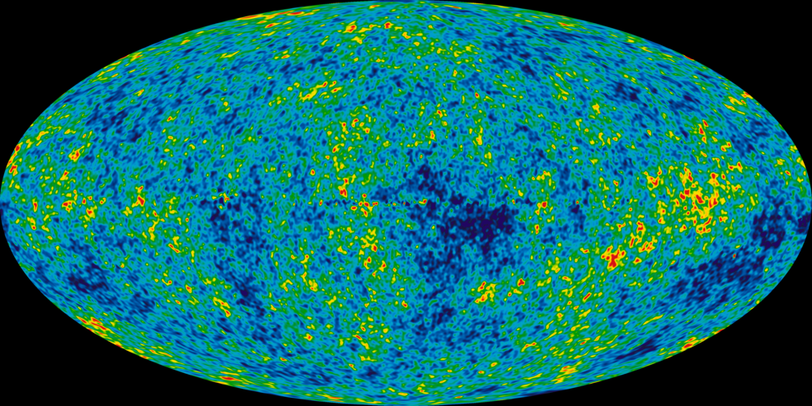
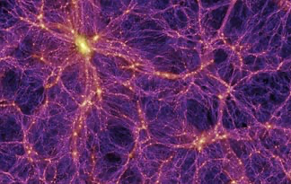
Introduction/Motivation:
Widespread Homogeneity to Cosmic Webs
  Unknown as to how transition happened
Simulations can help
Full Physics Simulation (FPS) vs. Dark Matter Only Simulations (DMOS)
Full physics is a lot….but just gravity?
Image provided by NASA: Wilkinson Microwave Anisotropy Probe June 28, 2016
Image provided by Millennium Simulation Project; Springel V., et al

Slide 3
Motivating Literature
Based on one of the five papers produced from IllustrisTNG project
  “First Results from the IllustrisTNG simulations: Matter and Galaxy Clustering” (Springel, V. et al., Monthly Notices of the Royal Astronomical Society, Volume 475, pg 676-698, (2017))
IllustrisTNG: Successor to the pre-existing Illustris Suite
  Larger (TNG300) Higher Resolution (TNG50) Updated Cosmology (TNG100)
  Each FPS has an identical DMOS counterpart
Results: FPS Strongly Correspond to Extant Observations

Slide 4
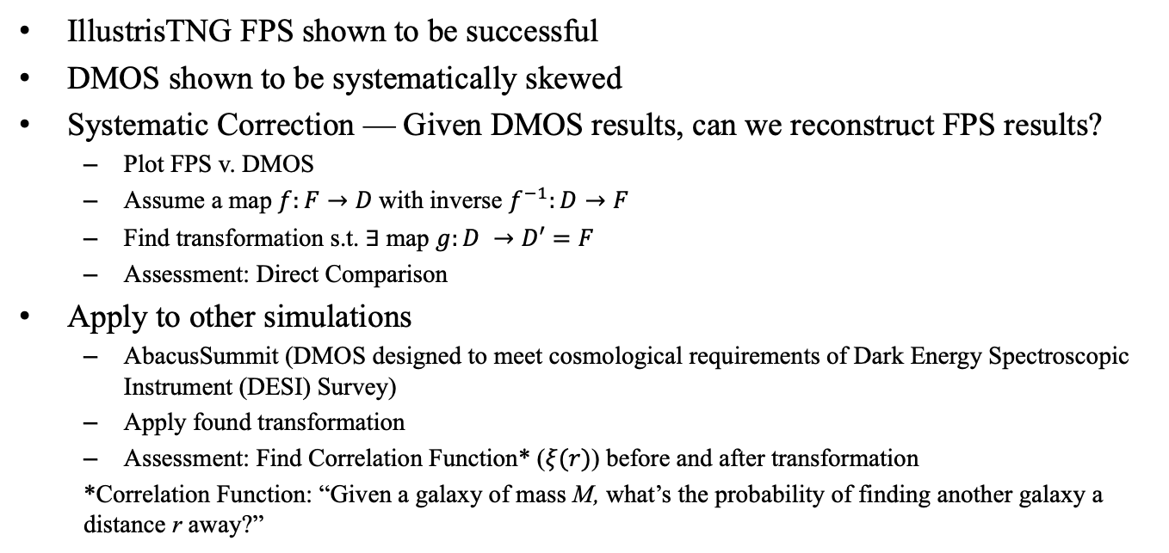
Theory
IllustrisTNG FPS shown to be successful
DMOS shown to be systematically skewed
Systematic Correction — Given DMOS results, can we reconstruct FPS results?
  Plot FPS v. DMOS
  Assume a map $f:F→D$with inverse $f^{−1}:D→F$
  Find transformation s.t. $∃$map $g:D →D′=F$
  Assessment: Direct Comparison
Apply to other simulations
  AbacusSummit (DMOS designed to meet cosmological requirements of Dark Energy Spectroscopic Instrument (DESI) Survey)
  Apply found transformation
  Assessment: Find Correlation Function* ($ξ(r)$) before and after transformation
  *Correlation Function: “Given a galaxy of mass M, what’s the probability of finding another galaxy a distance r away?”

Slide 5
Methods
IllustrisTNG
To construct sought after map, we plot relevant data points on an FPS v. DMOS scatter plot
Find line of best fit
Mix of linear algebra and trigonometry to correct trend
  Full Rotation
  DMOS Rotation
  Drop Method
AbacusSummit:
Apply Correction Methods
Halo Occupancy Distribution (HOD) module

Slide 6
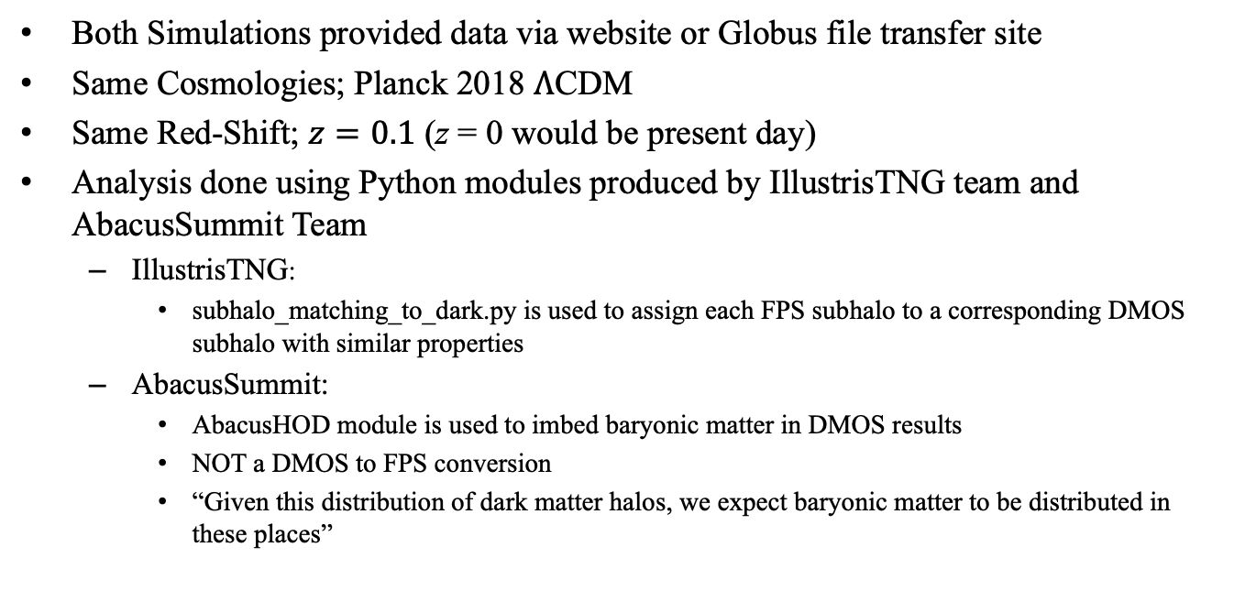
Data Collection/Analysis
Both Simulations provided data via website or Globus file transfer site
Same Cosmologies; Planck 2018 $Λ$CDM
Same Red-Shift; $z=0.1$ (z = 0 would be present day)
Analysis done using Python modules produced by IllustrisTNG team and AbacusSummit Team
  IllustrisTNG:
    subhalo_matching_to_dark.py is used to assign each FPS subhalo to a corresponding DMOS subhalo with similar properties
  AbacusSummit:
    AbacusHOD module is used to imbed baryonic matter in DMOS results
    NOT a DMOS to FPS conversion
    “Given this distribution of dark matter halos, we expect baryonic matter to be distributed in these places”

Slide 7
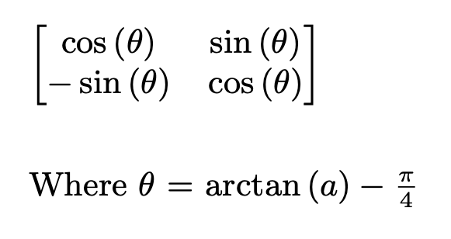
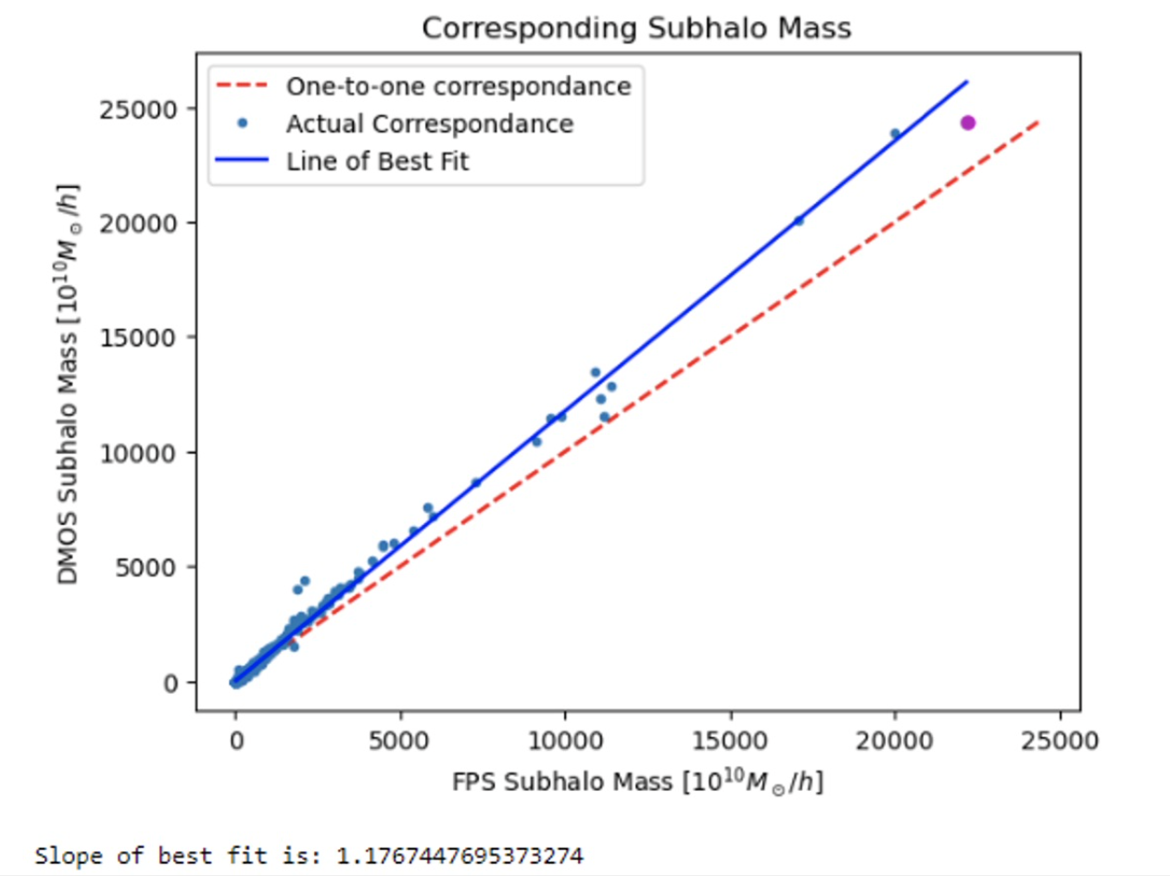
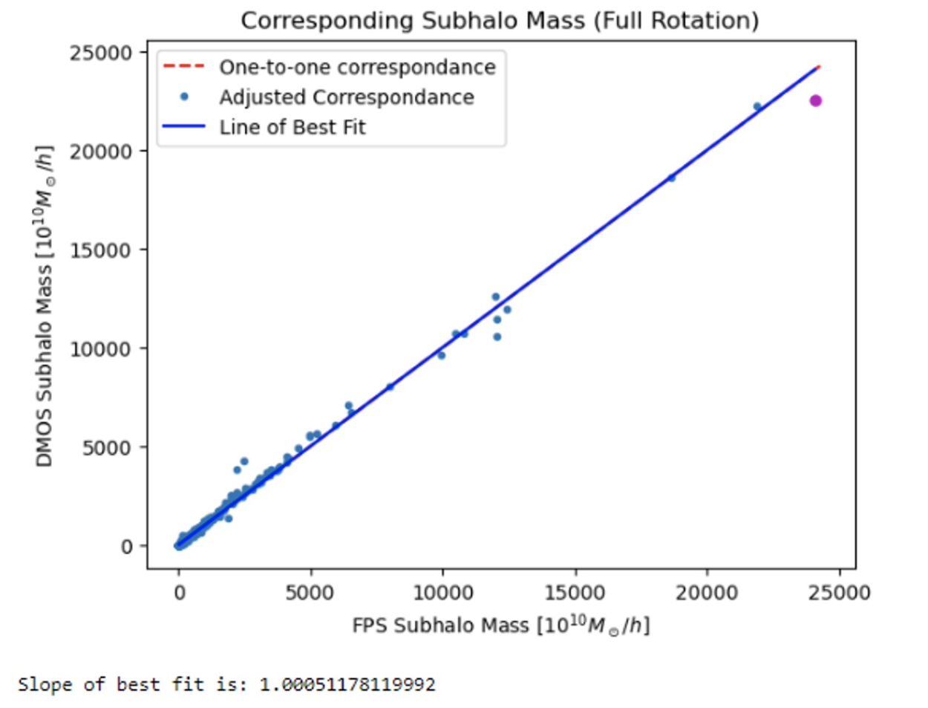
Results: IllustrisTNG
Full Rotation
(a is slope of best fit)
Source: Plots made by Weston Schwartz

Slide 8
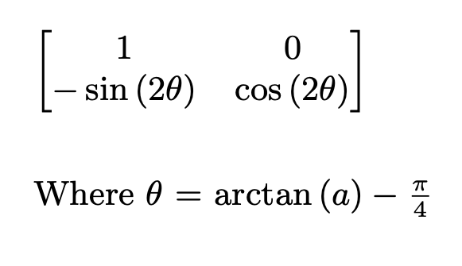
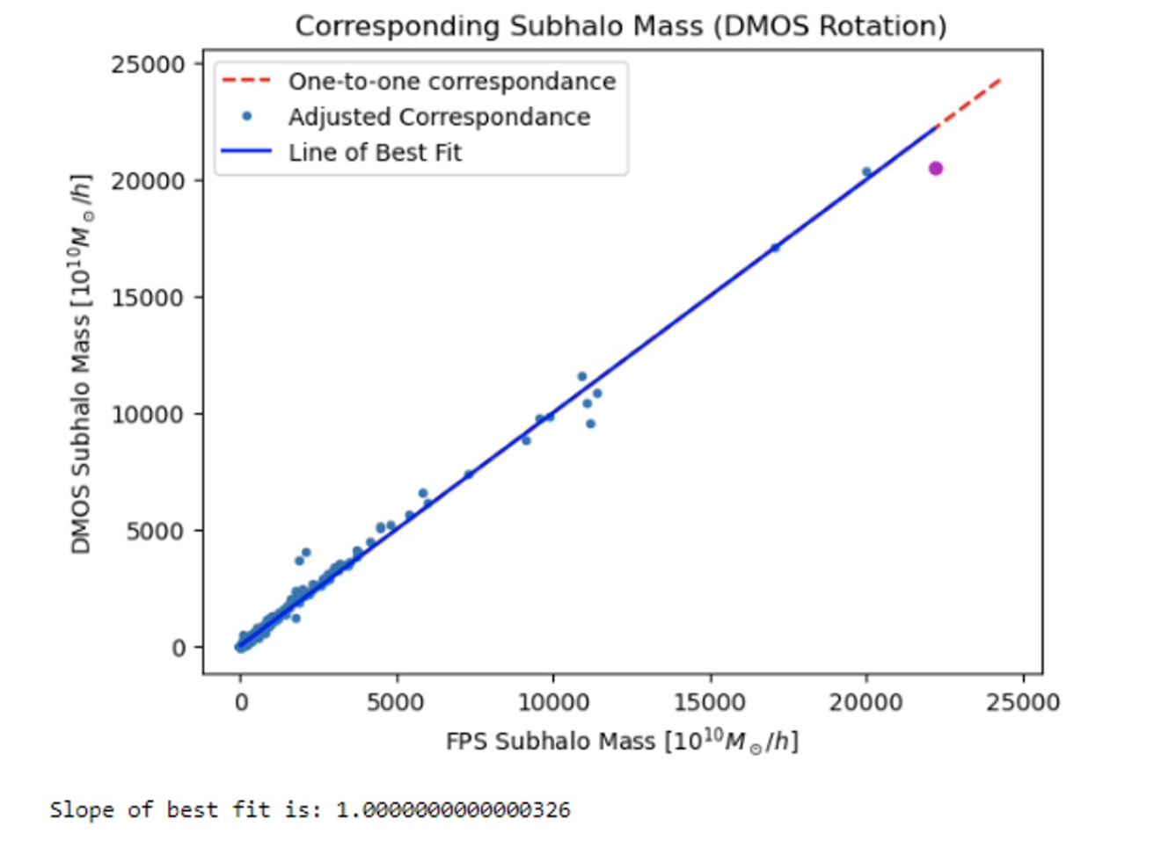
Results: IllustrisTNG (Cont.)
DMOS Rotation:
Source: Plots and matrix made by Weston Schwartz

Slide 9
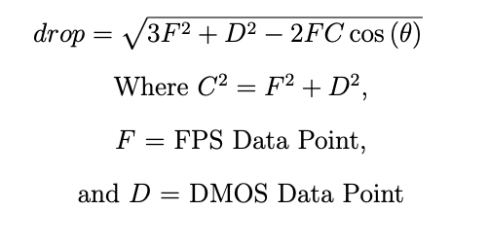
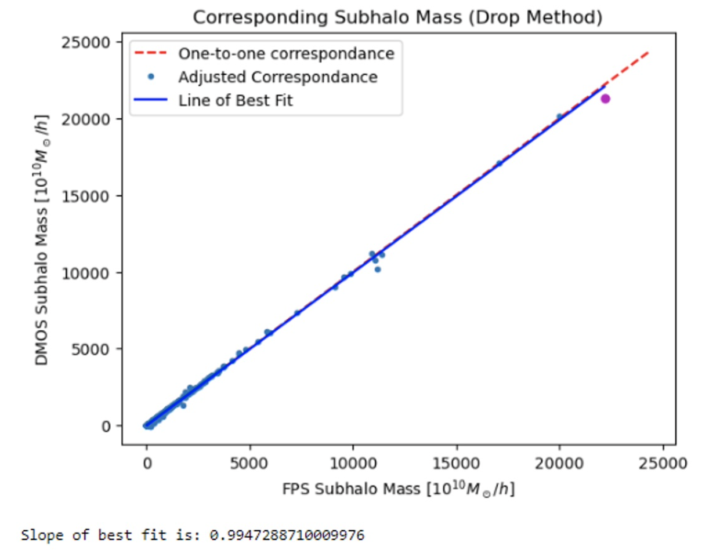
Results: IllustrisTNG (Cont.)
Drop Method
Source: Plots and eq. made by Weston Schwartz

Slide 10
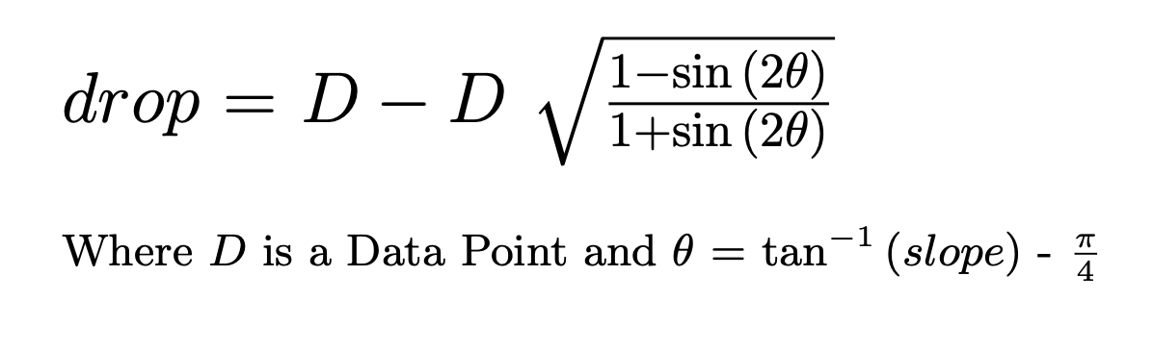
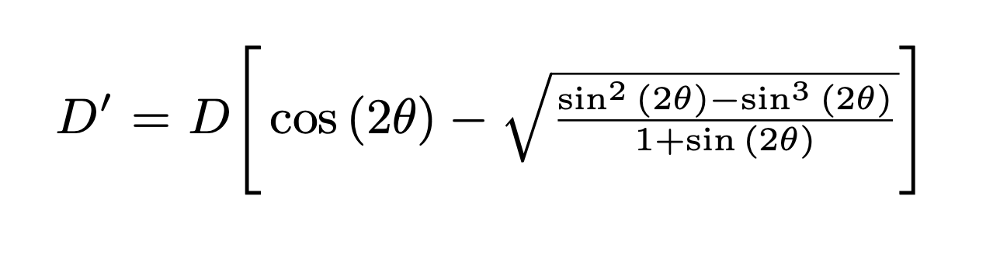
Results: Correcting the Correction
Realized these correction methods are still dependent on FPS data
Had to reformulate:
Equations by Weston Schwartz

Slide 11
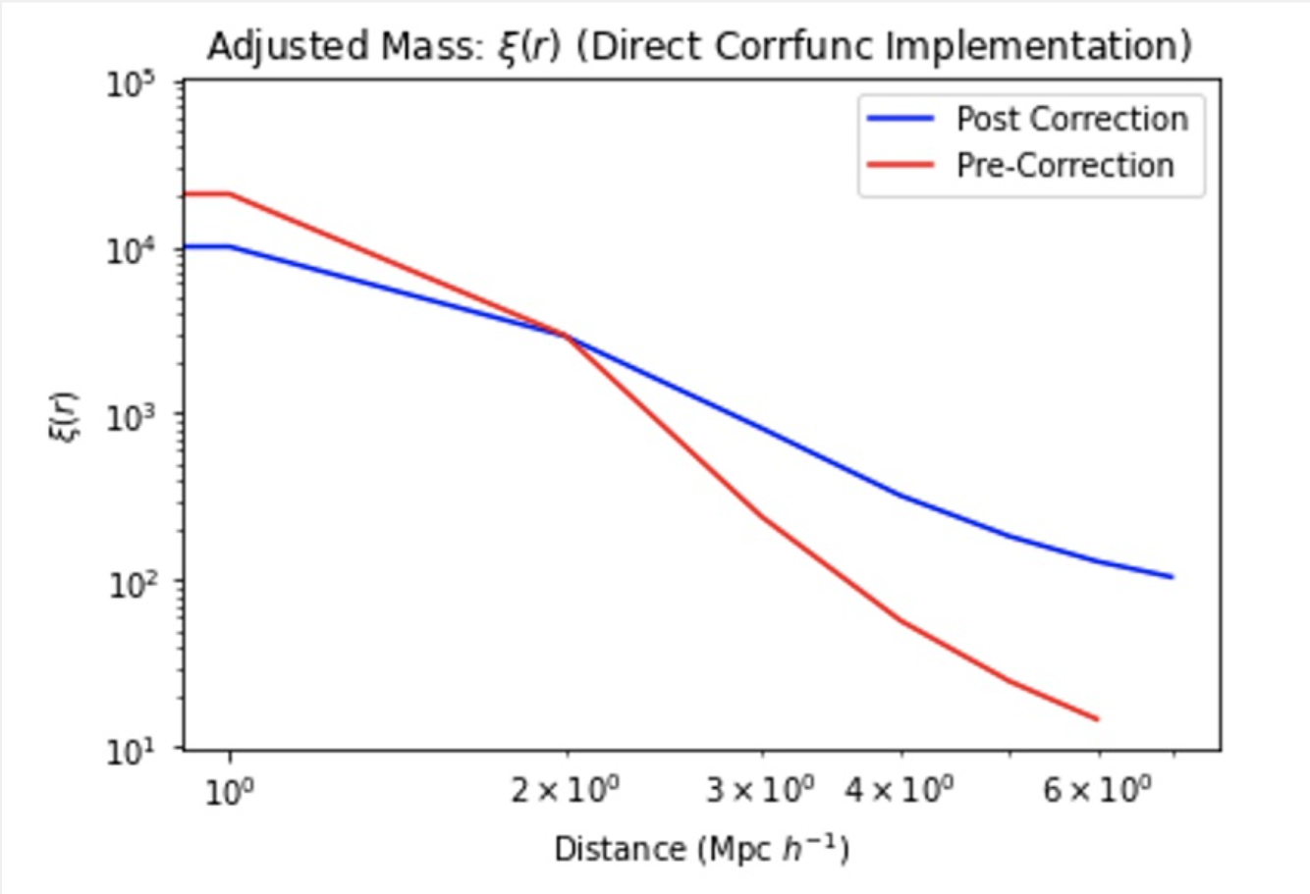
Results: AbacusSummit
Without Correction:
  Over estimated number of pairs are small distances
  Underestimated for larger distances
With Correction:
  More Gradual Descent
  Follows a quasi-power law
  Corresponds to IllustrisTNG results
Found, on average, DMOS produces halo
masses ~15% higher than FPS

Slide 12
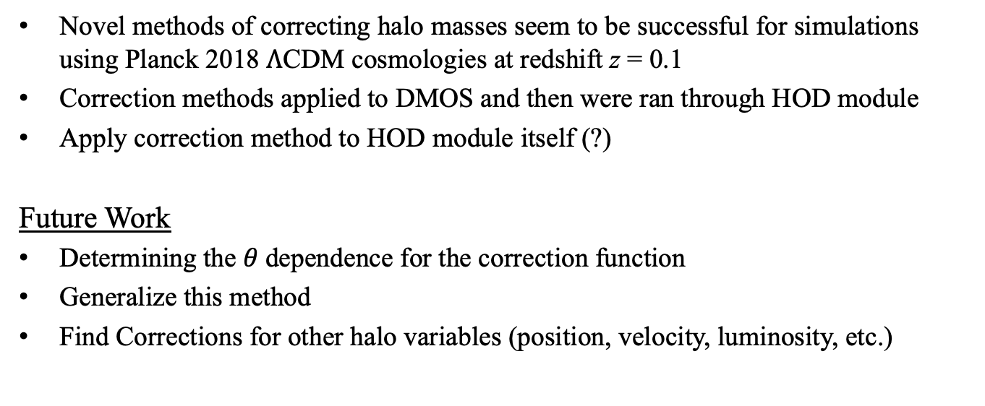
Discussion/Future Work
Novel methods of correcting halo masses seem to be successful for simulations using Planck 2018 $Λ$CDM cosmologies at redshift z = 0.1
Correction methods applied to DMOS and then were ran through HOD module
Apply correction method to HOD module itself (?)
Future Work
Determining the 𝜃 dependence for the correction function
Generalize this method
Find Corrections for other halo variables (position, velocity, luminosity, etc.)

Slide 13
Conclusion
Mock Universe Simulations:
  Invaluable to understanding large scale structure formation
  Helps understand overall structure of the Universe
  Dark Matter
Successful FPS reproduction via modified DMOS data
Modification methods offers possibility of optimizing modules such as AbacusHOD
More efficient Mock Universe Simulations

Slide 14


Acknowledgements
Thank you to:
National Science Foundation
K-State Physics Department and Faculty
Kim Coy, Dr. Loren Greenman, Dr. J.T. Laverty, Dr. Lado Samushia
"This material is based upon work supported by the National Science Foundation under Grant No. #2244539. Any opinions, findings, and conclusions or recommendations expressed in this material are those of the author(s) and do not necessarily reflect the views of the National Science Foundation."

Slide 15
Questions?

