Slide 1
Electron Event Selection in Doubly Charged Higgs Simulations
Reese Sanders
KSU REU 2023
0

Slide 2
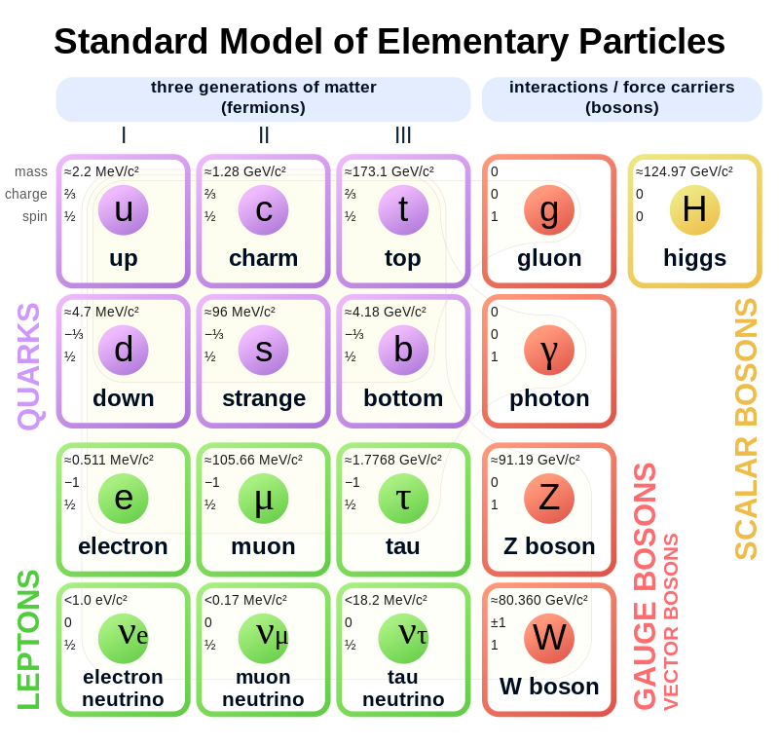
1

Slide 3
Type II Seesaw Model
m_{ν}
∝
M_{T}²
[1] Stefan Antusch, et al., arXiv:1811.03476 [hep-ph] (2018), “Low scale type II seesaw: Present constraints and prospects for displaced vertex searches.”
2

Slide 4
Modes of Decay
H±± → 𝓁 ±𝓁 ±
e⁻
μ⁻
τ⁻
e⁺
μ⁺
τ⁺
[2] The CMS Collaboration, CMS Physics Analysis Summary., “A search for doubly-charged Higgs boson production in three and four lepton final states at √ s = 13 TeV”
3

Slide 5
The Process
Choose Leptons
  Focus on electrons — 4e events in particular
Examine Triggers
Examine Cuts
  On Signal and Background
4

Slide 6
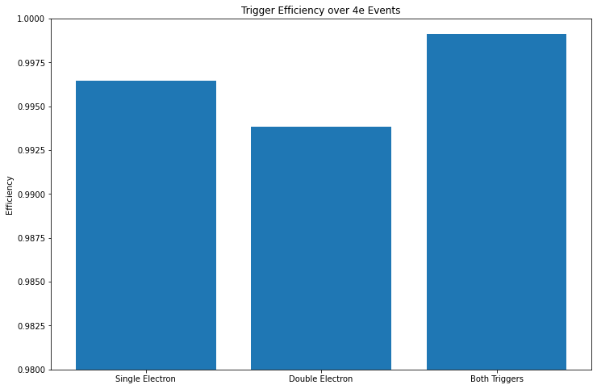
The Triggers
Two Triggers — 3 ways to apply
Single Electron Trigger
Double Electron Trigger
Both
5

Slide 7
The Cuts—Signal
e⁺
5 Levels of Cut:
  Veto
  Loose
  Medium
  HEEP
  Tight
What do these look like?
  What passes for reconstruction?
H⁺⁺
e⁺
e⁻
H⁻ ⁻
e⁻
6

Slide 8
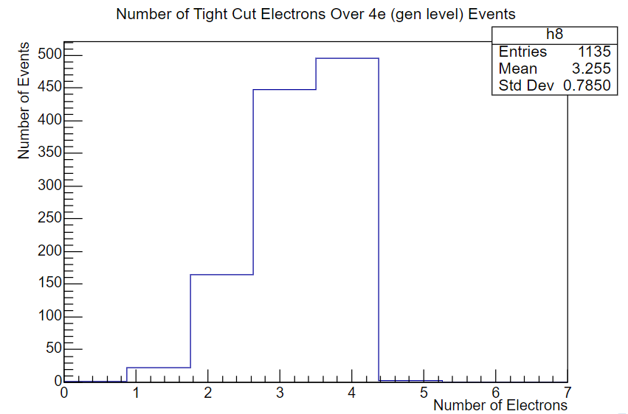
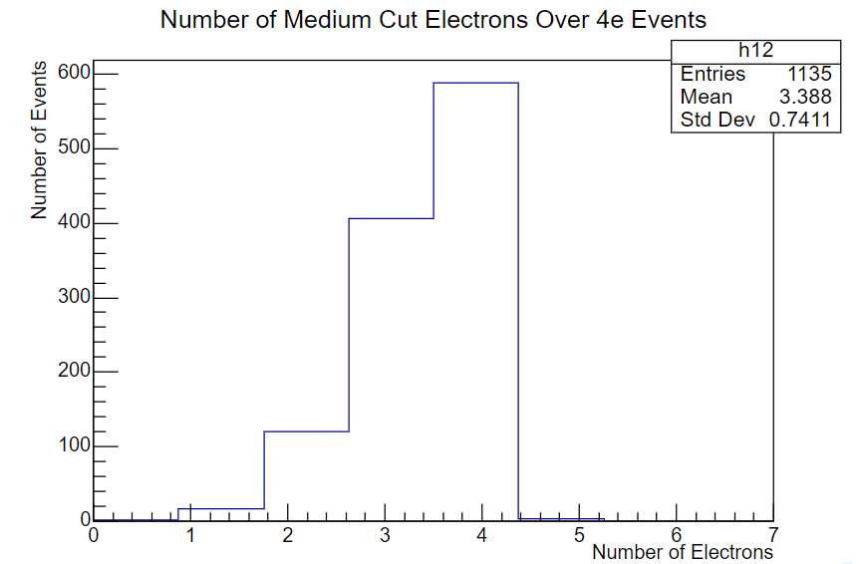
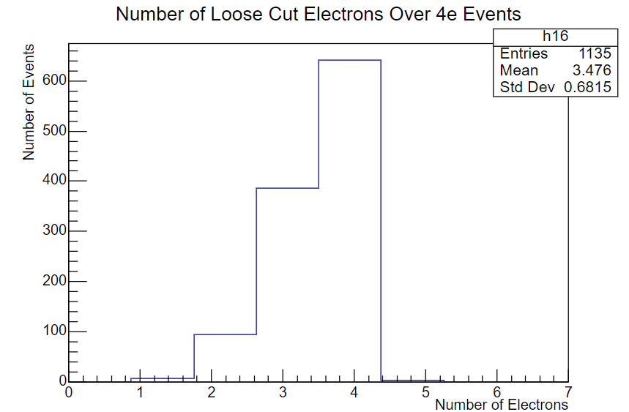
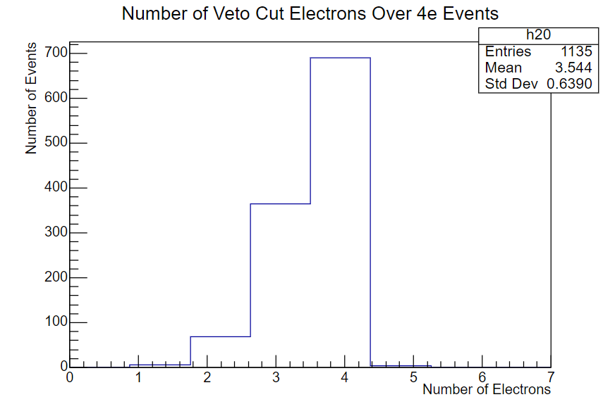
7

Slide 9
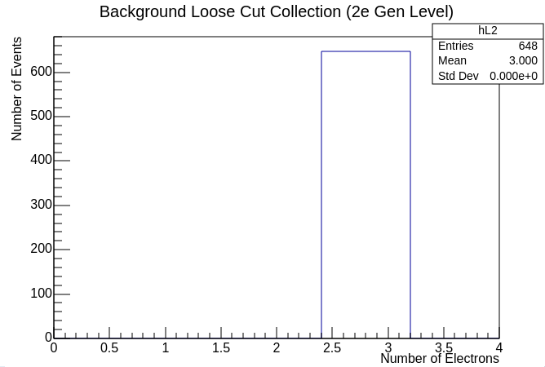
The Cuts—Background
Many backgrounds to analyze
  Focus on one
False electron sources
  Z boson
  Bottom quark
How many events pass 3+ loose electrons?
8

Slide 10
Quantifying Signal and Background
Background Contribution =
  Luminosity ✕ CS ✕ BR ✕ (3e Acceptance) ≈
Signal Contribution 3e =
  Luminosity ✕ CS ✕ (BR)² ✕ (3e Acceptance) ≈
Signal Contribution 4e =
  Luminosity ✕ CS ✕ (BR)² ✕ (4e Acceptance) ≈
Acceptance = N_{passing}/N_{total}
5409 events
1.6313 events
2.7062 events
9

Slide 11
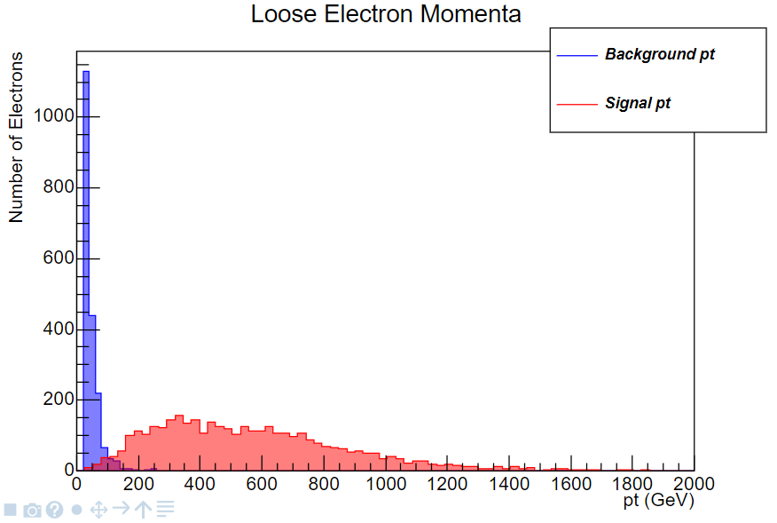
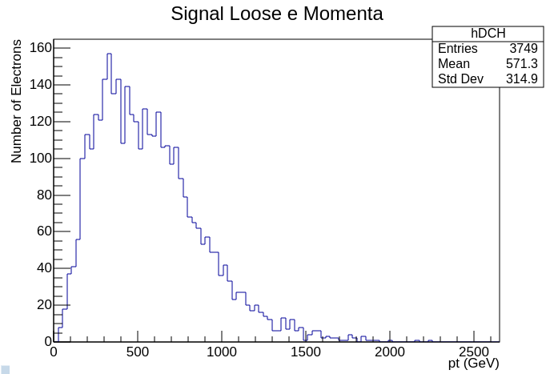
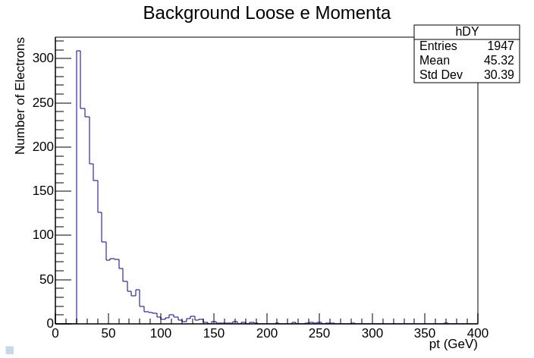
10

Slide 12
Conclusions & Future Work
Where do we cut our data?
  p_{T} > 200 GeV
Set Expectations for future data
  Only 1 to 3 H±± related electron events
  Significantly More Background events
Analyze the other backgrounds
  ZZ, WW, etc.
Analyze taus similarly
Analyze selected events
11

Slide 13



Acknowledgements
Kansas State University
Kim Coy
J.T. Laverty
Loren Greenman
Andrew Ivanov
CERN
National Science Foundation
This material is based upon work supported by the National Science Foundation under Grant No. #2244539. Any opinions, findings, and conclusions or recommendations expressed in this material are those of the author(s) and do not necessarily reflect the views of the National Science Foundation.
12

Slide 14
Questions?
13

