Slide 1
Potential Energy Surfaces for Excited States of CH₂I₂
Michael Quintieri
2023 Kansas State University Physics REU

Slide 2
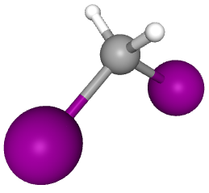
Coulomb Explosion
This method investigates molecules, like CH₂I₂, by breaking them.
In this case, a “pump” photon with a wavelength of 200 nanometers excites the molecule.
An infrared “probe” breaks the molecule.
The pieces are examined.
Pubchem: https://pubchem.ncbi.nlm.nih.gov/compound/diiodomethane#section=3D-Conformer
Notes:
I am studying CH2I2.

Slide 3
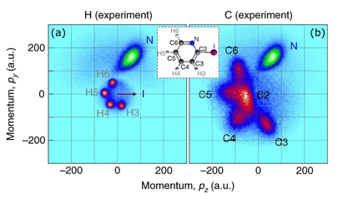
Theory Connection
Coulomb Explosion Imaging looks at the products.
The theorist tries to match models to the experimental results.
  How do the results come about?
My project was to describe the excited state dynamics of CH₂I₂.
Crane, et al. Phys. Chem. Chem. Phys. 25 (2023)

Slide 4
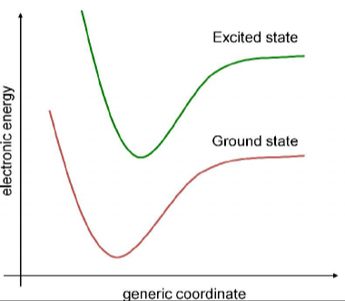
Potential Curves
A geometric parameter is plotted against potential energy.
The bond is at equilibrium at the lowest point.
Excited states can have different equilibrium bond lengths, or be unbound.
Ullah, H. (2015) Density Functional Theory Study of Electronic and Structural Properties of Polyaniline and Poly(o-Phenylinediamine) Oligomers.
Notes:
Note the nonspecific horizontal axis. Many dimensions; I’ll deal with one for simplicity.

Slide 5
Schrödinger Equation
EΨ = HΨ
EΨ = (kinetic + potential)Ψ
EΨ = (Σp²/2m_{e} + Σq₁q₂/r²)Ψ
Solving the molecular Schrödinger equation.
The potential term is a Coulomb potential.

Slide 6
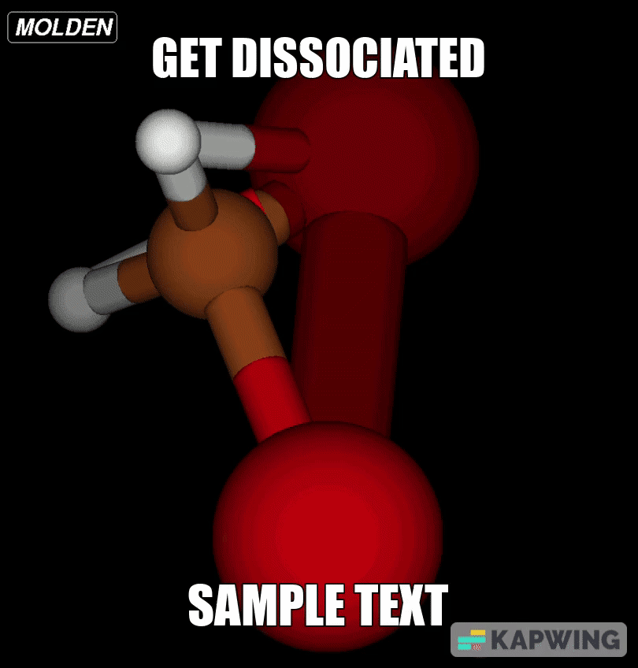
The Process
Molpro solves the equation!
Fed the geometry into Molpro to optimize electron orbitals and potential.
Varied the geometry to make a curve.
  Changed bond lengths.
Increased the number of excited states in Molpro.
Notes:
Geometry optimization gives an idea of where to place things. Mention anomaly handling. Next: Results.

Slide 7
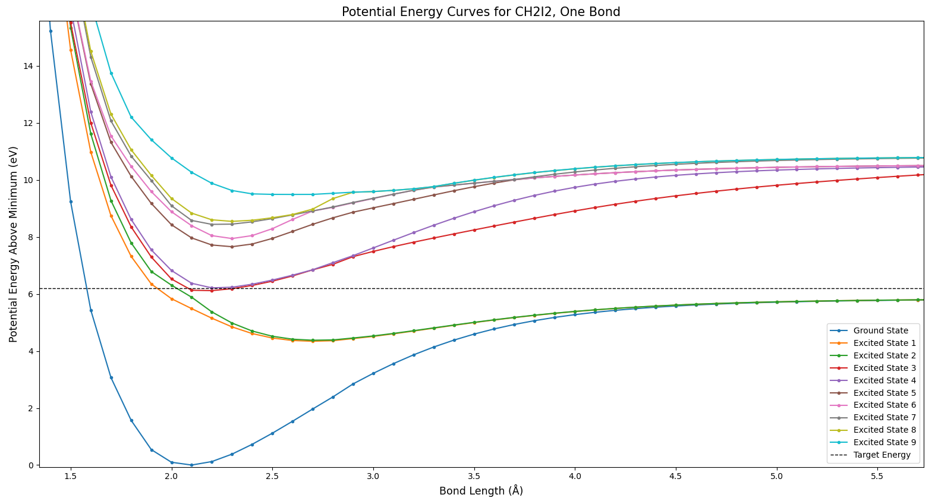
Results: One Bond
As radius approaches zero, potential approaches infinity.
Different dissociation energies: atoms can be excited.

Slide 8
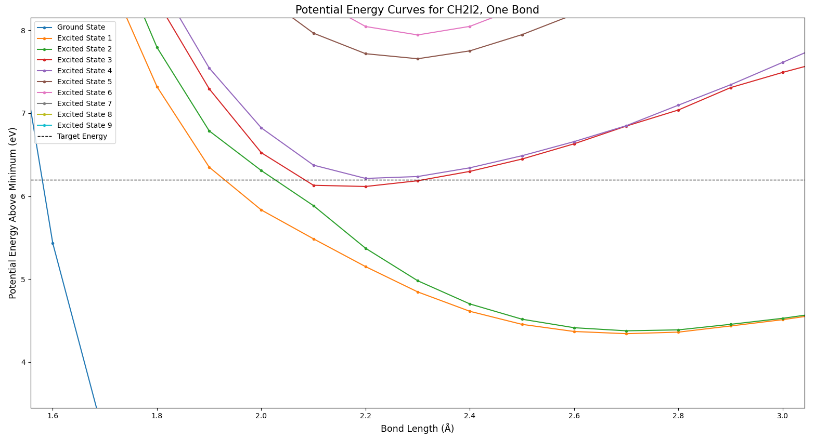
Results: One Bond
Avoided crossing: States are prevented from touching.

Slide 9
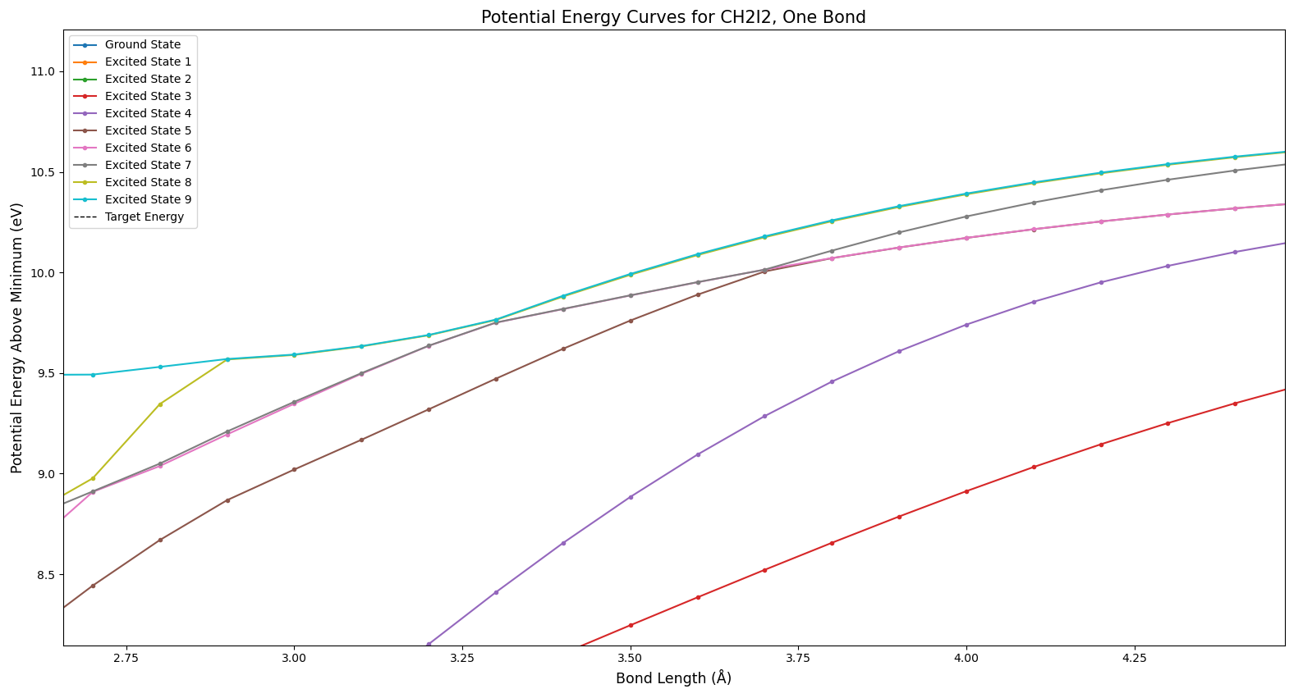
Results: One Bond
States cross, but colors stay in the same order.

Slide 10
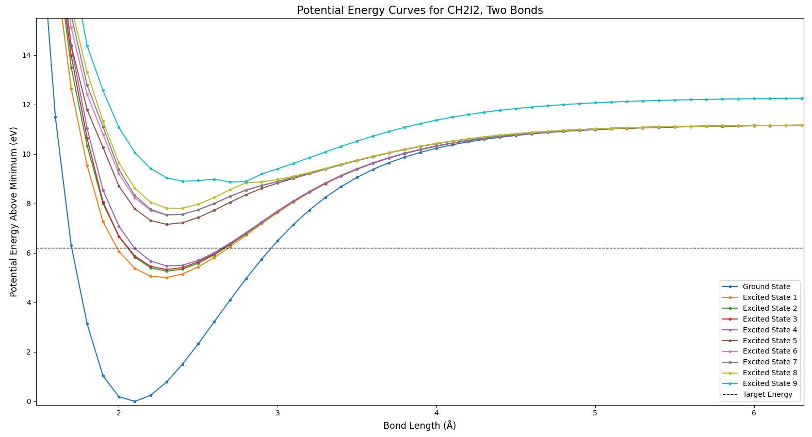
Results: Two Bonds
Generally, higher energies compared to using one bond.

Slide 11
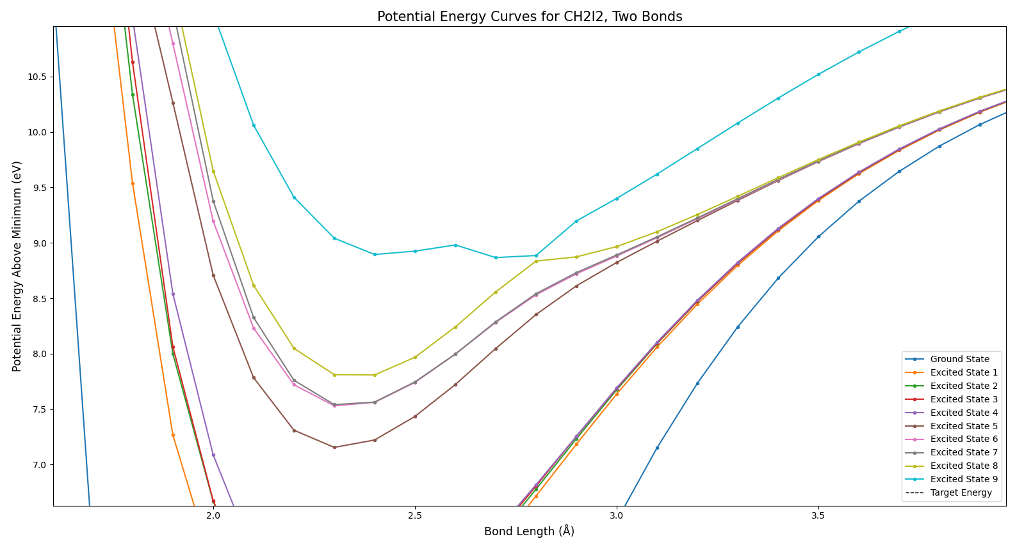
Results: Two Bonds
Molpro minimizes average potential. Some errors persist.
Notes:
Also cover the possibility of increasing the active space.

Slide 12
In Summary…
The goal of this research was to characterize the excited states of CH₂I₂, up to an energy of 200 nm.
This was accomplished by the creation of potential energy surfaces.
Bond lengths were varied, and the minimum possible potential was recorded for each length.

Slide 13



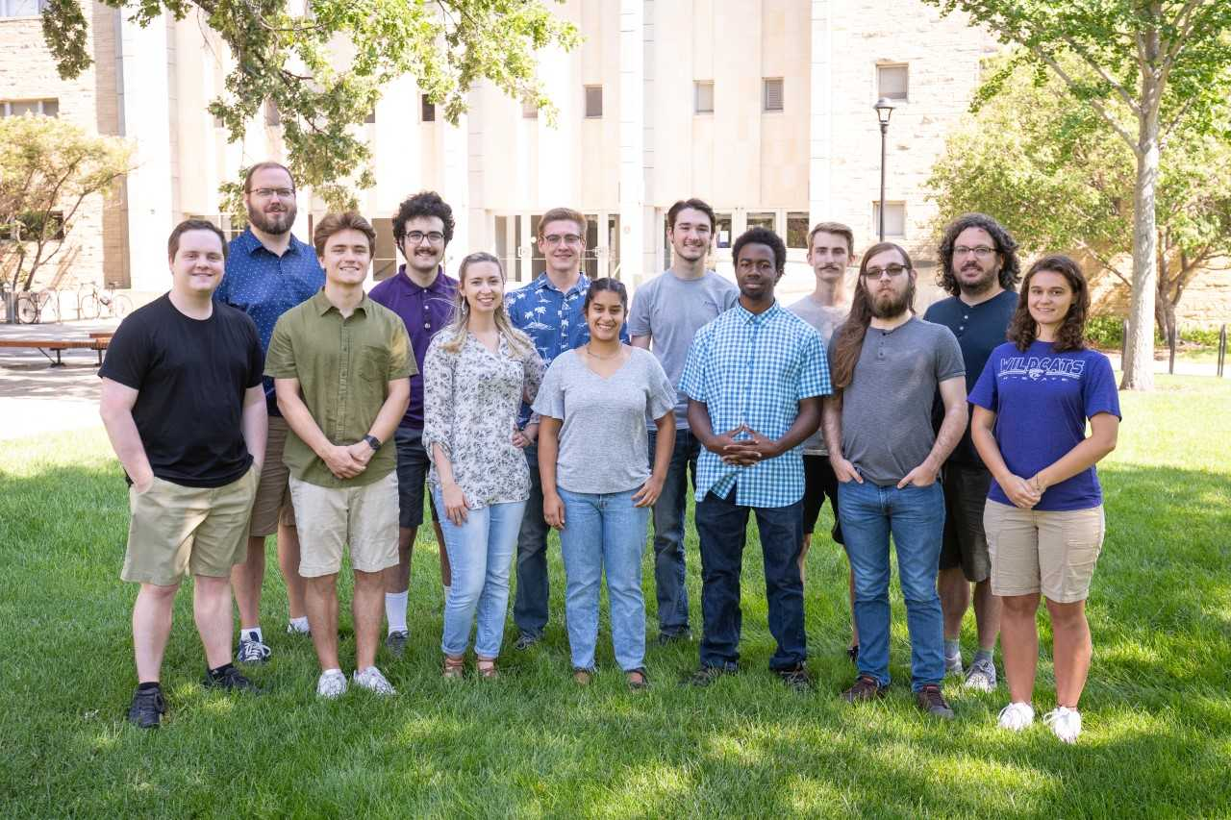


Acknowledgements
This material is based upon work supported by the National Science Foundation under Grant No. #2244539. Any opinions, findings, and conclusions or recommendations expressed in this material are those of the author and do not necessarily reflect the views of the National Science Foundation.

Slide 14
Any Questions?

