Slide 1
Selecting Muon Identification Criteria for the Search for Doubly-Charged Higgs Signals
Gabi Kennedy Orive
K-State Physics REU 2023

Slide 2
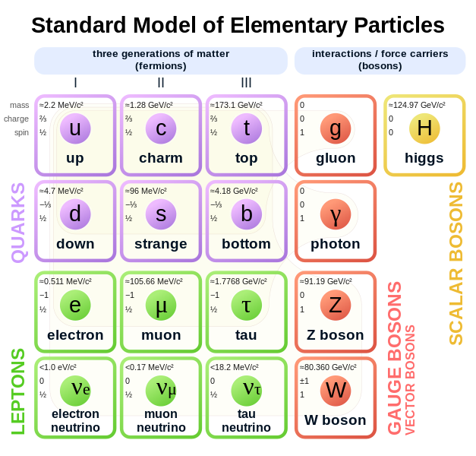
Standard Model

Slide 3
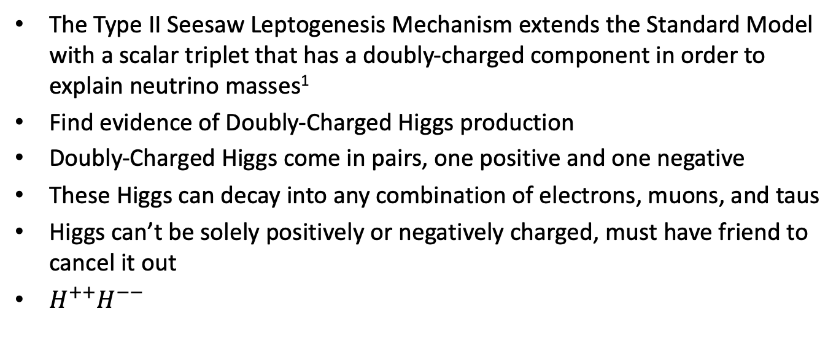
Doubly-Charged Higgs
The Type II Seesaw Leptogenesis Mechanism extends the Standard Model with a scalar triplet that has a doubly-charged component in order to explain neutrino masses¹
Find evidence of Doubly-Charged Higgs production
Doubly-Charged Higgs come in pairs, one positive and one negative
These Higgs can decay into any combination of electrons, muons, and taus
Higgs can’t be solely positively or negatively charged, must have friend to cancel it out
$H^{++}H^{−−}$
1. Sánchez Villamizar, Yozara. (2019)

Slide 4
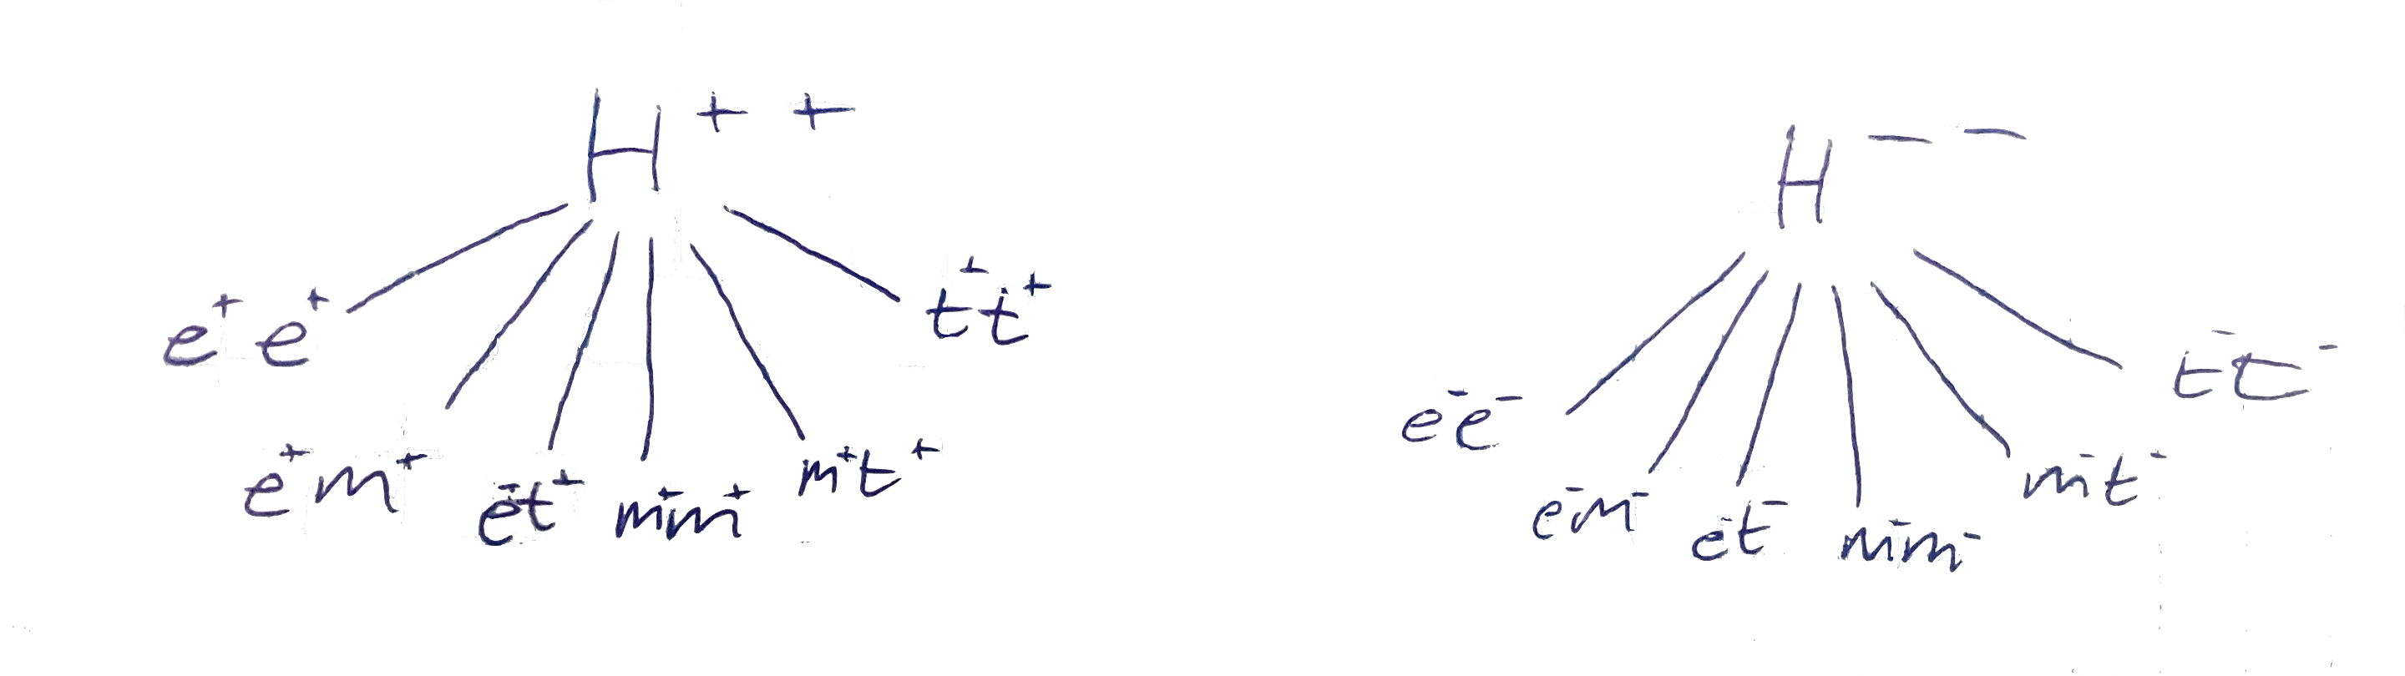
“Decay Model”
u⁺u⁺u⁻u⁻

Slide 5
Aim of the Game
We want to find the best way to define a “Good Muon” so we can better detect Doubly-Charged Higgs
Working with loose, medium, and tight IDs to see which is the best fit
Criteria for the original code is just the medium and tight ID
Find a good place to put a p_{T} cut
  Signal
    p_{T} > 40 GeV
  Background
    p_{T} > 20 GeV)

Slide 6
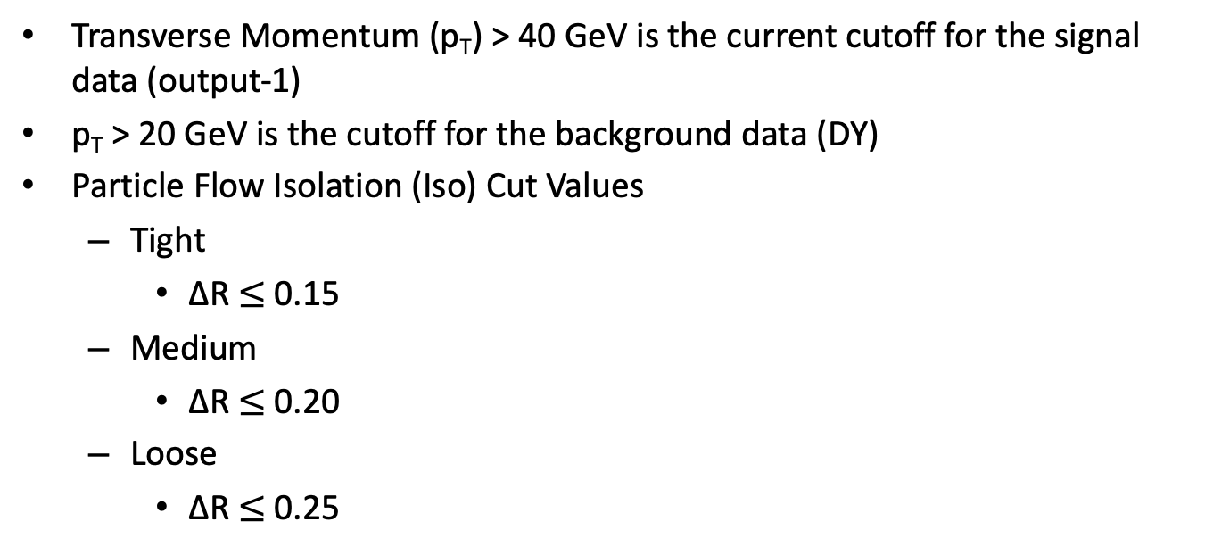
Criteria (aka “Cuts”)
Transverse Momentum (p_{T}) > 40 GeV is the current cutoff for the signal data (output-1)
p_{T} > 20 GeV is the cutoff for the background data (DY)
Particle Flow Isolation (Iso) Cut Values
  Tight
    ∆R $≤$0.15
  Medium
    ∆R $≤$0.20
  Loose
    ∆R $≤$0.25

Slide 7
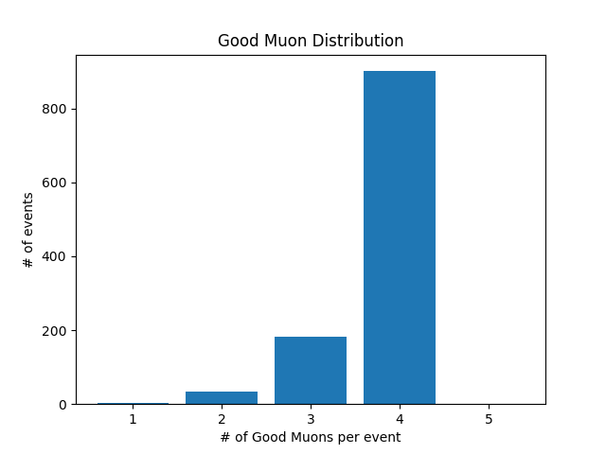
Counting Good Muons from Signal Data(with previous cuts)
1 (+ or -) | 2
2 (++, +-, or --) | 34
3 (++- or +--) | 181
4 (++--) | 902
Total | 42222

Slide 8
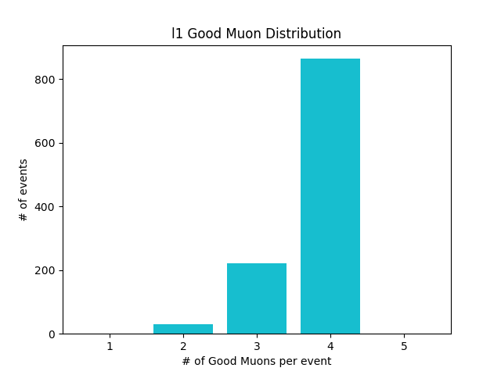
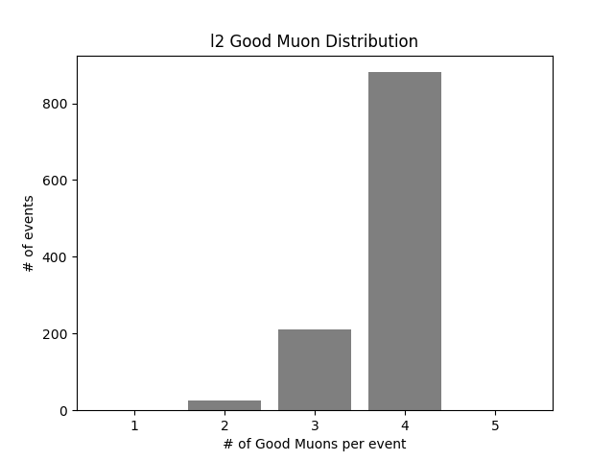
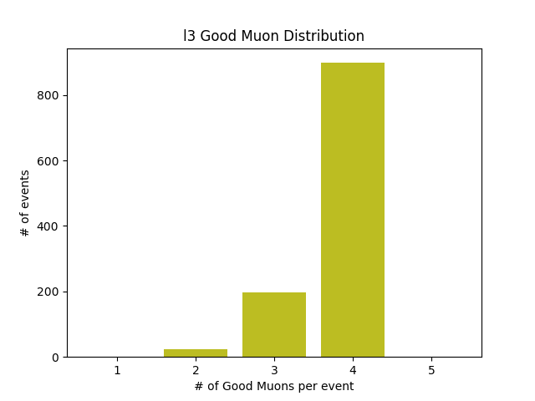
New Criteria, Loose (Signal)
1 (+ or -) | 1
2 (++, +-, or --) | 31
3 (++- or +--) | 222
4 (++--) | 864
Total | 4190
1 (+ or -) | 1
2 (++, +-, or --) | 26
3 (++- or +--) | 210
4 (++--) | 881
Total | 4212
1 (+ or -) | 1
2 (++, +-, or --) | 23
3 (++- or +--) | 196
4 (++--) | 898
Total | 4232

Slide 9
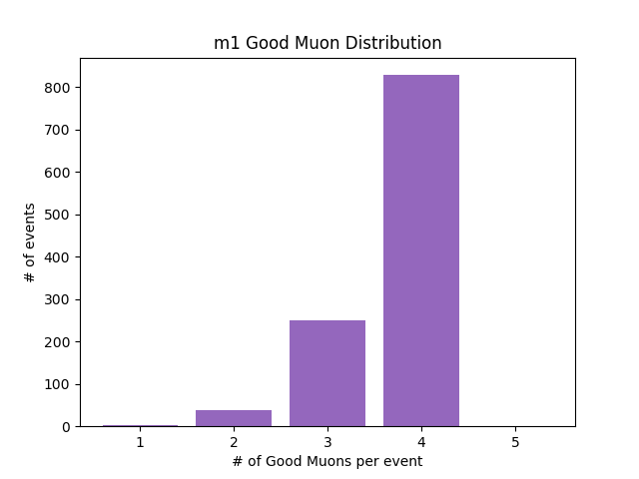
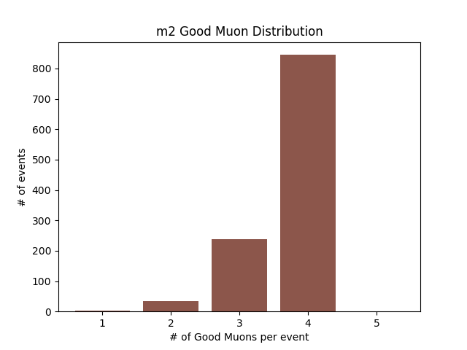
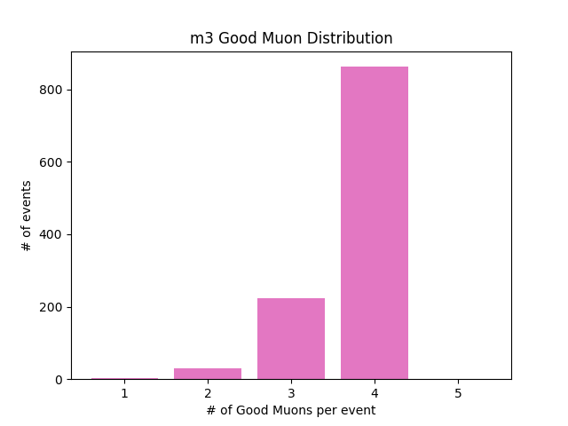
New Criteria, Medium (Signal)
1 (+ or -) | 2
2 (++, +-, or --) | 38
3 (++- or +--) | 250
4 (++--) | 828
Total | 4145
1 (+ or -) | 2
2 (++, +-, or --) | 33
3 (++- or +--) | 238
4 (++--) | 845
Total | 4167
1 (+ or -) | 2
2 (++, +-, or --) | 30
3 (++- or +--) | 224
4 (++--) | 862
Total | 4187

Slide 10
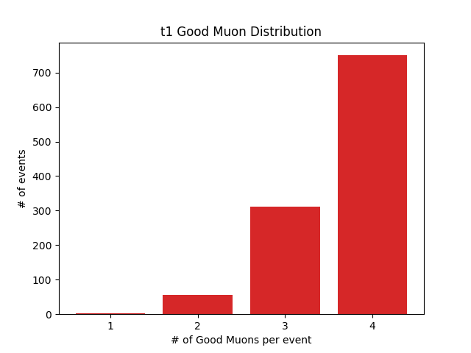
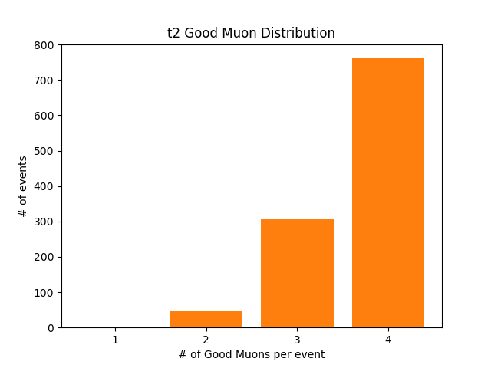
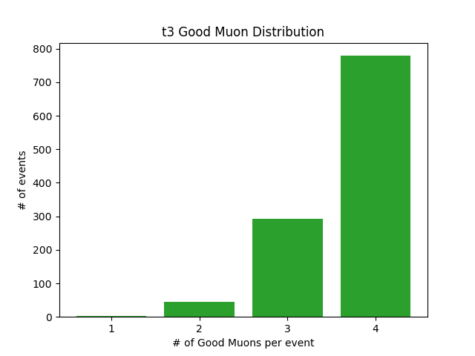
New Criteria, Tight (Signal)
1 (+ or -) | 3
2 (++, +-, or --) | 55
3 (++- or +--) | 311
4 (++--) | 750
Total | 4046
1 (+ or -) | 3
2 (++, +-, or --) | 48
3 (++- or +--) | 305
4 (++--) | 763
Total | 4066
1 (+ or -) | 3
2 (++, +-, or --) | 45
3 (++- or +--) | 292
4 (++--) | 779
Total | 4085

Slide 11
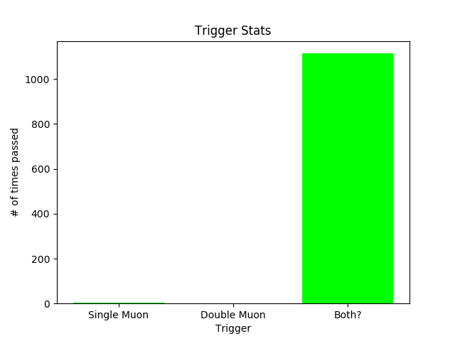
Signal Triggers
Single Trigger | 4
Double Trigger | 1
Both | 1114
By using only Single, we lose 1 event.
By using only Double, we lose 4 events.
By using both, we lose 5 events.
Using both presents 99.55% accuracy.

Slide 12
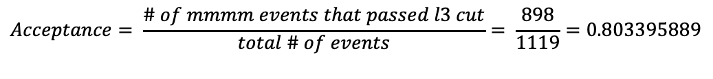
Results (Signal)
Integrated Luminosity (L) | 137.6 fb⁻¹
Cross Section (X) | 0.03477 fb
Branching Ratio (R) | 1
Acceptance (A) | 0.803395889
Expected Number of mmmm Events | 3.843728729
$$Acceptance= \frac{\# of mmmm events that passed l3 cut}{total \# of events}= \frac{898}{1119}=\text{0.803395889}$$
$$Expected \# of mmmm Events=L ∗X ∗R^{2} ∗A=3.843728729$$

Slide 13
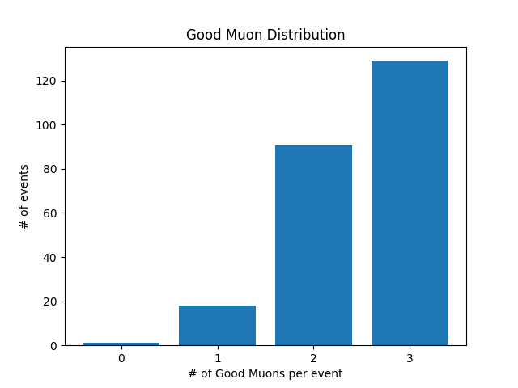
Counting Good Muons from Given Background Data (with previous cuts)
1 (+ or -) | 18
2 (++, +-, or --) | 91
3 (++- or +--) | 129
4 (++--) | 0
Total | 587

Slide 14
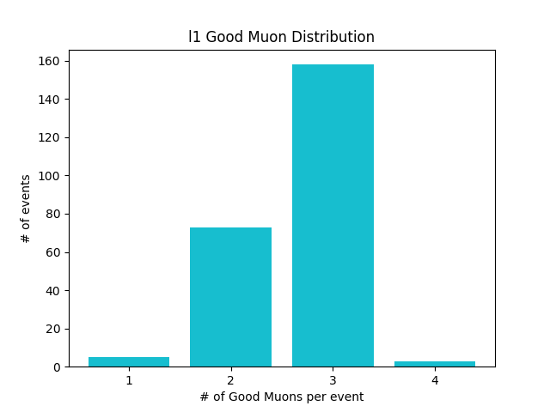
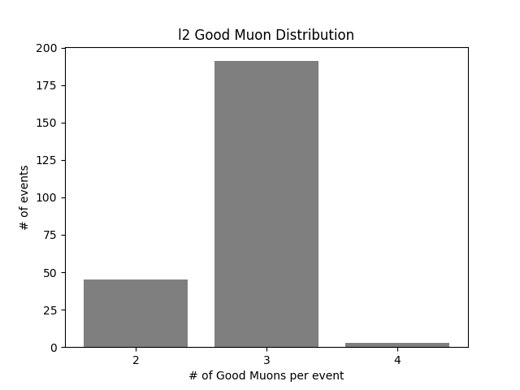
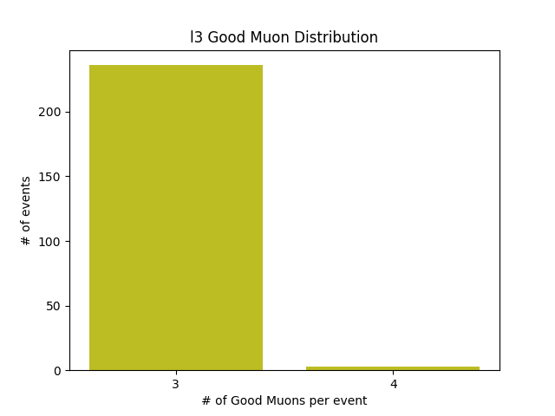
New Criteria, Loose (Background)
1 (+ or -) | 5
2 (++, +-, or --) | 73
3 (++- or +--) | 158
4 (++--) | 3
Total | 637
1 (+ or -) | 0
2 (++, +-, or --) | 45
3 (++- or +--) | 191
4 (++--) | 3
Total | 675
1 (+ or -) | 0
2 (++, +-, or --) | 0
3 (++- or +--) | 236
4 (++--) | 3
Total | 720

Slide 15
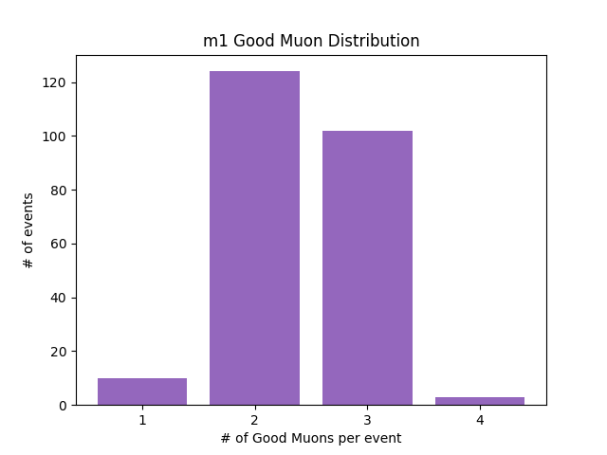
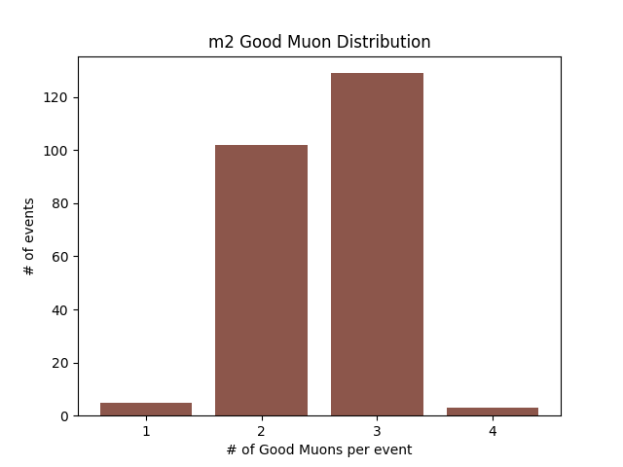
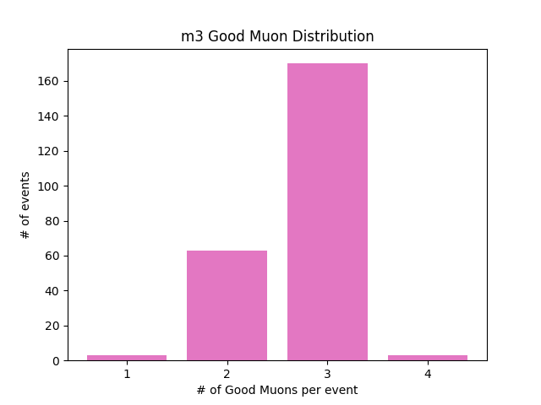
New Criteria, Medium (Background)
1 (+ or -) | 10
2 (++, +-, or --) | 124
3 (++- or +--) | 102
4 (++--) | 3
Total | 576
1 (+ or -) | 5
2 (++, +-, or --) | 102
3 (++- or +--) | 129
4 (++--) | 3
Total | 608
1 (+ or -) | 3
2 (++, +-, or --) | 63
3 (++- or +--) | 170
4 (++--) | 3
Total | 651

Slide 16
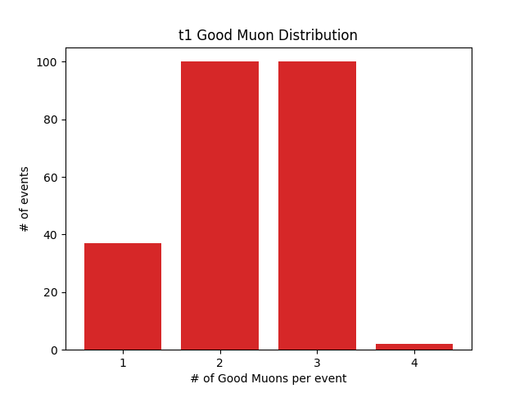
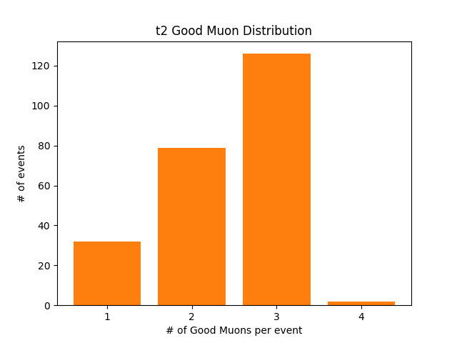
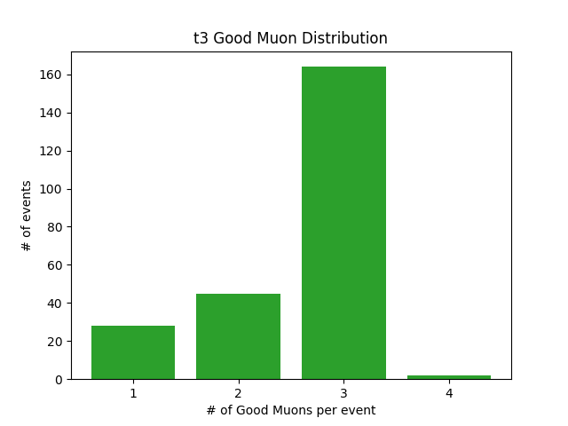
New Criteria, Tight (Background)
1 (+ or -) | 37
2 (++, +-, or --) | 100
3 (++- or +--) | 100
4 (++--) | 2
Total | 545
1 (+ or -) | 32
2 (++, +-, or --) | 79
3 (++- or +--) | 126
4 (++--) | 2
Total | 576
1 (+ or -) | 28
2 (++, +-, or --) | 45
3 (++- or +--) | 164
4 (++--) | 2
Total | 618

Slide 17
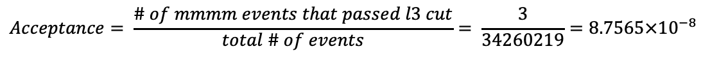
Results (Background)
Integrated Luminosity (L) | 137.6 fb⁻¹
Cross Section (X) | 6225420 fb
Branching Ratio (R) | 1/3
Acceptance (A) | 8.7565x10⁻⁸
Expected Number of mmmm Events | 25.0032764
$$Acceptance= \frac{\# of mmmm events that passed l3 cut}{total \# of events}= \frac{3}{34260219}=8.7565×{10}^{−8}$$
$$Expected \# of mmmm Events=L ∗X ∗R ∗A=25.0032764$$

Slide 18
Expected Number of mmmm Events
Background
Expected Number of mmmm Events | 25.0032764
Signal
Expected Number of mmmm Events | 3.843728729

Slide 19
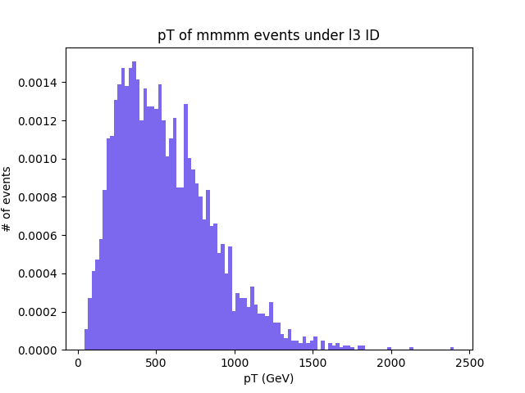
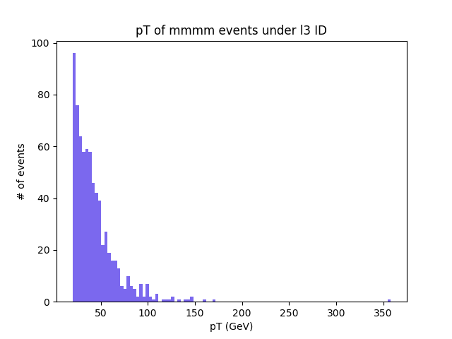
Transverse Momentum Graphs
Signal
Background
p_{T} < 200 GeV

Slide 20
Conclusions & Future Work
Conclusions
p_{T} < 200 GeV cut
Loose Iso3 seems to be the best choice for ID
Without more work, differentiating Signal muons from Background muons will be difficult
Future Work
Apply the p_{T} cut
Continue testing with different criteria
Compare with results of testing with electrons and taus
Checking other background examples

Slide 21



Thank you
Dr. Andrew Ivanov
Reese Sanders
Kim Coy, Dr. Loren Greenman, Dr. JT Laverty
You!
This material is based upon work supported by the National Science Foundation under Grant No. #2244539. Any opinions, findings, conclusions, or recommendations expressed in this material are those of the author and do not necessarily reflect the views of the National Science Foundation.

Slide 22
Questions
?

