Slide 1
Stable Dispersion of Graphene Synthesis
Taj Johnson and Arjun Nepal
Notes:
Why Graphene Dispersion Important
Detonation Chamber
All Data Graph (observations)
Explain UV-Vis
Concentration Calculation

Slide 2
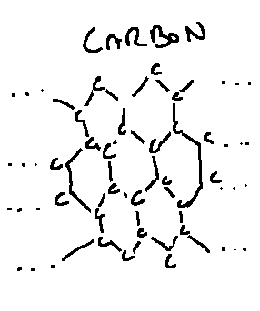
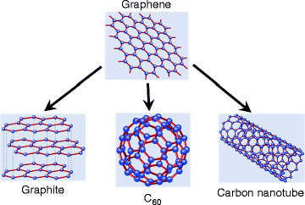
Hexagons are the Bestagons
Dinadayalane, T.C., Leszczynski, J. Handbook of Computational Chemistry (2012)
Notes:
Look at introductory chapter of thesis
2D foundational structure
Tubes, fullerenes, graphite

Slide 3
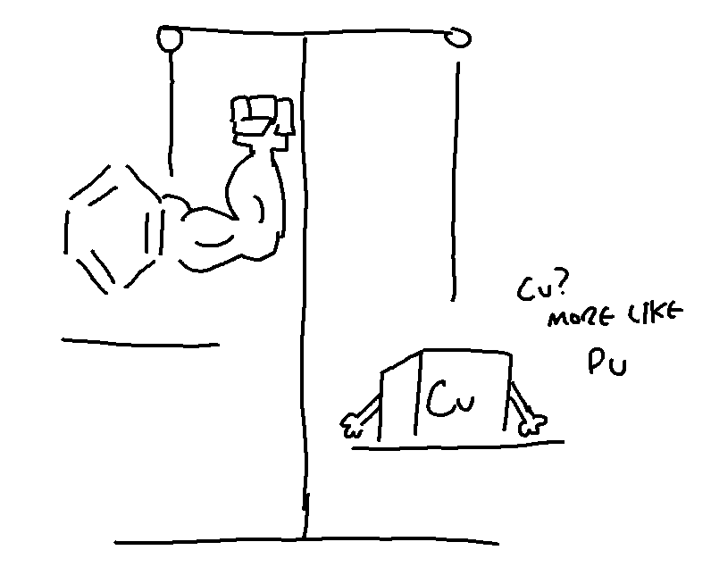
What does it do? A lot.
Durable
Light
VERY thin
Flexible
Conductive
Thermal Conductivity
Magnetism
Filtration
Lubrication
Waterproof
And more
Notes:
Site other sources

Slide 4
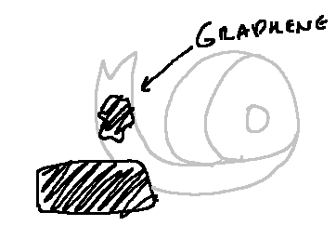
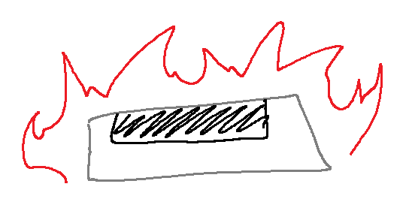
Wow, how do I get it?
Top Down
Bottom up

Slide 5

The Easy Way

Slide 6
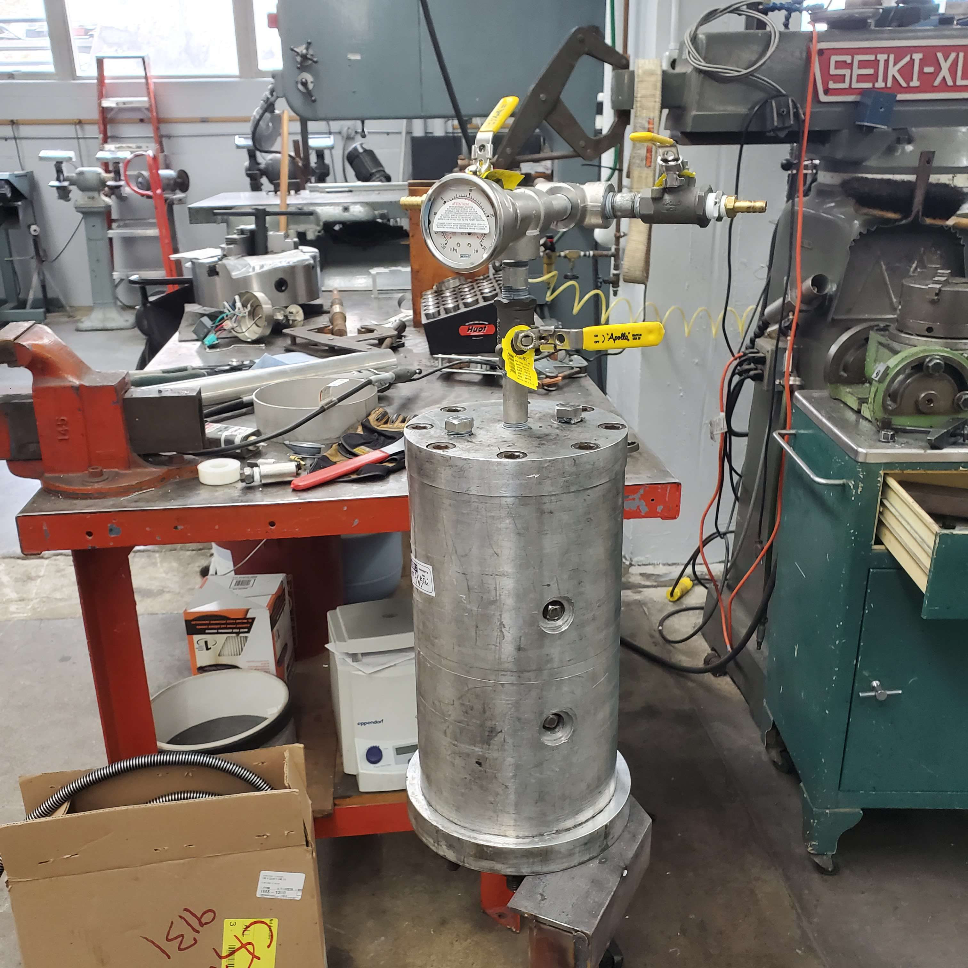
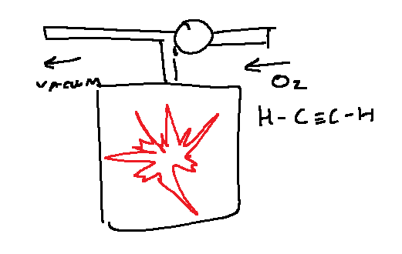
Controlled Hydrocarbon Detonation
Oxygen +
Acetylene =
Graphene Dust +
Water Vapor
Notes:
Picture of graphene dust

Slide 7
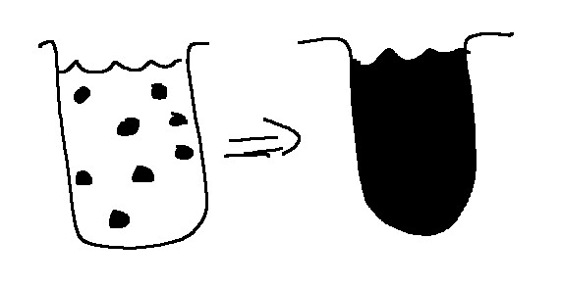
My Experiment
Highest Concentration of Graphene
Lowest Concentration of PSS
Notes:
Why is this important?
Easier to mix
Easier to measure

Slide 8
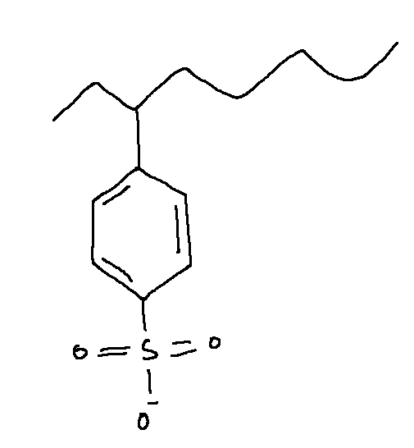
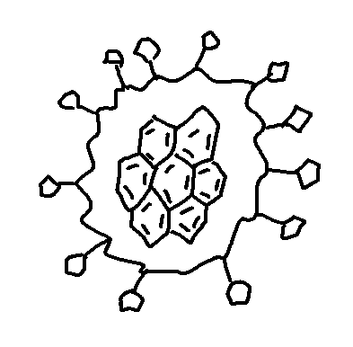
Graphene Dispersion
Polystyrene Sulfonate (PSS)
Notes:
My specific technique is PSS
it is safe

Slide 9
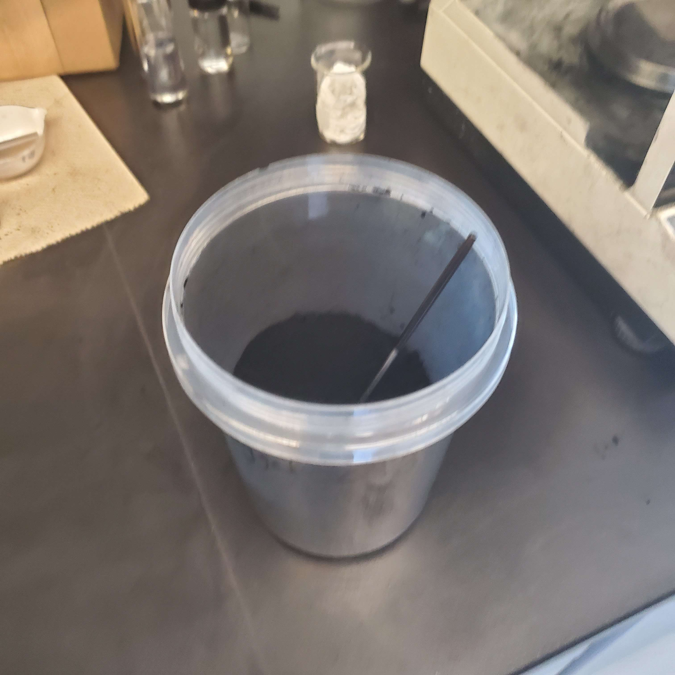
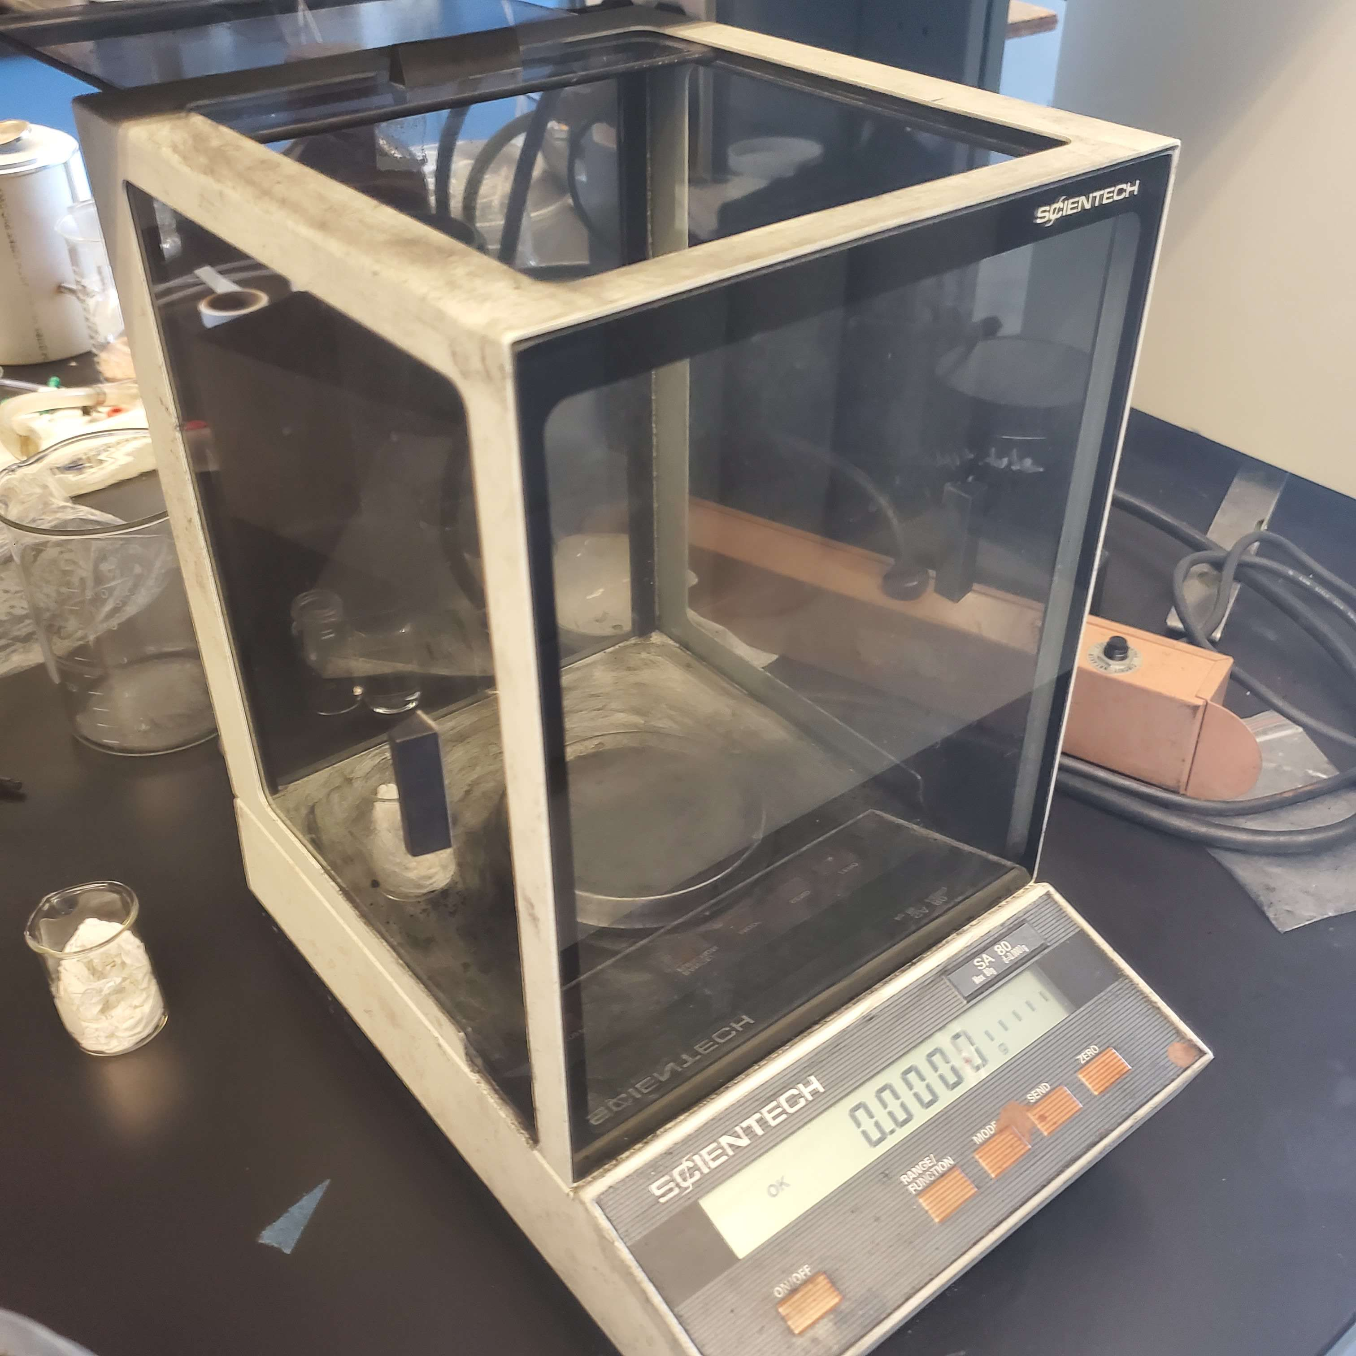
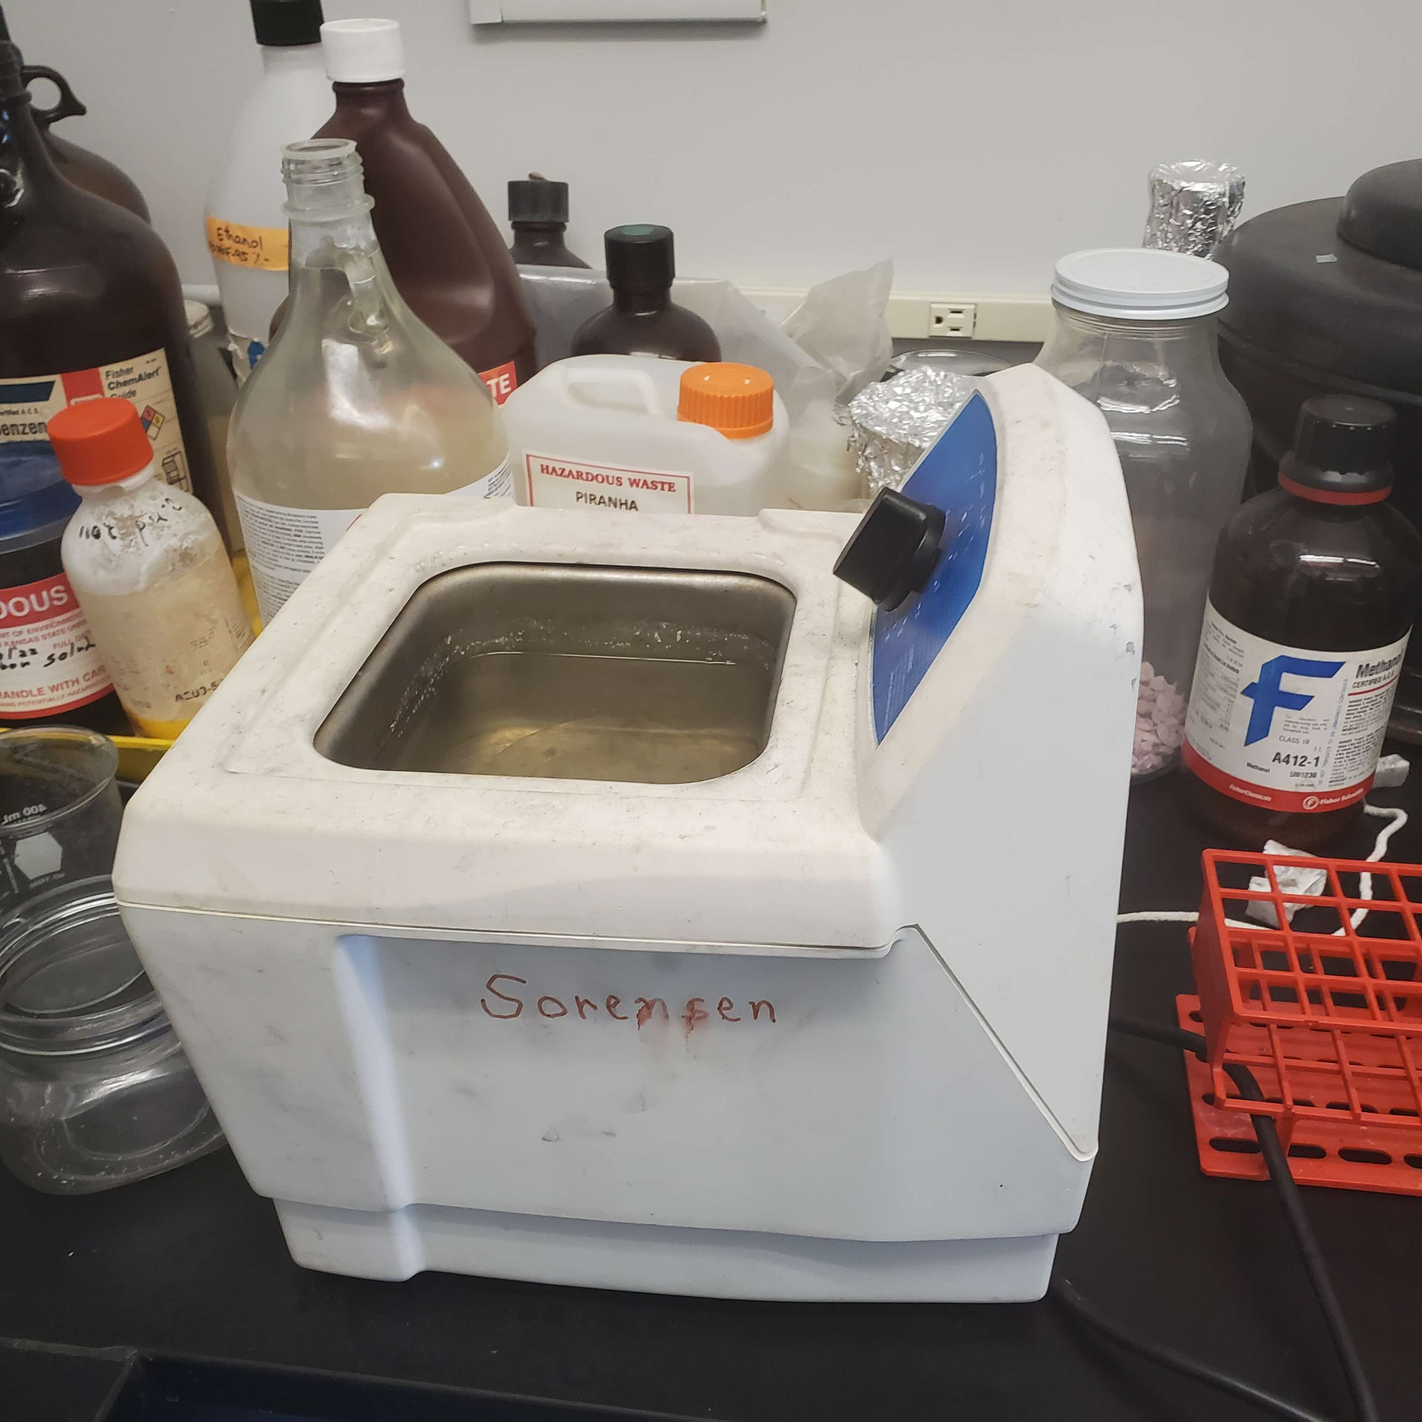
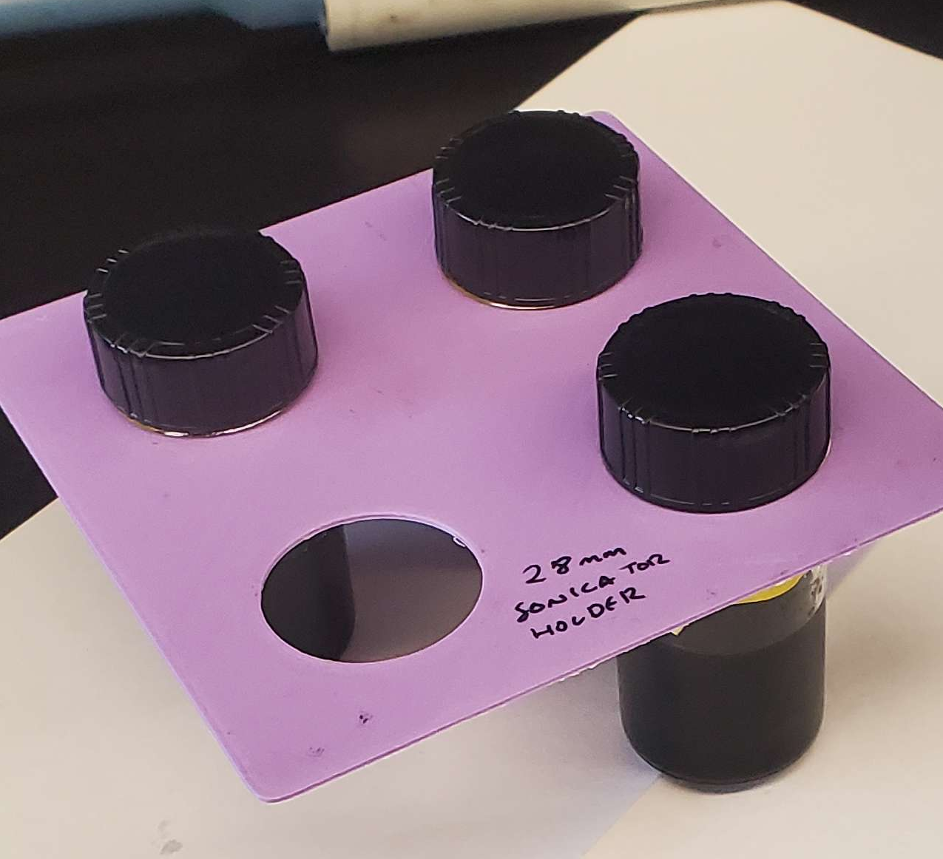
Procedure
Measure
Shake
Wait
Repeat
Notes:
Sonicator Picture
Show vials as much as possible

Slide 10
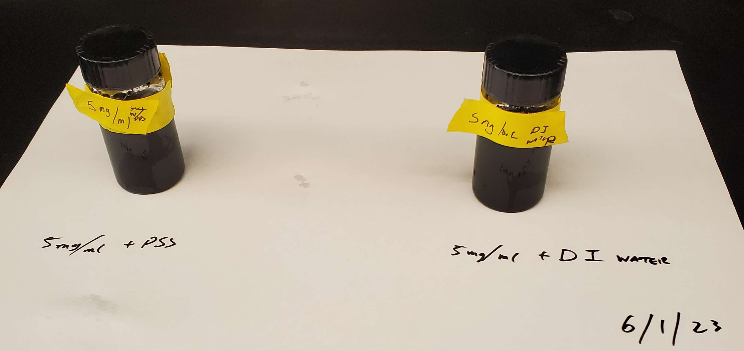
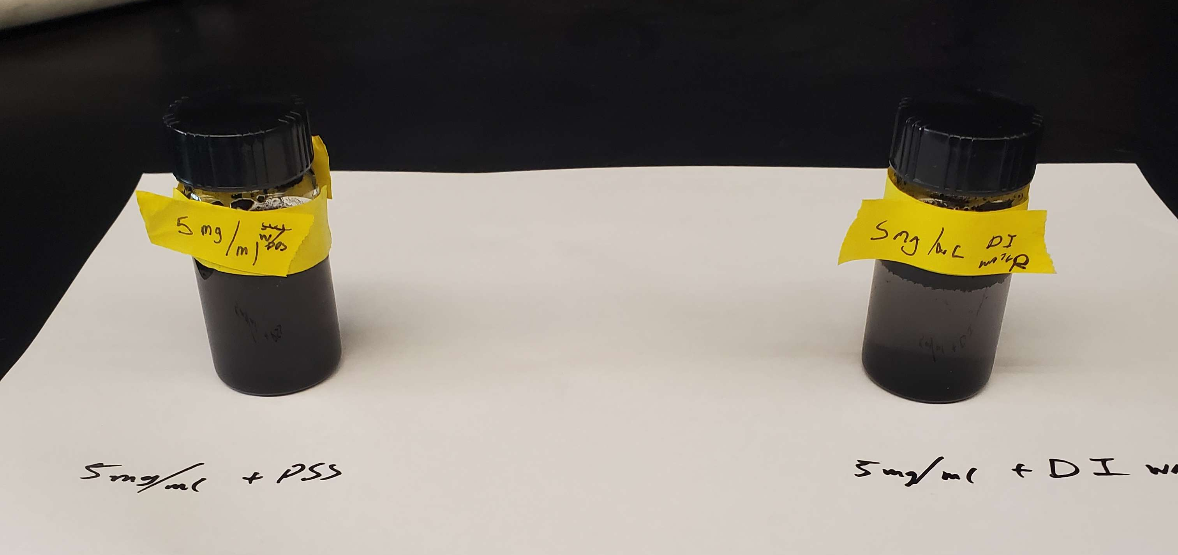
Experiment #1
Notes:
Perhaps another slide just full of all 16 experiments

Slide 11
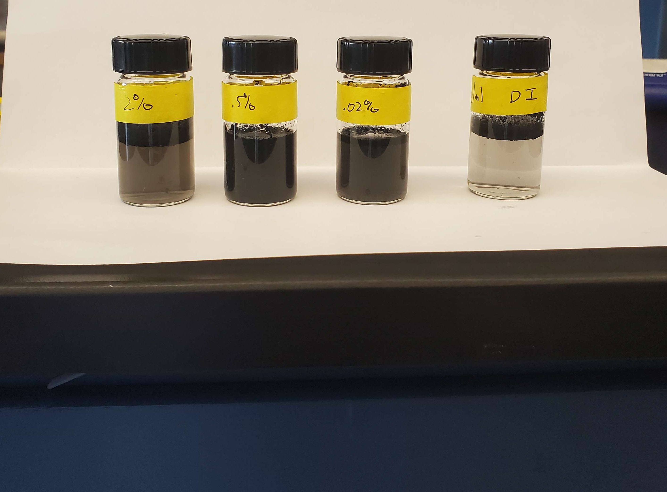
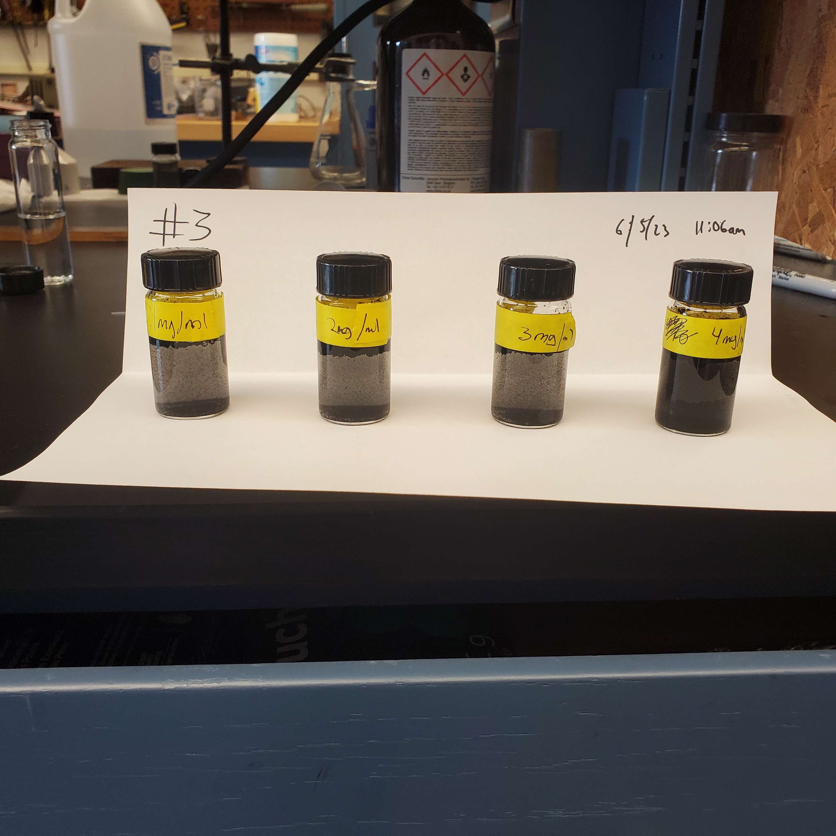
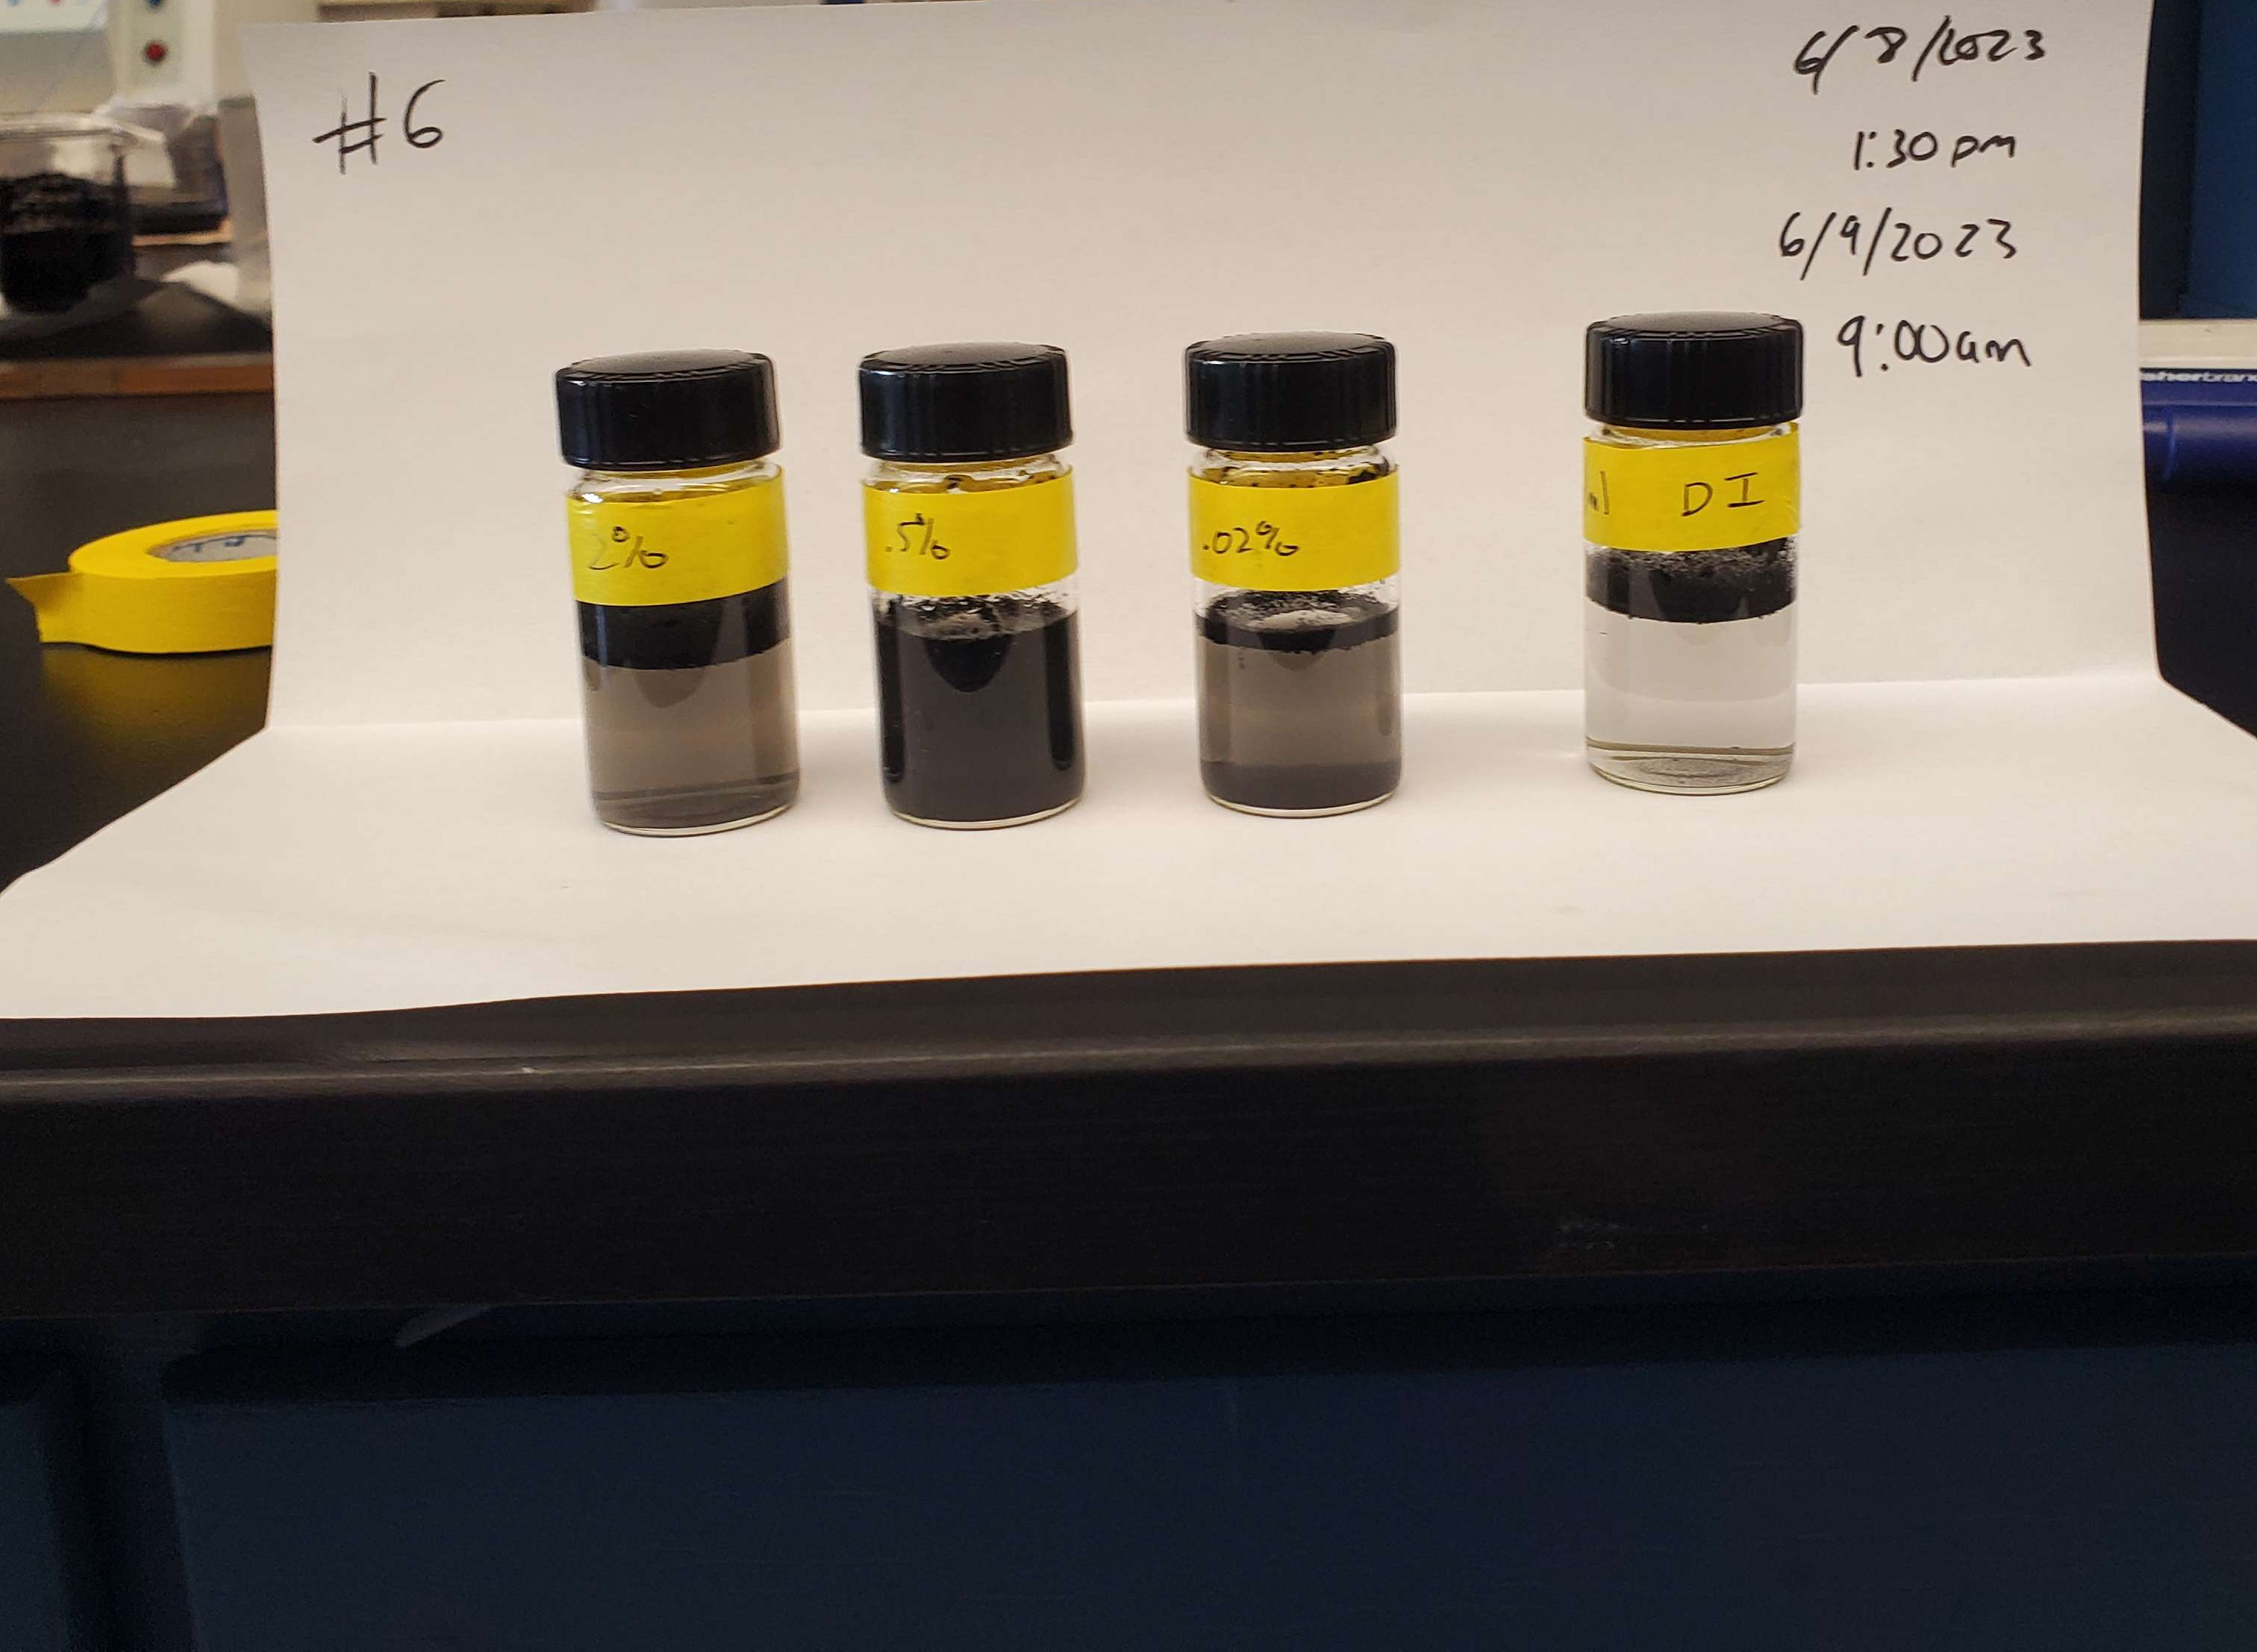
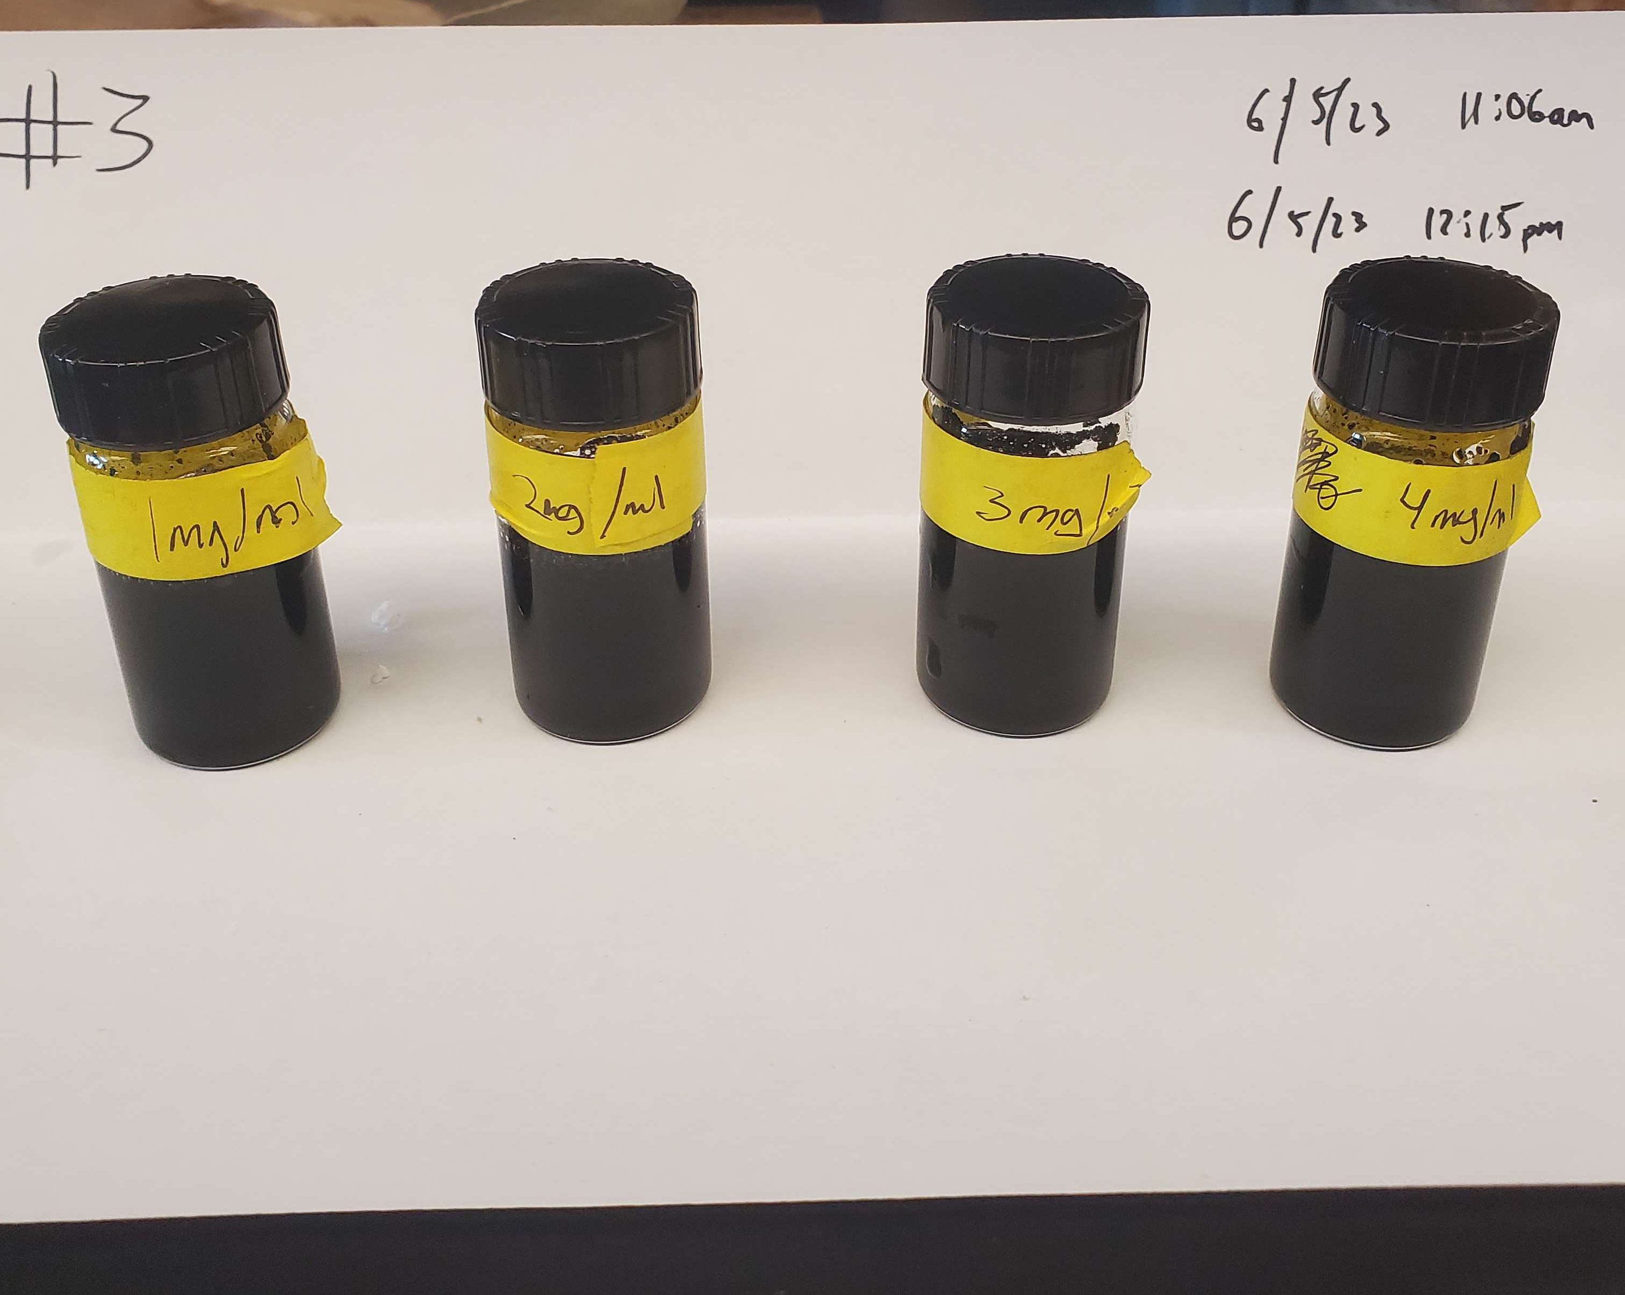
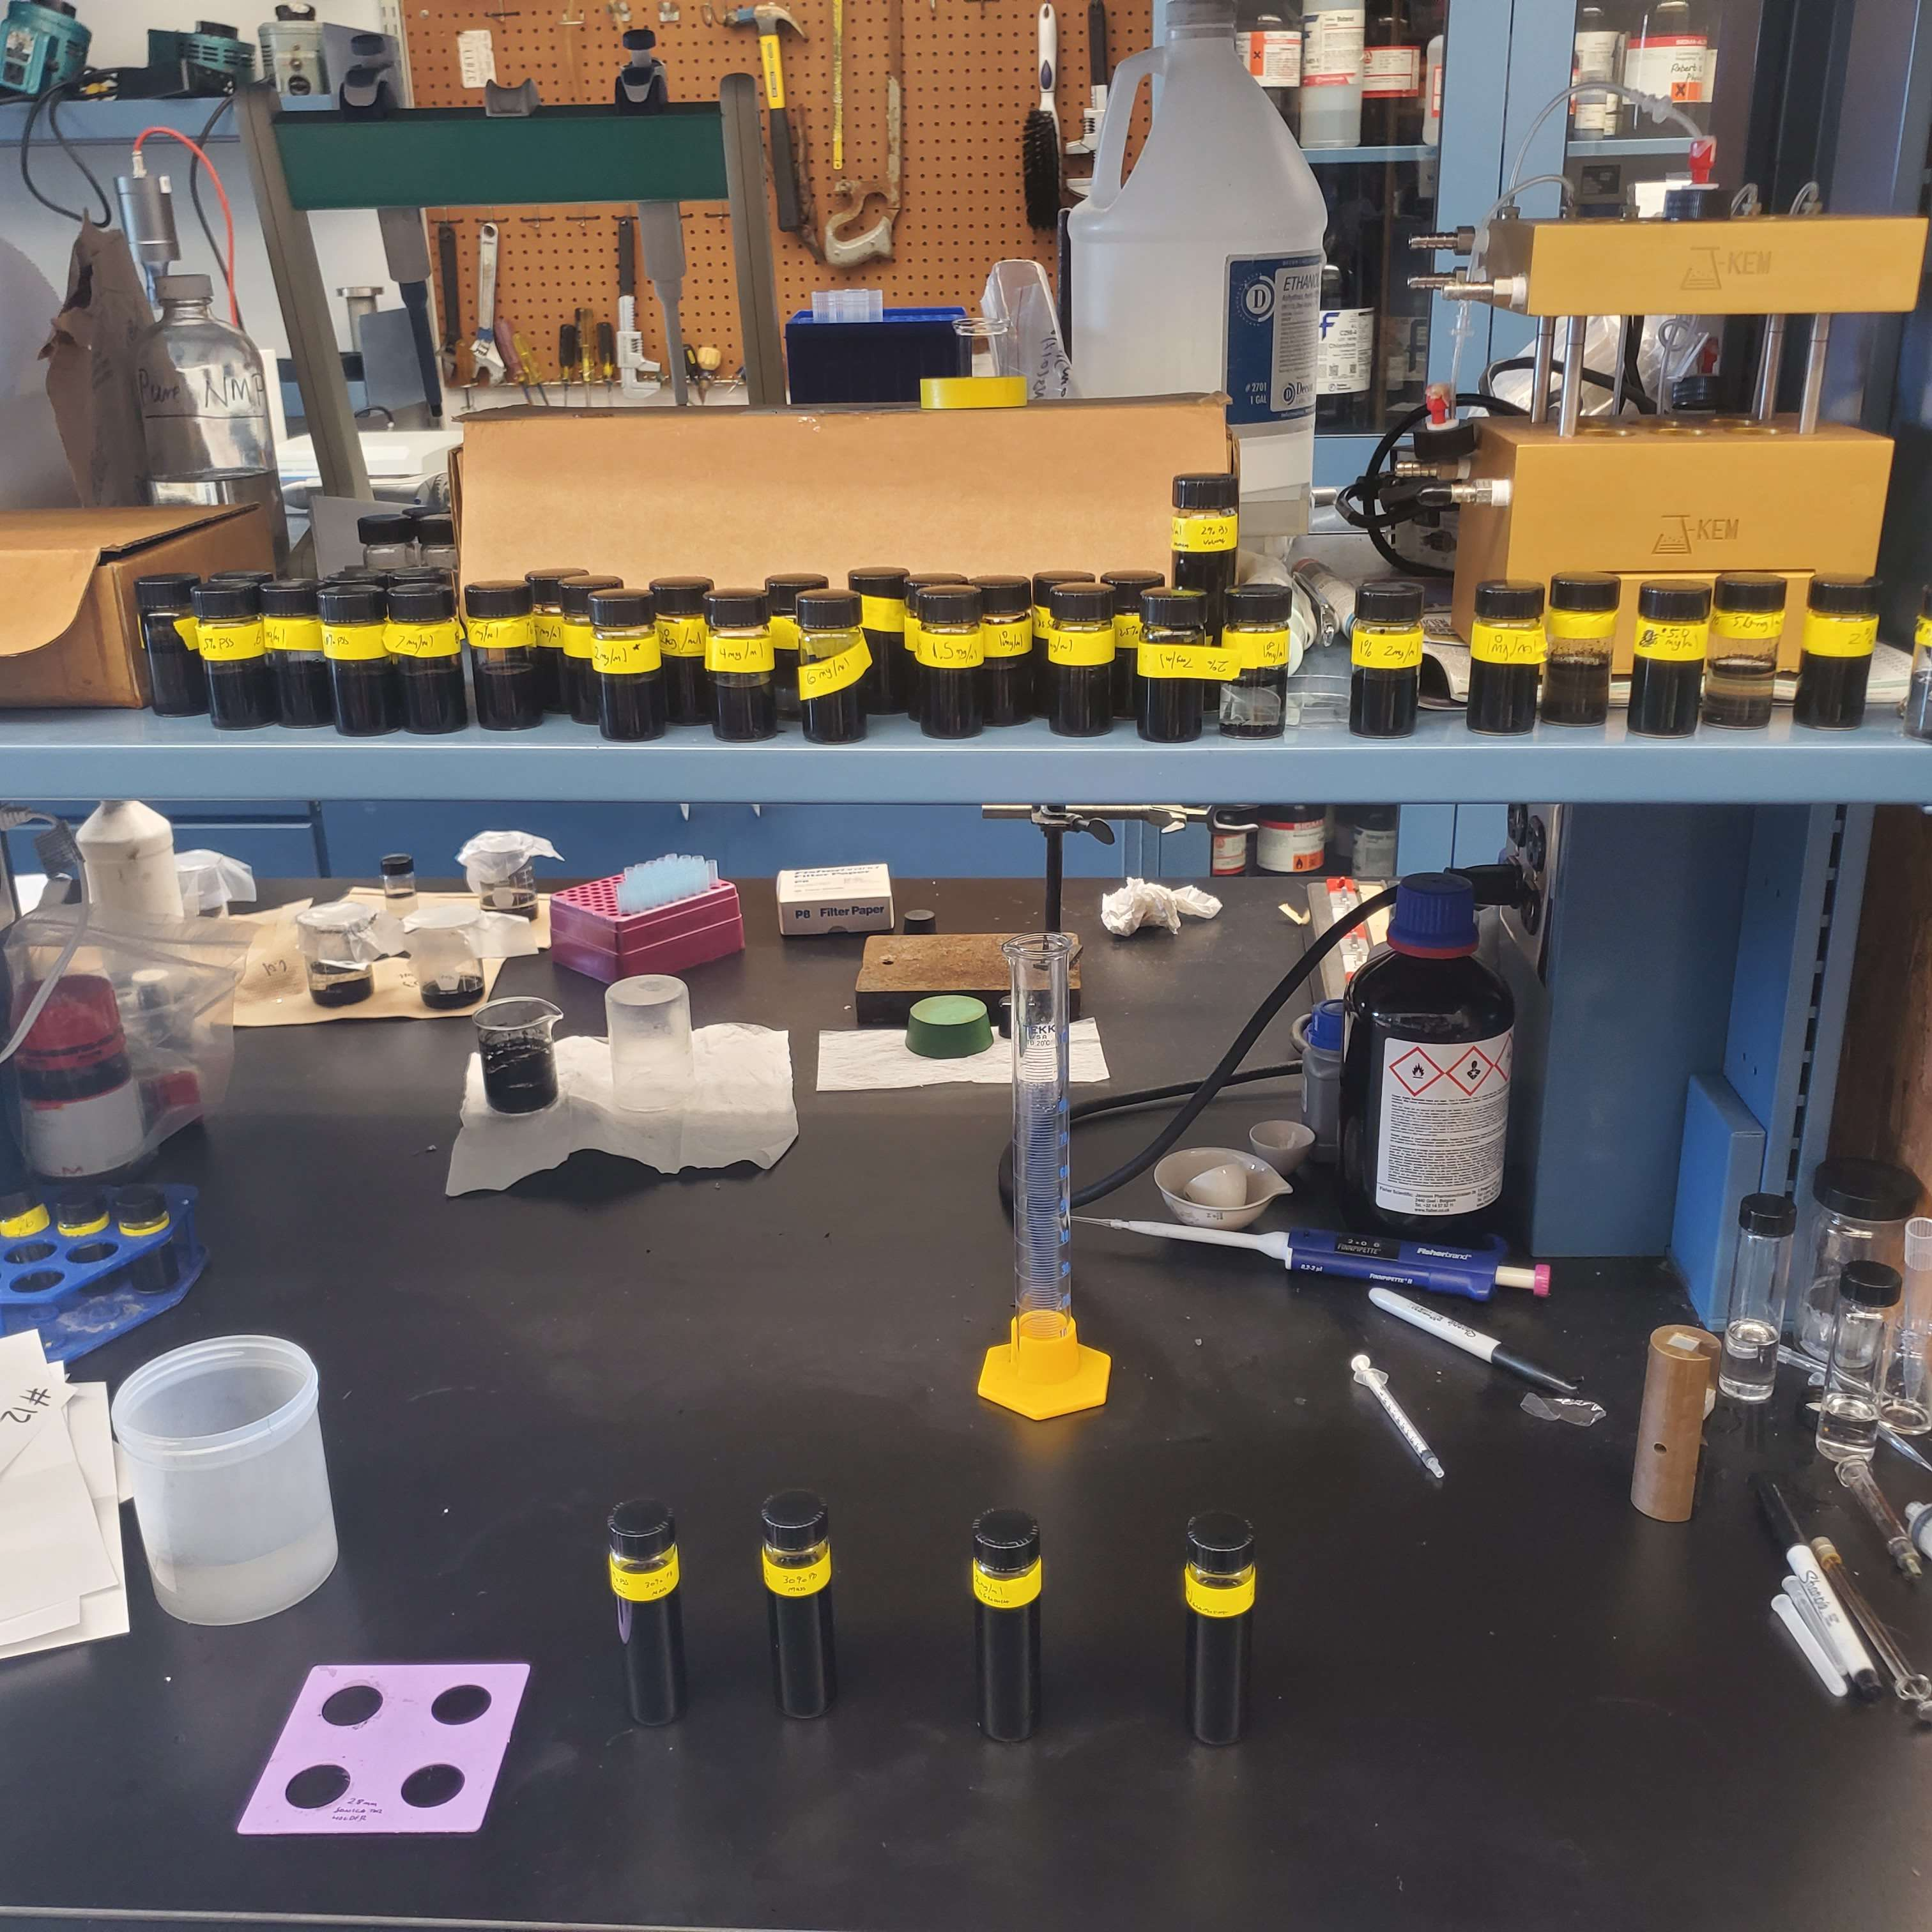
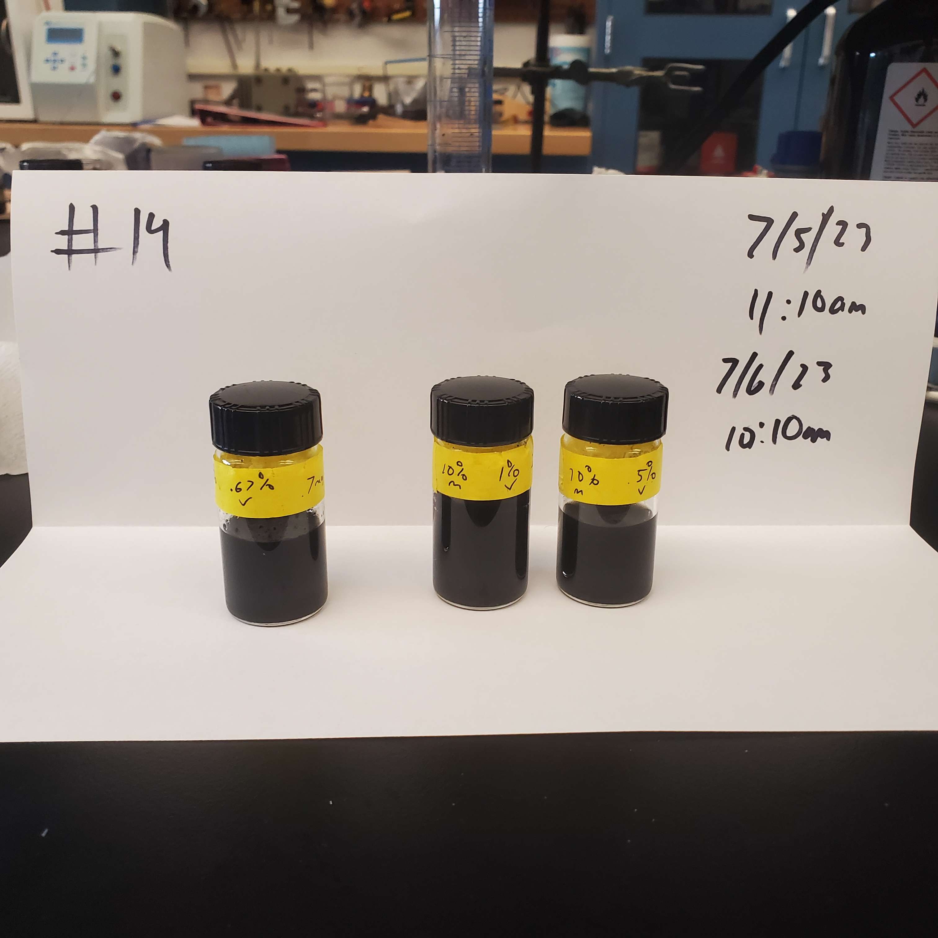
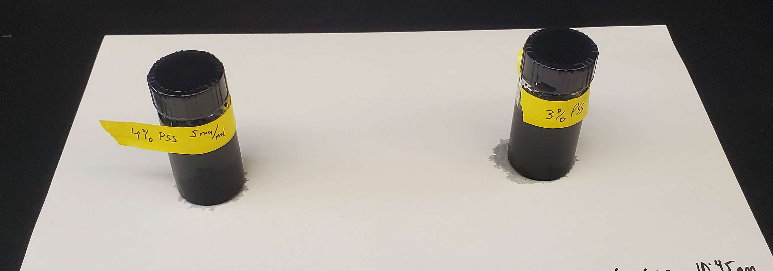
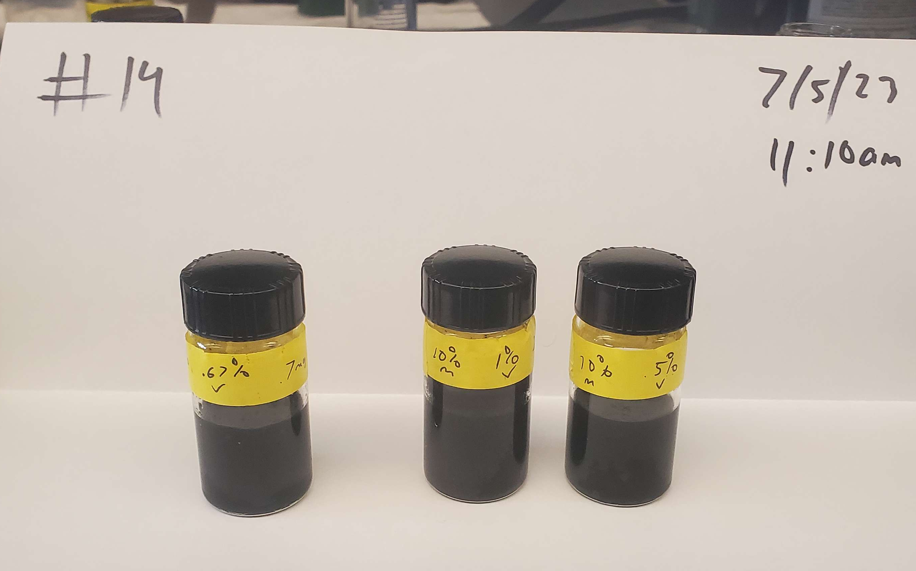
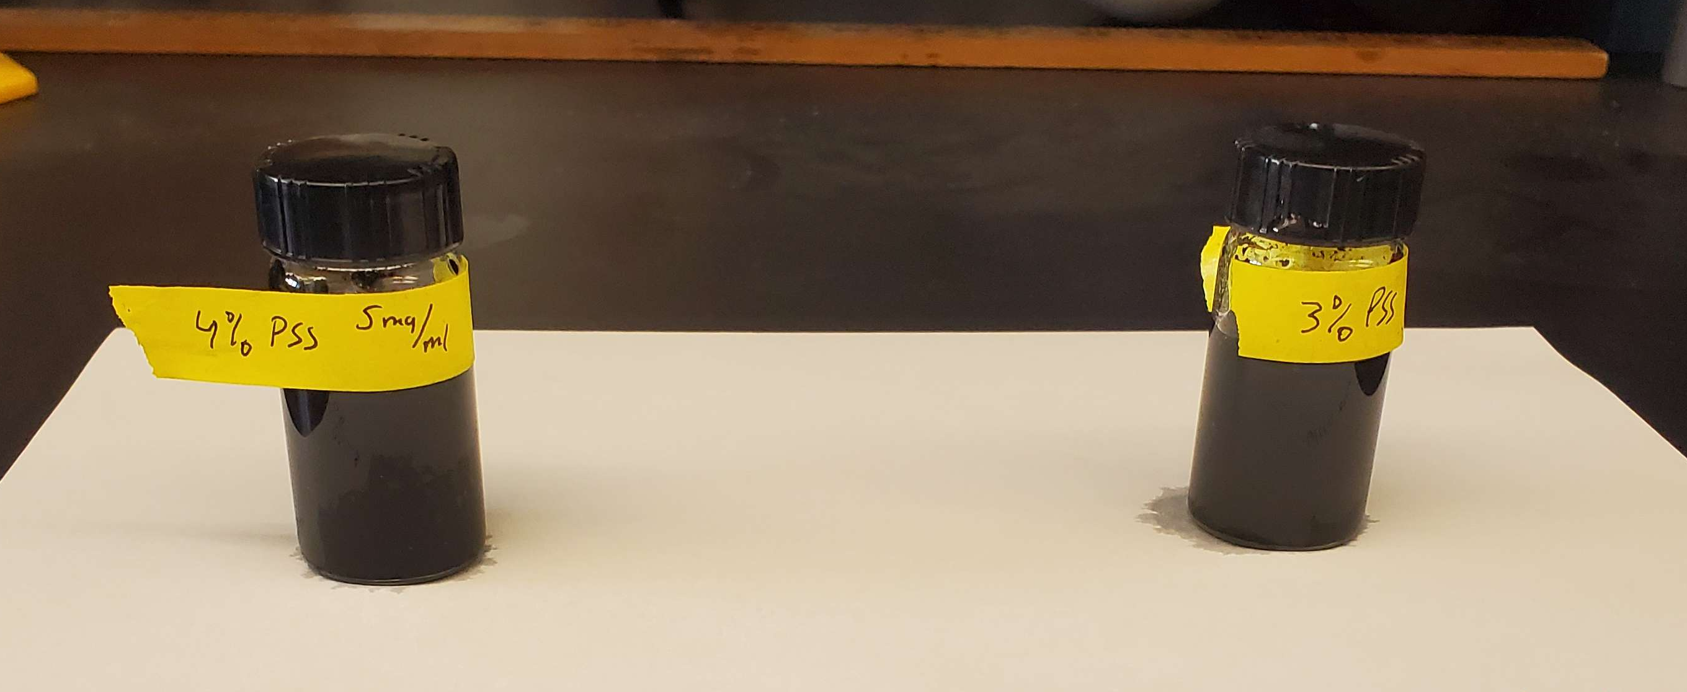
Experiment #2 - 14

Slide 12
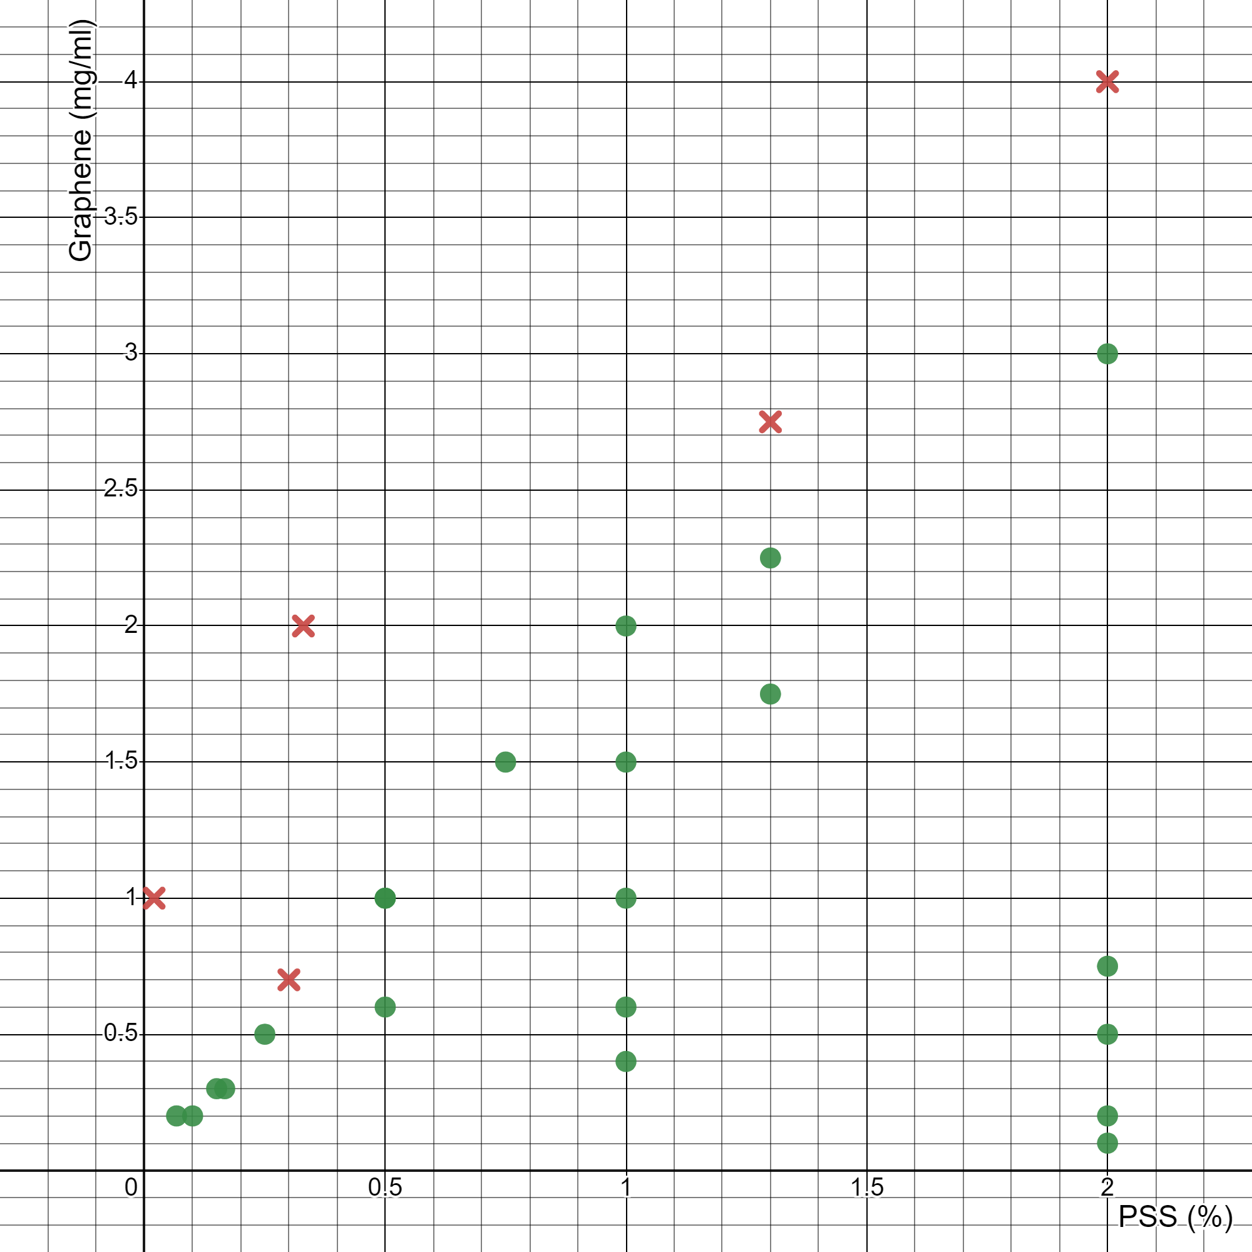
All Data Plot
Green: Dispersed
Red: Settlement

Slide 13
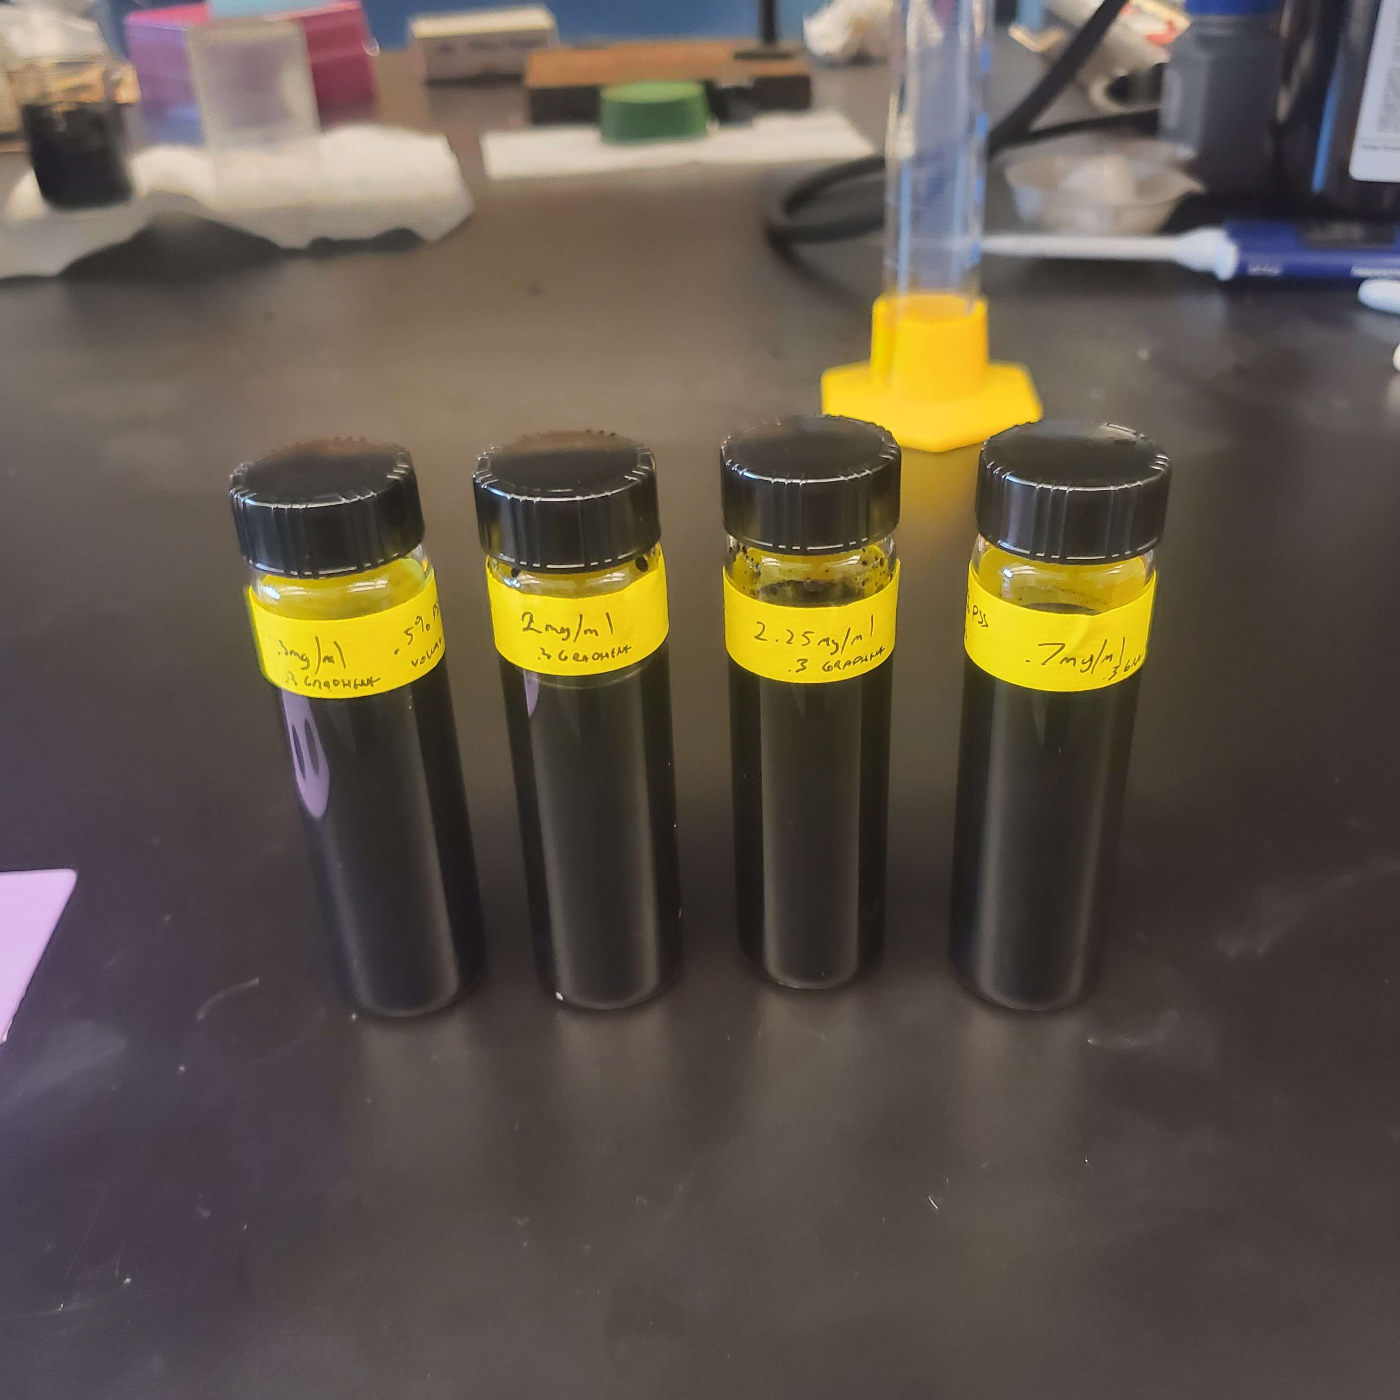
Results
PSS : Graphene Ratio
  1% PSS per 2mg/ml
Notes:
Add graphene success and failure plots

Slide 14
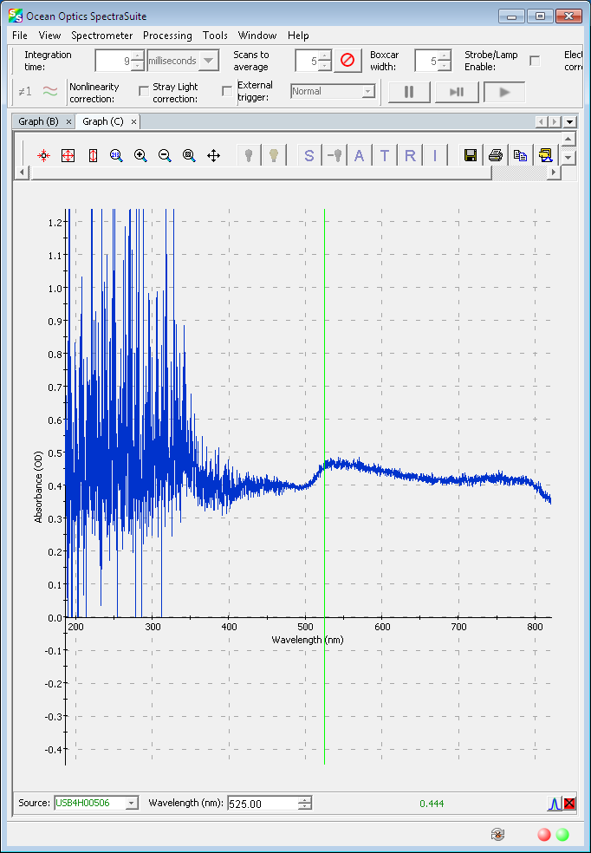
Further Research
Maximum saturation
More Precision
Testing Physical Properties
Using UV-Vis
Too Much Interference

Slide 15

Concentration Calculation Beer-Lambert
$$A=εcl \\ A_{1}=εc_{1}l \\ A_{2}=εc_{2}l \\ \frac{A_{1}}{A_{2}}=\frac{c_{1}}{c_{2}}$$
𝐴 = Absorbance
𝜀 = Molar Absorption Coefficient
𝑐 = Molar Concentration
𝑙 = Optical Path Length
Notes:
Ratio

Slide 16
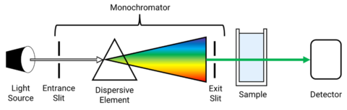
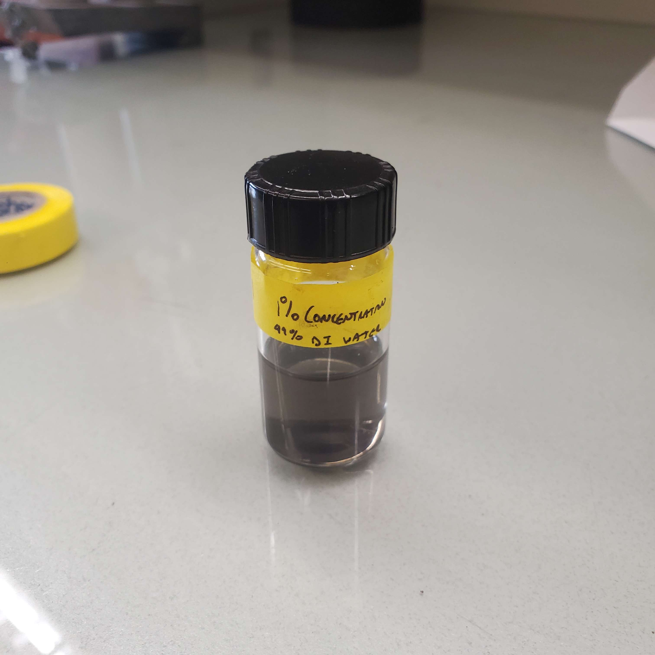
UV-Vis

Slide 17
Acknowledgement
Kim Coy
Arjun Nepal
Shusil Sidgel
Dr. Sorensen
This material is based upon work supported by the National Science Foundation under Grant No. #2244539. Any opinions, findings, and conclusions or recommendations expressed in this material are those of the author(s) and do not necessarily reflect the views of the National Science Foundation.

Slide 18
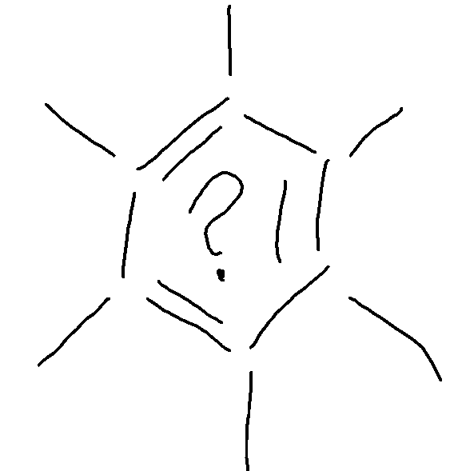
Questions?

