Slide 1
Characterizing a Parallel plate Imaging Deflector
Anjali Filinovich

Slide 2
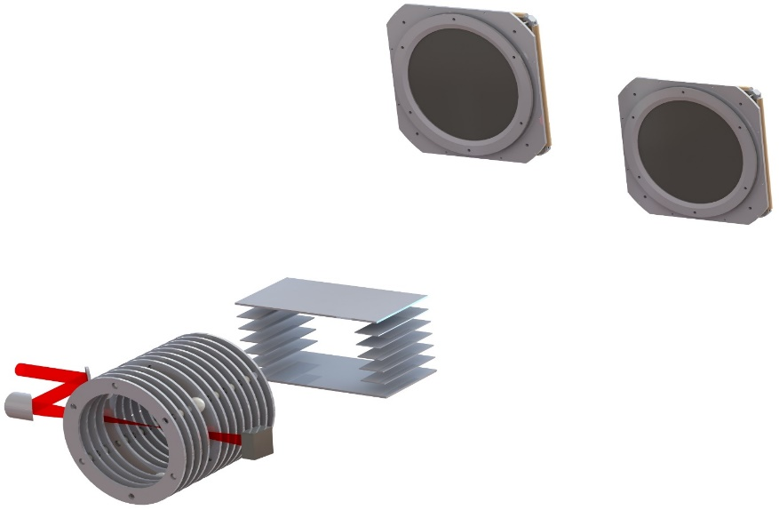


Understanding laser-molecular ion interactions using momentum imaging
Time- and position-sensitive detectors
Measure final position and time of flight of each fragment
Calculate momentum information, learn about fragmentation process
My project does not deal with the spectrometer field.
Adjustable height
H⁺
D⁺
Faraday
cup
Neutrals
Spectrometer
$$E_{def}$$
Ultrafast
laser
Imaging deflector
4.5 keV HD⁺
ion beam
$$E_{spec}$$

Slide 3
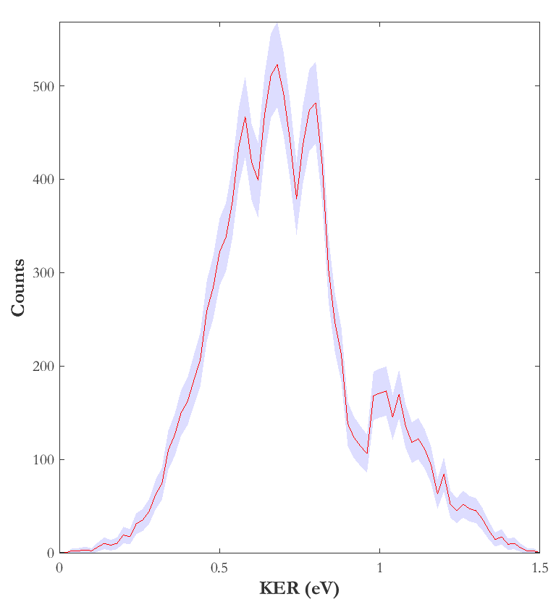
Understanding laser-ion interactions using momentum imaging
Examining fragmentation of HD⁺ resulting from its interaction with a 790 nm laser pulse.
H⁺ + D Dissociation channel
H⁺ + D vibrational states
McKenna, J., et al. Phys. Review A. 80 (2009).
Notes:
In this graph, you can see the signature of the different vibr states of HD+

Slide 4
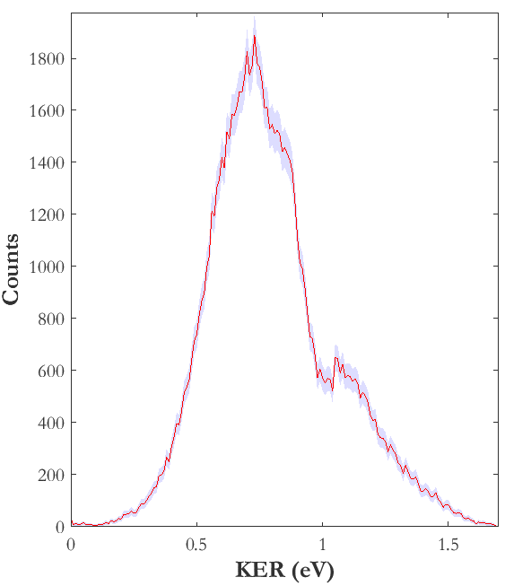
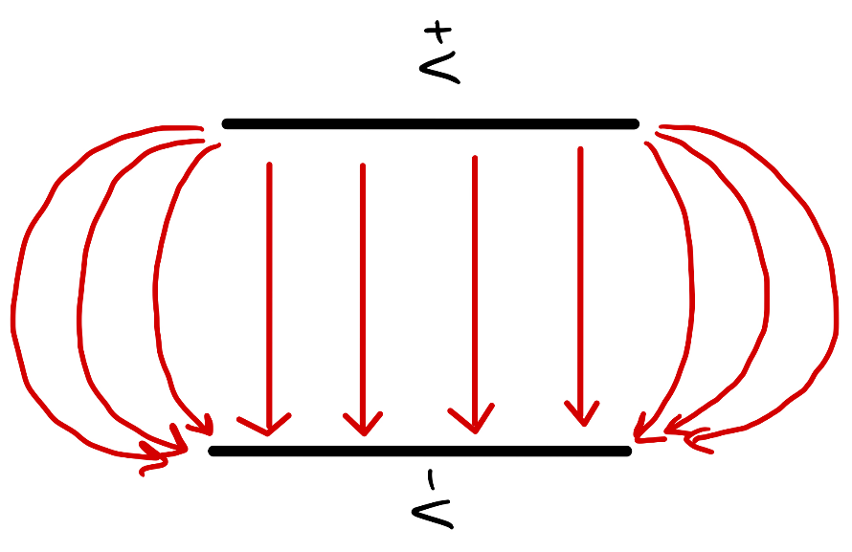
Goal
There is a discrepancy between model (ideal) and real parallel plate deflector fields.
Distortions in the real deflector field decrease the resolution of position and TOF data.
Ideal parallel plate deflector field lines
Real parallel plate deflector field lines
1-detector measurement
without imaging deflector
2-detector measurement
with imaging deflector
Notes:
With defl off, we could resolve different vibrational levels, w defl on, high defl voltage distorts imaging,vibr. structure blurs
My contribution to this project has been… then goal
The addition of a second target made it necessary to use an imaging deflector, causing some probs
Looking for vibrational energies of HD+ which acts kind of like a harmonic oscillator. Peaks are those energies. Not as clear in fig. 2
Higher voltage used to deflect different masses means more fringe field effects
Ions flying off of deflector axis
The fringe field of deflector causes distortions
Decrease in resolution of measurements

Slide 5
Goal
Characterize imaging deflector to enable retrieval of momentum information.
  Use simulation to represent experimental data (real deflector field)
  Generate analytical formula to fit simulated data
    - The basis of this analytical formula is the model of an ideal parallel plate deflector
  Use analytical formula to find position and time of flight without deflector distortions

Slide 6
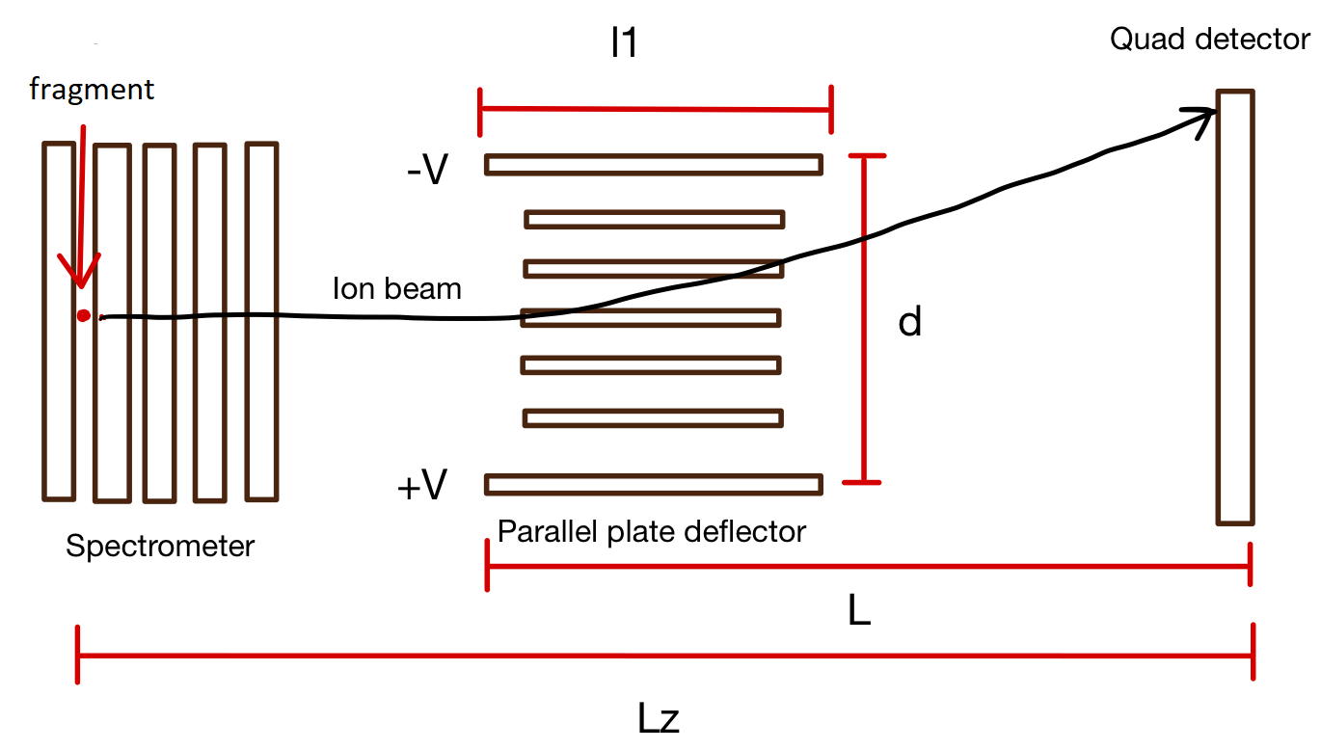

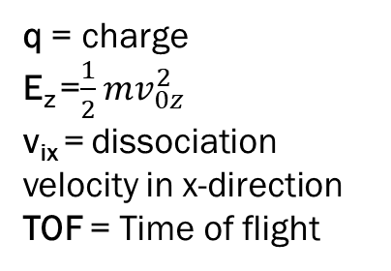
Model
q = charge
E_{z} =$\frac{1}{2}mv_{0z}^{2}$
v_{ix} = dissociation velocity in x-direction
TOF = Time of flight
$x_{f}=\frac{qVl_{1}}{E_{z}d}\left(L−\frac{l_{1}}{2}\right)+v_{ix}TOF$… or simply put, $x deflection \text{∝} \frac{qV}{E_{z}}$
+x
Notes:
X should have a lot of deflection, Y should have no deflection, z should have a time delay

Slide 7

Model
q = charge
E_{z} =$\frac{1}{2}mv_{0z}^{2}$
v_{ix} = dissociation velocity in x-direction
TOF = Time of flight
$x_{f}=\frac{qVl_{1}}{E_{z}d}\left(L−\frac{l_{1}}{2}\right)+v_{ix}TOF$… or simply put, $x deflection \text{∝} \frac{qV}{E_{z}}$
Characterize distortion in position by fitting the model to simulated data.
Notes:
X should have a lot of deflection, Y should have no deflection, z should have a time delay

Slide 8
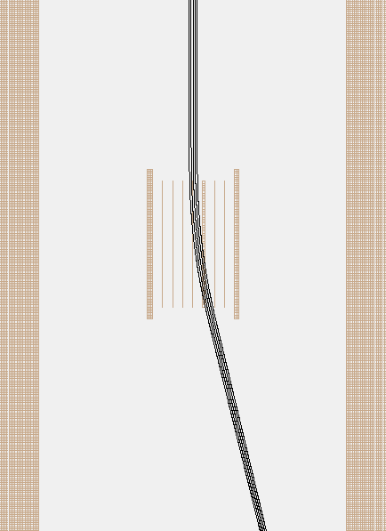
Methods
Ion trajectories
Generate initial conditions for simulation in Matlab
Collect time of flight, impact position, and other ion trajectory data in Simion
Compare simulated result to model, modify model equation and add correction terms to describe the distortion due to the deflector field.
Deflector
Example of an ion trajectory in Simion
Notes:
Simion solves Laplace equation

Slide 9


Results
Characterize distortions in the
  x - direction
  z - direction (TOF)
  y - direction
H⁺
D⁺
Neutrals
x
z
$$E_{def}$$
y
$$E_{spec}$$
Notes:
How motion in these directions effects our measurement of position, TOF, and momentum

Slide 10
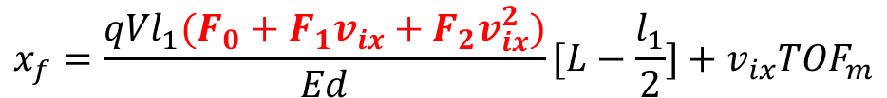

Correcting x-position model
Position resolution of imaging setup: 0.25 mm
$$x_{f}=\frac{qVl_{1}}{E_{z}d}\left(L−\frac{l_{1}}{2}\right)+v_{ix}TOF$$
Compared simulation results to model results, corrected model
2nd order correction
$$x_{f}=\frac{qVl_{1}(F_{0}+F_{1}v_{ix}+F_{2}v_{ix}^{2})}{Ed}[L−\frac{l_{1}}{2}]+v_{ix}TOF_{m}$$
Notes:
Show coefficients in F graph
We know our correction is good enough because the residuals are less than 0.2 mm.

Slide 11
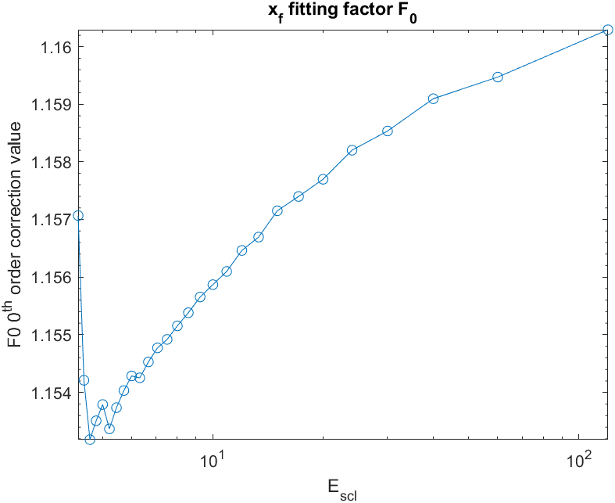
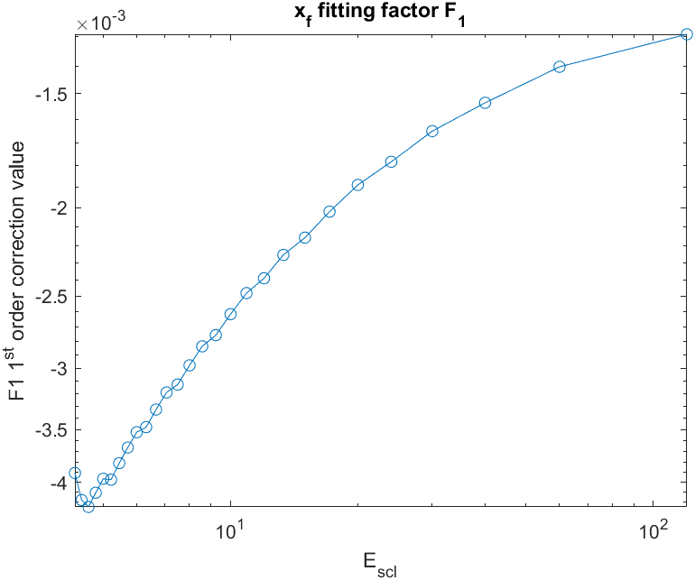
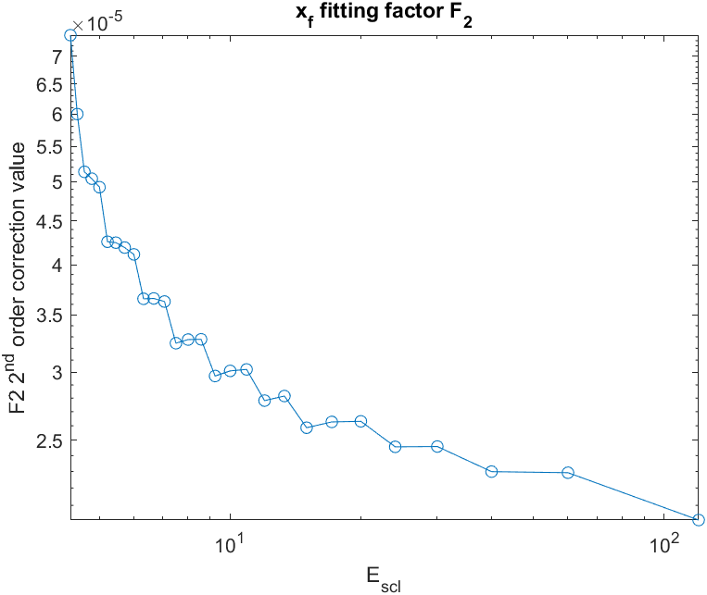

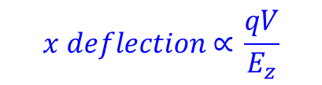

x-position correction coefficients
$$x_{f}=\frac{qVl_{1}(F_{0}+F_{1}v_{ix}+F_{2}v_{ix}^{2})}{Ed}[L−\frac{l_{1}}{2}]+v_{ix}TOF_{m}$$
$$x deflection \text{∝} \frac{qV}{E_{z}}$$
$$E_{scl}=\frac{E_{z}}{qV}$$
Plotting F vs E_{scl} allows us to remove deflector distortions in position under a variety of initial conditions
Fit curves to find functional form of each coefficient
Notes:
We plot F vs Escl because each fragment might have different Escl because of different initial conditions in the energy or the charge.

Slide 12


Modeling distortions in TOF
Fit time delay
Residual is smaller than time resolution (0.2 ns) with second order fit
$$TOF_{ND}=TOF with no distortion$$
$$F_{0}+F_{1}x_{f}+F_{2}x_{f}^{2}=TOF_{S}−TOF_{ND}$$
$$TOF_{s}=Simulated TOF$$
Notes:
Show coefficients in F graph
We know our correction is good enough because the residuals are less than 0.2 mm.

Slide 13
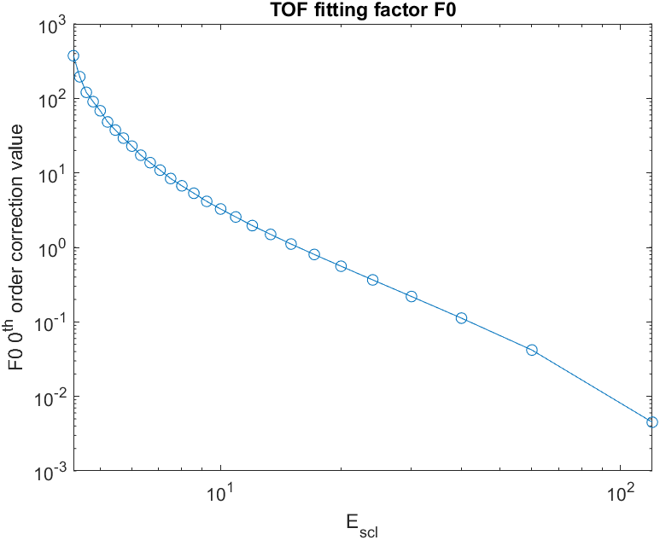
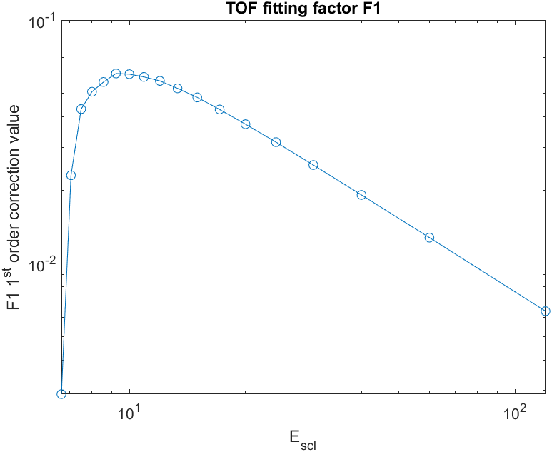
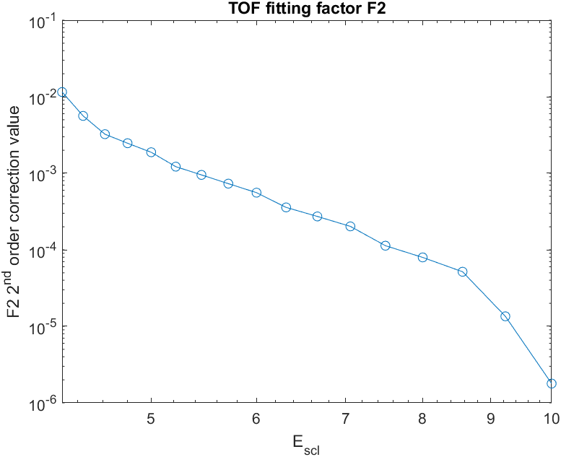
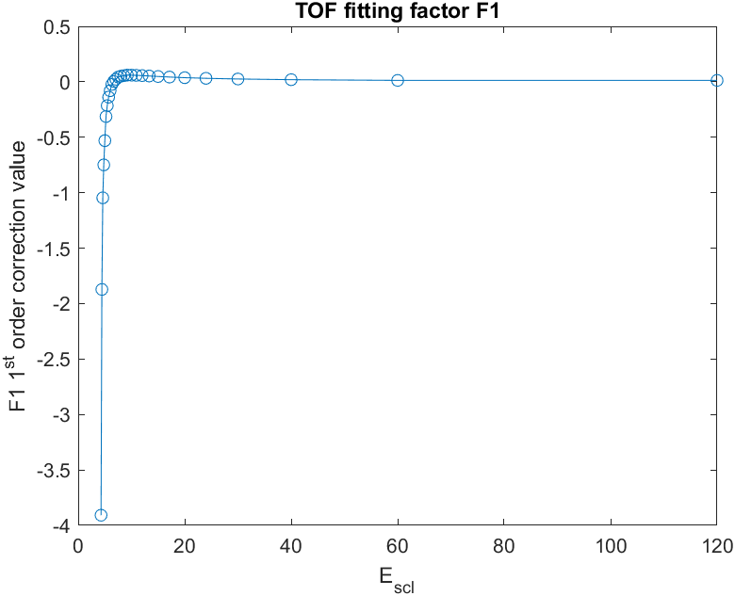



TOF model coefficients for different conditions
$$TOF_{ND}=TOF with no distortion (′ideal^{′})$$
$$F_{0}+F_{1}x_{f}+F_{2}x_{f}^{2}=TOF_{S}−TOF_{ND}$$
$$E_{scl}=\frac{E}{qV}$$
$$TOF_{s}=Simulated TOF$$
Fit curves to find functional form of each coefficient
Use analytic expression to remove distortions in TOF for a variety of initial conditions.
*Some negative values omitted in middle plot. See inset graph
Notes:
Show coefficients in F graph

Slide 14
Summary
Corrected x-position model, allowing us to remove distortions in x-direction.
Determined an analytic expression for TOF delay to remove distortions in TOF.
Distortions in the y-direction are small enough to neglect for now.

Slide 15
Future Work
Fit F vs. E_{scl} curves to describe corrections for different initial conditions
Compare fitted model to simulation results to ensure its accuracy. Test in x, y, and z directions.
Use fitting expressions to recover fragment momentum information from experimental data

Slide 16


Acknowledgements and Thanks
K-State REU Faculty
Itzik Ben-Itzhak
Chandan Bagdia (postdoc)
Kim Coy
Loren Greenman
J.T. Laverty
The National Science Foundation
Kansas State University
"This material is based upon work supported by the National Science Foundation under Grant No. #2244539. Any opinions, findings, and conclusions or recommendations expressed in this material are those of the author(s) and do not necessarily reflect the views of the National Science Foundation."

Slide 18
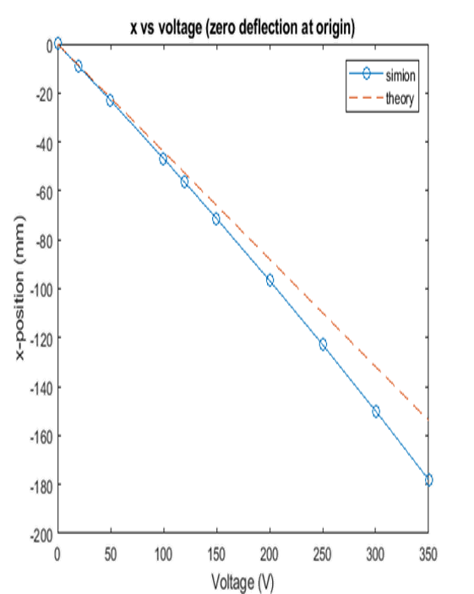
Discrepancies between model and Simion results
Notes:
-

Slide 19
Characterizing motion in y

Slide 20
Defining terms
y_{f} – measured final y-position
TOF – measured time of flight
v_{iy} – initial velocity in the y-direction that was input into Simion.
v_{iyM} – y-velocity calculated using y_{f}/TOF
V –volts
v_{y} –instantaneous y-direction velocity as ion flies
v_{iy} was varied from -5 → +5 eV (±0.0309497 mm/ns)
Total KE varied from 1500→1505 eV.

Slide 21


Correcting deflector length (l₁)
$$x_{f}=\frac{qVl_{1}F_{0}}{Ed}[L−F_{0}\frac{l_{1}}{2}]+v_{ix}TOF_{m}$$
Multiplying equation by correction factor
$$x_{f}=\frac{qVl_{1}F_{0}}{Ed}[L−\frac{l_{1}}{2}]+v_{ix}TOF_{m}$$
Both corrections fit the data equally well, but adding the correction factor in one place is much simpler.

Slide 22
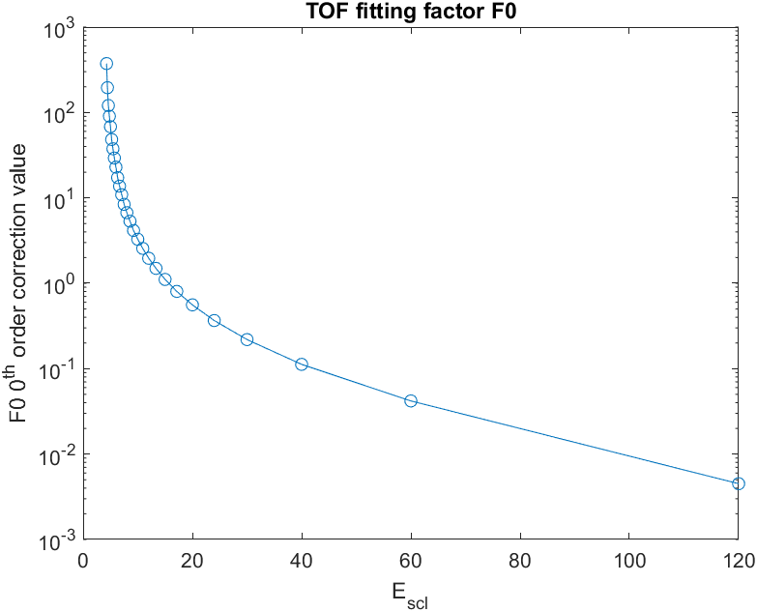
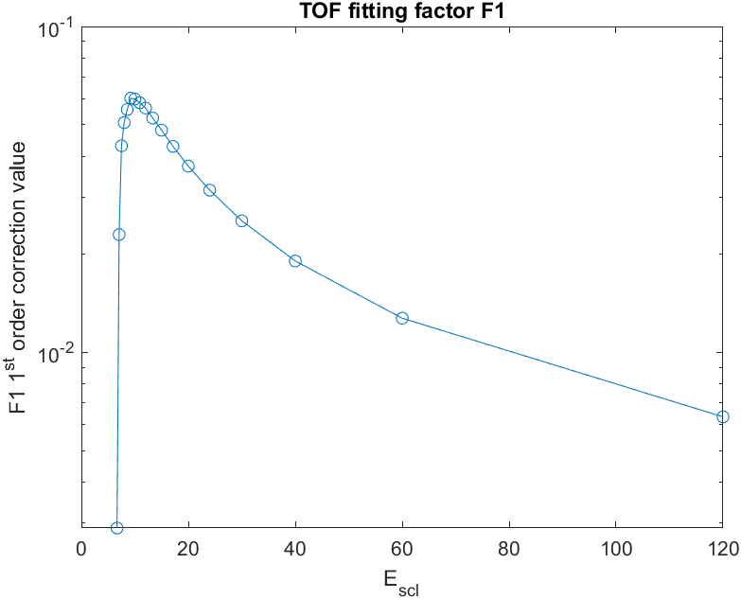
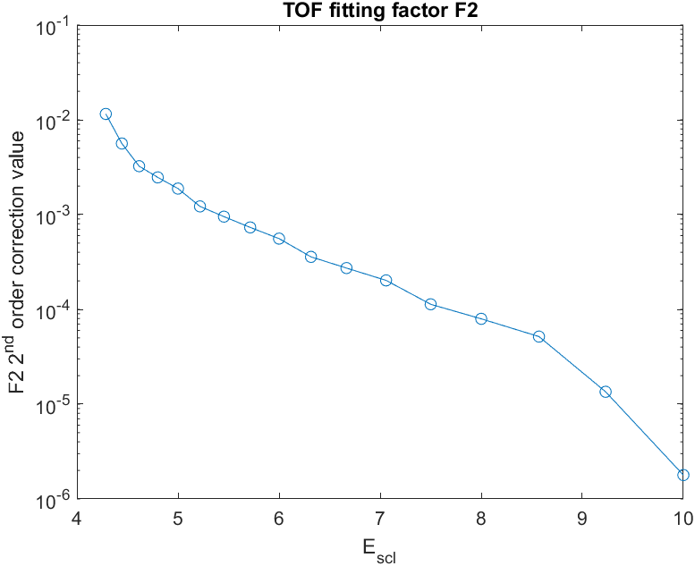




Semi-log (y) Fitting Factor vs E_{scl}
$$TOF_{ND}=No deflection TOF$$
$$TOF_{s}=Simulated TOF$$
$$F_{0}+F_{1}x_{f}+F_{2}x_{f}^{2}=TOF_{S}−TOF_{ND}$$
*negative data ignored in F1 graph
$$E_{scl}=\frac{E}{qV}$$

Slide 23
Characterizing effects of motion in y
For v_{iy} less than 5 eV, TOF deviation is less than 0.2 ns. The time resolution of our setup is 0.2 ns.
Percent error in velocity is around 2%.
Notes:
How motion in y impacts measurements of y, TOF

