Slide 1
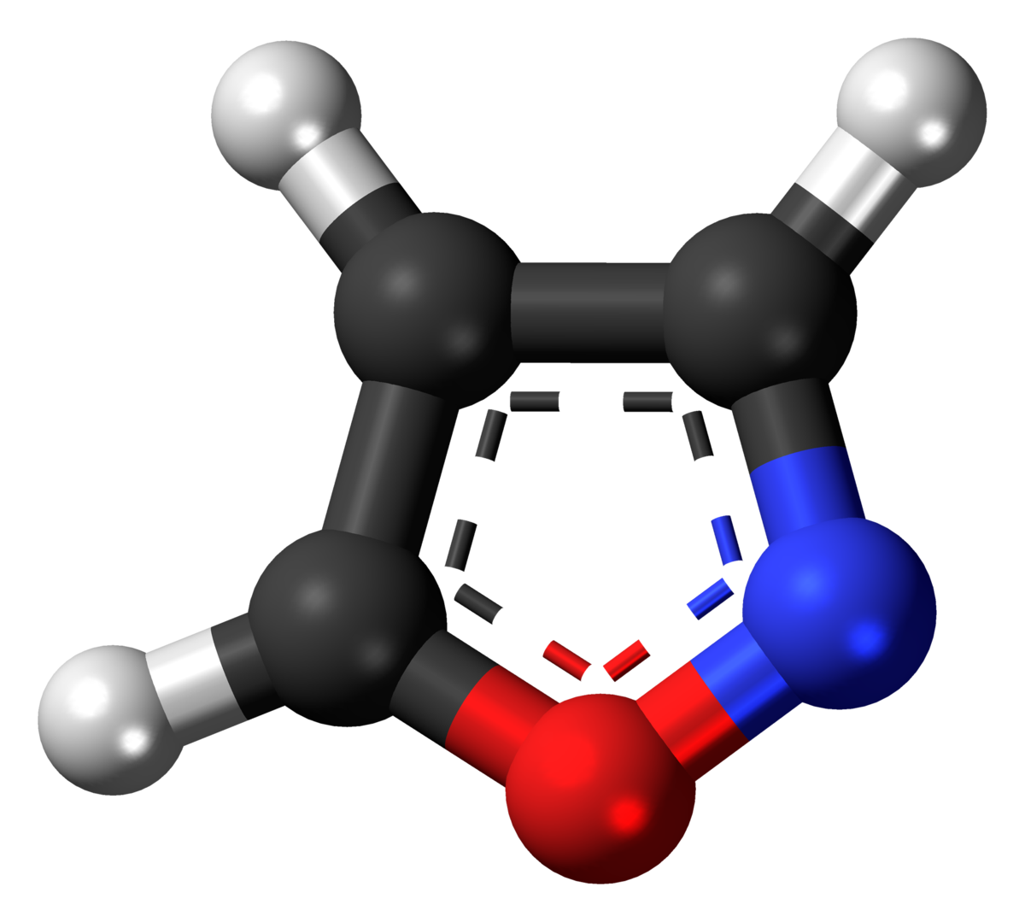
Cleaning coulomb explosion data via random coincidence subtraction
Mason Clark
James R. Macdonald Laboratory, Department of Physics, Kansas State University Manhattan, KS 66506, USA

Slide 2
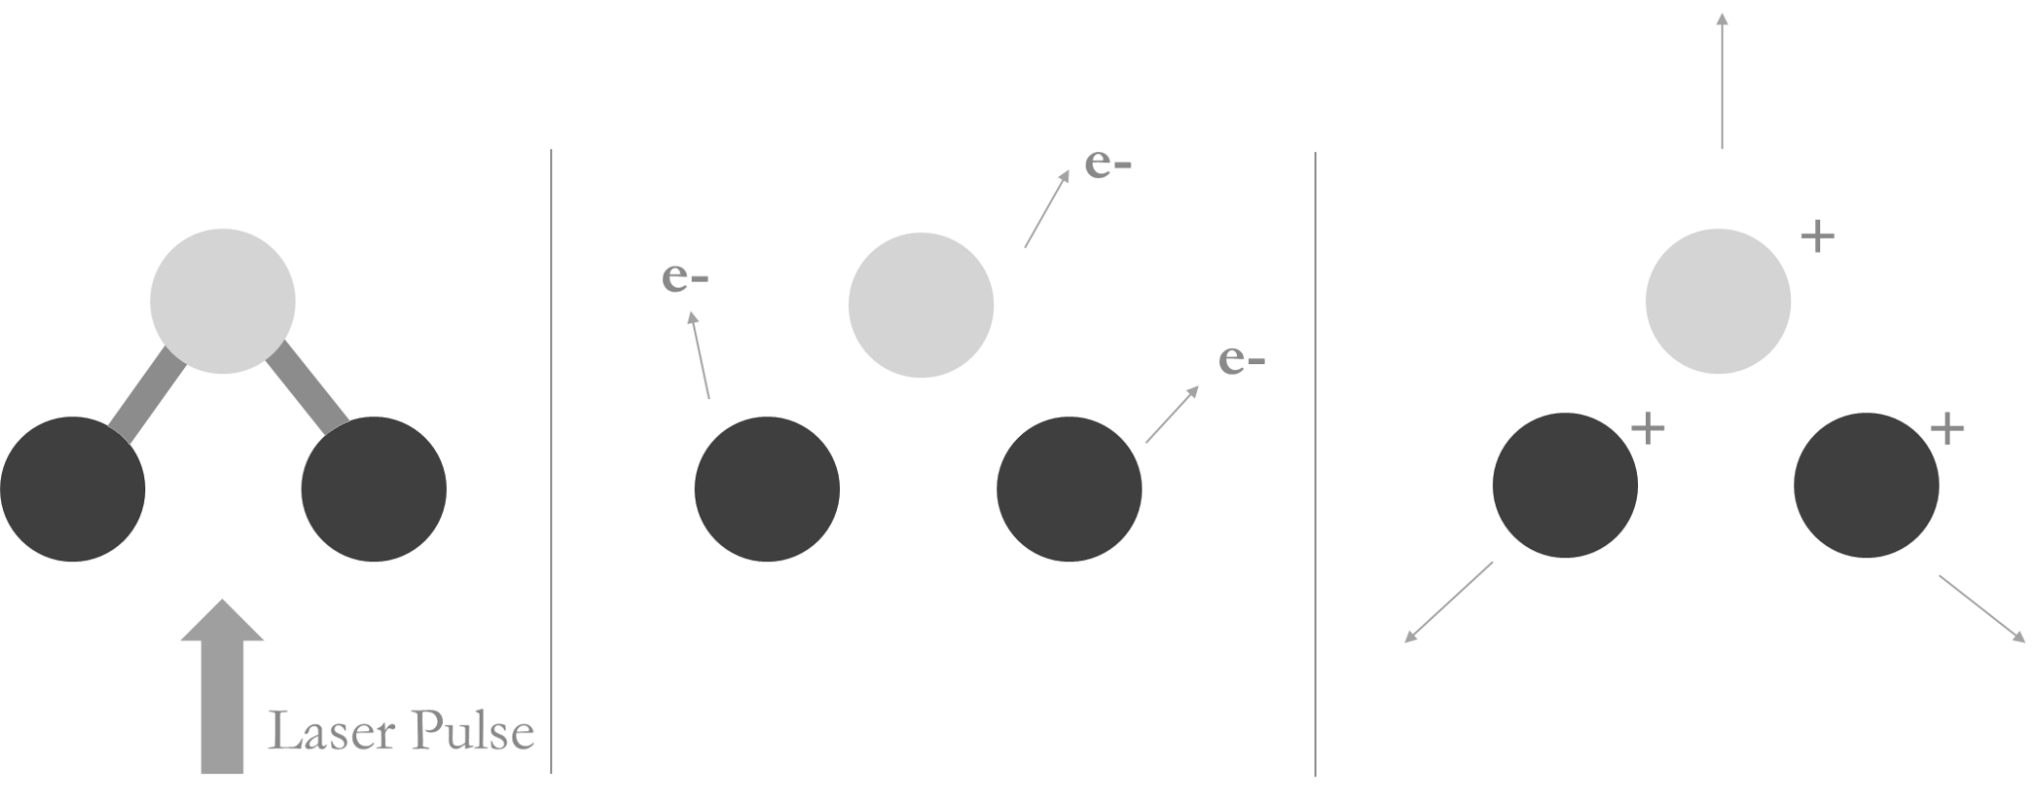
Coulomb Explosion Imaging
We measure these
(insight into the structure)
Ionize a sample
  Remove an electron from each atom
  Repel each other
2

Slide 3
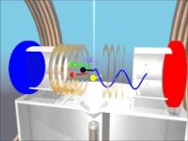
Pitzer, M., Fehre, K., Kunitski, M., Jahnke, T., Schmidt, L., Schmidt-Böcking, H., Dörner, R., Schöffler, M. Coulomb Explosion Imaging as a Tool to Distinguish Between Stereoisomers. J. Vis. Exp. (126), e56062, doi:10.3791/56062 (2017).
Coulomb Explosion Imaging
Atoms now have charge and fall to the detector via the electric field
Observe when and where the ions hit the detector
  Get momenta
3
Notes:
https://www.youtube.com/watch?v=dpogiiKnIXA

Slide 4
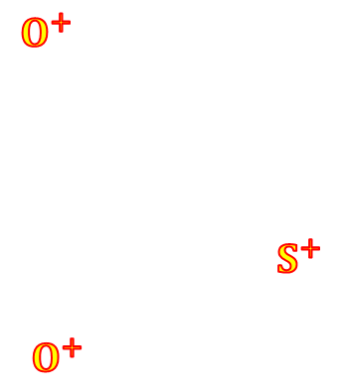
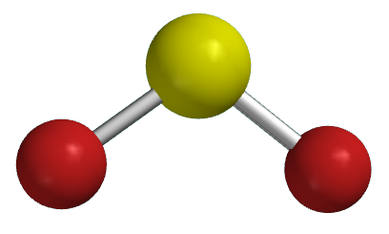
Sulfur Dioxide
Smaller Molecule
4

Slide 5
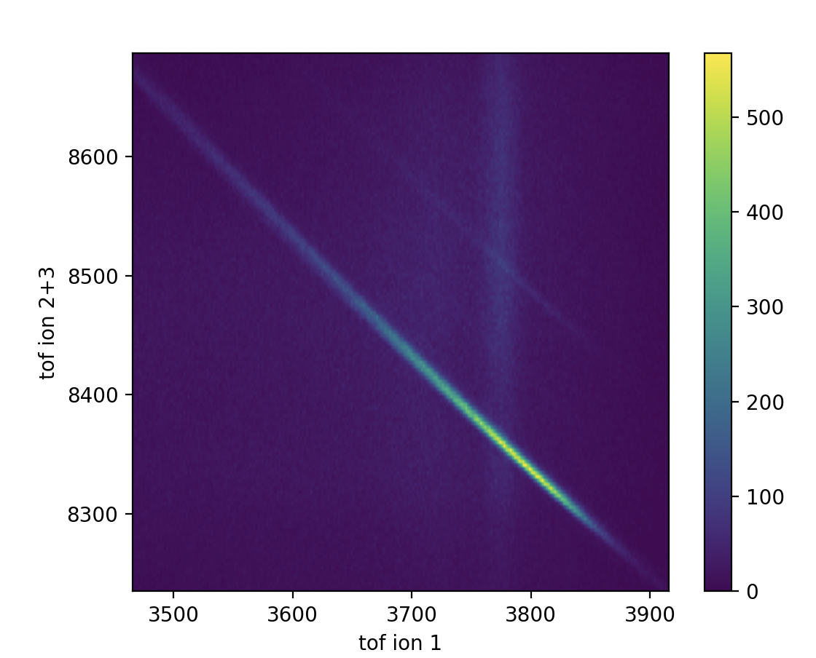
3-fold Coincidence for SO₂ → S+ O+ O+
“Complete Channel”
Momentum conservation
Easy to cut randoms
  Leads to “clean” images
5

Slide 6
3-fold Coincidence for SO₂ → S+ O+ O+
“Complete Channel”
Momentum conservation
Easy to cut randoms
  Leads to “clean” images
Residual H20
Real Data Following
Momentum Conservation
6

Slide 7
Isoxazole C₃H₃NO
Larger Molecule
File:Isoxazole-3D-balls.png. (2020, October 30). Wikimedia Commons. Retrieved 19:53, July 21, 2023 from https://commons.wikimedia.org/w/index.php?title=File:Isoxazole-3D-balls.png&oldid=507693222.
7
Notes:
Authors, Journal Page (Year)

Slide 8
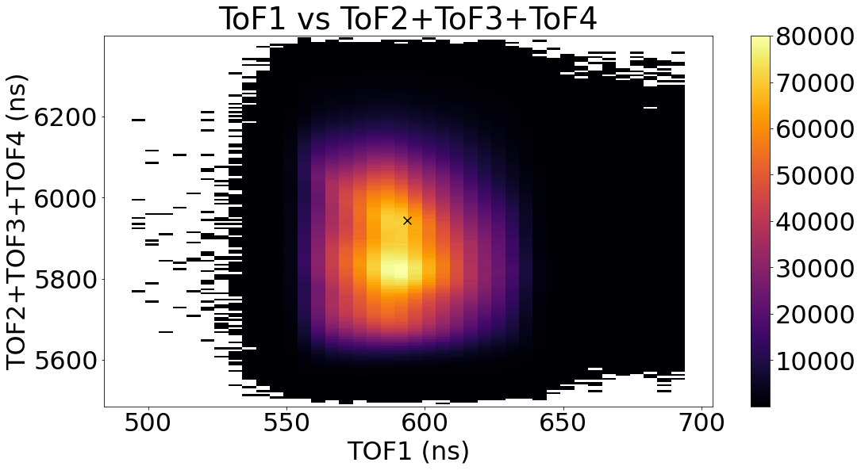
4-fold Coincidence Plot for Isoxazole
H+ C+ N+ O+ Channel
”Incomplete Channel”
Only getting 1/2 of the ions, so can’t find momentum conservation
  No clear coincidence line
8

Slide 9
4-fold Coincidence for Isoxazole
H+ C+ N+ O+ channel
Harder to remove bad data in incomplete channels
”Incomplete Channel”
Only getting 1/2 of the ions, so can’t find momentum conservation
  No clear coincidence line
9

Slide 10
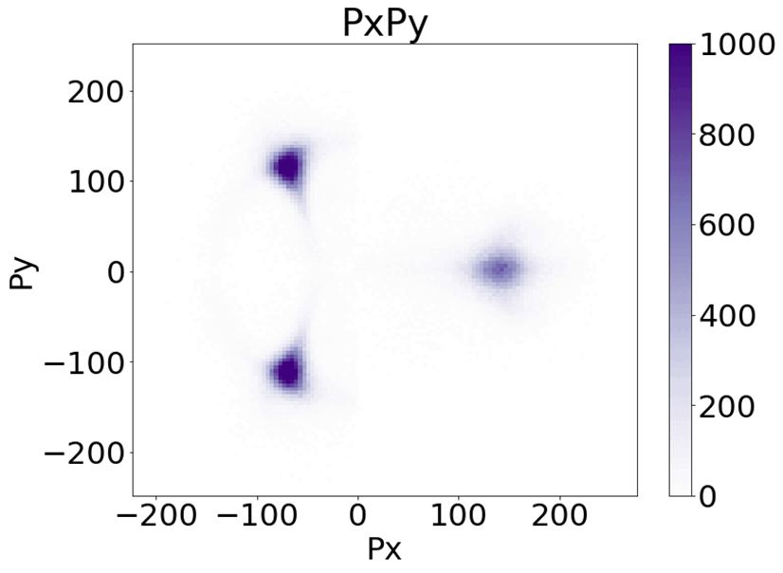
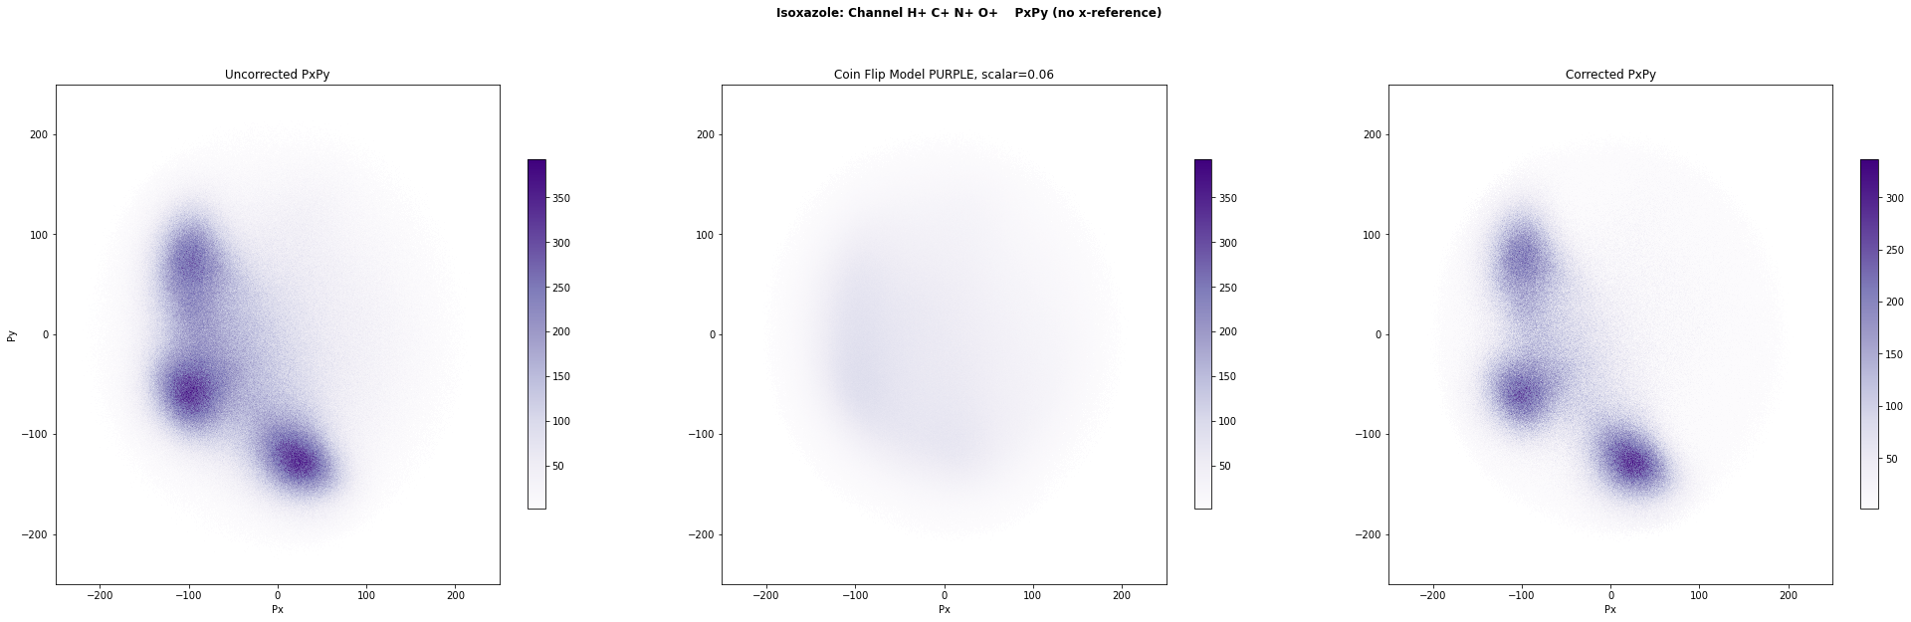
Incomplete Channels are less clean
Sulfur Dioxide Isoxazole
10

Slide 11
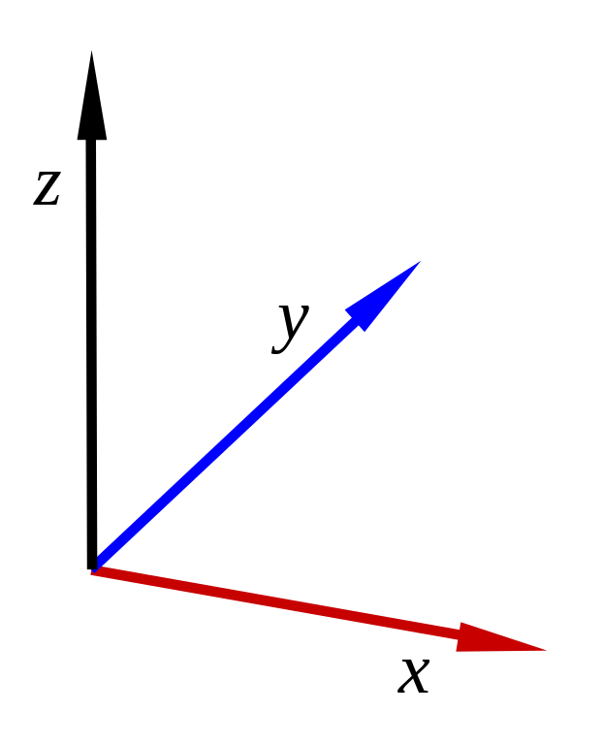
Newton Plot for Isoxazole C₃H₃NO
H+ C+ N+ O+ Channel
Plotting momenta from the Coulomb Explosion
Not plotting hydrogens
Oxygen as reference and x-direction
Nitrogen to define plane
Dots are carbons
N+
O+
11

Slide 12
Motivation
Are the structures real or from ‘fuzziness’ ?
C+
C+
C+
12

Slide 13
Motivation
Are the structures real or from ‘fuzziness’ ?
Probability of carbons being here?
C+
C+
C+
13

Slide 14
Motivation
Are the structures real or from ‘fuzziness’ ?
Probability of carbons being here?
Probability of them being way out to the center & top right?
C+
C+
C+
14

Slide 15
Remove “bad data” by identifying its components.
15

Slide 16
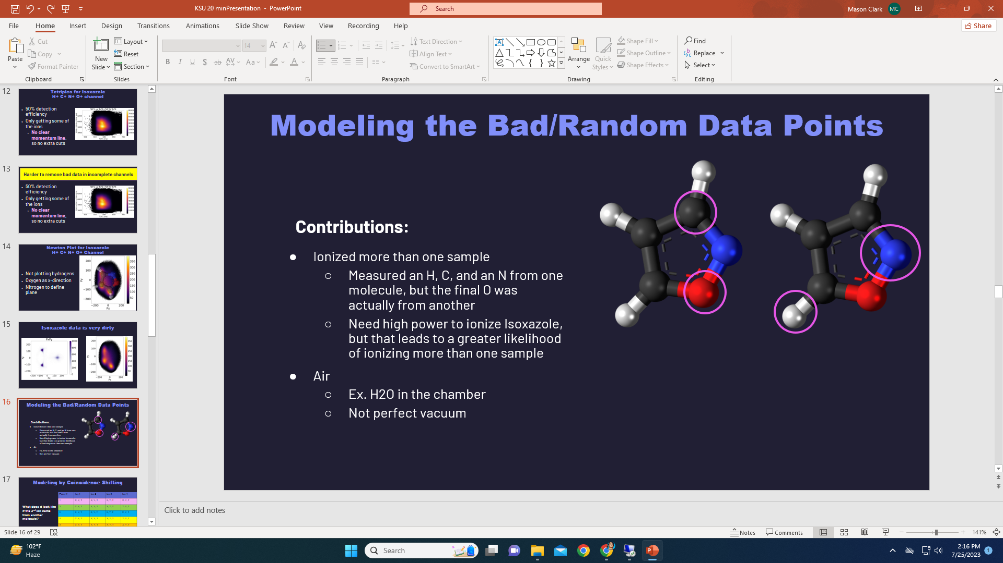
Modeling the Bad/Random Data Points
Contributions:
Ionized more than one sample
  Measured another molecule’s ion
    Ionized the whole molecule or just part
  More likely because high power is needed for Isoxazole breakup
Residual Gasses
  Ex. H2O in the chamber
  Not perfect vacuum
16

Slide 17
How many ways could this infiltrate our data?
17

Slide 18
How many ways can “Bad Data” be permutated among the four measured ions?
T is a good datapoint (True)
F is an incorrect datapoint (False)
TTTF = first three ions are correct but the 4th is wrong.
Combinations of ways an event could be invalid are:
  If one is wrong: TTTF, TTFT…
  If two are wrong: TTFF, TFFT…
  If three are wrong: TFFF, FTFF…
  All wrong: FFFF
“Boolean Model”
18

Slide 19
Modeling by Coincidence Shifting
Event # | Ion 1 | Ion 2 | Ion 3 | Ion 4
1 | X, Y, T | X, Y, T | X, Y, T | X, Y, T
2 | X, Y, T | X, Y, T | X, Y, T | X, Y, T
3 | X, Y, T | X, Y, T | X, Y, T | X, Y, T
4 | X, Y, T | X, Y, T | X, Y, T | X, Y, T
5 | X, Y, T | X, Y, T | X, Y, T | X, Y, T
What does it look like if the 2nd ion came from another source?
i.e. Incorrect Datapoint (False)
19

Slide 20
Modeling by Coincidence Shifting
Event # | Ion 1 | Ion 2 | Ion 3 | Ion 4
1 | X, Y, T | X, Y, T | X, Y, T | X, Y, T
2 | X, Y, T | X, Y, T | X, Y, T | X, Y, T
3 | X, Y, T | X, Y, T | X, Y, T | X, Y, T
4 | X, Y, T | X, Y, T | X, Y, T | X, Y, T
5 | X, Y, T | X, Y, T | X, Y, T | X, Y, T
Events are independent of each other, so it is replaced by a random Ion 2 data point
20

Slide 21
Modeling by Coincidence Shifting
Prob. replaced by residual gas
Prob. replaced by not fully ionized sample
Prob. replaced by fully ionized sample
Event # | Ion 1 | Ion 2 | Ion 3 | Ion 4
1 | X, Y, T | X, Y, T | X, Y, T | X, Y, T
2 | X, Y, T | X, Y, T | X, Y, T | X, Y, T
3 | X, Y, T | X, Y, T | X, Y, T | X, Y, T
4 | X, Y, T | X, Y, T | X, Y, T | X, Y, T
5 | X, Y, T | X, Y, T | X, Y, T | X, Y, T
21

Slide 22
Include all permutations of invalid events
-> Model is complete!
22

Slide 23
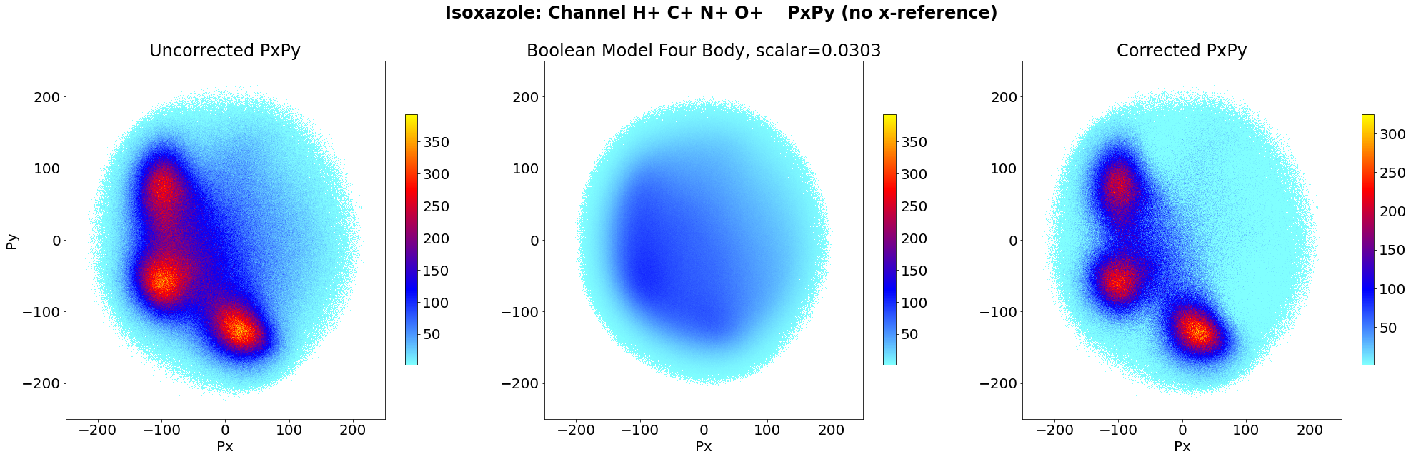
Results
Uncorrected Data Model Corrected
23

Slide 24
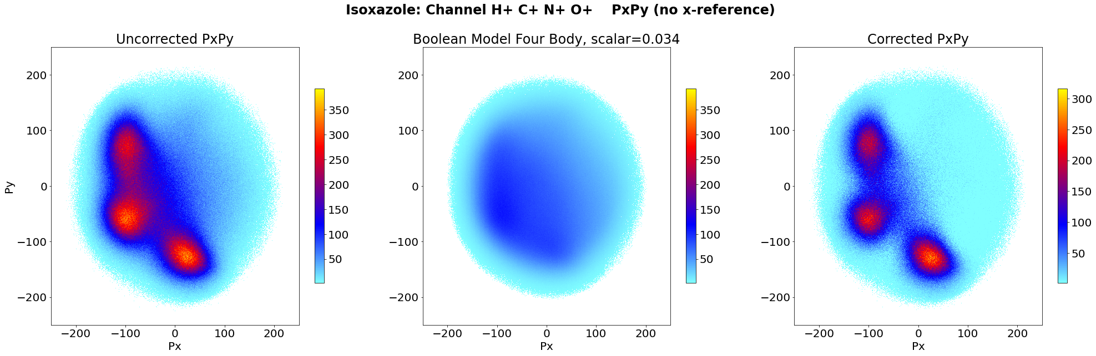
Results
Uncorrected Data Corrected
24

Slide 25
Results
Uncorrected Data Corrected
25

Slide 26
Results
Effective method for sharpening incomplete channel images & plots
Helps determine real structures
      Can account for secondary molecules and some residual gasses
Background terms are non-isotropic
26

Slide 27
Future outlook
Shifting model is biased towards fully ionized contributions
  Good data that is shifted == bad data from second fully ionized sample
    Data: 70% good data
    Model: >70% fully ionized contributions
    Means it’s better at this, but worse at others
More likely that one is wrong than all four
Applying this to more incomplete channel experiments
  Ex. May work best with messy data with ions that include lots of residual gas points
27

Slide 28



Acknowledgements
Daniel Rolles, Zane Phelps, Sanduni Kudagama, Tu Nguyen, Huynh Van Sa Lam, Keyu Chen
&
All members of the JRML Team
Also thank you to Kim Coy and Loren Greenman!
This material is based upon work supported by the National Science Foundation under Grant No. #2244539. Any opinions, findings, and conclusions or recommendations expressed in this material are those of the author(s) and do not necessarily reflect the views of the National Science Foundation.

Slide 29
Questions?
Can you correct things other than newton plots?
What do you mean “the model is biased towards secondary contributions”?
Could you go back to that one slide?

Slide 31
Bias Towards Total Ionization
Original Data Model
Prob. residual gas
Prob. not fully ionized sample
Prob. separate fully ionized sample
Prob. original fully ionized sample
Prob. replaced by residual gas
Prob. replaced by not fully ionized sample
Prob. its from a separate fully ionized sample

Slide 32
Bias Towards Total Ionization
Original Data Scaled Down Model
Prob. residual gas
Prob. not fully ionized sample
Prob. separate fully ionized sample
Prob. original fully ionized sample
Still subtracts randoms, but it is more effective at removing separate fully ionized samples.
Fundamental issue if you expect zero secondary fully ionized samples

Slide 33
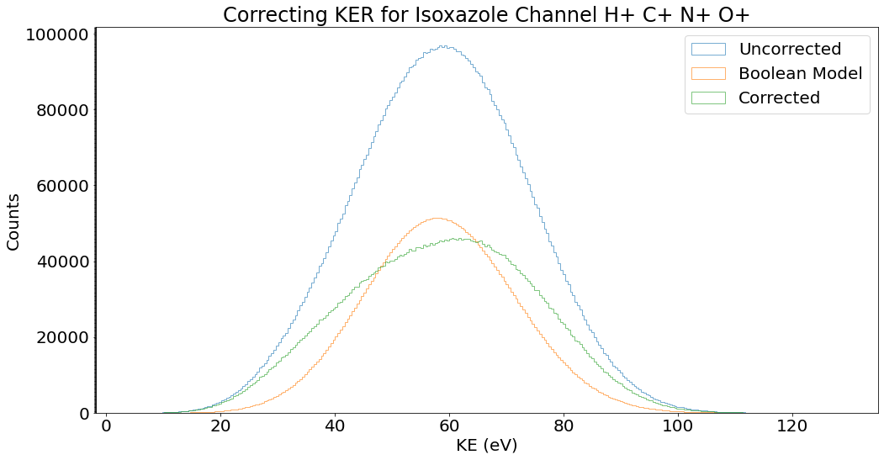
Corrected KER

Slide 34
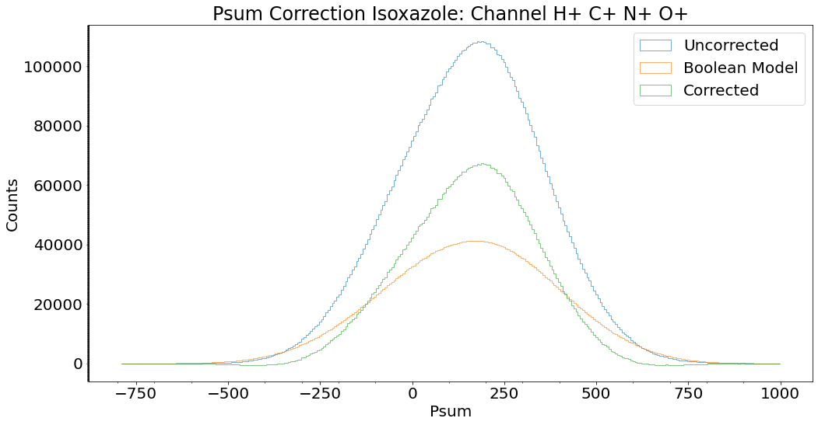
Corrected Psum

Slide 35
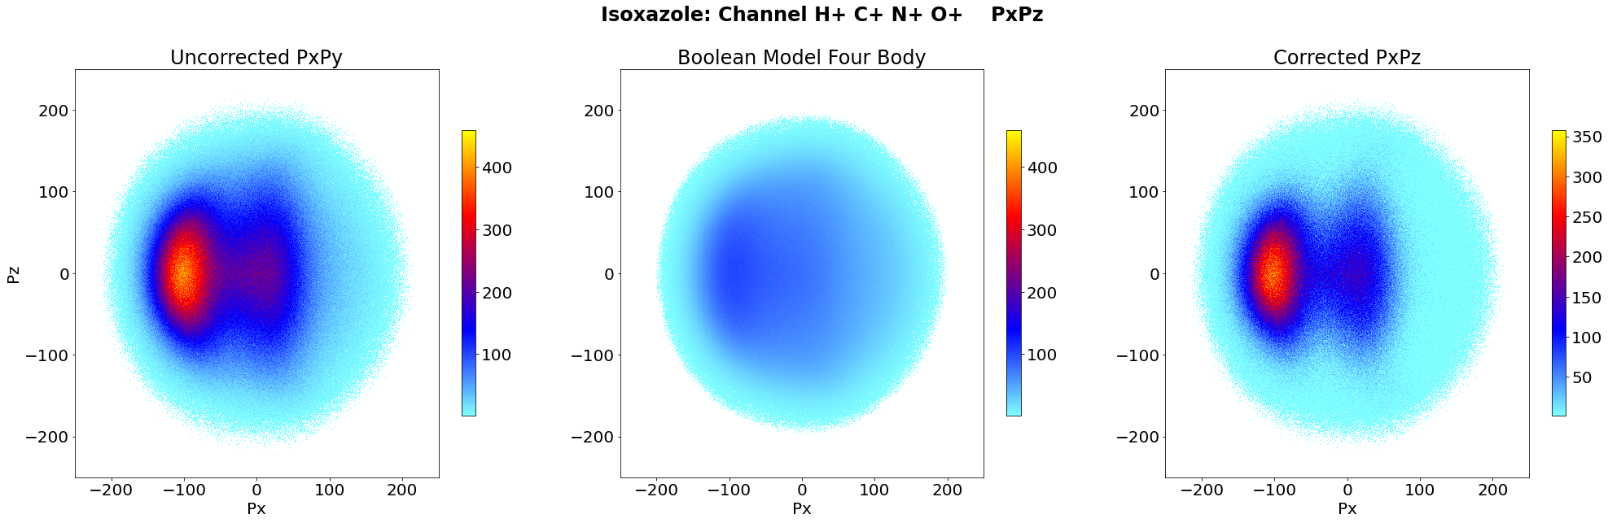
PxPy
(no x-reference)
PxPz

Slide 36
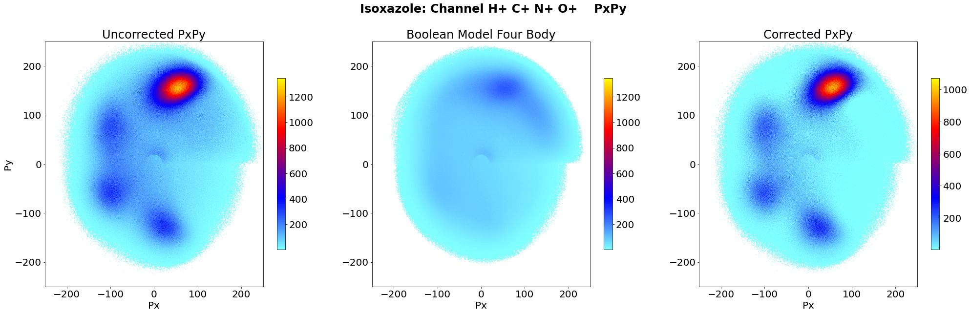
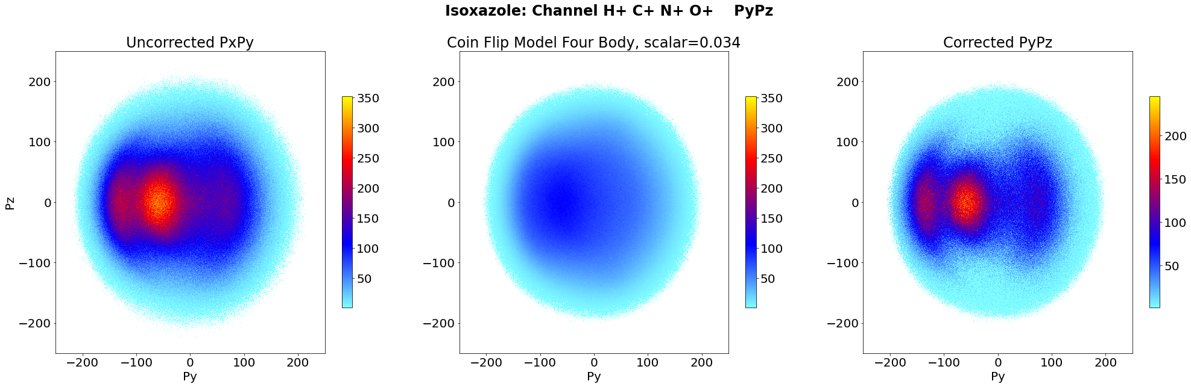
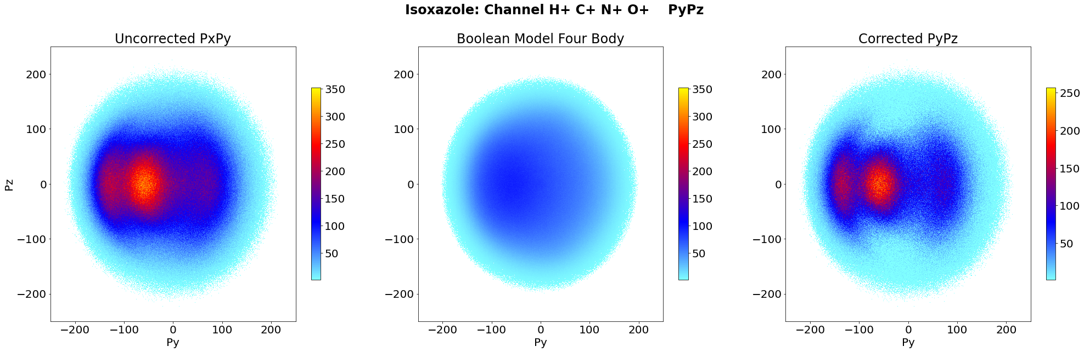
PxPy
PyPz

Slide 37
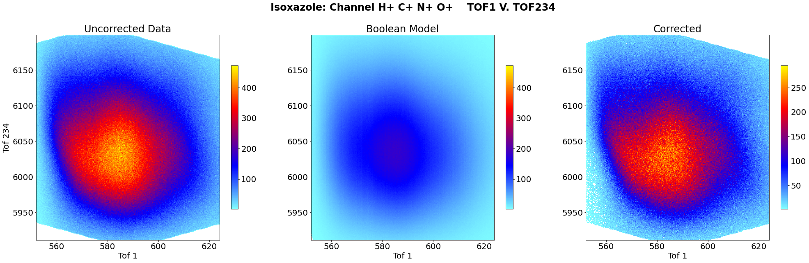
Corrected Gated 4-Fold Coincidence

Slide 38
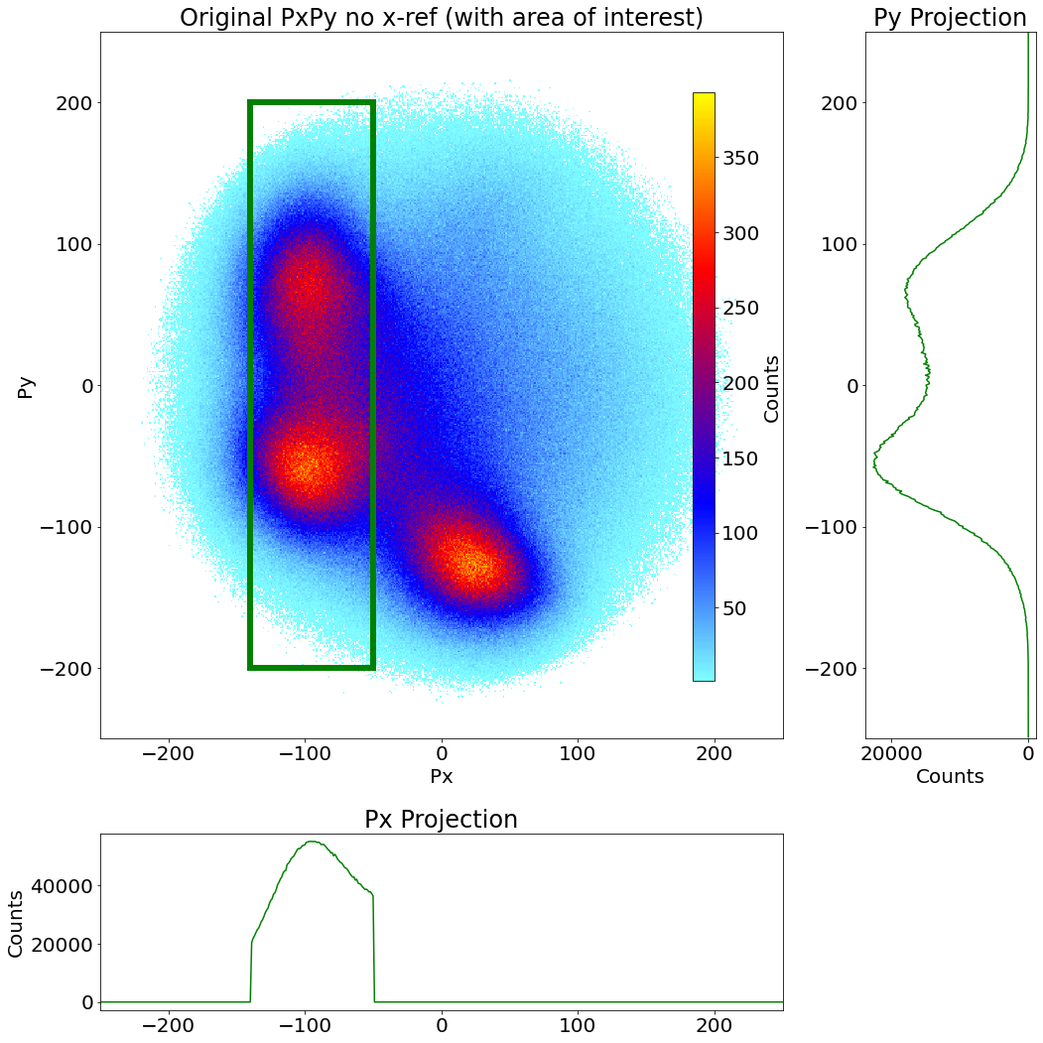
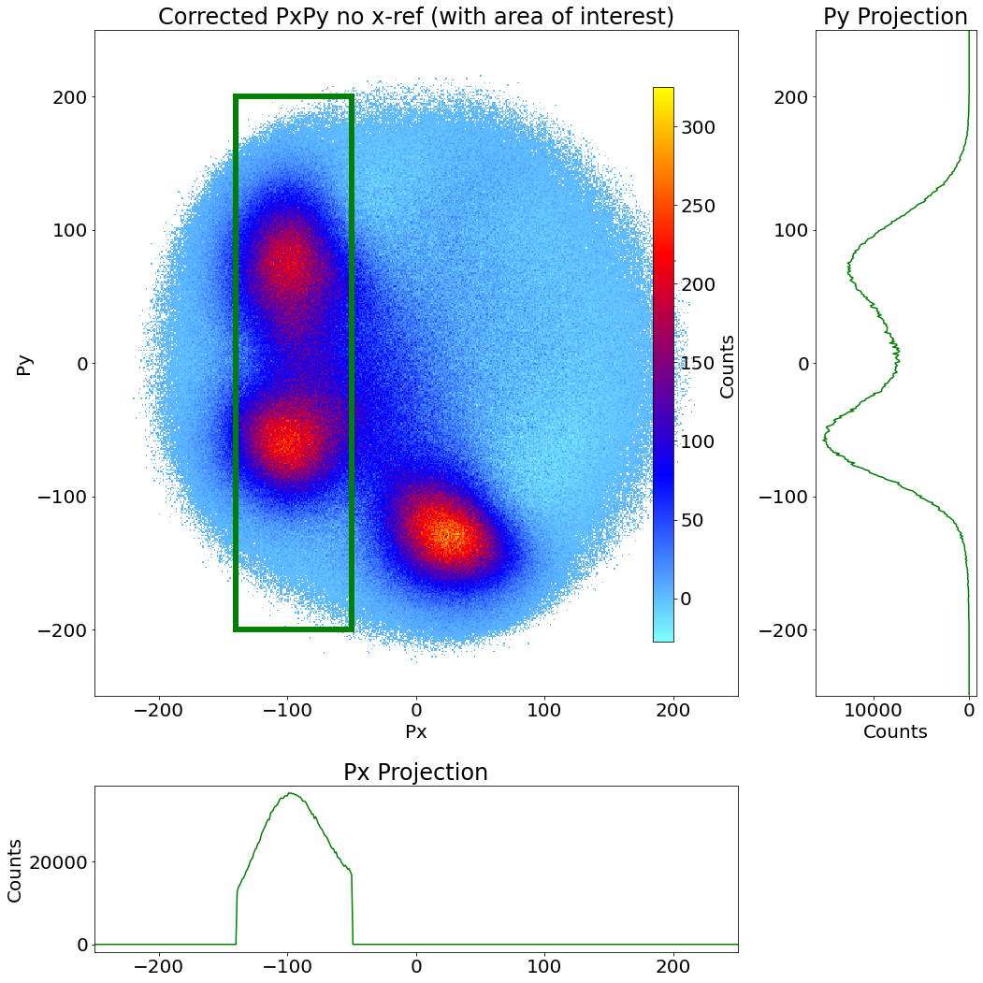
Projections in region where we want the peak to trough ratio

Slide 39
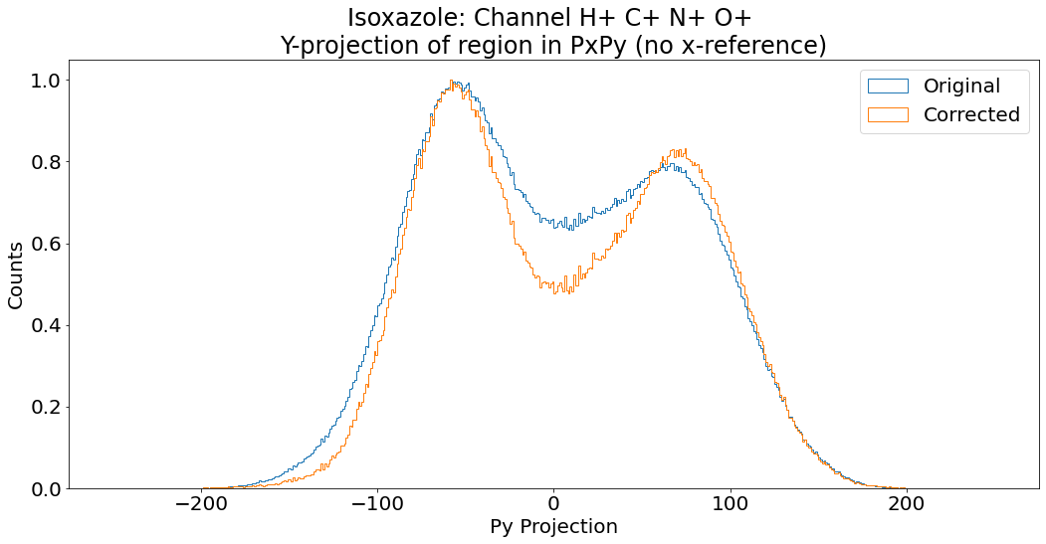
Normalized Py projection in region where we want the peak to trough ratio

Slide 40
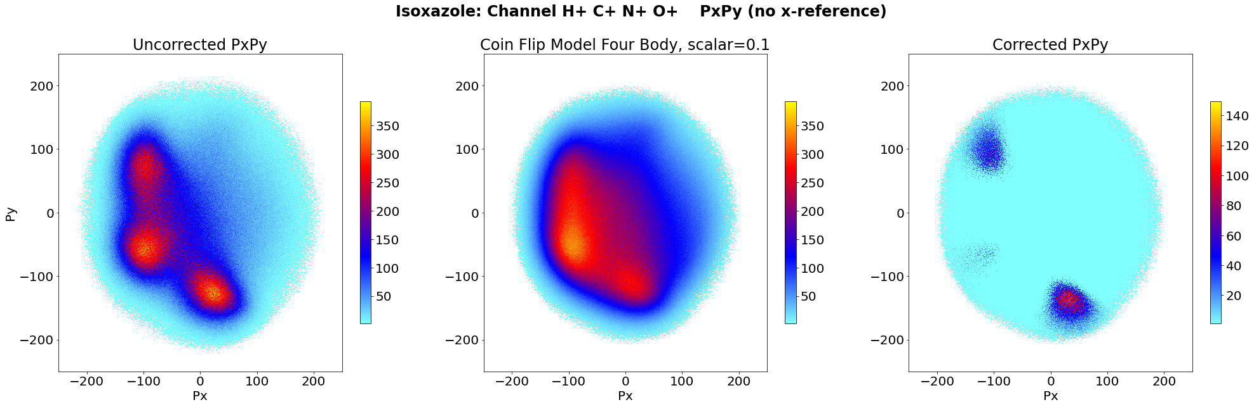
Over-Subtraction
Uncorrected Data Model “Corrected”
Subtracts too much and leave negative counts, which make no physical sense (points < 0 not plotted)

Slide 41
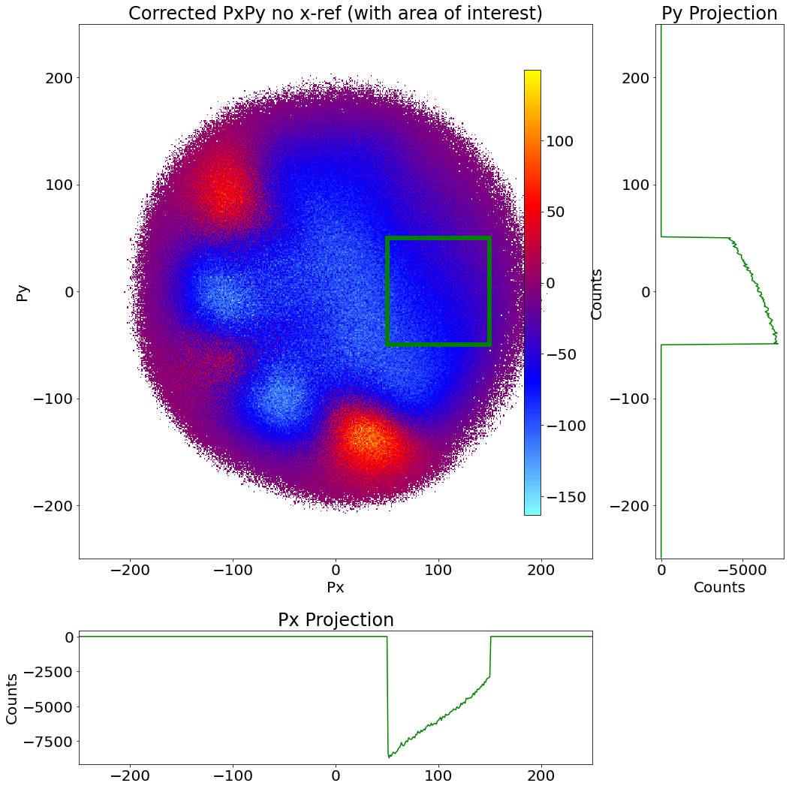
Plotting the negative counts, we see that there are regions with lots of negative points.
Scale down to reduce negative points

Slide 42
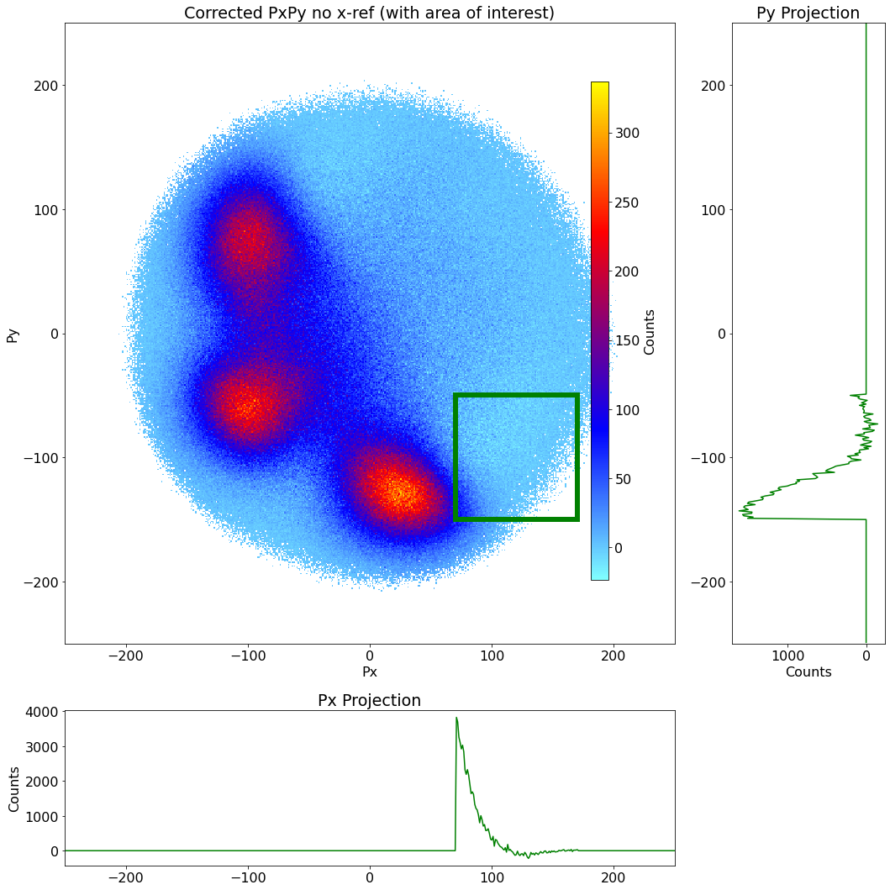
It’s okay if one tiny square is negative, so long as the average is ~0

Slide 43
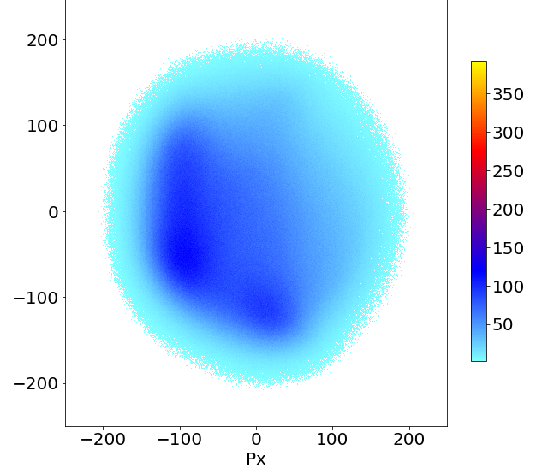
Scalar Change for Reduced Negatives
Scalar = 0.1, too much subtraction
Scalar = 0.0303, just enough

Slide 44
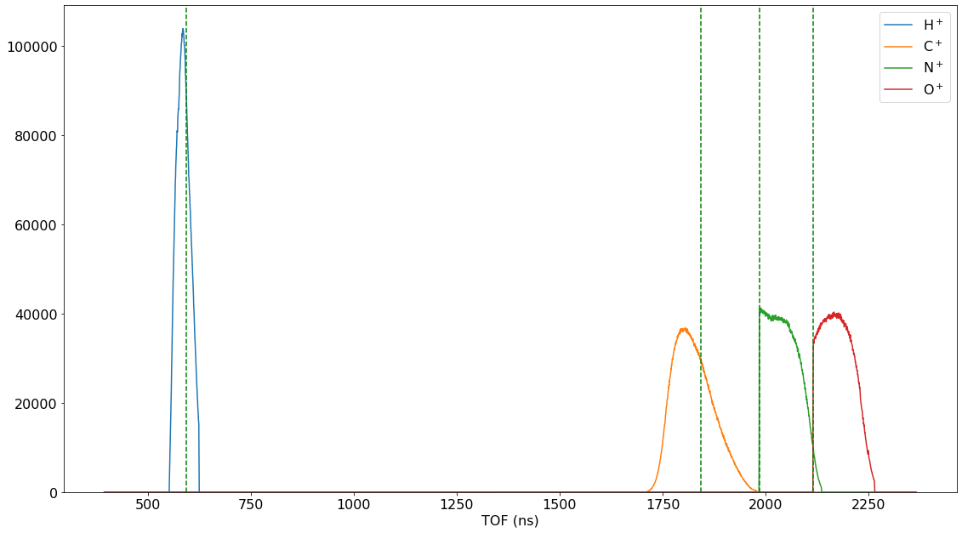
TOF Gating

Slide 45
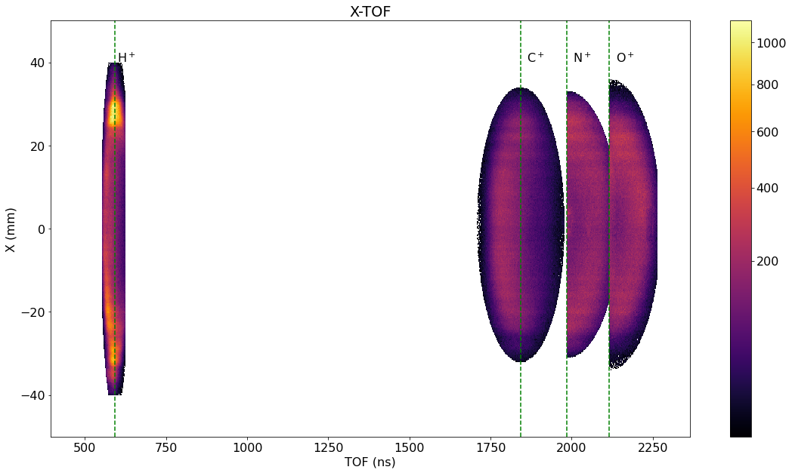
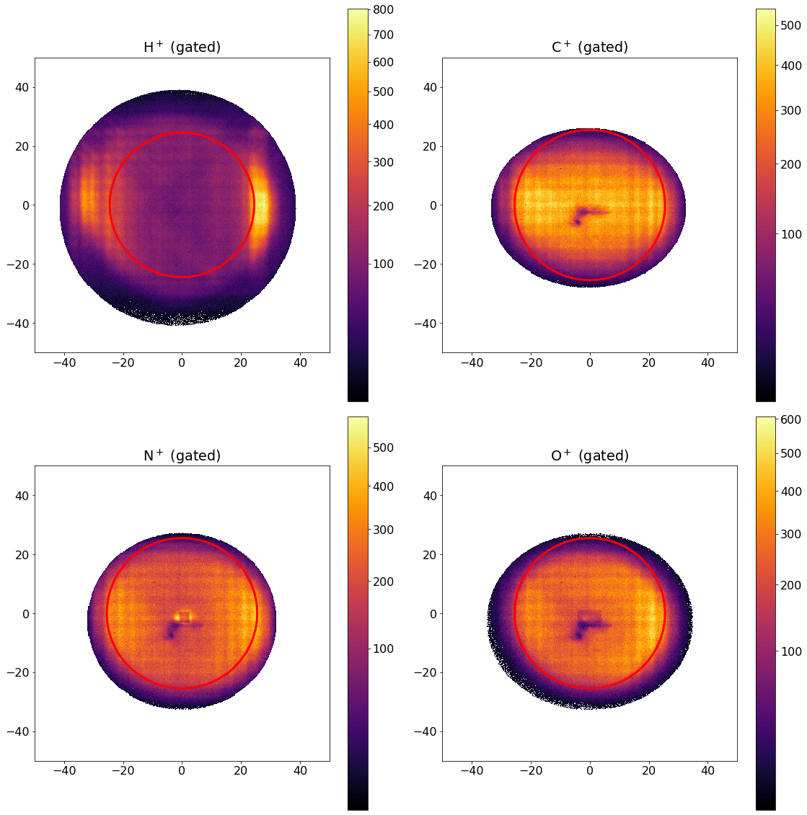
X and Y – TOF Gating

Slide 46
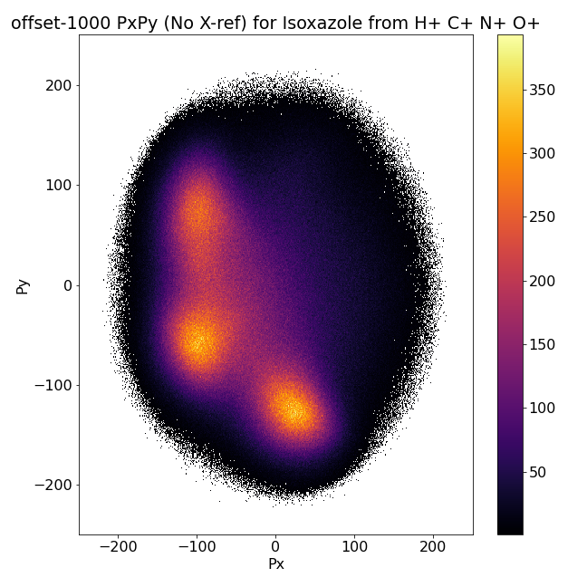
Hydrogen isn’t plotted, so don’t adjust it
Hydrogen isn’t plotted, so no adjustment is seen
Hydrogen Offset
Original
Notes:
Fix award statement
Say ty loren + kim
Bad permutations

