Slide 1
Sequential Double Ionization
of Ar to Ar2+ Over Intense Laser Field Pulses
Kansas State REU 2023; Professor C.D. Lin and Dr. Isaac Yuen
Kathryn Chain

Slide 2
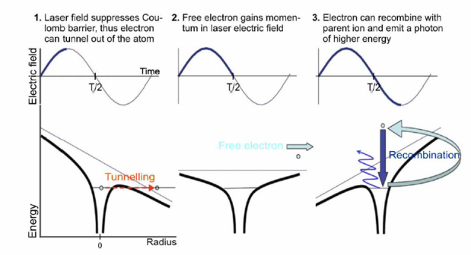
Three Step Model
2
Notes:
https://sciences.ucf.edu/physics/ultrafast/high-harmonic-generation/
https://iramis.cea.fr/LIDYL/en/Phocea/Vie_des_labos/Ast/ast_visu.php?id_ast=2881

Slide 3
Sequential Double Ionization
3
Notes:
https://sciences.ucf.edu/physics/ultrafast/high-harmonic-generation/
https://iramis.cea.fr/LIDYL/en/Phocea/Vie_des_labos/Ast/ast_visu.php?id_ast=2881

Slide 4
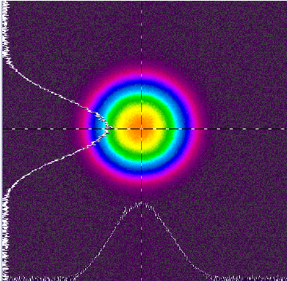
Laser Profiles
Intensities above 1x10¹⁵ W/cm² are too difficult to distinguish
We need a program to calibrate these profiles
4
Kim, Kyungbum, Peng, Xiang & Lee, Proceedings of SPIE - The International Society for Optical Engineering, (2014)
Notes:
1x10^16 times more powerful than the sun

Slide 5

Pathway from Ar to Ar2+
Electric Field >> Ionization Rate
1
Survival Factor >> Probability of Ionization
2
3
Ionization Rate >> Survival Factor
Determine probability of ionization given laser pulse parameters
Goal
GOAL
5

Slide 6
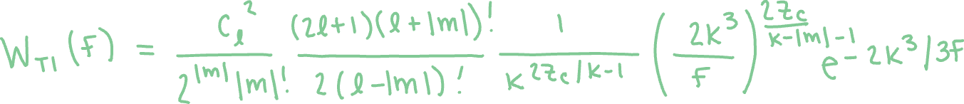

Step 1
Ammosov-Delone-Krainov theory plus modification:
6
Tong, X.M., Lin, C.D., Journal of Physics B: Atomic, Molecular, and Optical Physics. 2595 (2005)
Notes:
Perturbation theory does not work at high intensities, which is where SDI is, so need correction

Slide 7
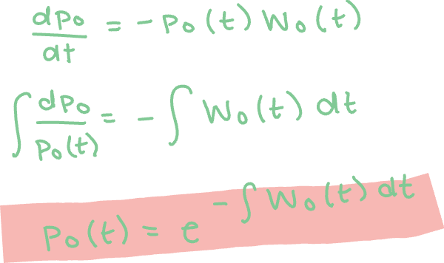
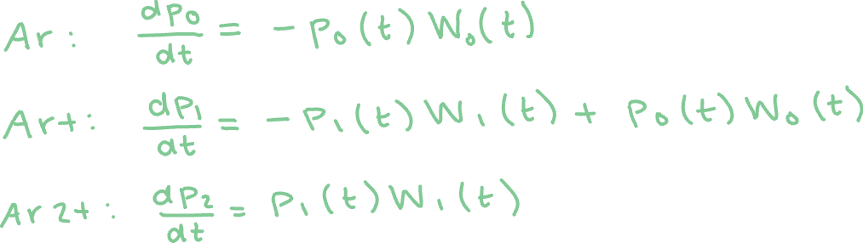
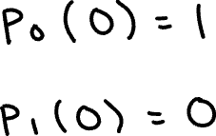
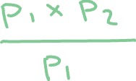
Step 2
Method 1
Method 2
7
Lin, C.D., Yuen, I., Physical Review 023120 (2022)
Notes:
W0: a=9 and Ip=0.579
W1: a=8 and Ip=1.016

Slide 8
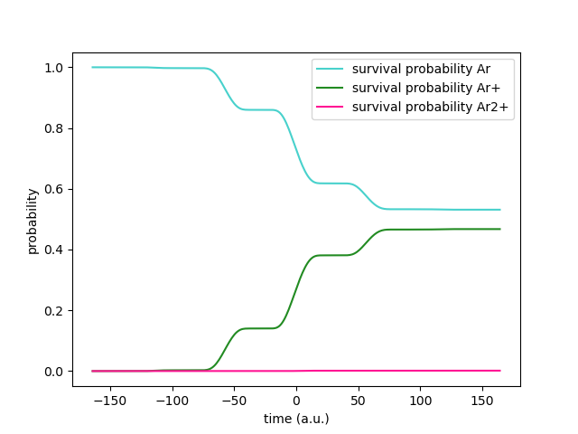

Step 2
8
Lin, C.D., Yuen, I., “Density-matrix approach for sequential dissociative double ionization of molecules” Physical Review 023120 (2022)
Notes:
Intensity = 7x10^14 W/cm^2

Slide 9
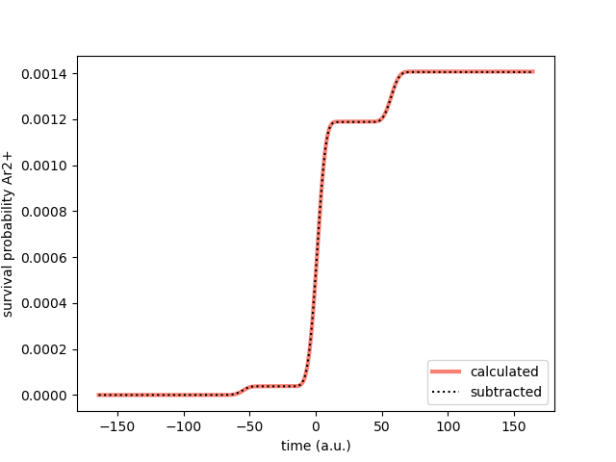
Step 2
9
Lin, C.D., Yuen, I., Physical Review 023120 (2022)

Slide 10
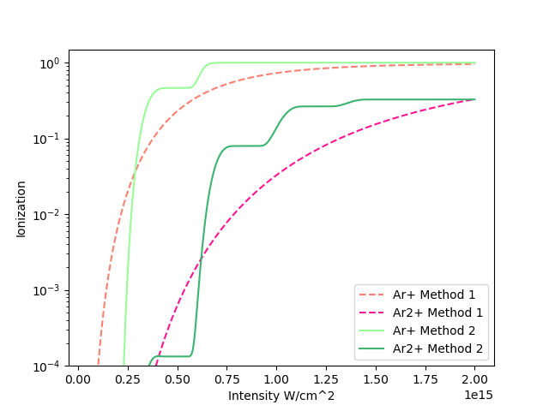
Step 3
What happens as we increase the intensity?
10
Kubel, M. et al. Physical Review A 053422-2 (2016)

Slide 11

Finish Line
I would tell you an ion joke...
but all the good ones Argon.
Goal: Determine probability of ionization given laser pulse parameters
Future Work:
Determine cause of error in Method 2
Test other parameters
Test other elements
11

Slide 12
Acknowledgements
Thank you to…
Kansas State University
National Science Foundation
Kim Coy, Dr. Loren Greenman, and Dr. J.T. Laverty
Chi Dong Lin and Isaac Yuen
This material is based upon work supported by the National Science Foundation under Grant #2244539 for support of the Kansas State University REU program. Any opinions, findings, and conclusions or recommendations expressed in this material are those of the author(s) and do not necessarily reflect the views of the National Science Foundation.
12

