Slide 1
Calculation of Ionization Asymmetries in Chiral Molecules
Corbin Allison

Slide 2
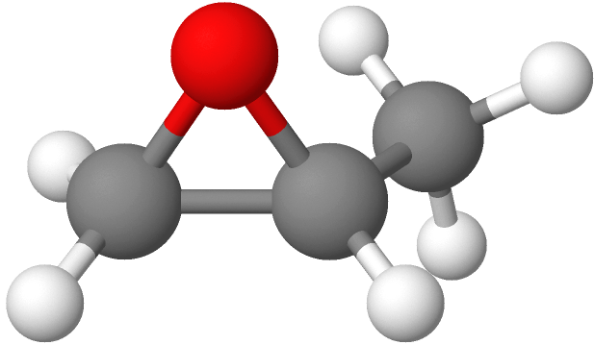
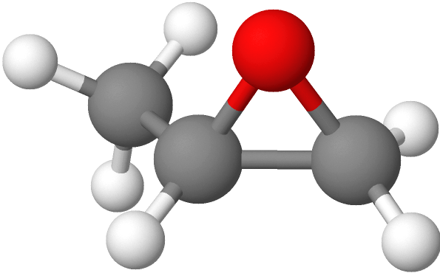
Chirality
A molecule that cannot be superimposed onto its mirror image
  Distinct images called enantiomers
R-enantiomer
S-enantiomer
Propylene oxide (methyloxirane), made with MolView

Slide 3

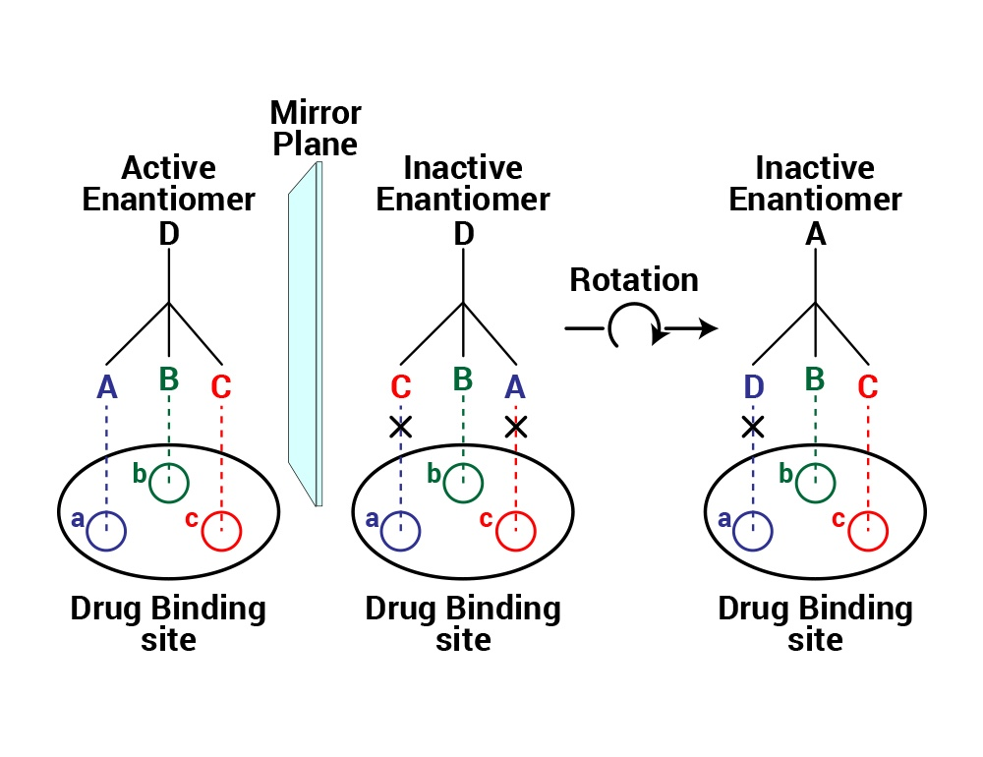
Chiral Analysis
Most biological molecules are chiral
Ratio of enantiomers in a solution (enantiomeric excess) can be vital for drug synthesis
Traditionally measured through absorption based measurements
  Relatively weak signal

Slide 4
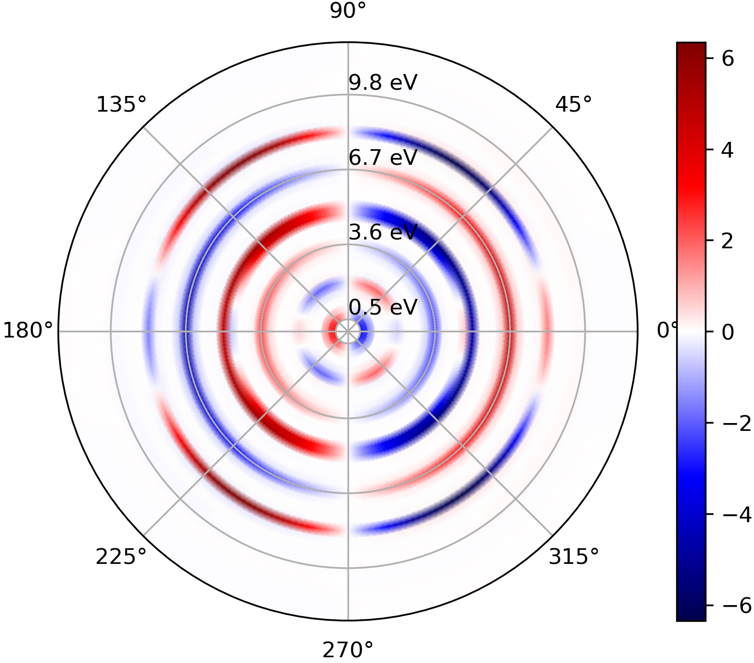
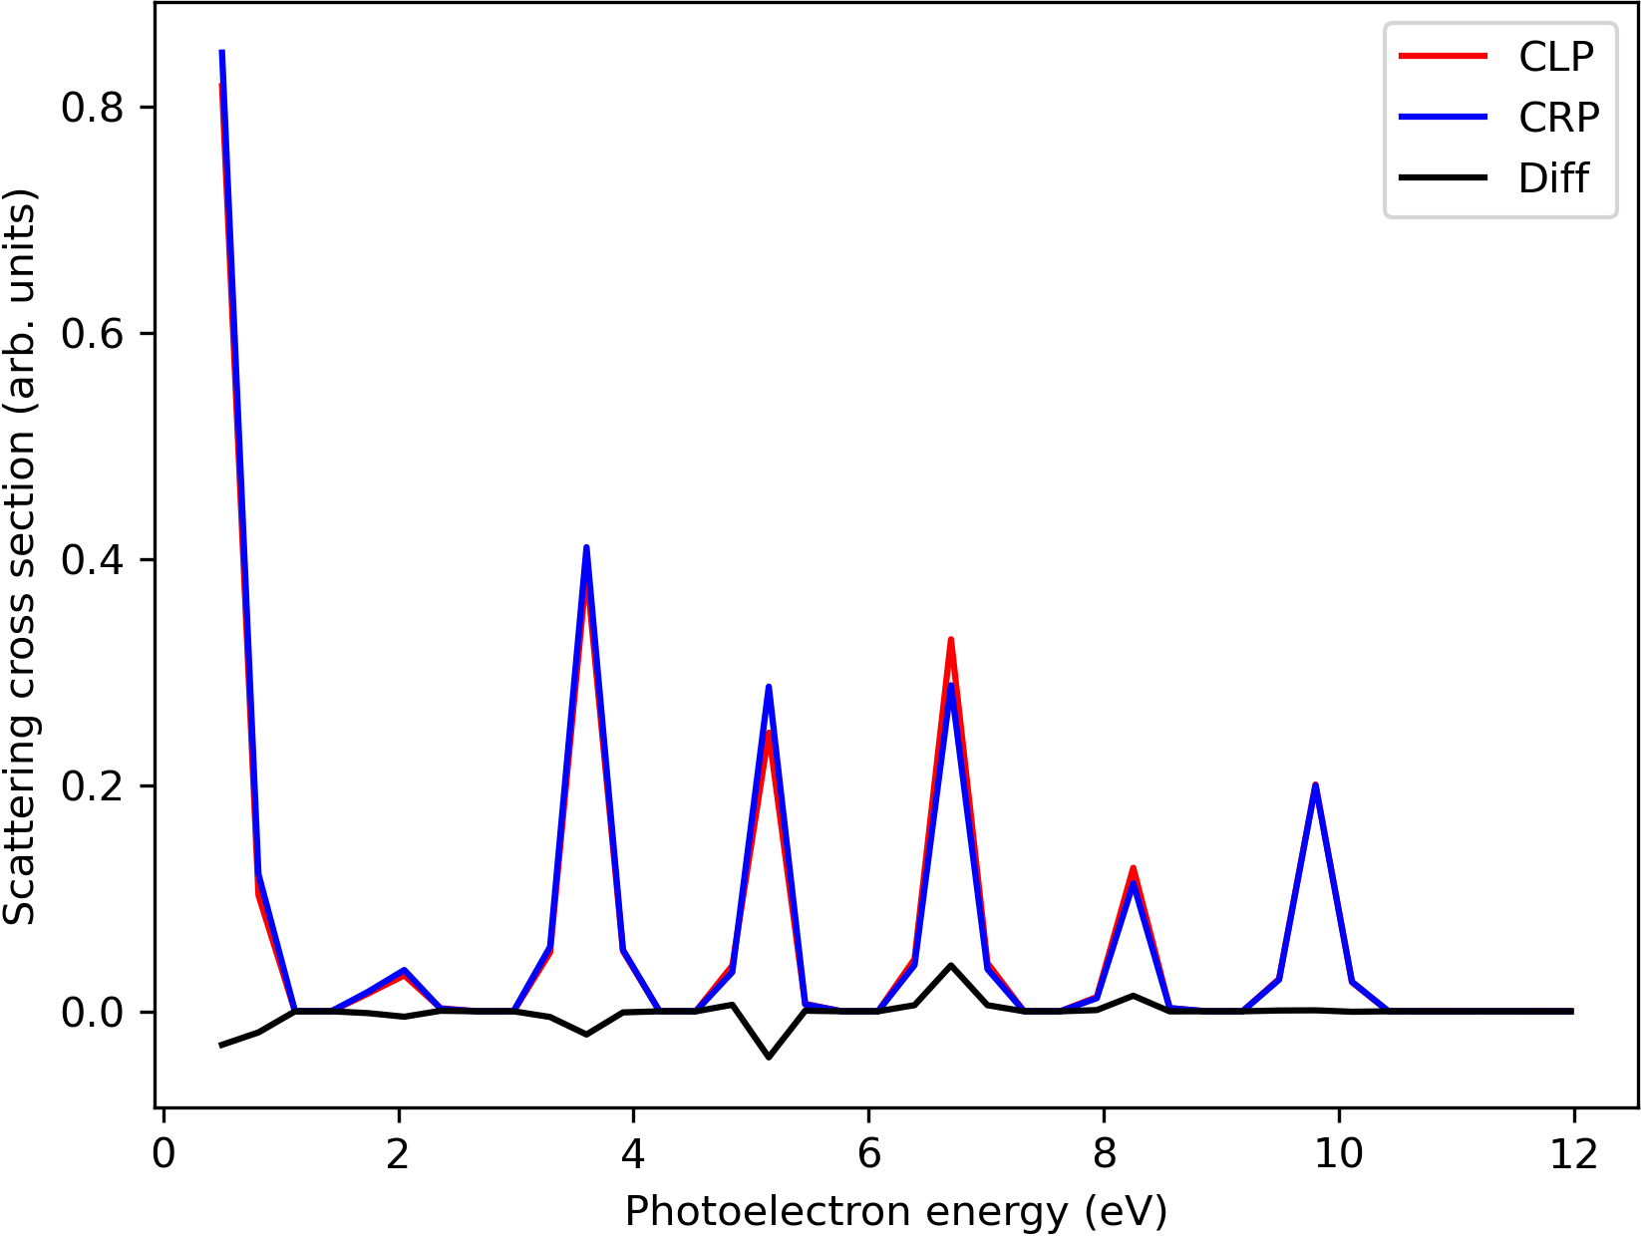
Photoelectron Circular Dichroism
Chiral molecules will interact differently with different polarizations of light
Circular dichroism: difference between interaction with CRP and CLP
PECD measures angular distributions of photoelectrons
(with normalization)

Slide 5
Calculating PECD
Quantum chemistry: used to obtain the molecular orbitals
Scattering calculation: describes continuum states after ionization
Time-dependent perturbation theory: describes interaction with time-dependent field
E
Electronic orbitals approximated as linear combination of Gaussians
Hartree-Fock calculation
Variational principle
Solves for coefficients in the N-electron wave function
Momentum distribution

Slide 6
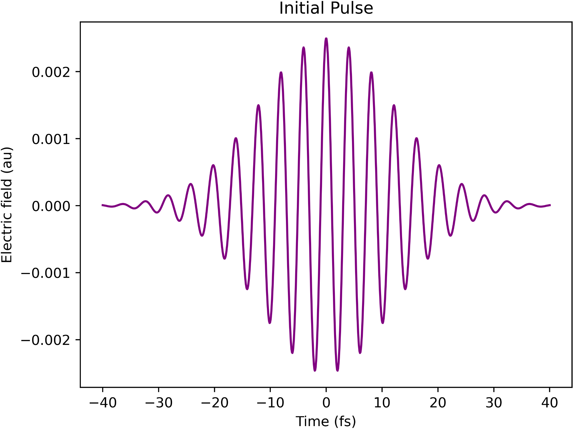
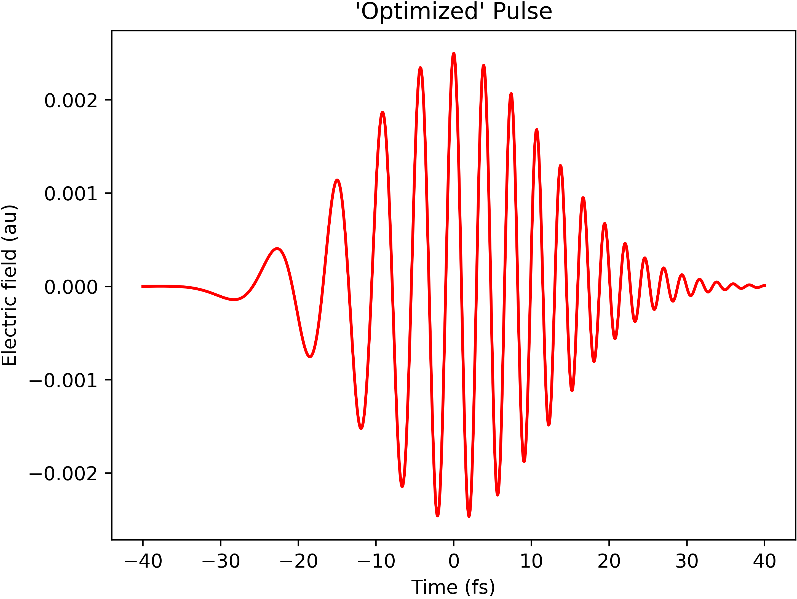
Quantum Control
The driving field parameters (frequency, amplitude, etc.) are optimized for maximal PECD yields

Slide 7
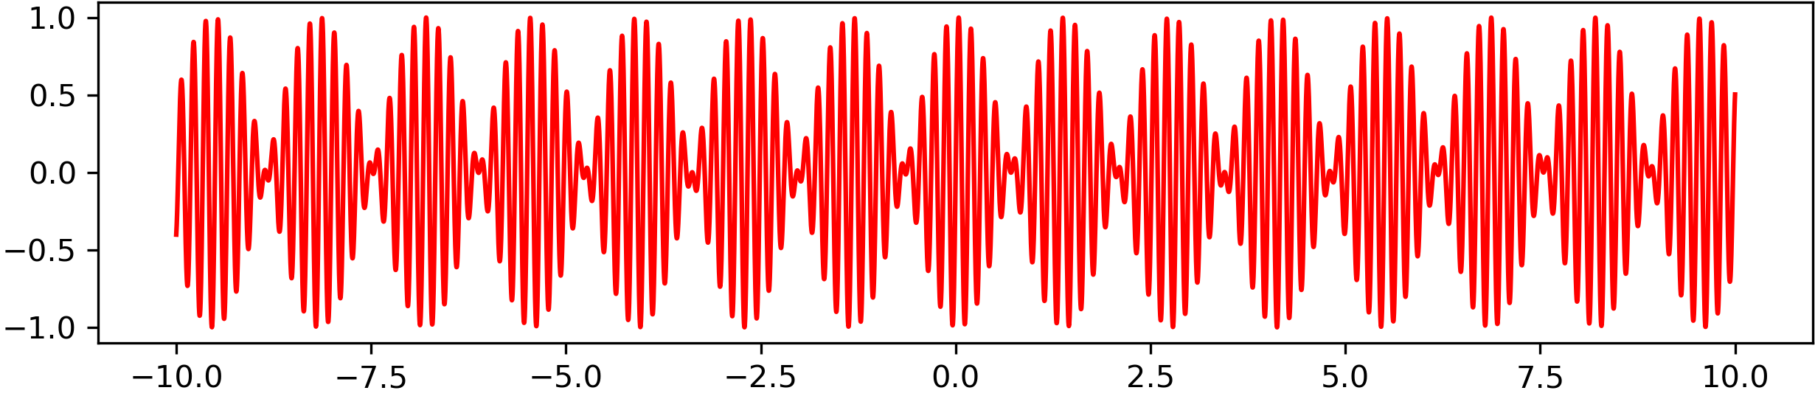
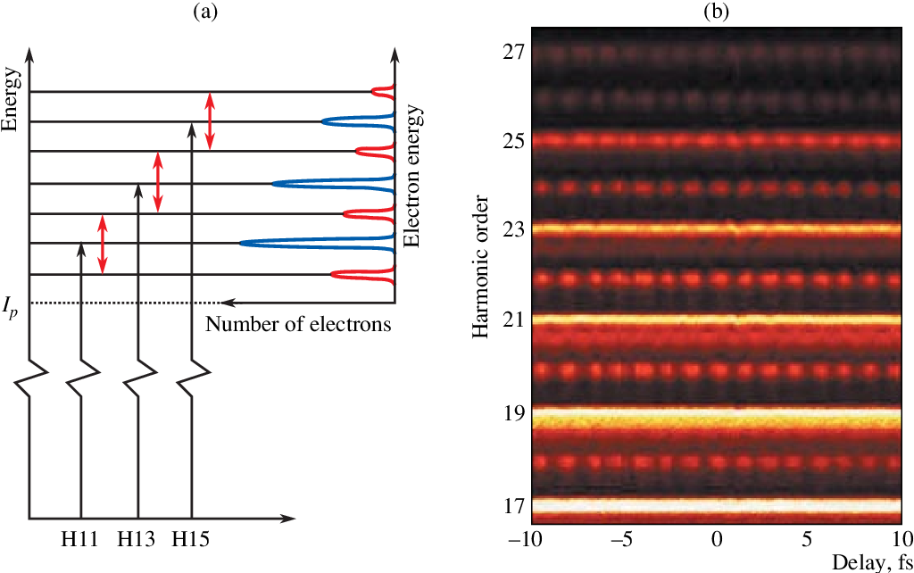
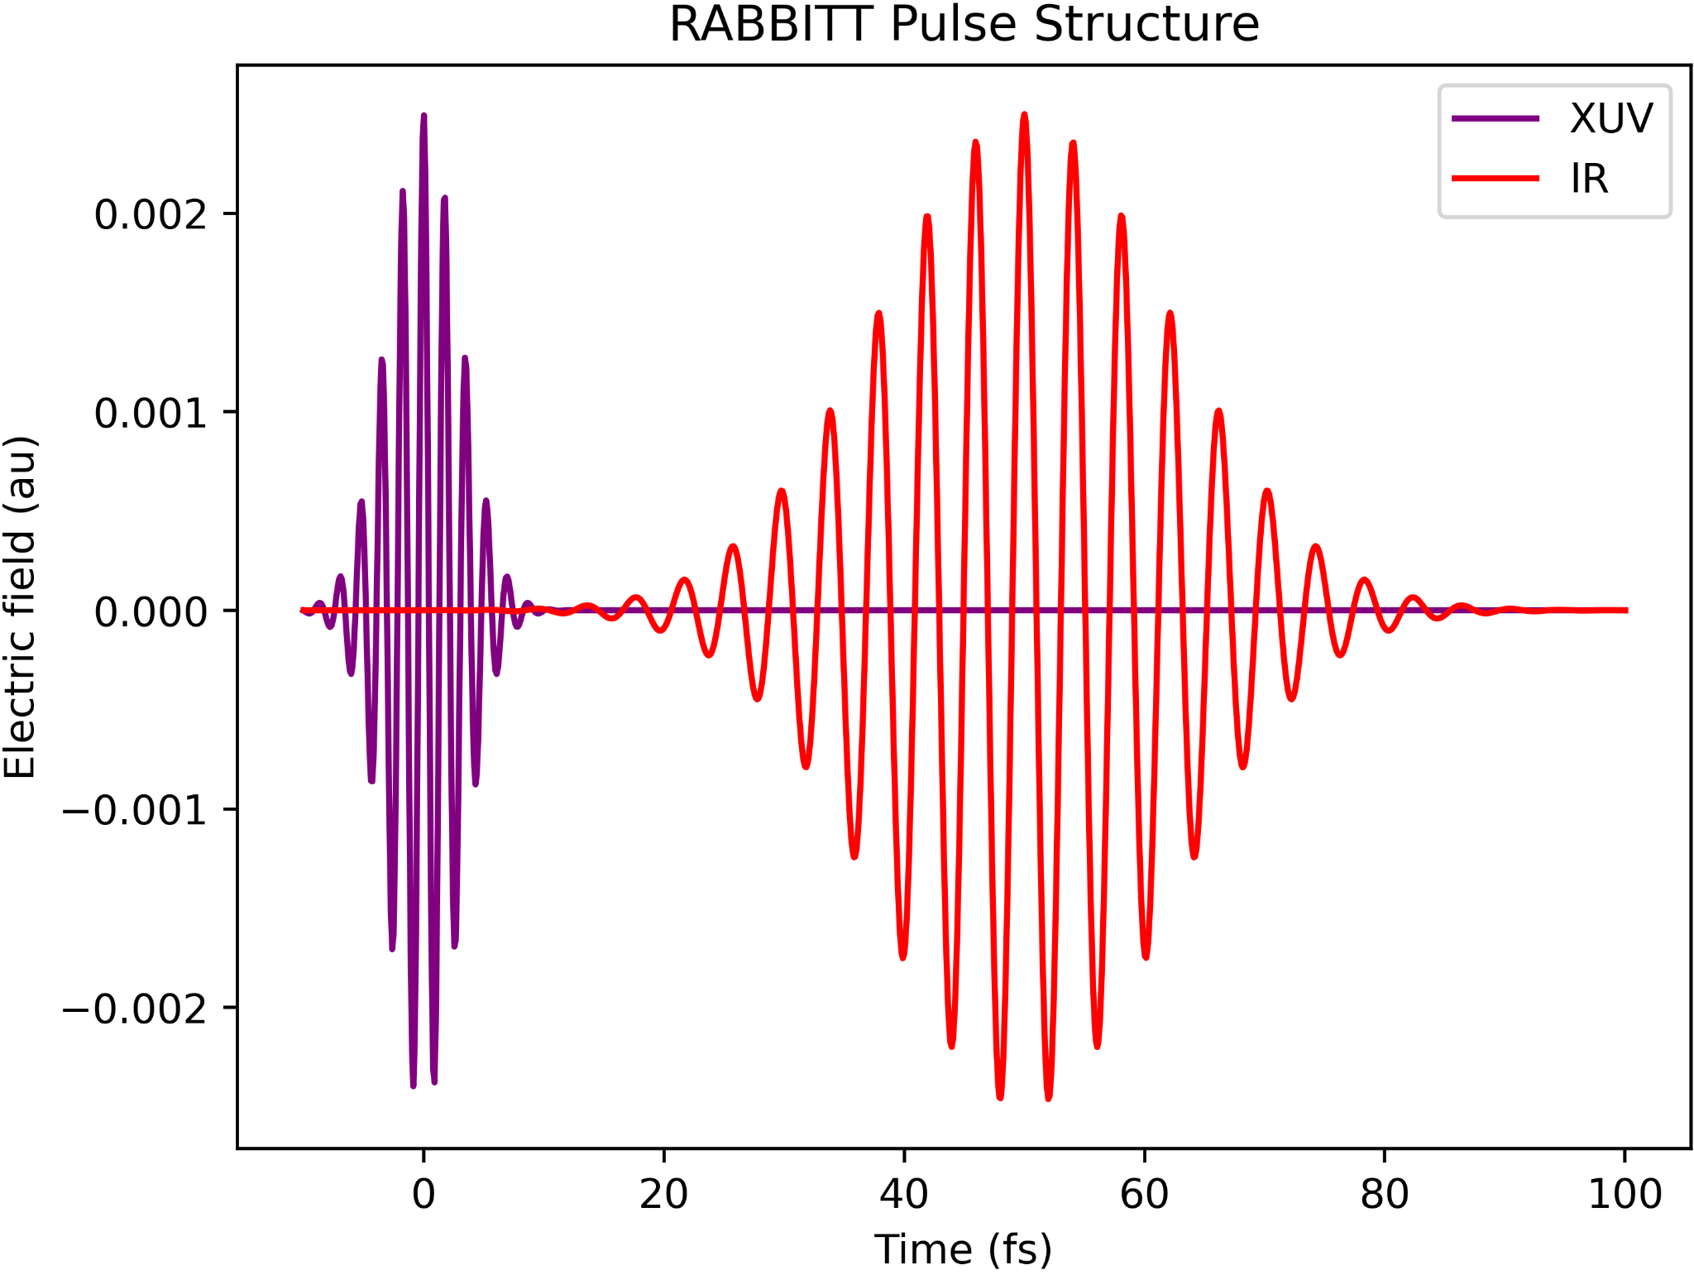
RABBITT
Allows control of experimentally attainable pulses through relative delay
K.Varj´u et al., LASER PHYSICS (2005)

Slide 8
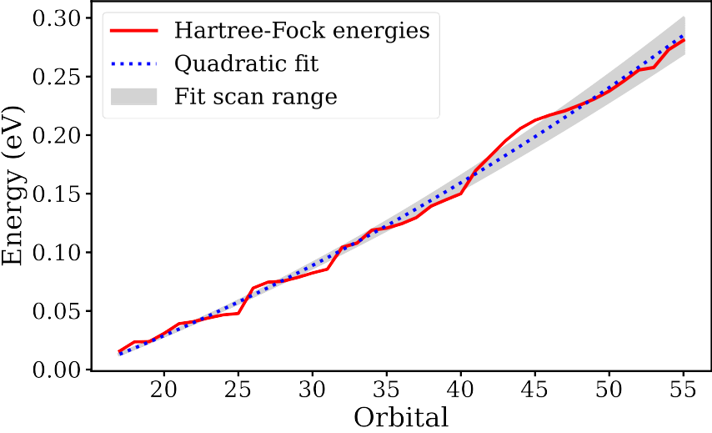
Quantum Chemistry Sensitivity
Determine robustness of calculation
Virtual orbital energies from quantum chemistry are fit using linear and quadratic fit
  Anisotropy parameters, PECD calculated as function of varying fit parameters
Imaginary components are also added

Slide 9
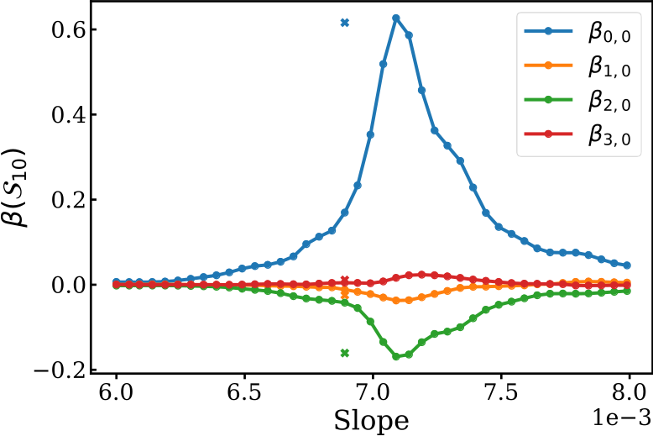
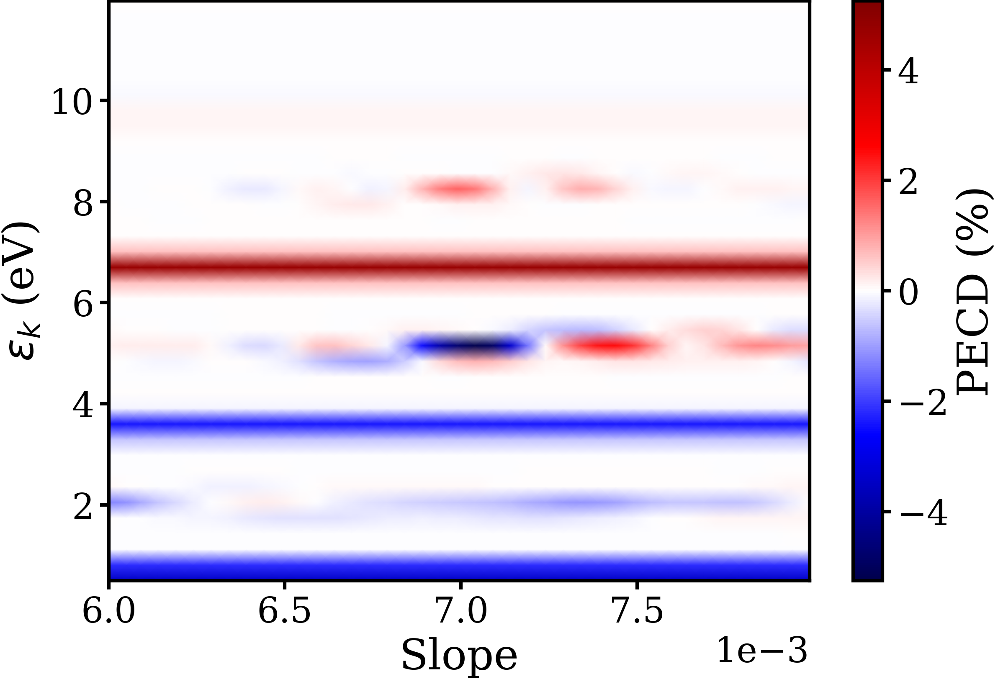
Slope Fit
Direct HF
energies

Slide 10
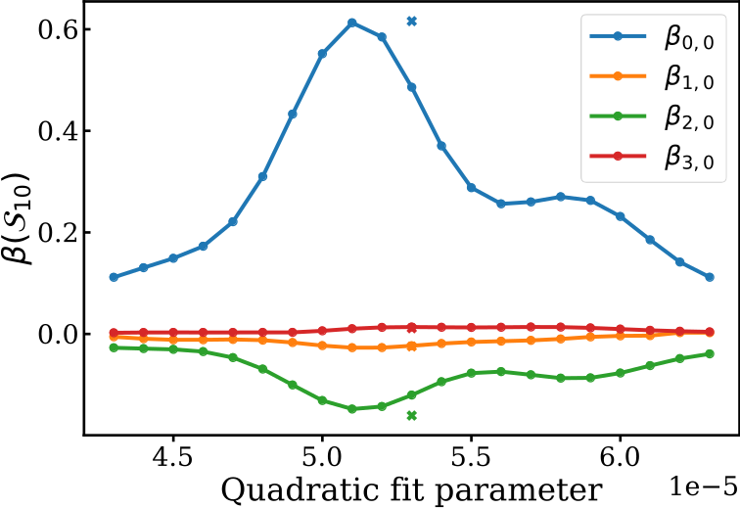
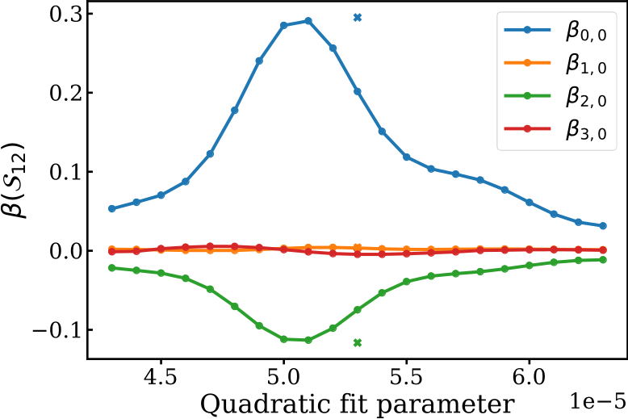
Quadratic Fit

Slide 11
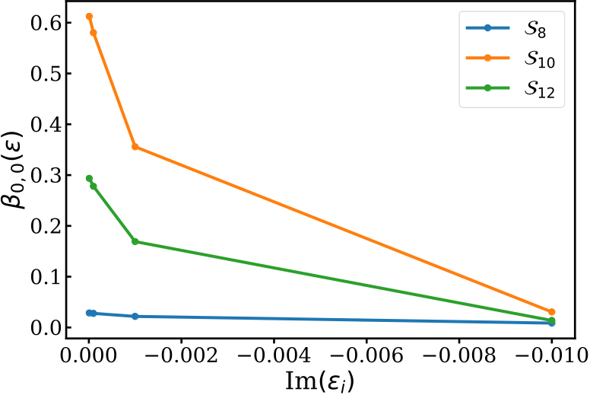
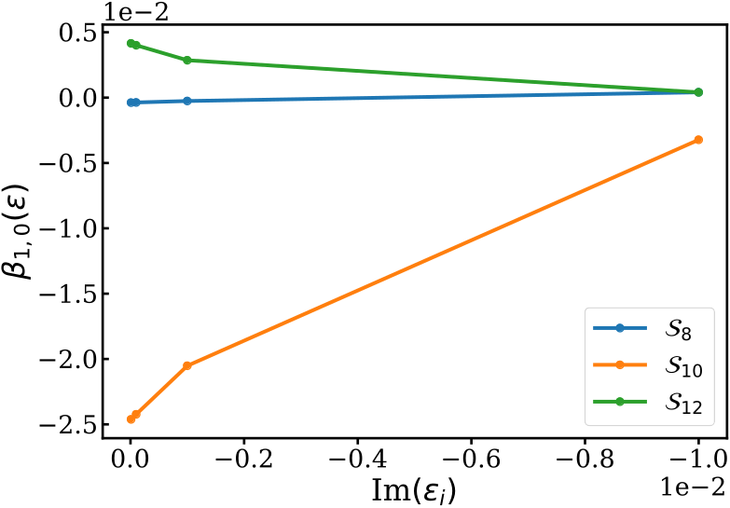
Complex

Slide 12
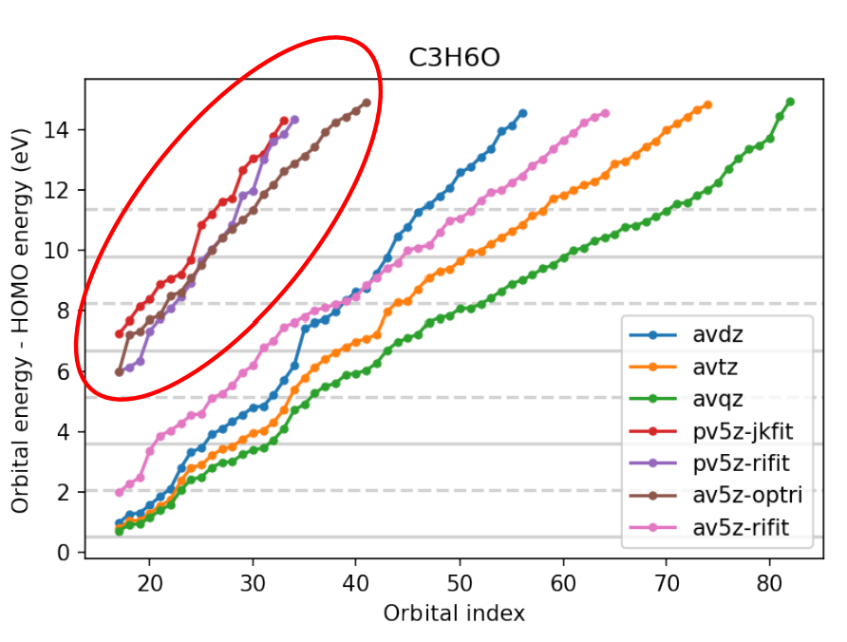
Conclusions
PECD signals in RABBITT sidebands are sensitive to virtual orbital energies
Sensitivity is present in anisotropy parameters
Imaginary parts can be added to damp anisotropy parameters

Slide 13

Acknowledgements
- Kim Coy, Loren Greenman, JT Laverty, and the NSF
- Kansas State University
Our collaborators:
  UConn: E Goetz
  Freie Universitat Berlin: C Koch and A Blech
  ETH Zürich: M Han, HJ Wörner, and JB Ji
This material is based upon work supported by the National Science Foundation under Grant No. #2244539. Any opinions, findings, and conclusions or recommendations expressed in this material are those of the author(s) and do not necessarily reflect the views of the National Science Foundation.
Computations for this project were performed on Beocat Research Cluster at Kansas State University, and used resources of the National Energy Research Scientific Computing Center (NERSC)

