Slide 1
Measuring Pulse Width with an Autocorrelator
Katya Mikhailova, Mentor: Daniel Rolles
Funded by NSF

Slide 2
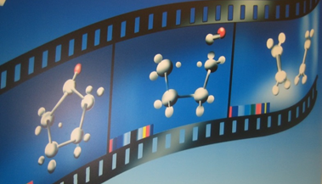
Introduction
Background/Motivation
Goal: create molecular movies of light-induced molecular reactions to be able to visualize the dynamics of the reaction
How: use a femtosecond laser pulses to trigger the reaction and take snapshots of the reaction
  pump-probe experiment

Slide 3
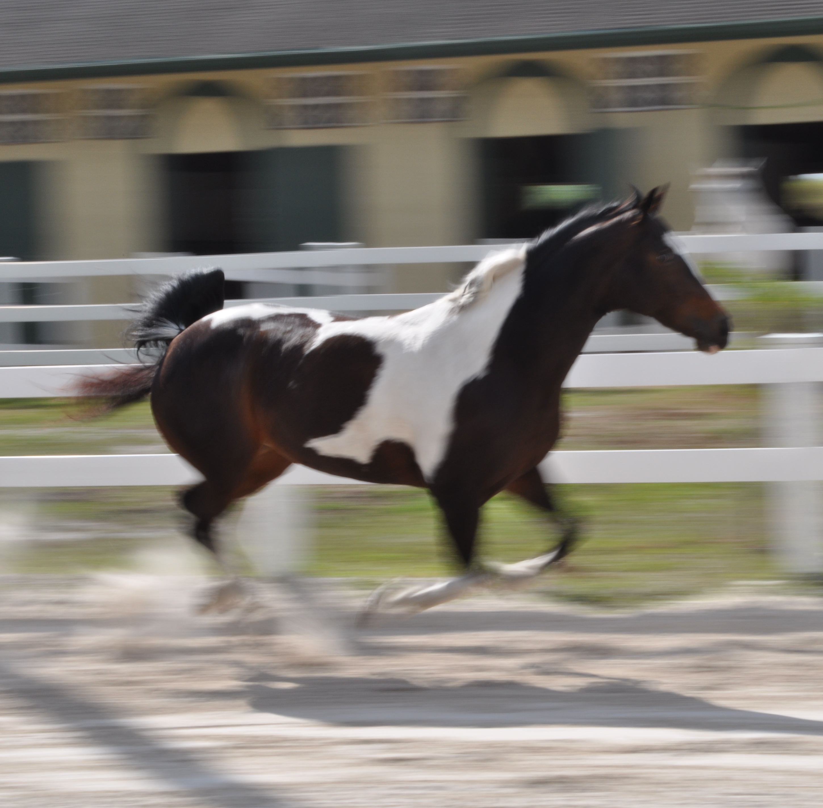
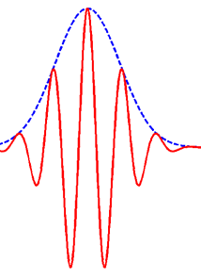
Introduction
Pulse Width
Important to characterize the pulse duration
  “shutter speed”
  laser pulse reference
Can be measured using an autocorrelator setup
  why use an autocorrelator?
[1]
Notes:
detector is delay line anode

Slide 4
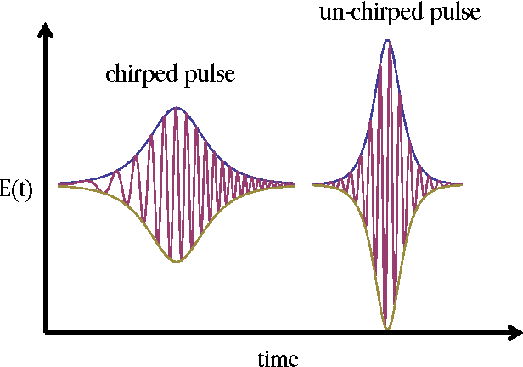
Introduction
Chirp
Time dependent wavelength
Causes inaccurate pulse width measurements in autocorrelator
Want to be able to detect if a pulse is chirped
[2]
Notes:
detector is delay line anode

Slide 5
Autocorrelator Setup
delay stage
move delay stage to change if pulses overlap in crystal
pump
probe
spectrometer detects the probe byproduct
non-linear process in crystal “uses up” some of the probe
crystal
spectrometer
Notes:
detector is delay line anode

Slide 6
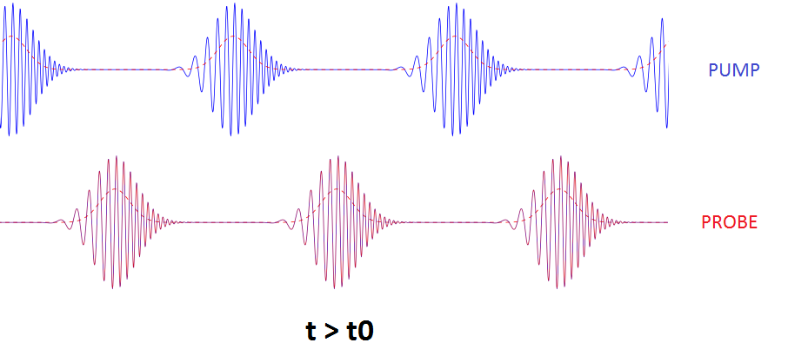
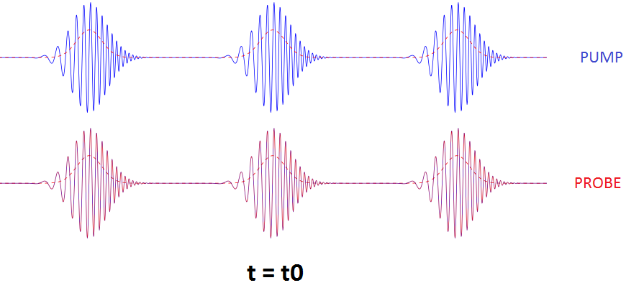
How to Get Pulse Width
Step 1) Find time zero
what is time zero?
Notes:
detector is delay line anode

Slide 7
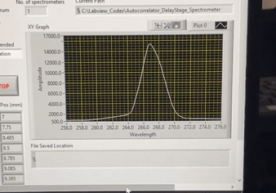
How to Get Pulse Width
Step 1) Find time zero
spatial overlap by aligning optics
temporal overlap by moving delay stage
will see max depletion
spectrometer signal
Notes:
detector is delay line anode

Slide 8
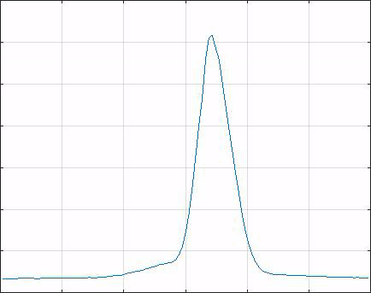
How to Get Pulse Width
Step 2) Take measurements
take measurements at different delays moving through time zero
take multiple runs
Amplitude
250 255 260 265 270 275 280
Wavelength
Notes:
detector is delay line anode

Slide 9
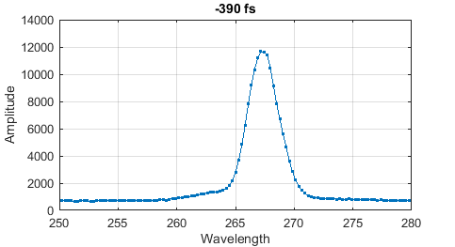
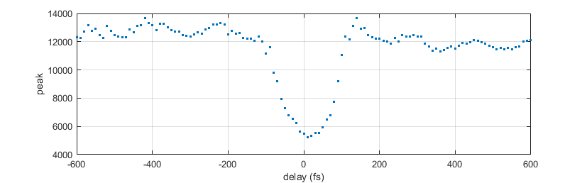
How to Get Pulse Width
Step 3) Analyze data
plot sum of spectra over region vs delay
  can use peaks
Notes:
detector is delay line anode

Slide 10
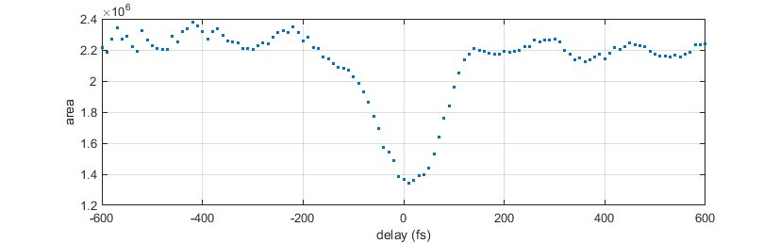
How to Get Pulse Width
Step 3) Analyze data
plot sum of spectra over region vs delay
  can use peaks
  or area
Notes:
detector is delay line anode

Slide 11
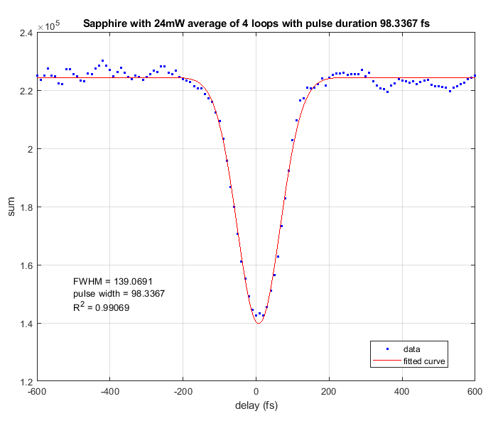
How to Get Pulse Width
Step 3) Analyze data
plot sum of spectra over region vs delay
  can use peaks
  or area
fit a gaussian to deconvolute and get pulse width
Notes:
detector is delay line anode

Slide 12
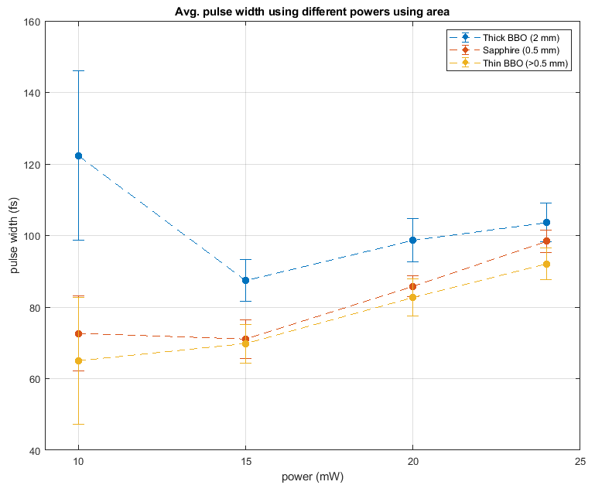
FLAME 266 nm Uncompressed
Crystal type
can analyze different powers and different crystals
look into band gap of different crystals
thicker crystals have greater PW
increase in PW with power
Notes:
detector is delay line anode

Slide 13
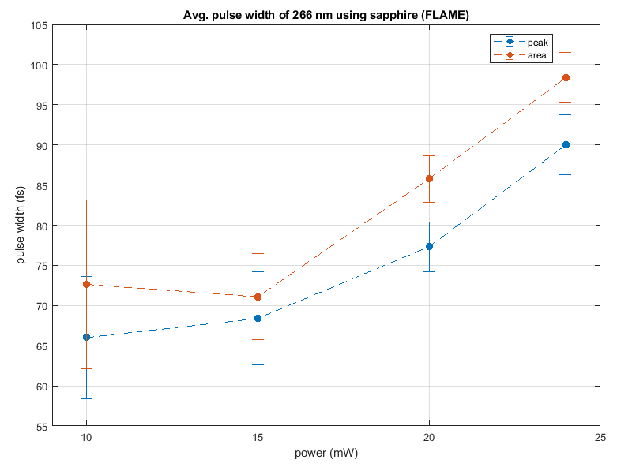
FLAME 266 nm Uncompressed
Peak vs Area
can analyze different powers and using peak vs area values
Difference appears to be within error
  about 10 fs
Notes:
detector is delay line anode

Slide 14
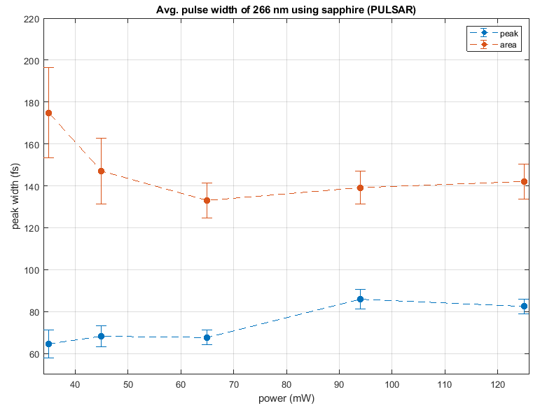
PULSAR 266nm Uncompressed
Peak vs Area
see a huge difference between the area and peak measurements
  50 fs to 100 fs difference
Area starts depleting before peak
  chirp?
Notes:
detector is delay line anode

Slide 15
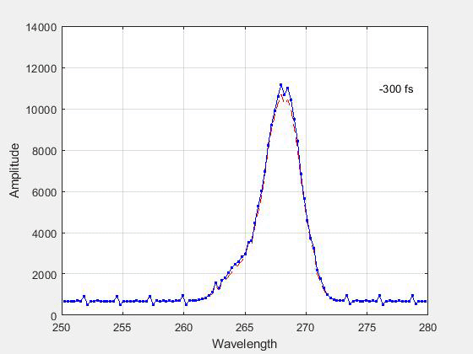
PULSAR 266nm Uncompressed
Chirp Evidence in Spectrometer Data
can see the peak shift as the different wavelengths come in at different speeds
  higher wavelengths faster
follow the outline of the average spectra shape
Notes:
detector is delay line anode

Slide 16
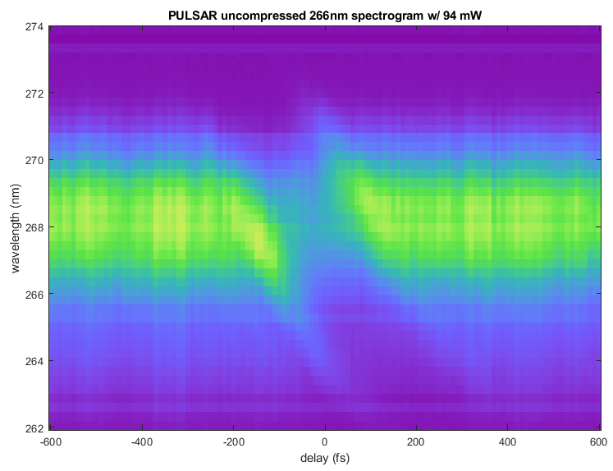
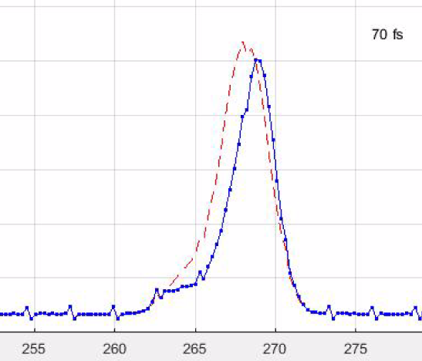
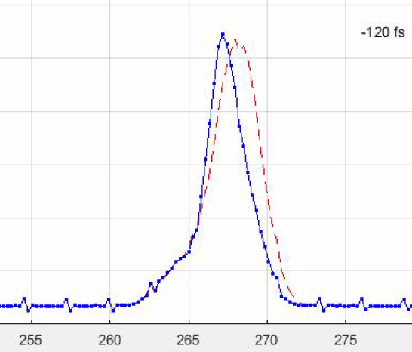
PULSAR 266 nm Uncompressed
Autocorrelator 2D Spectrogram
Peak shifted to higher wavelength
Peak shifted to lower wavelength
clearly see a diagonal signature in the depletion
clearer visual of chirped pulse
Notes:
detector is delay line anode

Slide 17
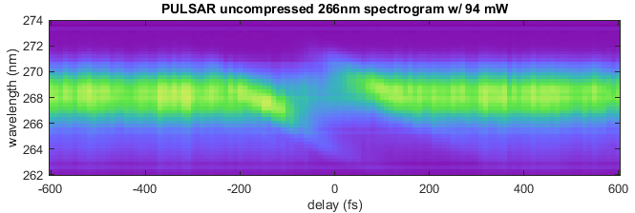
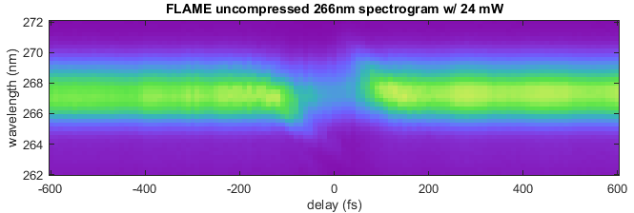
PULSAR 266nm vs FLAME 266nm Spectrogram
clearly see a diagonal signature in the depletion
  Expect vertical slope when unchirped
the FLAME data appears to have less of a slope compared to PULSAR
PULSAR
FLAME
Notes:
detector is delay line anode

Slide 18
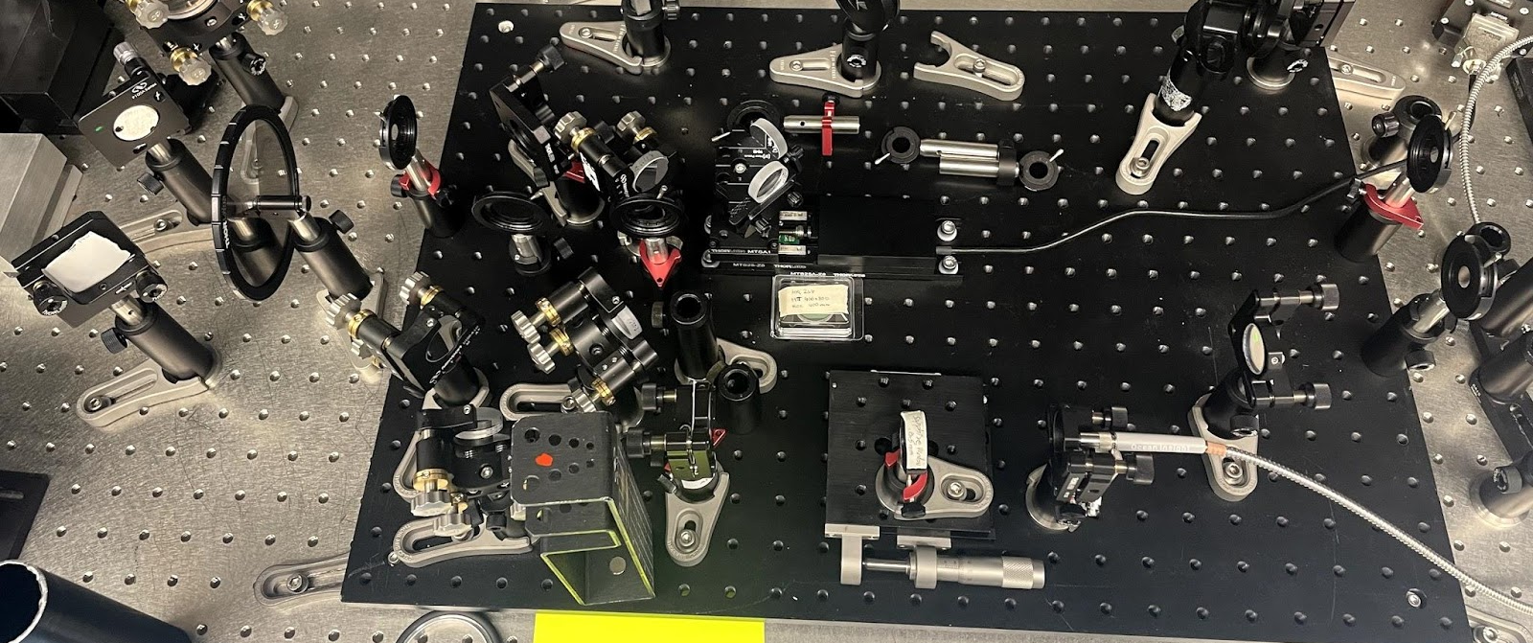
Conclusion
The autocorrelator is a promising method for measuring pulse width
Can be used as a chirp detection tool
  Literature shows can extract FROG traces
Future work: implementing noise/background subtraction techniques

Slide 19



Acknowledgements
Daniel Rolles
Zane Phelps
Surjendu Bhattacharyya
Anbu Venkatachalam
James R. Macdonald Laboratory
Kansas State University
National Science Foundation

Slide 20
Thank you for your time! Questions?

Slide 21
References
Homann, C., Krebs, N. & Riedle, E. Convenient pulse length measurement of sub-20-fs pulses down to the deep UV via two-photon absorption in bulk material. Appl. Phys. B 104, 783 (2011). https://doi.org/10.1007/s00340-011-4683-0
[2] Hoyt, C., A. Schaffer, C. Fredrick, N. Parks, A. Thomas, D. Mohr and R. Jones. “Ultrafast Optics with a Mode-locked Erbium Fiber Laser.” (2015).
K. Ogawa and M. D. Pelusi. High-sensitivity pulse spectrogram measurement using two-photon absorption in a semiconductor at 1.5-µm wavelength. Opt. Express 7, 135-140 (2000).
https://doi.org/10.1364/OE.7.000135
[1] Peng, Jiahui. “Tunable Femtosecond Pulse Generation and Applications in Raman Micro-Spectroscopy.” (2021).
Trebino R., Zeek E. The Autocorrelation, the Spectrum, and Phase Retrieval. In: Frequency-Resolved Optical Gating: The Measurement of Ultrashort Laser Pulses. Springer, Boston, MA (2000). https://doi.org/10.1007/978-1-4615-1181-6_4
Paschotta, Rudiger. Chirp. RP Photonics. https://www.rp-photonics.com/chirp.html
Paschotta, Rudiger. Autocorrelators. RP Photonics. https://www.rp-photonics.com/autocorrelators.html

Slide 22
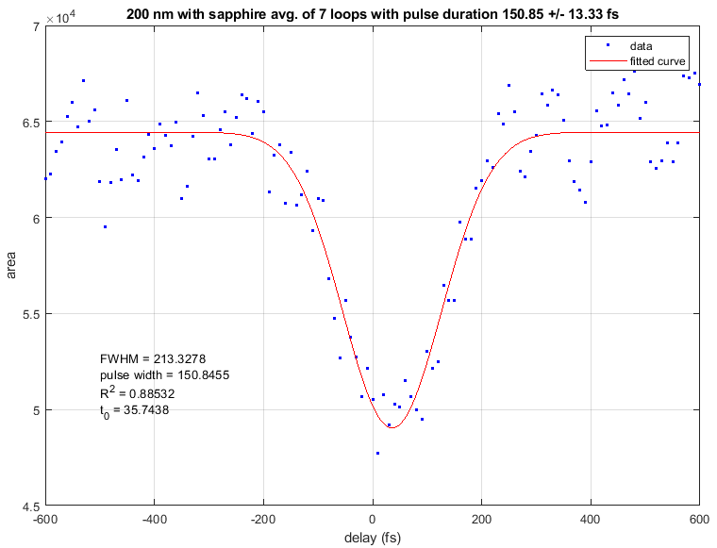
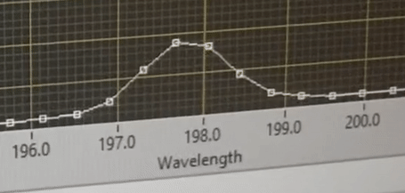
Pulse Width for 200 nm from PULSAR
Pulse Width (PW) Measurement
get PW of 151 +/- 13 fs
  expect 140 fs
very noisy
Notes:
detector is delay line anode

