Slide 1
Faraday Rotation of Gold Nanoparticles
By Christopher Ramirez
Mentored Dr. Viktor Chikan
Kansas State University
Summer 2013 Research Experience for Undergraduates

Slide 2
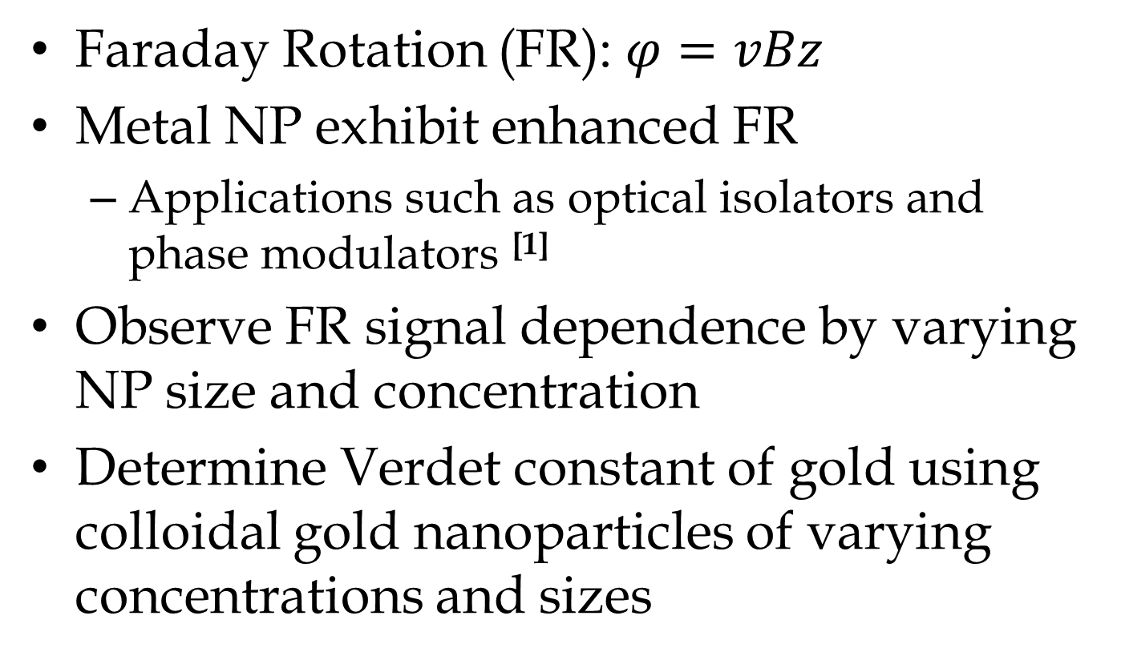
Motivation
Faraday Rotation (FR): $φ=vBz$
Metal NP exhibit enhanced FR
Applications such as optical isolators and phase modulators ^{[1]}
Observe FR signal dependence by varying NP size and concentration
Determine Verdet constant of gold using colloidal gold nanoparticles of varying concentrations and sizes
Notes:
Faraday rotation is the magneto-optical phenomenon in which the plane of polarization of light is rotated as it travels through a medium which is parallel to an external magnetic field
Although all transparent materials exhibit FR (including water and air), metal NP show a greater signal, partly due to the delocalization of their electrons. When induced by EM radiation, these electrons become a plasma which—when excited resonantly—can create propagating plasma waves.

Slide 3
How Faraday Rotation Works
k_{R}
k_{L}
Linearly polarized
k_{L} - left-circularly polarized EM vector
k_{R} - right-circularly polarized EM vector
Equal in magnitude and phase
dɸ
k_{R}
k_{L}
FR occurs results from phase difference
Birefringent material – index of refraction depends on propagation direction of light
Notes:
Verdet constant is wavelength-dependent function unique for every dielectric material
Birefringent material is a substance which has a different refractive index for different polarizations of light
Birefringent material – EM-induced plasma electron cloud that surrounds gold nanoparticles

Slide 4
Setup Schematic View
I
I
x
u
z
To spectrograph
v
y
w
Light source
Linear polarizer
Cell containing NP solution
Solenoid
Analyzer
Light collector
Notes:
White light source containing wavelengths including UV
Linear polarizer
Size of cell is important because of phi = vBz
Solenoid connected to capacitor which provides 6,000 V
Analyzer, without which we could not calculate the change in intensity
Light collector, CCD which spits out data
NB: we have a couple lenses in between to focus, but this is a simplified view

Slide 5
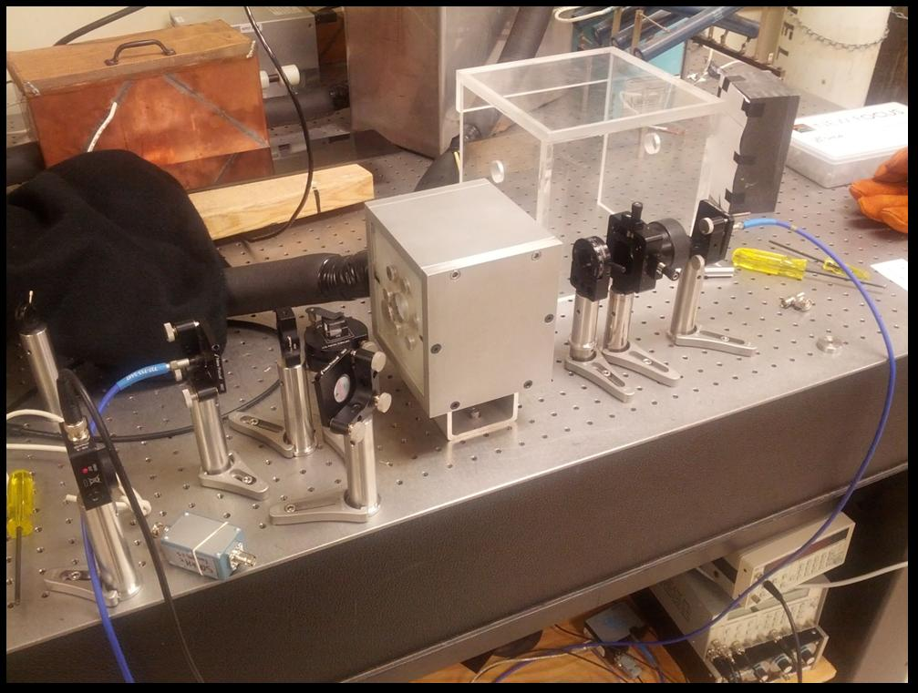
Setup
Notes:
After setup, go straight into data

Slide 6
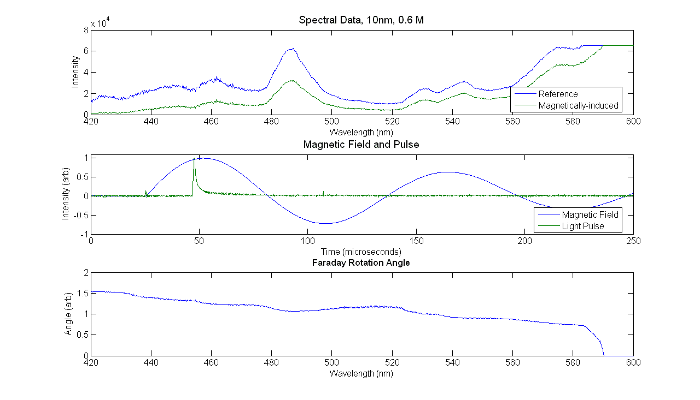
Data Example from A Single Trial
Notes:
Spectra
B-field
Pulse
FR signal was normalized to each trial’s relative magnetic field

Slide 7
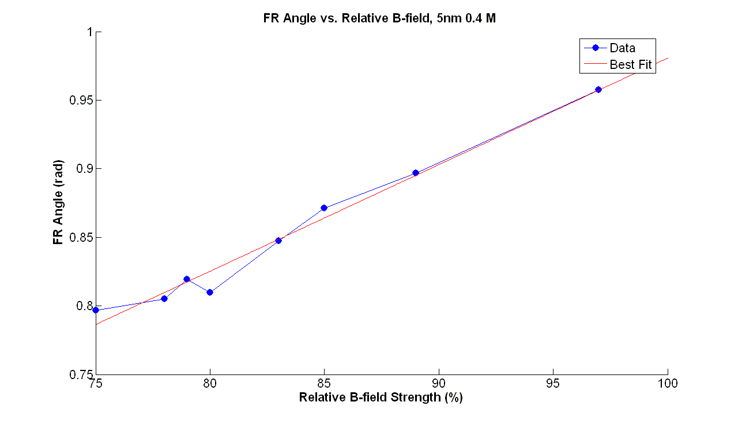
Results FR Angle vs. Relative B-field
Notes:
Add 10 nm? Other Concentrations?

Slide 8
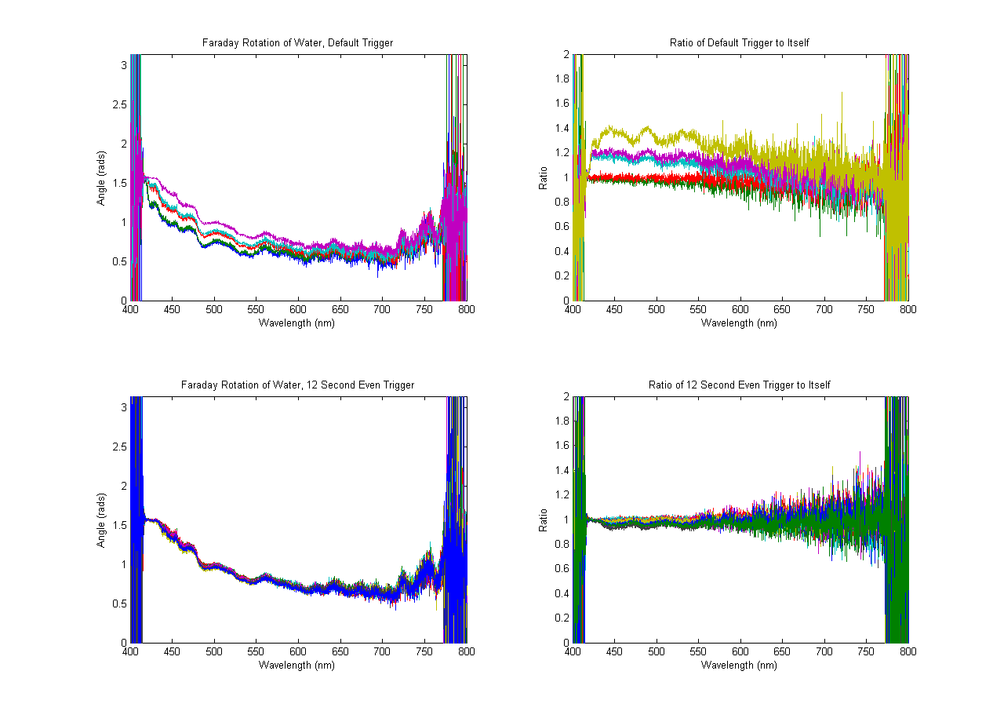
Methodology CCD Temperature Correction via Timing Calibration
Notes:
Too 30 spectra with no medium or b-field present in order to see if delaying the light pulses to even trigger times would affect the temperature of the CCDs
Results? Yes, it DID work and we call this priming.

Slide 9
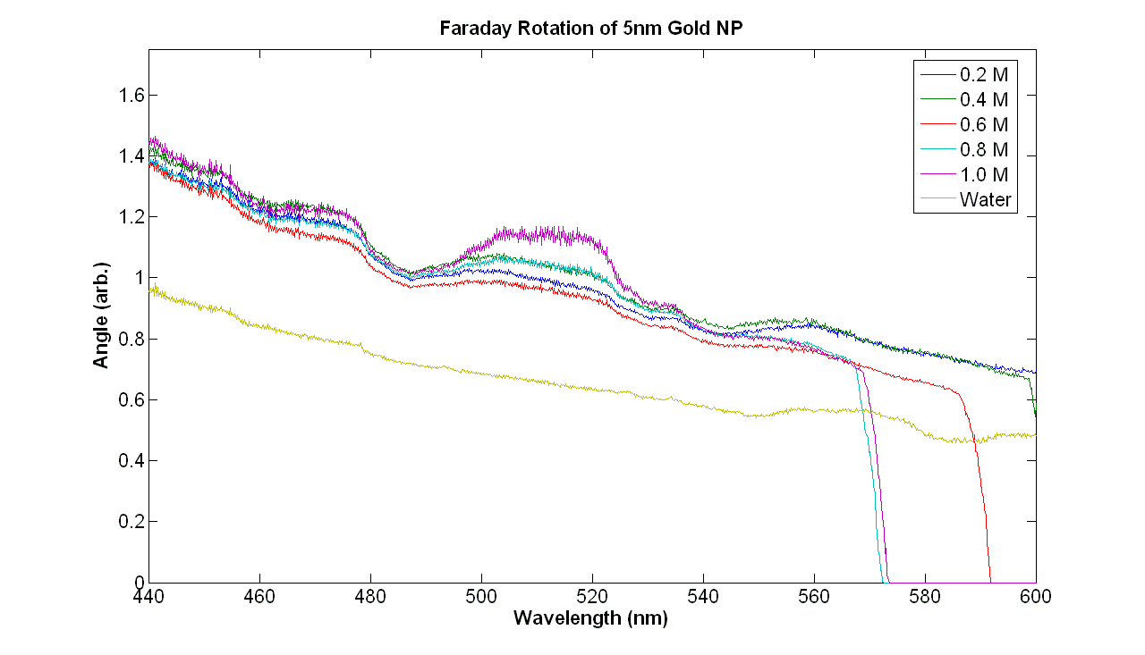
Results FR of 5nm, Various Concentrations

Slide 10
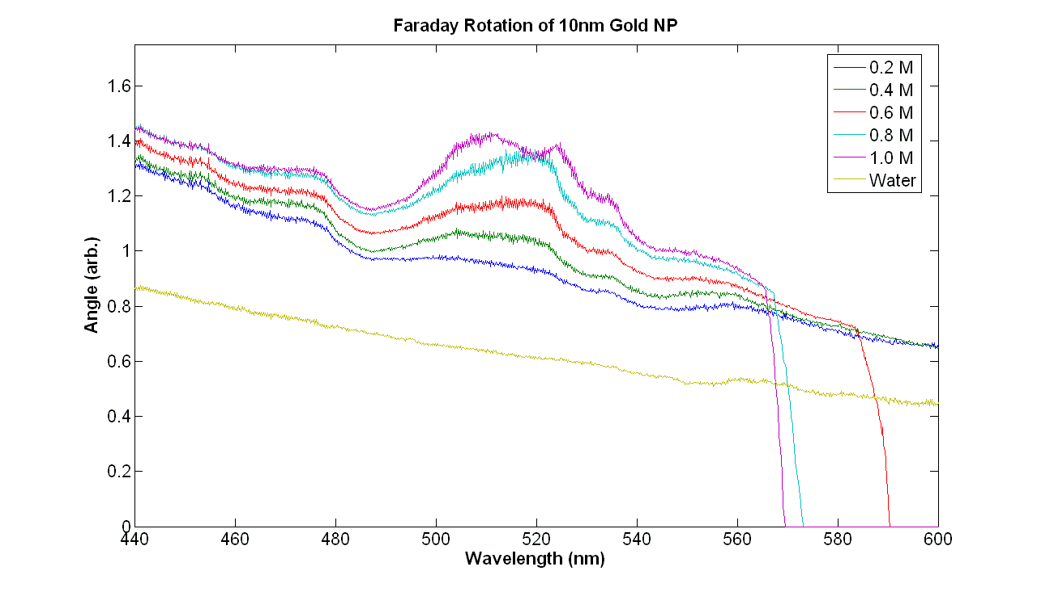
Results FR of 10nm, Various Concentrations
Notes:
Are all the lines supposed to fall on the same offset? They don’t for the smaller wavelengths but they do for the larger. This may be because we diluted them in something other than the citrate buffer that surrounds the gold NP.

Slide 11
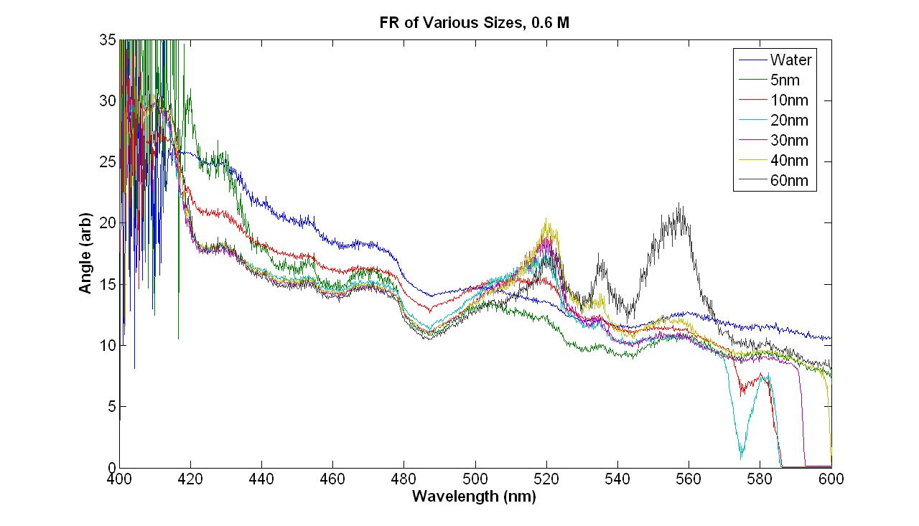
Results FR of Various Sizes, 0.6 M

Slide 12
Plasmon Peaks from Literature
[2]

Slide 13
Conclusion
FR signal for NP is concentration-dependent
As shown for 5nm and 10nm NP
FR signal increases linearly with magnetic field strength
Plasmon peaks are more pronounced and blueshifted as size increases
Verdet constant calculation may require more data

Slide 14
References
[1] Chikan V.; Dani R. D.; Wysin, G. M.; Young, N. Effects of Interband Transitions on Faraday Rotation in Metallic Nanoparticles 2013
[2] Link, S.; El-Sayed, M. A. J. Phys. Chem. B 1999, 103, 4215

